Slide 1

Treks -> Trips
- Manan Rajdev & Posha Dave
The way to get started is to quit talking and begin doing.
-Walt Disney

Slide 2

Introduction
Building Knowledge
- Trails
- National parks
- Hotels

Slide 3


























The Problem
3

Slide 4
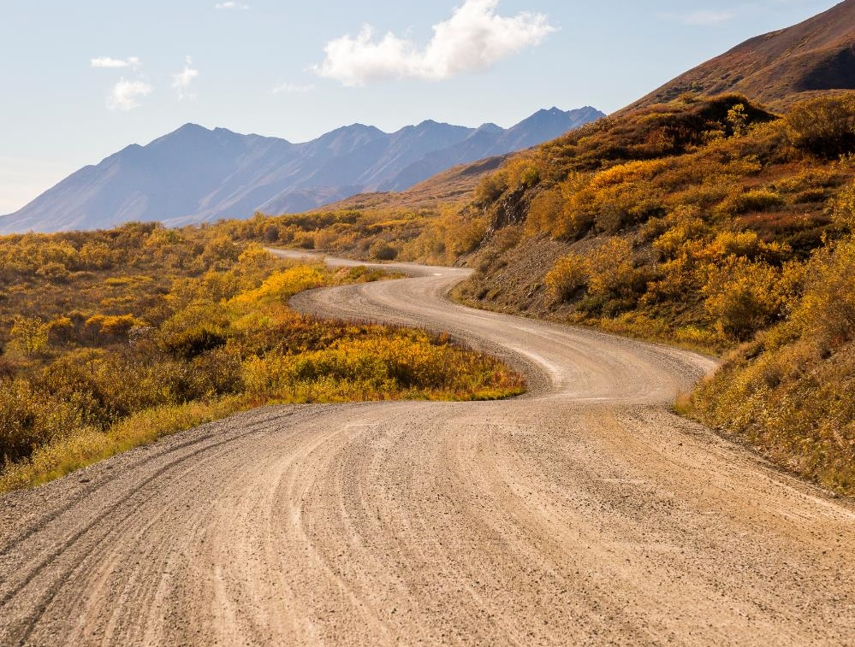

Technical Challenges
Filtering (dog friendly/kid friendly)
Recommendation System
Hotels Suggestion
GUI

Slide 5
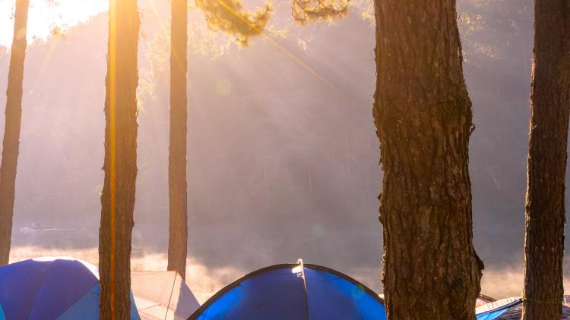
Thank You

