Slide 1

Magna International Inc. (NYSE: MGA)
Company Description
Magna International Inc. is a mobility technology company founded in 1957, headquartered in Aurora, Canada. They are the third largest automotive supplier in the world, and they design, develop and manufacture automotive systems, assemblies, modules, and components.
Current Price (05/06/21) | 12 Month Target Price
$96.06 | $104.11
Sector: Industrials
Industry: Automotive, Manufacturing

Slide 2
Investment Summary
Dominant Automotive Supplier: Largest automotive supplier in North America.
Strong Financial Fundamentals: Great Cash Flow, $1.2B cash in hand, low leverage ratios.
Growth Opportunities: Key player in Vehicle Electrification Market, Autonomous Driving (MAX4), Advanced Driving Assistance Systems (ADAS)
Expanding International Market
Increase in Joint Ventures
Strong 2021 Q1 results

Slide 3
Company Overview
Business Model
OEM
Magna
Tier 1
Medium & Heavy Trucks
Non-Automotive

Slide 4
Company Overview
Customer Revenue Breakdown
Revenue Segment Breakdown

Slide 5
Company Overview
Geographical Revenue Breakdown

Slide 6
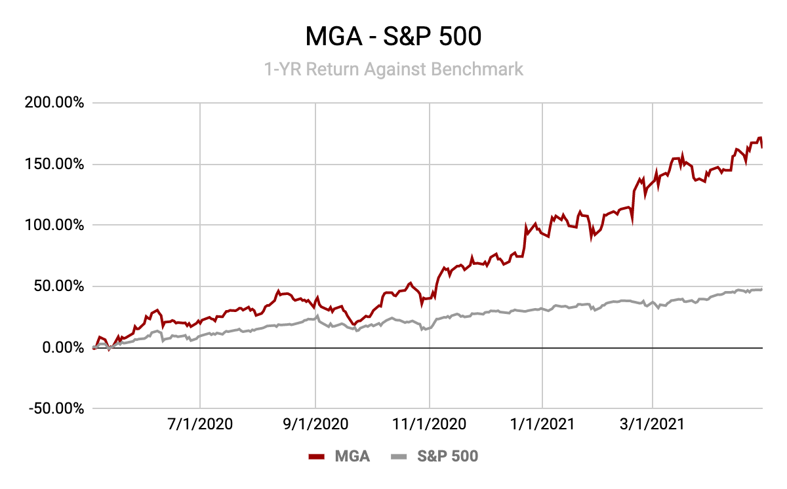
1-Year Price Performance

Slide 7
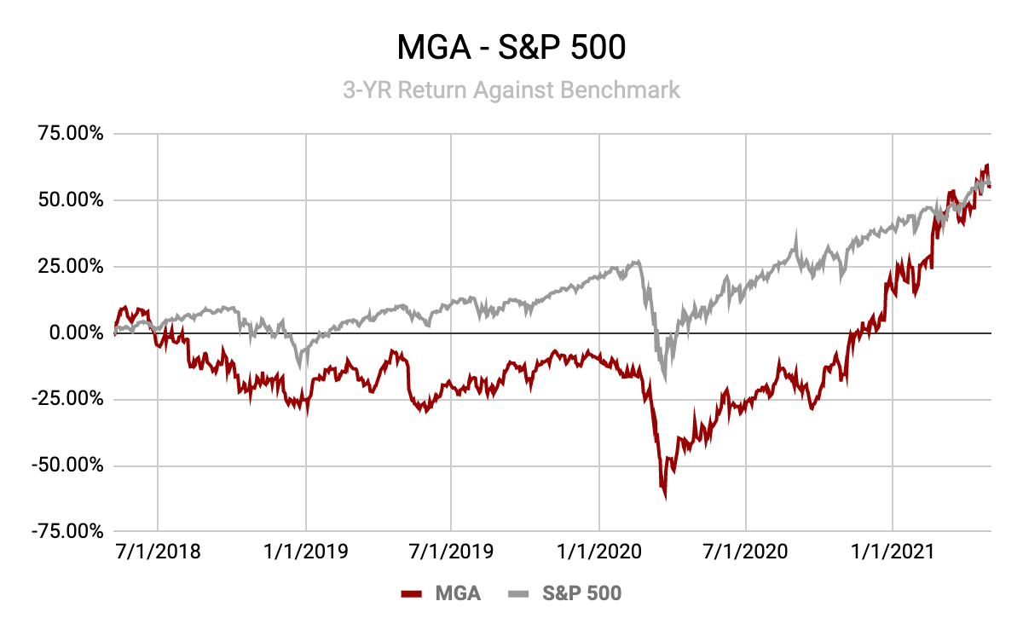
3-Year Price Performance

Slide 8
Industry Overview
Overall industry growth opportunities
Company Competitive Advantages
Global Industry Leader – able to supply parts for an entire vehicle
International Presence in 28 countries
Dominant Distribution Network – supplies top 3 automobile firms (General Motors, Ford, Chrysler)
Economies of Scale in production and distribution
High barrier to entry
Industry-specific metrics:
Electronic systems will account for half of the total price of a new car by 2030.
Every third new car sold is anticipated to be powered by an electric battery by 2025.
Autonomous car market was valued at $19.46B in 2020. Market is expected to grow at a CAGR 18.06% from 2021-2026.
Advanced Driver Assistance Systems (ADAS) Market Size is expected to grow from $27B in 2020 to $83B by 2030 at a CAGR of 11.9%.
More strict safety regulations for cars.

Slide 9
Growth Opportunities
Catalysts
Increasing demand in developing countries as global per capita income rises
Asia Pacific Market
Trends related to Autonomous Driving & ADAS
Easing or removal of COVID-19 related governmental restrictions
Vehicle Electrification market
Apple Car Contract
ADAS in Cheaper Cars

Slide 10
Partnerships
Joint venture with Jiangling Motors Co.
Signed an agreement to acquire a majority ownership of Honglizhixin (HLZX), a leading supplier to Chinese automakers
Joint venture with Beijing Electric Vehicle Co.
launched the “ArcFox α-T”
Arranged to supply Fisker to build its Ocean Electric SUV
Partnership with Israeli startup, REE Automotive to develop EV
Joint venture with LG Electronics to manufacture e-motors, inverters, on-board chargers, and complete e-drive systems

Slide 11
Financial Highlights
MGA Forecast Data
Year | 2021 | 2022 | 2023 | 2024
NOPAT | $1.57B | $1.65B | $1.72B | $1.78B
FCF | $2.16B | $2.28B | $2.37B | $2.45B
EPS | $6.52 | $6.86 | $7.15 | $7.39
BVPS | $42.34 | $46.89 | $51.45 | $56.07
MGA Financial Summary
(millions) | 2019 | 2020 | 2021E | 2022E | 2023E
Revenue | $39,431 | $32,647 | $38,000 | $39,954 | $41,657
Gross Profit | $5,409 | $4,440 | $5,168.01 | $5433.75 | $5,665.36
EBITDA | $3,969 | $3,068 | $3,571.05 | $3,754.67 | $3,194.71
Net Income | $1,765 | $1,648.66 | $1,918.98 | $2,017.66 | $2,013.66

Slide 12
Financial Highlights
52-Week Range | $34.82 - $99.72
Market Cap | $28.61B
Dividend Yield | 1.82%
Beta | 1.56
P/E Ratio | 37.81x
P/B Ratio | 2.4x
P/S Ratio | 0.8x
 | MGA
Gross Margin | 13.60%
Operating Margin | 4.55%
Net Profit Margin | 2.32%
Current Ratio | 1.37
ROA | 2.89%
ROE | 7.10%
ROI | 10.39%
Highlights:
Strong Cash Flow:
2018: $3.7B, 2019: $3.96B, 2020: $3.28B

Slide 13
Financial Highlights
MGA Debt Analysis
Current Ratio | 1.37
Quick Ratio | 1.02
Total Debt / Equity | 51.20%
Total Debt / Capital | 33.90%
Long-Term Debt / Equity | 48%
Long Term Debt / Capital | 31.80%
Total liabilities / Total Assets | 59%
Highlights:
Low Leverage Ratios

Slide 14
2021 Q1 Results
$10.2B in sales reported for Q1 2021 (increase in 18% YoY)
Income from operations before income taxes increased 109%
Global light vehicle production was up 18% driven by an 87% increase in China
Adjusted EBIT was up 91%.
Diluted and Adjusted EPS increased 136% and 116%
ROE increased 11.1% compared to Q1 2020.

Slide 15
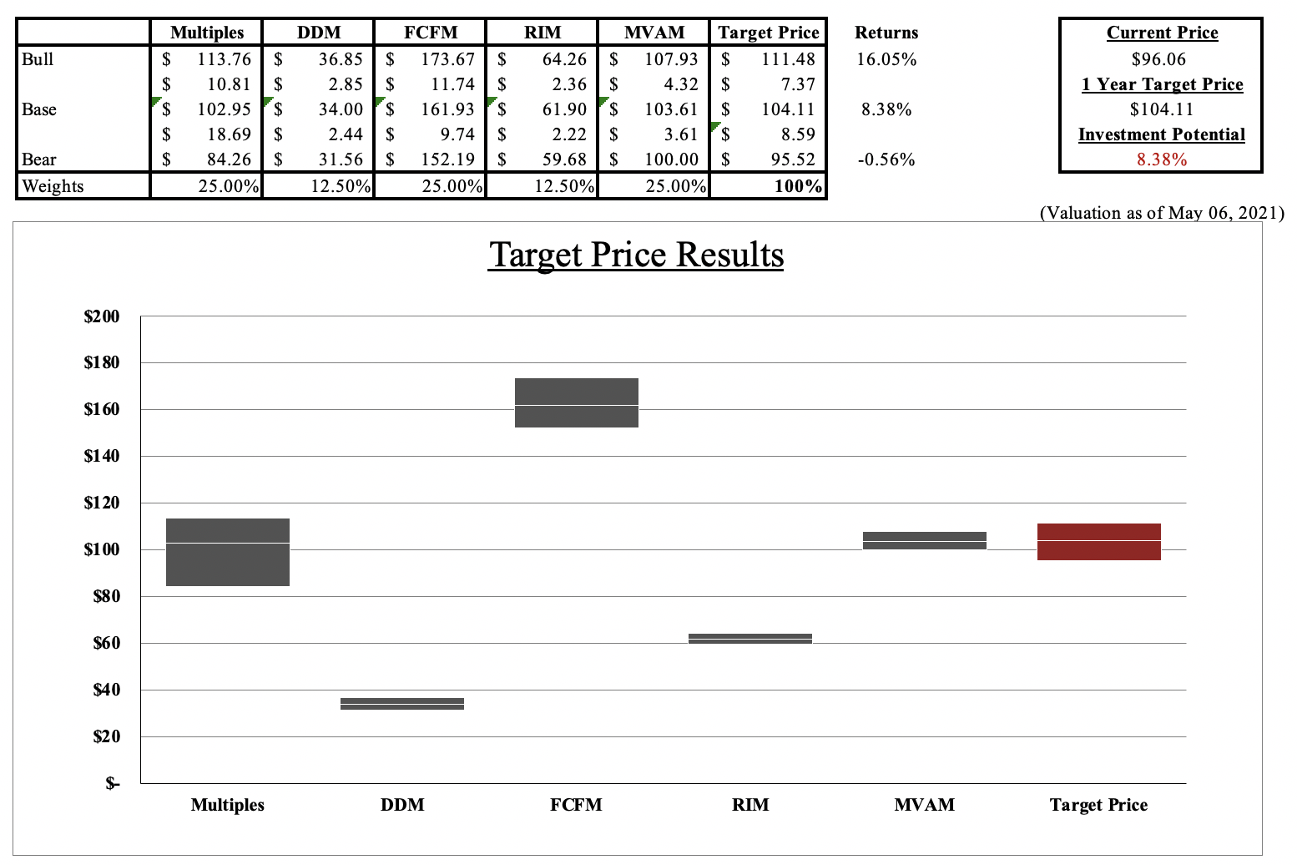
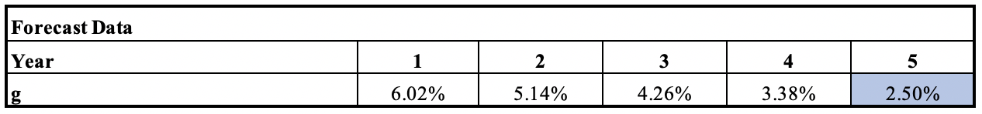
Valuation
Recommendation:
BUY

Slide 16
Investment Thesis & Risk
Thesis
Strong Financials
Strong Cash Flow
Low Leverage Ratios
Growth in Vehicle Electrification, Autonomous Driving, and ADAS
Post COVID-19
Increase in demand for developing countries & Asia Pacific Region
Risk
Economic Cyclicality
Worsening supply distribution of critical materials
Unpredictable Margins
Reliability on GM, Ford, Fiat Chrysler (>40% Revenue)
LOW | MEDIUM | HIGH

Slide 17

Thank You
Q&A

