Slide 1
Image Compression and Blurring Using Different Techniques
Signals and Systems Term Project (Sem I)

Slide 2
Team Members
Manan Shah (B18CSE030)
Nishant Jain (B18CSE067)
Ishit Patel (B18EE021)
Manvendra Shah (B18EE026)
Manav Garg (B18BB016)

Slide 3
Introduction
Image compression is lowering the size of a graphical file without much degradation of the quality of the image. The reduction of storing needs allows a number of images per fixed storage space and also reduces the time required to be transferred over the internet or downloaded from online sources. Blurring is used before edge detection and many such tasks.

Slide 4
Aim of the Project
Comparative study of various Image Compression techniques.
Compare execution time of Blurring in Frequency and Spatial Domain.

Slide 5
Techniques Used For Compression-
Discrete Cosine Transform (DCT)
Discrete Wavelet Transform (DWT)
Chroma Subsampling

Slide 6
Image Compression using Discrete Cosine Transform (DCT)

Slide 7
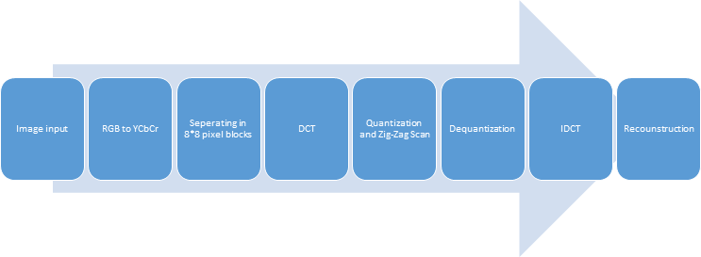
Block diagram of DCT

Slide 8
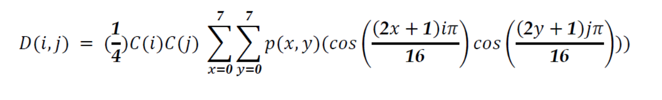
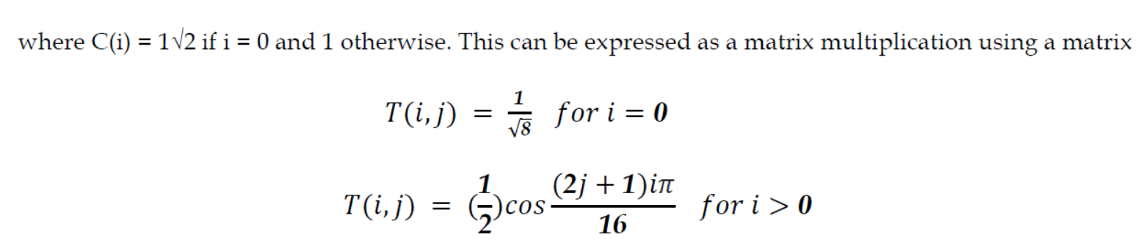
Formula Used:

Slide 9
Algorithm of image compression using DCT
Input image and convert the RGB values to YCbCr and divide it in 8x8 matrices for further processing.
Now take the Discrete Cosine Transform of the 8x8 image matrices by using the predefined DCT matrix and then recombine the 8x8 matrices.
Now, divide the transformed matrix by quantization matrix (standard for JPEG) that is adjusted according the amount of compression required and round of the values<1 to zero.
Now we have the transform matrix of final image, we multiply it again by the quantization matrix.
Now, we take the IDCT of the matrix and get the YCbCr matrix of the final image.
Converting it into RGB and saving it would give us the compressed image.

Slide 10
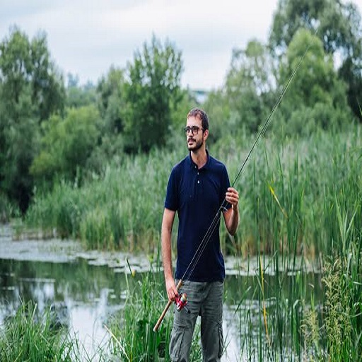

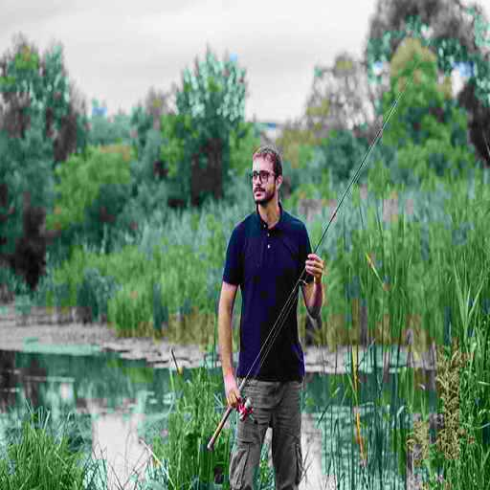
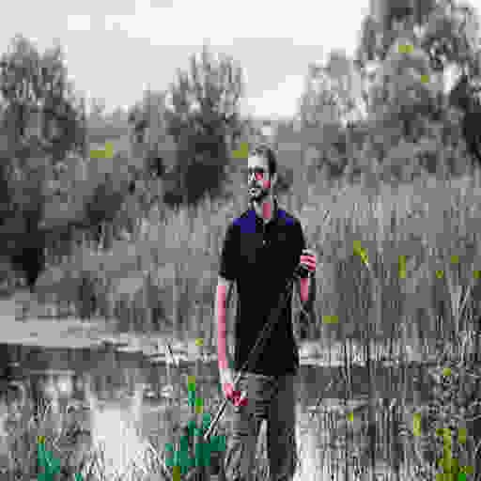
Results and Observations-
Original Image(103 KB)
Compression with q=(1,3,3) (44KB)
Compression with q=(10,10,10) ( 31 KB)
Compression with q=(10,20,20) (15.3 KB)
As we can see, there is significant decrease in storage requirements of image from first to second to third from left with any visible loss in quality, but we see that as we increase the compression ratios the image loses its originalities and thus this method is not efficient for higher compression ratios as it is lossy. But, for low compression ratios, it is a very fast and efficient method.

Slide 11
Multilevel Decomposition of Images Using Discrete Wavelet Transform (DWT)

Slide 12
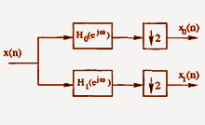
Decomposition of 1-D signal or array

Slide 13
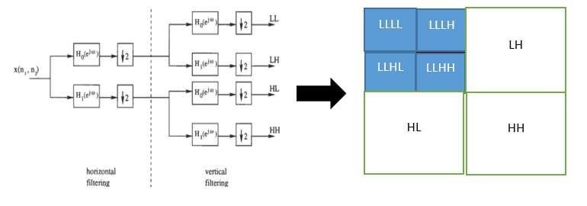
Extension to Images (Single Level)
We apply the previous process to rows to get two sub-images,
We apply the process again on these two images to get four sub-images namely, LL(low-low), LH(low-high), HL(high-low), HH(high-high).

Slide 14
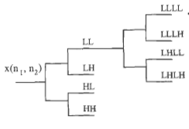
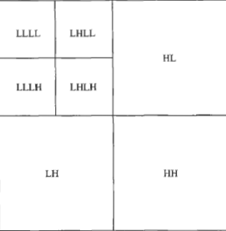
Multilevel Decomposition(Second Level)

Slide 15
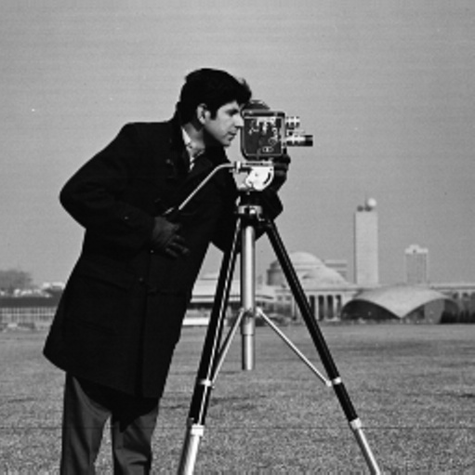
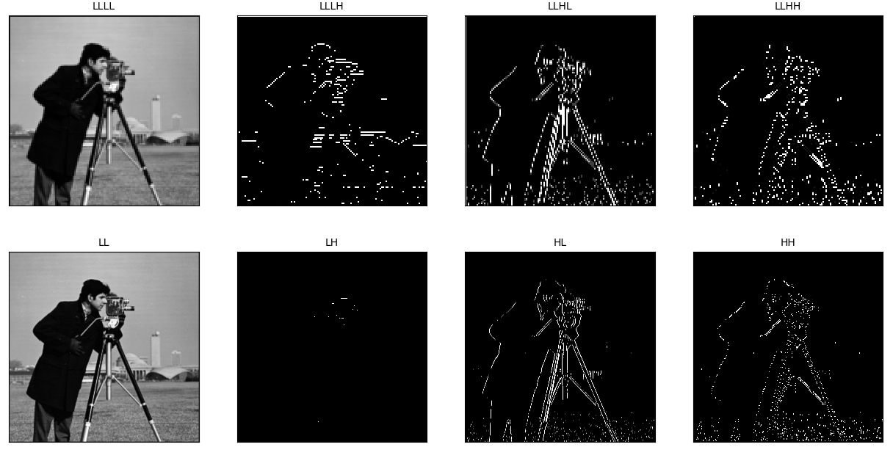
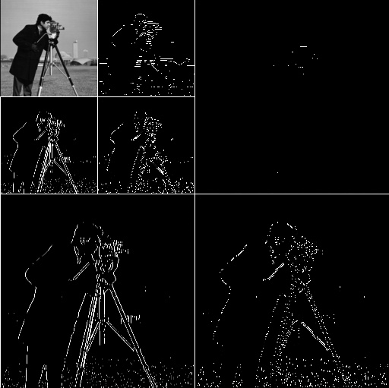
Results and Observations:
We observe that-
LL - Coarse low resolution of image
LH-Horizontal details
HL-Vertical Details
HH - Diagonal details

Slide 16
Bandwidth Reduction using Chroma subsampling

Slide 17
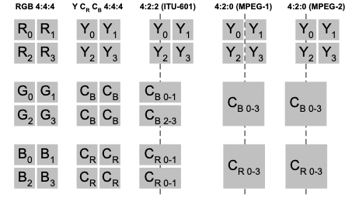
->Human eye is sensitive to Luma more than Chroma

Slide 18
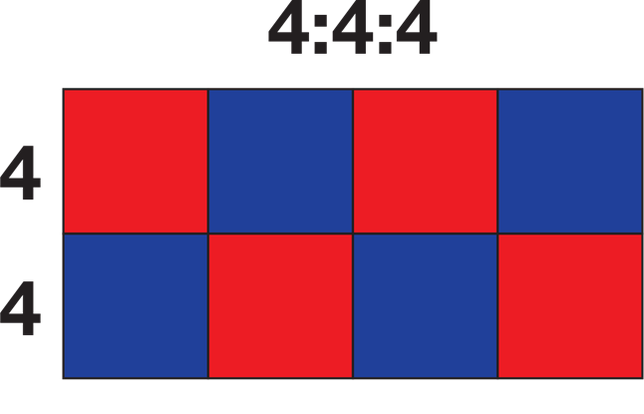
4:4:4 means four luminance or green pixels to every four each red and blue pixel which hold the colour information for the shot.

Slide 19
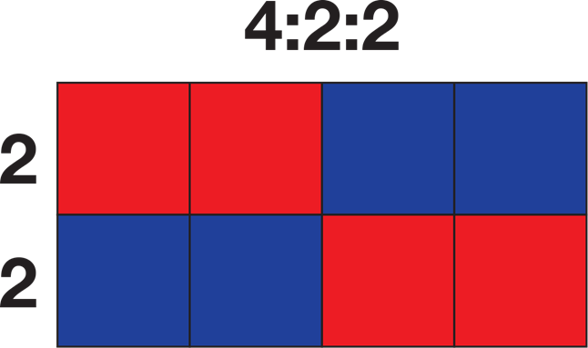
The two chroma components are sampled at half the sample rate of luma: the horizontal chroma resolution is halved. This reduces the bandwidth of an uncompressed video signal by one-third with little to no visual difference.

Slide 20
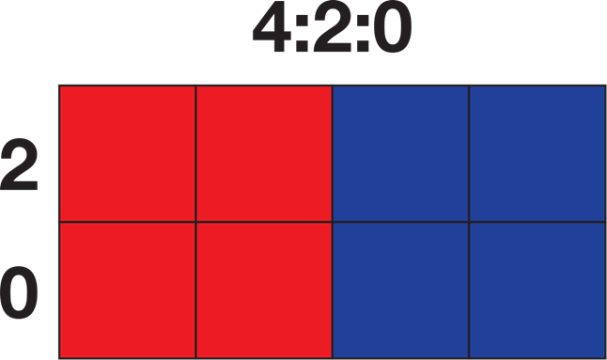
In 4:2:0, the horizontal sampling is doubled compared to 4:1:1, but as the Cb and Cr channels are only sampled on each alternate line in this scheme, the vertical resolution is halved.

Slide 21
Image Blurring

Slide 22
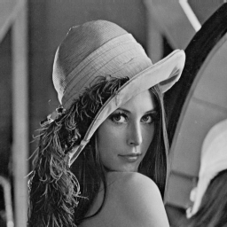
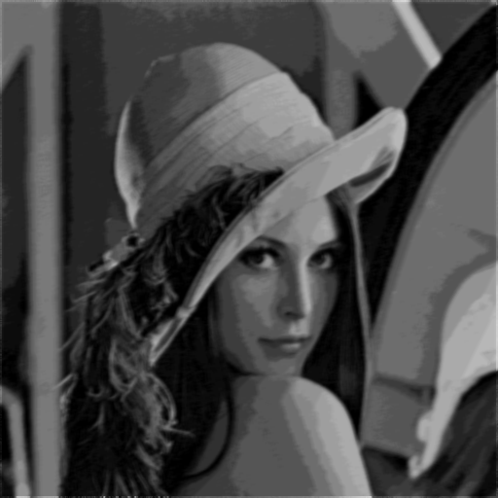
In Spatial Domain
(Convolution)
1/25 | 1/25 | 1/25 | 1/25 | 1/25
1/25 | 1/25 | 1/25 | 1/25 | 1/25
1/25 | 1/25 | 1/25 | 1/25 | 1/25
1/25 | 1/25 | 1/25 | 1/25 | 1/25
1/25 | 1/25 | 1/25 | 1/25 | 1/25
=
*
Blurred Image

Slide 23
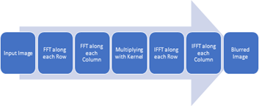
In Frequency Domain
(Multiplication)

Slide 24
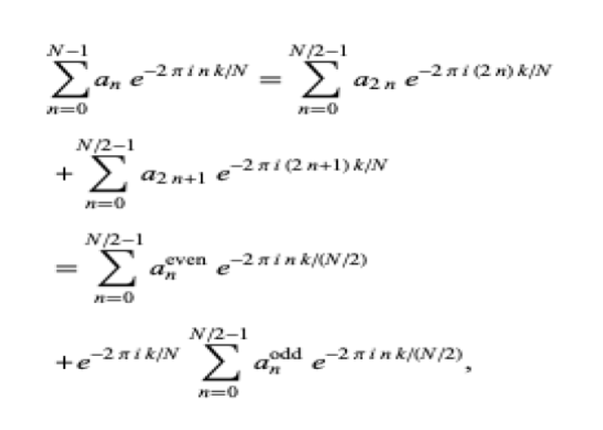
Exploiting the periodic property:

Slide 25
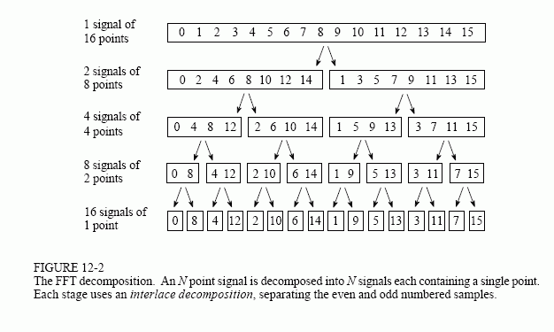
Fast Fourier Transform
(1D - Array)
Explanation using Example of 16 values

Slide 26
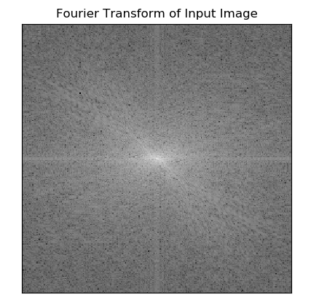
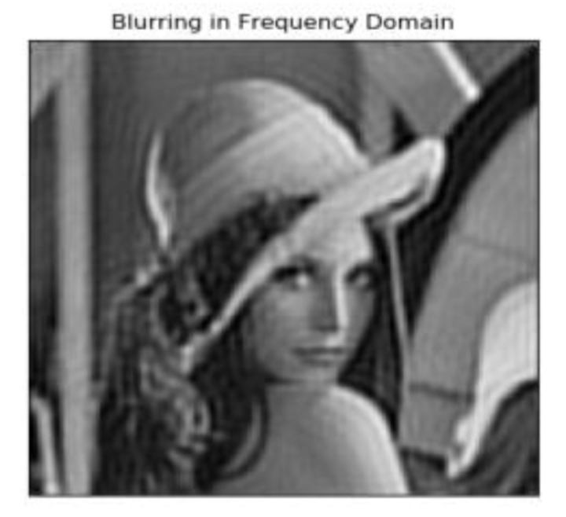
Results and Observations:

Slide 27
Conclusion-
DWT is the best technique amongst those used in the project as it can do lossless compression also.
DCT is lossy and thus creates low efficiency but can be made better by using entropy coding and Huffman tables. Blurring in Frequency Domain takes less execution time then Blurring in Spatial Domain.
Chroma subsampling creates losses in originality in images with high color variations.
(contd.)

Slide 28
We can do blurring in both Frequency Domain and Spatial Domain.
In Spatial Domain it takes O((N^2)*(M^2)) complexity.
N = size of image
M = size of kernel
In Frequency Domain it takes O((N^2)logN) complexity.
N = max(size of image,size of kernel)

Slide 29
Future Scope:
To apply Entropy , Run-length and Hoffman Encoding in compression techniques.
To convert 5*5 kernel into size of image so that we can get same blurred image from convolution and multiplication .

Slide 30
Thank You!😃

