Slide 1
Democratizing Efficiency with Decentralized smart actuators
“We know a guy”

Slide 2
Problem description
Telemetric Devices: actuators, control valves, sensors generates operational data;
These data could be used not currently being used to generate insights, optimize energy efficiency, detect malfunction;
How to generate value-added to the customers through these data?

Slide 3
What data?
Low-level, device specific telemetry data;
InfluxDB for the case purposes, and through various protocols (Modbus, BACNet, KNX) in general;
“Intelligent insights” through low level data?

Slide 4
Proposed approach
“Low-level, decentralized intelligence”;
Devices in a network act as a “swarm of agents”, with a chosen “leader”;
Each device detects anomalies, and performs “load-balancing” when necessary;
These anomalies are recorded by the “leader” to capture the anomalies of the system;

Slide 5
Proposed approach
Target user: Facility managers, building operators;
For small projects/buildings where an integrated BMS solution is not cost-effective
“Local intelligence”

Slide 6
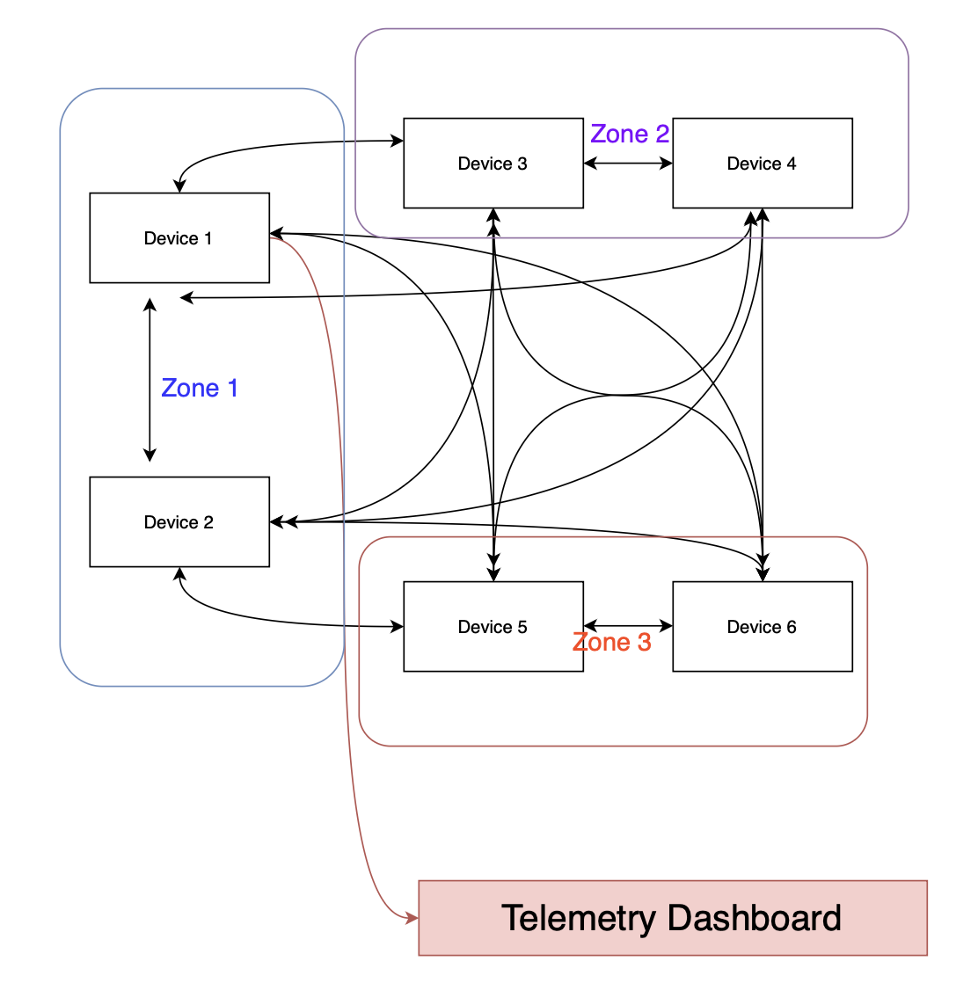
overview

