Slide 1
LANGUAGE TRANSLATOR EasyPhysics
Name : manan solanki
Id : 17itubs015
Roll no. IT-108
Name : soni meet
Id : 18ITUOD012
Roll no. IT-109

Slide 2
LANGUAGE DESCRIPTION
Our language helps you evaluate some of the physics formula.
It is used to find perimeter of some of the shapes and equivalent resistance in series and parallel by providing corresponding inputs such as resistor values and length of sides , radius in order to find perimeter.
Also helps to find arc length , force , pressure , density , power , speed by giving corresponding input .
Link : https://github.com/manansolanki/LT_language.git

Slide 3
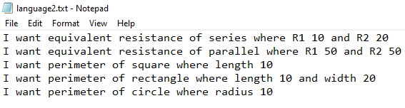
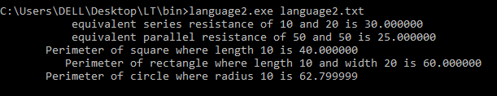
Find perimeter and equivalent resistance

Slide 4
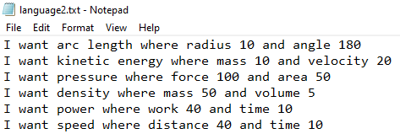
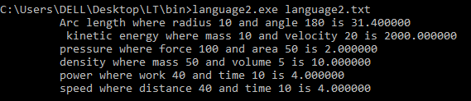
Evaluate basic physics formulas

