Slide 1

CBIO313 — DATA MINING & MACHINE LEARNING
Chronic Kidney Disease
Prediction
An end-to-end machine learning pipeline for early CKD detection
from routine clinical and laboratory measurements

Slide 2
01 · PROBLEM & OBJECTIVE
Why Chronic Kidney Disease?
!
🩸
🎯
Silent progression
Detectable early
Our objective
CKD often shows no symptoms until kidney function has already declined significantly.
Routine blood & urine tests (creatinine, hemoglobin, albumin...) carry early warning signals.
Predict CKD vs. not-CKD from 24 routine clinical features, and identify which measurements matter most.
Research question: Given a patient's routine clinical and laboratory measurements, can we predict whether they have CKD — and which measurements matter most?
02

Slide 3
02 · DATASET
A genuinely messy, real dataset
UCI Machine Learning Repository — Chronic Kidney Disease dataset, Tamil Nadu, India hospital, 2015
Why this is NOT a clean dataset
400
25
Missing values scattered across nearly every column
patient records
raw columns
A literal "?" used as a missing-value marker
Embedded tab characters inside cell values
1,012
250 / 150
Numeric columns stored as text due to stray tokens
One corrupted target label requiring a fix
missing cells
CKD / not-CKD
03

Slide 4
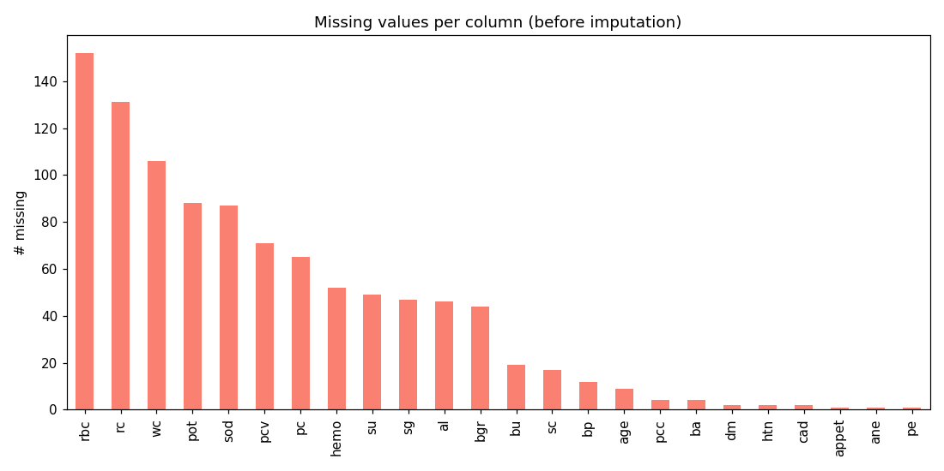
03 · DATA CLEANING
From raw mess to model-ready
1
Strip & standardize
Whitespace/tabs removed; "?" and blanks unified to NaN
2
Fix labels & types
Corrupted target label repaired; numeric columns coerced back from text
3
Drop identifier
The id column carries no predictive information
Missing values per column, before imputation
4
Impute
Numeric → column median (robust to skewed labs); categorical → column mode
Result: 0 missing values across 400 rows × 24 usable features
04

Slide 5
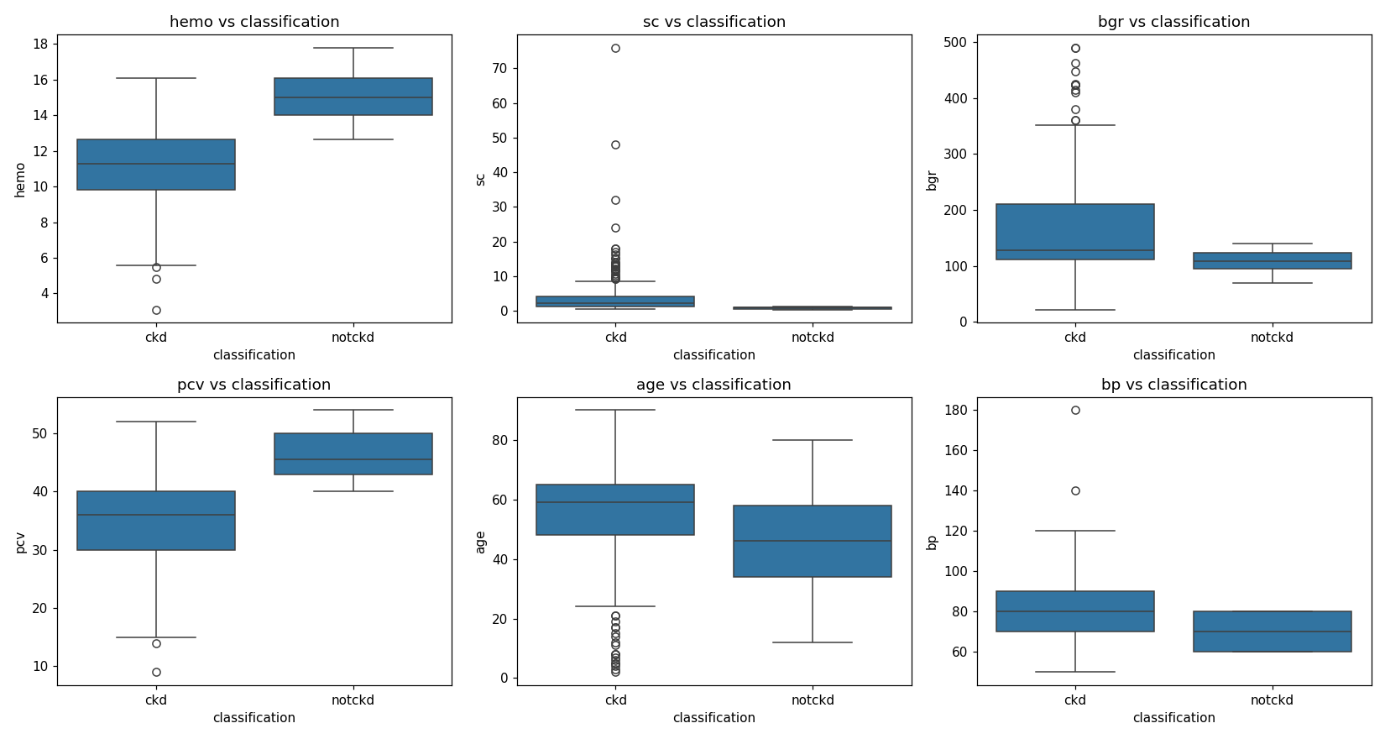
04 · EXPLORATORY DATA ANALYSIS
The clinical signal is visible early
6+ variables examined, univariate + bivariate, across 5 plot types
Key reading
Hemoglobin & packed-cell-volume are visibly lower in CKD patients
Serum creatinine is visibly higher in CKD patients
Matches clinical expectations — a good sanity check on the cleaned data
5 plot types used: histograms, boxplots, count plots, stacked bar, correlation heatmap
Numeric features vs. classification (bivariate)
05

Slide 6
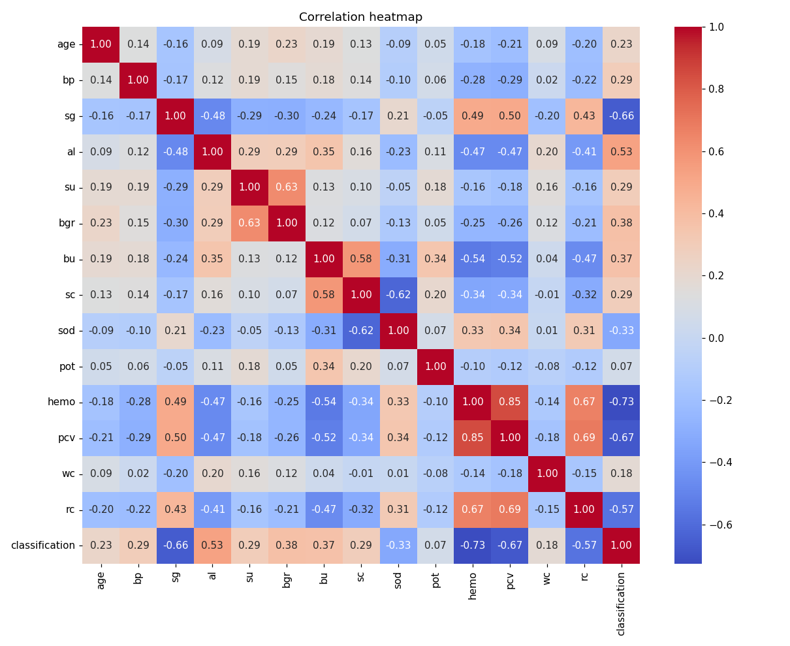
04 · EXPLORATORY DATA ANALYSIS
How features relate to each other
06

Slide 7
05 · FEATURE ENGINEERING & SELECTION
Adding clinical knowledge, then trimming noise
Selected features (top 12)
New engineered feature
sg
al
pc
bgr
bun_creatinine_ratio
hemo
pcv
rc
htn
Blood Urea Nitrogen ÷ Serum Creatinine — a recognized nephrology marker used to distinguish pre-renal from intrinsic renal causes of dysfunction. Added explicitly rather than left for the model to infer implicitly from the two raw columns.
dm
appet
pe
bun_creatinine_ratio
Feature selection — filter method
SelectKBest with the ANOVA F-statistic scores each feature's individual relationship with the target, independent of any model — fast, model-agnostic first pass. Top 12 features kept.
07

Slide 8
06 · MODELING
Three algorithms, tuned and validated
Logistic Regression
Random Forest
SVM
Simple, interpretable linear baseline
Bagged tree ensemble — captures non-linear interactions
Margin-based classifier, linear or kernelized
Tuned: C (regularization strength)
Tuned: n_estimators, max_depth
Tuned: C, kernel
Tuning method: GridSearchCV, 5-fold cross-validation, optimizing F1-score
Why tuning matters: hyperparameters aren't learned from data — poor choices cause overfitting (memorizing noise) or underfitting (missing real patterns). Grid search tries every combination and keeps the one with the best cross-validated score, not a single lucky split.
Why validation matters: 5-fold CV picks robust hyperparameters, and a held-out 20% test set (stratified, untouched by training/tuning) gives an unbiased final comparison.
08

Slide 9
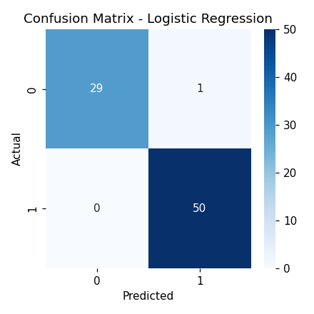
07 · RESULTS
Model comparison on the held-out test set
Model | Accuracy | Precision | Recall | F1 | ROC-AUC
Logistic Regression | 0.9875 | 0.9804 | 1.0000 | 0.9901 | 1.0000
Random Forest | 0.9875 | 0.9804 | 1.0000 | 0.9901 | 0.9967
SVM | 0.9875 | 0.9804 | 1.0000 | 0.9901 | 1.0000
Best model: Logistic Regression (highest test-set F1)
All three tuned models perform strongly and similarly — the classes are well separated once hemoglobin, serum creatinine, specific gravity and albumin are available. Precision and recall both far exceed the project's 0.30 minimum, independently confirmed by tester.py.
Confusion matrix — best model
09

Slide 10
08 · DEPLOYMENT
From notebook to a usable web app
Trained model
+ scaler
+ encoders
→
Streamlit
app.py
→
Patient enters
clinical values
→
CKD risk +
probability shown
All preprocessing artifacts saved: model, scaler, label encoders, selected feature list, imputation medians
Streamlit form lets a user enter a patient's clinical values and get an instant prediction + probability
Deployable for free on Streamlit Community Cloud → public URL, satisfying the project's deployment requirement
10

Slide 11
09 · CONCLUSION
What this project shows
Achieved
Also delivered
Real, messy data can be cleaned transparently and auditably
3 tuned algorithms validated rigorously (CV + held-out test)
EDA across many variables confirms known clinical markers drive the signal
Strong, honest performance — precision & recall far above requirement
Feature engineering + filter selection sharpen the input space
A working deployed app closes the loop from data to decision support
Limitations & future work
Single-hospital, 400-patient dataset — external multi-site validation needed before real clinical use. Median/mode imputation could be replaced with model-based imputation. Explainable-AI methods (e.g. SHAP) could make individual predictions more interpretable for clinicians.
11

Slide 12
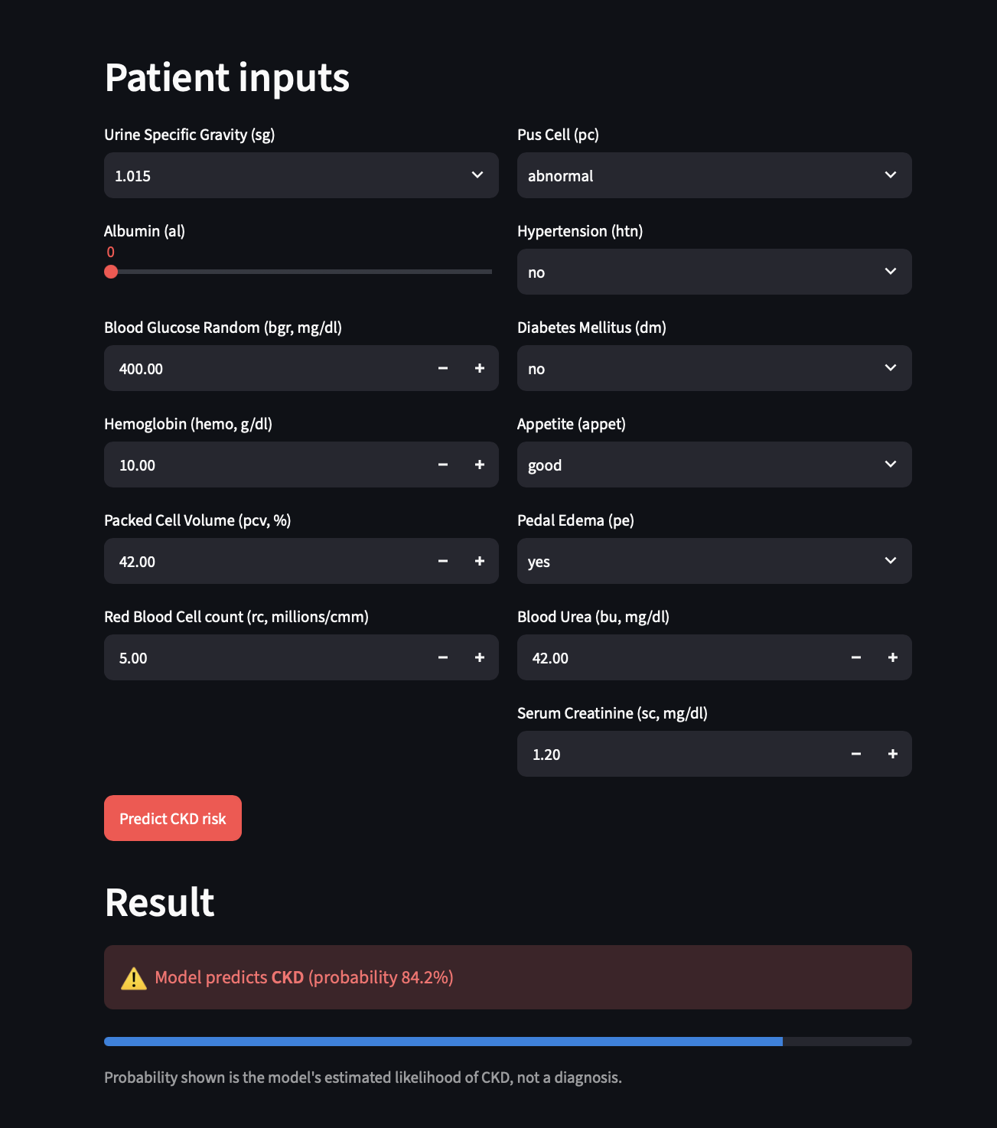
The streamlit app screenshot

Slide 13
Thank you
Questions & Discussion
Repository, notebook, report, and live app link available in the project README.
12
Notes:
Thank you — I'm happy to take any questions. The GitHub repository README has links to the full notebook, the written report, and the live deployed app if you'd like to try it yourself.

