Slide 1

beauty salon booking system
BY: Manar Basim Rashid
TO: ASST.LEC.SAAD B.YOUNIS
UNVERSITY OF AL_NAHRAIN/COLLAGE OF INFORMATION/ NETWORK DEPARTMENT

Slide 2

Project Overview
Title: Beauty Salon Booking System
Description: A web-based application that allows clients to book beauty salon services online, and salon staff to manage appointments.
Domain: Business (Beauty & Personal Care)
Problem it Solves: The system helps beauty salons organize and track appointments easily, reducing manual booking errors and saving time for both clients and salon staff.

Slide 3
Entity-Relationship (ER) Diagram
Entities:
1
. Users (user_id, name)
. Appointments (appointment_id, user_id,service, date, time)
Relationships:
2
. A User can have many Appointments.
. An Appointment belongs to one user.

Slide 4
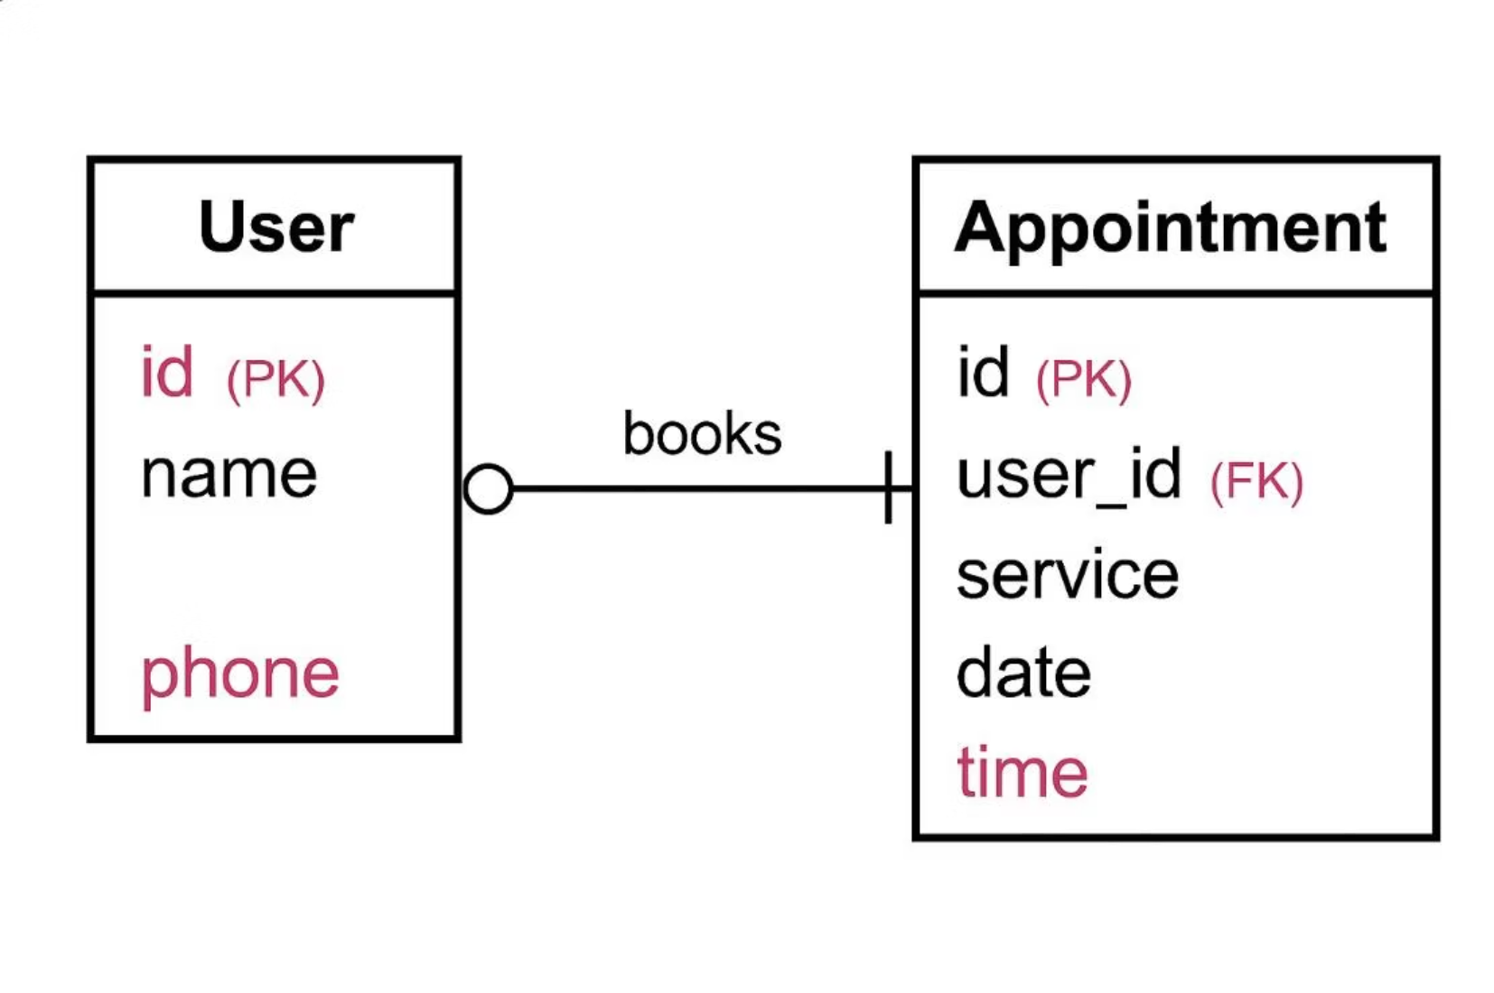

Slide 5
Relational Schema
Users:
• user_id (INT, PK, AUTO_INCREMENT)
• name (VARCHAR(100), NOT NULL)
Appointments:
• appointment_id (INT, PK, AUTO_INCREMENT) • user_id (INT, FK, NOT NULL)
• service (VARCHAR(50), NOT NULL)
• date (DATE, NOT NULL)
• time (TIME, NOT NULL)
Constraints:
• NOT NULL, PRIMARY KEY, FOREIGN KEY

Slide 6
Normalization
Normalization is the process of organizing the database structure to reduce redundancy and improve data integrity. In our Beauty Salon Booking System, we applied three levels:
• 1NF (First Normal Form):
We removed repeating groups and ensured that each column contains atomic values.
Example: We replaced multiple service columns with a separate Service table.
• 2NF (Second Normal Form):
We removed partial dependencies by ensuring that non-key attributes depend on the whole primary key, not a part of it.
Example: Customer names were moved from the Booking table to a separate Customer table.
• 3NF (Third Normal Form):
We removed transitive dependencies, making sure that attributes depend only on the primary key. Example: City phone codes were moved to a separate City table because they depend on the city, not directly on the customer.

Slide 7

Queries & Operations
1- SELECT with JOIN
SELECT u.name, a.service, a.date, a.time
FROM appointments a
JOIN users u ON a.user_id = u.id;
Use: This query displays all booked appointments along with the client’s name by joining the appointments table with the users table.
2- INSERT
INSERT INTO appointments (user_id, service, date, time)
VALUES (1, 'Facial', '2025-04-25', '14:00');
Use: This query inserts a new appointment booking into the database.

Slide 8
3- UPDATE
UPDATE appointments
SET service = 'Massage', date = '2025-04-26', time = '16:00'
WHERE id = 3; Use: This query updates an existing appointment’s service, date, and time.
Use: This query updates an existing appointment’s service, date, and time.
4- DELETE
DELETE FROM appointments
WHERE id = 5;
Use: This query deletes an appointment based on its ID.
5- COUNT + GROUP BY
SELECT service, COUNT(*) AS total_appointments
FROM appointments
GROUP BY service;
Use: This query shows the total number of appointments for each service type.
6-SUM Example
SELECT SUM(price) AS total_income FROM appointments;
Use: Calculates the total income from all appointments.

Slide 9
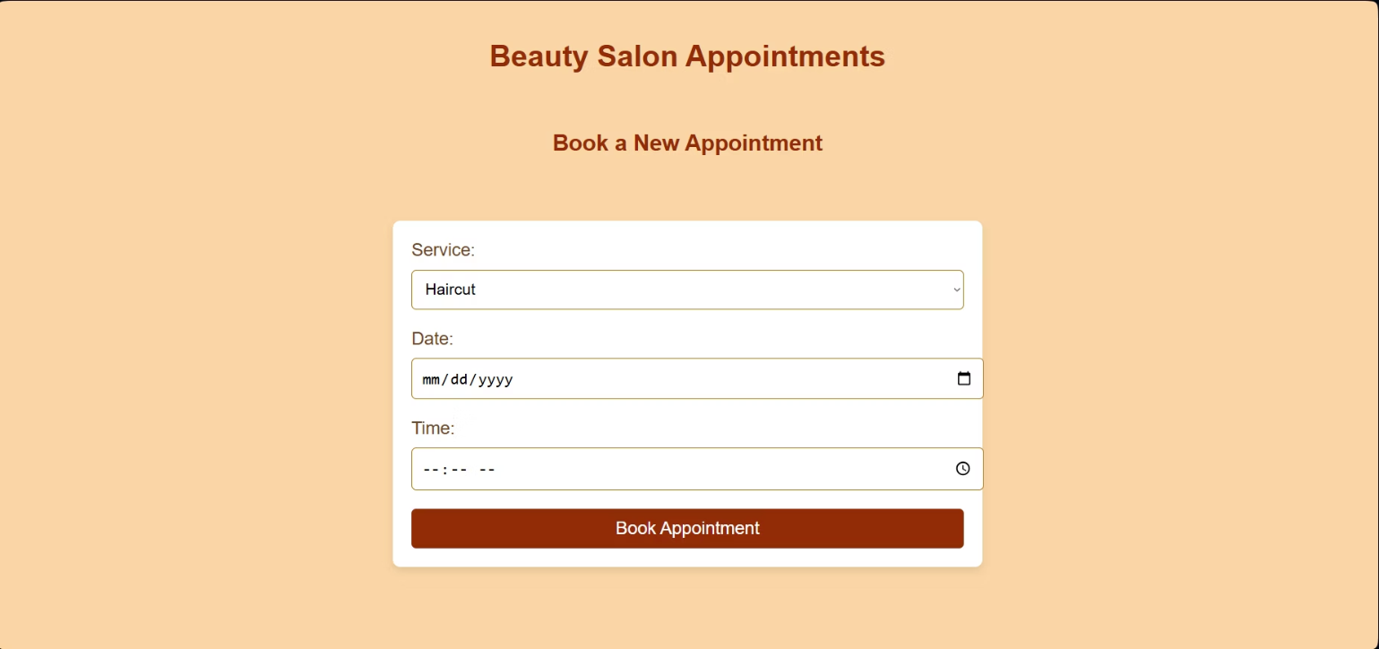
Application Interface:

Slide 10
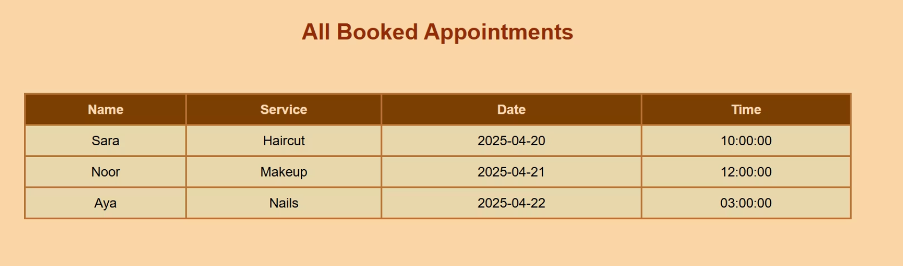

Slide 11


