Slide 1

Instructor Kick-off
Analyze A/B Test Results
© 2019 Udacity. All rights reserved.

Slide 2
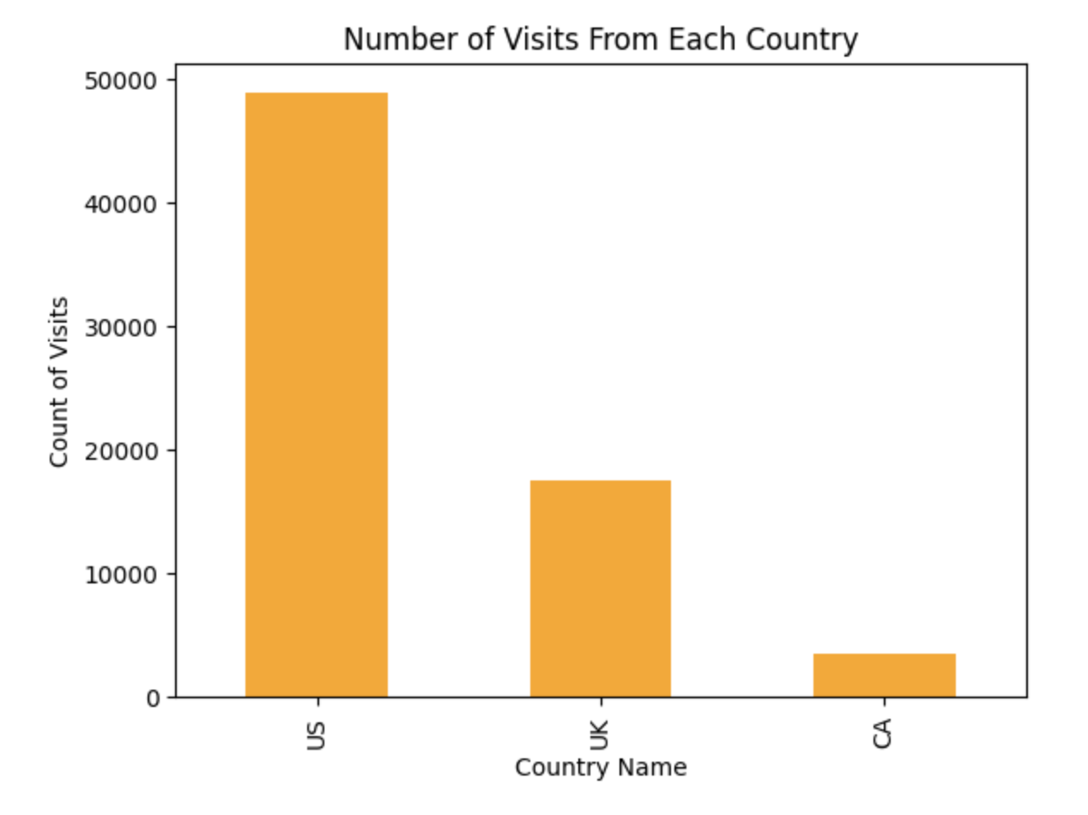
How Was The Experiment Implemented?​
Total Variant Visitors: 69,889
Total Control Participants:​ 34,678
​
Bar Chart Highlighting where Users are From

Slide 3
Conversion Rates
 | U.S. | U.K. | CA
Control | 10.7% | 10.2% | 10.7%
Treatment | 15.8% | 14.9% | 15.8%
Executive Summary: In all the countries including but not limited to UK, Canada, and US, the Treatment group has higher conversion rates compared to the Control group. The largest increase is found in Canada and the smallest is found among users from the UK.

Slide 4
Experiment Results
Treatment Conversion Rate: 15.5%
Control Conversion Rate:​ 10.5%
Delta in Treatment vs. Control Conversion Rate:​ 10.53%
p-value:​ 0.000
Conclusion:​ The treatment page has a higher impact when being compared to the control page statistically; This rejects the null hypothesis as the treatment page performs better than the control page.

Slide 5
Country Results
Conclusion:​ The conversion rate between the countries are not equal where they differ from one to another.

