Slide 1

Hybrid Text Encryption and Audio Steganography System
Supervised by
Dr. Sahar Hassan

Slide 2
Participants
Eman Mohamed
Manar Essam
Mohamed Gamal
Mina Ashraf

Slide 3
INTRODUCTION
Digital security:
Encryption
Steganography:
Audio Steganography

Slide 4
Our system
It proposes a hybrid system of cryptography and audio steganography
to enhance and strengthen the security of the data
and protect secret texts, messages, and sensitive information transmission between two entities
using these two-security techniques from unauthorized access of third parties and attackers.
Notes:
The process of hiding a secret message in an audio file is much more difficult to be extracted compared to others steganography techniques cause of being invisible.

Slide 5

Encryption

Slide 6


Encryption
Encryption is a method of safeguarding data by mathematically encoding it so that only those with the right key or cipher may read or decode it.
Notes:
Encryption is a way of scrambling data so that only authorized parties can understand the information. In technical terms, it is the process of converting human-readable plaintext to incomprehensible text, also known as ciphertext. In simpler terms, encryption takes readable data and alters it so that it appears random. Encryption requires the use of a cryptographic key: a set of mathematical values that both the sender and the recipient of an encrypted message agree on.

Slide 7
Why is data encryption necessary?
Privacy.
Security.
Data integrity.
Authentication.
Notes:
Privacy: encryption ensures that only the intended receiver or the rightful data owner may read messages or data at rest. This protects sensitive data from being intercepted and read by attackers, ad networks, Internet service providers, and, in certain situations, governments.
Security: Whether the data is in transit or at rest, encryption helps prevent data breaches. The data on a business device that has been lost or stolen and whose hard disc has been appropriately encrypted will remain safe. Encrypted communications, on the other hand, allow communicative parties to transmit sensitive material without it being leaked.
Data integrity: encryption also aids in the prevention of harmful activities such as on-path attacks. When data is sent over the Internet, encryption (together with additional integrity safeguards) ensures that the data received by the receiver has not been tampered with along the way.
Authentication: Public key encryption may be used to prove that the owner of a website possesses the private key mentioned in the website's TLS certificate, among other things. This ensures that visitors are linked to the correct website (for more information, see What is public key encryption?).

Slide 8

types of encryption
The two main types of encryption are:
symmetric encryption
asymmetric encryption (public key encryption)
Notes:
In symmetric encryption, there is only one key, and all communicating parties use the same (secret) key for both encryption and decryption. In asymmetric, or public key, encryption, there are two keys: one key is used for encryption, and a different key is used for decryption. The decryption key is kept private (hence the "private key" name), while the encryption key is shared publicly, for anyone to use (hence the "public key" name). Asymmetric encryption is a foundational technology for TLS (often called SSL).

Slide 9
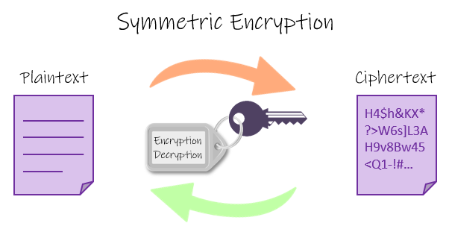
symmetric encryption
In symmetric encryption, there is only one key and all communication parties utilize the same (secret) key for encryption and decryption.

Slide 10
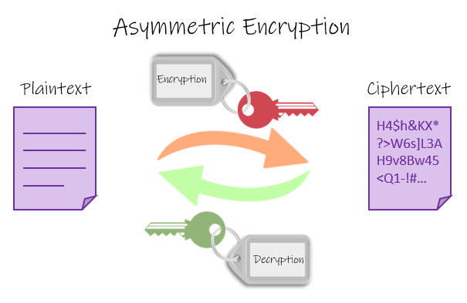
asymmetric encryption
In asymmetric encryption, there are two keys
one is used for encryption (public key),
and the other is used for decryption(private key).

Slide 11
encryption algorithms
Commonly used symmetric encryption algorithms include:
AES
3-DES
SNOW
Commonly used asymmetric encryption algorithms include:
RSA
Elliptic curve cryptography
Notes:
The encryption key will be used by an algorithm to modify the data in a predictable fashion, such that even though the encrypted data appears random, it can be decrypted using the decryption key.

Slide 12
Advanced Encryption Algorithm (AES)
The Advanced Encryption Standard (AES) was created by the US National Institute of Standards and Technology (NIST) in 2001.
Despite being more difficult to build, AES is frequently used today because it is substantially stronger than DES and triple DES.
AES is a block cipher.

Slide 13
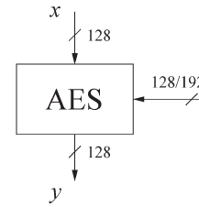
Working of the cipher :
AES uses bytes rather than bits to perform operations.
The number of rounds is determined by the length of the key as follows:
128 bit key – 10 rounds (what system used)
192 bit key – 12 rounds
256 bit key – 14 rounds

Slide 14
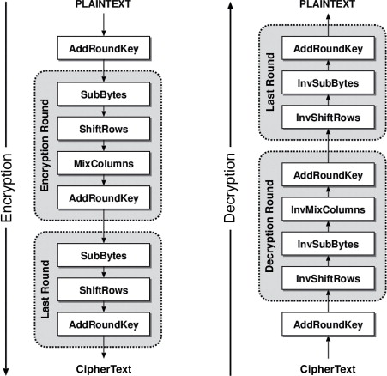
Encryption:

Slide 15
AES algorithm have 5 standard modes of operations
Electronic Code Book (ECB)
Cipher Block Chaining (CBC)
Cipher FeedBack (CFB)
Output FeedBack (OFB)
Counter (CTR)
Mode of operation used to be able to securely send data with length is larger than block size
System interested in CBC and CTR mode

Slide 16
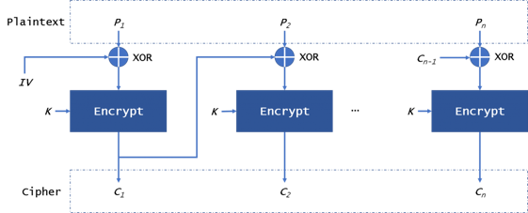
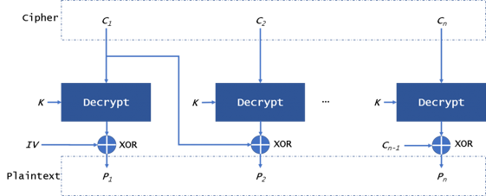
Cipher Block Chaining (CBC).

Slide 17
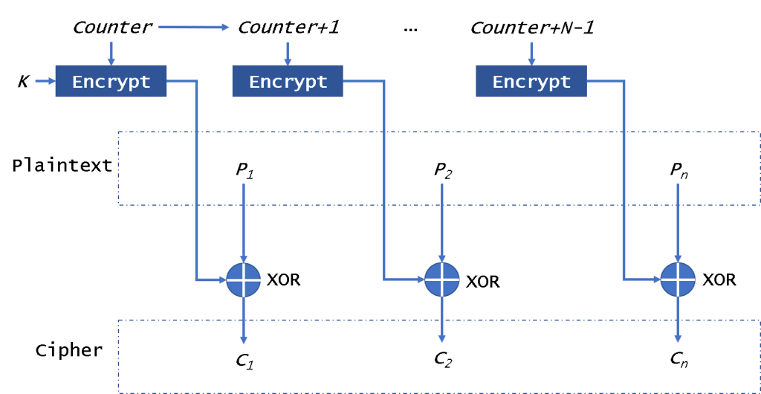
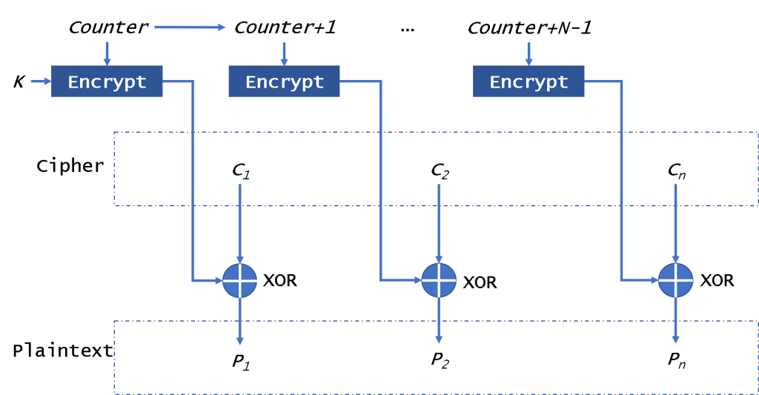
Counter (CTR)
Notes:
This mode uses the value of a counter as an IV. It uses the counter to be encrypted every time instead of the IV.
This mode has two strengths, including encryption/decryption parallelization, and noise in one block does not affect other blocks.

Slide 18
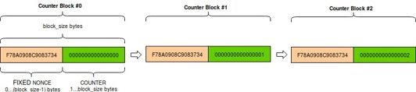

Slide 19
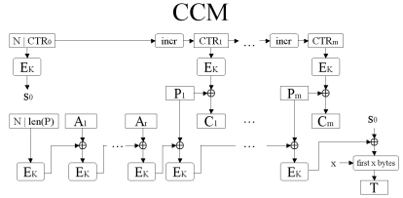
(CCM)
It is a combination of CTR mode and a CBC-MAC (same as CBC but with IV = 0 used to get MAC tag ) based on the AES block cipher.

Slide 20
Decryption
Decryption process is inversion of Encryption procedures:
MixColumn layer → Inv MixColumn layer
ShiftRows layer→ Inv ShiftRows layer
Byte Substitution layer → Inv Byte Substitution layer
Key Addition layer is its own inverse

Slide 22
Steganography

Slide 23
Steganography
Steganography is the science of covering secret message under any media file, so that the secret message is undetectable.
Secret message can be any type of information: text, image, audio, or video
Media file can be: text, document, image, audio or video.

Slide 24
Steganography types
Text Steganography
Image Steganography
Audio Steganography
Video Steganography
System implements Audio Steganography.

Slide 25
Audio Steganography
Audio steganography covers secret message under audio file.
Audio steganography is used with digital audio formats like WAVE, MIDI, and AVI MPEG.
There are many algorithms to carry audio steganography, the most common one is the Least Significant Bit algorithm.

Slide 26
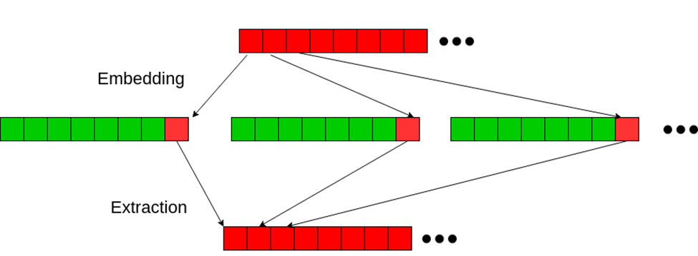
LSB Algorithm
How LSB works?
In Embedding: It replaces the least significant bit from every byte of the audio file with a bit from the secret message.
In Extraction: It extract the message bits by collecting the least significant bits from the audio file bytes.

Slide 27
Steganography
Results

Slide 28
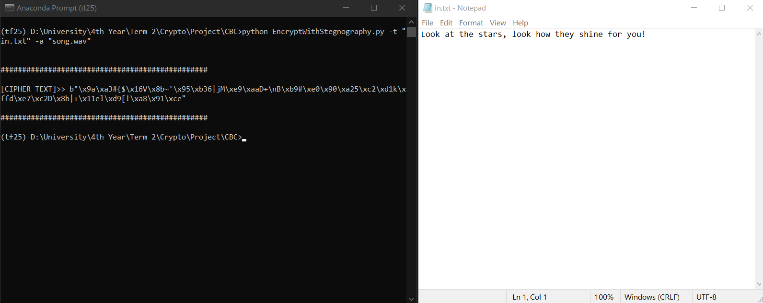
Test Case 1: If AES with CBC mode with no attacks
Encryption and Embedding

Slide 29
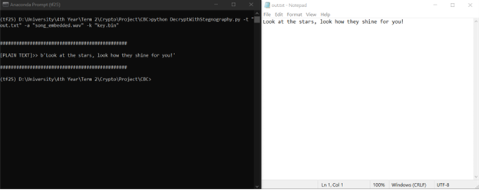
Extraction and Decryption

Slide 30
Test Case 2: If AES with CBC mode + Attack (cipher bits modification)
Encryption and Embedding

Slide 31
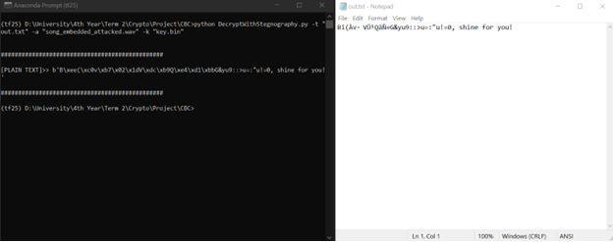
Extraction and Decryption

Slide 32
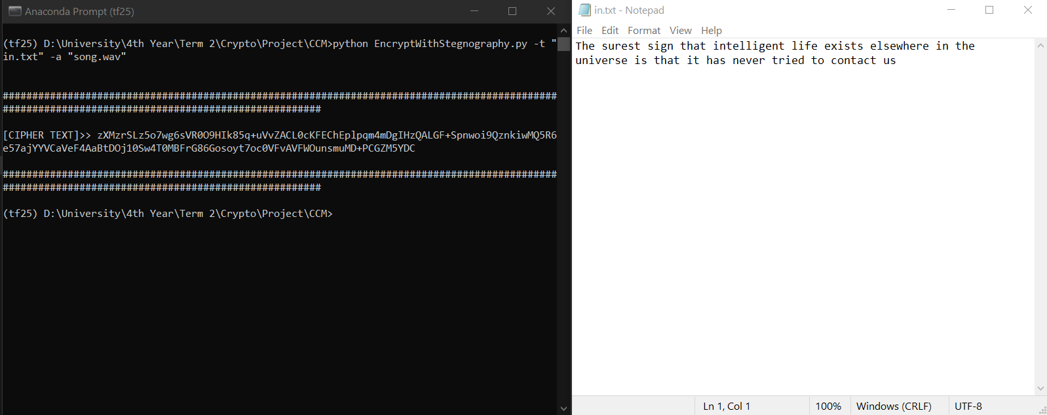
Test Case 3: If AES with CCM mode with no attacks
Encryption and Embedding

Slide 33
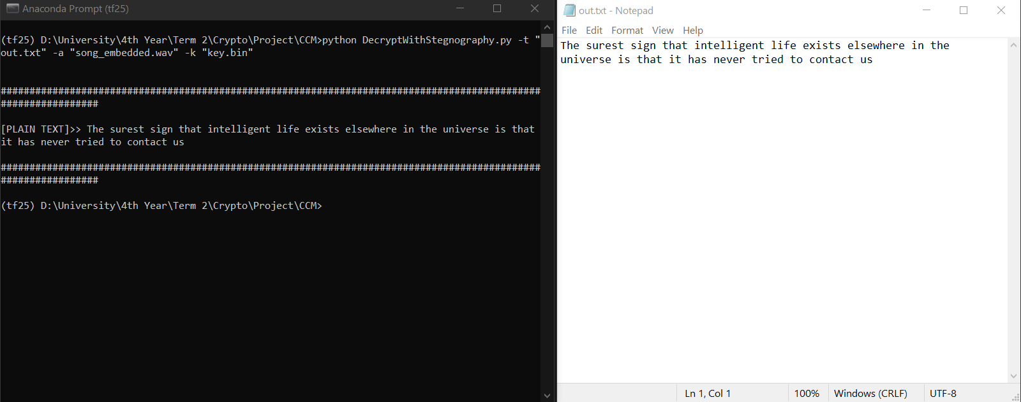
Extraction and Decryption

Slide 34
Test Case 4: If AES with CCM mode + Attack (cipher bits modification)
Encryption and Embedding

Slide 35
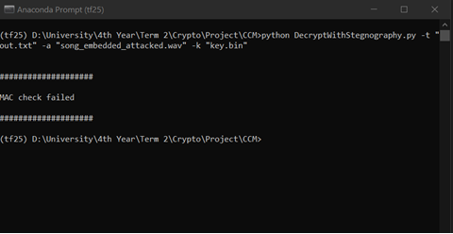
Extraction and Decryption

Slide 36
Steganography
THANK YOU

