Slide 1


Slide 2
•The code implements a game to guess a 4-digit secret code.
•- Key features:
• * Random code generation.
• * Validating user guesses.
• * Providing feedback.
• * Saving and displaying high scores.
* Plotting progress using Matplotlib

Slide 3
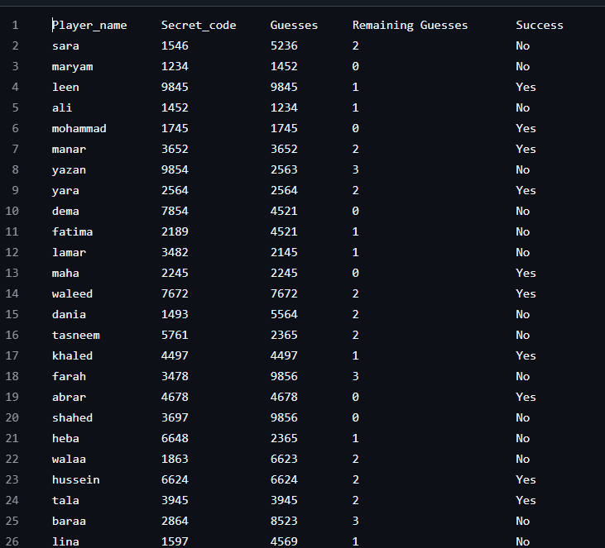
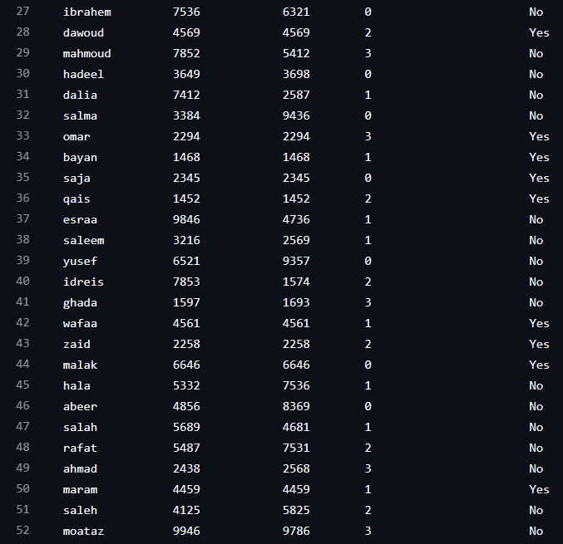
The datasets

Slide 4
Main Class: SecretCodeBreaker
•The class `SecretCodeBreaker` defines:
•- `self.code`: The random code.
•- `self.attempts_left`: Number of attempts allowed.
•- `self.player_name`: Player's name.
•- `self.correct_digits_progress`: Track progress of guesses.

Slide 5
Generate Random Code
•Code to generate the random secret code:
•
•def generate_code(self):
• self.code = [random.randint(1, 9) for _ in range(4)]
•
•- Generates a list of 4 random digits (1-9).

Slide 6
Validate Player's Guess
•Code to validate the player's input:
•
•def validate_guess(guess):
• return len(guess) == 4 and all(
• digit.isdigit() and 1 <= int(digit) <= 9 for digit in guess)
•
•- Ensures the input is a 4-digit number with digits between 1 and 9.

Slide 7

Feedback Function
•Provides feedback on the player's guess:
•
•def get_feedback(self, guess):
• correct_position = sum(1 for i in range(4) if self.code[i] == guess[i])
• correct_digit = sum(min(self.code.count(digit), guess.count(digit)) for digit in set(guess))
• return correct_position, correct_digit - correct_position

Slide 8
Handling High Scores
•- `read_high_scores()`: Reads high scores from 'high_scores.csv'.
•- `save_high_scores(df)`: Saves high scores to the file.
•
Uses the `pandas` library for managing high scores

Slide 9

Plotting Progress
•Code to visualize progress:
•def plot_progress(self):
• plt.plot(range(1, len(self.correct_digits_progress) + 1), self.correct_digits_progress, marker='o')
• plt.title('Progress of Correct Digits')
• plt.xlabel('Attempt Number')
• plt.ylabel('Correct Digits')
• plt.show()
•- Uses Matplotlib to create a line chart.

Slide 10
Main Game Logic
• Code to play the game:
• def play_game(self):
• self.generate_code()
• self.player_name = input('Enter your name: ')
• while self.attempts_left > 0:
• guess = input('Enter your guess: ')
• # Validate, provide feedback, and track progress.
• # Plot progress and update high scores if player wins.

Slide 11
Main Menu
•Main menu logic:
•def main():
• game = SecretCodeBreaker()
•while True:
• choice = input('Choose an option: 1. Play, 2. Show Scores, 3. Exit')
• if choice == '1':
• game.play_game()
• elif choice == '2':
• # Show high scores.
• elif choice == '3': break

Slide 12

Conclusion
•- The game is implemented using Object-Oriented Programming (OOP).
•- Key libraries: `pandas`, `matplotlib`.
•- Provides an interactive and fun way to practice coding skills.

