Slide 1
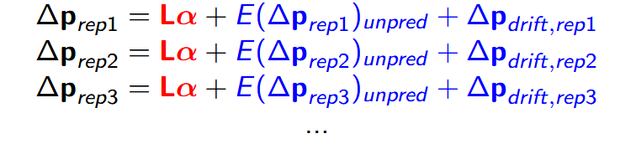
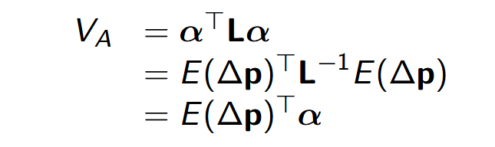

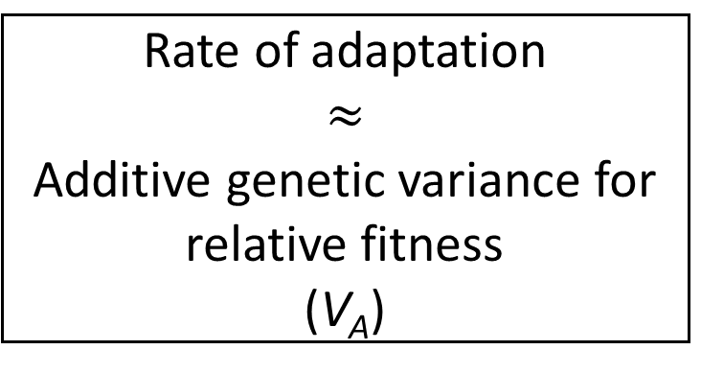
Additive genetic variance for relative fitness from changes in allele frequency
Additive genetic variance for relative fitness from changes in allele frequency
Δp
Rate of adaptation
$$≈$$
Additive genetic variance for relative fitness
(V_{A})
Δp
Rate of adaptation
$$≈$$
Additive genetic variance for relative fitness
(V_{A})
Gen = 0
Gen = t
Gen = τ
Gen = 0
Gen = t
Gen = τ
rep1
rep1
rep1
rep1
Base population
Base population
rep2
rep2
rep2
rep2
rep3
rep3
rep3
rep3
Compute L
Compute L
rep4
rep4
rep4
rep4
Average effects for rel. fitness (α)
Average effects for rel. fitness (α)
Genetic diversity/LD matrix (L)
Genetic diversity/LD matrix (L)
Expected allele frequency change due to selection (E(Δp))
Expected allele frequency change due to selection (E(Δp))
Linear mixed model (random locus effects)
Linear mixed model (random locus effects)

