Slide 1
Designing a Terahertz Telescope Array with QUBO
What I did, what I found, what comes next
Manasa Vamsi
github.com/manas-vamsi/thz-quantum-optimization
Notes:
Today: what you asked, how I did it, three results, and what I need from you. Everything is in the repo.

Slide 2
What you asked, and what I did
I DID
YOU ASKED
Wrote the maths - done
Fixed one problem in it
Built the code and tested it
Ran it on real telescope data
Made a real design for Ladakh
Write the maths (objective function) so the problem can run on a quantum computer (QUBO)
Notes:
Main point: the request is done. Plus I tested it and used real data.

Slide 3
Basic terms and formulas
Term | Meaning | Formula | Our value
Lambda (wavelength) | Size of the radio wave | lambda = c / f | 1.3 mm at 230 GHz
Baseline | Distance between 2 antennas | N antennas give N(N-1)/2 | 16 antennas = 120
Resolution | Smallest detail we can see | lambda / longest baseline | 0.096 arcsec
Largest scale | Biggest thing we can see | 0.6 lambda / shortest baseline | 5 arcsec
UV coverage | How much of the picture we sample | (u, v) = baseline / lambda | ~50% of grid
QUBO | Form a quantum computer accepts | E = sum Q_ij x_i x_j, x = 0 or 1 | -
Rule: long baselines = sharp detail. Short baselines = see big things. We need both.
Notes:
Example: lambda = 3e8 / 230e9 = 1.3 mm. Resolution = 1.3 mm / 2788 m = 0.096 arcsec. One arcsecond is 1/3600 of a degree.

Slide 4
Your guide: one part right, one part fixed
RIGHT
FIXED
Less UV overlap = fewer false ghost images (sidelobes)
I proved it with Parseval's theorem
Checked by computer: 1.000000000000
Overlap needs 4 antennas (i, j, k, l)
Q_ij has only 2 slots - does not fit
Fix: add one switch per antenna pair
Now it fits QUBO again
Notes:
The fix is called Rosenberg quadratization. It adds y_k = x_i * x_j for each pair. Cost: more variables, about 15,000 for all ALMA pads.

Slide 5
Data I used - all real
1
ALMA antenna pads
174 real pads, Chile
Checked
2
Atmosphere
17,000 real ALMA observations
Our ALMA size: 16,195 m
Published: ~16 km
Our Hanle height: 4,491 m
Published: 4,500 m
3
Water vapour
20 years of measurements
4
Ladakh land
Real height maps (SRTM)
5
Test star
HL Tau, a real young star
Notes:
Nothing is made up. Every input is checked against a published number.

Slide 6
The process, step by step
1
2
3
4
5
6
Write the maths
Build optimiser
Find true best
Run QUBO
Make images
Design Ladakh
Step 2: search methods - greedy, swap, annealing
Step 3: exact solver (MILP) - gives the proven best answer to compare against
Step 4: QUBO run with D-Wave software (simulated, not real quantum hardware)
Step 5: make real pictures to check if our score means anything
Notes:
272 automated tests check every step.

Slide 7
Result 1: QUBO maths is right, but slower
QUBO maths is correct (checked all 2,324 options)
But simple search is better
And 35-72x faster
Quantum is not winning here yet
Notes:
Classical takes under 0.4 seconds, QUBO 3-35 seconds.

Slide 8
Result 2: golden ratio is not the key
How far antennas are from the centre matters most
The golden-ratio angle helps only a little (~2.5%)
Best: spread antennas evenly by area
Notes:
Tested 5 radius rules x 5 angle rules = 25 combinations, everything else fixed.

Slide 9
Result 3: Hanle is dry enough only 5% of the time
Guide says Hanle is like ALMA - data says no
But Hanle has roads, power, flat land
Say: good infrastructure, less dry air
Notes:
Source: Raghunath et al. 2026, 184 months of weather data. Hanle is still a good choice for practical reasons.

Slide 10
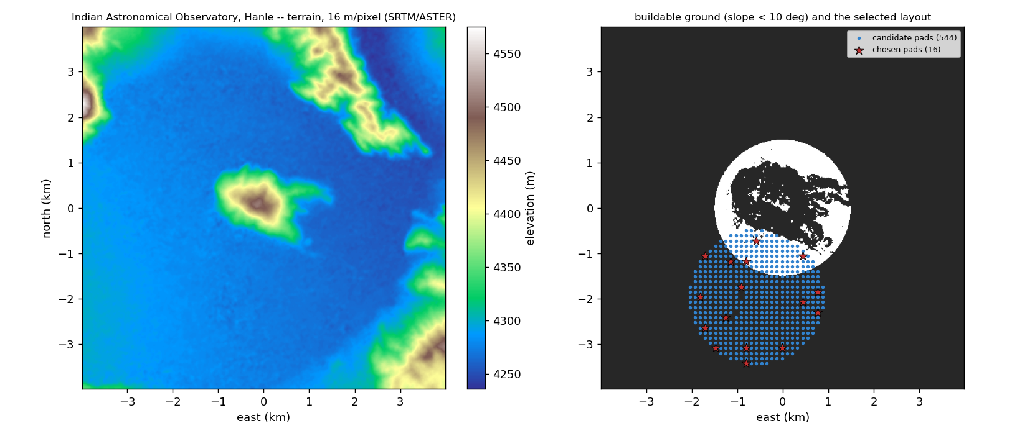
A real array design for Ladakh
16 antennas, 8 m dishes
3 layouts: small, medium, large
See detail 0.096 to 5 arcsec
Exact latitude / longitude for each antenna
Left: land height. Right: buildable land and chosen antenna spots (stars).
First design only - no land, road or power survey yet.
Notes:
Three layouts because one layout cannot give both sharp detail and big-scale view. Files: ladakh_array_design/outputs.

Slide 11
Result 4: does our score give good pictures?
SHAPE: YES
BRIGHTNESS: NO
More UV coverage = correct shape in the picture. Checked on 4 test images.
Best-score array caught only 42% of a big blurry source. Golden spiral caught 91%.
Lesson: we need short baselines too, not only long ones.
Notes:
Pipeline: sky model, visibilities, noise, CLEAN, compare with truth.

Slide 12
What I need from you
1
Coauthor?
Do you want to be on the paper?
2
Details for the paper
Affiliation, email, funding
3
Which story?
Honest result: quantum is not faster here yet
4
Science target
What should this telescope look at?
Paper: 13 pages ready | 272 tests pass | Code: github.com/manas-vamsi/thz-quantum-optimization
Notes:
The science target is the most useful input: everything else follows from it.

