Slide 1
Quantum Optimization of Terahertz Interferometric Architectures
Progress report: formulation, solver benchmark, and three findings
Manasa Vamsi
For: Vishwas, Space Applications Centre, ISRO
github.com/manas-vamsi/thz-quantum-optimization
Notes:
Thank you for the time. I will cover three things: what you asked for and where it is, what I built around it so it could be tested, and three results that change the plan. Two of them are not what we expected. Everything is in the repository and every number comes from a script you can re-run.

Slide 2
What was asked
DELIVERED
THE REQUEST
1
Full derivation
The mathematical formulation of the objective function for QUBO application
docs/objective_function.md
2
Implementation
src/thz_opt/qubo/
3
Write-up
QUBO = Quadratic Unconstrained Binary Optimization - the form a quantum annealer accepts
paper/manuscript.pdf, Section 2
Doing it properly turned up two things about the onboarding note.
Notes:
The brief was to formulate the objective so it can be written as a QUBO and handed to a quantum annealer. That is done: derivation, implementation and write-up. Doing it carefully turned up two things about the onboarding note, on the next two slides.

Slide 3
Your Section 4 claim is correct - and now proven
Claim in the note
Minimising UV auto-correlation minimises PSF sidelobes
Numerical check
1.000000000000
Follows from Parseval's theorem
Dirty-beam energy = sum of squared gridded sampling counts
So 'fewer sidelobes' and 'less UV overlap' are the same number
ratio of the two quantities on a real layout
Why it matters: this is what licenses the whole objective - it is the thing itself, not a proxy.
Notes:
The note says minimising UV overlap minimises sidelobes. That is true but not obvious. Through Parseval's theorem the dirty-beam energy equals the sum of squared sample counts per UV cell, so they are literally the same quantity. Checked numerically: ratio one to twelve decimal places. Source: src/thz_opt/qubo/baseline_qubo.py, sidelobe_energy_terms.

Slide 4
Your Q_ij recipe cannot be written as stated
THE PROBLEM
i
j
k
l
Baseline overlap needs 4 antenna indices (i, j, k, l). Q_ij has only 2 slots. Written directly the objective is quartic - not a QUBO.
baseline 1
baseline 2
4 indices > Q_ij's 2 slots
THE FIX (core contribution)
M + M(M-1)/2
~15,000
One activation variable y_k per antenna pair
Enforce y_k = x_i * x_j by Rosenberg quadratization
Overlap becomes y_k * y_l - quadratic again
variables after the fix
variables for all 174 ALMA pads
Notes:
This is the core contribution. Whether two baselines overlap depends on four antennas; Q_ij can reference only two, so the objective is fourth order, not a QUBO. The fix: a variable per antenna pair saying whether that baseline is active, forced to equal the product of the two pad variables by a Rosenberg penalty. The penalty weights are derived, not guessed, and a test shows the constraint breaks below them. The cost is more variables: about fifteen thousand for the full ALMA field.

Slide 5
Real data, checked against published values
Input | Source | Check
174 ALMA antenna pads | CASA configuration files | 16,195 m longest baseline (published ~16 km)
27 VLA pads (control) | CASA configuration files | 36,623 m (published ~36 km)
Atmospheric phase | ALMA Memo 624 - 17,000 observations | Memo's factors 1.51/1.59/1.22 reproduced as 1.516/1.595/1.223
Water vapour | Cortes 2020 - 20 years at Chajnantor | Monthly percentiles
Terrain (Ladakh) | SRTM / ASTER elevation | Hanle 4,491 m (pub. 4,500); ALMA 5,036 m (pub. 5,059)
Science source | HL Tau, ALMA 2015 | Gap radii 13.2 / 32.3 / 64.2 au
The VLA row is the load-bearing check: geocentric coordinates had to be rotated into a local frame, and recovering 36 km proves the transform.
Notes:
Nothing in the results is invented. Each input is checked against something published. The VLA check proves the coordinate transformation, not just the file. The atmosphere memo publishes its own scaling factors and our implementation reproduces them to three decimals. Source: data/external/SOURCES.md.

Slide 6
What I built around the formulation
Optimisers
Exact solver
QUBO solver
Science objective
greedy, local search, annealing
MILP with proven dual bound
dwave-samplers (D-Wave interface)
Fisher information on a real source
Imaging
Instrument model
Site design
CLI tool
sky > visibilities > CLEAN > compare
primary beam, smearing, mJy
terrain-constrained Ladakh pads
pad coordinates in seconds
272
17
56
47
automated tests
experiments
modules
commits
Notes:
The code could score a layout but not search for one, so the first job was optimisers, and an exact solver that returns a proven optimum with a certificate. That gives every other method something to be measured against. The rest followed from asking how we would know if each step is right. 272 tests pass.

Slide 7
Finding 1: the QUBO formulation is correct
Is the mathematics right? Checked exhaustively on a 16-pad instance of real ALMA geometry.
2,324
0 cells
0.929
feasible selections enumerated - every one
formulation gap: QUBO optimum = true optimum
correlation, QUBO score vs true coverage
Whatever happens next is about the solver, not the mathematics.
Notes:
Two separate questions: is the formulation right, and does the solver work? For a small instance you can check exhaustively: all 2,324 legal ways to choose 6 of 16 real pads. What the QUBO thinks is best is what is actually best. Formulation gap zero. Source: experiments/12_qubo_solver.py.

Slide 8
Finding 1: but the QUBO route loses
35-72x
faster: classical takes <0.4 s, annealing 3-35 s
Every annealing sample was feasible - not a tuning failure
Gap widens with problem size
40 pads already = 820 variables, 33,689 couplings
Notes:
The uncomfortable result. The QUBO ran through dwave-samplers, the same interface a real D-Wave machine uses. Annealing reaches 86 to 92 percent of the proven optimum; plain greedy plus swaps reaches 98 percent in under half a second. Every annealing sample was feasible, so the formulation works; converting and annealing is simply worse here. A quantum result must beat a 0.35 second classical method already within 2 percent of optimal.

Slide 9
Finding 2: the golden ratio is not the point
Named layouts change two things at once - how radius grows and how angle advances. So I crossed 5 radial laws x 5 angular laws, everything else fixed.
2.7x
uniform-in-area vs Gaussian radial profile
2.5%
golden angle vs a degenerate 5-bearing angle
Notes:
A golden spiral changes radius and angle together, so a ranking cannot say which matters. Separated with a factorial design and variance decomposition: radial distribution explains 85 percent, angle 11. The golden angle beats a deliberately bad 5-bearing angle by 2.5 percent. Caveat: sidelobes behave differently, with a large interaction. Source: experiments/16_factorial_layout.py.

Slide 10
Finding 3: Hanle versus the onboarding note
The note: Hanle is 'a comparable high-altitude, low-PWV site' to ALMA. Measured against the note's own 1 mm threshold:
NOT a rejection of Hanle
Only candidate with road, power, observatory
Flattest ground: 15 m relief vs 57 m at site A
Argue it as infrastructure vs dryness - not parity with ALMA
Raghunath et al. 2026, arXiv:2604.13487 - 184 months of ERA5
Notes:
Careful framing: this is about framing, not the site. Against the note's own threshold Hanle qualifies about 5 percent of the time and Chajnantor about 50, an order of magnitude. Hanle still has road, power and the flattest ground. Argue it as infrastructure against dryness with numbers stated; if the paper claims parity a reviewer will check.

Slide 11
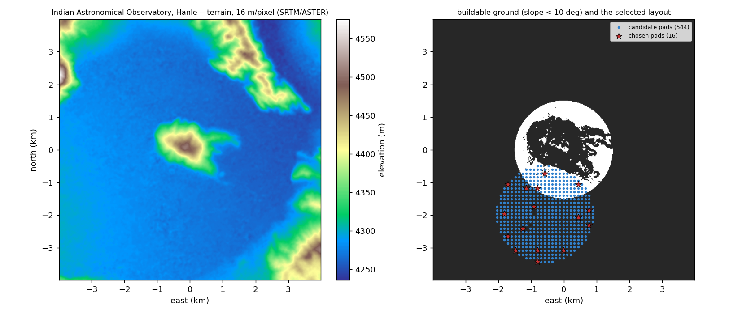
A real array design for Ladakh
 | Compact | Intermediate | Extended
Baselines | 32-232 m | 64-878 m | 338-2,788 m
Resolves to | 1.16" | 0.31" | 0.096"
Sees up to | 5.01" | 2.50" | 0.48"
Relief | 11 m | 9 m | 15 m
Continuous coverage 0.096" to 5.01" (52x)
Pad lat / long / elevation, CASA format
Centre moved 2,049 m off the summit onto the plain
Hanle terrain (left) and buildable ground with chosen pads (right)
Preliminary geometry - not a construction plan (no land rights, roads, power).
Notes:
Real elevation data, filtered for buildable slope and confined to one landform. Outputs are latitude, longitude and elevation for every pad in ALMA's own file format. Three configurations because sixteen antennas over three kilometres cannot also give 32 metre baselines; I checked they overlap so nothing falls between them. Not a construction plan.

Slide 12
Replacing an invented score with a derived one
Problem
Parameter | Error-bar gain | UV cells lost
Gap depth | 10.4% | 43%
Gap radius | 16.0% | 9%
Gap width | 10.9% | 45%
The score was 'occupied UV cells' - chosen for convenience. Optimising a score you invented is circular.
1. HL Tau disc model
Arrays now compare by the error bar on a physical quantity. Bonus: this objective needs no Rosenberg trick at all.
2. Visibility
3. Fisher information
4. Error bar (Cramer-Rao)
Notes:
Nobody builds a telescope to touch UV cells. The replacement comes from estimation theory: for a real source, HL Tau, Fisher information says exactly how much each UV sample is worth for measuring a ring's depth, radius or width. Optimising for the measurement beats cell count by 10 to 16 percent on the error bar, at a cost in coverage: the estimation versus imaging trade-off.

Slide 13
Does UV coverage actually predict image quality?
Built end-to-end imaging: sky > visibilities > real coverage > noise > CLEAN > compare. Transform verified to 2e-16.
Sky model | Cells predict STRUCTURE | Cells predict FLUX
Point source | +1.000 | +1.000
Close double | +1.000 | +0.600
Smooth Gaussian | +1.000 | 0.000
Disc with gap | +1.000 | +0.300
Structure: validated
Perfect rank correlation against every sky model.
Flux: not predicted
Zero correlation on extended sources.
Notes:
Everything so far optimises a stand-in for image quality. I built an end-to-end imaging pipeline to test it. The transform returns the input sky to one part in ten to the sixteen. For structure, occupied cells predict perfectly. For flux on extended sources they predict nothing. Source: experiments/14_imaging_validation.py.

Slide 14
The failure a cell count cannot see
Searched, maximum cells
Golden spiral, on real pads
5,204 UV cells
3,350 UV cells
42%
91%
of the source's flux recovered
of the source's flux recovered
55% more cells, less than half the source. Maximising cells pushes antennas outward and resolves extended emission out.
This qualifies our own headline: the +10.1% from search is a gain in structure, not in flux.
Notes:
The cell-maximising array has 55 percent more cells and recovers 42 percent of a smooth source where the spiral recovers 91. More cells live at large UV radius, so maximising cells drives antennas outward, and long baselines resolve out extended emission. The paper now says the 10 percent search gain is structural, not flux, because a reviewer would find it otherwise.

Slide 15
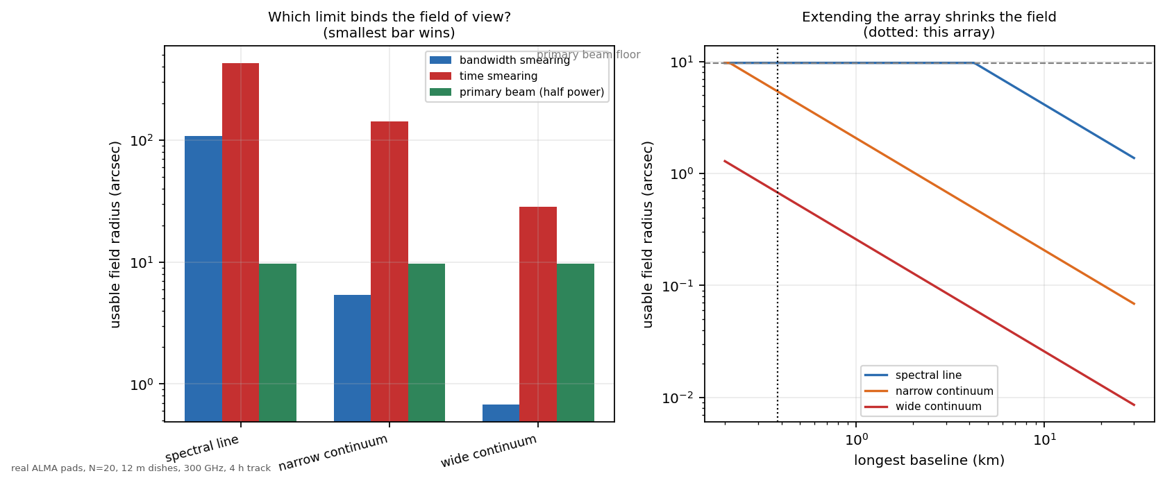
Limits the coverage metrics cannot see
Setup | Bandwidth | Time | Primary beam | Binds
Spectral line | 108" | 427" | 9.7" | primary beam
Narrow continuum | 5.4" | 142" | 9.7" | bandwidth
Wide continuum | 0.67" | 28" | 9.7" | bandwidth
The tension
Smearing scales with the synthesised beam. Extend the array for resolution and the usable field shrinks in proportion.
Notes:
Three effects were missing: primary beam, bandwidth and time smearing. Which one limits the usable field depends on the observation: the dish for spectral line, bandwidth for continuum, collapsing to two-thirds of an arcsecond for wide continuum. Both smearing limits scale with the synthesised beam, so extending the array shrinks the usable field. Sensitivity is now in physical units: about 30 microjansky per hour at Hanle in good winter conditions.

Slide 16
A tool anyone can use
python design_array.py --site alma --n 20 --dish 12
python design_array.py --site hanle --n 16 --dish 8 --max-baseline 3000
pads.csv
baselines.csv
array.cfg
run.yaml
latitude, longitude, elevation
every pairwise distance
CASA format, loads in simobserve
every parameter, exact rerun
No penalty-weight input, deliberately.
The classical search never breaks the antenna count, so nothing needs penalising. QUBO penalties are derived and shown with --show-penalties: a hand-typed value below them makes the formulation wrong silently.
Notes:
Everything is wrapped in a command-line tool: give it a site, antenna count and dish size, get pad coordinates and every pairwise distance. There is no penalty input because the classical search never changes the count; on the QUBO route the code derives the smallest safe penalty and shows it, rather than inviting a wrong value.

Slide 17
Where it stands
13
17
25
272
manuscript pages
figures
references, 0 broken
tests passing
READY
NOT READY - 7 fields
The science. Every figure and table is generated by a script; paper/ is self-contained and checksummed.
Affiliation, email, coauthors, funding, acknowledgements, venue, DOI.
paper/build_pdf.py --check-metadata
Notes:
The paper is thirteen pages, every number generated not typed, and the paper folder is self-contained with checksummed code. What blocks submission is not science but seven metadata fields I cannot fill in. The build refuses to call itself ready while any is blank.

Slide 18
What I need from you
1
Coauthorship
Do you want to be on the paper? Anyone else at SAC?
2
Seven metadata fields
Affiliation, email, funding, acknowledgements, interests, venue, DOI
3
Which story do we tell?
'Formulated, solved, quantum route does not currently pay' is defensible. 'Quantum optimization of THz arrays' is not.
4
What should this array observe?
The one input I could not derive. Everything downstream follows from it.
Notes:
Four things. Authorship: your entry is prepared but nobody goes on a paper without reading it. The metadata I cannot supply. The real decision: the evidence supports an honest paper that says the quantum route does not currently pay, not one titled around quantum succeeding. And the single most valuable input: what should this array observe? One sentence, measure X in sources of type Y, unblocks more than any further optimisation.

Slide 19
Backup: glossary
Term | Plain meaning | Our value
Lambda (wavelength) | Size of the radio wave | 1.3 mm at 230 GHz; 1 mm at 300 GHz
Baseline | Distance between two antennas | 32-2,788 m (Ladakh); up to 16,195 m (ALMA)
N / M | Antennas placed / candidate spots | e.g. 16 of 544
Resolution | Finest detail = lambda / longest baseline (smaller better) | 0.096"
Largest scale | Biggest structure = 0.6 lambda / shortest baseline | 5.01"
Primary beam | Field of view of one dish ~ 1.13 lambda / D | 38" (8 m at 230 GHz)
Sidelobe | False ghost near a real source (lower better) | 0.08-0.10
Shadowing | Minimum separation = 1.5 x dish | 12 m for 8 m dishes
Notes:
Reference if asked about terms. One arcsecond is 1/3600 of a degree, roughly a one-rupee coin seen from 4 km.

Slide 20
Backup: what is deliberately not claimed
1
No quantum hardware
QUBO ran on a classical annealer behind the hardware interface
2
No real visibility data
Imaging is simulated - correctly, but simulated
3
Synthetic pads in Sections 4.1-4.6
By design, so N and extent stay fixed across comparisons
4
No Ladakh phase measurement
Needs an interferometer on site for years; ALMA values transferred and labelled a model
5
Terrain only for Ladakh
No land rights, roads, power or geotechnics
Notes:
Have this ready if the quantum angle is pushed. Each is stated in the manuscript.

