Slide 1
QUBO-Based Design of a Terahertz Telescope Array
Progress Report
Manasa Vamsi
github.com/manas-vamsi/thz-quantum-optimization
Notes:
Agenda: objective, method, results, and the strength and limitation of each result.

Slide 2
Project Objective
DELIVERABLES
OBJECTIVE
QUBO formula - completed
One error in the formula - corrected
Working code - 272 tests pass
Tested on real telescope data
First array design for Ladakh
Write the antenna-placement problem as a QUBO, so it can be solved on a quantum computer
Notes:
QUBO means every choice is 0 or 1. Here: 1 = antenna on this pad, 0 = empty. Quantum annealers only accept this form.

Slide 3
Key Terms and Formulas
Term | Meaning | Formula | Our value
Wavelength (lambda) | Size of the radio wave | lambda = c / f | 1.3 mm at 230 GHz
Baseline | Distance between 2 antennas | N(N-1)/2 baselines | 16 antennas = 120
Resolution | Smallest detail seen | lambda / longest baseline | 0.096 arcsec
Largest scale | Biggest object seen | 0.6 lambda / shortest baseline | 5 arcsec
UV coverage | Share of picture sampled | (u,v) = baseline / lambda | about 50%
QUBO | Form a quantum computer accepts | E = sum Q_ij x_i x_j, x = 0 or 1 | -
Long baselines give sharp detail. Short baselines show big objects. A good array needs both.
Notes:
Worked example: lambda = 3e8 / 230e9 = 1.3 mm. Resolution = 1.3 mm / 2788 m = 0.096 arcsec. 1 arcsec = 1/3600 degree. Note: lambda is also the name of the penalty weights in the QUBO - ask which one is meant.

Slide 4
Parseval's Theorem and How We Used It
WHAT IT SAYS
UV overlap
Total energy is the same in space and in frequency.
sum of n^2
sum|image|^2 = sum|UV|^2 / N
Parseval
equal
HOW WE USED IT
Ghost images
Image and UV plane are a Fourier pair
So ghost-image energy = UV overlap count
Reduce UV overlap = reduce ghost images
sidelobe energy
Checked by computer: ratio = 1.000000000000
Notes:
Why it matters: ghost images are expensive to compute and not quadratic. UV overlap is simple counting and quadratic, so it fits a QUBO. Parseval proves the two are the same, so we can optimise the easy one. This also proves the guide's Section 4 claim is correct.

Slide 5
Correction to the QUBO Formula
i
j
k
l
+
STRENGTH
Formula is now correct
Works with quantum software
baseline 1
baseline 2
PROBLEM
Overlap needs 4 antennas. Q_ij holds only 2. It does not fit.
-
LIMITATION
FIX (Rosenberg method)
Many more variables
About 15,000 for 174 pads
Add one 0/1 switch per antenna pair: y = x_i * x_j. Now it fits.
Notes:
Formula: E(x) = sum Q_ii x_i + sum Q_ij x_i x_j. Full objective H = H_select + H_shadow + H_uv + H_phase. H_select = lambda_s (sum x - N)^2 forces N antennas. Rosenberg penalty = lambda_R (x_i x_j - 2 x_i y - 2 x_j y + 3y). Penalty weights are calculated, not guessed.

Slide 6
Data Sources (All Real and Verified)
1
Antenna pads
174 real ALMA pads, Chile
VERIFIED
2
ALMA size
Ours: 16,195 m
Published: ~16 km
Hanle height
Ours: 4,491 m
Published: 4,500 m
Atmosphere
17,000 real ALMA observations
3
Water vapour
20 years of measurements
4
Ladakh land
Real height maps (SRTM)
5
Test star
HL Tau, a real young star
Notes:
No data is invented. Each input is checked against a published value.

Slide 7
Methodology
1
2
3
4
5
6
Write QUBO formula
Build search code
Find proven best
Run QUBO solver
Make test images
Design for Ladakh
Search code: greedy, swap and annealing methods
Proven best: exact solver (MILP) - the answer key to compare against
QUBO solver: D-Wave software on a normal computer (not quantum hardware)
Test images: check if our score gives good pictures
Notes:
Each step has automated tests - 272 in total.

Slide 8
Result 1: QUBO Solver vs Classical Search
+
STRENGTH
QUBO formula is correct
Checked all 2,324 options
-
LIMITATION
Classical is more accurate
Classical is 35-72x faster
Notes:
Classical: under 0.4 s at 98%. QUBO: 3-35 s at 86-92%. Quantum is not faster on this problem yet.

Slide 9
Result 2: What Makes a Good Antenna Layout
+
STRENGTH
Clear design rule found
Spread antennas evenly by area
-
LIMITATION
Golden ratio helps only ~2.5%
Rule differs for ghost images
Notes:
Tested 5 distance rules x 5 angle rules = 25 layouts, all else fixed. Method: ANOVA (separates which factor causes the difference).

Slide 10
Result 3: Site Assessment - Hanle
+
STRENGTH
Roads, power, observatory
Very flat land (15 m)
-
LIMITATION
Dry only 5% vs ALMA 50%
Not equal to ALMA
Notes:
Source: Raghunath et al. 2026, 184 months of weather data. PWV = water in the air; water absorbs these radio waves. Suggested wording: good infrastructure, less dry air.

Slide 11
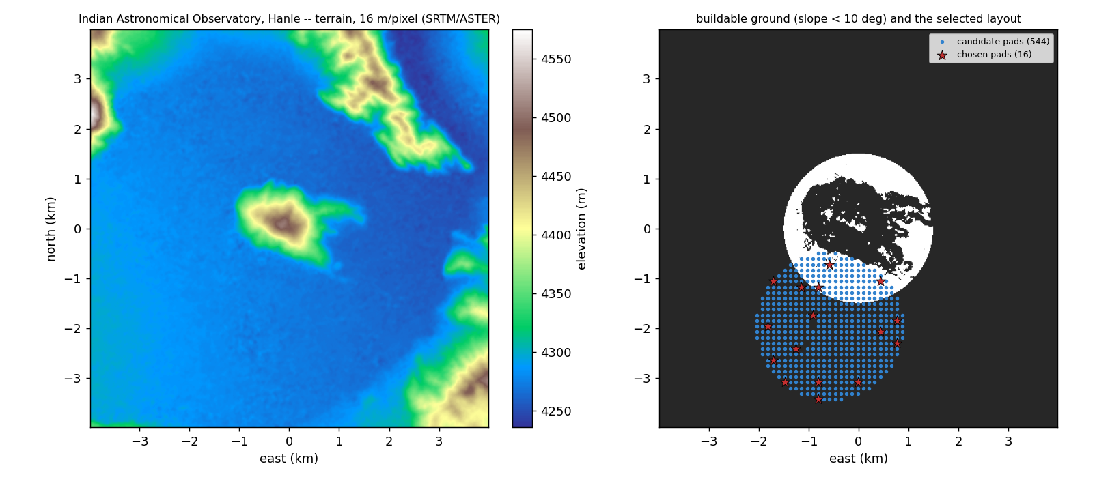
Result 4: First Array Design for Ladakh
+
STRENGTH
Exact location of each antenna
Built on real land data
Left: land height. Right: buildable land and chosen antenna spots.
-
LIMITATION
16 antennas, 8 m dishes
3 layouts: small, medium, large
Detail from 0.096 to 5 arcsec
First design only
No land, road or power survey
Notes:
Three layouts because one layout cannot give both sharp detail and big-scale view. ALMA also moves antennas between layouts.

Slide 12
Result 5: Image Quality Check
Best-score array
Golden spiral
+
STRENGTH
42%
91%
Our score predicts shape perfectly
Validates the whole method
brightness captured
brightness captured
-
LIMITATION
Made real test pictures from 4 sky models
Compared each picture with the true sky
Misses brightness of big objects
Needs short baselines too
Notes:
Pipeline: sky model, visibilities, noise, CLEAN, compare. Shape correlation = 1.000. Brightness correlation for big blurry sources = 0.

Slide 13
Summary
Result | Strength | Limitation
QUBO formula | Correct, fixed one error | Many variables
QUBO solver | Works, all answers valid | Slower than classical
Antenna layout | Clear rule: spread by area | Golden ratio adds little
Hanle site | Roads, power, flat land | Dry only 5% of time
Ladakh design | Exact antenna positions | No survey yet
Image check | Shape predicted perfectly | Brightness not predicted
Notes:
Paper: 13 pages. 272 tests pass. All code and results are in the repository.

