Slide 1
RESUME CLASSIFICATION
OPIM-5671-Data Mining and Business Intelligence
Prof Sudip Bhattacharjee
Team 5 :
1.Anand Shiv Sharma
2.Manas Joshi
3.Sri Varshini Chava
4.Anuja Sunil Kamble
5.Mitul Krishnasamy Sivakumar

Slide 2
Problem Statement:
Solution:
Recruiters struggle to categorize resumes due to high volume of applicants
This projects aims to parse and categorize unstructured resume data(text) using predicted labels in a dataset to streamline the process.
Develop a machine learning model to automate the categorization process using text mining
Providing training or guidance to recruiters on how to categorize resumes based on predefined parameters.

Slide 3
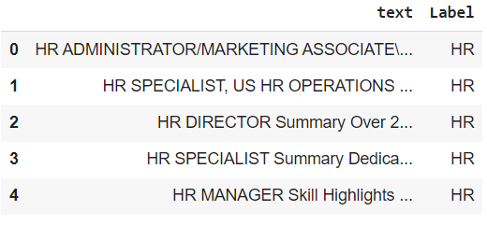
Introduction
Resume categorization of Resume data using classification models.
Before any data cleaning, the dataset consist of 4 column and 2484 rows
There are no null values
Target Variables: Label
Independent Variables: Text
After data cleaning there are 2 columns and 2463 rows.

Slide 4
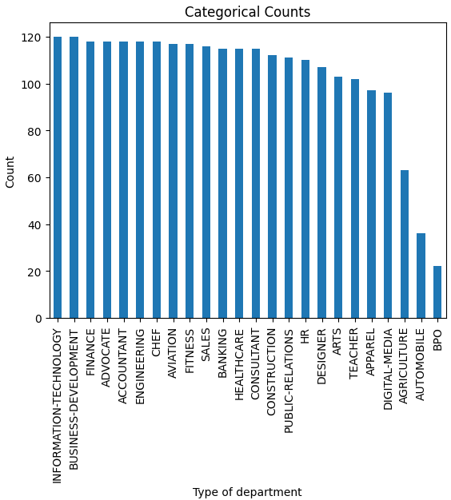
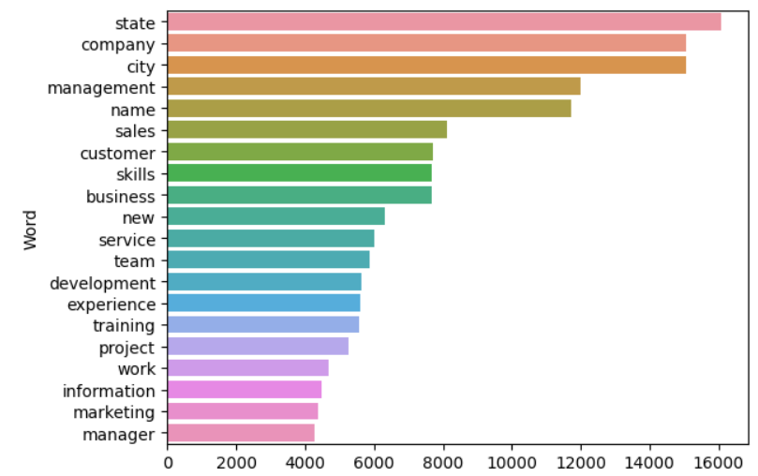
Exploratory Data Analysis
20 Most frequent words in document
Category vs count graph

Slide 5
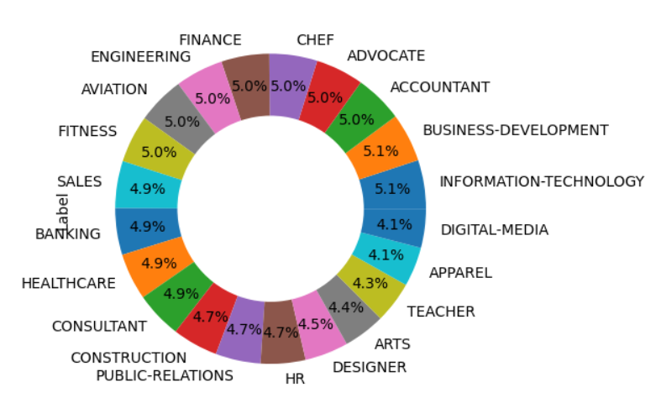
Exploratory Data Analysis
Categories in label variable

Slide 6
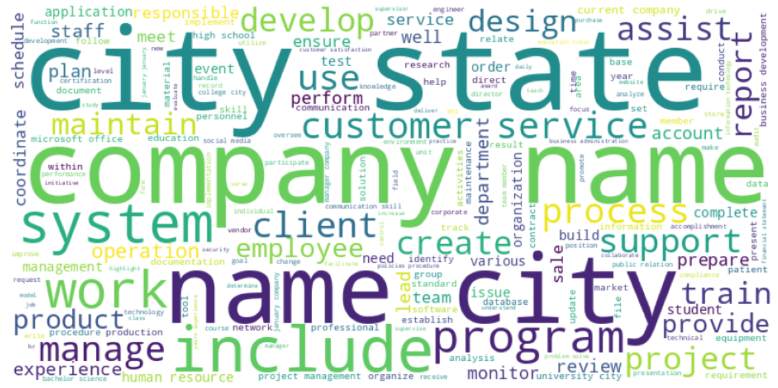
Data Preprocessing and Modification
Remove punctuation from the document
Eliminate digits from the document
Convert text to lowercase
Token creation, lemmatization and proper noun removal

Slide 7
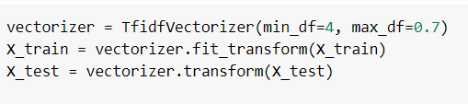
Classification Model
Models:
Support Vector Classifier
Naive Bayes
Random Forest Classifier
Logistic Regression
Gradient Boosting Classifier
Decision Tree Classifier
Training Data: 80%
Testing Data: 20%
Text to Numerical Feature vector

Slide 8
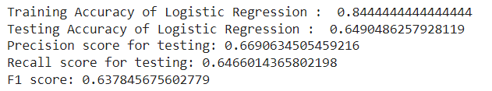
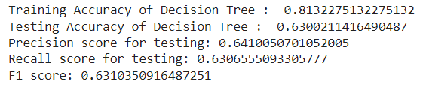
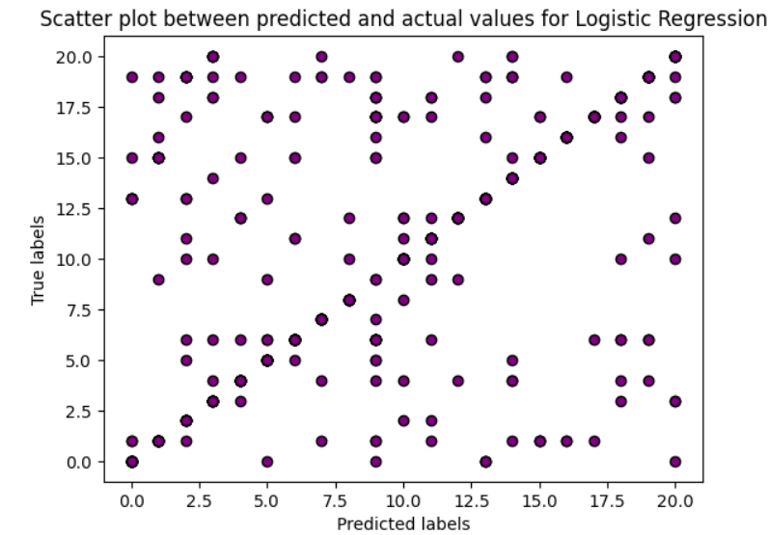
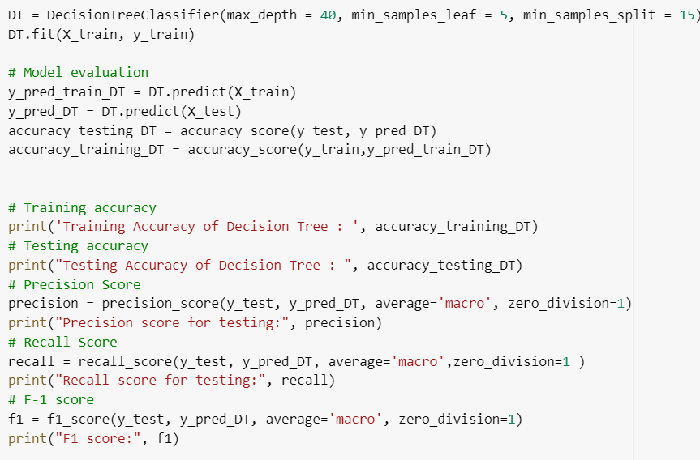
Logistic Regression
Decision Tree

Slide 9
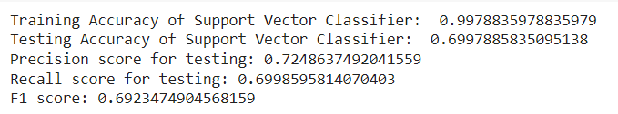
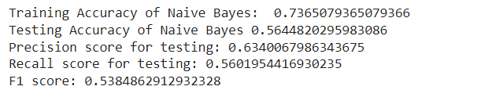
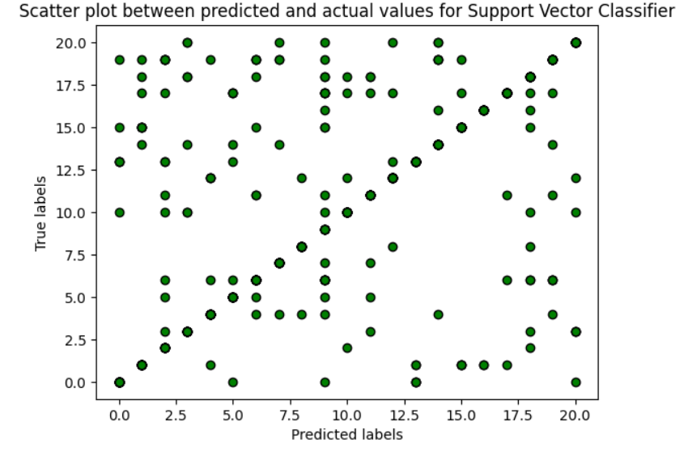
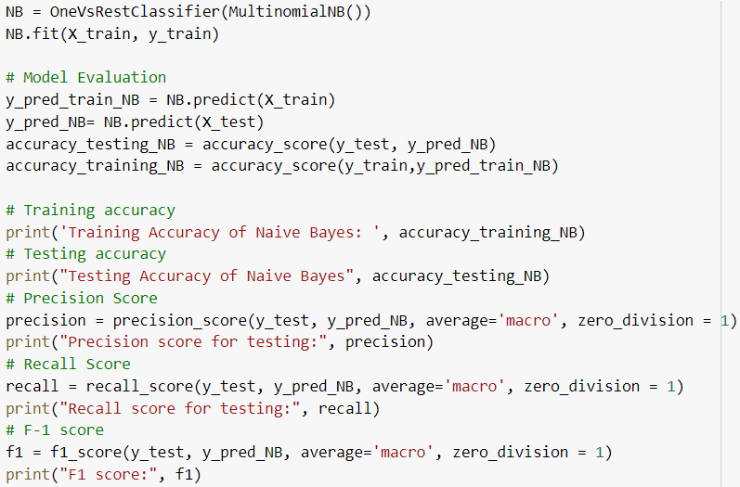
Support Vector Classifier
Naive Bayes

Slide 10
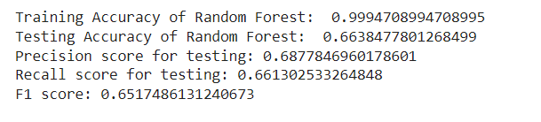
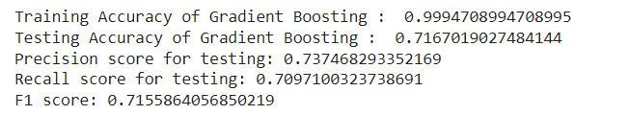
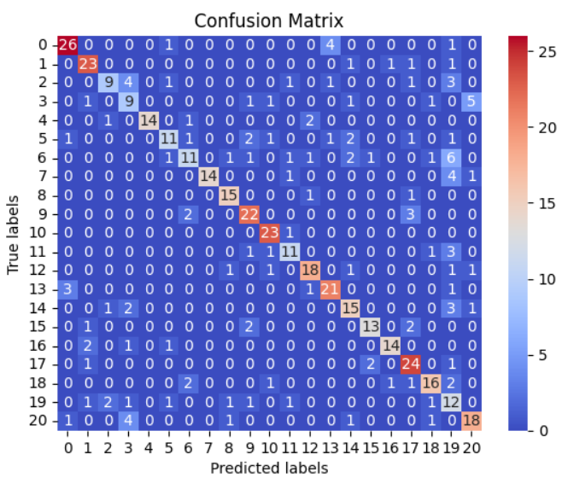
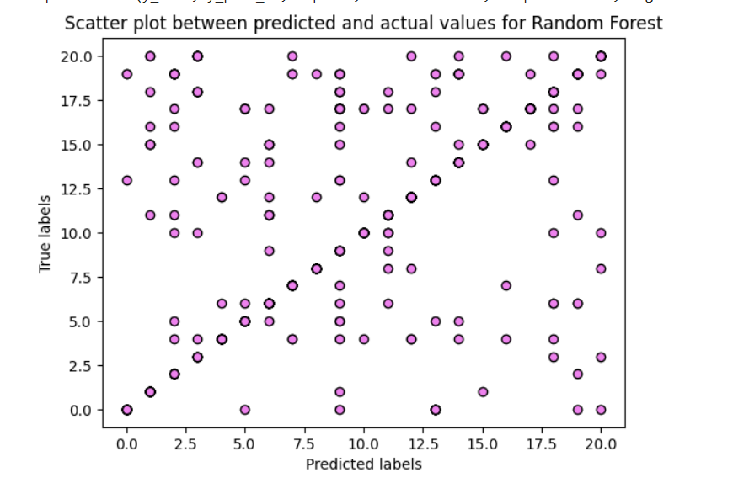
Random Forest Classifier
Gradient Boosting Classifier

Slide 11
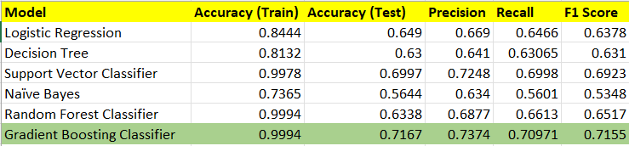
Model Comparison & Business Insights
Improved Recruitment Efficiency
Better Hiring Decision
Standardized Recruitment Process
Data Driven Recruitment
Continuous Improvement

Slide 12
References
Data - https://www.kaggle.com/datasets/snehaanbhawal/resume-dataset

Slide 13


