Slide 1
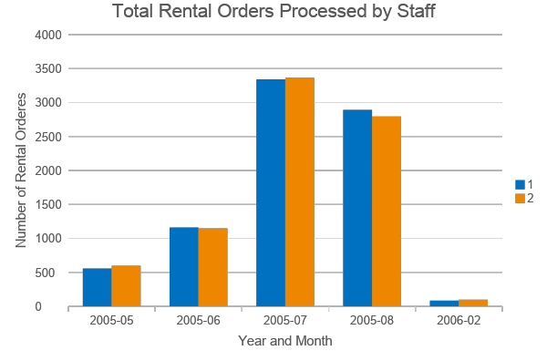
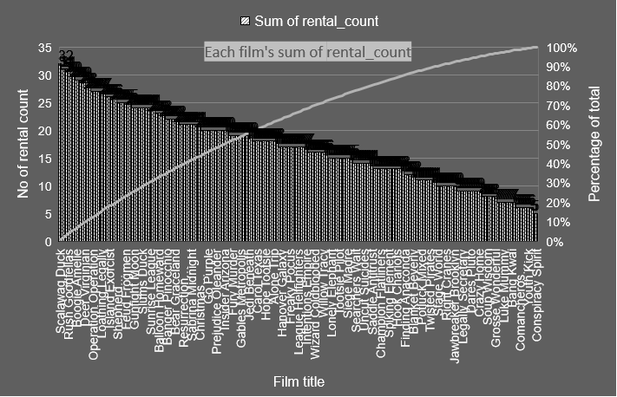
What was the number of times a film has been rented out in family category ?
Scalawag Duck (Music category) is the maximum rented film whereas Conspiracy Spirit (Classics category) is the least rented. Every other movie rental count is shown in decreasing order in the plot.
Staff ID
Notes:
Underlying code to plot the visualisation-Set 1 Q1 in sql_codes.txt file

Slide 2
Which is the quartile a film falls into based on average rental duration for movies across family categories ?
Family (357) followed by Animation (323) is the most watched segment based on average rental duration. Quartile 4 has the highest no of movies, highest watched belonging to Family (116). Least watched movie is in Music category (45) falls under quartile 1.
Notes:
Underlying code to plot the visualisation-Set 1 Q2 in sql_codes.txt file

Slide 3
How many movies within each film category fall in each quartile?
4th quartile in Family & 1st quartile in Animation are highest. These 2 seem kind of outliers compared to rest of the plot across categories. Every other category has different count of movies in each quartile hence it cannot be said a particular quartile across the view is significant.
Notes:
Underlying code to plot the visualisation-Set 1 Q3 in sql_codes.txt file

Slide 4
How the two stores in their count of rental orders during every month for all the years compare?
The 2 stores perform in a similar fashion in all the months of available data. Maximum rented by both the stores was in 2005 July & August, respectively.
Notes:
Underlying code to plot the visualisation-Set 2 Q1 in sql_codes.txt file

Slide 5
Who are top 10 paying customers, no of payments & amount they paid on a monthly basis during 2007 ?
The plot is based on sum of amount paid. Eleanor hunt in April has paid the most. Marcia Dean in February paid the least. Almost all of them did highest payments in April followed by March.
Notes:
Underlying code to plot the visualisation-Set 2 Q2 in sql_codes.txt file

