Slide 1
AQUA TRASH COLLECTOR

Slide 2
FACULTY DETAILS: Md . Asma(assistant professor) B . Bala Krishna(assistant professor) B . Kondalu(assistant professor) TEAM DETAILS:
21H51A05C8-T.AKHILA
21H51A0581-G.AKHILA
21H51A05D2-B.VINITHA
21H51A0512-MANAS CHHATWAL
21H51A0532-HARI CHARAN
21H51A0566-K.SHAILESH

Slide 3
ABSTRACT
Rivers are important part of human lives . But unfortunately , only few are aware of its importance . The proof : tons of trash in our rivers and creeks , making it look and smell like a dumpsite . The garbage in rivers is more than just an eyesore because it can possibly contaminate our drinking water and threaten nature , our lives . Even a piece of litter thrown on the street may contribute to piling garbage in our rivers and lakes . Rivers remain an important role in the drinking water for many areas . The water is purified is purified before it reaches to our taps.
Now a days we use many water purifying system in India .But we are not stopping the contamination of rivers and lakes . By keeping this situation in mind we have come up with a solution called as the Aqua cleaning machine .By using this machine we can easily clean the rivers and lakes and this machine is portable. We are using the Solar panel instead of using many batteries . Because using of many batteries it may be difficult so we use solar panel because in the day time it will works on the solar energy and in the night time it use the stored energy for moving . We use propellers to move and float on the water without sinking in the water . We are using coveyor belt to catch the plastic and any water bottles which are thrown into the rivers and lakes.

Slide 4
LITERATURE SURVEY
Sharma ; Dec (2011) “universal reverence to water” have stated that , i many religions of the world water is used to celebrate the occasion which causes pollution of water . This is hazardous for aquatic lives and make the water unsual . Due to which the concept of removing waste from water is arrived
H . Larsen , N . H. Ipsen and L . Ulmgrem : In many countries , one of the many reasons the major reason behind water pollution is use of fertilizers in agricultures.
To make the country pollution free the principle instead implemented is “best environmental practice”
The capability of people to make choice for corrective action implementation is mentioned.
S . Veenstra, G . J. Alaerts and M . Bijlma ICWE in the International Conference on Water and Environment in the year January 1992,have stated that , in the newly industrializing cities economic growth is the very basic factor of consideration.
More attention on pollution carrying capacity of environment is preferred . Basic west water treatment plant transferred 1ml of west water in to 1-2lit of concentrated sludge.
Ganesh U L, et.al.[1] Showed the usage of mechanical drainage cleaner to replace the manual work required for drainage cleaning system . Drainage pipes are very dirty . Sometimes it is harmful for human life while it is need for cleaning system. To overcome this problem , they implemented mechanical semi-automatic drainage water cleaner .

Slide 5
NEED STATEMENT
To remove the waste materials like plastic bags and bottles in the rivers and lakes and make them clean .

Slide 6
EXISTING SOLUTIONS
RC River cleaning machine is the first existing solution for river water cleaning system.
In this existing project they have used the container like structure to collect the waste materials.
This project works with the RC that is remote controller.
In the existing solution they have used only 5 to 6 12v batteries to run.
This project is widely used in the rivers and pools also.

Slide 7
SDG GOALS
CLEAN WATER :
We need to ensure access to clean water .
Advocate water security through needed investments.
Its main aim to remove the wastage from rivers and lakes.

Slide 8
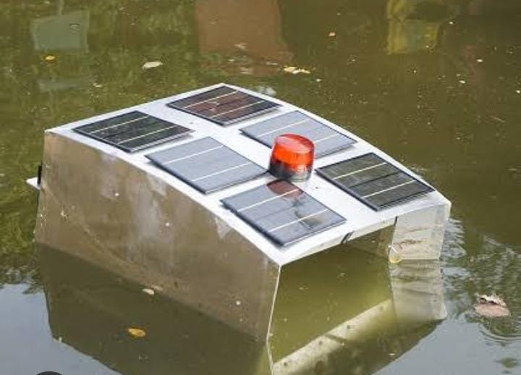
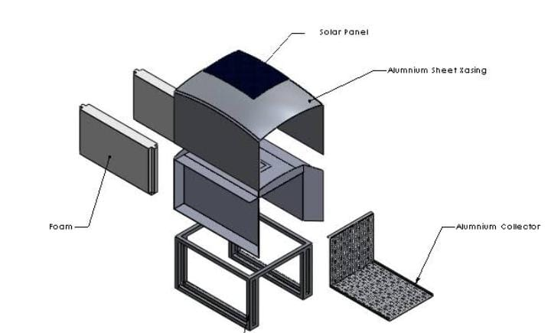
EXISTING SOLUTION PHOTOS

Slide 9
DRAWBACKS OF THE EXISTING SOLUTION
The existing solution is very expensive.
The existing solution is not portable.
The existing solution uses the Remote controller which is sometimes difficult to operate.
In the existing solution more metal has been used which very difficult to float on water even with the propellers.
In the existing solution aquatic animals have very much risk.

Slide 10
PROPOSED SOLUTION
We had come up with a solution which is used for removing the wastages from the rivers and lakes.
It is called as the Aqua cleaning machine in order to over come the drawbacks of the existing solutions.
We are using solar panel to work machine for the long time.
In order to over come existing solution draw back that is not portable we are making our project which can be portable.
We are using conveyer belt instead of using the mesh like structure to remove the waste materials on the water.
We can implement this project with the help of mobile app which is interconnected with the help of the Bluetooth module and the conveyor belt.
4 motors has been used two are at the wheels for moving and two are at the conveyor.
PVC pipes are used so that it will float on the water.
PVC pipes are also used at the conveyor belt to collect the waste materials.

Slide 11
COMPONENTS REQUIRED:
Bo motors (4)
Conveyor belt
Foam sheets
Arduino Uno
Jumper wires
Collecting box
PVC pipes
L298N Motor drive
Bluetooth module
Wheels
Mobile app
Switch
Solar panel(1.3W)
3000mAh batteries
Cycle Tyre

Slide 12
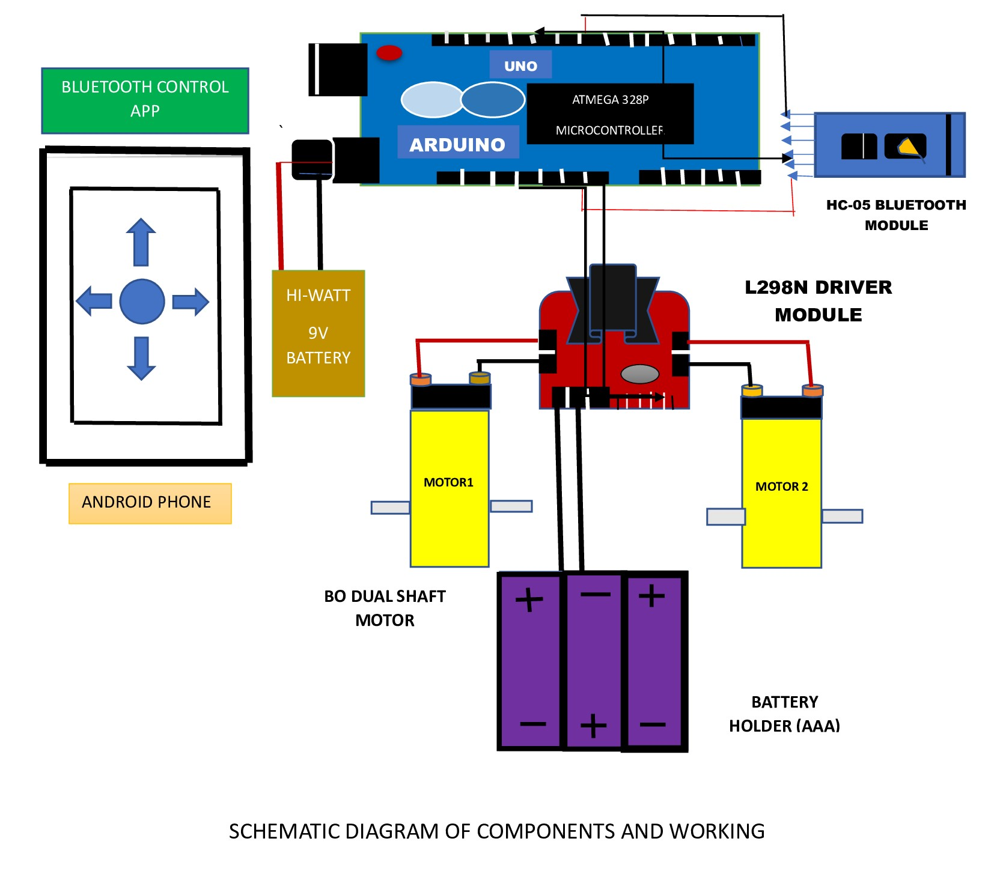
BLOCK DIAGRAM

Slide 13
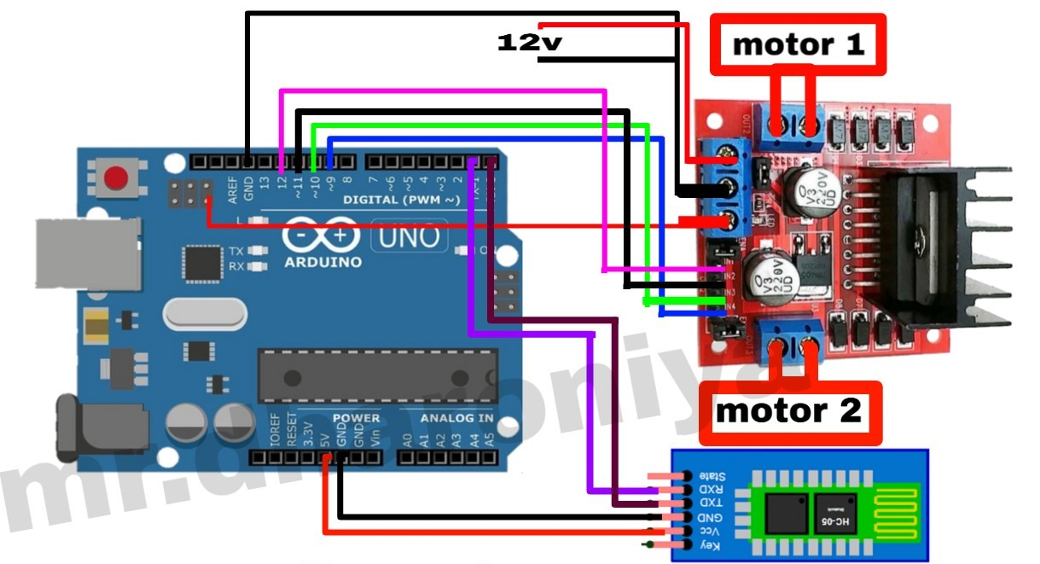
CIRCUIT DIAGRAM

Slide 14
APPLICATIONS
This project is used to clean the surface of water.
This project is used even to clean the pools in restaurants and apartments.
By using this aqua cleaning machine we can clean the nearby water bodies and prevent the water pollutions from harmful plastic bags and bottles.
This machine is very easily portable.

Slide 15
ADVANTAGES
This model can be easily portable.
No need of the labour working for cleaning the water bodies.
One man control machine instead of many working labours.
Low cost.
Even we can use this project model for cleaning small lakes in the villages that are used for watering for the agriculture.
This project can also be used in the night times.
There is harmful to the aquatic animals.
This can also be used with the help of remote controllers or with the help of Bluecontrol system.

Slide 16
LIMITATIONS
The limitations in our project is that at least one individual is required to operate the entire system.
To operate the model they should at least know the basic instructions like giving left , right, forward and backward
It collects only for the minimum range of water surface .
All connections must be carefully handled as they are made to collect the trash from the surface of the water.

Slide 17
CONCLUSION
Our project model is made to clean the small rivers and lakes and to over come the limitations in the existing solutions . The main aim is to clean the plastic materials by running the machine only by a single individual person by operating in the mobile app which is interconnected with the help of the Arduino and uno and Bluetooth module.

Slide 18
THANK YOU

