Slide 1


TO-INFINITY

Slide 2
TEAM NAME and MEMBER DETAILS
Anshuman Singh Sisodia
Amrita Nayak
Manas Oswal
Sakilam Raviteja
Shaik Yasmeen
THEME: Konnex

Slide 3
PROBLEM STATEMENT
Create an innovative solution or application that integrates the end to end user experience and application support into one single place, which is accessible as an onscreen floating widget on top of any application/webpage, with one single click and looks simple + user friendly, that connects the users with the IT product teams.

Slide 4
SOLUTION
An end to end platform which integrates query-resolving, tutorials, bug-reporting and announcements altogether with the use of AI.
Frameworks and libraries: Angular, Django, Rasa
Technology and concepts: Web sockets, REST API, SQL (SQLite), caching.
Frontend styling: Bootstrap, Jquery, Tailwindcss, Tippy, Alertify.

Slide 5
Solution decision points:
Assumptions, constraints, and solution decision points (Reason behind choosing a technology)
Angular provides consistency, security and easier debugging (because angular uses typescript) as compared to other frameworks.
Django – Python is vastly more writable and scalable, provides security, easier database management and provides a vast variety of plugins.
AI and ML are used for smart decision making and enhanced user experience.
Extent of Scalability/Usability :
Django allows us to create a multi tenant application which allows us to serve multiple clients with single installation.
Django’s modularity provides easy maintainance of code.

Slide 6
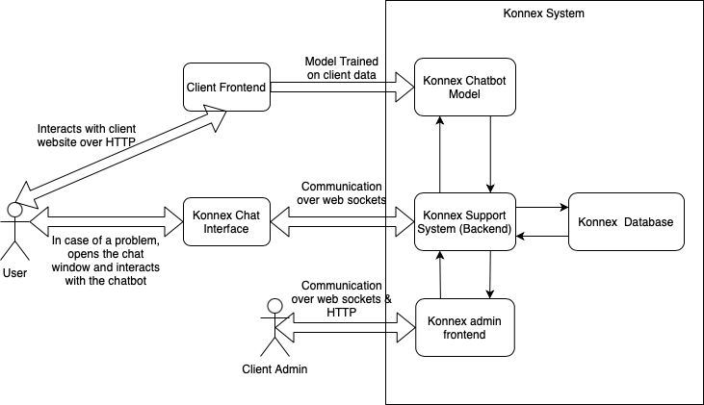
METHODOLOGY – Architecture Diagram

Slide 7
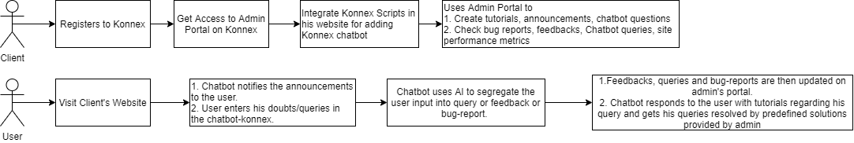
METHODOLOGY – Flow chart

Slide 8
WORKING PROTOTYPE
Github link: https://github.com/manas99/konnex-aerothon.git
Prototype link: https://drive.google.com/file/d/1lOCnA8XtYeKIgjGfJaLZQ8LA-q5JklTM/view?usp=drivesdk

Slide 9
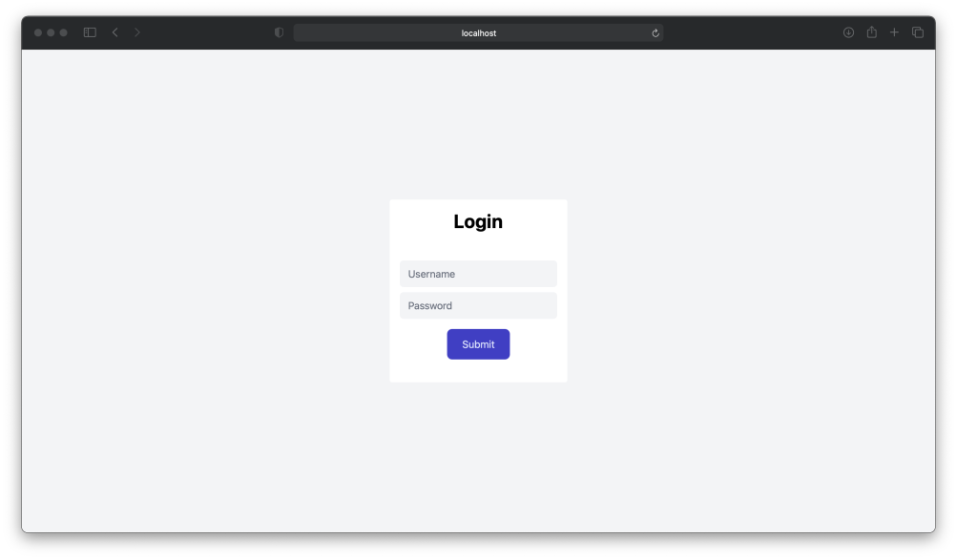
Screenshots of konnex:

Slide 10
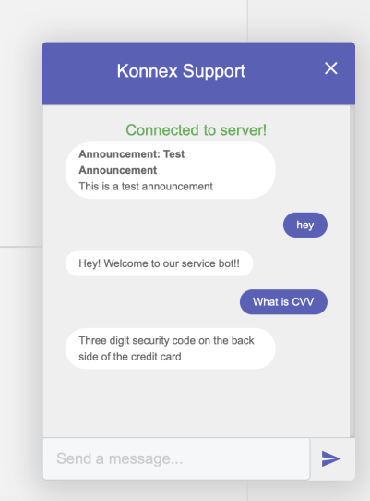
Screenshots of konnex:

Slide 11
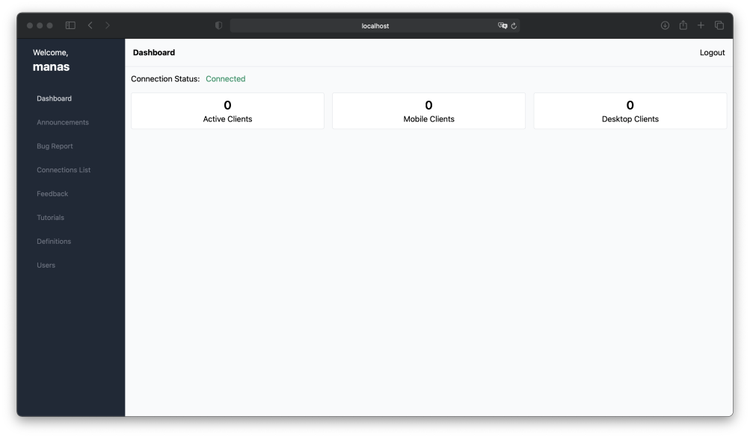
Screenshots of konnex:

Slide 12
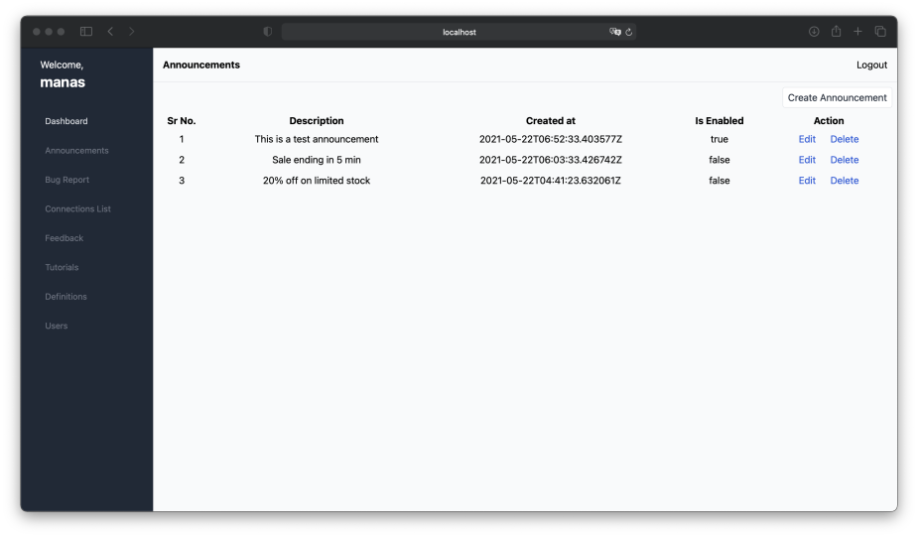
Screenshots of konnex:

Slide 13
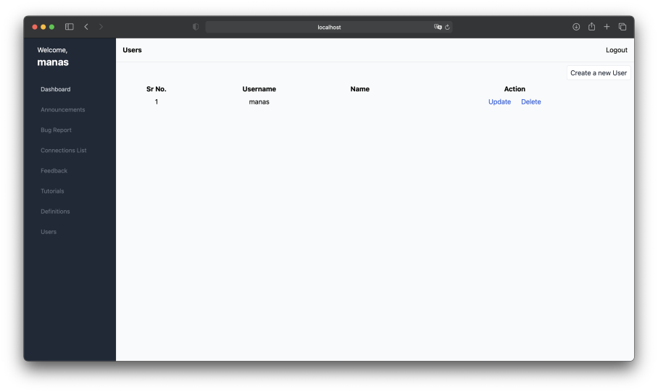
Screenshots of konnex:

Slide 14
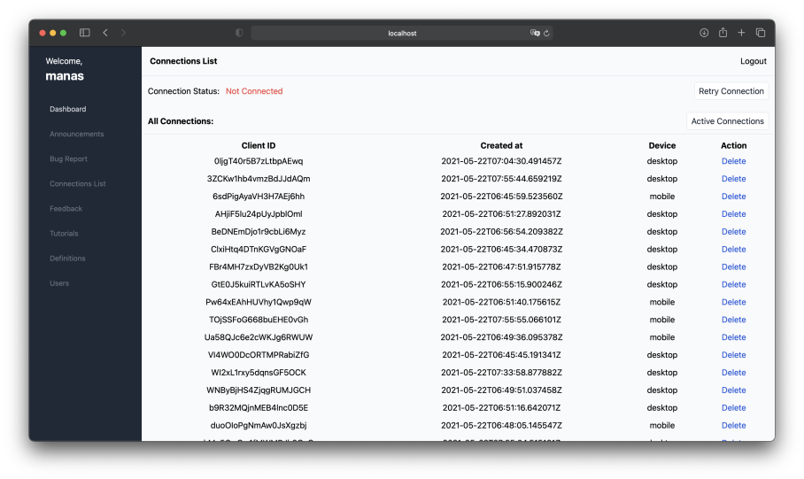
Screenshots of konnex:

