Slide 1
Sales forecasting for retail
Manasa Jayaprakash
Springboard

Slide 2


Problem Statement
This Photo by Unknown Author is licensed under CC BY
Sales forecasting is the process of estimating future sales.
The task here is to predict sales per department for a large-scale retail chain
Companies can base their forecasts on past sales data, industry-wide comparisons, and economic trends.
This Photo by Unknown Author is licensed under CC BY-SA

Slide 3
Why sales forecasting?
Sales forecasting helps companies to-
1. To predict and plan the inventory throughout the year
2. Helps to manage staff and other resources
3. Predict achievable sales revenue and in turn make wise business investments

Slide 4
Data information
Data ranging from the year Feb 2010 to Nov 2012.
Anonymized information for 45 stores in different locations. Dataset contains columns such as sales, discounts, size of the stores, CPI, fuel price etc.
3 .csv files – stores.csv, features.csv and sales.csv.
sales.csv contains 421,570 rows and 5 columns.
features.csv contains 8,190 rows and 12 columns.
Stores.csv contains 45 rows and 3 columns.

Slide 5
Data cleaning
Data Cleaning is crucial because it is the only way to make raw data usable.
Null values in features.csv dataset (Markdown, CPI and Unemployment columns) were replaced.
stores.csv
sales.csv
features.csv
Merged sales.csv, stores.csv and features.csv to form a single dataframe.
The resultant dataframe contains 42,1570 rows and 17 columns
retail_data.csv

Slide 6
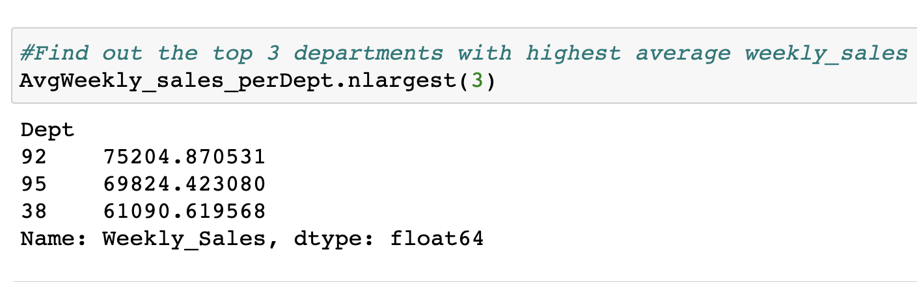
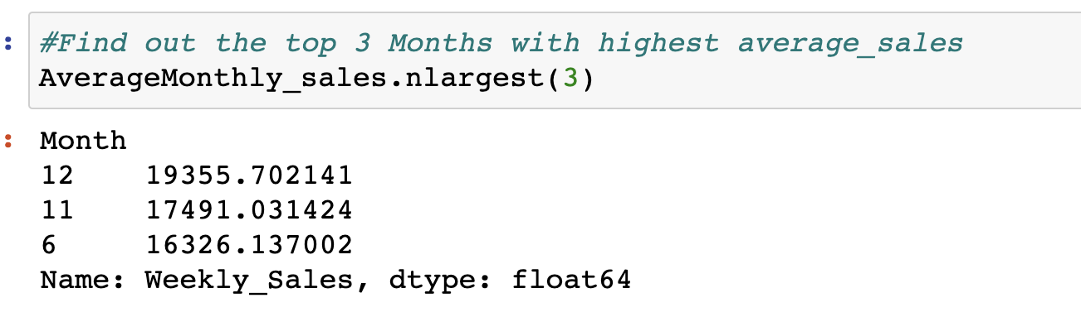
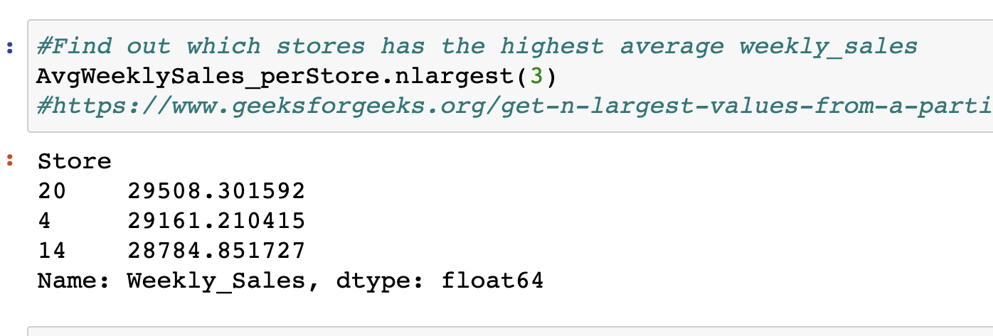
Exploratory analysis
Our end goal is to predict Sales for the next fiscal year.
So, we are particularly interested in – Average Weekly Sales
per department, per store and per month.
We can see that Dept 92 has the highest average sales.
Dec, Nov and June months lead in average sales.
Store 20, 4,14 have the highest average Weekly sales.

Slide 7
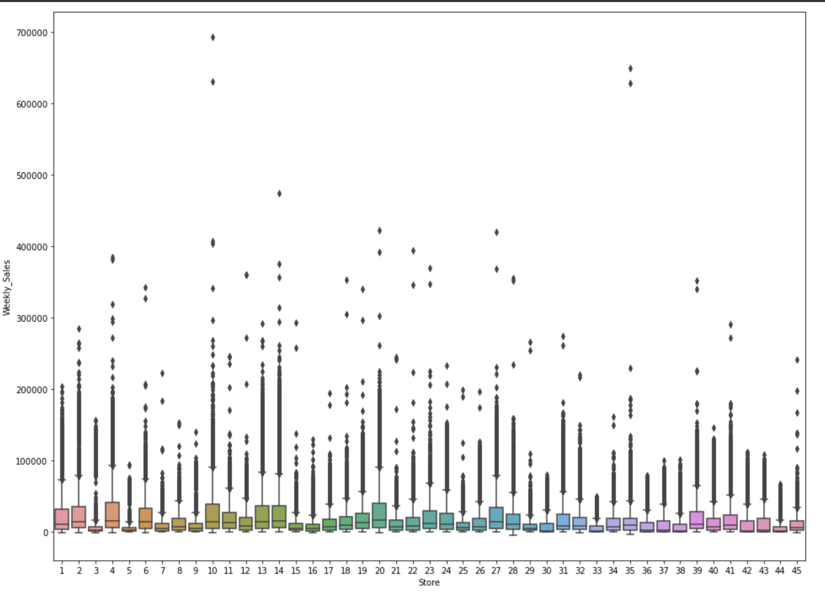
Judging by the graph, Average Weekly Sales looks pretty much same for all 45 stores.
All stores have lot of outliers in Sales.
Store #10 and #35 have very large outliers.
However, Our calculations suggests- Store #20 , #4, #14 have highest Average Weekly Sales – around 29,000$ each.

Slide 8
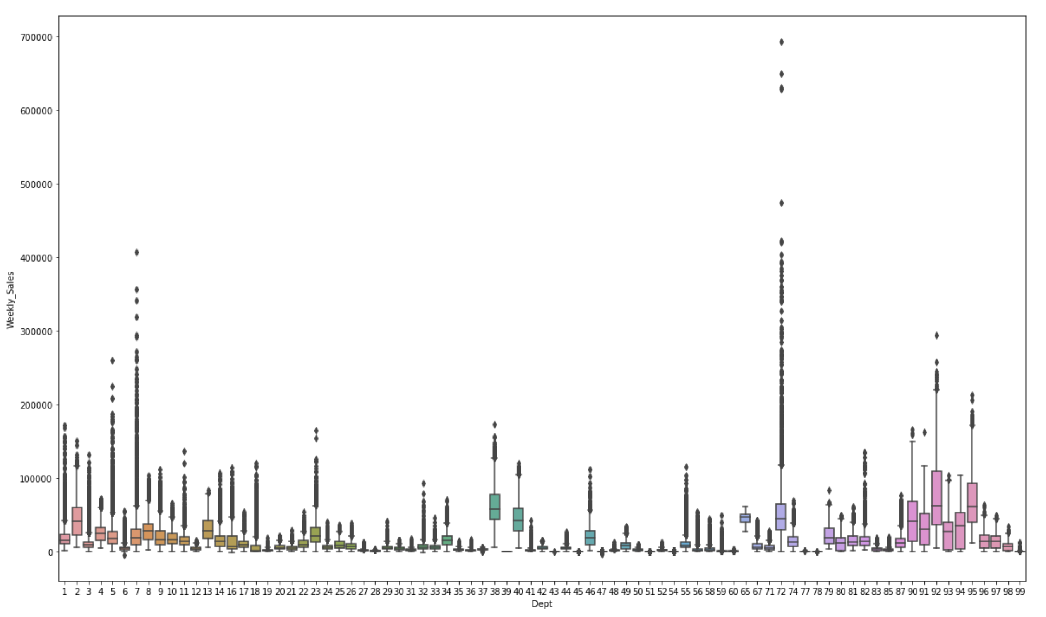
Most departments have outliers.
Dept #72 has the largest number of outliers , second largest is dept #7.
We can see that dept #92, #95 and #38( in that order) have the highest sales.
Dept #92 has an average Weekly Sales of around 75,000$.

Slide 9
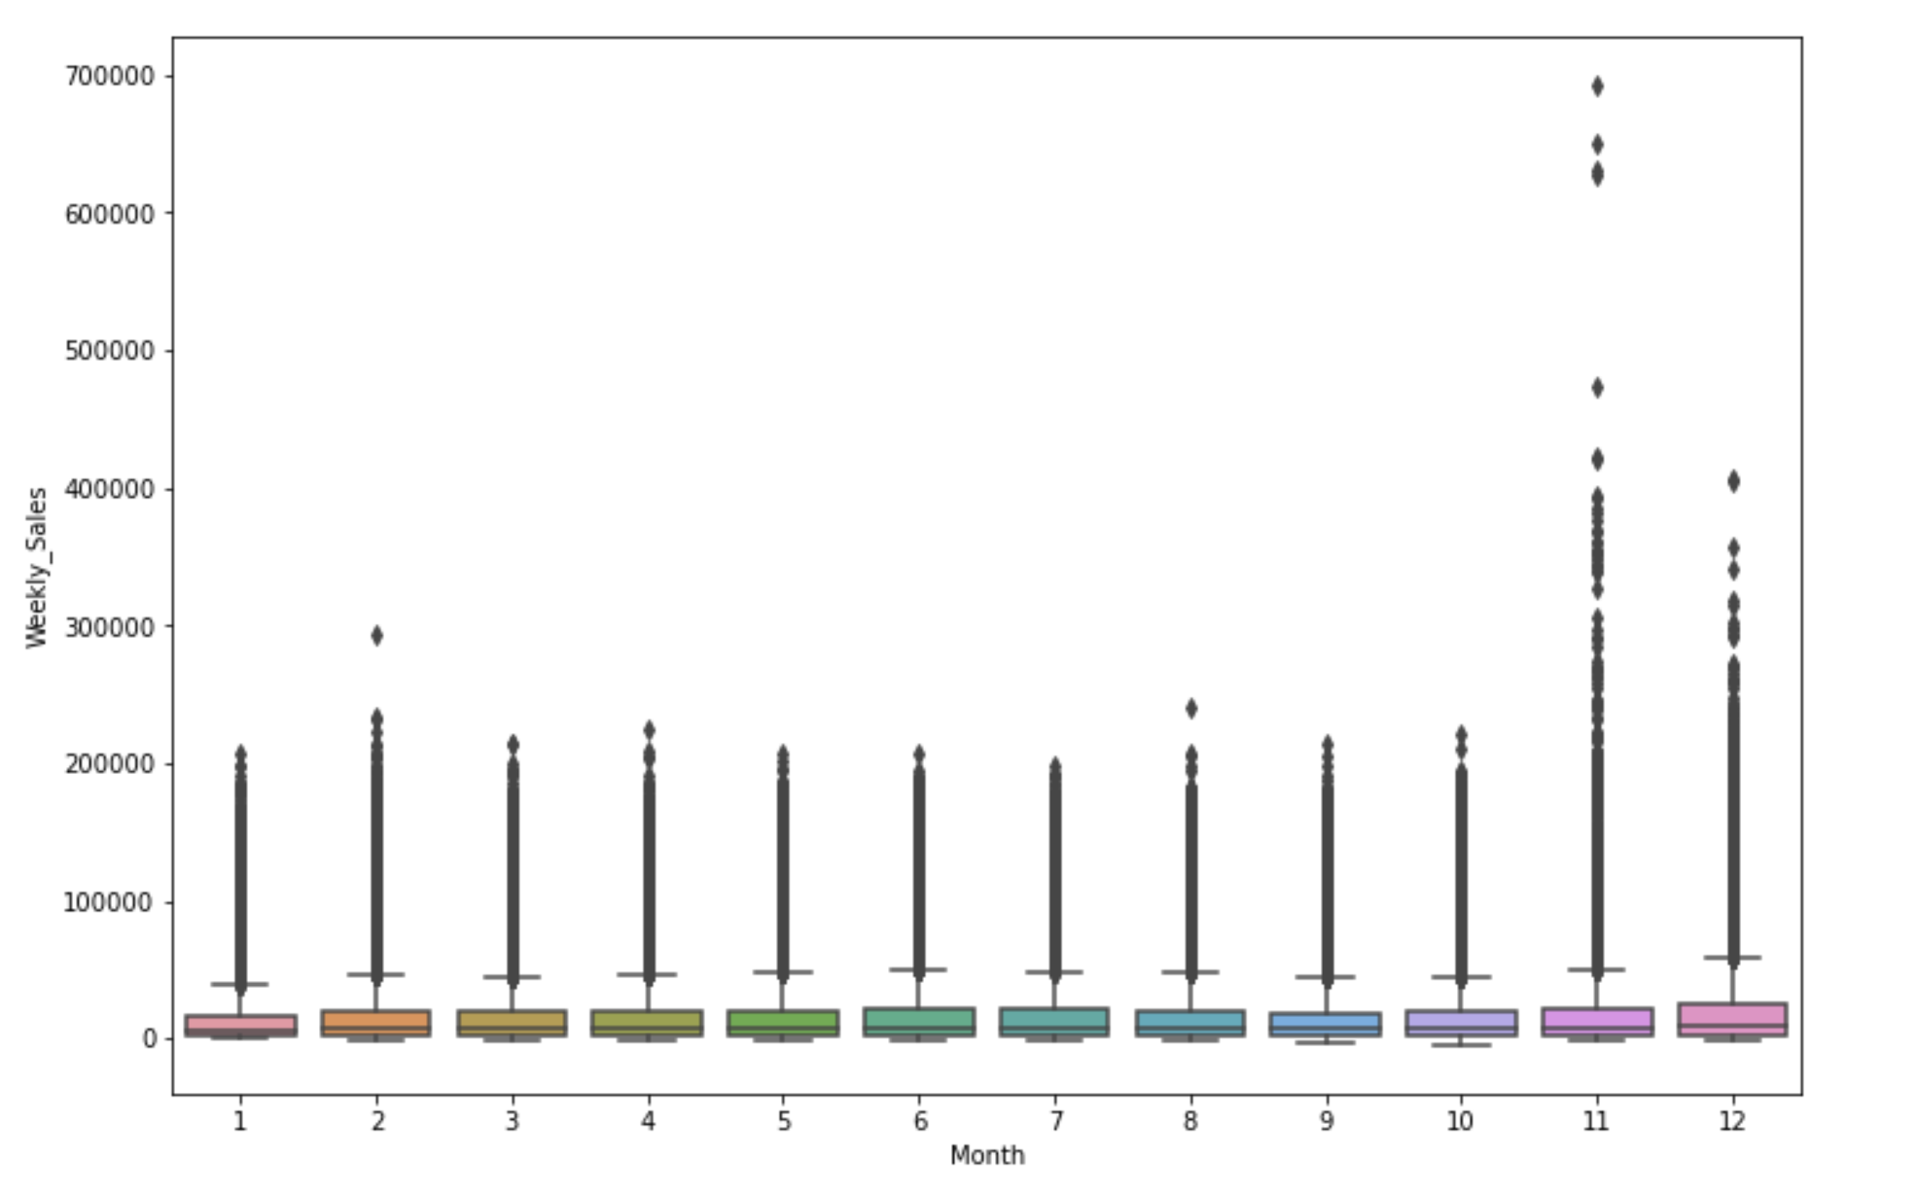
November and December have large outliers.
Our calculations suggests that July, April and June have highest total sales.
However, we should note that some months have 3 representation, and some have 2.
So, better consider Average Sales opposed to Total Sales.
Our calculations shows - December has the highest average sales, followed by November. June is 3rd highest.

Slide 10
Machine learning overview
Our goal – To predict sales for the next 12 months.
We apply Predictive modeling approach .
For Predictions, Regression models serves best.
We also see some seasonality in our sales data, so we apply Time Series Forecasting as well.

Slide 11
Preprocessing-modeling steps
Identified Categorical and Numerical columns in the dataframe.
Created dummy values for categorical columns and scaled numerical columns.
Split the data into 80% train set and 20% test set.
Fitted the model on train data.
Made predictions on X_test data.
Evaluated using suitable evaluation metrics.

Slide 12
Preprocessing-Modeling steps
Identified Categorical and Numerical columns in the dataframe
Created dummy values for categorical columns and scaled numerical columns
Split the data into 80% train set and 20% test set.
Time Series model
Regression models
Index the data by ‘date’
Fitted the model on train data.
Make data stationary if it is not stationary
Made predictions on X_test data
Fit the model on train data and make predictions on test data
Evaluate the models

Slide 13
Modeling Overview
Types of predictive algorithms applied
Time Series Forecasting (ARIMA)
Random Forest Regression
Linear Regression
XGBoost Regression

Slide 14
MODEL COMPARISON
Model | RMSE | MAE
Random Forest Regression | 365.19 | 20.79
Linear Regression | 10248.74 | 6788.46
XGBoost Regression | 4544 | 3067.31
ARIMA model | 16741 | 12733
Random Forest Regression is the best model since it has the least RMSE and MAE.

Slide 15
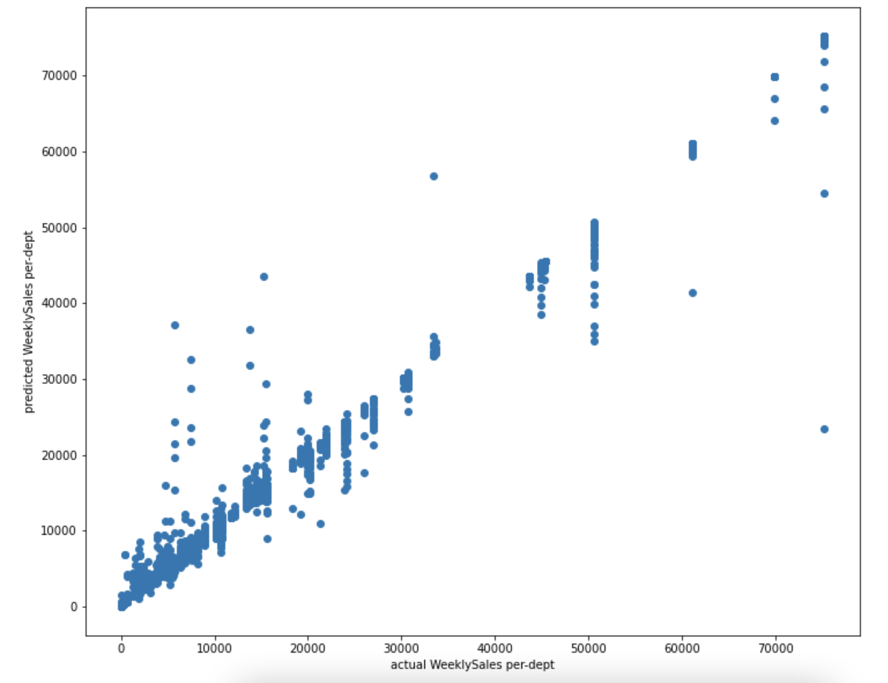
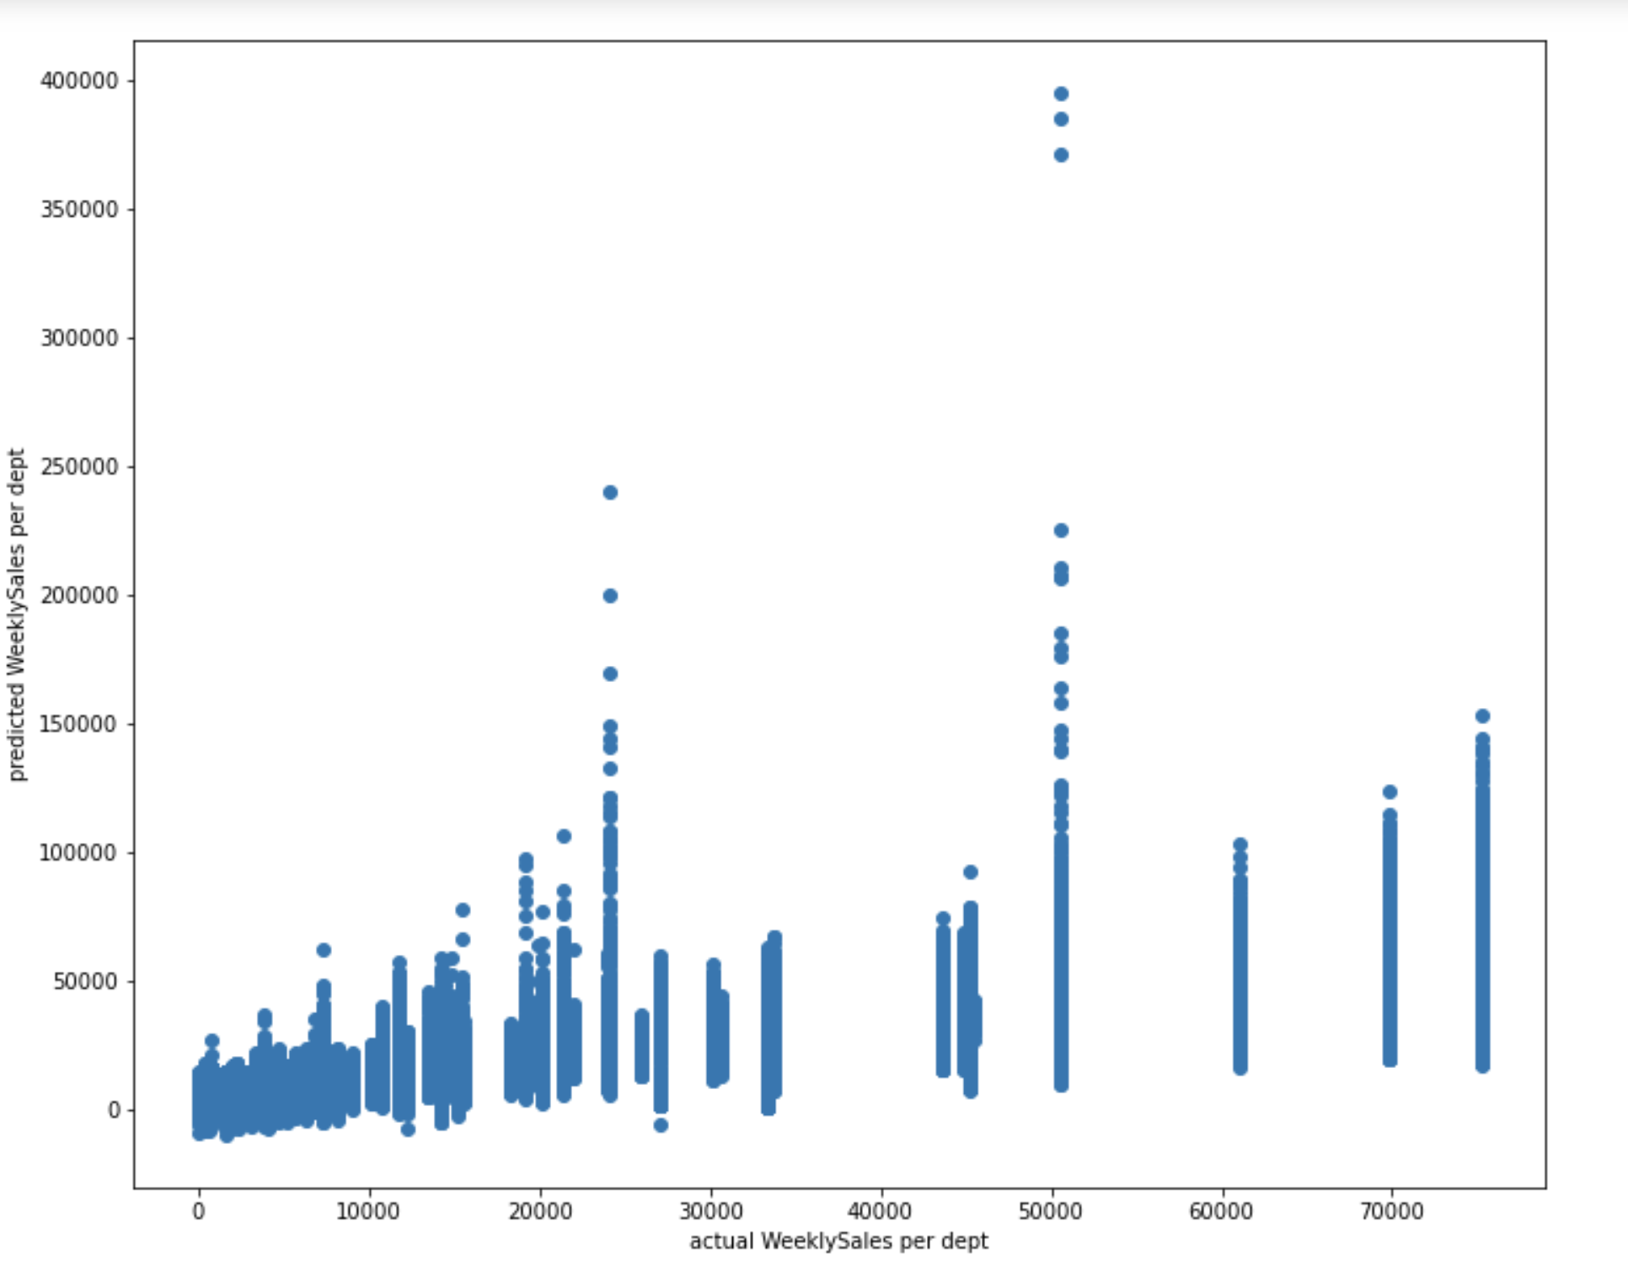
Visual comparison
Random Forest Regression
Linear Regression

Slide 16
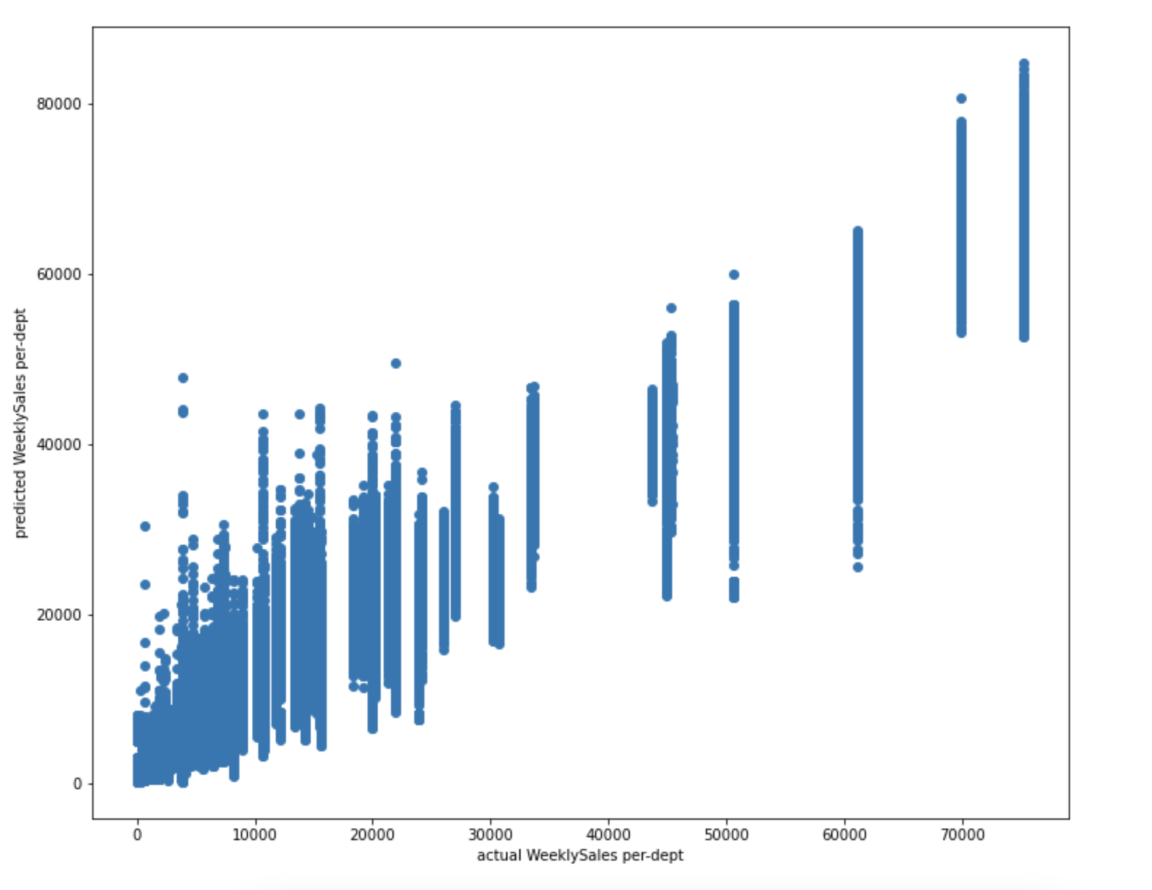
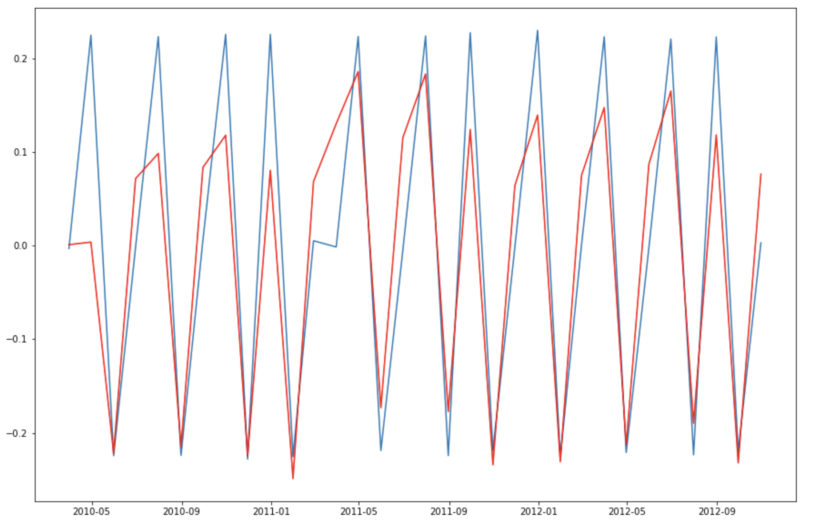
Visual comparison
XGBoost Regression
ARIMA model

Slide 17
Findings
Visual comparison
While comparing models visually, Random Forest Regression and ARIMA seems to be doing a good job at predicting.
XGBoost is average – no much correlation between actual and predicted values.
Linear Regression model is not performing well.
Evaluation metrics
Random Forest Regression model has the least RMSE and MAE in comparison to other models.
ARIMA model’s RMSE and MAE is disappointing compared to it’s graph.
XGBoost has higher RMSE and MAE than Random Regressor.
Linear Regression model’s RMSE and MAE are also not good.

Slide 18
conclusion
Our ARIMA model made predictions using just one variable. However, some sudden circumstances are not handled well by ARIMA.
Comparing all models, it looks like Random Forest Regression model is the best fit for our data.
Future Work
We could apply some variations of Time Series Forecasting model and experiment how those models perform on our data.

