Slide 1
Sentiment Analysis using NLP
Manasa Jayaprakash
Springboard

Slide 2
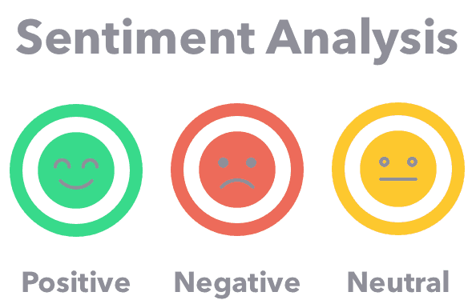
Problem Statement
Sentiment Analysis is the process of computationally identifying and categorizing opinions expressed in a piece of text, especially in order to determine whether the writer's attitude towards a particular topic, product, etc. is positive, negative, or neutral.
The goal of our project is to analyze customer reviews for cell phones and predict customer rating and categorize the reviews as 'positive', 'negative' or 'neutral' based on the review sentiment.
This Photo by Unknwn Author is licensed under CC BY-NC

Slide 3
Benefits of Sentiment Analysis
Helps improve customer service - Sentiment analysis provides businesses an idea of the customer opinion about their services.
Helps develop quality products- The responses from the customers can be used as a guideline to improve the service quality, better future product development, reduce customer churn or improve how the product is presented.
Develop new marketing strategies- With more data and information gathered through sentiment analysis, the organizations could develop an effective marketing strategy.
Improves crisis management- Frequent monitoring of the customers’ responses or opinions towards a brand would help to identify any issues quickly.

Slide 4
Data Information
The data was collected from Amazon website on Dec 26,2019. The data contains 2 csv files – items.csv and reviews.csv.
Items.csv contained 720 rows and 10 columns.
reviews.csv contained 67,986 rows and 8 columns.
Items.csv contains columns such as product asin, cellphone brand, phone title, total reviews, product URL, product rating, reviewurl, price, image.
Reviews.csv contains columns such as product asin, customer name, rating (overall rating by customer), review title, review body, helpful votes.

Slide 5
Data Cleaning
Data Cleaning is crucial because it is the only way to make raw data usable.
Items.csv and reviews.csv had NaN values which were dropped.
After removing NaN values, the 2 dataframes were merged.
Items.csv
Reviews.csv
The resultant dataframe has
67,781 rows and 17 columns.
asin
asin
Item_reviews.csv

Slide 6
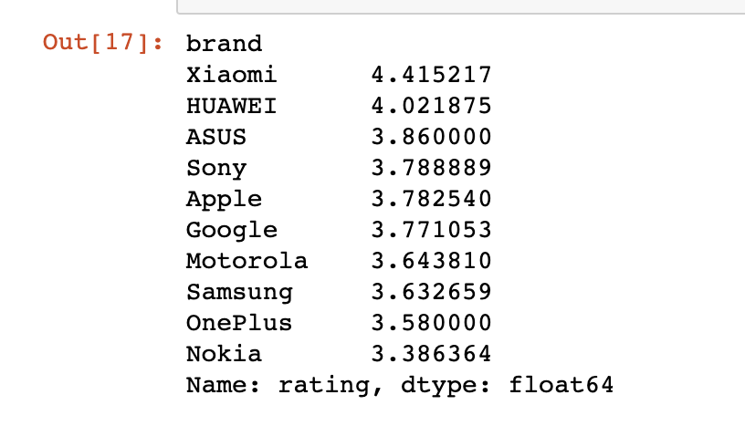
Exploratory Data Analysis
Our dataset contains customer reviews for 10 cellphone brands which includes Apple, Samsung, Motorola etc.
The end goal of our project is to predict rating and customer sentiment based on the reviews.
Here is a table showing the Item overall rating for each cellphone brand

Slide 7
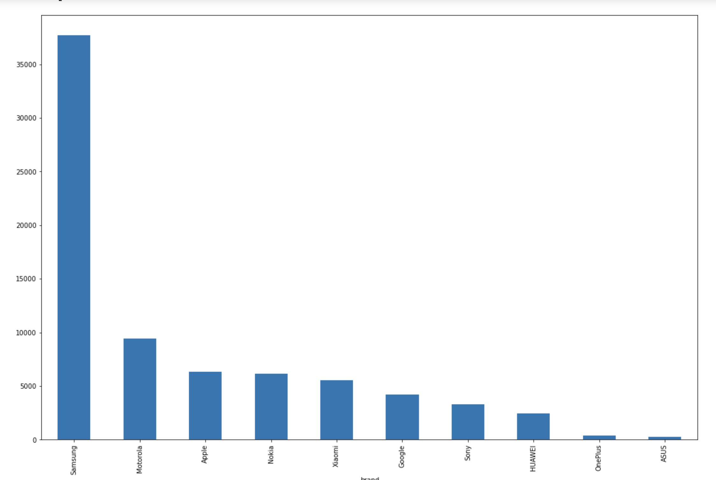
We can see that Samsung is the most reviewed cellphone brand - almost 37,000 reviews.
The second highest is Motorola with 9419 reviews.
Apple stands third with 6315 reviews.

Slide 8
Text Cleaning/Pre-processing/training
Used NLTK( Natural Language Toolkit) for text Cleaning and pre-processing.
To make to text clean – removed special characters, stop words, HTML tags, accented characters,
Performed lemmatization and stemming.
Chose top 4 reviewed cellphone brands from the list of 10 brands. - (optional).
Defined X and y, and then split X and y into 75% train and 25% test sets.
Used Count vectorizer to transform a given text into a vector based on the frequency (count) of each word.
The text is now ready for Modeling.

Slide 9
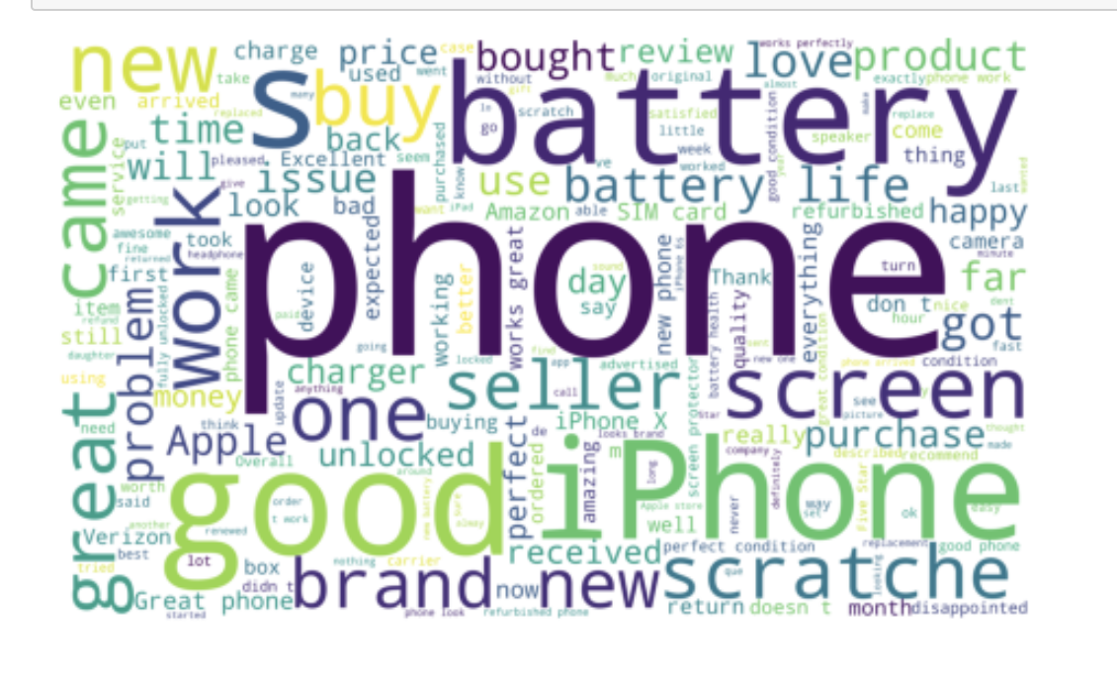
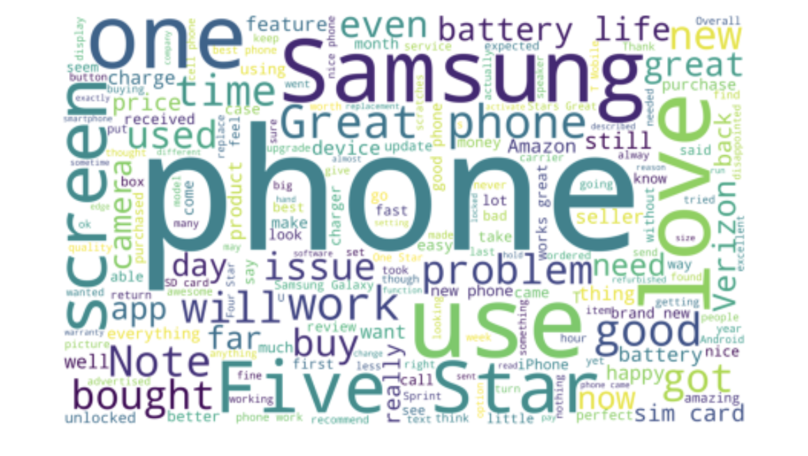
Text Visualization using WordCloud
Word Cloud is a data visualization technique used for representing text data in which the size of each word indicates its
frequency or importance.
Apple
Samsung

Slide 10
Text Visualization using WordCloud
Word Cloud is a data visualization technique used for representing text data in which the size of each word indicates its frequency or importance.
Here’s a text visualization for Apple

Slide 11
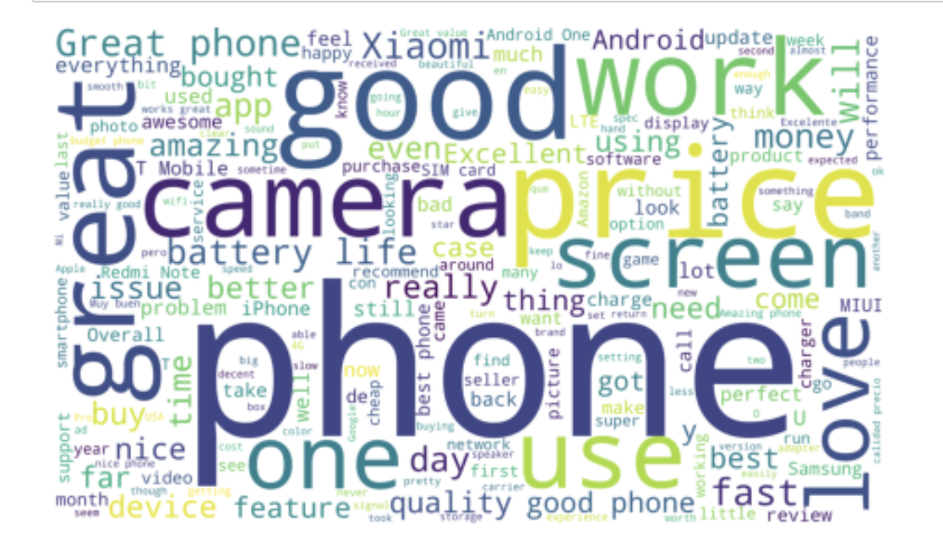
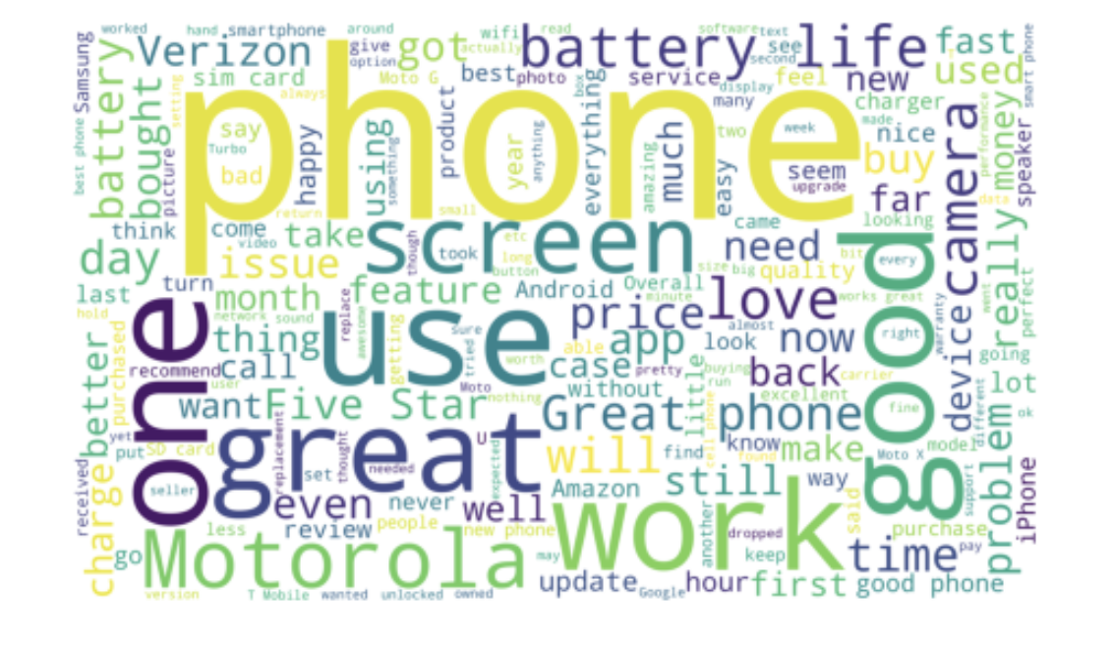
Text Visualizations using WordCloud
Xiaomi
Motorola

Slide 12
Modeling Overview
To predict customer rating, used Classification models –
1.Multinomial Naive Bayes
2.Random Forest Classifier
3.Support Vector Machine
To classify customer sentiment into positive, negative and neutral used VADER algorithm.

Slide 13
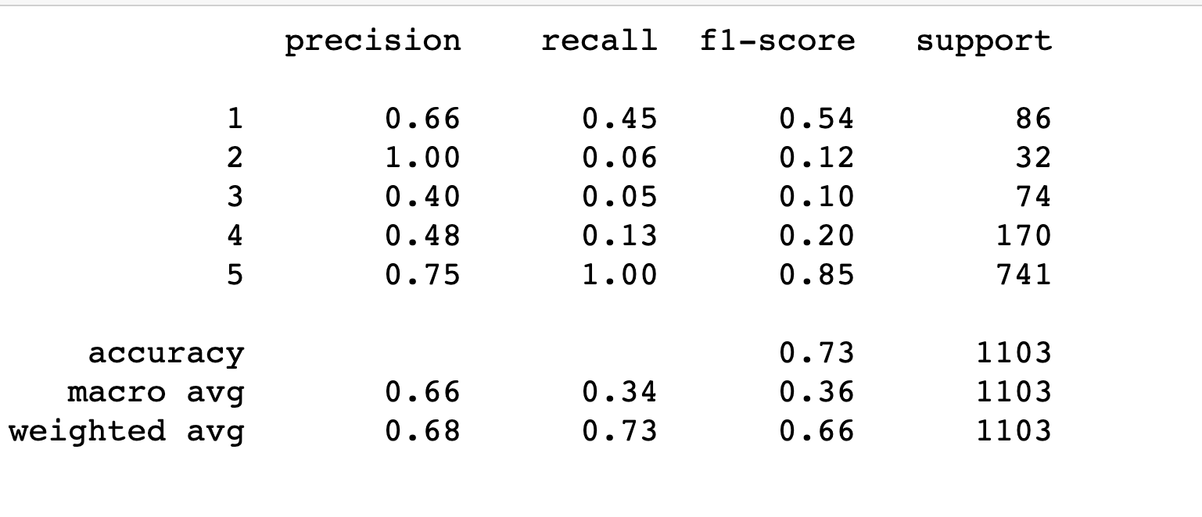
Model Comparison
Multinomial Naive Bayes

Slide 14
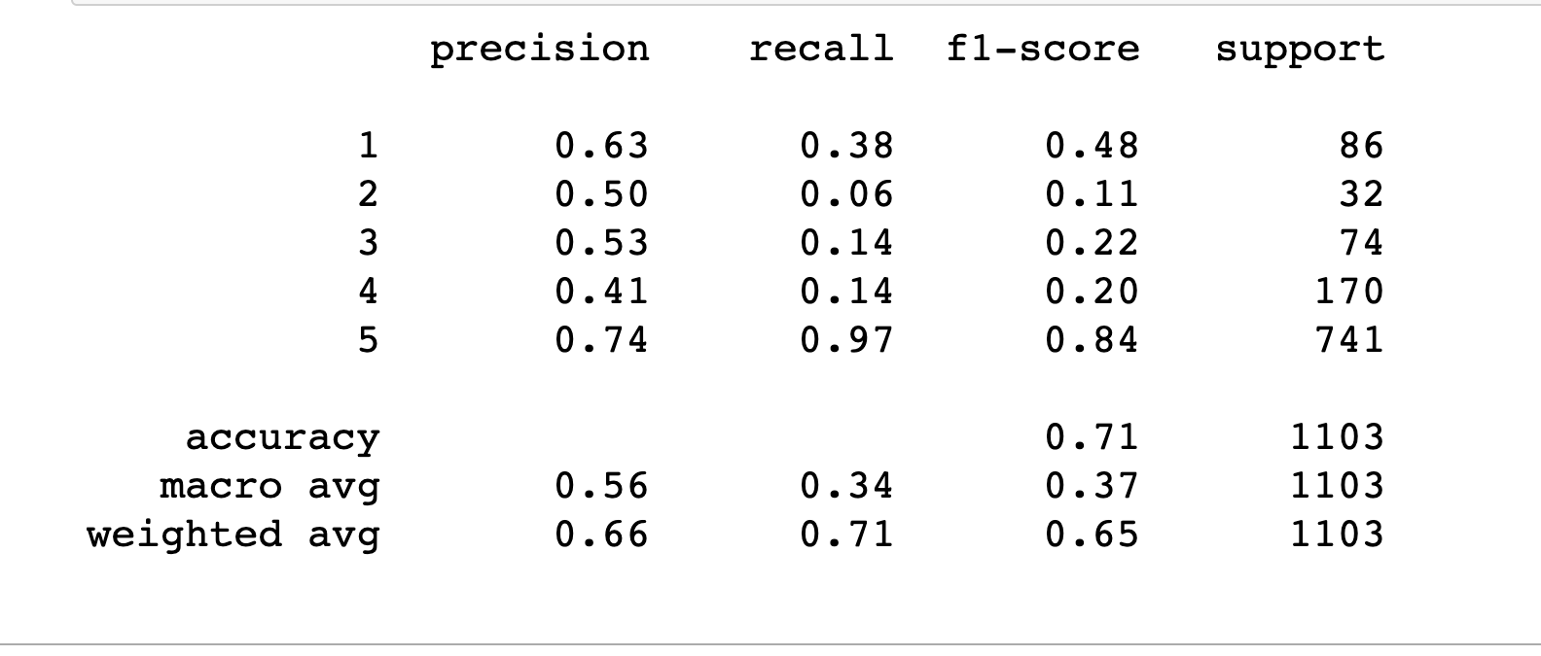
Random Forest Classifier

Slide 15
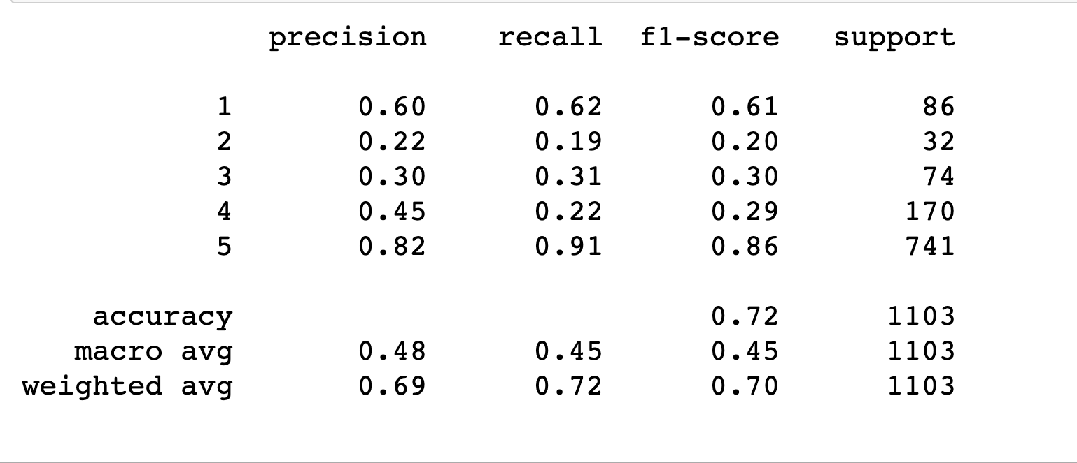
Support Vector Machine

Slide 16
Model Evaluation
We used Multinomial Naïve Bayes, Random Forest Classifier and Support Vector Machine to predict rating based on reviews.
We can see that our classifiers have high precision for rating 5 and rating 1.
Rating 5 has high recall, meaning that the model doesn't have a hard time detecting the 5-star reviews, high precision, meaning that when the model predicts a review is 5-star, it's usually correct.
Rating 1 also has a good precision and recall score.
Rating 2,3,4 has low recall, meaning that the model has a hard time detecting the 2,3,4-star reviews, but higher precision, meaning that when the model predicts a review's rating it's usually correct.
F1 score is an average of recall and precision. Weighted F1 score would be a better evaluation metric as our data is highly imbalanced.
Comparing all 3 models, Support Vector Machine is performing better than other classifiers at 0.71 Weighted F1-score.

Slide 17
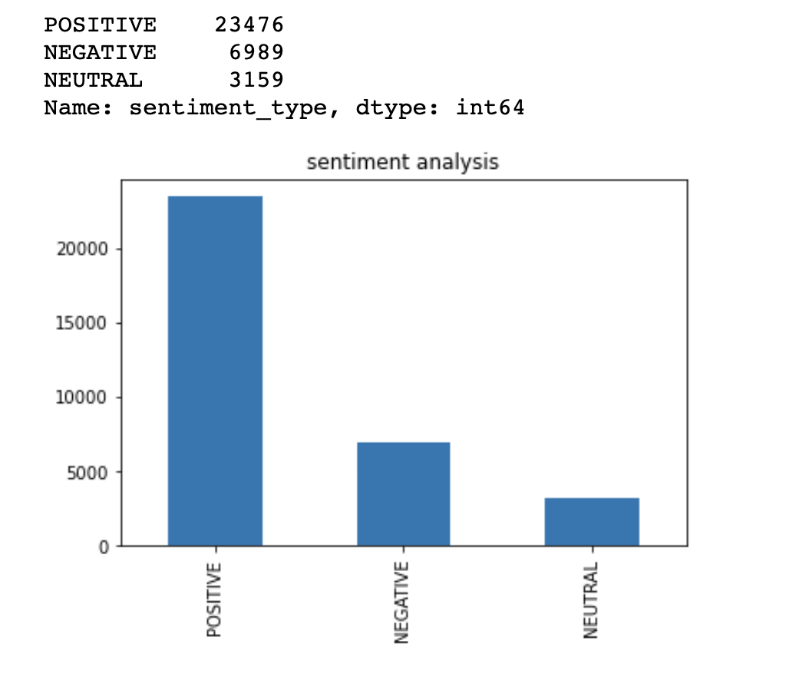
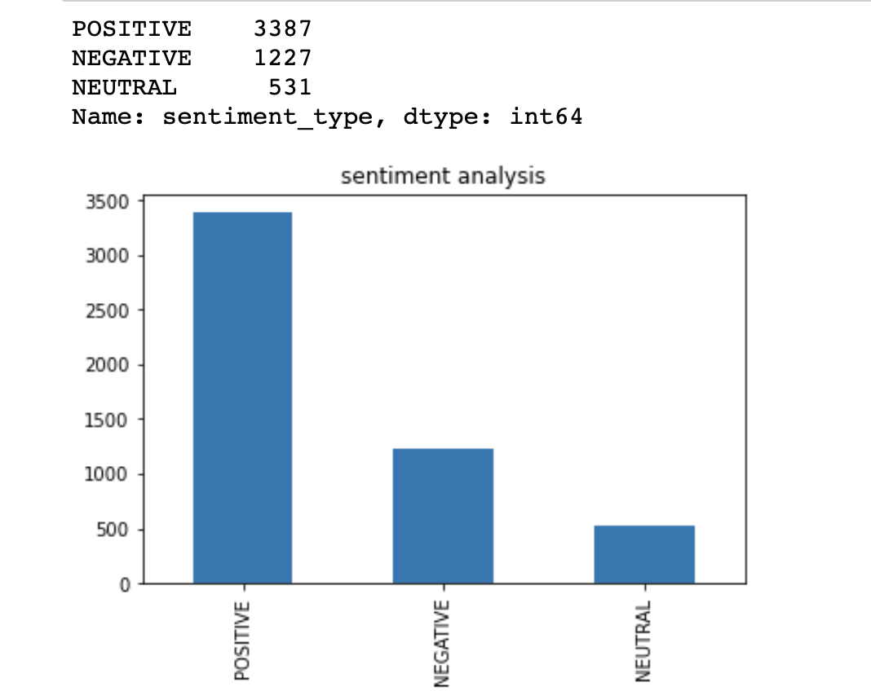
Sentiment Analysis Using Vader
Apple
Samsung

Slide 18
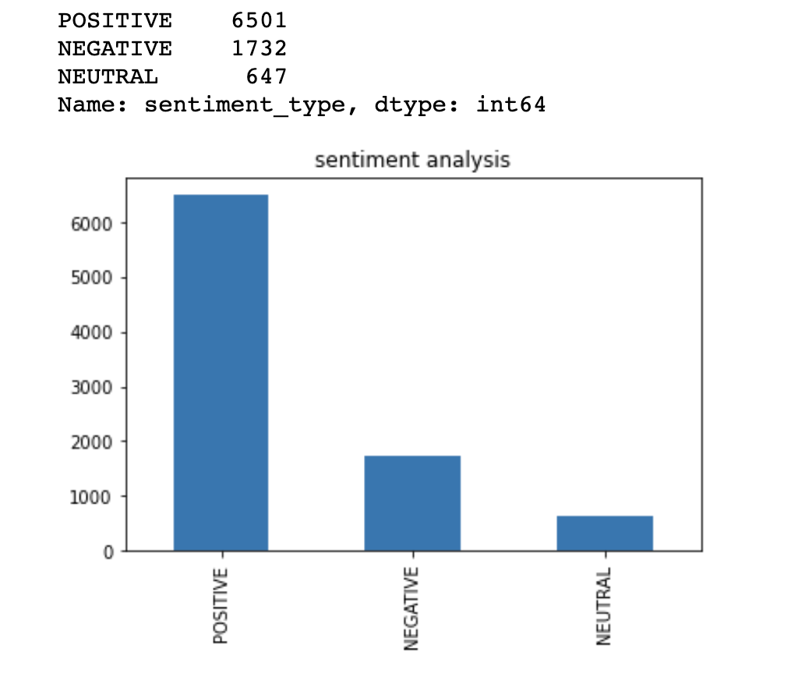
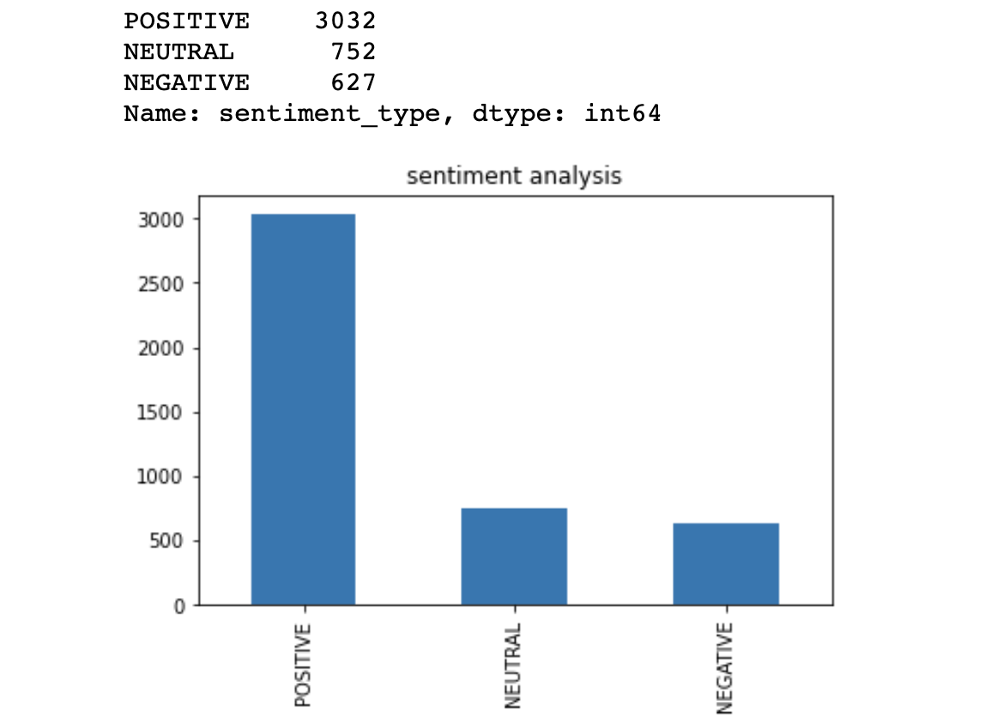
Motorola
Xiaomi

Slide 19
Conclusion
Apple has 53.6 percent positive reviews. Interestingly, Apple has the highest percentage of negative reviews(19.4 percent).
Samsung has the highest reviews- 37,701. Among them , 62 percent are positive reviews, 18.5 percent negative reviews.
Motorola has 69 percent positive reviews- the highest in the group!! Around 18.3 percent negative sentiment.
Xiaomi has the highest rating (4.4/5). However, it has only 54.3 percentage positive sentiment, a little more than Apple, and has 13.4 neutral sentiment and 11.2 percent negative sentiment.
Future Work
It would be good to try out some Regression models to predict rating and evaluate how it performs on our data.

