Slide 1
Guided Capstone Presentation
Big Mountain Resort, Montana

Slide 2
Our Client - Big Mountain Resort , a ski resort located in Montana, offers spectacular views of Glacier National Park and Flathead National Forest, with access to 105 trails.
Every year about 350,000 people ski or snowboard at Big Mountain. This
mountain can accommodate skiers and riders of all levels and abilities.
The resort has 11 lifts, 2 T-bars, and 1 magic carpet for novice skiers. The longest run is named Hellfire and is 3.3 miles in length. The base elevation is 4,464 ft, and the summit is 6,817 ft with a vertical drop of 2,353 ft.
The Resort has also recently installed an additional chair lift to help increase the distribution of visitors across the mountain.
This additional chair increases their operating costs by $1,540,000 this season.

Slide 3
There's a suspicion that Big Mountain is not capitalizing on its facilities as much as it could.
Basing their pricing on just the market average does not provide the business with a good sense of how important some facilities are compared to others.
To help them solve their problem, the business has now approached our Data Science team to implement a more data-driven business strategy.
The business wants some guidance on how to select a better value for their ticket price.
They are also considering changes that they hope will either cut costs without undermining the ticket price or will support an even higher ticket price.

Slide 4
We were provided with a file that contained data of 330 ski resorts across the United States.
The file contained key information regarding the facilities and ticket price for each of these resorts.
After analyzing all data that we had, and using various modeling techniques, we found that Big Mountain would benefit by increasing their vertical_drop by 150 feet, adding an extra run and an additional chair lift.
Our prediction also suggests that we could increase the Adult ticket price by $9.26.

Slide 5
Now let’s see some of our important analysis and modeling results that helped us come-up with the solution-
In our initial analysis, we found that there is a strong correlation between vertical drops and ticket price, and fastQuads and ticket price.
To further verify and support our analysis , we used 2 modelling techniques- Linear Model and Random Forest model to predict the most desirable features in our resorts.
According to these 2 models, vertical-drop, fastQuads, Runs, snowmaking area,
total chairs are among the most desired facilities in a resort.

Slide 6
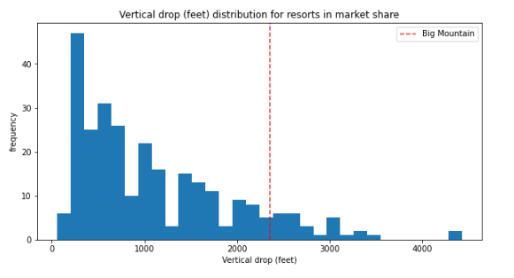
We compared the facilities provided by Big Mountain with facilities provided by its competitors.
Here’s a graphical representation which shows where Big Mountain resort stands, compared to its competitors. We are comparing the most desired features only –
Big Mountain has a vertical drop of 2353 ft, there are a few resorts with a greater drop.

Slide 7
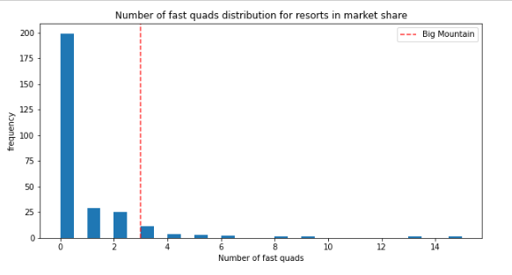
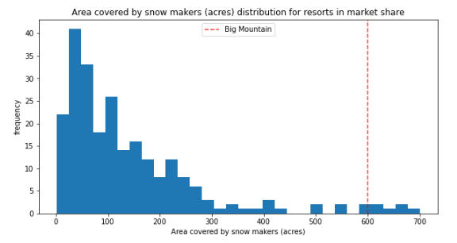
Big Mountain has 3 fastQuads. There are some resorts with higher number, but they are rare.
We can see that Big Mountain is very high up the league table of snow making area with around 600 acres.

Slide 8
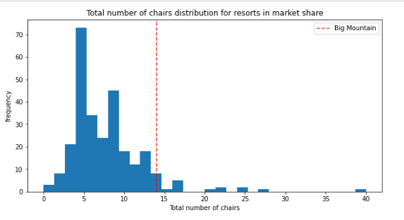
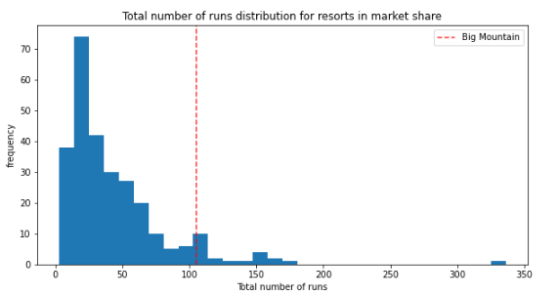
Big Mountain has 14 chairs, which amongst the highest number of total chairs, resorts with more appear to be outliers.
Big Mountain has 105 runs, it compares well for the number of runs. There are some resorts with more, but not many.

Slide 9
After reviewing various criteria the business has shortlisted some options :
Permanently closing up-to 10 of the least used runs.
Increase the vertical drop by adding a run to a point 150 feet lower down but requiring the installation of an additional chair lift to bring skiers back up, without additional snow making coverage.
Same as number 2 but adding 2 acres of snow making cover.
Increase the longest run by 0.2 mile to boast 3.5 miles length, requiring an additional snow making coverage of 4 acres.
We considered all these scenarios and combination of parameters , and our model suggests that Big Mountain will benefit from increasing vertical drop by 150 feet, increasing 1 run and installing one additional chair lift.
This scenario increases support for ticket price by $9.26 which puts our newly predicted ticket price at $90.26 per adult.
Over the season, this could be expected to amount to $16,208,333 on the basis that each visitor buys 5 tickets.

Slide 10
Thank you!

