Slide 1
GPU Vector Operations
(Addition and Multiplication)
Comparing CUDA Parallel Execution vs. CPU Sequential Execution
Aditya R Gavimath (01FE24BCI120)
Manasa B Vasare (01FE24BCI113)
Renuka Kagadal (01FE24BCI119)
KLE Technological University

Slide 2
Implementation & Methodology
Languages: C++ for sequential logic, CUDA for GPU parallelization.
Precision Timers: Used std::chrono for CPU execution and hardware-level cudaEvent_t for GPU timing.
Fair Benchmarking: Launched a 'dummy' warm-up kernel before timing to prevent initialization overhead from skewing results.
Correctness Verification: Validated GPU outputs against CPU outputs using a strict 1e-4 tolerance.

Slide 3
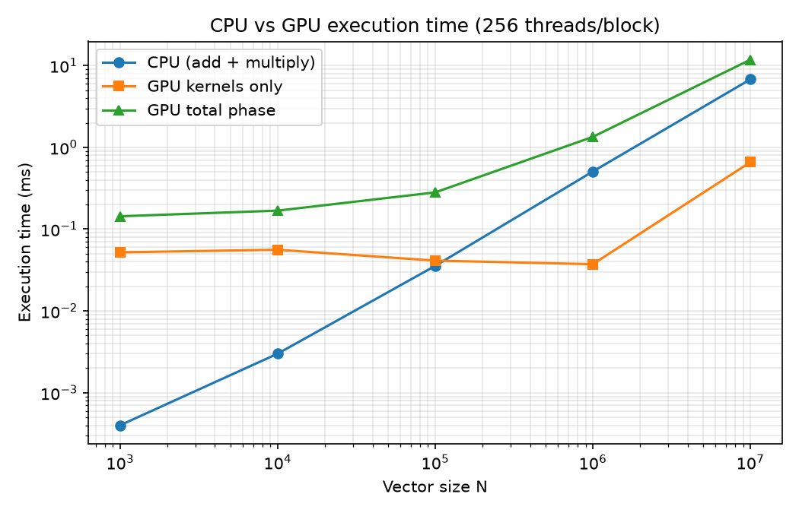
Execution Time vs. Vector Size
Small Vectors (N = 1,000): CPU outperforms the GPU, overhead of launching kernels outweighs benefits.
Medium Vectors (N = 100,000): GPU begins to catch up, multiplication ~2x faster than CPU.
Large Vectors (N = 1,000,000+): GPU drastically outperforms CPU, addition ~9.6x faster and multiplication ~23.8x faster.

Slide 4
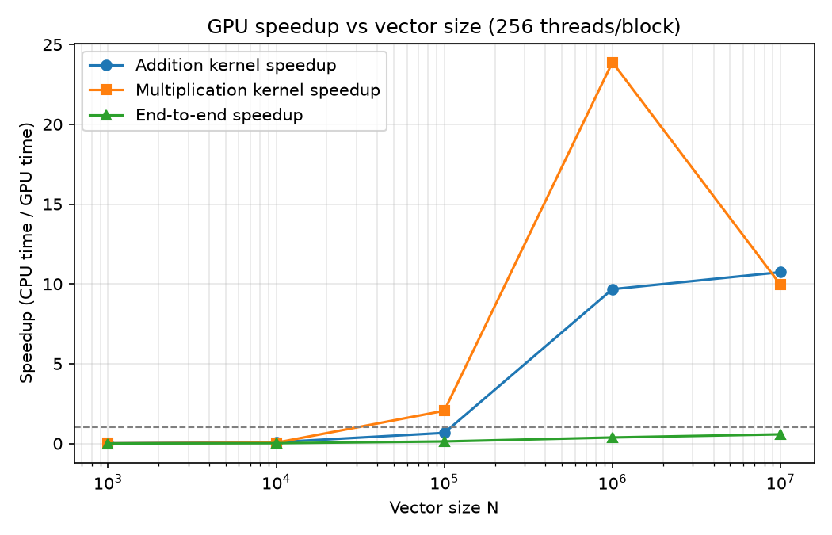
Speedup vs. Vector Size
Scaling Performance: The GPU speedup multiplier grows exponentially as computational workload increases.
Peak Performance: At 10,000,000 elements, individual GPU kernels achieved sustained speedups >10x.
Workload Complexity: Multiplication yielded higher speedups than addition at mid-range sizes, highlighting GPU efficiency.

Slide 5
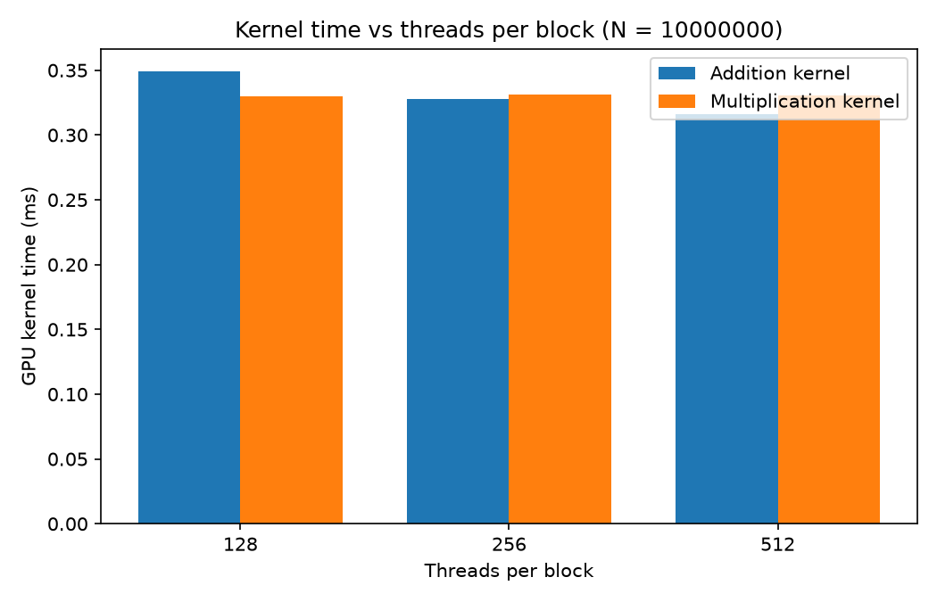
Optimizing Threads per Block (N = 10M)
Tested block dimensions of 128, 256, and 512 threads per block.
128 Threads: Achieved ~9.9x speedup for both operations.
256 Threads: Showed improvement, reaching ~10.7x for addition.
512 Threads: Best overall kernel performance, maxing out at ~11.08x speedup for addition and ~10.27x for multiplication.

Slide 6
Conclusion
Massive Parallel Advantage: GPU kernels successfully reached ~10x to 11x speedups over CPU for large arrays.
The Memory Bottleneck: While computation is fast, 'End-to-End' GPU time (including cudaMemcpy PCIe transfers) remains slower than CPU for simple addition.
Key Takeaway: GPUs are highly effective for large datasets and complex mathematical operations, but data transfer overhead must be factored into performance.

