Slide 1


Bhoj Reddy Engineering College for Women
(Sponsored by Sangam Laxmibai Vidyapeet, , Accredited by NAAC with A grade approved by AICTE and affiliated to JNTUH)
Recognised by UGC under section 2(f) of the UGC Act, 1956. Vinaynagar, I S Sadan Crossroads, Saidabad, Hyderabad – 500 059, Telangana. www.brecw.ac.in
Department of Computer Science and Engineering
Major Project Design Seminar on
TRAVEL PARTNER: AI ENHANCED TRAVEL COMPANION
Internal Guide: Mohammed Arshad Hussain Date : 19 February 2026
Assistant Professor Batch No : 22MP22
CSE-A Coordinator: Dr P Deepthi Eerla Deekshita 22321A0517
Associate Professor Kompella Manasa 22321A0541
Dahagam Manogna 22321A0552
Dr M Vinod Dr Gunda Shyama Chandra Prasad
Associate Professor & Head Professor & Principal

Slide 2
INTRODUCTION
Travel Partner: AI-Enhanced Travel Companion is an intelligent system designed to simplify and personalize the travel planning experience. Unlike traditional travel platforms that only focus on bookings and reviews, this system leverages Artificial Intelligence to generate customized itineraries, suggest destinations, optimize budgets, and provide real-time updates on weather, transport, and local events. By acting as a smart travel assistant, it ensures that users enjoy a seamless journey from planning to exploration.

Slide 3
PROJECT SCOPE
The project aims to develop a personalized travel recommendation, real-time assistance, and seamless booking experiences for travellers. The app leverages AI-powered algorithms to understand user preferences, behaviours, and interests, offering tailored suggestions for destinations, activities, accommodations, and transportation.

Slide 4
EXISTING SYSTEM
Existing travel planning systems primarily focus on providing online booking facilities and basic travel information. These platforms generally allow users to search for flights, hotels, and tour packages, while offering reviews and ratings to support decision-making. In addition, some systems provide limited itinerary suggestions, which are usually based on well-known tourist attractions and generic travel patterns.

Slide 5
DISADVANTAGES OF EXISTING SYSTEM
Fragmented Approach: Users typically need to switch between multiple applications for booking, navigation, food discovery, and itinerary planning
Static Planning: Most systems do not adapt travel plans in real-time when unexpected changes occur, such as weather disruptions or transportation delays.
Limited Local Guidance: While popular attractions are listed, there is little focus on personalized cultural experiences such as local cuisines or hidden gems

Slide 6
PROPOSED SYSTEM
The proposed system Travel Partner: AI-Enhanced Travel Companion, is designed to overcome the limitations of existing travel planning platforms by providing a personalized, intelligent, and adaptive travel solution. Unlike traditional systems that focus only on bookings and generic information, this system integrates Artificial Intelligence (AI) and Machine Learning (ML) to deliver end-to-end assistance throughout the travel journey.

Slide 7
ADVANTAGES OF PROPOSED SYSTEM
• Budget Optimization: Helps users compare options and choose the most
cost-effective plans for flights, hotels and activities
Personalized Experience: Generates customized itineraries based on user preferences such as budget, interests, and travel duration.
End-to-End Planning: Provides a complete solution covering destination suggestions, transport, accommodation, food, and activities in a single platform.
Real-Time Adaptability: Updates travel plans dynamically using live data such as weather forecasts, transport schedules, and local events.

Slide 8
REQUIREMENT ANALYSIS
Functional Requirements
1. User Module:
Register and login to the system securely.
Manage personal profile and travel preferences (budget, interests, travel dates).
Search and browse destinations.
Plan trips and create personalized itineraries.
Receive AI-based destination and package recommendations.
View maps, travel details, and itinerary summaries.
Provide feedback, ratings, and reviews for destinations or packages.
Logout securely from the system.

Slide 9
2. Admin Module:
Login securely with admin credentials.
Add, update, and delete destination information.
Manage travel packages (create, edit, remove, price updates).
Monitor registered users and their activities.
View system reports such as popular destinations and bookings.
Control recommendation settings and featured packages.
Manage feedback and reviews submitted by users.
Maintain system data and ensure database consistency
Logout securely from the admin panel.

Slide 10
REQUIREMENT ANALYSIS
Non-Functional Requirements
Performance
Scalability
Usability
Maintainability
Security

Slide 11
COMPUTATIONAL RESOURCES
Software Requirements:
1. Operating System: Windows 11
2. Frontend: HTML, CSS, JavaScript, React Native
3. Backend Framework: Python, AI&ML Libraries
4. Database: MySQL
Hardware Requirements:
1.Processor: Intel i7 and above
2. RAM: 8GB
3. Storage: 256GB SSD

Slide 12
DESIGN
In software engineering, design refers to the structured planning of how the system will function and how different components interact with each other.
The design of Travel partner : AI enhanced travel companion focuses to simplify
and personalize the travel planning experience

Slide 13
SOFTWARE ARCHITECTURE
Login
Manage Users
Add new features
Monitor bookings statistics
Verify AI recommendation
Feedback & Complaint Handling
Logout
Admin
Database
Register
Login
Search destination
AI based travel planning
Make Booking
Make payment
Review & Feedback
Logout
User

Slide 14
TECHNICAL ARCHITECTURE
React,JS,
HTML,
CSS
Python,
AIML Libraries
MySQL

Slide 15
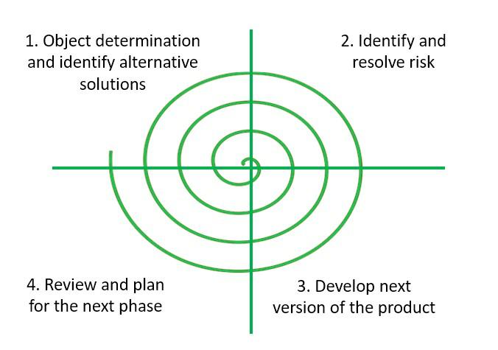
SOFTWARE PROCESS MODEL

Slide 16
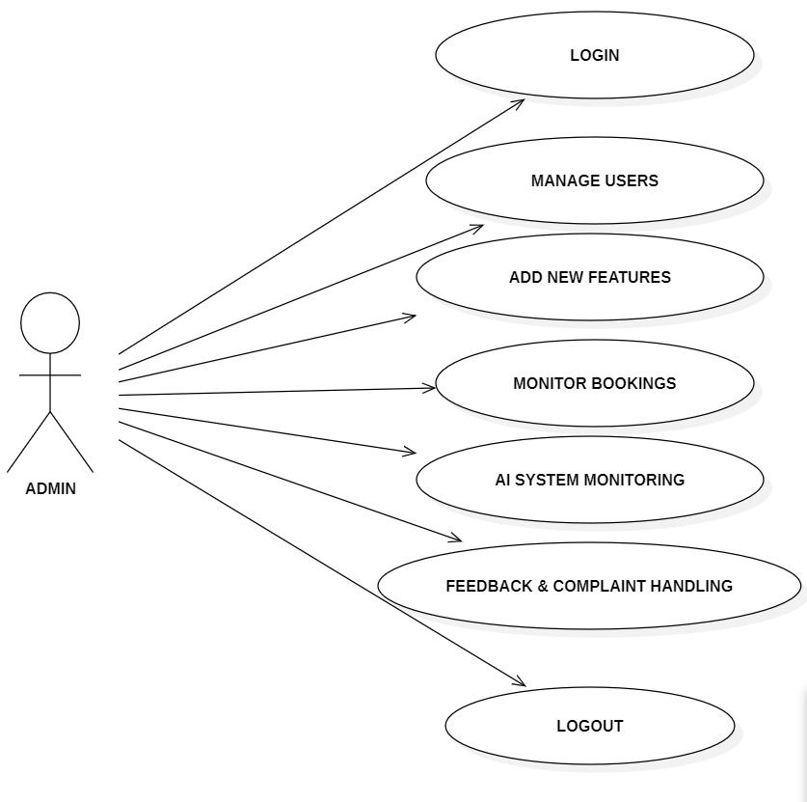
UML DIAGRAMS
Use case diagram for admin:

Slide 17
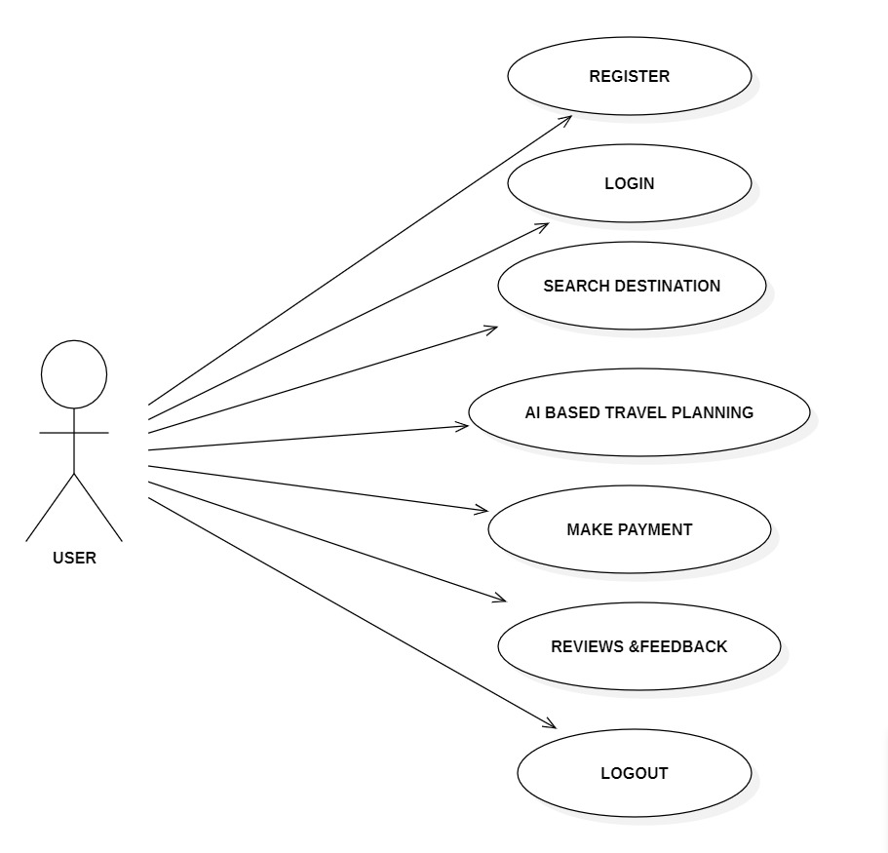
Use case diagram for User

Slide 18
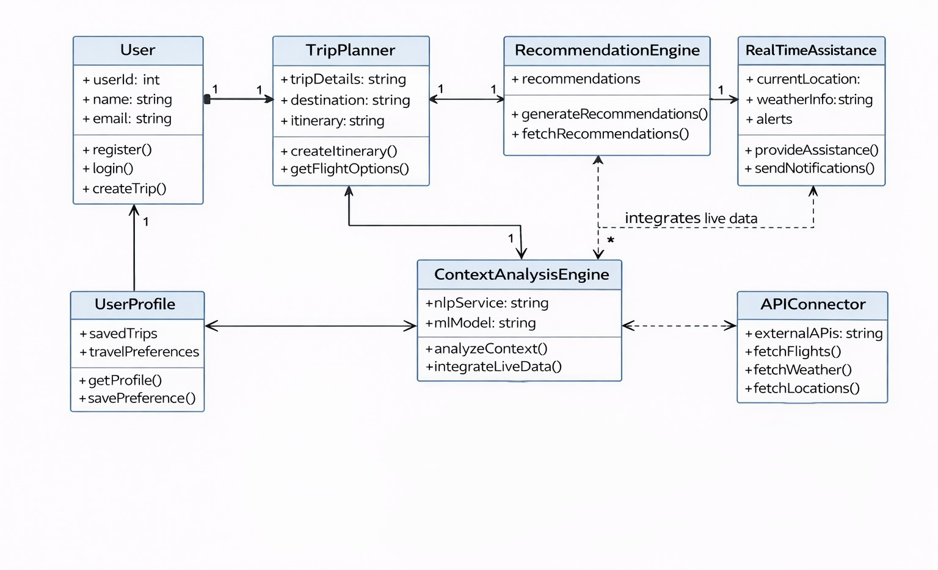
Class diagram

Slide 19
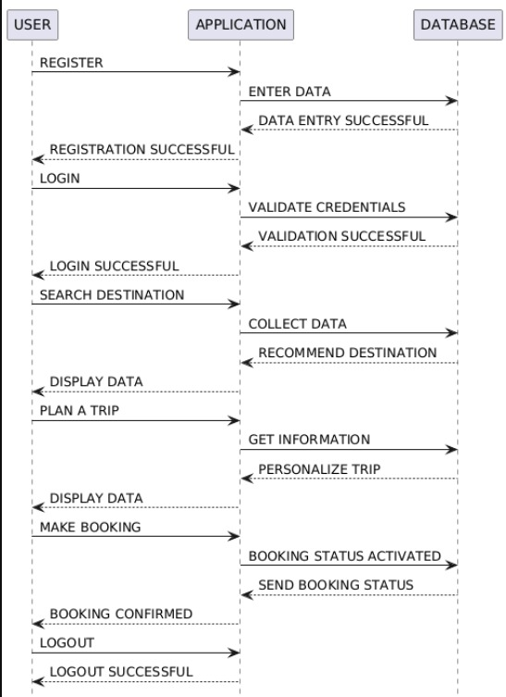
Sequence diagram for user :

Slide 20
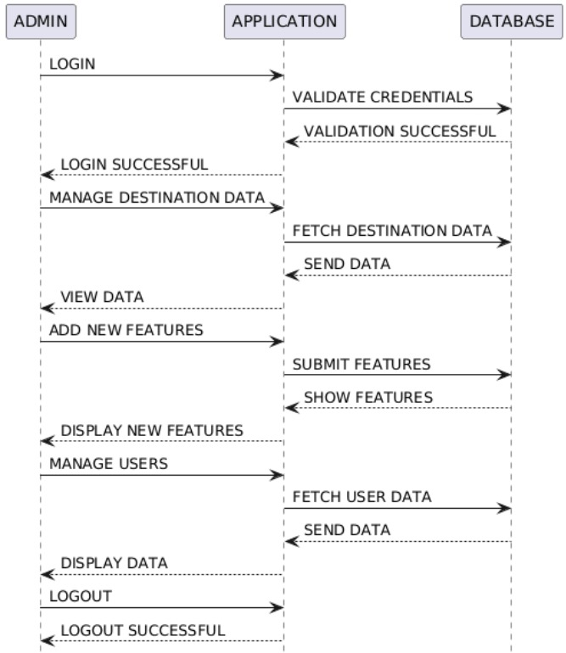
Sequence diagram for admin

Slide 21
Implementation Flow - TRAVEL PARTNER:AI ENHANCED TRAVEL COMPANION
Step 1: User Opens the Application
User accesses the Travel AI web/mobile application.
The welcome page displays project overview with Login and Register options.
Featured destinations and AI travel highlights are shown.
Step 2: User Registration / Login
New users create an account by entering personal details and travel preferences.
Existing users log in using their credentials.
After authentication, the system redirects the user to the dashboard.
Step 3: Travel Preference Entry
User enters trip details such as destination, budget, travel dates, number of travelers, and interests.
User may select preferences like adventure, relaxation, cultural trips, etc.
The system stores input data for AI processing.

Slide 22
Step 4: AI Itinerary Generation
The AI module analyzes user inputs.
The system generates a personalized day-by-day travel itinerary.
Estimated budget breakdown and activity suggestions are displayed.
Step 5: Destination Recommendation & Comparison
The system suggests alternative destinations based on user preferences.
User can compare destinations based on : Budget ,Weather, Popular attractions, Travel duration
Smart recommendations are shown using AI analysis.
Step 6: Booking Assistance & Plan Customization
User can modify itinerary (add/remove places).
The system provides hotel, transport, and activity suggestions.
Updated cost estimation is generated dynamically.
Step 7: Save Trip, Progress Tracking & Logout
User can save trip plans for future access.
Travel history and upcoming trips are stored securely.
User can track trip progress and log out safely.

Slide 23
ALOGORITHMS USED
Module 1 – User Preference Analysis
Algorithm: NLP-Based Travel Intent Extraction
Tokenization
Keyword Extraction
Pseudo Logic:
User input → Extract keywords → Classify travel type→ Store structured preference data
Module 2 – Destination Matching
Budget Range
Travel Duration
Algorithm: Content-Based Filtering
Interests → Season / Weather → Similarity Calculation → Destination Score

Slide 24
Module 3 – Route Optimization
Algorithm: Dijkstra’s Shortest Path Algorithm
Finding shortest path between tourist attractions
Minimizing travel time and transportation cost
Pseudo Logic:
Create distance graph→ Apply Dijkstra’s Algorithm→ Generate optimized travel route Module – Roadmap Generation
Module 4 – Itinerary Generation
Algorithm : Greedy Scheduling Algorithm
Select highest-rated attraction → Check time availability → Check distance feasibility → Assign activities sequentially

Slide 25
Module 5 – Budget Estimation
Algorithm: Linear Regression (Cost Prediction)
Parameters:
Number of Days, Destination, Hotel Category, Transport Type, Season
Cost Formula : Estimated Cost = (Base Cost × Days)+(Hotel Cost)+(Transport Cost)+(Seasonal Adjustment Factor)
Module 6 – Recommendation & Comparison
Algorithm: Multi-Criteria Decision Analysis (MCDA)
Parameters:Cost
Travel Time ,Popularity, User Rating, Safety Index
Final Score Calculation : Final Score =(Weight1 × Cost Score)(Weight2 × Popularity)(Weight3 × User Rating)(Weight4 × Safety)Destination with highest score is ranked first.

Slide 26
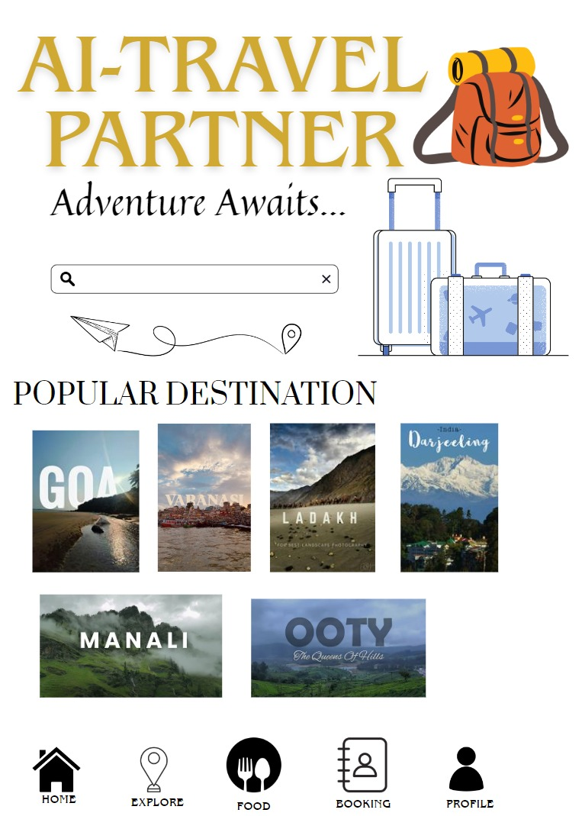
EXPECTED OUTPUT

Slide 27
CONCLUSION
Travel Partner: AI-Enhanced Travel Companion offers an intelligent and personalized approach to modern travel planning. By integrating AI and real-time data, it simplifies the entire journey from itinerary creation to on-trip assistance ensuring convenience, safety, and cost efficiency. The system not only saves time but also enhances the overall travel experience by adapting to user preferences and dynamic conditions, making it a reliable and smart companion for every traveler.

Slide 28
REFERENCES
Londhe, K. (2024) Enhanced Travel Experience using Artificial Intelligence. ScienceDirect.
Kongpeng, S. (2024) Tourist Destination Recommendation System based on Machine Learning. ACM Digital Library.
Chen, A. (2024). Travel Agent: An AI Assistant for Personalized Travel Planning. arXiv.
Department

