Slide 1



Metadata-Based Machine Learning Approach for Vehicle Insurance Fraud Detection
Team 4 – AIT-582-003
Yatish Chandra Nalla (G01512626)
Sai Vamsidhar Reddy Meruva (G01474023)
Manasa Rajagopal Madabushi(G01476994)
Sai Raga Sruthi Nalagandla (G01478476)
Sonal Ashok Kumar Masid (G01514651)
Madhu Yamini Nainala (G01483862)
Sowdhamini Bharadwaj Mandava Venkata (G01476219)
George Mason University

Slide 2
Introduction
Auto insurance fraud costs billions of dollars annually, leading to higher premiums for honest customers and major losses for companies.
Traditional fraud detection methods, such as manual audits and rule-based systems, are slow, error-prone, and unable to adapt to evolving fraud tactics.
The rise of big data and machine learning provides a smarter way to detect hidden patterns using structured metadata like:
Policyholder demographics
Vehicle and accident information
Claim histories
Our project uses machine learning models to classify insurance claims as fraudulent or legitimate, aiming to:
Reduce financial losses
Speed up claim processing
Protect the integrity of the insurance industry

Slide 3
Problem Statement
Insurance fraud causes major financial losses and raises premiums for honest policyholders.
Traditional fraud detection methods rely on manual audits and fixed rules, which are:
Slow
Expensive
Inaccurate
Fraudsters constantly adapt and evolve their methods, making static rule-based systems ineffective.
With large and complex datasets available today (metadata on policyholders, vehicles, claims), there's a need for automated, data-driven fraud detection.
Our project aims to develop machine learning models that can:
Analyze metadata
Identify suspicious patterns
Accurately predict fraudulent claims
Adapt over time to new fraud techniques

Slide 4
Motivation
Why This Project Matters?
Massive Financial Impact:
Insurance fraud leads to billions of dollars in losses each year, increasing costs for honest policyholders.
Limitations of Traditional Methods:
Manual audits and rule-based systems are slow, costly, prone to errors, and fail to adapt to evolving fraud patterns.
Rise of Big Data and Machine Learning:
Availability of rich metadata (claims, policyholder behavior, accident details) enables smarter, automated fraud detection.
Scalability and Real-Time Detection:
Machine learning models can process large volumes of claims quickly, improving speed and accuracy in identifying fraud.
Protecting Honest Customers:
Better fraud detection helps insurance companies maintain fair premiums and strengthens trust with genuine customers.

Slide 5
Research Questions
1. What effects do policyholder demographics—such as age, marital status, and sex—have on the probability of insurance fraud?
Hypothesis: Because of financial incentives or opportunistic fraud, younger policyholders and single people may be more likely to commit fraud.
2. Are false claims associated with policyholders changing their addresses frequently?
Hypothesis: Frequent address changes by policyholders increase the risk of fraud since they may be a sign of instability or an attempt to hide previous activity.
3. What is the effect of cDuring some months when financial laim timing (month of claim, policy tenure) on the probability of fraud?
Hypothesis: strains are greater or soon after the coverage begins, fraudulent claims are more common.
4. How can feature engineering and hyperparameter tweaking enhance the accuracy and recall of fraud detection models?
Hypothesis: By balancing accuracy and recall, feature engineering and hyperparameter tweaking (such as modifying the learning rate or tree depth) maximize model performance.
5.What function does the quantity of supplemental claims serve in detecting fraud?
Hypothesis: Multiple-supplement claims are more likely to be false since they could show inflated or extra created harm.

Slide 6
Data Cleaning Process
Missing Value Handling:
Dropped columns with excessive missing values:
→ Days_Policy_Accident, Days_Policy_Claim, AgeOfVehicle, AgeOfPolicyHolder, NumberOfSuppliments, NumberOfCars.
For remaining columns:
→ Imputed missing numerical values with the median.
→ Imputed missing categorical values with the mode (most frequent value).
Outlier Detection and Treatment:
Used the IQR (Interquartile Range) method to identify outliers in numerical columns (Age, Deductible, Driver Rating, Past Number of Claims, Year).
Applied Winsorization (capping) by replacing extreme outliers with upper and lower bounds.
Categorical Value Standardization:
Standardized the MaritalStatus column (e.g., 'widow' corrected to 'widowed') to maintain consistency in categorical variables.
Feature Engineering (Metadata Enhancements):
Created AddressChangeFrequency feature from AddressChange_Claim.
Calculated PolicyTenure based on the difference between the maximum year and the policy start year.
Created Claim Timing Features like MonthOfClaim and PolicyTenureAtClaim.
Created SupplementalClaimsCount to handle missing supplement data.
Data Scaling:
Standardized numerical features using StandardScaler for model input consistency.

Slide 7
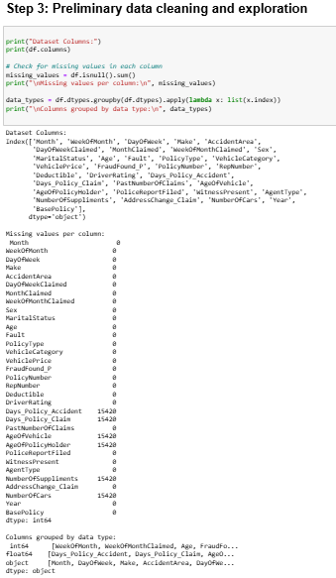
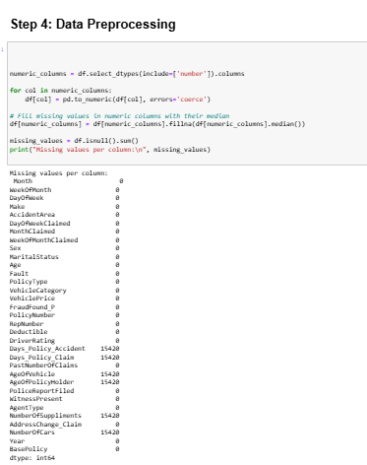
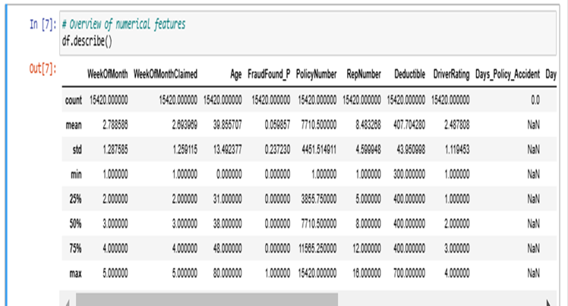

Slide 8
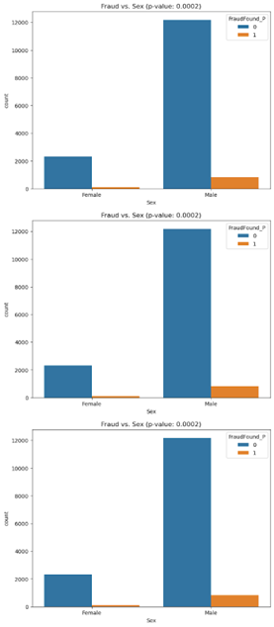
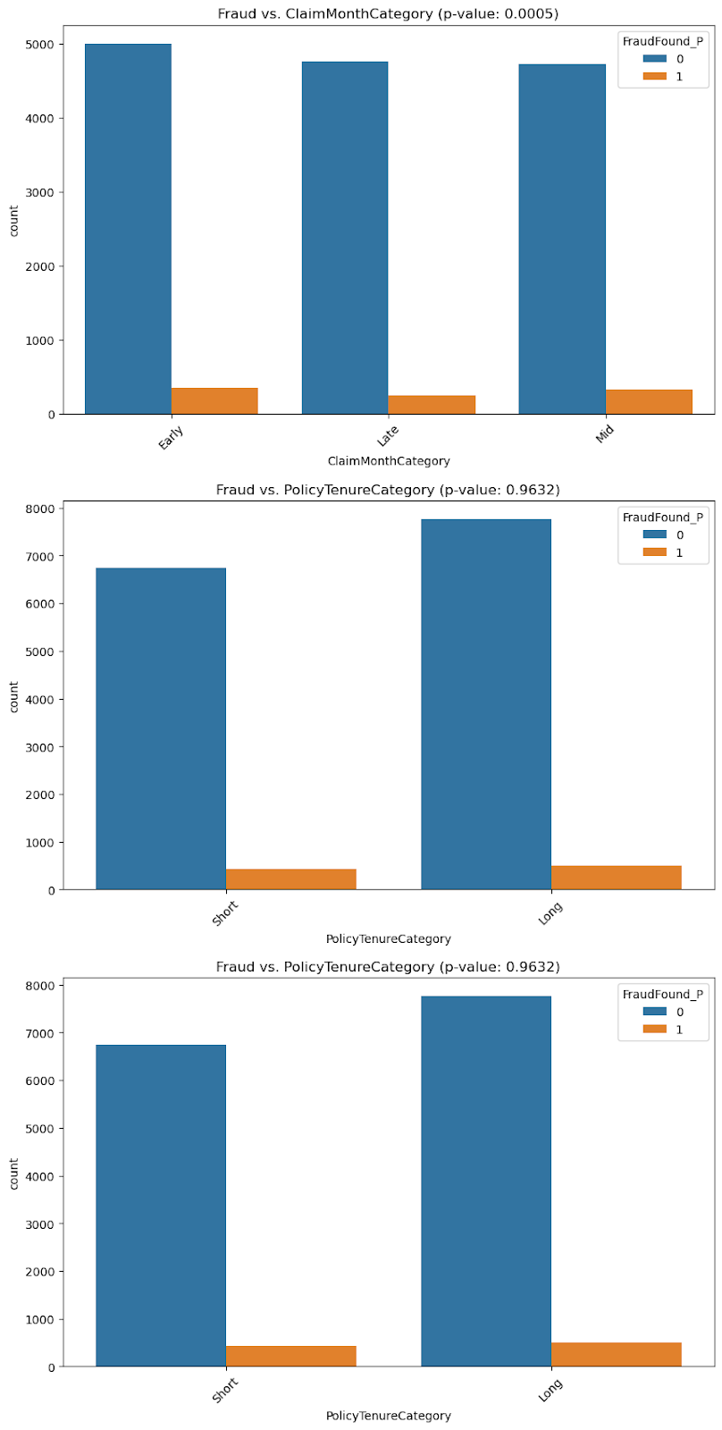
Exploratory Data Analysis (EDA)
Age distribution concentrated between 30–50 years.
Fraud is more common among male and younger policyholders.
Higher fraud rates observed in early-year claim months.
Strong class imbalance: only 8% of claims are fraudulent.
Address changes within 6 months associated with more fraud.

Slide 9
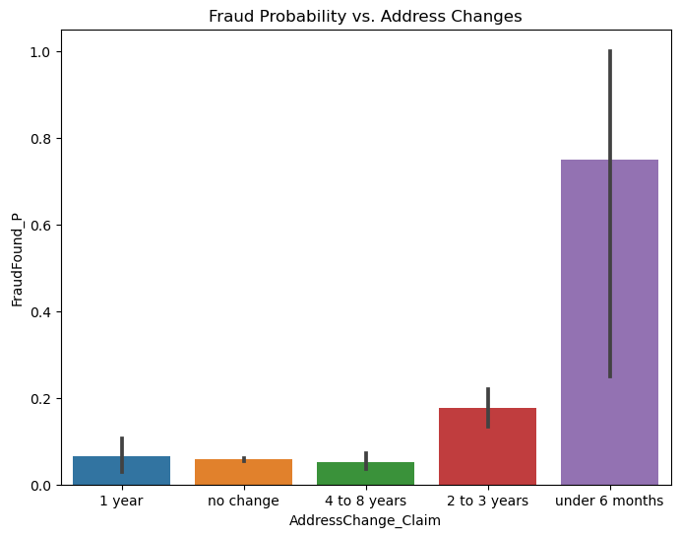
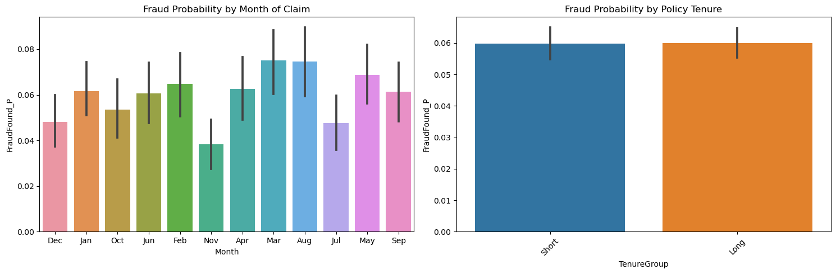
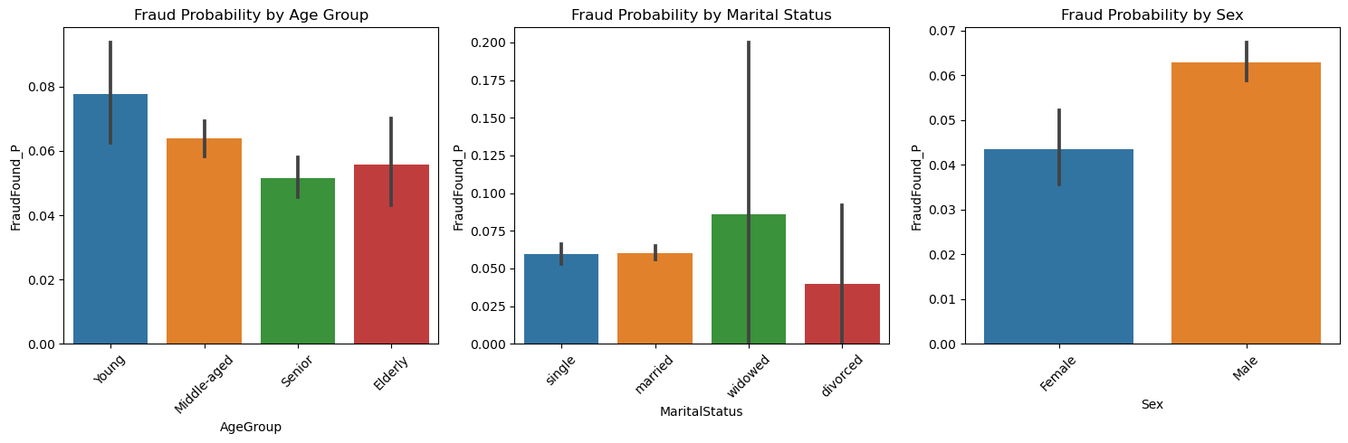
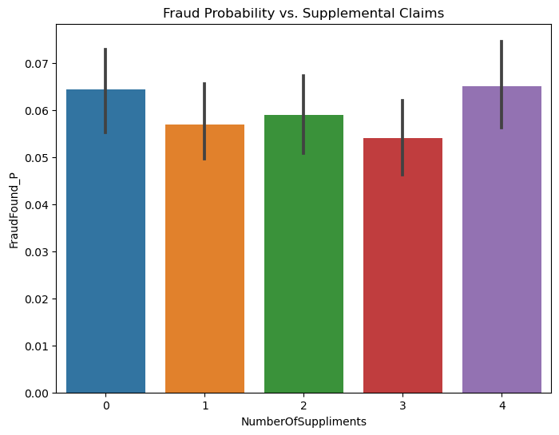
Fraud Probability Analysis by Metadata Features:

Slide 10
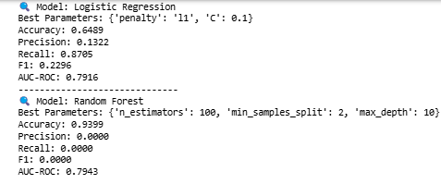
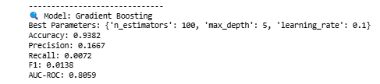
Model Performance Summary
Logistic Regression:
  Accuracy: 64.89% | AUC: 0.7916
  High recall (0.8705) but low precision (0.1322)
  Performs well at ranking fraud probability but not actual classification
Decision Tree:
  Accuracy: ~66% | AUC: ~0.66
  Tends to overfit and struggles with fraud class
  Helps visualize key metadata splits
Random Forest:
  Accuracy: 93.99% | AUC: 0.7943
  Excellent on non-fraud but fails to detect fraud (0.0 precision/recall)
Gradient Boosting:
  Accuracy: 93.82% | AUC: 0.8059
  Slightly better fraud detection (precision: 0.1667, recall: 0.0072)
  Most promising among ensemble models tested

Slide 11
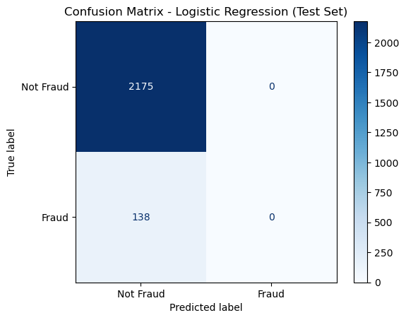
Confusion Matrix
The confusion matrix reveals the model's inability to detect any fraudulent claims—all 138 fraud cases were misclassified as non-fraud.
High true negative rate reflects strong performance in identifying legitimate claims.
Results highlight the severe impact of class imbalance on fraud detection accuracy.

Slide 12
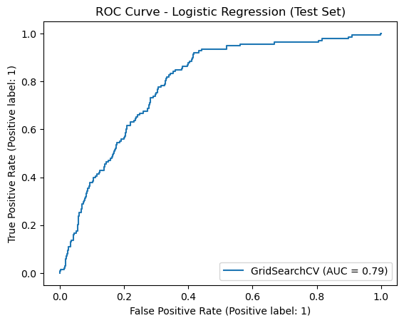
ROC Curve
The ROC curve for logistic regression demonstrates strong separation between fraud and non-fraud probabilities (AUC = 0.7916).
Despite poor classification, the model ranks fraudulent cases reasonably well based on probability.
AUC score indicates potential for improvement using threshold tuning or sampling techniques.

Slide 13
Time Plan
STEPS | DURATION | DATES | DELIVERABLES
Data Pre-Processing | 1 week | Feb 5 – Feb 11 | Cleaned and preprocessed dataset
EDA | 2 weeks | Feb 12 – Feb 25 | Summary statistics, visualizations, insights
Feature Engineering | 1 week | Feb 26 – Mar 3 | Fire impact analysis report
Predictive Modeling | 2 weeks | Mar 4 – Mar 17 | Predictive models for fire severity and resource allocation
Comparative Analysis | 1 week | Mar 18 – Mar 24 | Comparative analysis report
PPT & Draft Report | 1 week | Mar 25 – Mar 31 | Draft of final report and presentation
Model Refinement & Evaluation | 2 weeks | Apr 1 – Apr 14 | Model fine-tuning and final performance metrics
Final Report Revisions | 1 week | Apr 15 – Apr 21 | Revised final report based on feedback
Final Presentation | 1 week | Apr 22 – Apr 28 | Finalized presentation slides and practice
Final Submission | - | May 5 | Submission of final report and presentation

Slide 14
Project Outcome
Successfully built and evaluated machine learning models (Logistic Regression, Decision Tree, Random Forest, Gradient Boosting) for vehicle insurance fraud detection.
Achieved strong model performance on non-fraudulent claims (high overall accuracy and AUC scores).
Logistic Regression showed good fraud probability ranking (AUC = 0.7916) but struggled with actual fraud classification due to extreme class imbalance.
Identified key metadata features such as age, address change frequency, and policy tenure that correlate with fraud probability.
Highlighted severe class imbalance in the dataset (only 8% fraud cases), heavily impacting model detection capability.

Slide 15
Conclusion
Metadata-driven machine learning offers significant potential in automating vehicle insurance fraud detection.
While initial models performed well at identifying legitimate claims, challenges remain in accurately detecting fraudulent claims due to data imbalance.
Future enhancements, particularly in handling class imbalance and model refinement, could lead to a powerful and scalable fraud detection system.
Overall, the project demonstrates the viability of leveraging metadata and machine learning for improving the speed, accuracy, and efficiency of insurance fraud investigations.

Slide 16
Future Scope
Class Imbalance Solutions: Implement techniques like SMOTE (Synthetic Minority Over-sampling Technique) or ADASYN to balance the dataset and improve fraud detection rates.
Advanced Ensemble Methods: Explore more robust algorithms like XGBoost, CatBoost, or LightGBM for better handling of imbalanced classification problems.
Anomaly Detection Techniques: Introduce unsupervised or semi-supervised models (like Isolation Forest, One-Class SVM) which are often effective for rare event detection like fraud.
Metadata Enrichment: Integrate external metadata (e.g., credit history, telematics data) to provide richer context for claims and improve predictive performance.
Real-time Fraud Detection System: Deploy models into production environments for live fraud scoring during claims processing.
Threshold Tuning and Cost-sensitive Learning: Adjust classification thresholds and incorporate cost-sensitive approaches to minimize false negatives (missed frauds).

Slide 17
References
[1] Medicare Fraud Detection Using Random Forest with Class Imbalanced Big Data. (2018, July 1). IEEE Conference Publication | IEEE Xplore. https://ieeexplore.ieee.org/abstract/document/8424690
[2] Ngai, E., Hu, Y., Wong, Y., Chen, Y., & Sun, X. (2010). The application of data mining techniques in financial fraud detection: A classification framework and an academic review of literature. Decision Support Systems, 50(3), 559–569. https://doi.org/10.1016/j.dss.2010.08.006
[3] Asgarian, A., Saha, R., Jakubovitz, D., & Peyre, J. (2023, January 15). AutoFraudNet: a multimodal network to detect fraud in the auto insurance industry. arXiv.org. https://arxiv.org/abs/2301.07526
[4] Baran, S., & Rola, P. (2022, April 12). Prediction of motor insurance claims occurrence as an imbalanced machine learning problem. arXiv.org.https://arxiv.org/abs/2204.06109
[5] Óskarsdóttir, M., Ahmed, W., Antonio, K., Baesens, B., Dendievel, R., Donas, T., & Reynkens, T. (2021). Social Network Analytics for supervised fraud detection in insurance. Risk Analysis, 42(8), 1872–1890. https://doi.org/10.1111/risa.13693
[6] Gangadhar, K. S. N. V. K., Kumar, B. A., Vivek, Y., & Ravi, V. (2022, December 15). Chaotic Variational Auto Encoder based One Class Classifier for Insurance Fraud Detection. arXiv.org. https://arxiv.org/abs/2212.07802

Slide 18


