Slide 1

Team Members
Manasa Sukavasi
Indhu Allala
Sai Chandan Regati

Slide 2
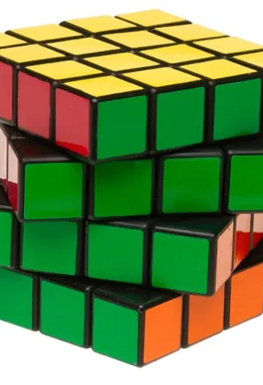
TOPIC
Feature Based Reinforcement Learning forThe Rubik’s Cube(4*4*4)

Slide 3
Agenda
Objectives
Introduction
Approach
Algorithm
Implementation
Results
Conclusion
Deliverables

Slide 4
RUBIK’S CUBE [4*4*4]
The 4x4x4 Rubik’s Cube, or Rubik's Revenge, is a puzzle that features 6 faces: front, back, left, right, top, and bottom. Each face is composed of 4x4 smaller squares, totaling 16 squares per face.
The puzzle has 8 corner pieces, each presenting three different colors, 24 edge pieces that come in pairs (each showing two colors), and 24 center pieces (4 per face) that show one color each. Unlike the 3x3x3 cube, the centers can move relative to each other.
The objective of the puzzle is to organize the squares so each face of the cube presents a uniform color, matching the original configuration of the puzzle.
To achieve the solved state, solvers typically use a layered approach: solving the center pieces first, then the edge pairs, and finally ordering the corners and remaining edges, similar to the 3x3x3 cube but with additional steps to handle unique 4x4x4 challenges such as parity errors.

Slide 5
OBJECTIVES
The main objective of this project is to solve a 4*4 Rubik’s cube without using the man-power/human intelligence.
This process involves understanding the cube’s structure and giving step-by-step solutions to give easy and efficient output.
Main goal of our project is to solve The Rubik’s cube in short span with minimum steps.

Slide 6
APPROACH
The plan is to use the Reinforcement Learning techniques and high-performance computing resources to achieve the goal.
The value iteration is used to build a representation of the cube’s state space, allowing the model to reason about the cube’s location and decide the best optimal steps to solve it.
Utilizing the reinforcement learning algorithms such as Q-learning,A3C, policy gradient or policy optimization algorithms.
To execute the training, feature-based Q-learning will be employed, as well as high-performance computer resources to accelerate the training process

Slide 7
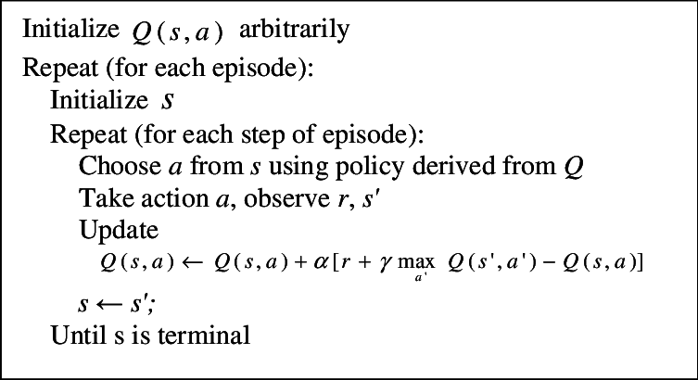
Feature based Q-Learning Algorithm

Slide 8
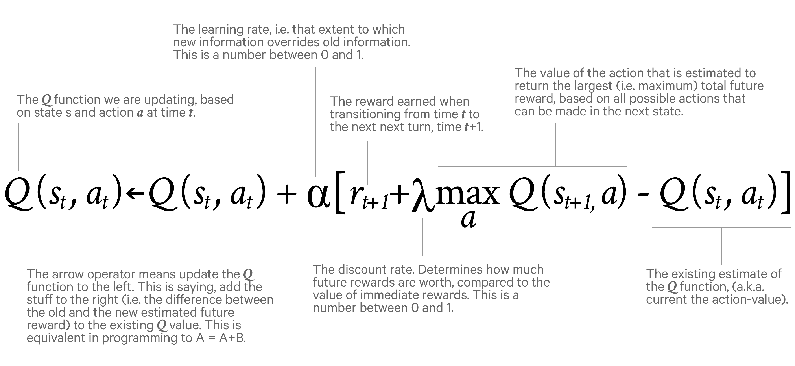
Q value

Slide 9
Implementation
Agent is trained with the Solved State(Goal).
Initialized with the Discount rate, Learning rate, epsilon, number of episodes.
Register the Input unsolved state and assign random Q-values initially.
Calculate the Q-value at each stage and select the best Q-value based on the Maximum reward returned and chosen the best action.

Slide 10
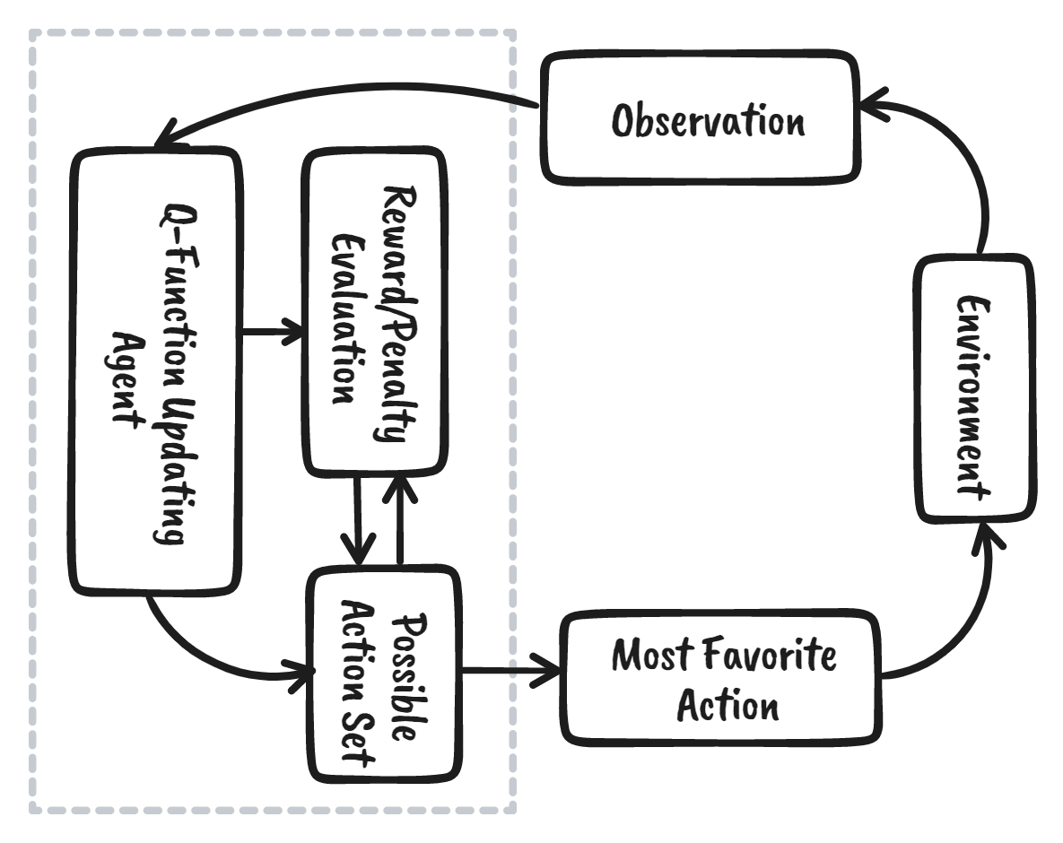
Flow Graph

Slide 11
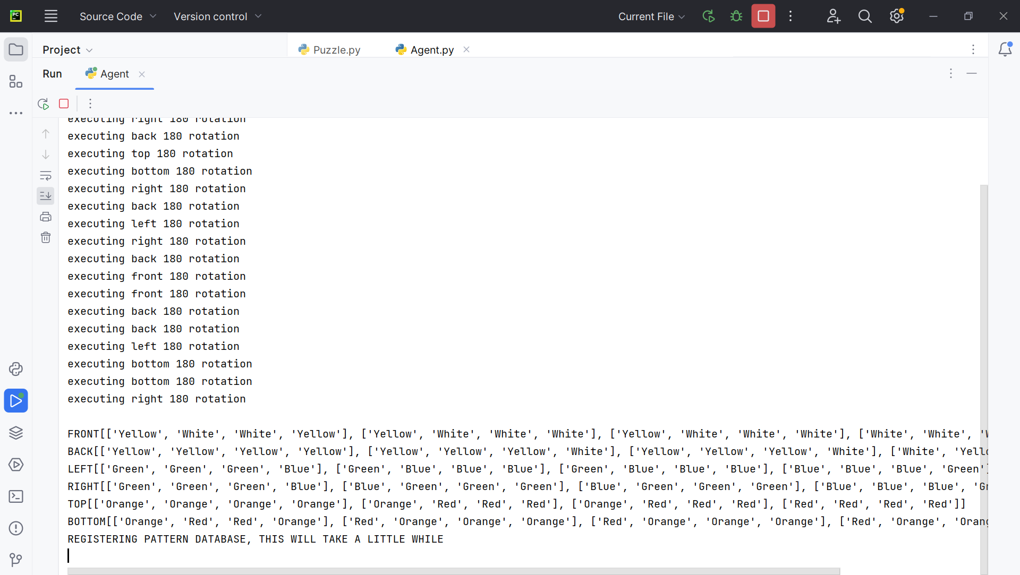
Initialized Unsolved Cube

Slide 12
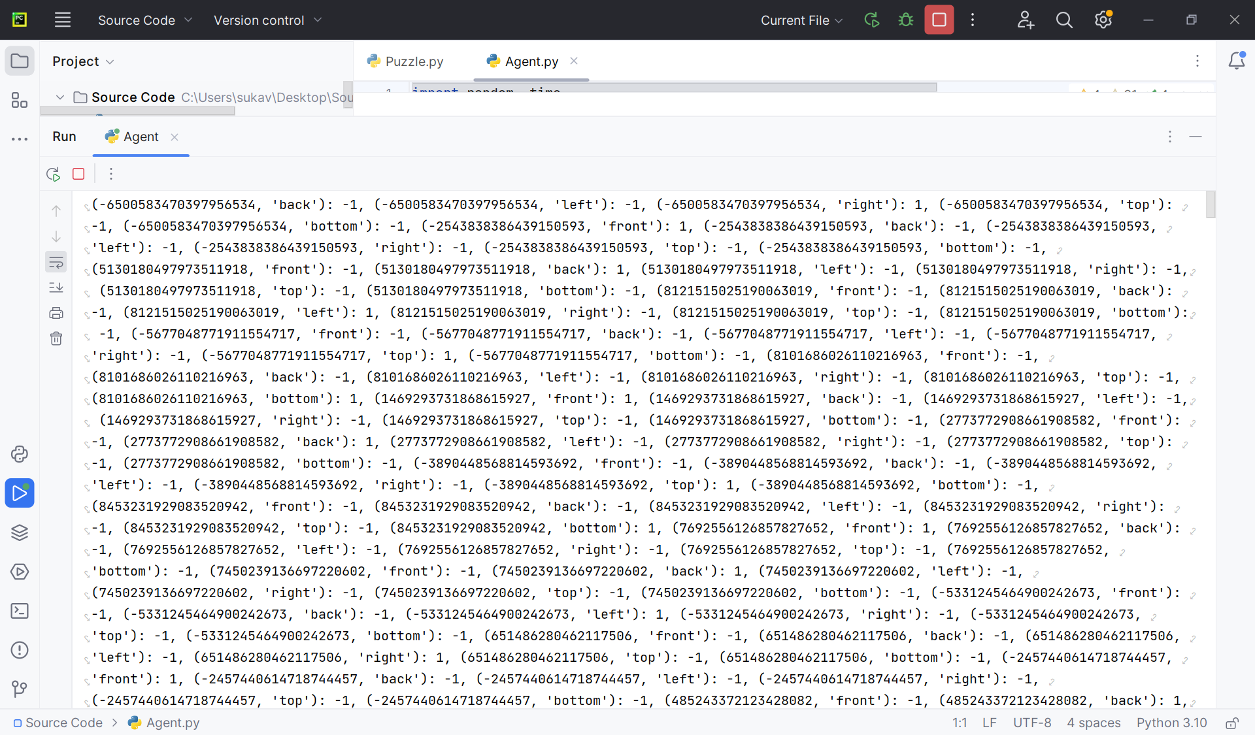
Training Stages and Q-Values

Slide 13
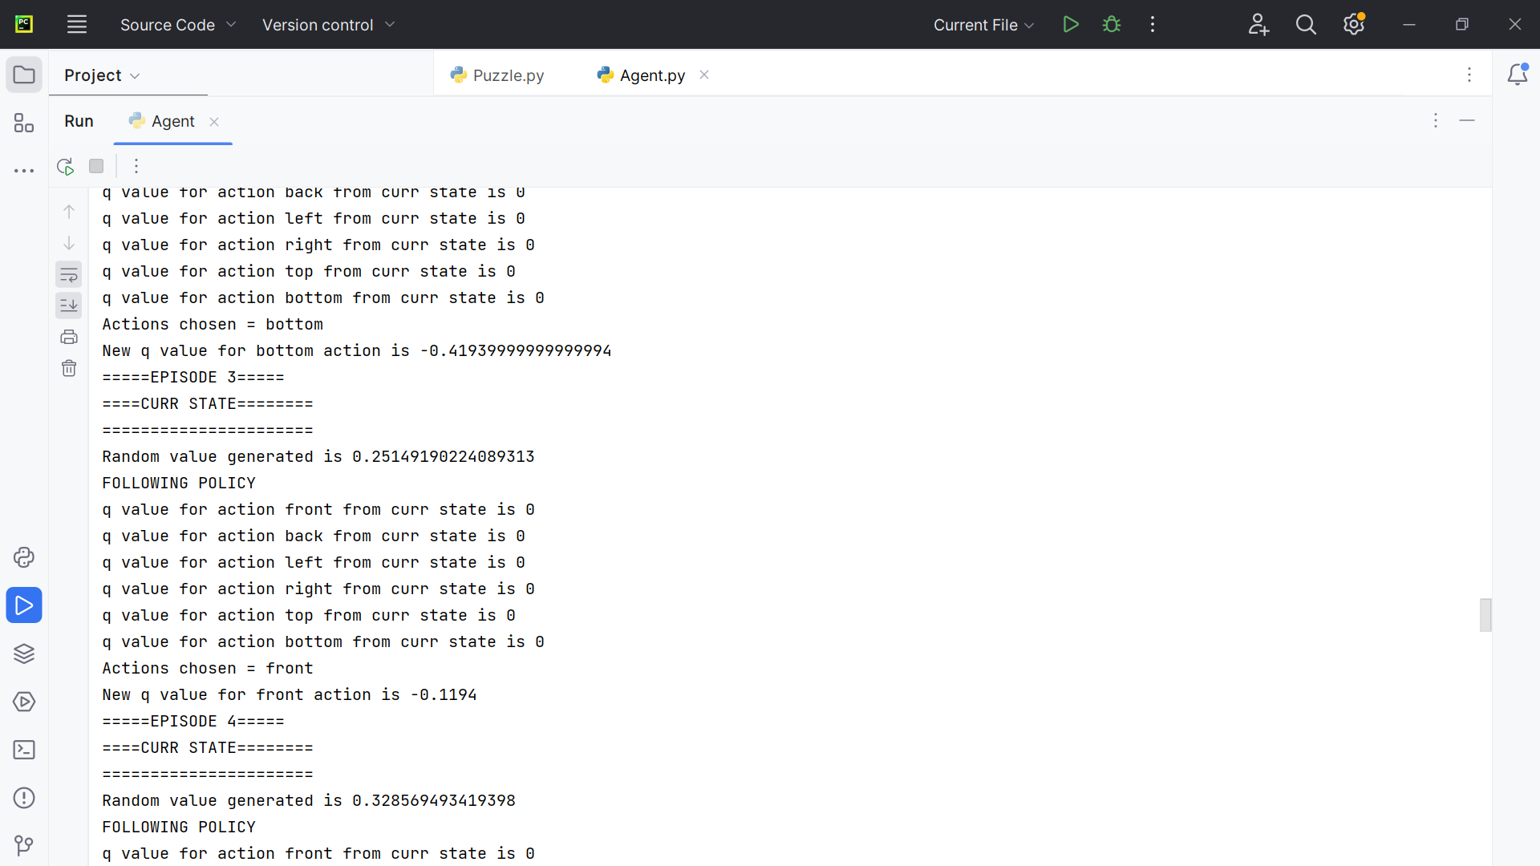
Snapshot of working in different episodes

Slide 14
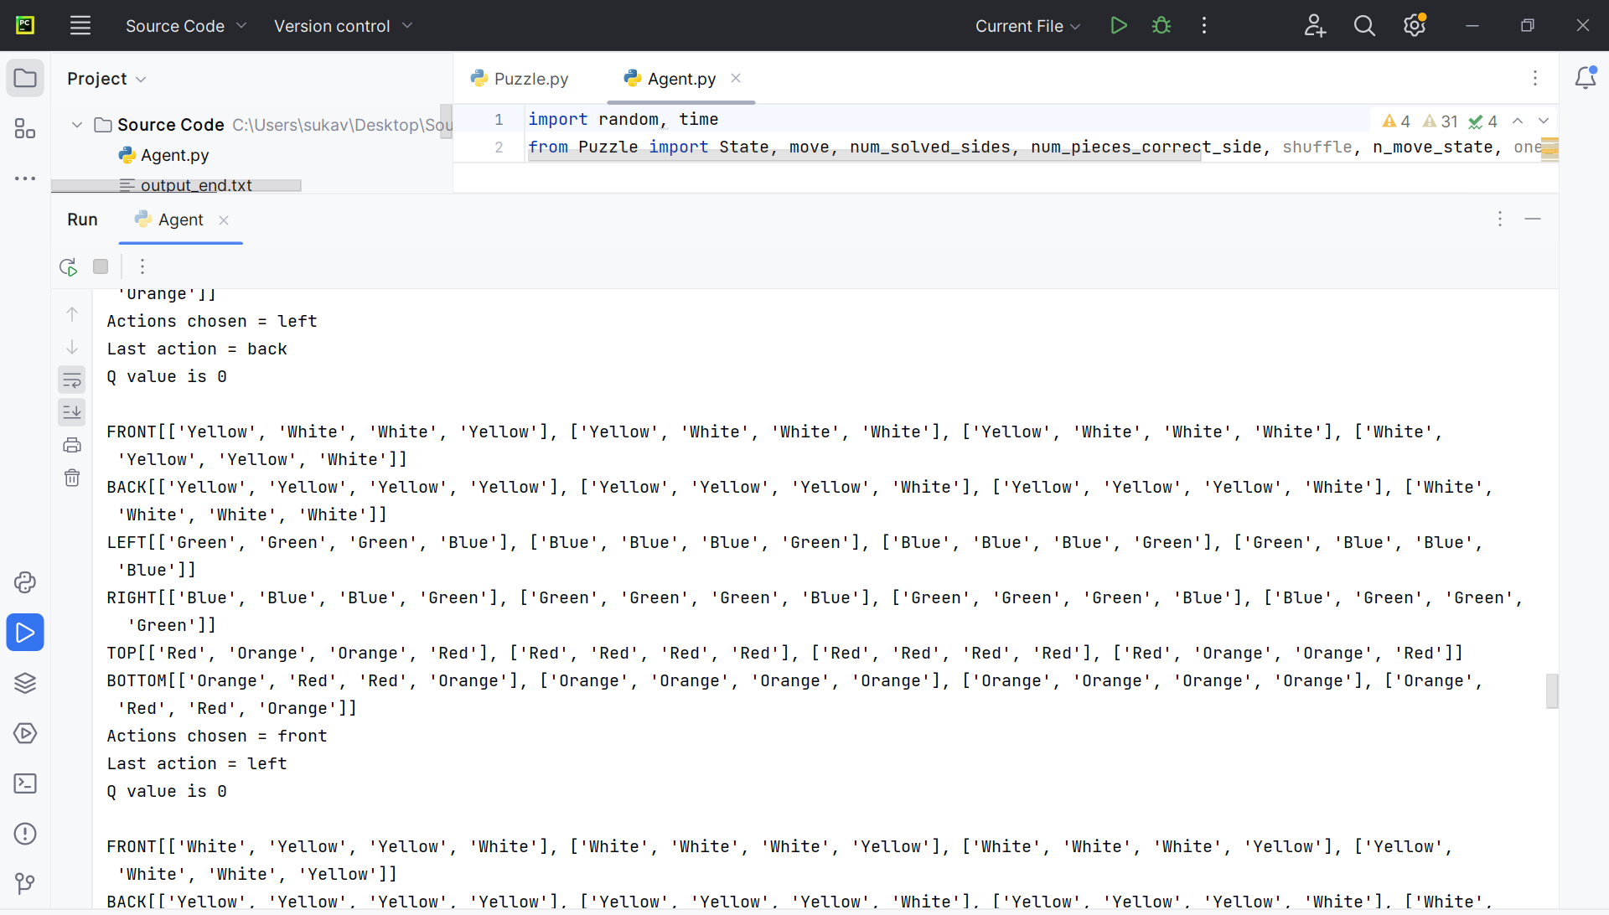
Pre-stages of solving the Cube

Slide 15
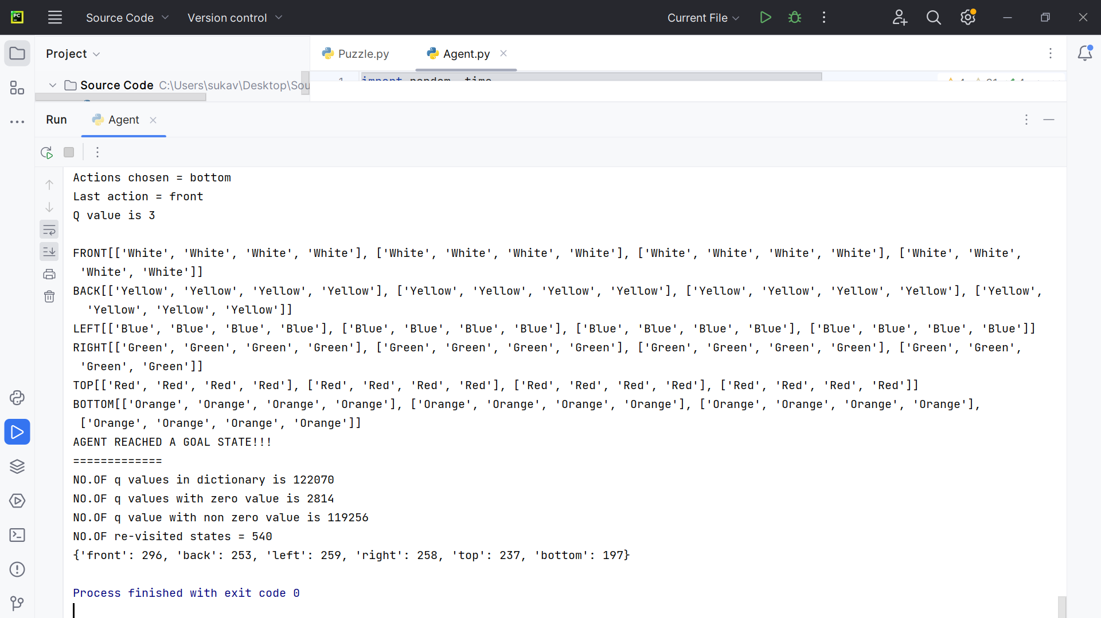
Solved Cube by the Agent

Slide 16
Evaluation Methodology
Efficiency and Accuracy of Algorithms
Documentation Quality
Completion Time
Complexity
User Feedback

Slide 17
Conclusion
The Agent is trained to solve the Rubik’s cube 4*4 using the Feature based Q-learning (Model-free Reinforcement Learning Algorithm).
The Agent chooses the best action based on the Q-value and the maximum reward associated with the action chosen by the agent.
The Cube with shuffled states <20 has been solved by the agent within 40 seconds of time and the agent stops the play after it reached the goal state (Solved Cube).

Slide 18
Deliverables
Code repository: The source code and any accompanying data files required to create the models and train the agent are included.
Technical documentation: Documenting the project’s technical features, such as the model architecture and training methodology.
Final presentation report: A comprehensive report that summarizes the project’s objectives, approach, methodology, outcomes, and conclusions.
Youtube video: The detailed video demonstrating the workings of the agent solving the cube and the results.

Slide 19
Thank you
msuka1@unh.newhaven.edu
ialla1@unh.newhaven.edu
Srega4@unh.newhaven.edu

