Slide 1

“Review of Major Project”
for E-4 2018 Admitted Batch
Submitted as part of Major project.
Submitted by
B. Manasa [S180122]
K.N.S. Swathi [S180463]
L.S. Deepika [S180125]
A. Sai Karthik [S180325]
Under the Esteemed Guidance of:
Sri. S. Sateesh Kumar
Assistant Professor
Department of Computer Science and Engineering
Rajiv Gandhi University of Knowledge Technologies
Srikakulam – 532402

Slide 2
Advanced Criminal Face Identification: A Computer vision and Machine Learning Based Solution for Enhanced Law Enforcement

Slide 3
CONTENTS
Abstract
Problem Statement
Introduction
Objective
Existing System & Disadvantages
Proposed System & Advantages
How LBPH Algorithm Helps Us
Technologies Used
H/W and S/W Requirements
Conclusion
References

Slide 4
ABSTRACT
Crime preventions and criminal identification are the primary issues for the police personnel, since property and life protection are the basic concerns of the police but to combat the crime, the availability of police personnel is limited. The goal of this project is to identify face of previously convicted persons and provide a solution with higher accuracy, better response rate and an initial step for video surveillance. Solution is proposed based on nature of criminal psychic of repeating crime or involvement in it. This system is used to track history sheeters and recognize them before and after any mischief or any unlawful activity. In the system we are storing the image of criminal in the database along with its other detail to provide ease in data retrieval and ensuring fast deployment of results in real world. The project is developed using Python 3.10 and employing OpenCV alongside algorithms such as Haar cascade classifier, LBPH, and face recognition, the project utilizes SQLite for storing comprehensive person-specific information.
Keywords: Computer vision, Machine Learning, criminal Identification ,Face Recognition.

Slide 5
PROBLEM STATEMENT
In India, Law enforcement agencies face challenges in preventing crime and identifying repeat offenders due to limited police resources. To address this, the project aims to develop a robust system for accurate face identification of previously convicted individuals. The primary objectives include enhancing accuracy, improving response time, and initiating video surveillance for proactive crime prevention. The system focuses on analyzing the behavioral patterns of criminals prone to repeating offenses. It aims to create a solution capable of tracking and recognizing history sheeters before and after engaging in unlawful activities. By leveraging a database that stores criminal images and associated details, the project seeks to facilitate efficient data retrieval and rapid deployment of real-time results.

Slide 6
INTRODUCTION
The criminal face identification system relies on face identification technology, emphasizing the significance of facial recognition in various social interactions.
It primarily aims to monitor habitual criminals who have been registered within the system, enabling authorities to track their activities and movements.
Developed using Python and leveraging OpenCV (Open Source Computer Vision Library) alongside the face-recognition library, this system utilizes advanced algorithms and techniques.
By combining these technologies, the system can efficiently detect and recognize faces, enabling law enforcement to track registered criminals, identify them in real-time scenarios, and potentially prevent or respond to criminal activities more effectively.

Slide 7
OBJECTIVE
This following system is use to facilitate the law enforcement official by the following
Registering criminal
Photo matching
Custom Video surveillance

Slide 8
EXISTED SYSTEM
The current criminal identification system relies on a FRCI is an existing system used for facial recognition and criminal identification purposes.
It involves capturing facial images, processing them using techniques like Principal Component Analysis (PCA).
And comparing them against a database of known individuals.

Slide 9
EXISTED SYSTEM DISADVANTAGES
The existed system have limitations in accuracy and response time, depending on the algorithm used and the database size.
The system is more dependent on image quality, lighting, and environmental factors, impacting their reliability.

Slide 10
PROPOSED SYSTEM
The proposed system aims to revolutionize criminal identification and prevention by utilizing advanced facial recognition technology.
It's designed to identify individuals previously convicted of crimes with enhanced accuracy and response rates.
The system leverages insights from criminal psychology to track repeat offenders, enabling recognition before and after unlawful activities.
By storing comprehensive criminal profiles including images and relevant details in a database, it enables swift data retrieval and real-world deployment
Ultimately, it serves as a crucial step towards more efficient video surveillance and proactive crime prevention.

Slide 11
PROPOSED SYSTEM
start
User choice
Enter Details
Select photo
Start the video
source
Select picture of criminal
Names of Detected criminals appears on list
If any frame matches with criminal it displays its name on the list
Create Dataset
Click on name to see details
Click to see details
Register
Exit

Slide 12
PROPOSED SYSTEM ADVANTAGES
The proposed system utilizes advanced facial recognition technology, providing higher accuracy and a better response rate
It helps to identify repeat offenders better, allowing their recognition before and after committing crimes.
Developed on Python 3.10 and employing sophisticated algorithms like Haar cascade classifier, LBPH, and face recognition, the proposed system offers a more advanced technological framework compared to the FRCI system.
These advantages collectively contribute to a more robust, accurate, and efficient system for criminal identification and proactive crime prevention

Slide 13
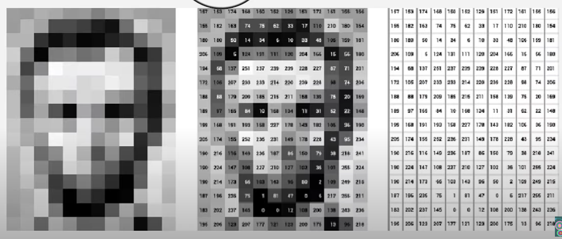
HOW LBPH ALORITHM HELPS US?

Slide 14
TECHNOLOGIES USED
Python 3.10
Open CV (Open Source Computer Vision Library)
Face Recognition Library
SQLite
Algorithms
Haar Cascade Classifier
LBPH(Local Binary Pattern Histogram)
Tkinter

Slide 15
HARDWARE & SOFTWARE REQUIREMENTS
Hardware
4 GB RAM (Minimum)
80 GB HDD.
Dual Core processor.
VGA resolution monitor.
Software
Microsoft Windows 7 or higher
Python 3.5+
OPEN-CV 4.4.0.40
Face_recognition
SQLite Studio
Notepad

Slide 16
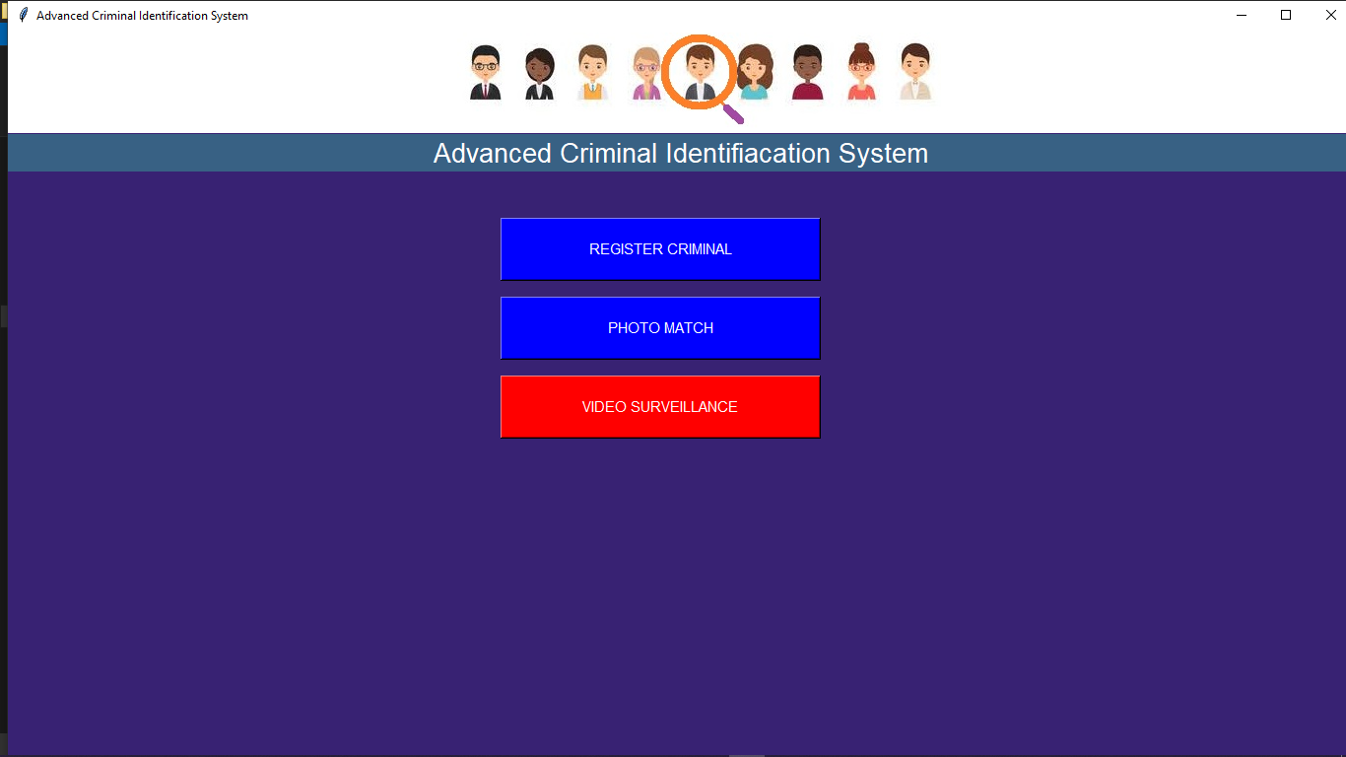
RESULT
Starting page

Slide 17
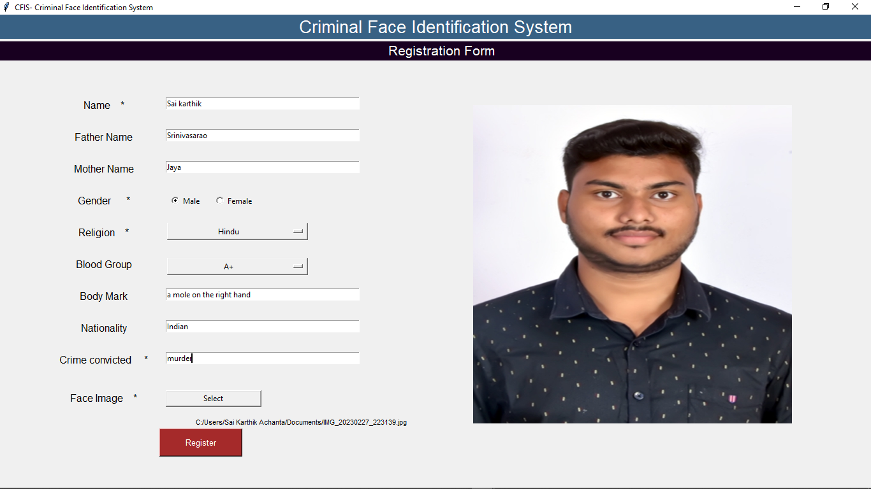
Register Criminal Page

Slide 18
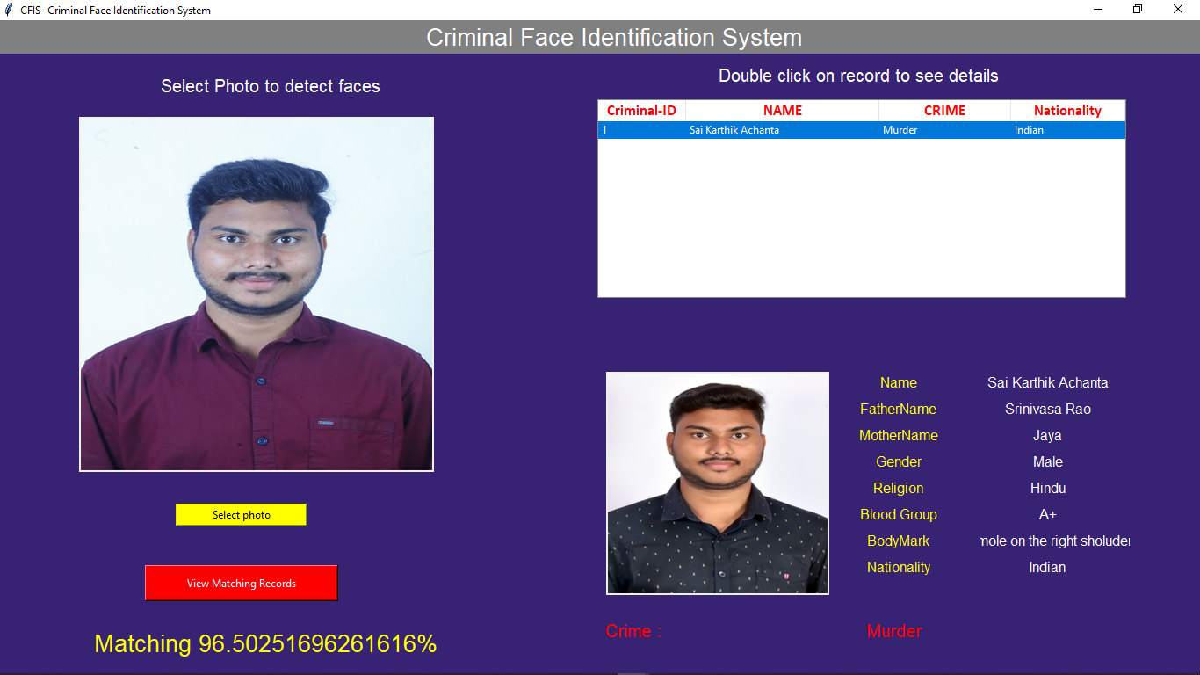
Detect Criminal Page

Slide 19
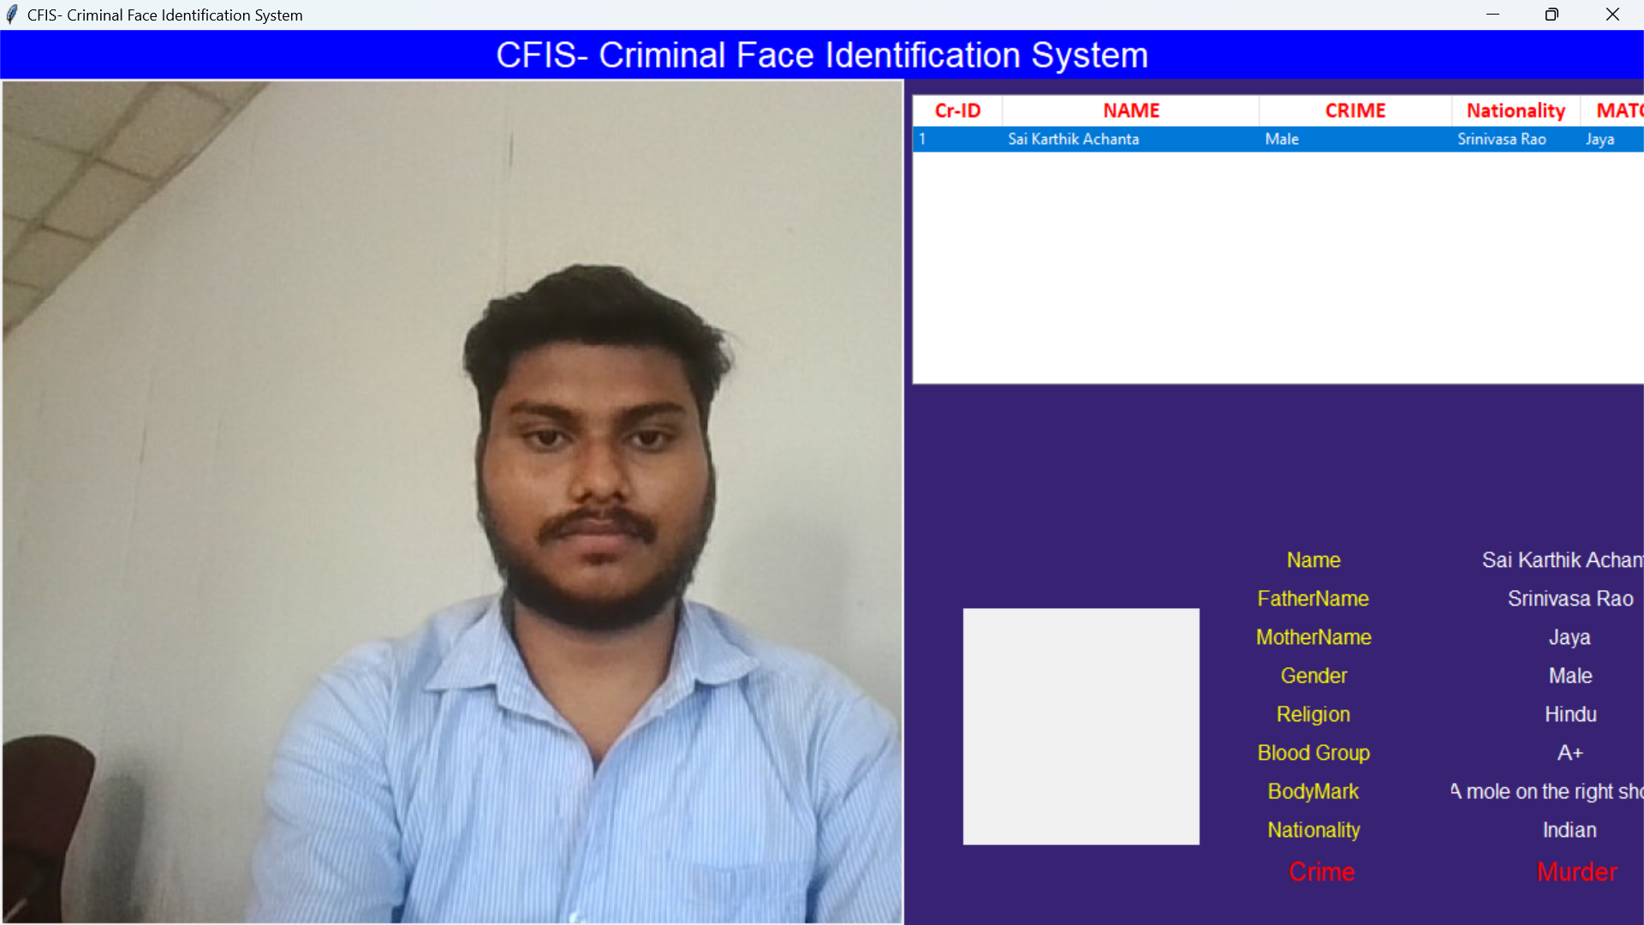
Video Surveillance page

Slide 20
CONCLUSION
We have used Haar feature-based cascade classifiers in OpenCV approach for face detection. It is a machine learning based approach where a cascade function is trained from a lot of positive and negative images. And we have used Local Binary Patterns Histograms (LBPH) for face recognition. Also in this project we have used face recognition library build with deep learning having higher accuracy. In this project, we are able to detect and recognize faces of the criminals in an image and in a video stream like CCTV footage. And expecting the proper working of project in real environment.

Slide 21
REFERENCES
https://ieeexplore.ieee.org/document/8396183
https://papers.ssrn.com/sol3/papers.cfm?abstract_id=3884827
https://www.ijert.org/criminal-face-recognition-system

Slide 22
Thank You!

