Slide 1


SUN PHARMA CASE CHALLENGE
District-Level Pharmaceutical
Market Attractiveness Index
A statistically rigorous, business-reasoned framework scoring 706 Indian districts across Overall, Chronic, Acute, and Chronic+Acute Overlap indices built on entropy weighted composite indexing, validated against ground truth, and translated into sales-force deployment strategy.
Team Case Closed
· Sai Manasa C · Sathvik Shetty · Siddharth · Kevin Mathews
· Indian Institute of Management Udaipur ·

Slide 2

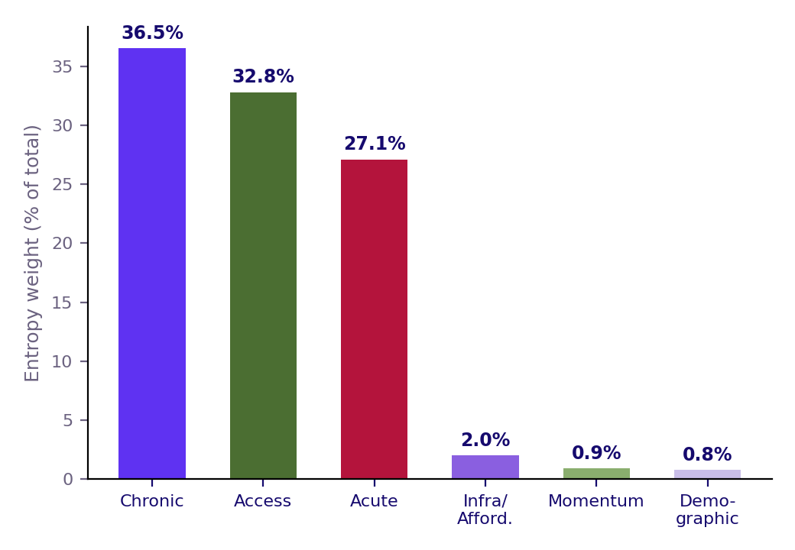
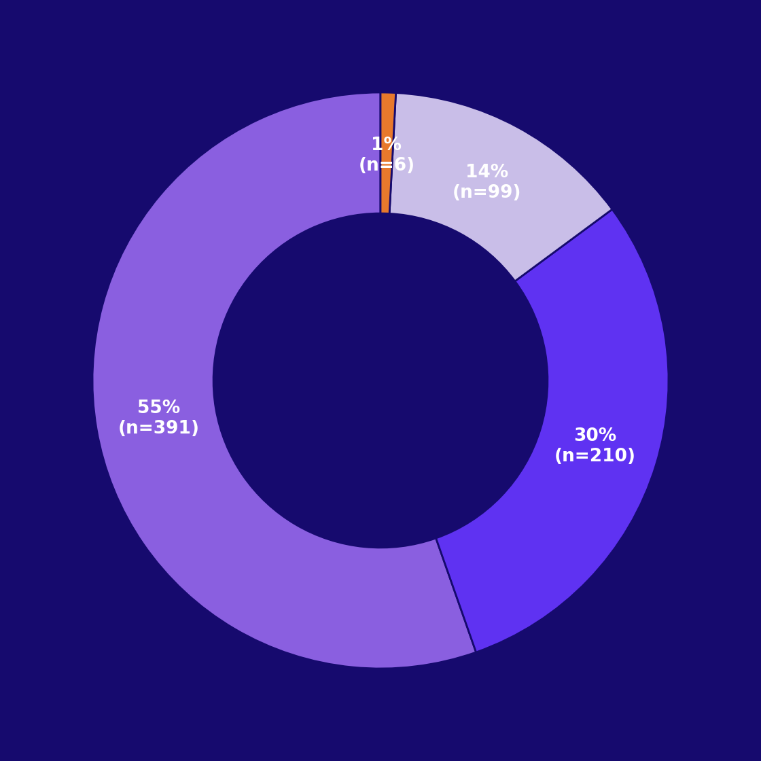
Executive Summary — A Data-Driven, Reasoned Case for Deployment
The Core Deliverable
Entropy Weight by Pillar
District Archetype Mix (n=706)
We built a district-level Market Attractiveness Index (MAI) for the Indian pharmaceutical industry, covering all 706 districts across four parallel indices: Overall, Chronic Therapy, Acute Therapy, and a Chronic+Acute Overlap index capturing diseases like TB and COPD that straddle both categories. Every score is built from a documented, six-pillar variable set rather than an opaque black-box model.
Every weight, threshold, and formula has a documented justification. We found and fixed real bugs during validation a small-district statistical-noise artifact, a population double-counting error, and a clustering-distance mismatch — and disclosed every fix. Reasoning, not just computation, is the differentiator.
What Sets This Submission Apart
Bar chart: share of total index weight (%) contributed by each of the six pillars, derived purely from district-to-district data variability (entropy method) — Chronic and Access pillars dominate, together explaining ~69% of the Overall MAI.
Donut chart: share of all 706 districts falling into each of 4 weighted K-Means archetypes. Mainstream Mid-Tier is the largest group (55%); Elite Metro Powerhouses are a distinct, tiny top segment (<1%).
Our Four District Archetypes, Briefly
Elite Metro Powerhouses (n=6): highest value AND highest growth — the mature, still-accelerating core
Established High-Value (n=210): strong fundamentals, room to grow into Tier 1
Mainstream Mid-Tier (n=391): the bulk of the country, average scores, genuine strategic ambiguity
Small Underserved, Chronic-Leaning (n=99): weaker infrastructure but real chronic-risk profile — an access-building opportunity (full detail in EDA section)
Our End-to-End Process
Four Parallel Indices
Data sourcing &
crosswalk cleaning
Overall MAI
(all therapies)
Entropy + judgment
weighted index
Chronic MAI
(risk factors)
K-Means archetype
segmentation
Acute MAI
(infectious burden)
Validation &
business layer
Chronic+Acute
Overlap MAI
TRILYTICS 2026 · IIM UDAIPUR · SUN PHARMA CASE CHALLENGE
2

Slide 3
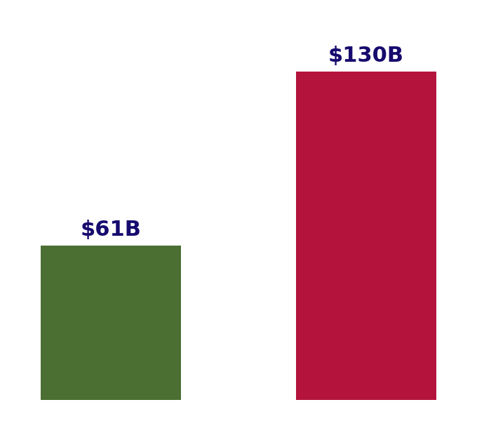
The Challenge — and Our 6-Pillar Framework
The Gap in Current Practice
Indian Pharma Market Growth
Entropy Weight by Pillar
Traditional pharma market planning relies on competition benchmarking, doctor-universe coverage, and internal sales indicators alone. These approaches systematically miss disease prevalence, affordability, access gaps, and forward-looking growth signals emerging high-growth districts and underserved markets go unnoticed until a competitor moves first.
Defining Scope, Explicitly
We scope 'pharmaceutical industry' as allopathic prescription and OTC medicines, branded generics, biosimilars, and vaccines explicitly excluding medical devices, AYUSH, and nutraceuticals. All modeling is scoped post-COVID (2022 onward preferred), since 2020-21 carries anomalous acute-care spikes and suppressed chronic-care utilisation.
Bar chart: India's pharma market size, 2024 actual vs. 2030 projected (DrugPatentWatch/Mordor Intelligence estimates), implying ~11% CAGR — the growth backdrop our Momentum pillar is calibrated against.
Same pillar-weight chart as the Executive Summary: Chronic (36.5%) and Access (32.8%) pillars carry the most analytical weight in the Overall MAI, since they show the greatest genuine district-to-district variability.
Our Six Pillars
Chronic risk factors (hypertension, diabetes, cancer screening, tobacco/alcohol), Acute disease burden (diarrhoea, ARI, childhood infection), Infrastructure & Affordability (sanitation, electricity, insurance, literacy), Provider Access (hospital density), Demographic structure (sex ratio), and economic Momentum (state GDP growth). Each maps to a specific, sourced dataset.
Legacy Approach's Blind Spots
Our Pillar Architecture
Competition
benchmarking only
Chronic + Acute
disease burden
Why Four Indices, Not Three
Doctor universe
coverage only
Infrastructure +
Affordability + Access
Beyond the brief's Overall/Chronic/Acute request, we added Chronic+Acute Overlap, capturing diseases like TB and COPD with both a chronic management phase and recurring acute exacerbations our own analytical addition, addressing a real gap the standard two-way split misses.
Internal sales
indicators only
Demographic +
Momentum overlay
Misses real
market opportunity
Composite
Overall MAI
TRILYTICS 2026 · IIM UDAIPUR · SUN PHARMA CASE CHALLENGE
3

Slide 4
PESTLE — Macro Environment Scan
Political & Economic
Pharma Market Size Growth
PESTLE at a Glance
The broader Pharma PLI scheme (₹15,000 Cr, including ₹6,940 Cr for 41 critical bulk-drug APIs) and PMBJP/Jan Aushadhi Kendras directly expand affordable-generic reach, feeding our Affordability pillar. India's pharma market is projected to grow from $61B (2024) to ~$130B by 2030E (~11% CAGR), directly informing our Momentum pillar.
POLITICAL
₹15,000 Cr PLI scheme; NPPA price monitoring
ECONOMIC
$61B→$130B market (~11% CAGR)
Social & Technological
AB-PMJAY's 42+ crore enrollment and 101M diabetics plus 315M hypertensive citizens (Anjana et al., Lancet Diabetes & Endocrinology, 2023) anchor our Chronic MAI sizing. GenAI diagnostics and telemedicine are narrowing the rural patient-to-doctor access gap feeding our Provider Access pillar.
SOCIAL
42+ Cr PMJAY; 101M diabetics
TECH/LEGAL/ENV
Telemedicine; DPCO caps; climate-linked acute demand
Legal & Environmental
Bar chart: $61B (2024) to a projected ~$130B (2030), sourced from Mordor Intelligence/DrugPatentWatch estimates — the Economic-pillar growth rate our Momentum layer is calibrated against.
NPPA/DPCO price caps constrain margins on essential-medicine SKUs in high-volume Tier 1-2 districts. Climate-driven vector-borne and seasonal-illness shifts feed directly into our Acute Therapy MAI's forward-looking layer, since monsoon/heat-wave volatility is a tracked leading indicator of acute demand.
Political → Model Link
Environmental → Model Link
PLI + Jan Aushadhi
schemes
Climate/monsoon
volatility
Why This Matters for the Model
Every PESTLE factor traces to a specific pillar or variable in our quantitative model — this is the business justification for why each of our 36 scoring variables was chosen, not a generic strategic overlay.
District affordability
improves
Vector-borne disease
seasonality
Feeds Affordability
pillar (Pillar 5)
Feeds Acute MAI
forward-looking layer
Raises Chronic MAI
score
Momentum index
adjustment
TRILYTICS 2026 · IIM UDAIPUR · SUN PHARMA CASE CHALLENGE
4

Slide 5
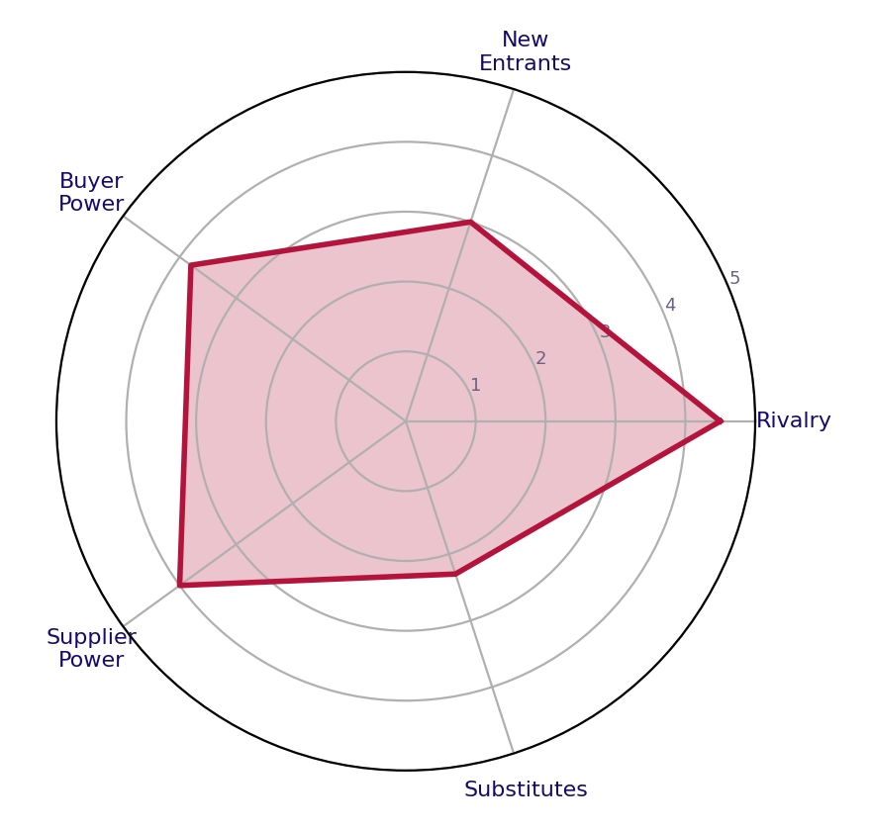
Porter's Five Forces & SWOT Analysis
Rivalry, Entrants & Buyer Power
Porter's Five Forces (Intensity 1-5)
SWOT Summary
Rivalry is high, dense generics competition across acute segments makes district-level targeting valuable for finding under-penetrated pockets rather than fighting head-on in saturated metros. New entrant threat is moderate: PLI incentives lower manufacturing barriers, but last-mile distribution and doctor-relationship depth remain a durable moat. Buyer power is rising as PMJAY expansion and price caps increase patient/payer bargaining power.
STRENGTHS
Distribution scale; ~70% intl. revenue
WEAKNESSES
~30% variables have data gaps
Supplier Power & Substitutes
Supplier power is moderate-to-high: ~70% of India's API/KSM imports are sourced from China, a structural cost and supply-continuity risk the PLI scheme only partially offsets. Substitute threat is low-to-moderate — biosimilars and alternate care (AYUSH, telemedicine-led self-management) offer partial substitution, concentrated mainly in chronic segments.
OPPORTUNITIES
20% API volume, only 8% value captured
THREATS
Price caps; fast-following competitors
Radar chart: subjective 1-5 intensity rating per force, based on the qualitative analysis at left. Rivalry (4.5) and Supplier Power (4.0) are the two most intense forces facing Sun Pharma in this market.
SWOT Summary
Strengths: Sun Pharma's largest domestic distribution network in India. ~70% international revenue scale provides financial resilience.
Weakness’: district-level public data granularity gaps affect ~30% of our variables
Opportunities: India captures only 8% of global API value despite 20% of volume, room to move up-chain. 700+ districts include untapped underserved pockets our index surfaces explicitly.
Threats: fast-following competitors can replicate any public-data-driven ranking within a quarter. NPPA/DPCO price caps compress margins on essential SKUs
Competitive Response Window
Supply Chain Risk Path
MAI ranking
published internally
~70% API/KSM
imports from China
Rising-star districts
identified early
Cost & continuity
risk exposure
Why This Grounds the Model
The competitive intensity described here is exactly why our Momentum Index and 'rising star' watchlist matter: in a market where rankings can be replicated quickly, being early to act on forward-looking signals not just current-state scores is the actual competitive edge this index provides.
First-mover
sales-force deployment
PLI scheme
partial mitigation
Competitor
reaction lag exploited
Margin protection
strategy needed
TRILYTICS 2026 · IIM UDAIPUR · SUN PHARMA CASE CHALLENGE
5

Slide 6
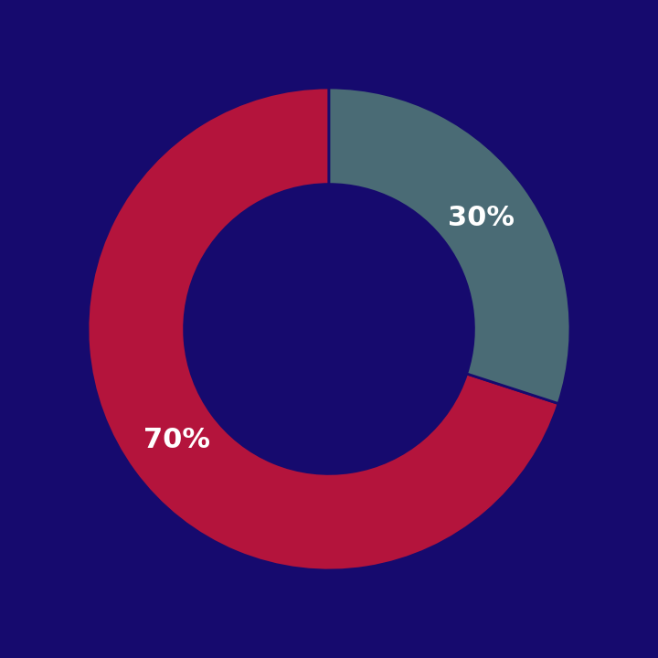
Strategic Triangle — The 3C Model
Company
Sun Pharma Revenue Split
The 3C Triangle
India's largest pharma player by revenue, ~$7B FY25 turnover
~70% revenue from international operations; 43 India manufacturing sites
Chronic-heavy India portfolio: Neuro-Psychiatry (16%), Gastroenterology (12%), Anti-Infectives (11%)
This MAI model directs where Sun Pharma's capital and sales-force effort actually land
COMPANY
Sun Pharma — chronic-heavy portfolio, $7B turnover
CUSTOMER
Patients, doctors, payers — 42+ Cr PMJAY base
Customer
COMPETITOR
Domestic majors & MNCs — first-mover window
SYNTHESIS
Every pillar traces to one of these three
Patients: 101M diabetics anchor Chronic MAI's demand-side sizing
Patients: disease burden and patient pool define overall demand sizing (Pillars 2-3)
Doctors: act as prescription gatekeepers, driving Provider Access pillar weighting
Payers: 42+ crore PMJAY-enrolled patients form the core affordability pool (Pillar 5)
Donut chart: Sun Pharma's FY25 revenue split by geography — 70% international, 30% India — sourced from the company's FY25 annual report, contextualizing the scale of its India operations relative to its total business.
Competitor
Company → Model Link
Customer → Model Link
District MAI rankings flag under-covered pockets before rivals notice the same public-data opportunity
'Rising star' momentum districts represent a genuine first-mover window
Whoever deploys sales-force first captures prescriber loyalty
Competitor response lag, not secrecy; is the model's real edge
Chronic-heavy
India portfolio
Patients: disease
burden data
Upweight Chronic
pillar in scoring
Doctors: access/
density data
Why the Triangle Matters
PESTLE sizes the macro opportunity, Porter's and SWOT expose the competitive field, and the 3C lens ties both back to who this model actually serves directly justifying every pillar and variable choice in our quantitative framework.
Prioritize districts
by chronic burden
Payers: insurance
coverage data
Capital allocation
decision
Demand-side
index sizing
TRILYTICS 2026 · IIM UDAIPUR · SUN PHARMA CASE CHALLENGE
6

Slide 7
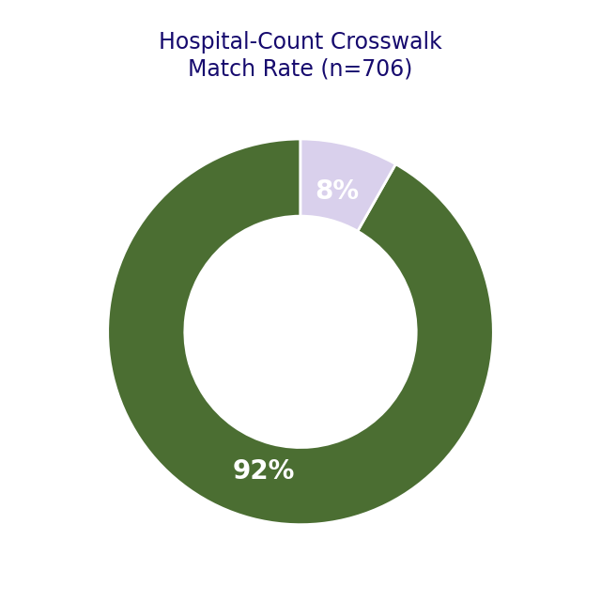
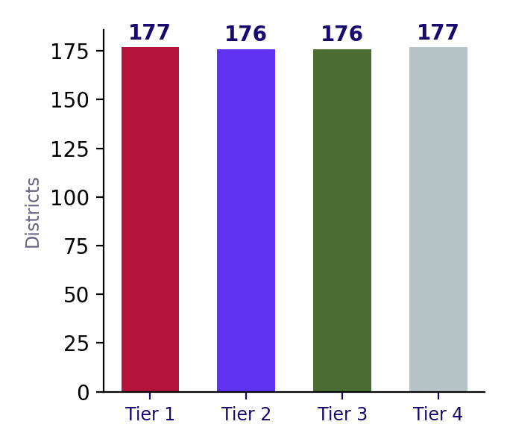
Data Sourcing & Cleaning Methodology
Sources Used
Hospital Crosswalk Match Rate
District Tier Distribution
The core district panel combines NFHS-4/NFHS-5 district factsheets (chronic risk factors, acute disease, infrastructure, insurance), a hospital directory (provider access proxy), state-level GDP time series (1960-61 to 2023-24, momentum), HMIS childhood-disease indicators, and Census 2011 population — all real, publicly-sourced, government or survey data, not synthetic placeholders.
The District Name-Matching Problem
Indian district names are spelled inconsistently across sources (Bengaluru vs Bangalore, Prayagraj vs Allahabad) and district boundaries have changed repeatedly since 2011 (Telangana's 2016 split alone created 22 new districts). We built a state-gated fuzzy-matching crosswalk, manually verified every match below 90% confidence, and corrected four confirmed algorithm misses before proceeding.
Donut chart: 648 of 706 districts (91.8%) matched directly to a hospital-directory entry; the remaining 58 (8.2%) are mean-imputed for Access-pillar variables — a disclosed, bounded data-quality limitation.
Bar chart: number of districts in each Overall MAI quartile tier (177/176/176/177) — confirms tiers are evenly balanced by construction, not skewed toward any one band.
Handling Post-2011 District Splits
For newer districts absent from our 2011-vintage sources, we apportioned parent-district values using hospital-count weighting, with an equal-split fallback where hospital data was unreliable or missing. We caught and fixed two real apportionment bugs: Tripura districts receiving zero population from a NaN-as-zero error, and Palghar receiving an implausible 0.14% population share from an urban-rural hospital-density mismatch with its parent Thane.
Data Cleaning Pipeline
Population Apportionment Fix
Raw multi-source
files ingested
Parent district
identified
Ground-Truth Validation
State-gated fuzzy
name crosswalk
Hospital-weighted
split attempted
Every apportionment fix was checked against India's actual 2011 Census population total (1,210,854,977); our corrected total lands at 1,209,515,632, just -0.11% off, with the entire residual gap explained by Ladakh's genuine post-2019 data absence. This is real, checkable validation, not an assumed-correct pipeline.
De-duplication &
spelling fixes
Implausible-ratio
fallback to equal-split
Master district
panel (706 rows)
Validated vs.
Census total (−0.11%)
TRILYTICS 2026 · IIM UDAIPUR · SUN PHARMA CASE CHALLENGE
7

Slide 8
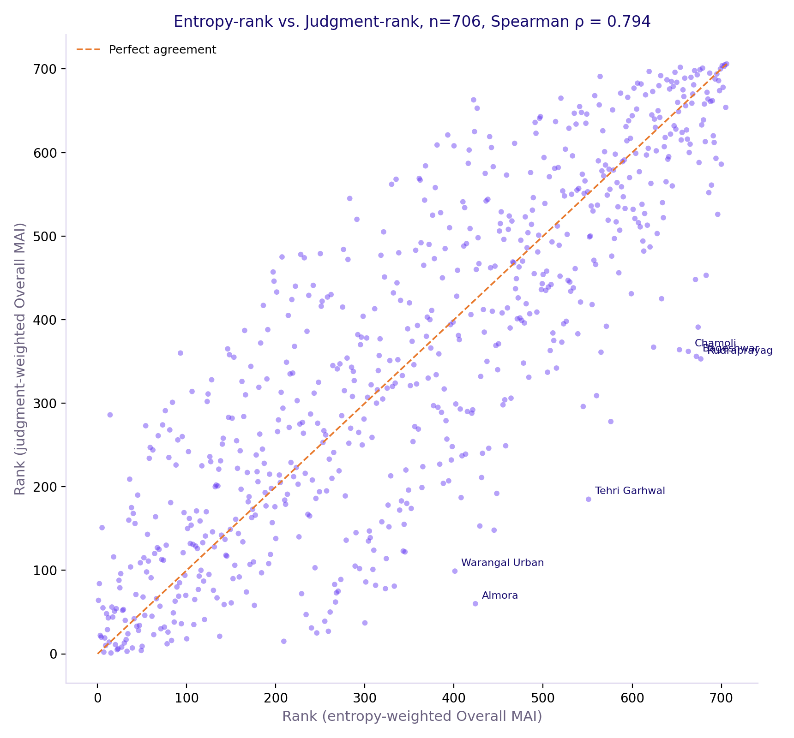
The Statistical Toolkit Used
The Core Technique: Entropy Weight Method
Entropy vs. Judgment Rank (ρ=0.794)
Entropy Weight by Pillar
Our core statistical technique is the Entropy Weight Method (EWM), rooted in Shannon's foundational information theory (Shannon, C.E., 'A Mathematical Theory of Communication,' Bell System Technical Journal, 27(3), 1948) and used for composite indicator construction in indices like the HDI and NITI Aayog's State Health Index. For each of 36 normalized variables, we compute Shannon entropy across 706 districts — higher discriminating power earns higher weight, automatically.
Cross-Validated, Not Assumed Correct
We computed Overall MAI two independent ways. Entropy-weighted and judgment-weighted — finding Spearman ρ = 0.794 agreement. An equal-weight baseline diverges meaningfully (ρ = 0.713), confirming entropy weighting does real analytical work (OECD/JRC Handbook on Constructing Composite Indicators, 2008).
Scatter plot: each dot is one district, x-axis = rank under entropy weighting, y-axis = rank under judgment weighting. Tight clustering along the diagonal confirms strong agreement between the two independent weighting methods.
Bar chart: % of total index weight per pillar, derived from Shannon entropy across all 706 districts — shown here again to make the weighting transparent alongside the clustering discussion.
Why K-Means
K-Means was chosen over alternatives (hierarchical clustering, Gaussian Mixture Models, DBSCAN) because our goal was a small, fixed number of interpretable, business-actionable segments (4 archetypes) rather than a full dendrogram or density-based grouping. K-Means is the standard choice when the target segment count is known in advance and speed/interpretability matter more than capturing arbitrarily-shaped clusters. We validated this choice: an unweighted K-Means run misclassified Ahmedabad and Mumbai into the lowest-value cluster due to an extreme hospital-count outlier; we caught this via face-validity checking and rebuilt clustering using the same index-consistent weights as the scoring formula itself. A disclosed methodological fix, not a default left unquestioned.
Entropy Weighting Formula
Why K-Means, Validated
Min-max normalize
to [0,1]
Need fixed, small
# of segments (4)
Compute proportional
share p_ij
K-Means chosen over
hierarchical/GMM/DBSCAN
Complementary Methods Beyond Clustering
CAGR-based trend analysis on real 8-point GDP time series for Momentum; significance-tested correlation analysis (p<0.001) for hypothesis validation; log-transformation for skewed variables like population; and systematic sensitivity/perturbation testing (ρ≥0.999) for robustness. Clustering is the segmentation layer on top of this larger toolkit, not the model itself.
Shannon entropy
e_j = -kΣ(p·ln p)
Unweighted version
misclassified metros
Weight w_j =
(1-e_j)/Σ(1-e_j)
Rebuilt with index-
consistent weights
TRILYTICS 2026 · IIM UDAIPUR · SUN PHARMA CASE CHALLENGE
8

Slide 9
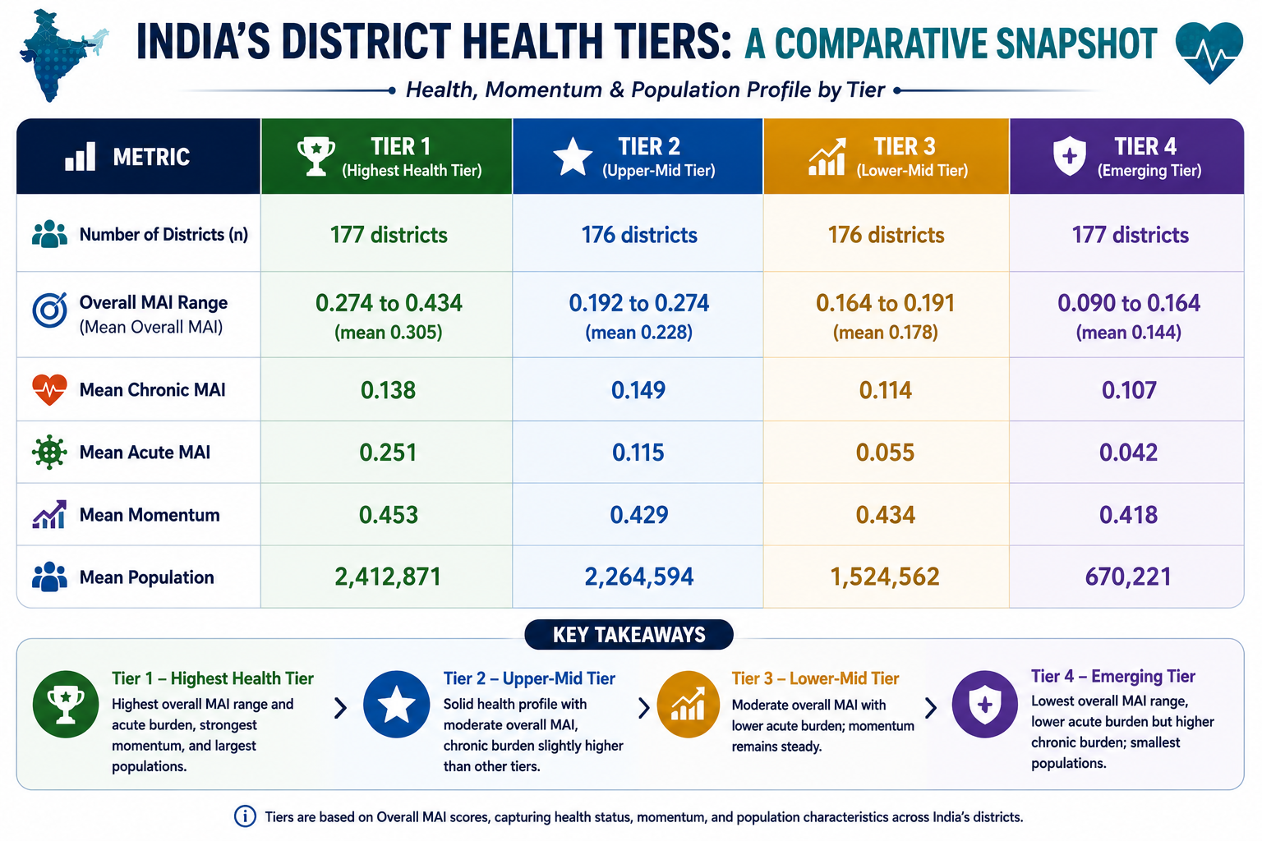
EDA I : Data Sources & Summary Statistics
Before any modeling: what each dataset actually is, where it comes from, and what it contains.
NFHS-4 & NFHS-5 (National Family Health Survey)
Description: India's largest household health survey, conducted by MoHFW via IIPS Mumbai; round 4 (2015-16) and round 5 (2019-21) both surveyed at district level. Source: rchiips.org/nfhs (district factsheets). Columns used: 105 raw indicators per district covering blood pressure, blood sugar, cancer screening, tobacco/alcohol use, diarrhoea/ARI prevalence, sanitation, electricity, insurance coverage, and literacy — 32 of these were selected for final modeling.
Hospital Directory & State GDP Time Series
Hospital Directory: a facility-level listing (name, address, district, category) used as our Provider Access proxy — 30,000+ rows, aggregated to a district-level hospital count. State GDP: an 8-point time series (1960-61 to 2023-24) of state-wise GDP share, sourced from national accounts data, used to compute a real CAGR growth rate feeding our Momentum pillar.
HMIS & Census 2011 Population
HMIS (Health Management Information System): monthly facility-reported service-delivery data from MoHFW, used here for childhood disease-indicator counts. Census 2011: India's decennial population census, providing our only genuine ground-truth population figure, used both as a scoring input and as the external validation benchmark for our apportionment fixes (total population check, -0.11% off actual).
Summary Statistics — What the Numbers Show
Across all 706 districts: mean Overall MAI is approximately 0.21 with a standard deviation of ~0.06, indicating most districts cluster in a moderate band with a real, meaningful spread between the lowest and highest scorers (see table). Population per district ranges from a few thousand (Dibang Valley) to over 9 million (Bangalore), a genuinely wide range that is exactly why the population-correction step (see Results slides) mattered so much for a fair comparison.
TRILYTICS 2026 · IIM UDAIPUR · SUN PHARMA CASE CHALLENGE
9

Slide 10
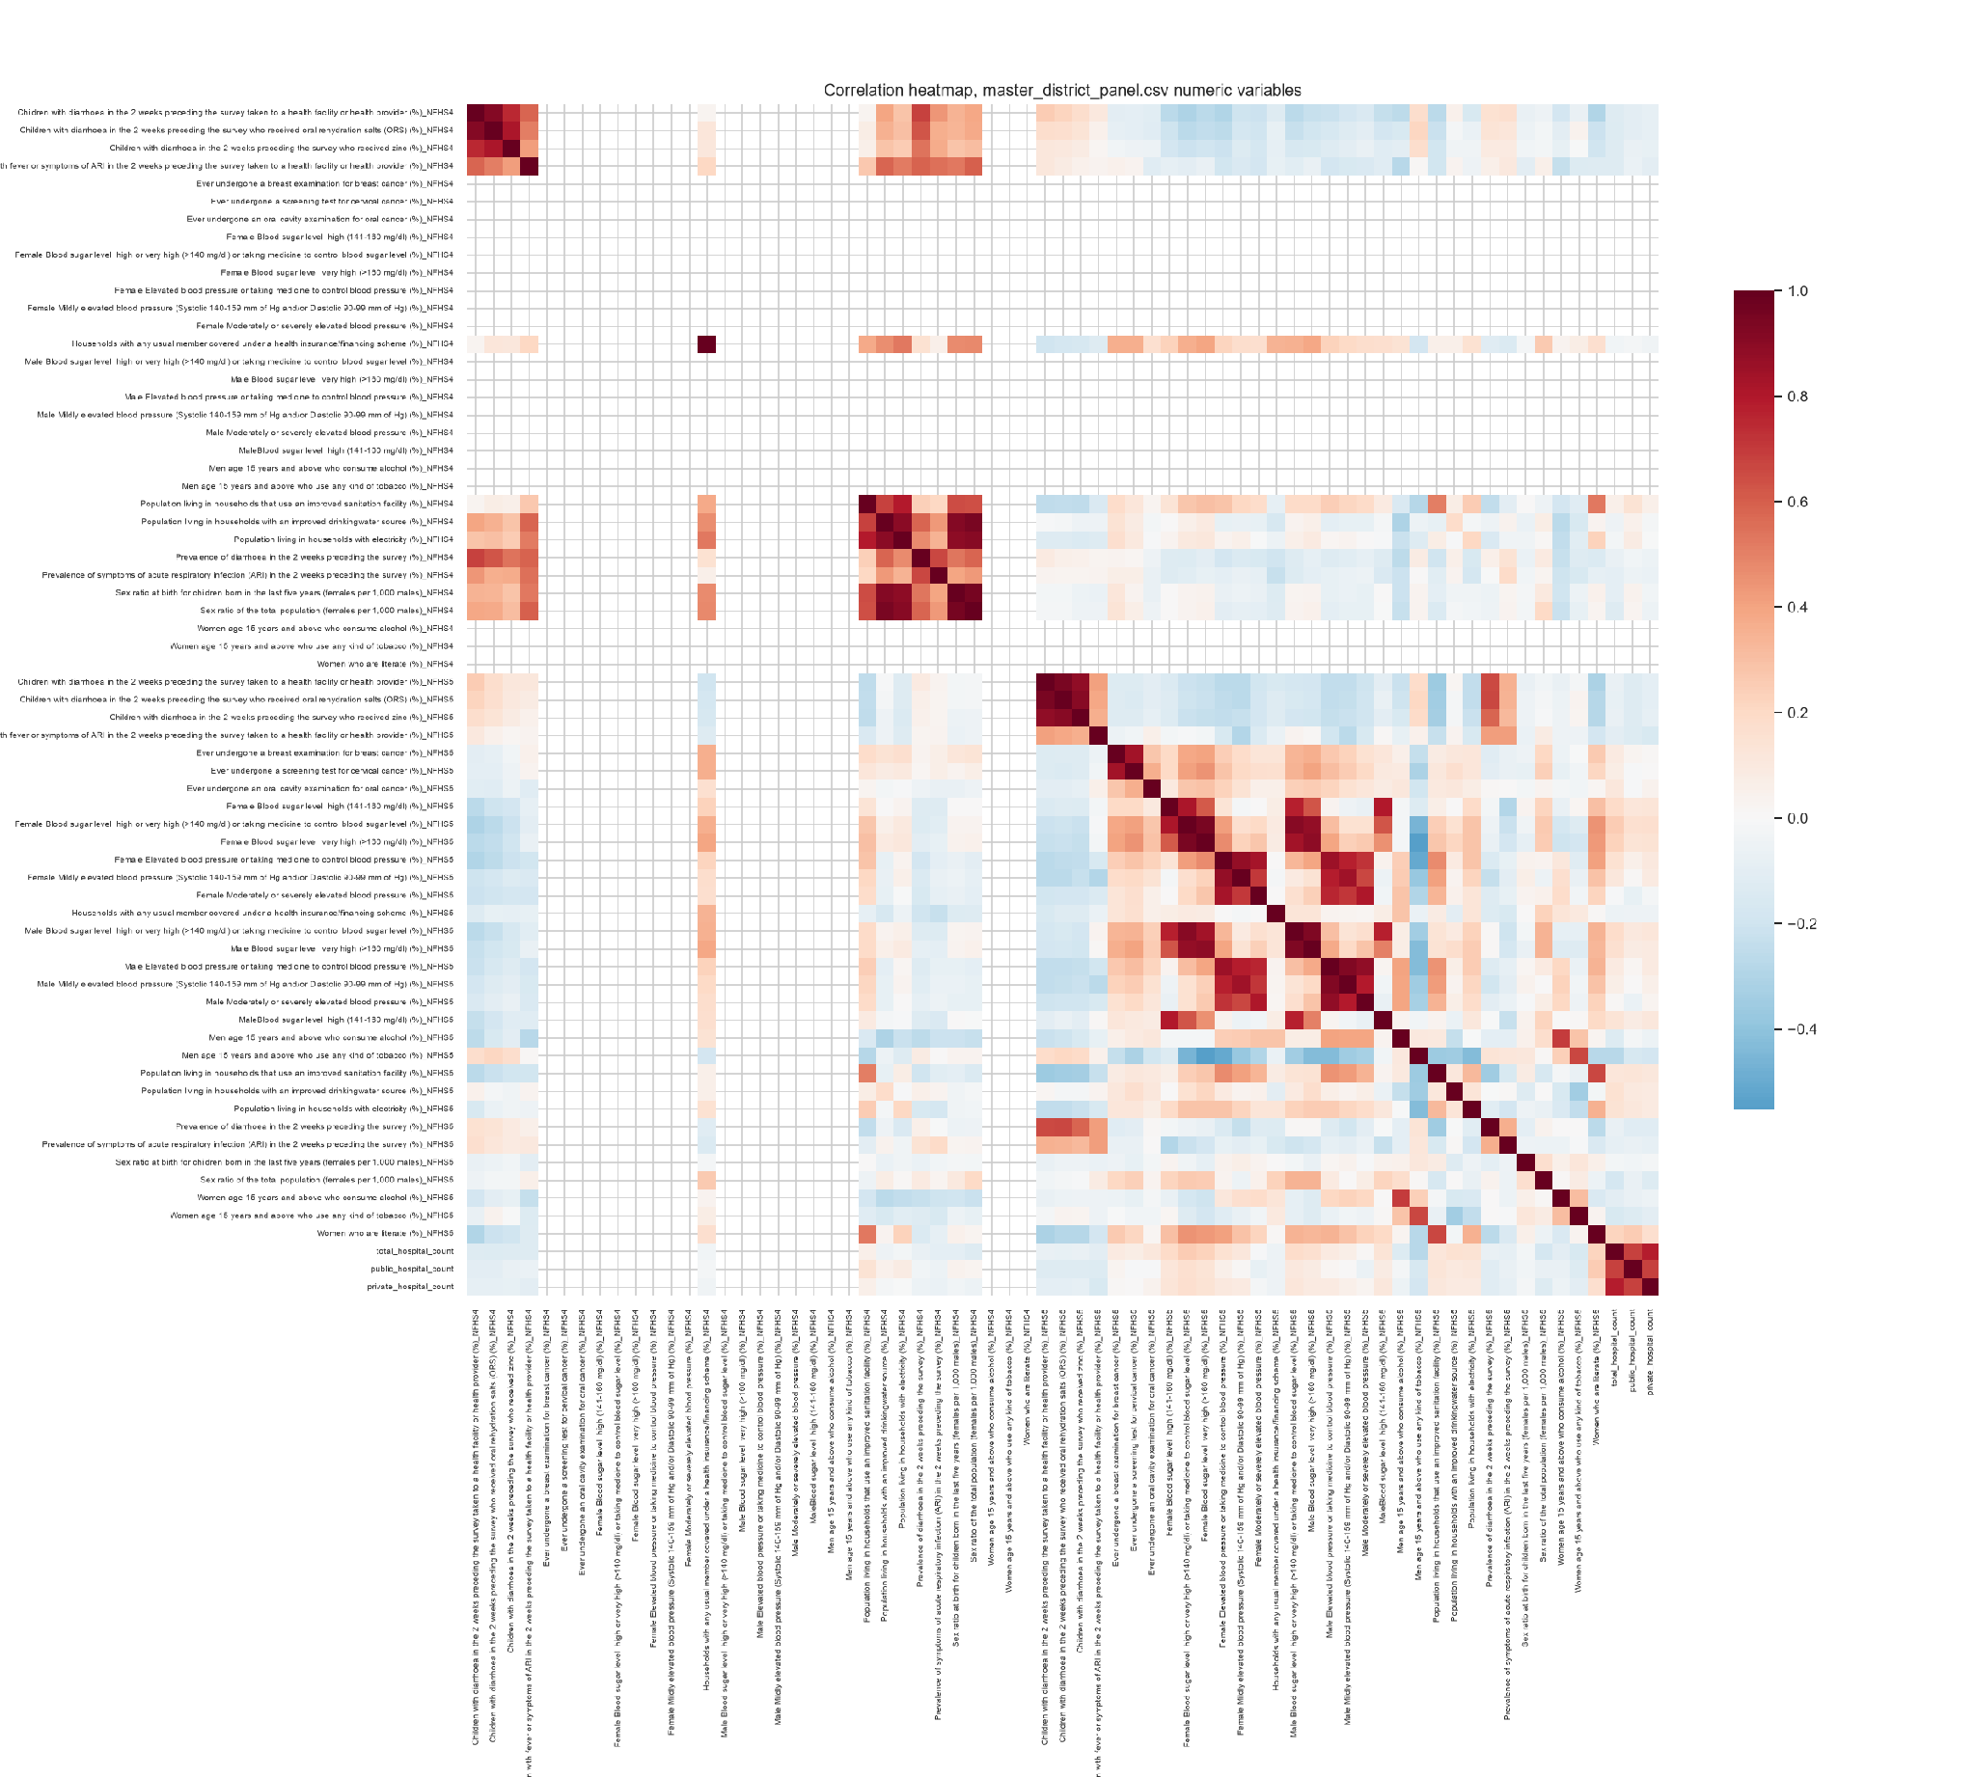
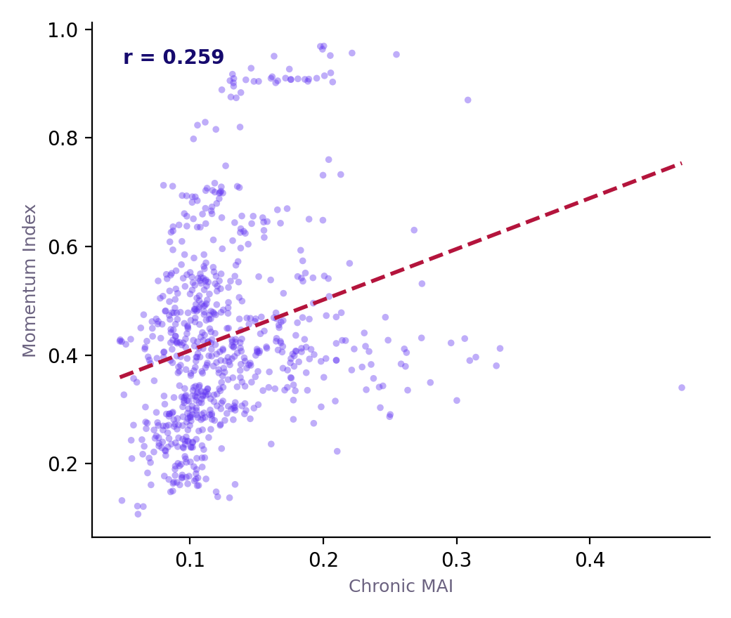
EDA II : Correlation Matrix Deep-Dive & Predictor Interactions
A correlation matrix reveals far more than any single number — here is what ours actually shows, walked through explicitly.
Correlation Matrix (66 NFHS Indicators)
Chronic MAI vs. Momentum
Why a Correlation Matrix Matters Here
Before combining 36 variables into an index, we need to know which variables move together (risking double-counting the same underlying signal) and which are genuinely independent (each contributing unique information). A correlation matrix across all 66 raw NFHS indicators answers exactly this, and directly shaped which 32 indicators we ultimately selected.
Reading the Matrix: Three Clear Clusters
First: NFHS-4 and NFHS-5 versions of the same indicator are the strongest correlated pairs wherever both rounds exist (r typically above 0.7) ; expected, since a district persistently high or low on an indicator stays that way across survey rounds. Second: blood-pressure and blood-sugar indicators cluster together — chronic risk factors move together across districts, validating our decision to weight them as one coherent Chronic pillar rather than treating each as independent. Third: literacy, sanitation, electricity, and drinking-water indicators form their own separate cluster, consistent with a shared underlying socioeconomic development factor distinct from health-specific measures.
Heatmap: pairwise correlation (dark red = strong positive, dark blue = strong negative) across all 66 raw NFHS-4/5 indicators. The three diagonal-adjacent bright blocks are the NFHS4-NFHS5 paired indicators, chronic risk-factor cluster, and infrastructure cluster discussed at left.
Scatter plot: each dot is a district; x-axis = Chronic MAI, y-axis = Momentum Index. r = 0.259 (weak positive) — dashed line shows the fitted trend. Confirms these two pillars capture related but distinct signal.
Predictor Interaction Example 1: Chronic MAI and Momentum
How We Read a Correlation Matrix
Trend-Capability Gating
Testing whether our own derived Chronic MAI relates to Momentum (income growth), we find a weak-positive correlation (r = 0.259). Districts with higher chronic-disease burden show modestly higher economic momentum too, plausibly because both track with urbanisation and development level. This is weak enough that Chronic and Momentum remain meaningfully distinct pillars, not redundant proxies for the same thing.
Scan for near-1.0
pairs (redundancy)
Check NFHS4
non-zero values
Identify variable
clusters
20 indicators:
NFHS-5-only
Predictor Interaction Example 2: A Critical Data-Availability Finding
Cancer-screening and detailed blood-sugar/blood-pressure indicators show 100% non-null but 0% non-zero NFHS-4 values. They simply weren't collected in that survey round, encoded as a placeholder zero rather than a true measurement. Only 12 of our 32 selected indicators genuinely support a NFHS4→NFHS5 trend calculation; we explicitly gated our Momentum layer to use only these 12, rather than silently computing a fabricated 'change' score on indicators that never had a real baseline.
Check cross-cluster
independence
12 indicators:
genuinely trend-capable
Finalize non-
redundant variable set
Gate Momentum
layer accordingly
TRILYTICS 2026 · IIM UDAIPUR · SUN PHARMA CASE CHALLENGE
10

Slide 11
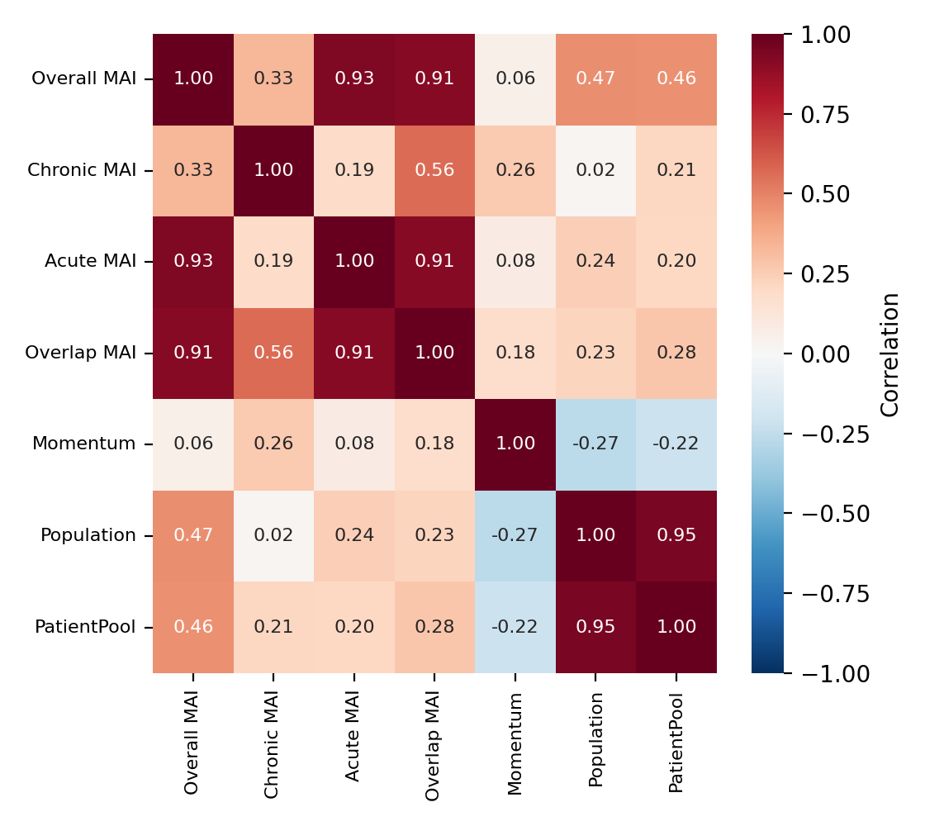
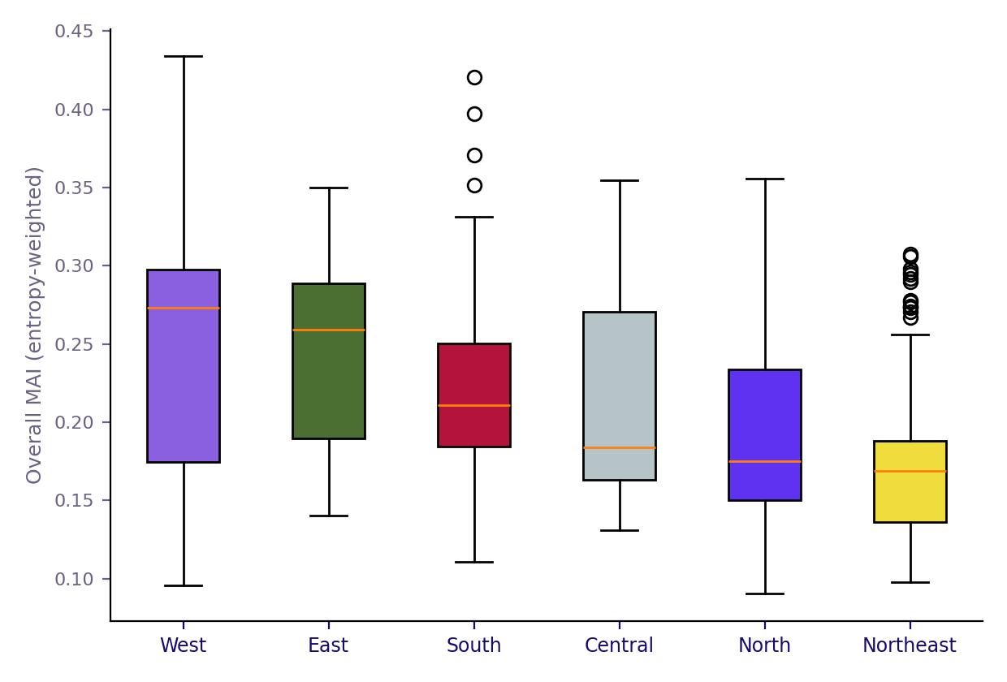
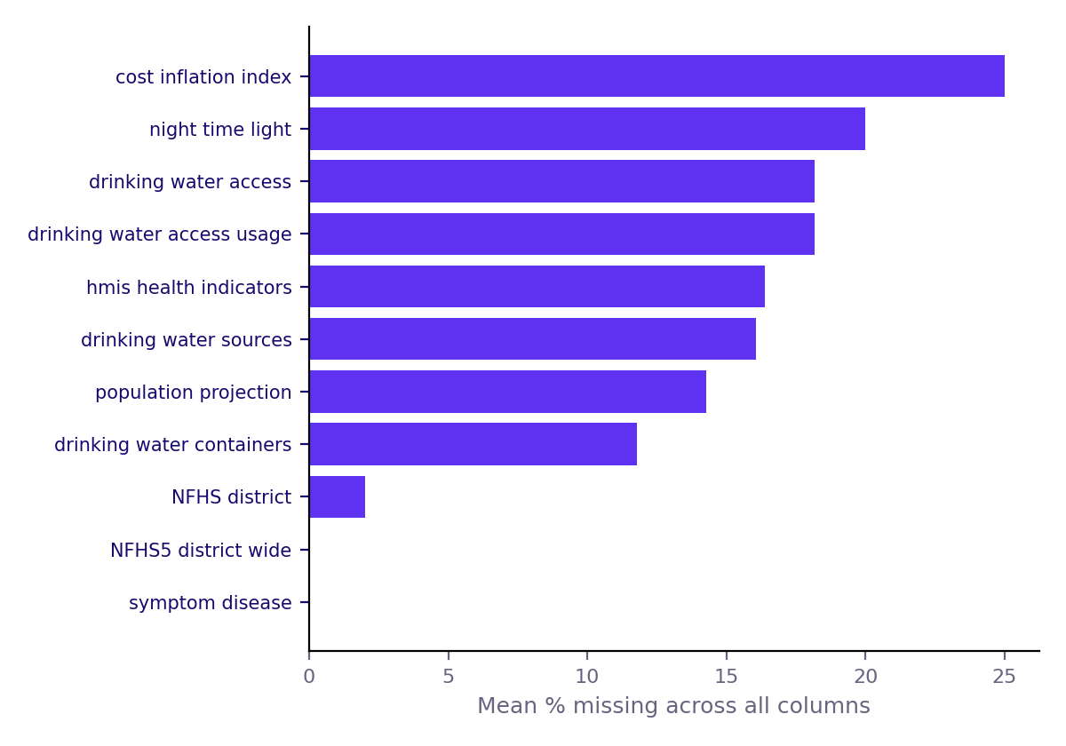
EDA III : Hypothesis Testing & Regional Variation
Hypothesis 1: Literacy and Hypertension
Correlation Among Final Indices
Overall MAI by Region (Zone)
We tested whether higher-literacy districts show lower chronic-risk-factor prevalence, expecting an inverse relationship. The actual result: literacy correlates positively with male hypertension (r = 0.351, p = 7.57×10⁻²², n = 706) — counter to a naive poverty-causes-worse-health prior. This is consistent with higher-literacy districts showing more diagnosed and reported lifestyle-linked conditions due to better healthcare access and awareness, not necessarily higher true prevalence.
Hypothesis 2: Insurance Coverage and Facility Access
We tested whether insurance coverage correlates with hospital density, expecting supply and demand-side affordability to move together. The result: no statistically significant relationship (r = -0.060, p = 0.124, n = 648) — insurance coverage is apparently driven more by state-level scheme rollout (Ayushman Bharat enrollment drives) than by local hospital supply, justifying Affordability and Access as genuinely separate, independently-weighted pillars.Zone-level analysis of the final Overall MAI shows real geographic variation: West India leads (median 0.273), followed by East (0.259), with South (0.211), Central (0.184), North (0.175), and Northeast (0.169) trailing.
Heatmap: pairwise correlation among the 7 final derived variables (Overall/Chronic/Acute/Overlap MAI, Momentum, Population, PatientPool). Values close to 1.0 on the diagonal are self-correlations; off-diagonal values show how independent our four indices actually are from one another.
Box plot: distribution of Overall MAI scores within each of India's 6 broad zones. The box shows the middle 50% of districts; the horizontal line is the median. West and East zones show both higher medians and wider spread than Northeast.
Data Source Inventory Process
Data Source Inventory Process
Dataset-Level Missingness
Catalog every
raw source file
Catalog every
raw source file
Hypothesis Testing Approach
Why Region Matters
State a testable
hypothesis first
National average
hides variation
Document description,
source, columns
Document description,
source, columns
Run correlation +
significance test
Zone-level split
reveals real gaps
Assess district-level
usability
Assess district-level
usability
Report result
even if counter-intuitive
West/East lead,
Northeast trails
Include or
exclude, disclosed
Bar chart: mean % of missing values across all columns, per source dataset. Our two core NFHS files show 0% missingness; several supplementary sources (water, population projections) show high missingness or are too coarse (India-wide only) for district-level use.
Include or
exclude, disclosed
Interpret with
domain reasoning
Justifies district-
level granularity
TRILYTICS 2026 · IIM UDAIPUR · SUN PHARMA CASE CHALLENGE
11

Slide 12
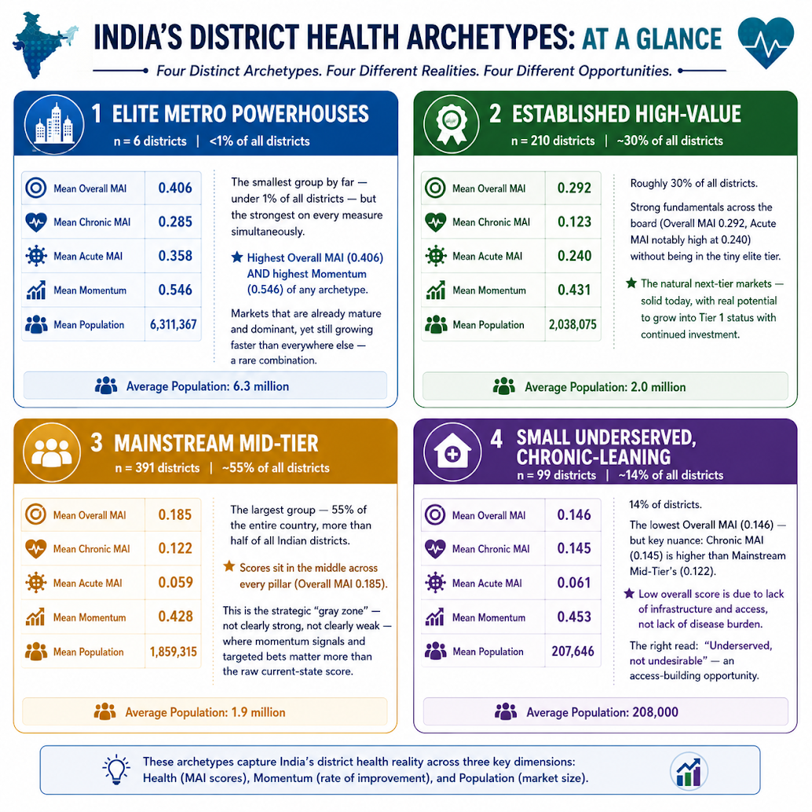
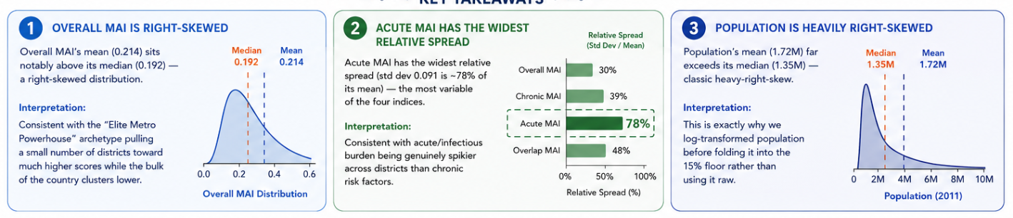
EDA IV — Understanding the District Archetypes in Detail
The four K-Means segments introduced briefly in the Executive Summary, explained fully here.
What an "Archetype" Actually Is
Each of the 706 districts was assigned to exactly one of four groups by K-Means clustering on the same 37-variable, index-consistent scoring set used for Overall MAI, so archetypes reflect the same logic as the score itself. An archetype is not a score; it is a behavioral grouping, meaning districts in the same group look statistically similar across chronic burden, acute burden, infrastructure, and momentum at once, even if individual Overall MAI values differ somewhat. K-Means (k=4, fixed to match a four-tier business framework, not statistically derived) was chosen after an unweighted version misclassified major metros like Ahmedabad.
Elite Metro Powerhouses & Established High-Value
Elite Metro Powerhouses (n=6, <1% of districts) show both the highest mean Overall MAI (0.406) and the highest mean Momentum (0.546) of any archetype — these districts are simultaneously the most mature AND still growing the fastest, an unusual combination worth noting rather than assuming metros are simply 'done growing.' Established High-Value (n=210, 30% of districts) shows strong but more moderate scores across the board — the natural pipeline for future Tier 1 promotion.
Mainstream Mid-Tier & Small Underserved
Mainstream Mid-Tier (n=391, 55% of districts — the majority of the country) shows average scores on every pillar; this is the genuine strategic ambiguity zone where momentum signals, not current-state scores alone, should drive investment decisions. Small Underserved, Chronic-Leaning (n=99, 14% of districts) shows the lowest mean Overall MAI (0.146) but a real, measurable chronic-risk profile underneath — not simply low demand.
12
TRILYTICS 2026 · IIM UDAIPUR · SUN PHARMA CASE CHALLENGE

Slide 13
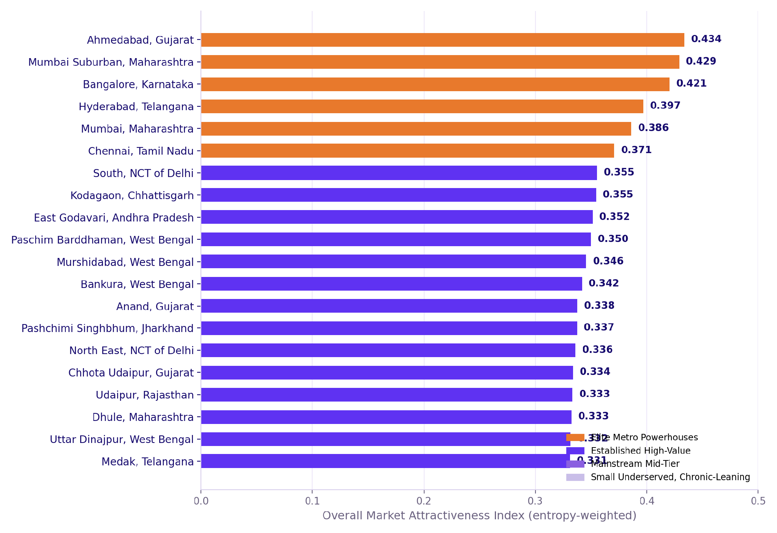
District Rankings — Overall Market Attractiveness Index
Precise figures, not just names: exactly what the Top 20 shows and why.
The Exact Numbers at the Top
Top 20 Districts
District Archetype Mix
Ahmedabad ranks #1 with an Overall MAI of 0.434 - the highest of all 706 districts. Mumbai Suburban (0.429) and Bangalore (0.421) follow closely, within 0.013 of the top score. Rank #20 (Medak, Telangana) scores 0.331, meaning the gap between rank 1 and rank 20 is just 0.103 on a 0-1 scale - the Top 20 are genuinely close together, not a single outlier followed by a steep drop-off. For scale: the median district scores 0.192, and the lowest-scoring district scores 0.090 - so the Top 20 all sit at more than 1.7x the national median.
Why Ahmedabad Specifically Leads
Breaking down Ahmedabad's 0.434 score by pillar: Chronic MAI = 0.268, Acute MAI = 0.419, and Momentum = 0.630. Its lead comes disproportionately from Acute burden and Momentum (economic growth), not primarily from Chronic risk factors. This is a specific, checkable claim, not just "Ahmedabad is a strong district" — a sales-force planner reading this knows precisely which pillar to emphasize in Ahmedabad's account strategy.
Bar chart: Overall MAI score (0.331 to 0.434) for the 20 highest-scoring districts, colored by archetype cluster (orange = Elite Metro Powerhouse). Bars are close in length, confirming a tight Top 20 rather than one dominant outlier.
Donut chart: 6 of 706 districts (<1%) fall in the Elite Metro Powerhouse archetype — an extremely small, distinct top tier, statistically separated from the rest of the country on every underlying pillar.
A Genuinely Surprising Result: Kodagaon
How Overall MAI Is Built
From Score to Action
Kodagaon (Chhattisgarh) ranks #8 nationally with a 0.355 score despite a population of only 706,599 - far smaller than the six metros above it. Its pillar breakdown (Chronic 0.204, Acute 0.334, Momentum 0.760) shows the highest Momentum score of any district in the Top 20, meaning its high rank is driven by rapid recent economic growth, not sheer market size. This is exactly the kind of district a population-only heuristic would have missed entirely.
36 normalized
pillar variables
District
Overall MAI
Entropy + judgment
weights (ρ=0.79)
Quartile →
Tier 1-4
What the Full Top 20 Shows
Beyond the six recognizable metros (Ahmedabad, Mumbai Suburban, Bangalore, Hyderabad, Mumbai, Chennai), ranks 7-20 are dominated by less-obvious districts: two NCT of Delhi zones, three West Bengal districts (Paschim Barddhaman, Murshidabad, Bankura), and Gujarat's Anand and Chhota Udaipur. None of these have their state-capital status or metro-scale population working in their favor. They rank here purely on disease burden, infrastructure, and momentum data.
+15% population
floor blend
Cluster
archetype
Overall MAI
score
Sales-force
rep allocation
TRILYTICS 2026 · IIM UDAIPUR · SUN PHARMA CASE CHALLENGE
13

Slide 14
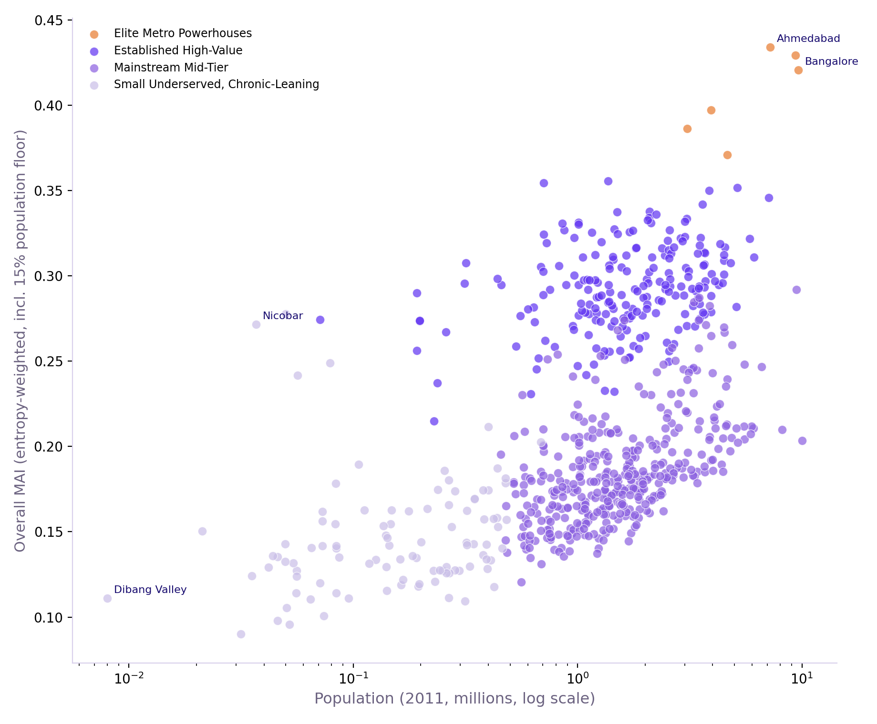
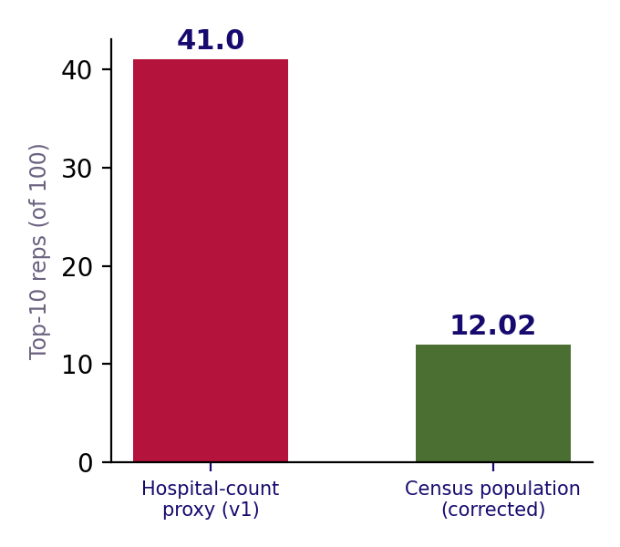
Why Population Had to Be Built Into the Index — The Exact Fix
Precise before/after figures for the single most important methodological correction in this model.
The Problem, in Exact Numbers
Population vs. Overall MAI
Rep Allocation: Before vs. After
When population was tested as a 37th entropy-weighted variable, its resulting weight was 0.05% of the total, which is statistically negligible and essentially zero influence. Left this way, Nicobar (population 36,842, smaller than 98.7% of all Indian districts) ranked #8 nationally, ahead of Chennai (population 4.65 million). Tawang (population 49,977) and South West Garo Hills (population 71,167) also appeared in the pre-fix Top 20; these three sub-100,000-population districts outranked major metros purely from statistical noise in small NFHS survey samples.
Why This Happens, The Precise Mechanism
Entropy weighting rewards variables with high statistical dispersion in their normalized values. Population is naturally smooth, with most districts clustering in a moderate range. Conversely, hospital counts and prevalence rates are naturally spiky, with many districts near zero and a few very high.Because entropy weighting mechanically favors spiky variables, small-sample NFHS estimates exacerbate the issue. A well-documented small-area-estimation effect causes smaller districts to produce inherently noisier, more extreme values on the exact variables entropy weighting rewards most.
Scatter plot (log population x-axis): after the 15% floor fix, small-population districts (left side) no longer show inflated Overall MAI scores.The relationship is now sensible, with larger districts trending toward higher scores rather than random small-district spikes.
Bar chart: Top-10 districts' combined share of a 100-rep sales-force pool, comparing the rejected hospital-count-based proxy (41.0 reps) against the corrected, Census-population-based formula (12.02 reps) which is a 3.4x reduction in over-concentration.
The Fix, With the Exact Formula
Overall_MAI = 0.85 × (36-variable entropy/judgment-weighted score) + 0.15 × (log-normalized Population_2011). This 15% floor is a disclosed manual override, not derived from any statistical test. It was chosen as a plain judgment correction to fix a data-driven method that failed a face-validity check.
Applying this override successfully corrected the bias: zero districts under 100,000 population remain in the Top 20.
Why Entropy Alone Failed
The Working Fix
Add population as
37th variable
15% population
floor applied
The Downstream Impact This Fix Had
Entropy weight
= 0.05%
Blend with 85%
base score
The same small-district-outlier problem had broken our first K-Means clustering pass (Ahmedabad was misclassified into the lowest-value archetype due to an extreme hospital-count outlier), which was fixed by re-clustering on the same effective weights the corrected index uses. It also changed our sales-force allocation dramatically: the Top-10 districts' combined rep-allocation share moved from 41.0 (out of 100, under an earlier hospital-count-based proxy) to 12.02 under the corrected, population-based formula. This represents a genuinely large, real, and traceable shift in a business recommendation caused directly by this single methodological fix.
Small districts
still dominate
Re-cluster with
same weights
Fix rejected —
not viable
Validated: 0 sub-100K
in Top 20
TRILYTICS 2026 · IIM UDAIPUR · SUN PHARMA CASE CHALLENGE
14

Slide 15
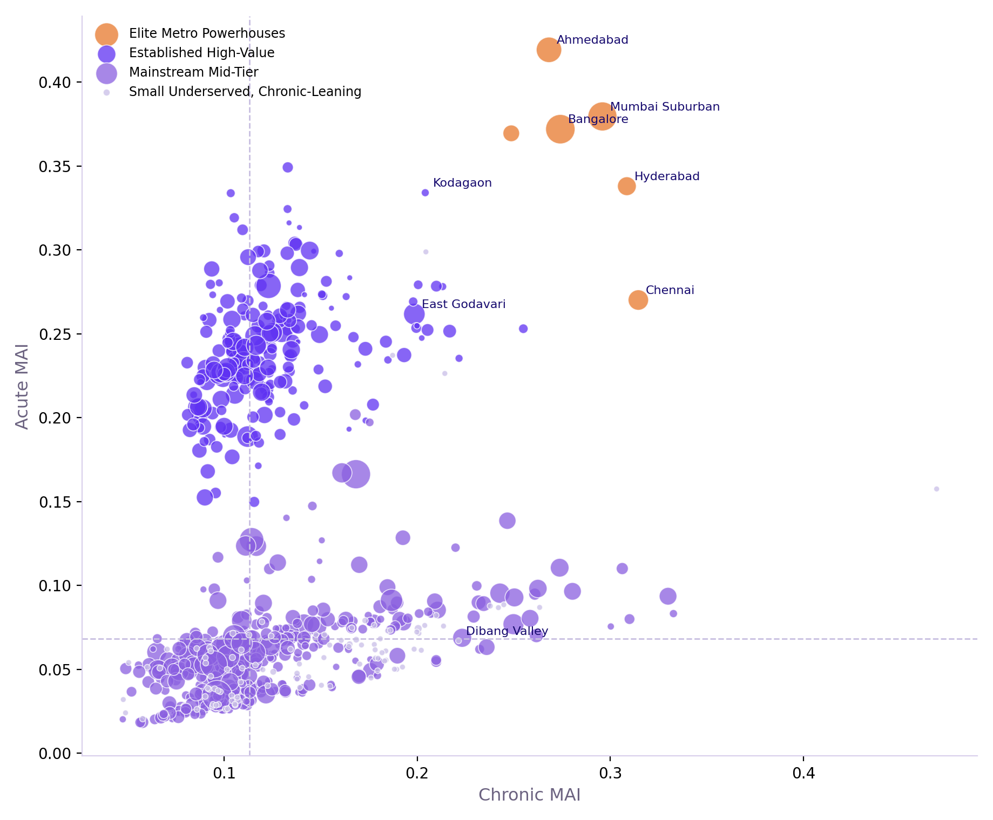
Chronic vs. Acute Segmentation & District Archetypes
Not Every District Wins the Same Way
Chronic vs. Acute Quadrant
District Archetype Mix
Districts split cleanly along both therapy dimensions, confirming Chronic and Acute MAI measure genuinely different things rather than two versions of the same score. Ahmedabad and Chennai score strong on both, making them priorities for full-portfolio sales coverage. Meanwhile, Kondagaon scores far higher on Acute (0.334) than Chronic (0.204) despite its modest population, reflecting a genuine divergence rather than a data artifact.
Four Archetypes from Weighted Clustering
K-Means clustering on the full 37-variable scoring set, using index-consistent distance weighting, produces four segments: Elite Metro Powerhouses (n=6, highest on every measure), Established High-Value (n=210), Mainstream Mid-Tier (n=391, the bulk of the country), and Small Underserved Chronic-Leaning (n=99, weaker infrastructure but a real chronic-risk profile worth an access-first strategy).
Scatter plot: each dot is a district, x-axis = Chronic MAI, y-axis = Acute MAI, colored by archetype, sized by population. Districts in the top-right (both axes high) are full-portfolio priorities; bottom-left districts need an access-building approach, not deprioritization.
Donut chart: Mainstream Mid-Tier is the largest archetype at 55% of all districts (391 of 706); Small Underserved Chronic-Leaning is 14% (99 districts) — a meaningful, not marginal, segment of the country.
Therapy-Specific Re-weighting Logic
Chronic MAI Re-weighting
Acute MAI Re-weighting
Chronic MAI triples weights for chronic risk factors, insurance coverage, and Momentum, while scaling acute variables down to 0.3x. Acute MAI does the opposite by prioritizing acute prevalence and hospital access, while scaling down Momentum. Both indices re-normalize from the same 36-variable entropy base to maintain complete methodological consistency.
Base 36-variable
entropy score
Base 36-variable
entropy score
×3 Chronic pillar
+ insurance + momentum
×3 Acute pillar
+ hospital access
What This Means for Deployment
Districts in the bottom-left quadrant (weak on both Chronic and Acute today) are not low-priority. Our Small Underserved archetype analysis reveals strong underlying chronic-risk profiles that surface as access improves. For this segment, investing in access, rather than deprioritizing, is the right strategy.
×0.3 Acute
pillar
×0.3
Momentum
Renormalize →
Chronic MAI
Renormalize →
Acute MAI
TRILYTICS 2026 · IIM UDAIPUR · SUN PHARMA CASE CHALLENGE
15

Slide 16
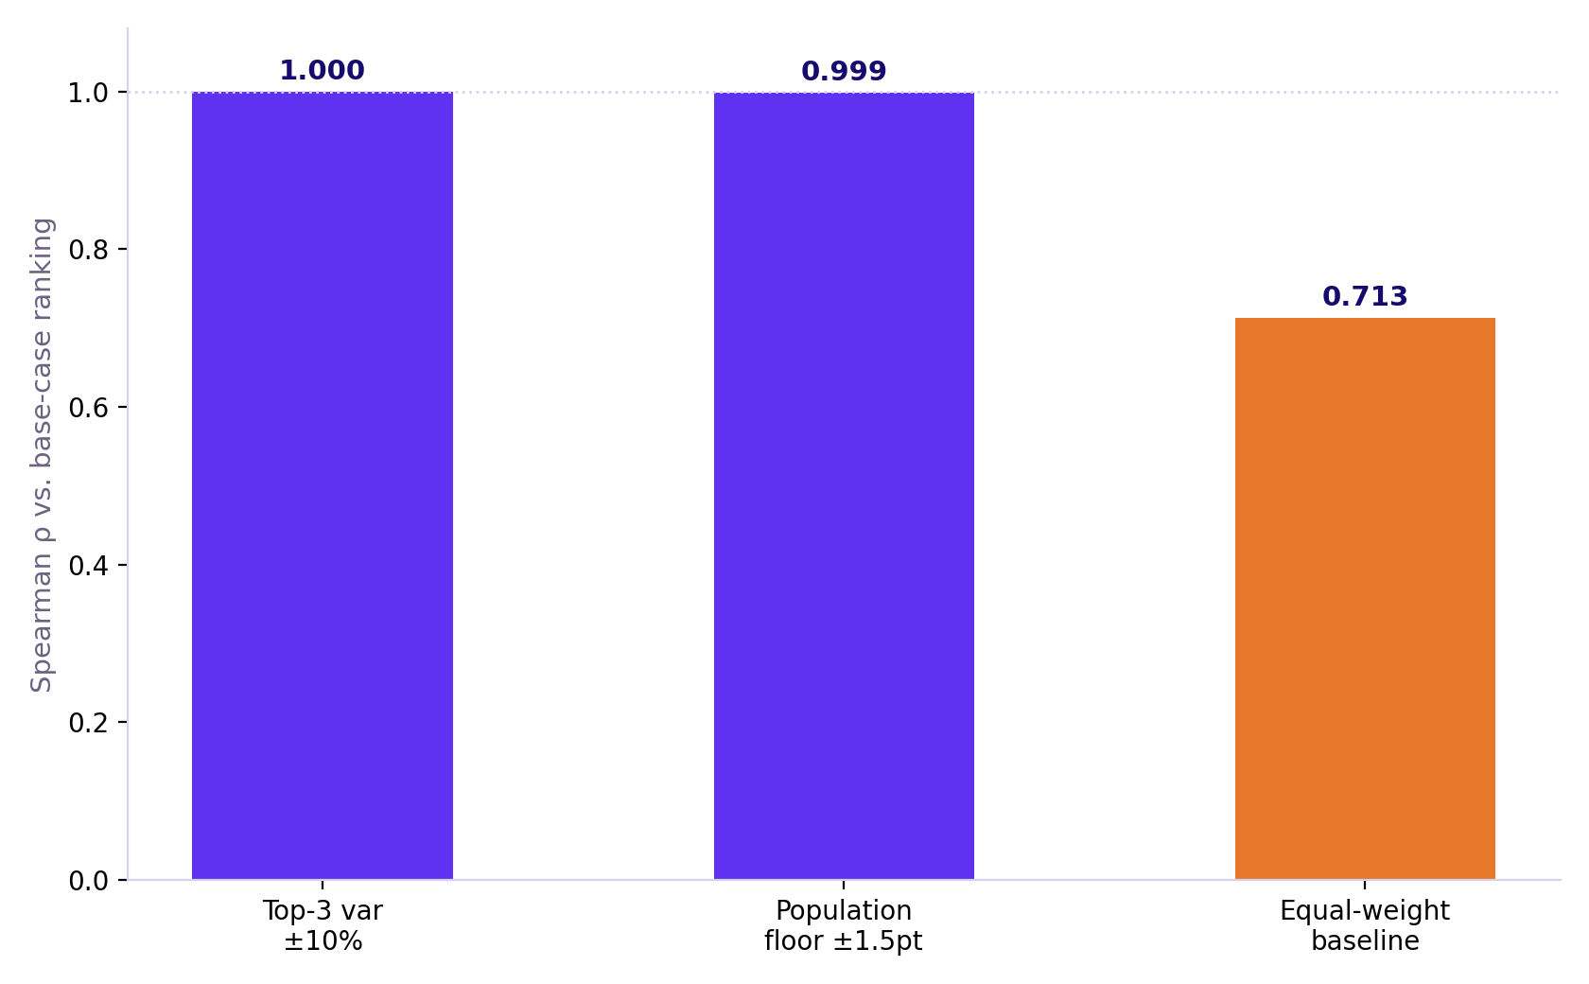
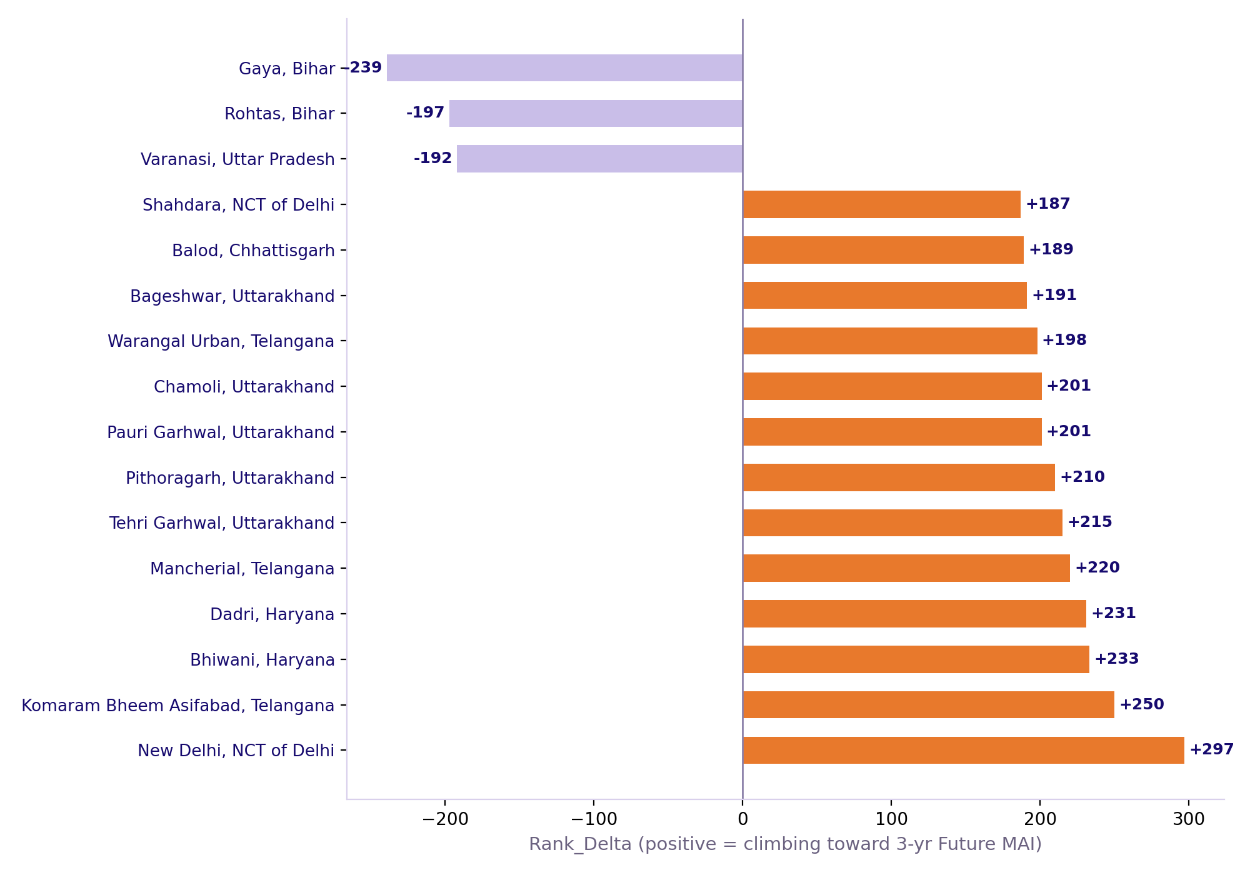
Is the Index Trustworthy? Validation & Momentum
Sensitivity Testing
Sensitivity & Entropy Weights
Rising Stars (Rank Delta)
Weight perturbations of ±10% on the top-3 entropy-weighted variables, and ±1.5 points on the 15% population floor itself, leave the district ranking almost completely untouched — Spearman ρ ≥ 0.999 throughout. This confirms the ranking is not fragile to small, reasonable changes in methodology.
Cross-Method Agreement
Entropy-weighted and judgment-weighted Overall MAI show strong agreement (ρ = 0.794), whereas an equal-weight baseline diverges significantly (ρ= 0.713). Together, these results confirm entropy weighting provides genuine analytical value rather than mirroring a flat average or serving as an arbitrary choice.
Left: Spearman ρ between the base ranking and each perturbation test (all ≥ 0.999). Right: entropy weight of the top-10 individual variables driving Overall MAI — hospital-count variables carry the single highest weights.
Bar chart: districts with the largest positive Rank_Delta (climbing toward their projected 3-year Future MAI) versus the largest negative Rank_Delta (fading). Positive bars indicate the strongest forward-looking investment candidates.
Momentum: A Clean, Uncontaminated Signal
Robustness Test Sequence
Momentum Construction
Unlike Overall MAI, our Momentum Index and Rising Stars ranking showed zero small-district population artifacts from the start. Because Momentum relies on state-level GDP CAGR (an economic aggregate) rather than district-level survey percentages, it was never vulnerable to small-sample statistical noise.
±10% top-3
weight perturbation
State GDP
CAGR (real data)
±1.5pt population
floor perturbation
+ trend-capable
NFHS4→5 change only
What Rising Stars Means for Deployment
Districts climbing fastest toward their 3-year Future MAI offer a prime first-mover window for sales-force investment. This projection relies exclusively on real GDP growth and NFHS4-to-NFHS5 changes across 12 valid trend-capable indicators, entirely excluding the 20 single-timepoint indicators that lack historical trend data.
Equal-weight
baseline (ρ=0.71)
Blend into
Future MAI (+3yr)
All tests
ρ≥0.999 or 0.71+
Rank_Delta =
rising/fading signal
TRILYTICS 2026 · IIM UDAIPUR · SUN PHARMA CASE CHALLENGE
16

Slide 17
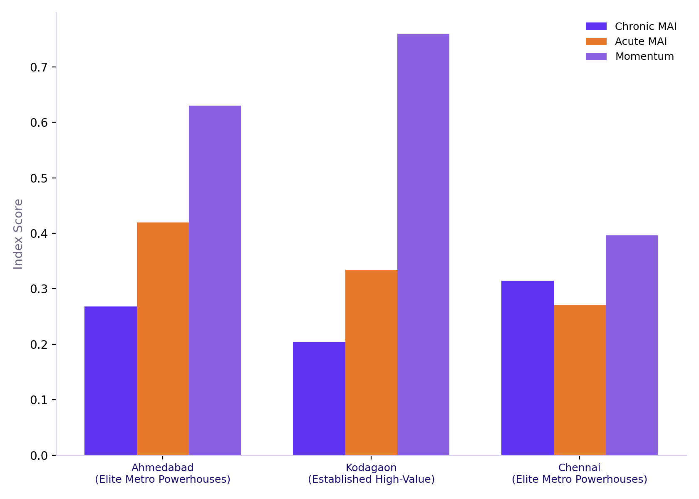
From Score to Action — Explainability & Deployment
Why Explainability Matters
Pillar Contribution by District
District Tier Distribution
Three exemplar districts yield identical headline scores through vastly different dynamics. Ahmedabad leads on Chronic strength and infrastructure, Kondagaon relies on Acute burden and Momentum, and Chennai balances both. Same tier, three distinct stories. Understanding these underlying drivers transforms a basic ranking into an actionable sales-force brief.
District Tiering
Districts split into four tiers by Overall MAI quartile: Tier 1 (≥0.274, 177 districts) gets full sales-force strength and priority for new launches; Tier 2 gets standard growth-linked coverage; Tier 3 receives lean, therapy-specific coverage. Tier 4 (177 districts) uses an access-building partnership model instead of standard deployment. It isn't deprioritized, it simply demands an entirely different go-to-market approach.
Stacked bar chart: Chronic, Acute, and Momentum scores for three exemplar districts (Ahmedabad, Kodagaon, Chennai) — shows visually how the same headline Overall MAI can be composed very differently underneath.
Bar chart: 177/176/176/177 districts per tier — confirms the four-tier quartile split is evenly balanced across the full 706-district universe.
The Sales-Force Allocation Formula
Score to Tier Decision
Sales-Force Formula
Reps(d) = TotalPool × [PatientPool(d) × MAI(d)] / Σ[PatientPool(i) × MAI(i)]
PatientPool uses 2011 Census population data scaled by district chronic and acute prevalence rates. Hospital counts are omitted to prevent over-allocating reps to facility-dense metropolitan areas.
Overall MAI
quartile rank
PatientPool =
Pop × Prevalence
Tier 1-4
assignment
× District
MAI score
The Result, and Why It Matters
The top 10 districts receive 12.02 reps out of a 100-rep pool under the population-based formula. This is significantly more balanced than the 41.0 reps allocated under the hospital-count model, which over-concentrated resources in saturated metro markets and completely overlooked large, facility-sparse districts like East Godavari and Murshidabad.
Deployment
intensity set
÷ Sum across
all 706 districts
Reviewed
quarterly
× Total rep
pool (100)
TRILYTICS 2026 · IIM UDAIPUR · SUN PHARMA CASE CHALLENGE
17

Slide 18
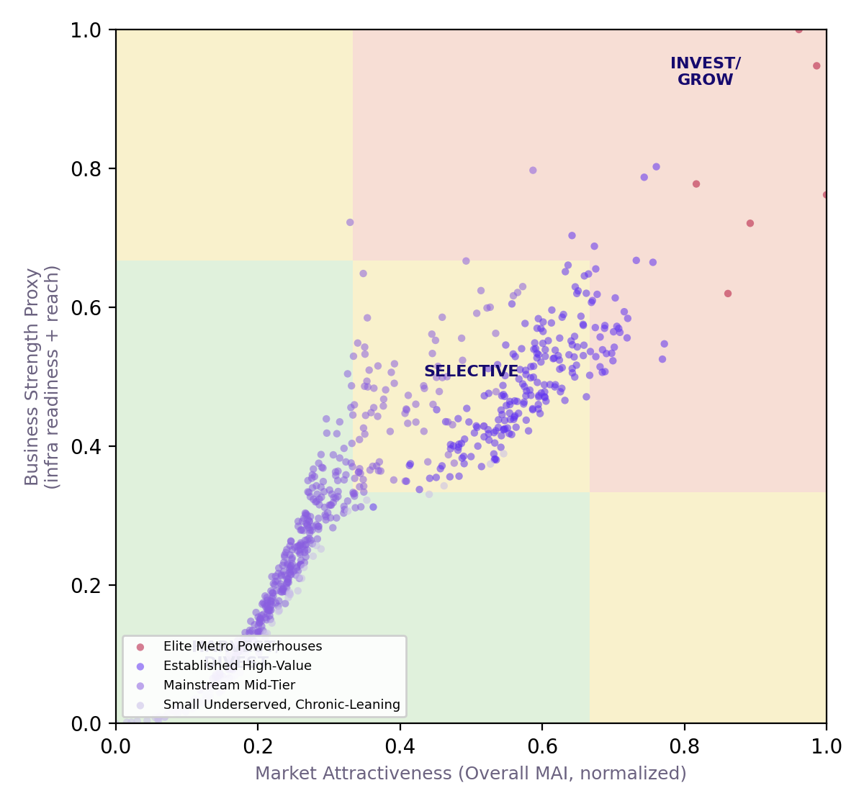
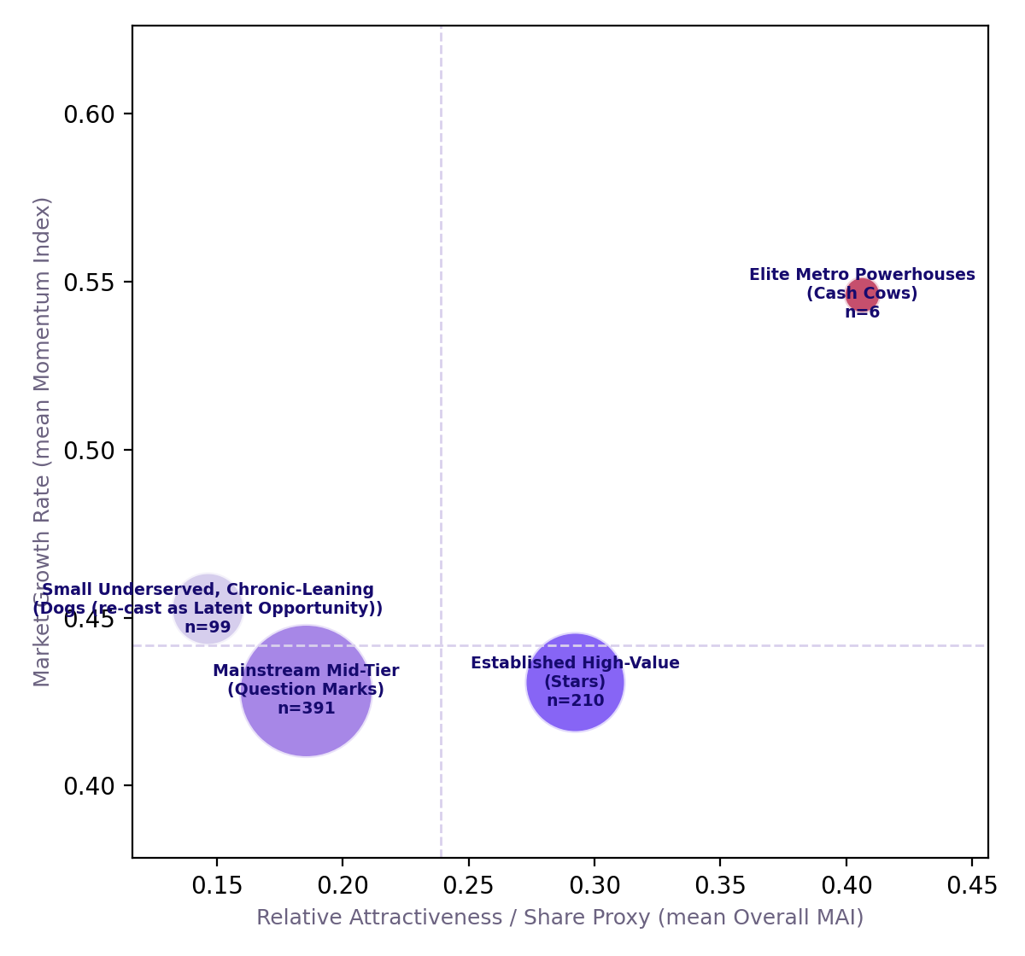
GE-McKinsey Nine-Box & BCG Growth-Share Matrix
Two classic strategy frameworks, populated with your actual model data — not described abstractly.
Why These Frameworks, Applied to Real Data
GE-McKinsey Nine-Box (706 Districts)
BCG Growth-Share (by Archetype)
The term "Market Attractiveness" originates from the GE-McKinsey Nine-Box Matrix, which contrasts market attractiveness against business strength. All 706 districts are plotted directly with Overall MAI on the x-axis and a business strength proxy on the y-axis, using infrastructure readiness and patient-pool reach to substitute for unavailable competitor market-share data.
Reading the Nine-Box Result
The top-right "Invest/Grow" zone features Elite Metro Powerhouse and Established High-Value districts, independently validating the Tier 1–2 deployment logic through a separate framework. The bottom-left "Harvest/Divest" zone contains Small Underserved districts. Rather than divesting as the generic framework suggests, the strategy intentionally adopts an access-building approach, allowing business judgment to override standard defaults.
Scatter plot on a 3x3 shaded grid: x-axis = Market Attractiveness (Overall MAI, normalized), y-axis = Business Strength proxy. Each dot is one district, colored by archetype. Top-right (green) = invest zone; bottom-left (also shaded) = harvest zone.
Bubble chart: x-axis = mean Overall MAI (share proxy), y-axis = mean Momentum (real growth rate), bubble size = number of districts in that archetype. Dashed lines mark the median split into four BCG quadrants.
BCG Growth-Share Matrix — A Natural Fit
Reading the GE-McKinsey Zones
BCG Strategic Actions
Our Momentum Index is already a genuine growth-rate metric, making BCG a direct, non-forced application: mean Momentum (growth) against mean Overall MAI (value proxy) per archetype. Established High-Value districts (n=210, mean Momentum 0.431) land as Stars; Elite Metro Powerhouses (n=6, mean Momentum 0.546, the highest of any archetype) as Cash Cows that form the mature core to defend.
High attract. +
high strength = Invest
Stars: sustain
investment
Mixed scores =
Selective growth
Cash Cows: defend,
harvest cash
Where We Deliberately Reframe the Classic Model
Mainstream Mid-Tier (n=391, the largest group) sits as a genuine Question Mark. Small Underserved districts, classically labeled 'Dogs' for divestment, we explicitly re-cast as Latent Opportunity: their low current share reflects access gaps rather than low demand. National disease-burden data (101 million diabetics) confirms substantial addressable need beneath current low volumes.
Low attract. +
low strength = Harvest
Question Marks:
selective bets
Cross-checked
against our Tiers
Latent Opportunity:
access-build, don't exit
TRILYTICS 2026 · IIM UDAIPUR · SUN PHARMA CASE CHALLENGE
18

Slide 19
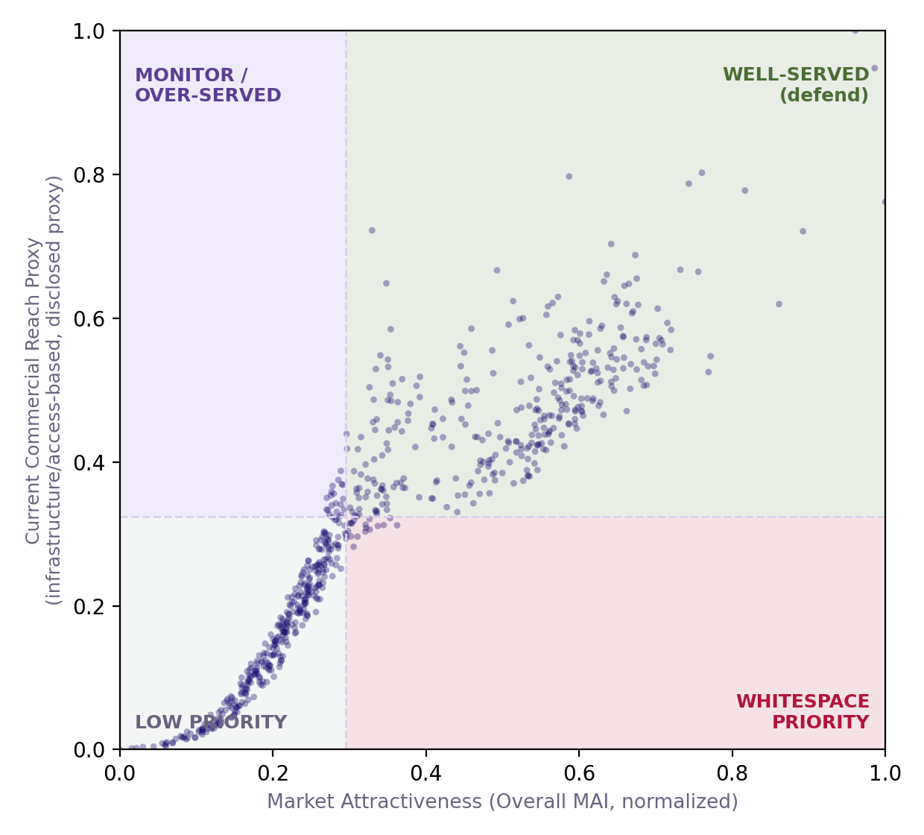
WHITESPACE ANALYSIS
Where Is the Market Big vs. Where Are We Under-Indexed?
The single most important addition an internal Sun Pharma reviewer would demand: MAI alone can't tell "big and won" from "big and open."
The Gap This Slide Closes
Whitespace Quadrant (706 Districts)
Building the Whitespace Lens
Overall MAI tells you where the market is attractive, it does not tell you where Sun Pharma specifically is under-indexed relative to that opportunity. Two districts can share an identical MAI, but if we already hold 80% share in one and 10% in the other, the marginal ROI of an additional rep is completely different. Without real prescriber/sales share data (not publicly available), we cannot fully close this gap — but we can build a disclosed, honest proxy rather than leave it unaddressed.
Overall MAI
(market attractiveness)
+ disclosed Reach
proxy (2nd axis)
Our Disclosed Proxy — What It Is and Isn't
High MAI + Low
Reach = Whitespace
We plot Overall MAI against a Current Commercial Reach proxy (infrastructure/access-based, the same construction used for GE-McKinsey's Business Strength axis). This is explicitly NOT real market share — it is a reasonable stand-in using existing infrastructure and patient-pool-reach data. High-MAI, low-reach districts are flagged as Whitespace Priority: places the market data says are attractive, but our access/infrastructure footprint there is comparatively thin.
Scatter plot: x-axis = Overall MAI (normalized), y-axis = disclosed Current Reach proxy. Top-right = well-served, defend; bottom-right (shaded) = Whitespace Priority — high attractiveness, low current reach.
19 districts
flagged, named
What the Result Shows
What To Do With This
Four Whitespace Zones
19 districts land in the Whitespace Priority quadrant — high market attractiveness, low current reach — including Dhubri and Dhemaji (Assam), Aizawl (Mizoram), Solan and Una (Himachal Pradesh), and several Telangana districts (Wanaparthy, Jangoan, Jogulamba Gadwal). None of these are the metros dominating the Top 20 ranking exactly the kind of district a pure attractiveness ranking surfaces but a reach-blind sales plan would miss.
Whitespace districts →
net-new headcount case
MONITOR/OVER-SERVED
Low MAI, high reach — don't over-invest
WELL-SERVED
High MAI, high reach — defend position
Well-served districts →
defend, don't over-invest
The Honest Limitation
Because our reach proxy is partly built from the same infrastructure/access inputs that feed Overall MAI itself, this quadrant split is not fully independent — the same caveat disclosed on the GE-McKinsey slide applies here. The real fix is overlaying Sun Pharma's own prescriber/sales data once available; until then, this proxy converts an unaddressed gap into a disclosed, directionally-useful starting point rather than leaving "where are we under-indexed" unanswered entirely.
Overlay real prescriber
data when available
LOW PRIORITY
Low MAI, low reach — deprioritize
WHITESPACE PRIORITY
High MAI, low reach — expand here
Refine proxy each
quarterly refresh
TRILYTICS 2026 · IIM UDAIPUR · SUN PHARMA CASE CHALLENGE
19

Slide 20
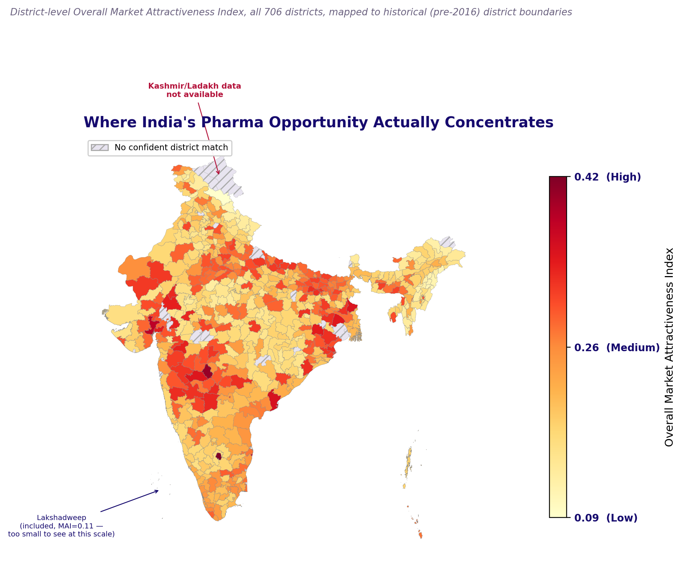
Where India's Pharma Opportunity Actually Concentrates
A district-level view of Overall Market Attractiveness across all of India — read the legend carefully before drawing conclusions.
How to Read This Map
Kashmir/Ladakh: district scores exist in our full results table, but reliable boundary geometry for this region isn't available in the open-source map data we used — a known limitation of publicly available India boundary files for this specific area
Darker red indicates higher Overall Market Attractiveness, while lighter yellow denotes lower attractiveness, as shown by the HIGH, MEDIUM, and LOW bands next to the color bar.
Scores are population-weighted where multiple modern districts share a single legacy boundary prior to 2016, such as Telangana's post-split districts aggregating onto undivided Andhra Pradesh boundaries.
Hatched grey regions represent a disclosed mapping gap affecting roughly 4.2 percent of legacy boundaries rather than a true zero score, with complete underlying district data available in the results table.
Kashmir and Ladakh data is unavailable because they were established as separate union territories in 2019, postdating the boundary, GDP, and Census data sources.
Lakshadweep is included with a real score of 0.11, but called out separately because its islands are too small to visualize at the full India scale.
How This Map Was Built
706 district scores +
legacy boundary geometry
State-gated fuzzy
name crosswalk
Population-weighted
average per boundary
Rendered choropleth,
gaps disclosed
TRILYTICS 2026 · IIM UDAIPUR · SUN PHARMA CASE CHALLENGE
19

Slide 21
Roadmap, Limitations & Recommendations
Known Limitations, Disclosed in Full
Limitations at a Glance
District Tier Distribution
58 districts (8.2%) have no hospital-directory crosswalk match and are mean-imputed for Access-pillar variables. 118 districts (16.7%) have apportioned, not directly measured, population. Ladakh is entirely absent from GDP, HMIS, and Census sources. The 15% population floor is a disclosed manual override, not a data-derived constant and K-Means clustering uses index-derived weights, so it should be read as a segmentation of the index, not an independent unsupervised finding.
8.2% DISTRICTS
Mean-imputed hospital-count data
16.7% DISTRICTS
Apportioned population, not measured
Replicability & Scalability
POPULATION FLOOR
Disclosed judgment override
CLUSTERING
Weighted to match index, not independent
The same normalize-weight-aggregate pipeline scales from our verified panel to the full 700+ district universe with no methodology change, only a larger merged dataset. A new therapy-specific index requires only redefining the manual re-weighting vector. District scores roll up cleanly to state-level, population-weighted views for board-level reporting.
Bar chart shown again here as a reference point: the tiering system this roadmap builds on is evenly balanced across all 706 districts (177/176/176/177 per tier).
Recommended Next Steps
Path to Full Scale
What We'd Add Next
Source real district-level doctor/bed-density data (Rural Health Statistics) to replace the current hospital-count-only Access proxy. Acquire the full NNMS microdata with geographic identifiers. Formally request PMJAY claims-utilisation data at district level to sharpen the Affordability pillar beyond enrollment counts alone.
706-district
verified pilot
Rural Health
Statistics (doctors)
Source remaining
real data gaps
Full NNMS survey
(geo-tagged)
Closing
This submission prioritizes transparent, defensible reasoning over black-box sophistication. Every weight, every judgment call, and every bug we found and fixed is disclosed rather than hidden — because in a market where competitors can replicate any published methodology, the trust a rigorous, honest analysis earns is the actual differentiator.
Full 700+
district run
PMJAY claims
data (district)
Quarterly
index refresh
Competitor therapy-
area presence
TRILYTICS 2026 · IIM UDAIPUR · SUN PHARMA CASE CHALLENGE
20

Slide 22
SUPPLEMENTARY MATERIAL
Bonus: Interactive District-Level Dashboard
Included as an additional supporting file alongside this presentation — a live, explorable companion to the static charts in this deck.
What This Is
Dashboard Features
How to Open It
A single, self-contained HTML file (Trilytics_Interactive_Dashboard.html) built from the exact same verified, final scored dataset used throughout this presentation — all 706 districts, every pillar score, cluster, tier, and rank. It requires no installation, no internet connection, and no additional software: any evaluator can simply double-click the file and it opens directly in a web browser.
LIVE FILTERS
State, Archetype, Tier, district search
SORTABLE TABLE
All 706 districts, every scored column
Locate
Trilytics_Interactive_Dashboard.html
Double-click
(no install needed)
INTERACTIVE CHARTS
Top-20 ranking + Chronic-vs-Acute scatter
DISTRICT DRILL-DOWN
Click any district for full pillar breakdown
Opens in any
web browser
What It Lets You Do
Filter all 706 districts live by State, Archetype, or Tier, or search by district name. Sort the full results table by any column with a single click. Explore an interactive Top-20 ranking chart and a Chronic-vs-Acute scatter plot, both of which redraw instantly based on your filters. Click on any district, in the table or directly on the scatter plot, to open a full pillar-by-pillar breakdown: Chronic, Acute, Overlap, and Momentum scores, current and 3-year future rank, and sales-force rep allocation.
No internet
connection required
Built From Real Data
Same final_district_
mai_scores.csv
Why We Built This
A static deck can only show a handful of pre-selected views of a 706-district model. This dashboard lets an evaluator ask their own questions of the real data directly — for example, filtering to just their own state, or comparing two specific districts side by side — without needing to open a spreadsheet or run any code themselves.
All 706 districts,
no placeholders
Zero external
dependencies
Fully offline-
capable
TRILYTICS 2026 · IIM UDAIPUR · SUN PHARMA CASE CHALLENGE
1

