Slide 1

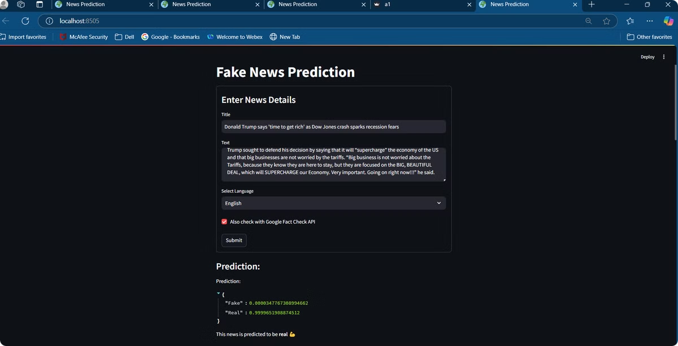
FakeShield: Real-Time Fake News Detection Tool
"An AI-powered truth detective that reads, reasons, and reveals the reality behind the headlines."
Welcome to the Future of Fake News Detection
Meet FakeShield—a powerful tool built to combat misinformation. In this presentation, we’ll explore the FakeShield core features and technical strengths.
Team Name: ch.manasa_d09b
Hackathon: Truth Tell Hackathon

Slide 2
Meet the Maker : Behind FakeShield
"I'm a passionate individual who loves solving real-world problems using innovative AI solutions. I thrive in collaborative environments, driven by curiosity and a desire to build tools that create meaningful impact"
Team Members
Manasa Gangotri [Final year graduate of UCEOU]

Slide 3

Problem Statement
Fake news spreads faster than true news on social media.
In an era dominated by rapid information exchange, misinformation threatens public opinion, trust, and safety.
Manual fact-checking is time-consuming and can't scale with the volume of digital content.
Introducing FakeShield
An AI-powered truth detective that reads, reasons, and reveals the reality behind the headlines.
Fake Shield is built to handle what manual efforts can’t — bringing speed, accuracy, and smart solutions to fight misinformation.

Slide 4

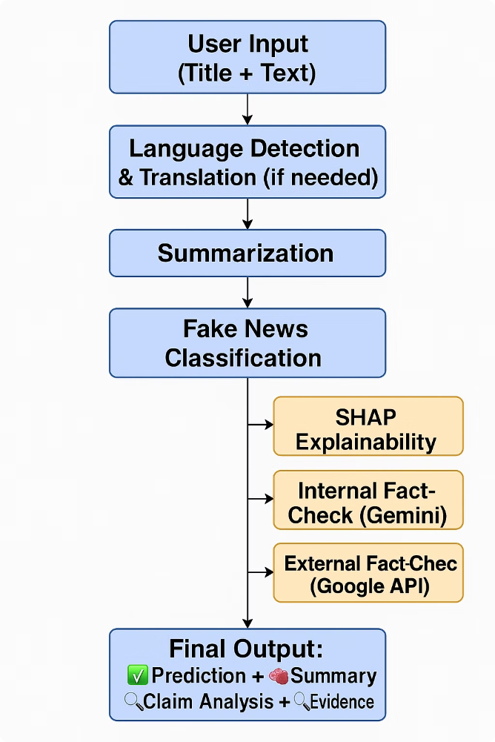
Our Solution – Fake News Detection Assistant
What It Does:
An AI-powered assistant that:
Detects whether a news article is real or fake.
Summarizes long news content into digestible points.
Fact-checks key claims using Google Fact Check API and Gemini API.

Slide 5
What Makes It Innovative:
Multi-layered verification: Combines ML prediction, summarization, and cross-verification for robust accuracy.
Language-agnostic input: Translates any language to English using Google Translate API before processing.
AI-generated fact-check queries: Uses Gemini API to extract precise, verifiable queries automatically.
Explainability: Integrates SHAP to interpret model predictions and show which parts influenced the decision.
Novel Integrations:
Gemini API + Google Fact Check: Dual-layer verification with LLM and official sources
SHAP: Rare in fake news apps—offers transparency in model decisions
Auto Query Generation: Gemini extracts concise, high-precision fact-checkable queries

Slide 6
Key Technologies:
Technology
Purpose
🤖 RoBERTa Pretrained Model
Fake news classification
📄 BART Summarizer
Summarization of long text
🌐 Gemini API
Claim extraction & internal fact-checking
🔍 Google Fact Check API
External claim verification
🧠 SHAP
Model interpretability
🌎 Deep Translator
Translation for multilingual inputs
🧱 Streamlit
User-friendly web interface
Dataset Used : "​fake-and-real-news-dataset​" from Kaggle.

Slide 7
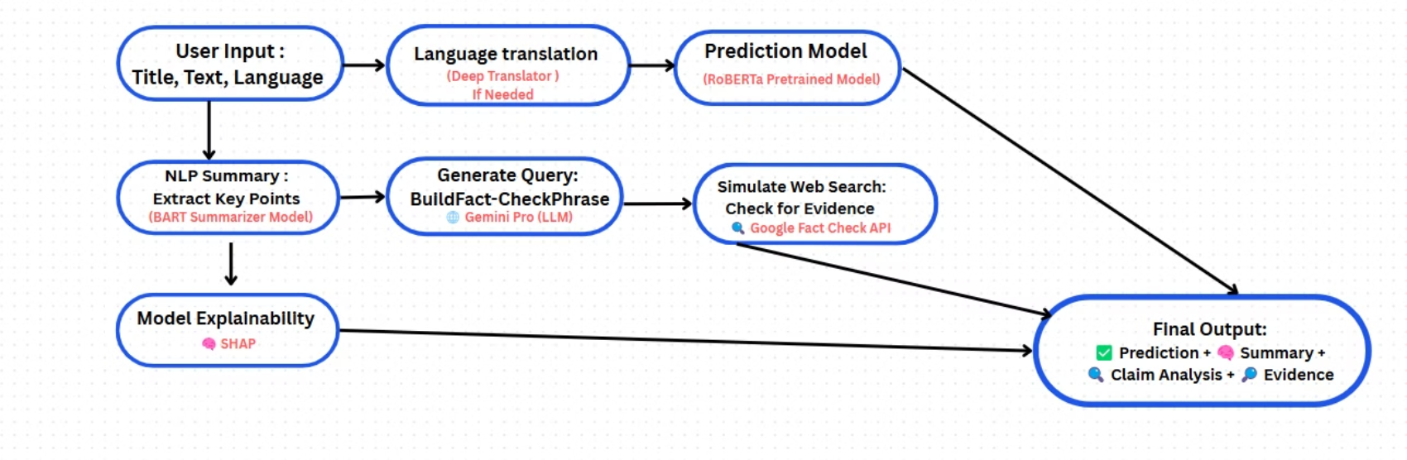
System Architecture

Slide 8
DEMO:

Slide 9
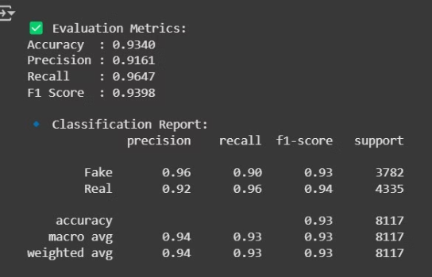
System Latency Metrics
Component
Latency
Prediction
1.45 seconds
Summarization
8.91 seconds
Optimized Query Generation
1.98 seconds
Google Fact Check API
0.61 seconds
Gemini Fact Check Process
3.04 seconds
Model – Evaluation Metrics

Slide 10

Integration into Existing Broadcast Workflows
Our solution is designed to seamlessly plug into existing digital journalism and broadcast environments. Here's how it can be integrated:
API Integration: The app can be deployed as an internal tool or integrated via APIs to allow newsrooms to automatically vet stories before publication or broadcasting.
CMS Plugin: A plugin can be built for popular CMS platforms (like WordPress, Drupal) to auto-analyze submitted articles.
Editor Dashboard: Journalists and editors can input story drafts to get real-time validation, summaries, and evidence reports—enabling quick editorial decisions.
Live Fact-Checking: While a live debate or news event is happening, our app listens to what's being said. The Gemini model quickly picks out important claims, and the app checks in the background to see if those claims are true or false — all in real time.

Slide 11

Future Enhancements
Future developments will focus on enhancing the tool's capabilities, including expanding language support, integrating with social media platforms, and developing personalized learning modules to educate users about fake news identification
Apache Kafka Integration
Real-time streaming support for handling live news feeds and broadcasts.
Cross-Media Detection
Identify misinformation in text, images (memes), and video subtitles.
Multilingual Support Expansion
Enhance detection in regional and low-resource languages.

Slide 12
FakeShield – Roadmap for Scaling & Improvement
Phase 1: System Enhancement
Multilingual news detection (regional & global languages)
Larger, diverse datasets from global fact-checking bodies
Enhanced model accuracy with fine-tuned transformers & ensembles
Natural-language explanations (Explainable AI)
Phase 2: Real-Time Integration
Apache Kafka & Spark Streaming for real-time processing
CMS & newsroom integration for live TV/radio verification
Voice-to-Text pipelines for verifying spoken news in live broadcasts
Phase 3: Scale & Deployment
Cloud-based deployment (AWS/GCP) with autoscaling
REST API access + browser extensions & mobile app
Multi-organization access (newsrooms, agencies, social platforms)
Phase 4: Advanced Capabilities
Deepfake & image/video misinformation detection
Blockchain-based audit trail for verified claims
AI-powered misinformation trend analysis & heatmaps
Adaptive learning from user feedback to reduce false positives

Slide 13
Thank You!!
"Empowering media, protecting truth."
~Presented by: Manasa Gangotri

