Slide 1
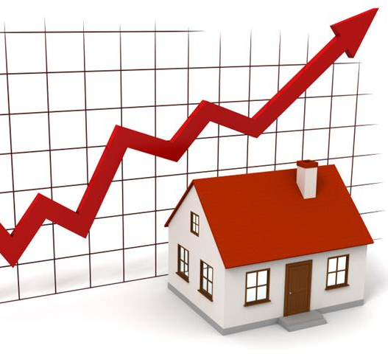
Hou$e Price$
A MACHINE LEARNING PROJECT
Gradient De$cendant$

Slide 2
Agenda
Project aims at predicting house prices (residential) in Ames, Iowa, USA based on data set provided by Kaggle between 2006 and 2010.
Data Exploration
Data Cleaning
Feature Engineering
Model Training
Model Evaluation

Slide 3


Slide 4
Data Exploration

Slide 5
What factors do we believe to influence house prices?
The dataset contains 1460 observations in the training set and 1459 observations in the test set.
There are 46 categorical variables including 23 nominal and 23 ordinal ones, and 33 numeric variables in the dataset.
The training set has the sale price as response while the test set doesn’t.

Slide 6
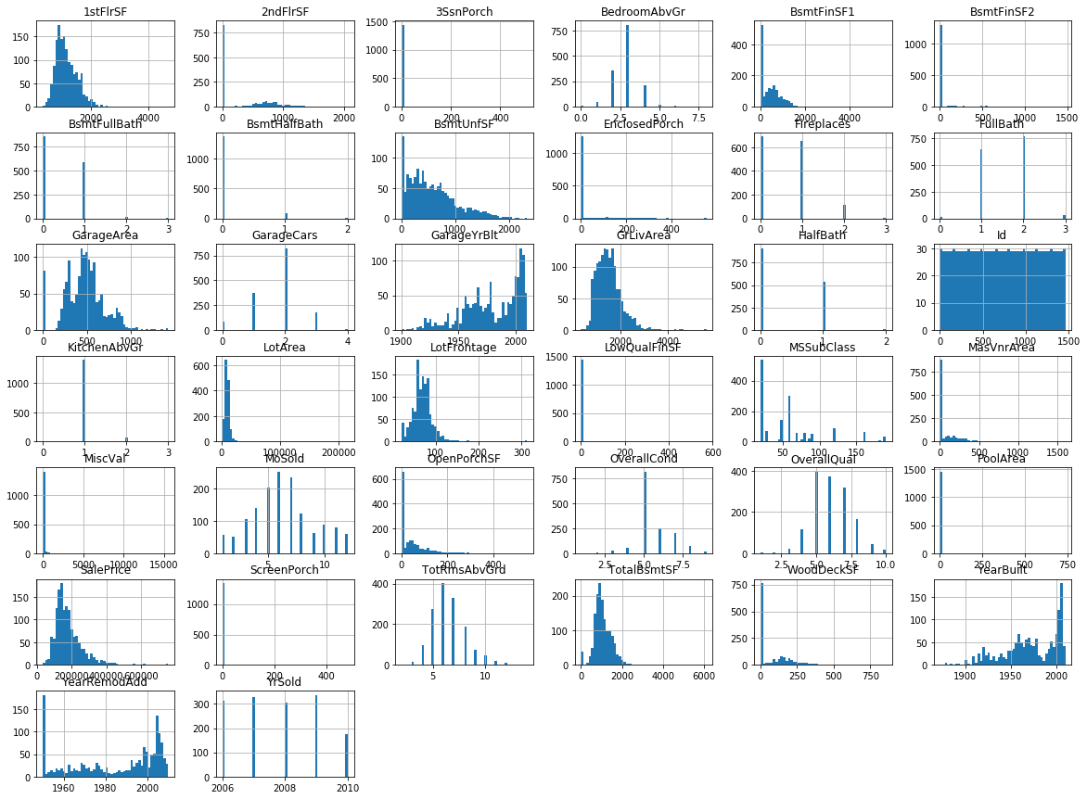
Univariate Analysis

Slide 7
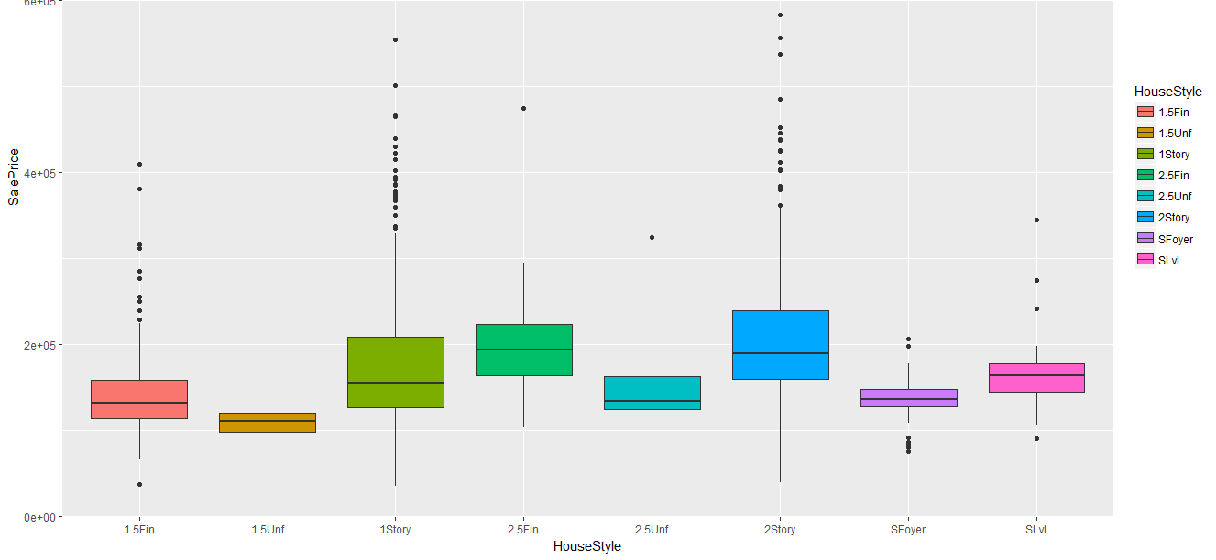
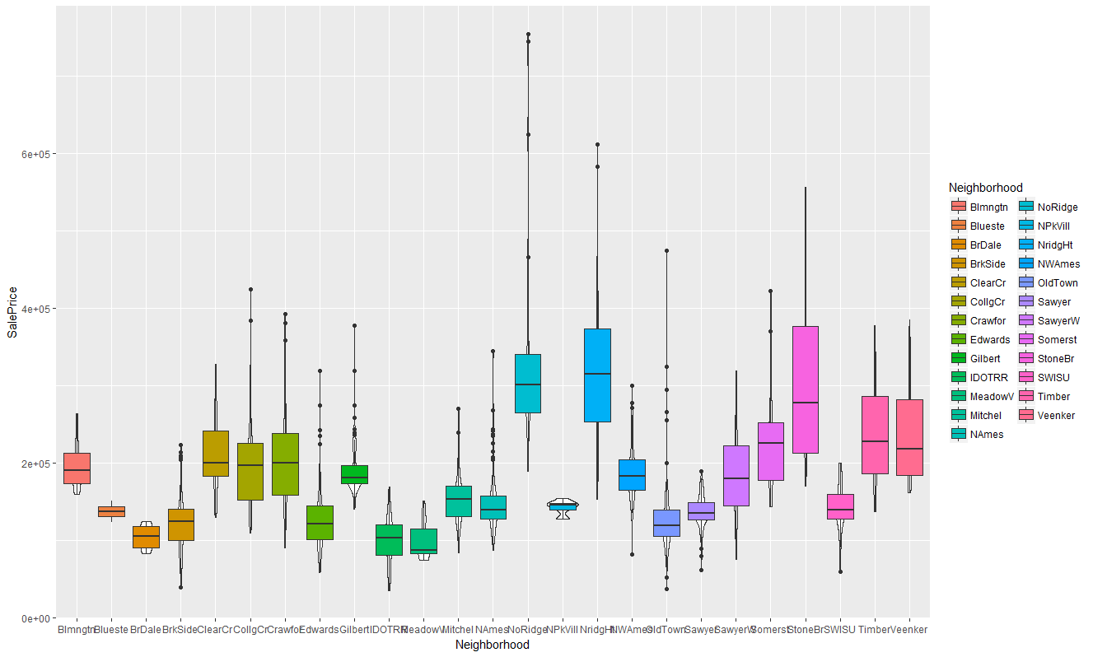
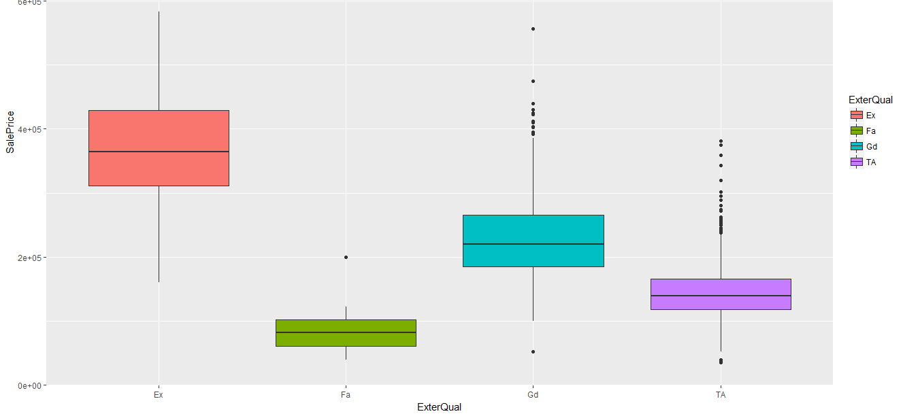
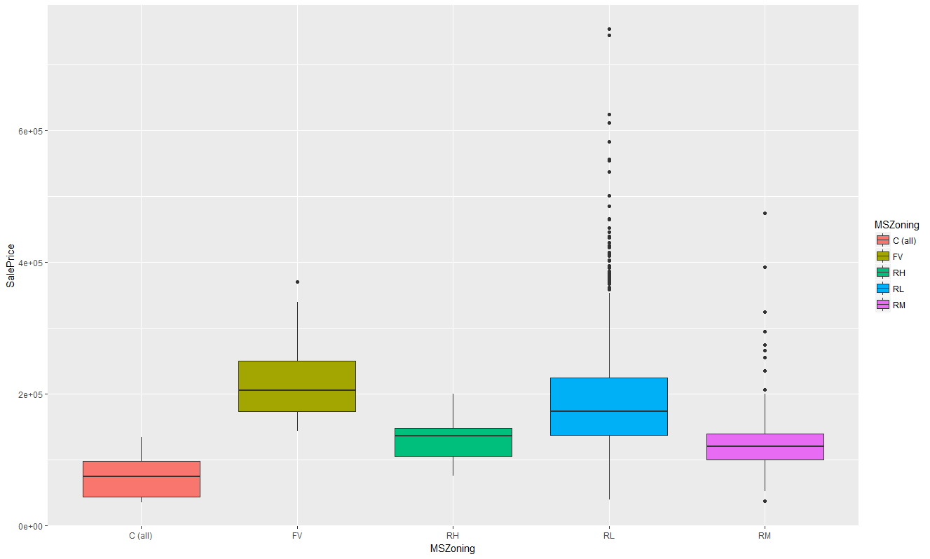
Qualitative vs Sale Price

Slide 8
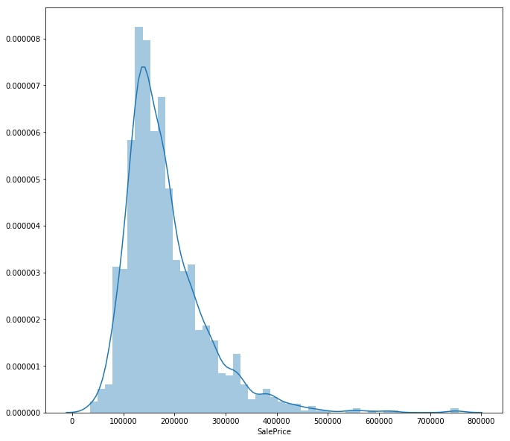
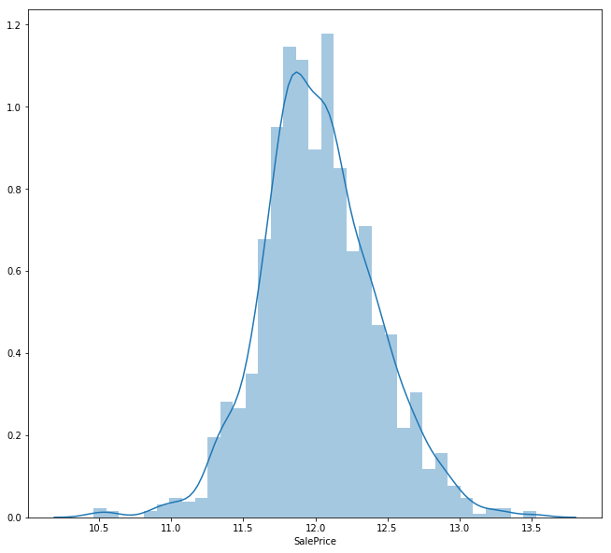
Log(Sale Price)

Slide 9
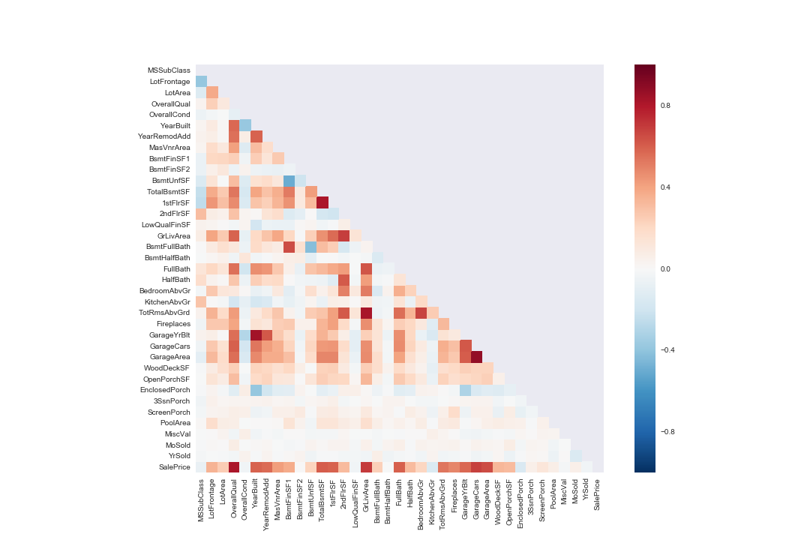
Correlation
Variables | Variance
overallqual | 0.79
Totalbsmtsf | 0.61
1stflrsf | 0.61
Grlivearea | 0.71
Garagecars | 0.64
Garagearea | 0.62

Slide 10
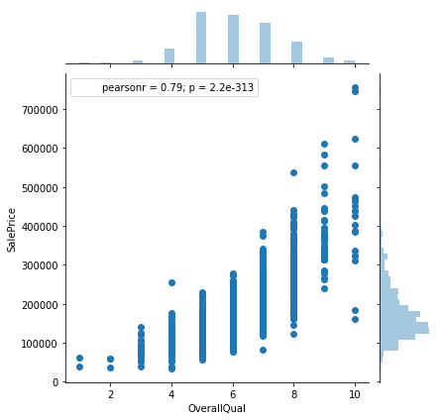
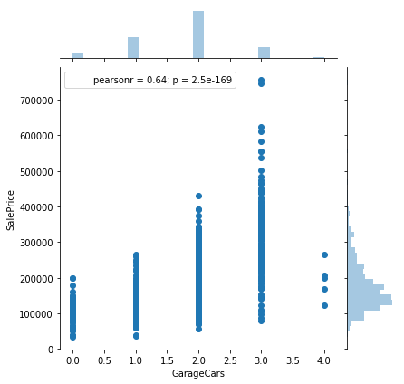
Overall Quality & Garage

Slide 11
Data Pre-processing I thought I told you to clean the basement!

Slide 12
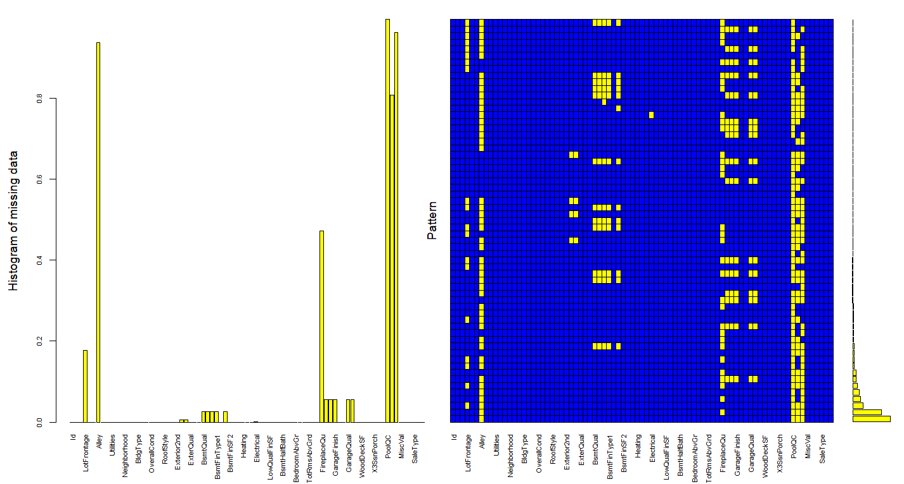
Missing Values
Variable | Missing
PoolQC | 1453
MiscFeature | 1406
Alley | 1369
Fence | 1179
FireplaceQu | 1179
LotFrontage | 259
GargeType | 81
Categorical values to “None”
Quantitative values to 0

Slide 13
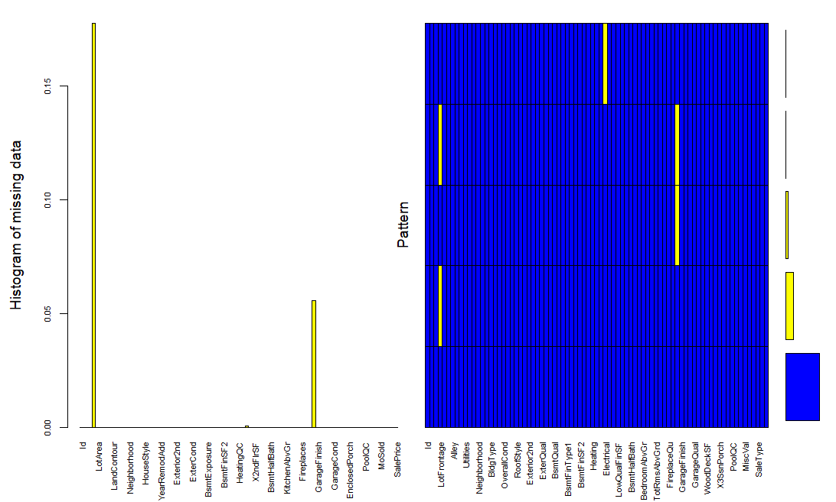
Missing Values
Before
After

Slide 14
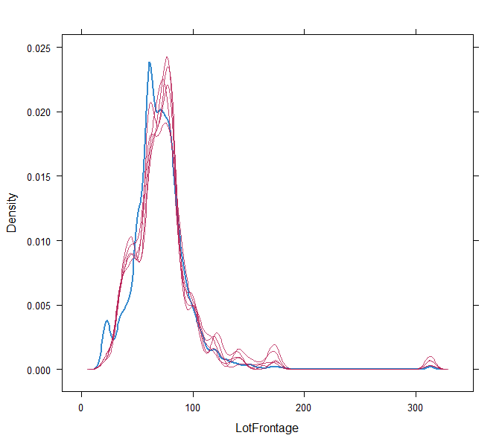
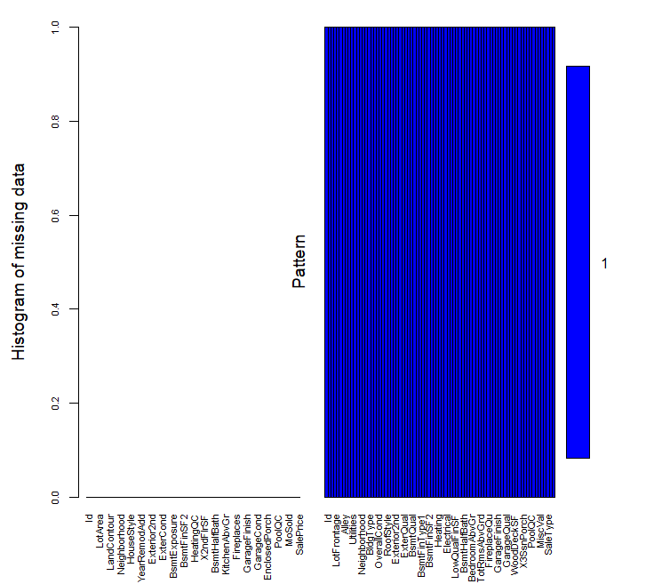
Mice Imputations

Slide 15
Pre-preocessing
Skewness
Anova
Chi-Square

Slide 16
Pre-Processing
SalePrice transformation
New features
IsRemodeled
QtrSold
TotalSF
Abnormal sale condition
Data correction
GarageYrBlt in Test Data

Slide 17
Features Engineering

Slide 18
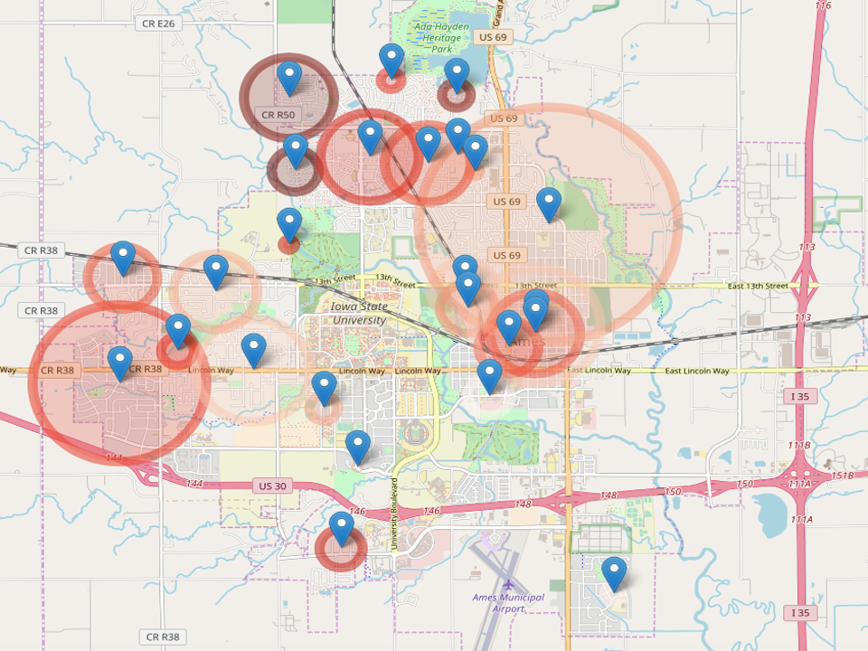
Ames, IA Neighborhood

Slide 19
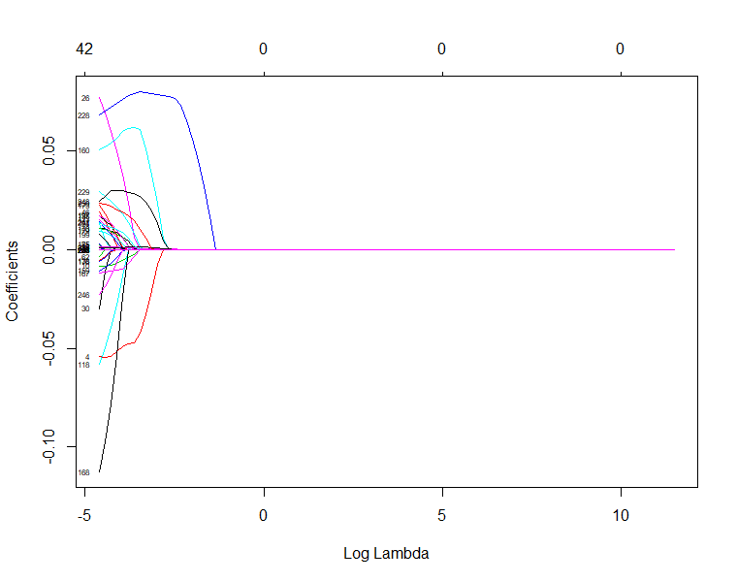
Lasso Regression Fore Reduction of Parameters

Slide 20
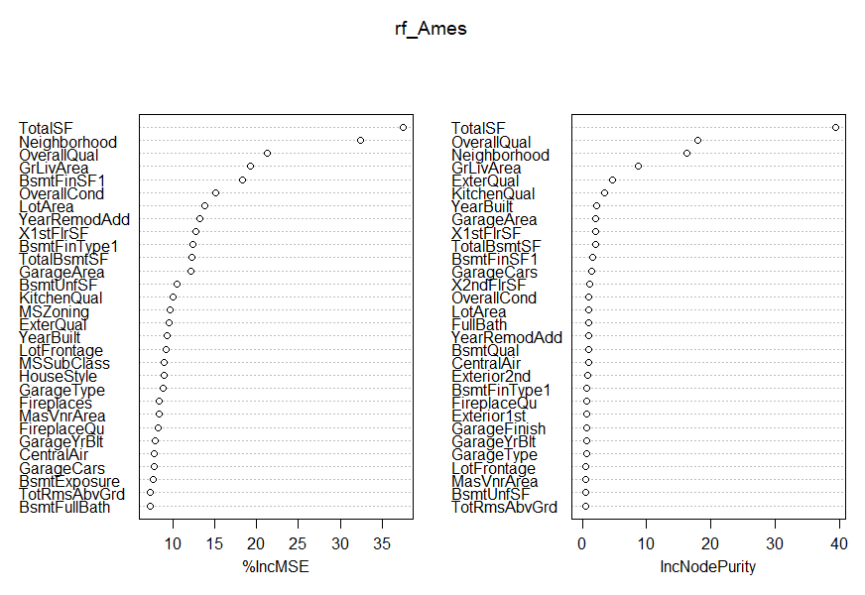
Random Forest For Best Variables

Slide 21
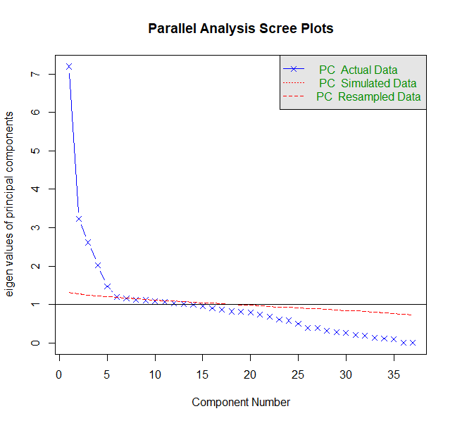
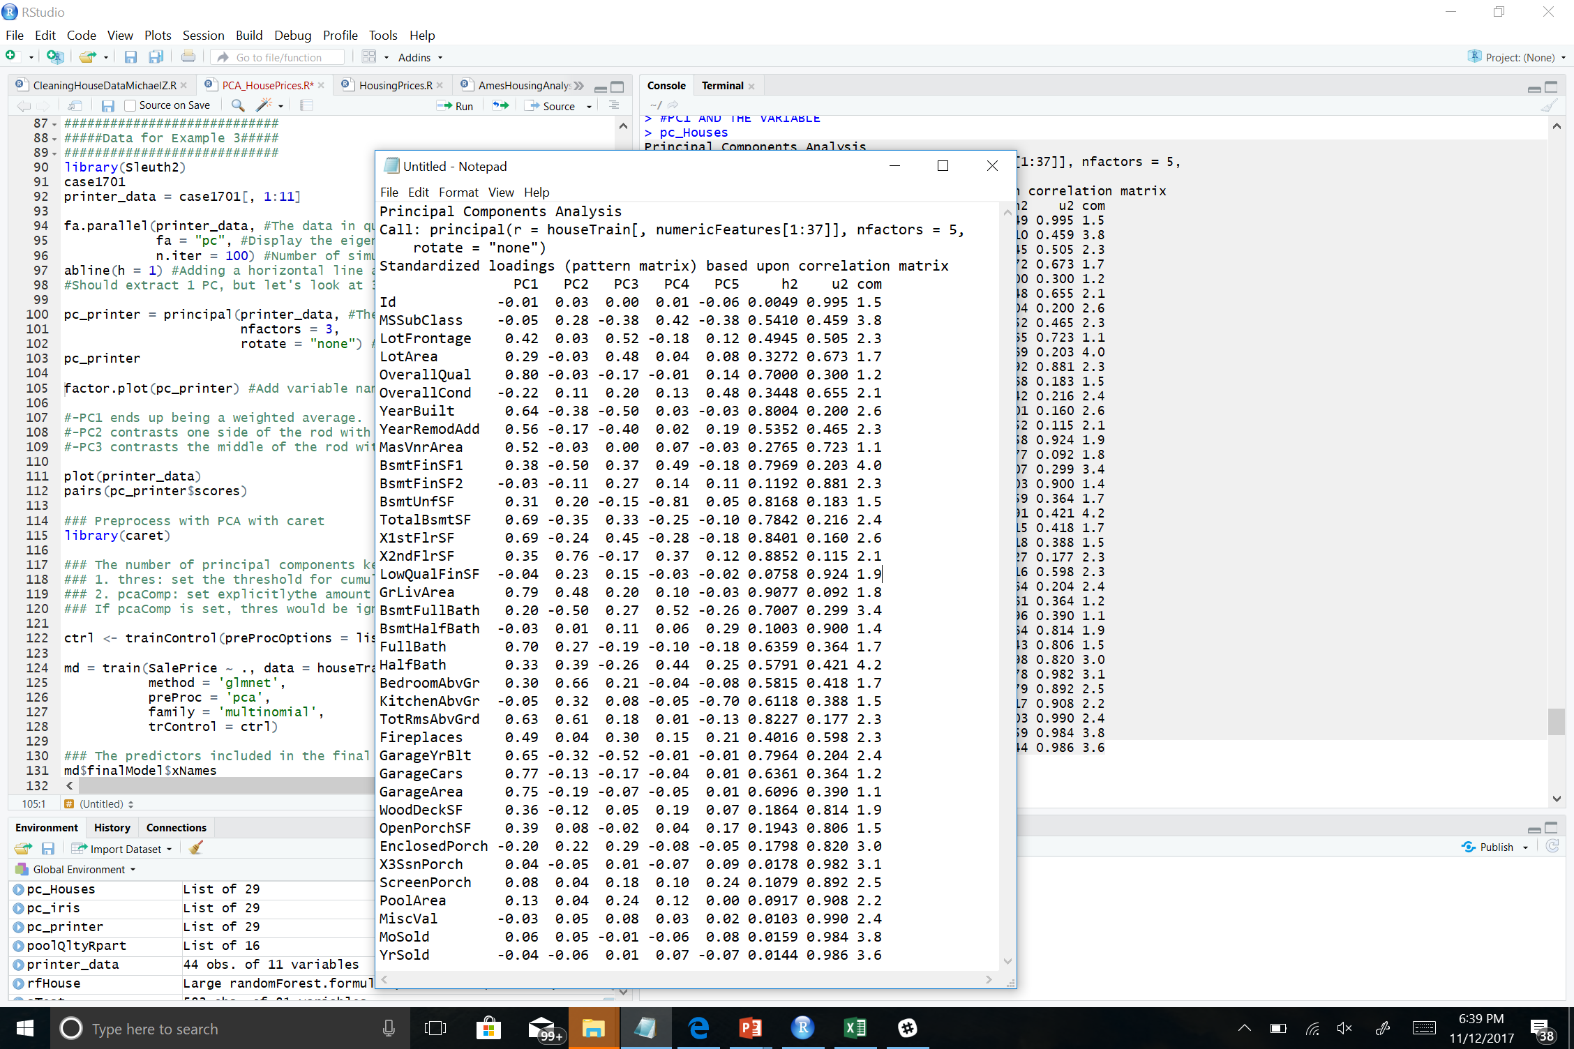
PCA – Components
sp$finalModel$xNames
[1] "PC1" "PC2" "PC3"

Slide 22
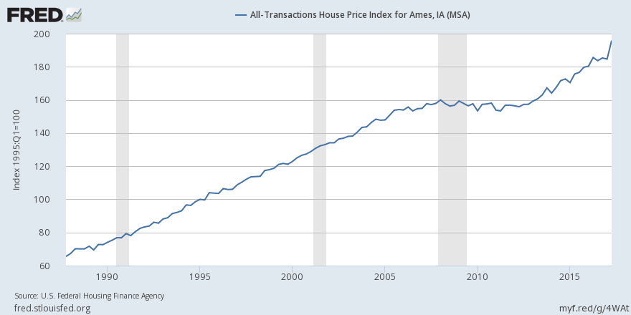
Case-Shiller Ames Housing Index

Slide 23
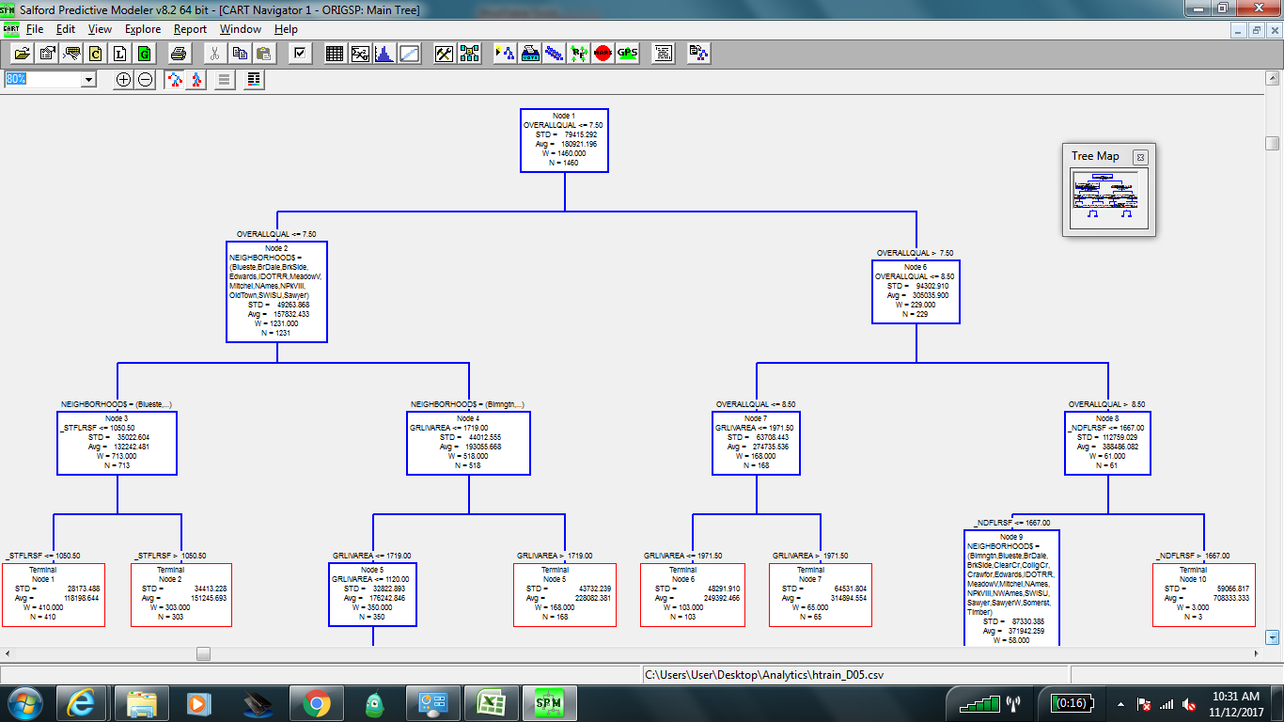
Decision Tree for Variable Selection

Slide 24
Model Training and Evaluation

Slide 25
Multiple Linear Regression

Slide 26
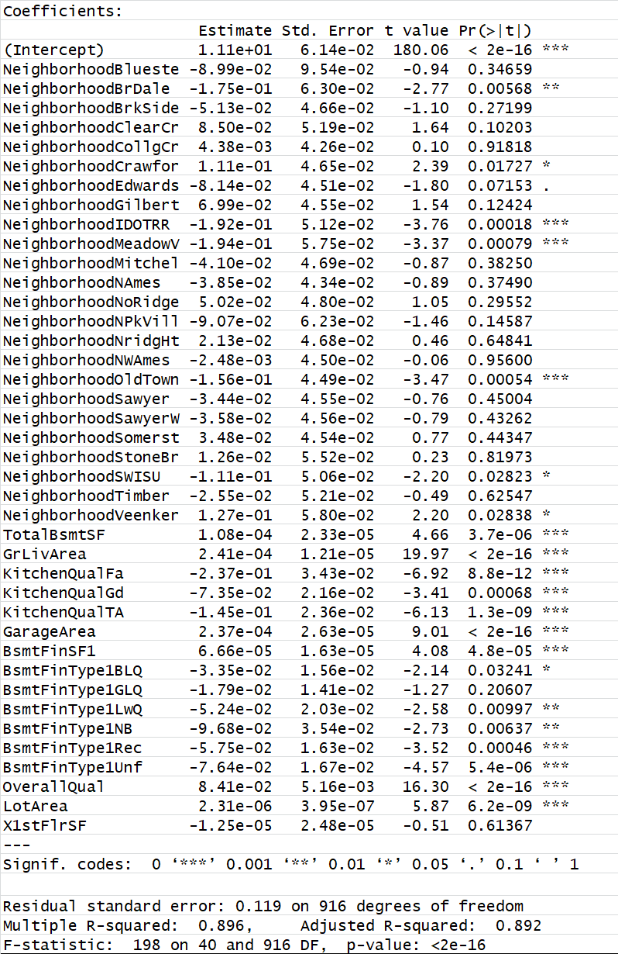
Summary Statistics

Slide 27
Assumptions

Slide 28
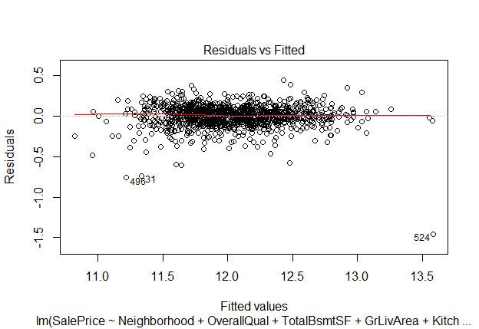
Constant Variance

Slide 29
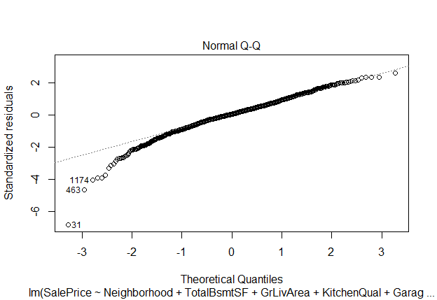
Normality

Slide 30
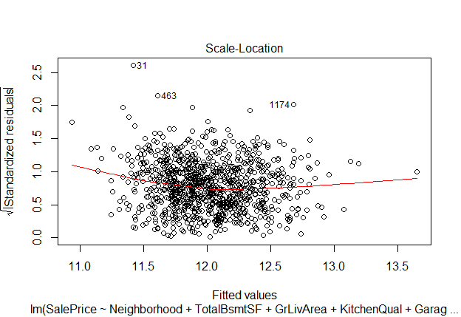
Independent Error

Slide 31
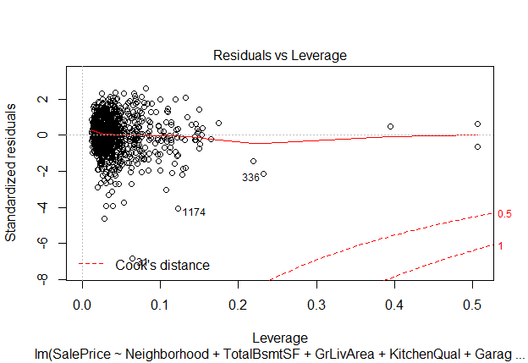
Residuals and Leverage

Slide 32
Cross Validation

Slide 33
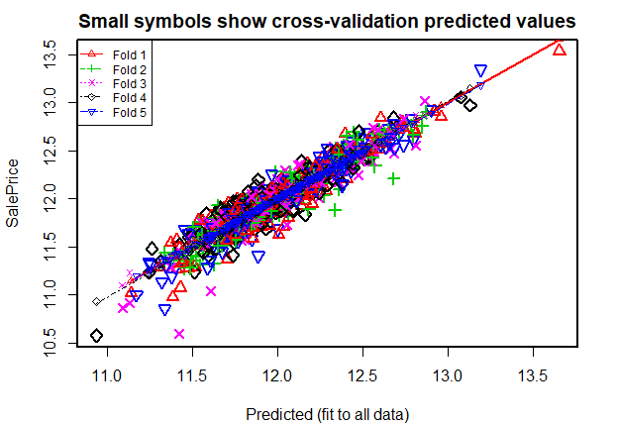
Predicted vs Actuals

Slide 34
Analysis, Conclusions, and Considerations

Slide 35
Extracting Additional Value from the Models
Key Stakeholders: individuals (home seekers, investors), real estate developers, asset managers, realtors, contractors, creditors/banks
Discovering investment opportunities by comparing fixed features vs changeable features
Considering macro/micro economic factors
Quantifying the opportunity and deriving actionable insights and conclusions

Slide 36
Statistically supported conclusions
Go Big or Go Home (pun intended)
Total Square Footage(using basement + living + garage space) average (mean) of homes in Ames cost 68 sq/ft.
73% of sales price is implied by attributes related to size (R-sq)
Sorry Guys, Size Matters!
2. Be Selective but not obsessive
6 variables including Size, Age (year built and year remodeled) , Location and Fireplaces account for 81% for price.
12 Variables that include (Lot Area, Year Built, YearRemodAdd, TotalBsmtSf, BsmtFinSFOne, GrLivArea, BedroomAbvGr, KitchenAbvGr, Fireplaces, Garage Area, Good Neighborhood, Troubled Neighborhood) tells 88% of the story (based on R-sq).

Slide 37
Flip or Flop – Investment opportunities by renovating?
If 88% of price is accounted for by fixed features, only 12% (or $19k of house value) remains to other features which limits upside potential to add value via renovation and repairs using “Quality” (ie kitchen quality) and “Condition” (ie garage condition) metrics, including roof, exterior features, heating, electric components, etc.
If the goal is to add value via renovation, the most promising upside will come from:
Adding a garage if land and zoning eligibility permits (worth approximately $6k per car)
Complete and unfinished basement (amounts to $35/sq. ft.)
Remodel/Upgrade the kitchen.
Profit model relies on ability to source low cost contractors.
Analysis suggests that the most prudent investment strategy would be investing in underpriced listings based on the criteria in the linear model vs “flipping” houses by renovating features and making improvements.

