Slide 1

House Prices
A MACHINE LEARNING PROJECT

Slide 2
Exploratory Data Analysis
The data covers all the recorded house sale price in Ames, IA from January 2006 to July 2010.
The dataset contains 1460 observations in the training set and 1459 observations in the test set. There are 46 categorical variables including 23 nominal and 23 ordinal ones, and 33 numeric variables in the dataset. The training set also has the sale price as response while the test set doesn’t.

Slide 3
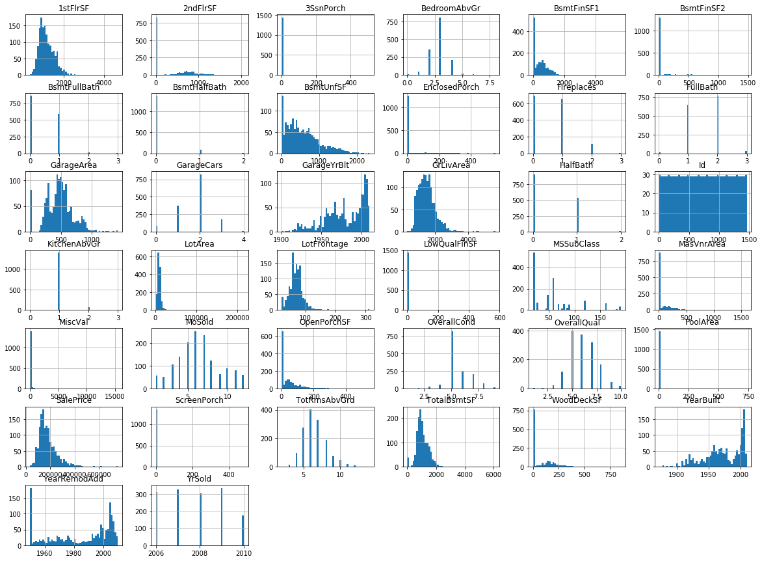
Histogram

Slide 4
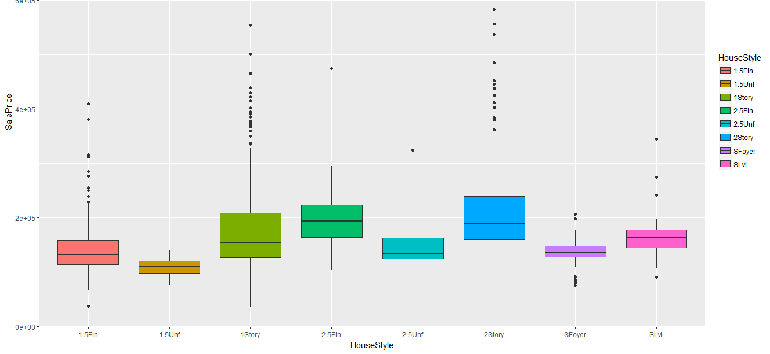
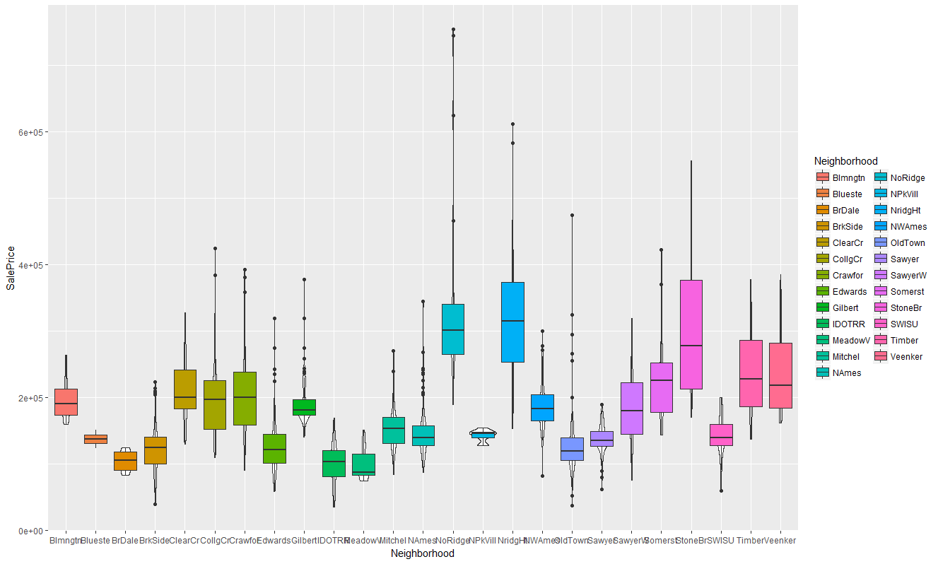
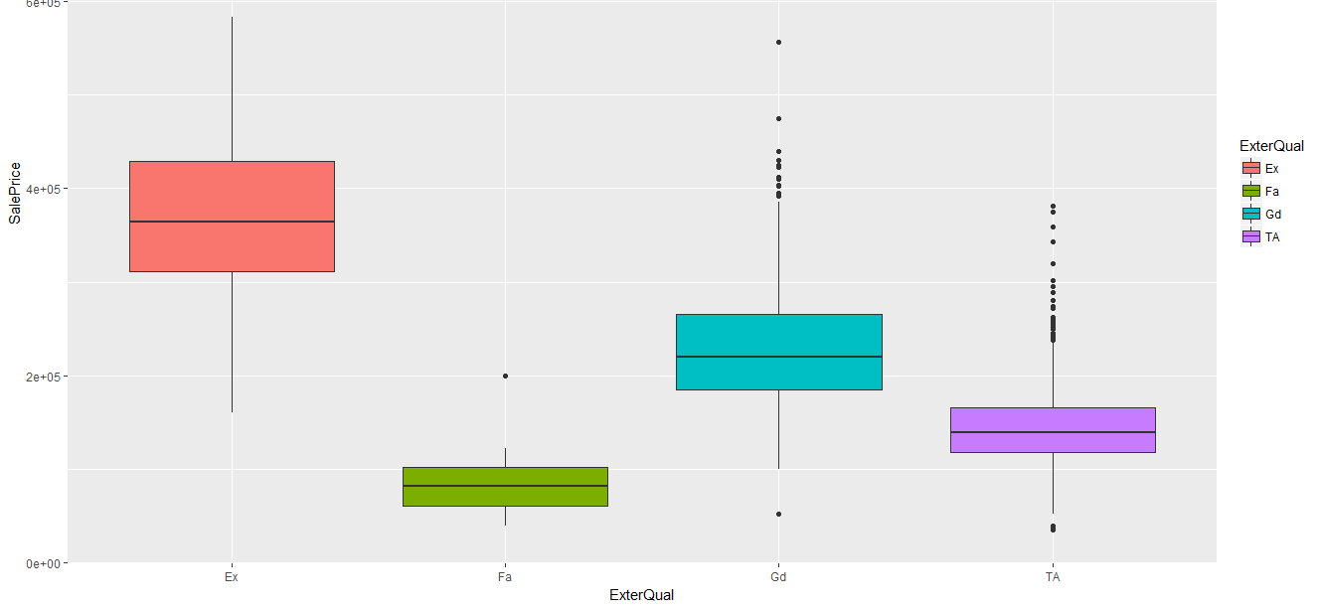
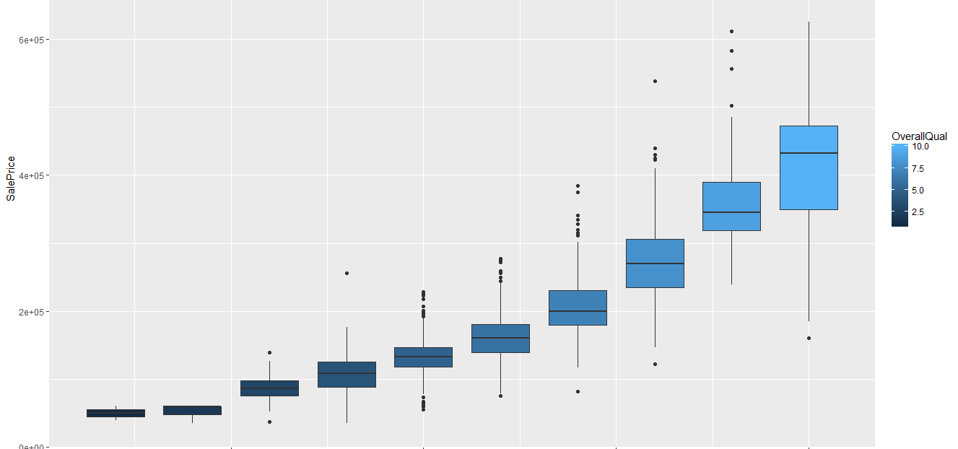
Price Dispersion

Slide 5
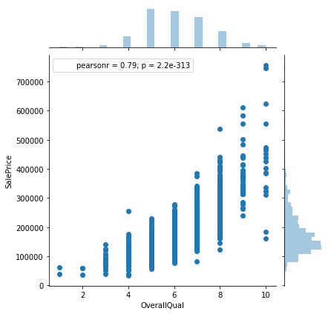
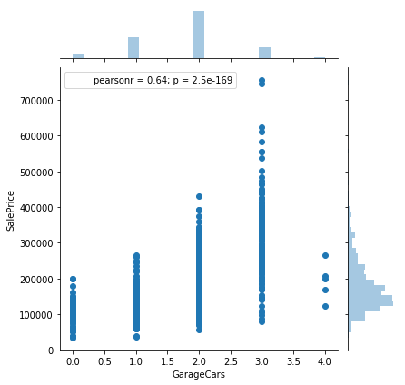
Price Dispersion - Joint Plots

Slide 6
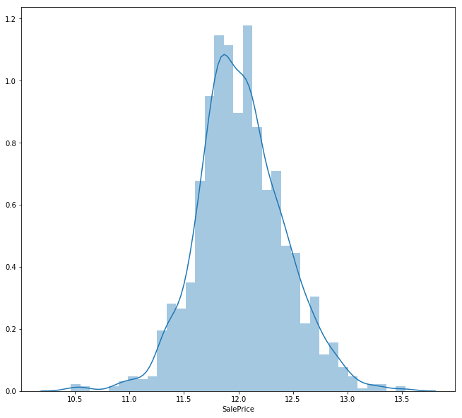
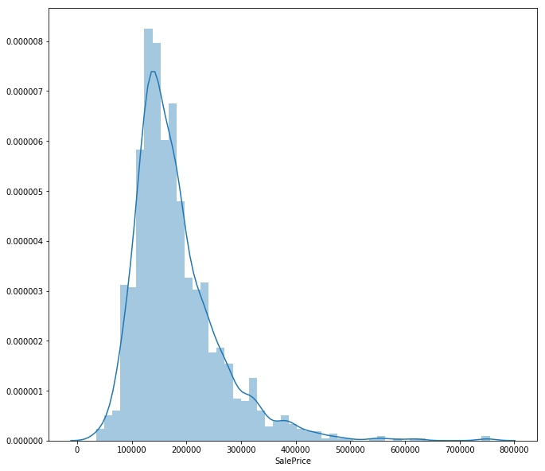
Log(Sale Price)

Slide 7
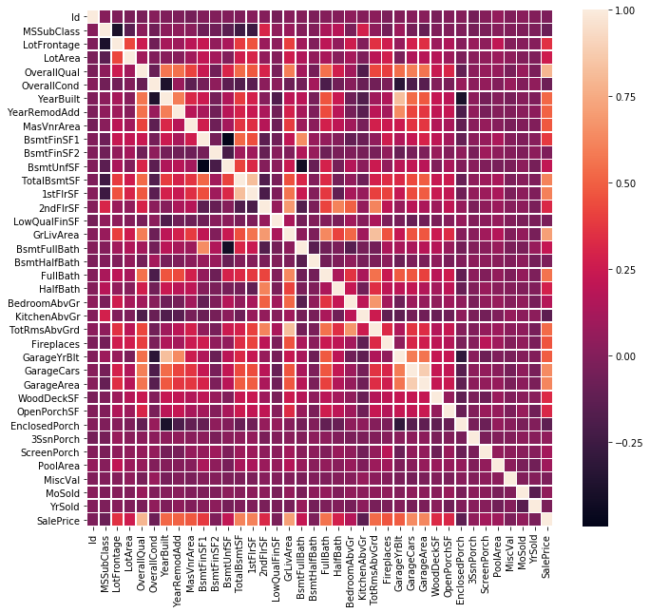

Slide 8
Missingness & Imputations

Slide 9
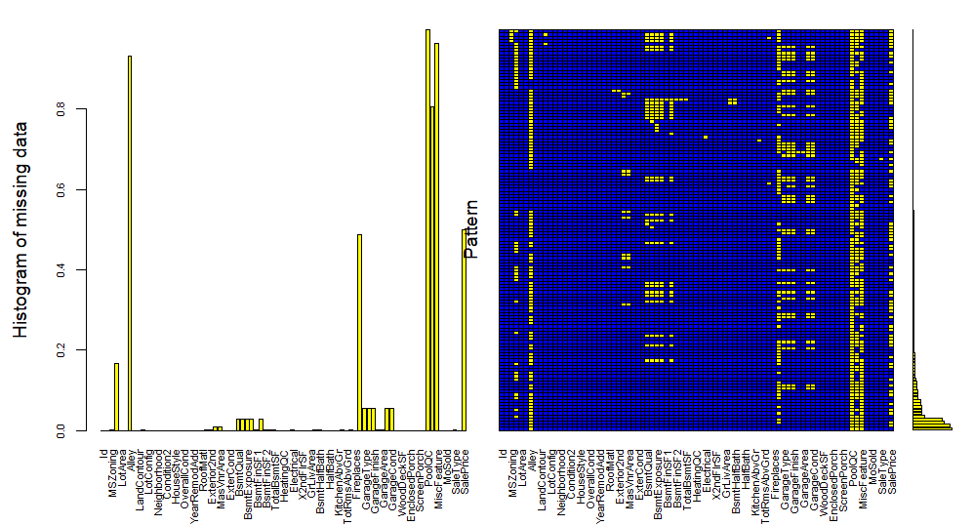
Mice Plot – Missing Values

Slide 10
The Garage is a mess!

Slide 11
Features Engineering

