Slide 1
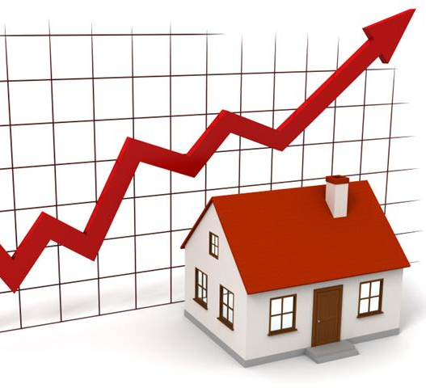
Hou$e Price$
A MACHINE LEARNING PROJECT
Gradient De$cendant$

Slide 2
Agenda
Project aims at predicting house prices (residential) in Ames, Iowa, USA based on data set provided by Kaggle between 2006 and 2010.
Data Exploration
Data Pre-Processing
Feature Engineering
Model Training
Model Evaluation

Slide 3


Slide 4
Data Exploration

Slide 5
What factors do we believe to influence house prices?
The dataset contains 1460 observations in the training set and 1459 observations in the test set.
There are 46 categorical variables including 23 nominal and 23 ordinal ones, and 33 numeric variables in the dataset.
The training set has the sale price as response while the test set doesn’t.

Slide 6
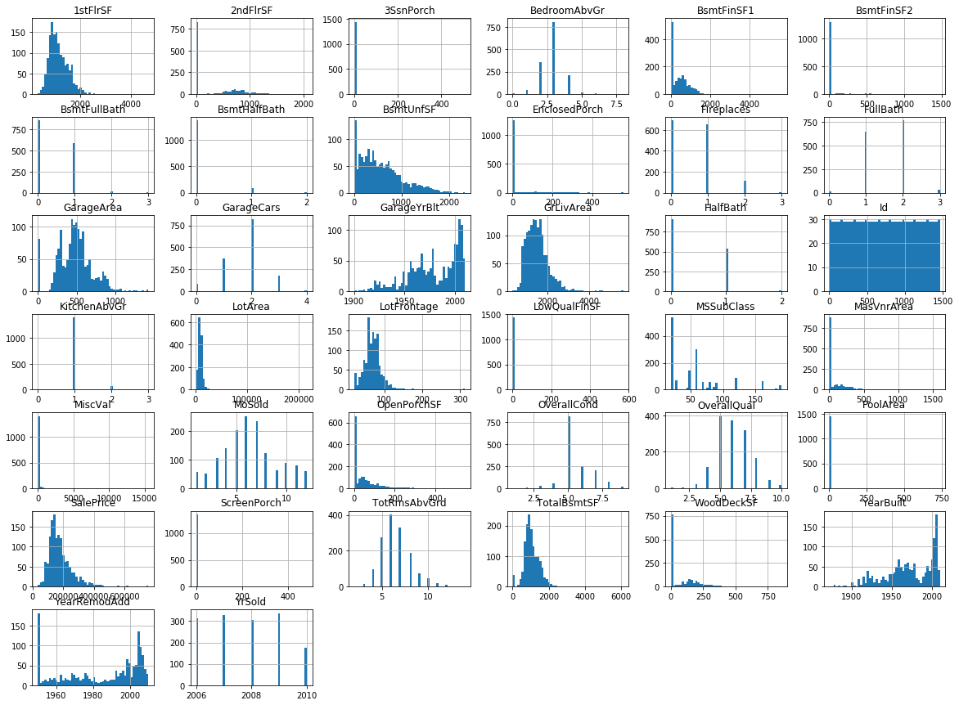
Univariate Analysis

Slide 7
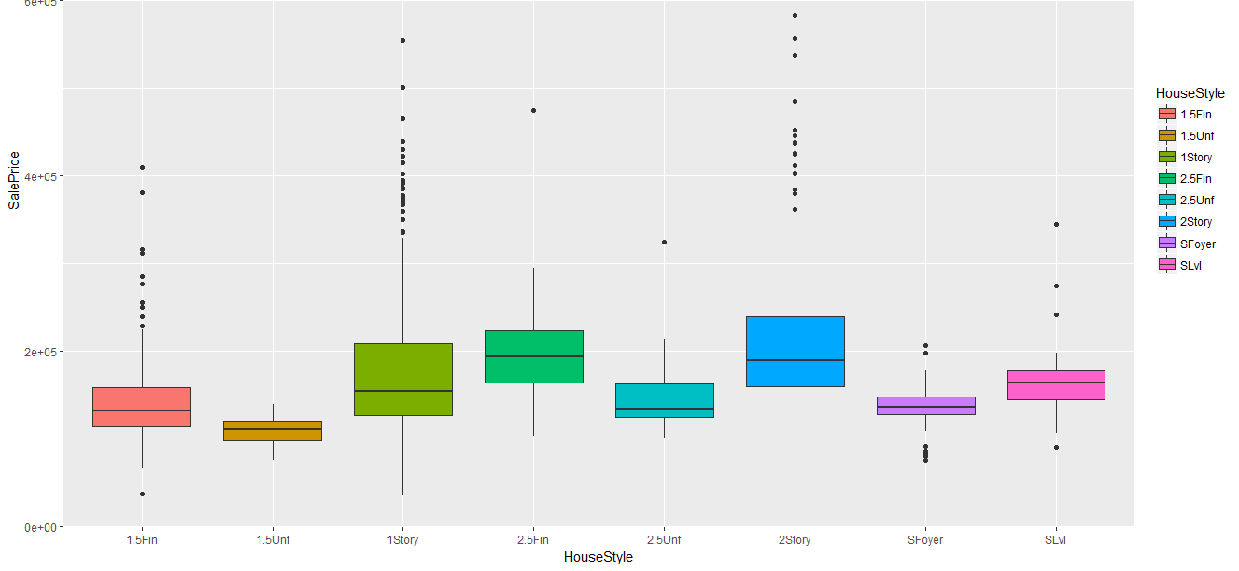
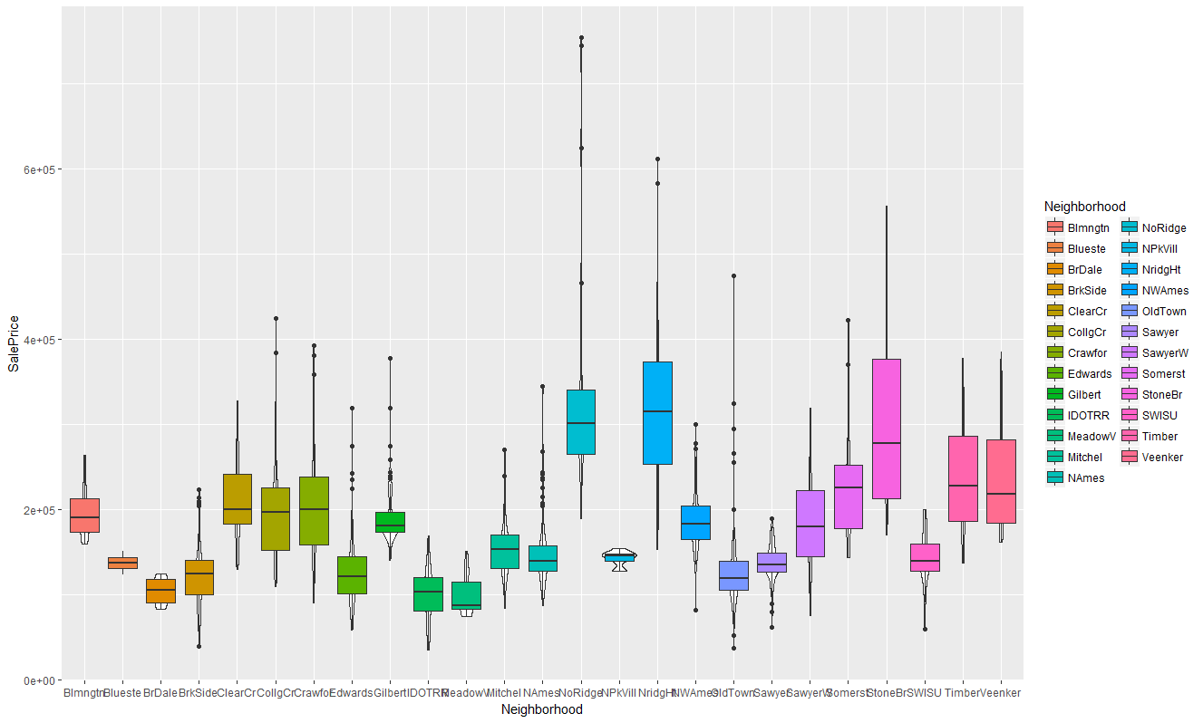
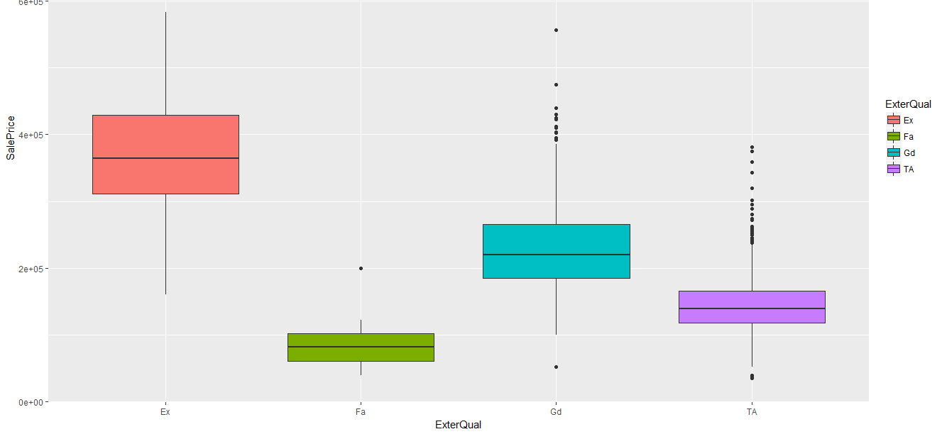
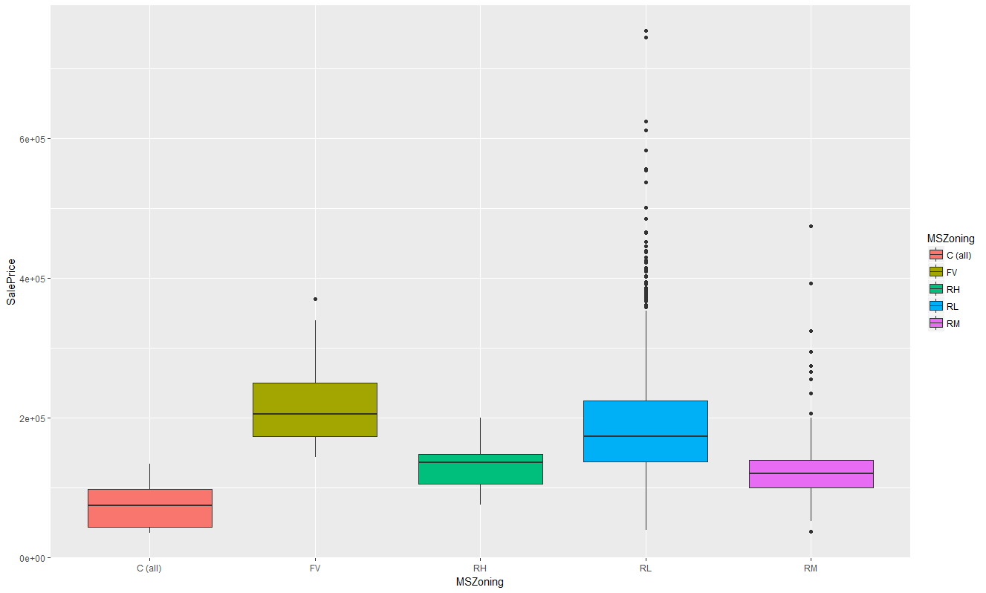
Price Dispersion
They show consistency with our common sense that neighborhood, zoning, house quality and facility might distinguish the house value.

Slide 8
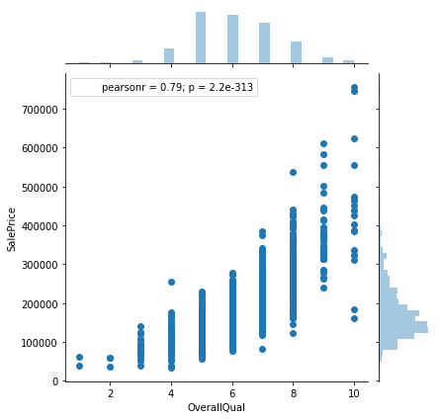
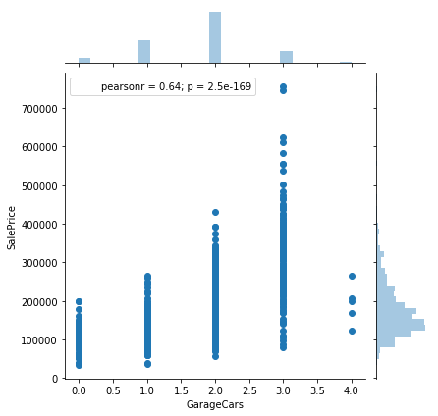
Overall Quality & Garage

Slide 9
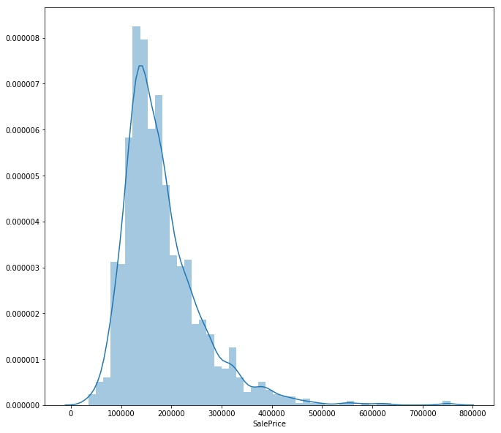
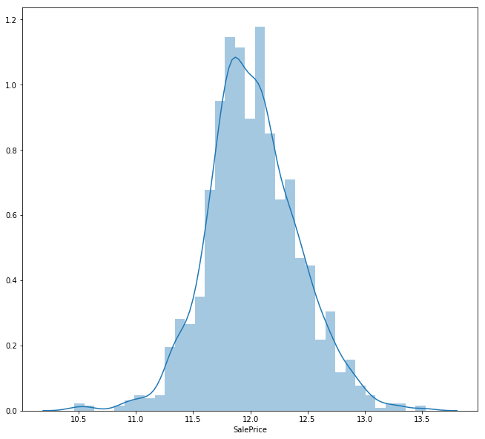
Log(Sale Price)

Slide 10
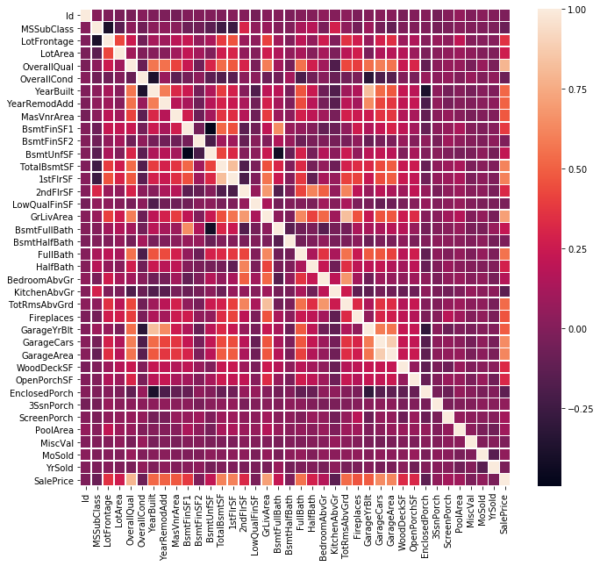
Correlation
Variables | Variance
overallqual | 0.79
Totalbsmtsf | 0.61
1stflrsf | 0.61
Grlivearea | 0.71
Garagecars | 0.64
Garagearea | 0.62

Slide 11
Data Pre-Processing

Slide 12
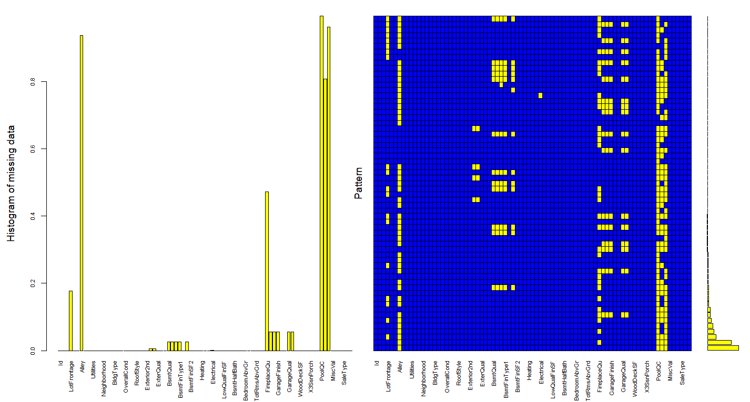
Missing Values

Slide 13
The Garage is a mess!

Slide 14
SaleCondition
SalePrice normalization

Slide 15
Features Engineering

Slide 16
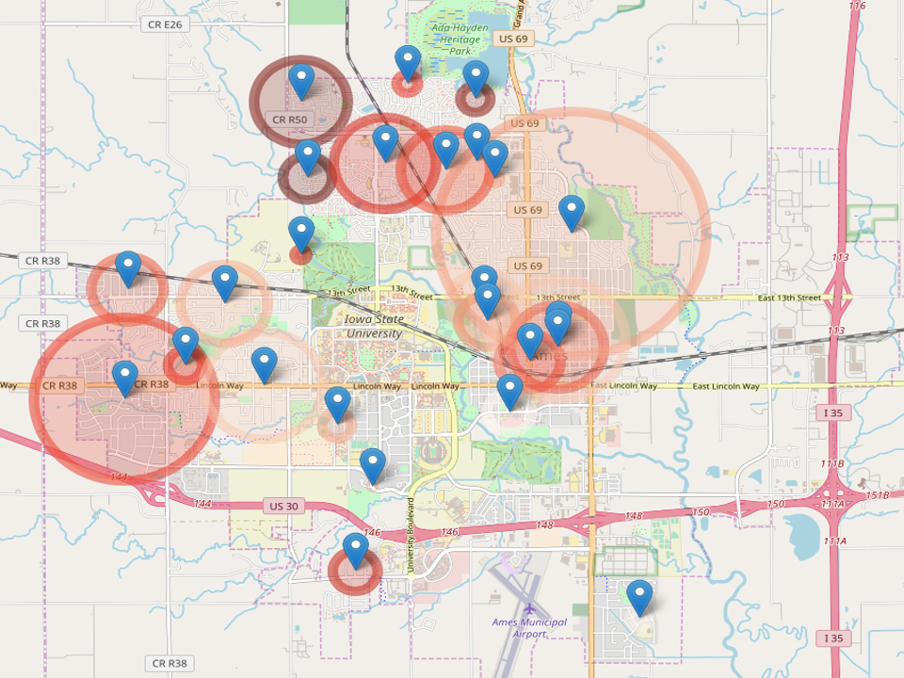
Ames, IA Neighborhood

Slide 17
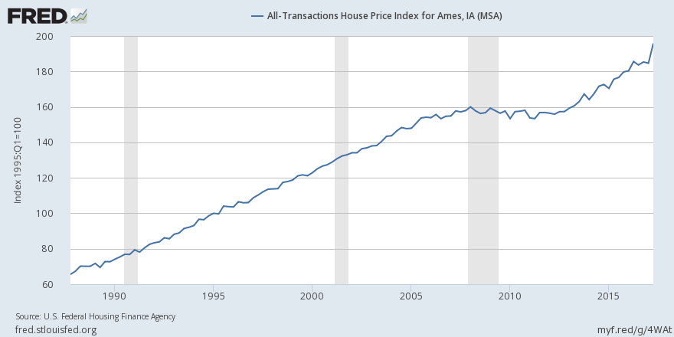
Case-Shiller Housing Index

Slide 18
Model Selection
‘If you torture the data enough, it will always confess’
- Ronald Coase, British Economist

Slide 20
Model Evaluation

