Slide 1
Twitter Sentiment on Clinton vs. Trump
Manasa Hariharan
578 Final Project

Slide 2


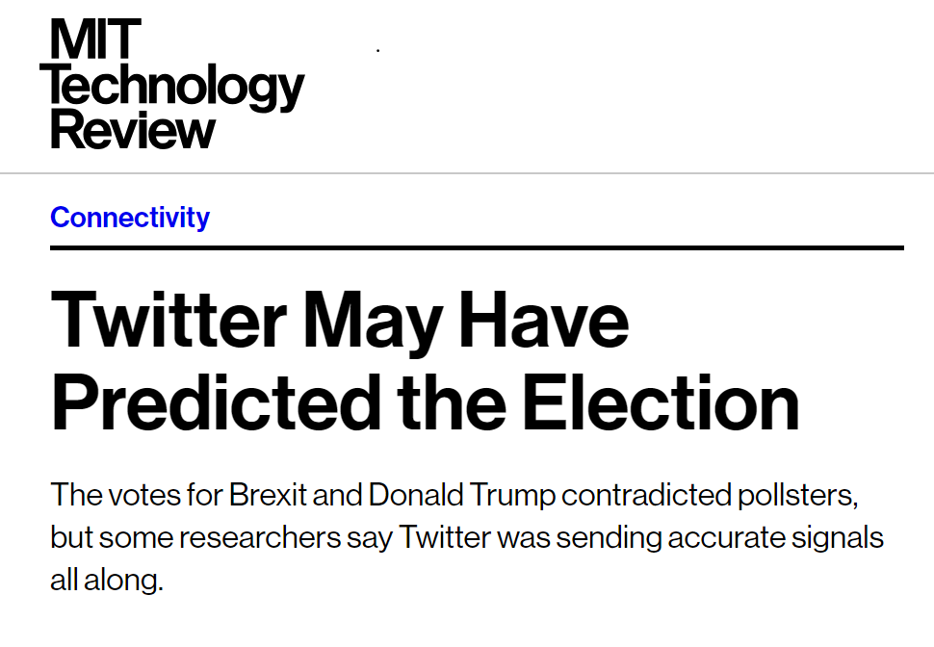


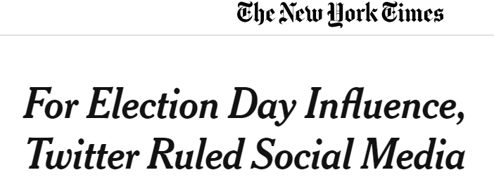

MOTIVATION
Social media has changed the way elections are conducted and understanding the role it plays is very important for future elections
Twitter and other social media can be used by pollsters along with traditional techniques to help understand their electorate and vice versa

Slide 3
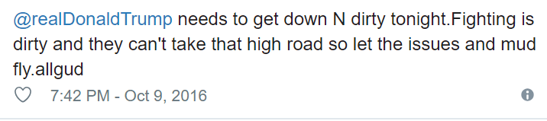
THE PROBLEMS
Average of 2 million tweets a day related to the 2016 election In the final four months of campaign
No labeled dataset
Slang, sarcasm, bad spelling, bad grammar, lots of external media
Tweets from bots and other unreliable clients
Twitter has rate limits
Lots of deleted tweets, deleted accounts etc

Slide 4
THE DATA
Data collected on 6 important timepoints along the campaign (republic and democratic conventions, 3 presidential debates and the election day)
List of hashtags that indicate positive or negative towards candidates used to scrape tweets that will serve as the labeled dataset (pro-clinton, pro-trump, anti-clinton,anti-trump)
Exclude retweets to reduce redundancy. Data collected with Python GetOldTweets library

Slide 5
THE MODEL
Processing tweets
Extracting features from tweets
Building classifier
Cross validation and GridSearch to choose hyperparameters
Training Classifier with full tagged dataset
Predicting sentiment of Unlabeled tweets data for the 6 timepoints

Slide 6

PROCESSING TWEETS
Tokenize data
Handle emojis :D, ☹ etc, Handle html links
Ensure handles and hashtags are used as features
Many tweets have slang words and lengthened phrases eg: waaayyy, toooo, yaayyy, !!!!, etc.
Nltk library has a tweet tokenizer that takes care of twitter specific text

Slide 7

Extracting Features
Dataset has two classes (tweets that were either pro clinton or anti trump and tweets that were either anti clinton or pro trump)
Both Unigrams and Bigrams were shown to have better performance than either one alone
343000 tweets in the training set, 46% of tweets are pro clinton

Slide 8
Choosing Classifier
Tuning for hyperparameters including:
Loss function: log loss, huber loss
Alpha values: for regularization
Regularization of features: l1 or l2
Class_weights: no weights or balanced weights
K-fold is used for cross validation and f1-score is used for optimization
Final parameters were log loss with 1e-3 alpha, l2 regularization and no weights with 0.84 f1-score on the test set

Slide 9
Output
Train classifier with optimal parameters, and use trained classifier to predict sentiments of tweets in the 6 time points
For each timepoint, calculated overall sentiment of users by grouping tweets by user and calculating percentage of users supporting either candidate
The results are also compared with average of polls conducting around the respective dates

Slide 10
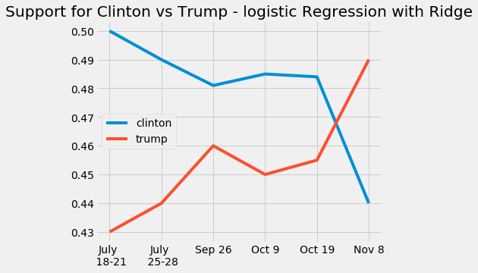
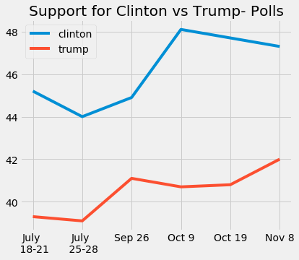
Results

Slide 11
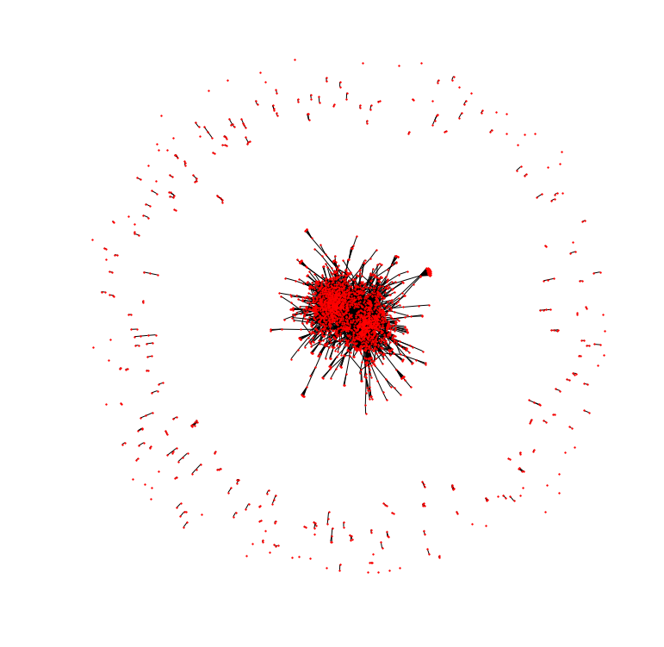
User Networks

