Slide 1
GENDER CLASSIFICATION USING SUPPORT VECTOR MACHINE
SUBMITTED BY
V.SITA MAHALAKSHMI(20NG1A0561)
K.MANASA(20NG1A0528)
K.PRUDHVI RAJU(20NG1A0531)
K.CHAITANYA BABU(20NG1A0530)
Guided by
Dr K P N V SATYA SREE
T NAGA MOUNIKA

Slide 2
CONTENTS
System requirements
Introduction
Image dataset
Feature extraction
SVM in gender classification
Preprocessing
Training SVM
Result
Comparison with Other Classification Algorithms
Real-Life Applications
Limitations
Conclusion

Slide 3
SYSTEM REQUIREMENT
SOFTWARE REQUIREMENTS:
Operating system : windows 8.1 or later(windows 10 recommended)
Coding language : python 3.8
HARDWARE REQUIREMENTS:
System : i3 processor
Hard disk : 500GB
Monitor : 15” LED
Input : Keyboard, Mouse
Ram : 4GB

Slide 4
INTRODUCTION
SVM is a machine learning algorithm that uses a discriminative model to classify data.
Gender classification using support vector machine (SVM) with image dataset is an effective approach for automatic gender recognition
By training SVM with image datasets, we can develop a model that can accurately predict the gender of a person based on their facial features.

Slide 5
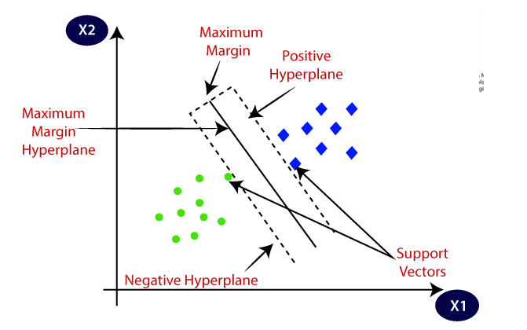

Slide 6
Image Dataset
An image dataset is essential for training an SVM model for gender classification.
The dataset should consist of labeled images, where each image is associated with the correct gender.
The dataset should be diverse, containing different ethnicities, ages, and poses to improve the model's generalization.
Dataset is taken from ‘Kaggle.com’ website.

Slide 7
Feature Extraction
Feature extraction involves extracting meaningful facial features from the images.
Commonly used features for gender classification include facial landmarks, and color histograms, grayscale pixels.
These features capture distinctive patterns that help SVM in accurately classifying the gender.

Slide 8
SVM IN GENDER CLASSIFICATION
SVM is a supervised learning algorithm that separates data into classes using a hyperplane.
In gender classification, SVM learns to classify images into male or female categories based on extracted features.
SVM aims to find the optimal hyperplane that maximizes the margin between the two classes.

Slide 9
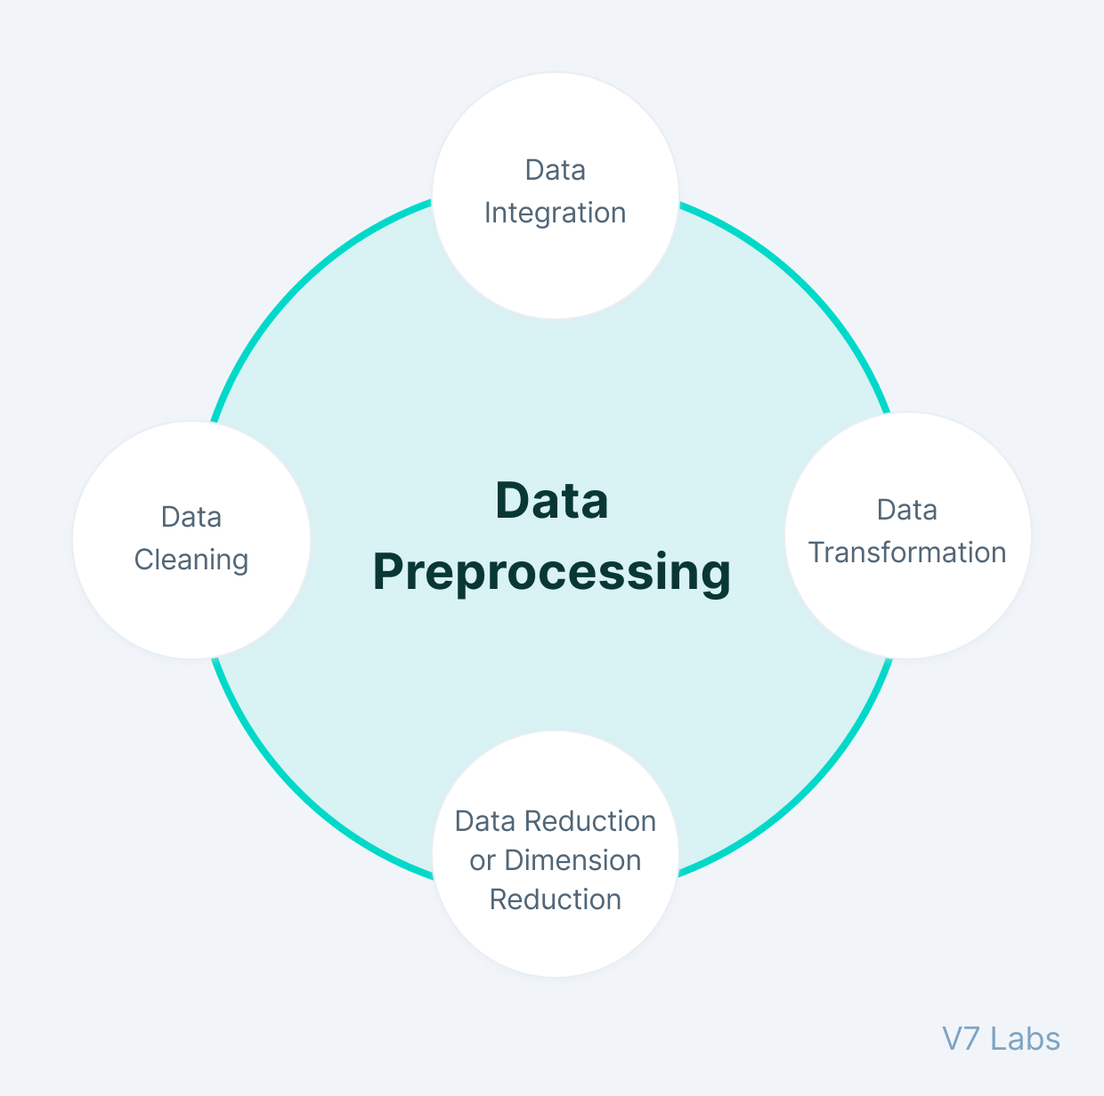
preprocessing
Preprocessing steps such as normalization and resizing are crucial to ensure consistency in the dataset.
Normalization enhances the robustness of the model by reducing variations in illumination and color.
Resizing the images to a fixed size ensures that all images have the same dimensions for efficient processing.

Slide 10
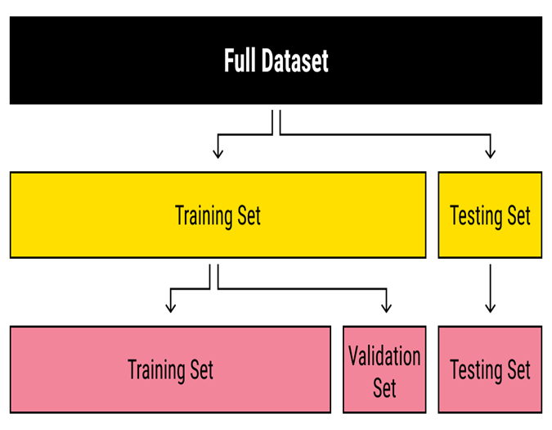
Training SVM
To train an SVM model, the preprocessed dataset is split into training and testing sets.
The training set is used to learn the optimal hyperplane that separates male and female classes.
The SVM algorithm adjusts the hyperplane parameters by minimizing the classification error.
The trained SVM model is evaluated using the testing set to measure its performance.

Slide 11





Result
Female
TRAINING MODEL
PREDICTION
Female
Male

Slide 12
Comparison with Other Classification ALGORITHMS
We have chosen the support vector machine algorithm for gender classification in our project. Compared to other classification algorithms, such as logistic regression or decision trees, SVMs have some advantages.
Firstly, SVMs can handle high-dimensional data very well, making them suitable for image recognition tasks such as gender classification based on facial features
Secondly, SVMs can effectively deal with noisy or overlapping data by finding the optimal hyperplane that maximizes the margin between the two classes.
Finally , SVMs have a regularization parameter that can be adjusted to prevent overfitting. which is ,when the algorithm fits too closely to the training data and performs poorly on new data.

Slide 13
Real-Life Applications
Face detection.
Text and hypertext categorization.
Classification of images.
Handwriting recognition.
Generalized predictive control(GPC).

Slide 14
Limitations
Large training time
More features, more complexities
Bad performance on high noise
Does not determine Local optima

Slide 15
Conclusion
Gender classification using SVM with image dataset is an effective approach for automatic gender recognition.
SVM learns to classify images based on extracted features, providing accurate predictions.
However, like any machine learning algorithm, the accuracy of the SVM model depends on the quality and representativeness of the training data. Therefore, in this project we are getting 0.84 accuracy score which gives better performance.

Slide 16
THANK YOU

