Slide 1
Exploratory Analysis:
CO₂ Emissions and Impact of Electricity Generation
By: Manasa Mangipudi and Vijay Koduri

Slide 2
Problem Statement
Human emissions of greenhouse gases are the primary driver of climate change today and if we want to reduce these emissions, we need to transform our energy systems to avoid excessive CO₂ emissions.
We combined a CO₂ emission data set with an energy generation/consumption dataset to see the relationship of how our energy production and use impacts our air pollution mostly focusing on CO₂ emissions.

Slide 3
CO₂ Emissions: Dataset 1 - Dataset Details
The dataset is from Our World in Data - It has the CO₂ emissions and other air polluting gasses for 165 countries from 1800-2022.
Key Details about the Dataset:
CO₂, Methane and Nitrous Oxide Emissions
CO₂ Emissions from different sources such as coal, flaring, gas, and oil
Share of each country’s CO₂ emissions from each source.
Temperature change due to CO₂ emissions.

Slide 4
Electricity Generation : Dataset 2 - Dataset Details
This dataset from Our World in Data - contains detailed information about Electricity Generation of 165 countries over time (1800-2022) - from fossil fuels and renewable energy sources
Key details from dataset :
Total electricity generation of each country
GDP of each country
Population
Share of electricity (Fossil Fuels - Coal, Gas, Oil & Renewable Sources - Wind, Solar, Hydro)

Slide 5
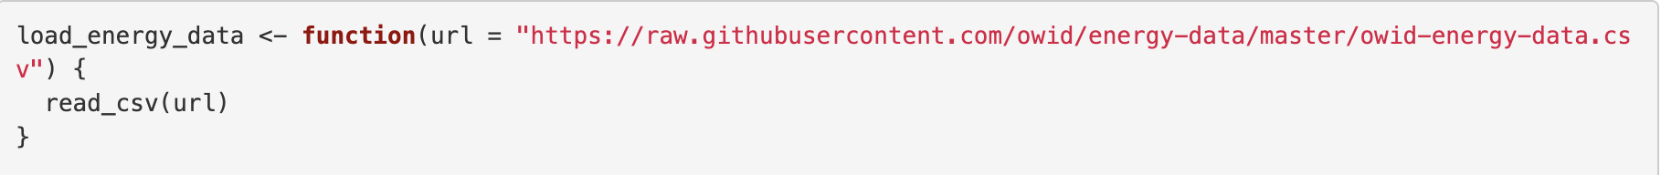
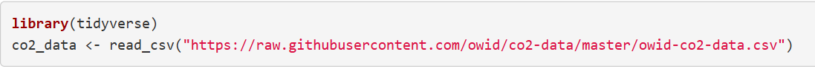
Data Wrangling - Loading Both Datasets
Data Loading :
They are both publicly available datasets. Accessed them from their git repositories

Slide 6
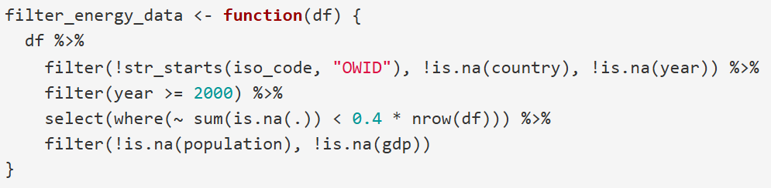
Data Wrangling - Handling Missing Values and Duplicates
Step 2 - Missing Value and Duplicate Handling
Dropped data from 1800-1999 - to keep data more relevant and modern, also many columns have 100% N/A.
Checked for duplicate rows but found none at all.
After this, columns with more than 60% of missing values are removed

Slide 7
Data Wrangling: Dataset 1 - Transformation
Data Transformation:
Removed 15 unnecessary and irrelevant columns such as cement_co2, cement_co2_per_capita.
Created new columns like: CO₂ emissions year-over-year change, Total CO₂ from fossil fuel types.
Log transformed co2 and gdp to address skewness.

Slide 8
Electricity Generation : Dataset 2 - Data Transformations
Data Transformation :
Selected the most significant and related variables - 15 from the remaining data and created more columns based on them.
1. Energy Ratios and Splits : solar_elec_share, wind_elec_share etc
2. Normalized metrics : electricity_per_capita, fossil_per_capita, etc
3. Continent : for easier plot creation

Slide 9
Dataset 1 - Before and After Data Wrangling
Data Wrangling Step | Rows | Columns | Missing Values
Raw Dataset | 50191 | 79 | 53.11%
N/A Columns Drop | 3,772 | 65 | 12.34%
New Columns Addition | 3,772 | 69 | 12.25%

Slide 10
Dataset 2 - Before and After Data Wrangling
Data Wrangling Step | Rows | Columns | Missing Values
Raw Dataset | 21812 | 130 | 67.32%
N/A Columns Drop | 3795 | 66 | 36.68%
New Columns Addition | 3795 | 31 | 0.18%

Slide 11
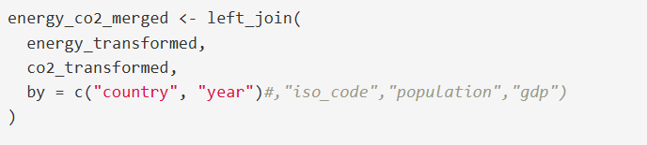
Merging both Datasets Together
Using Country and Year as keys we merged both datasets with a left join.
Energy transformed was the left table and co2 was the right.
Rows: 3795
Columns: 89

Slide 12
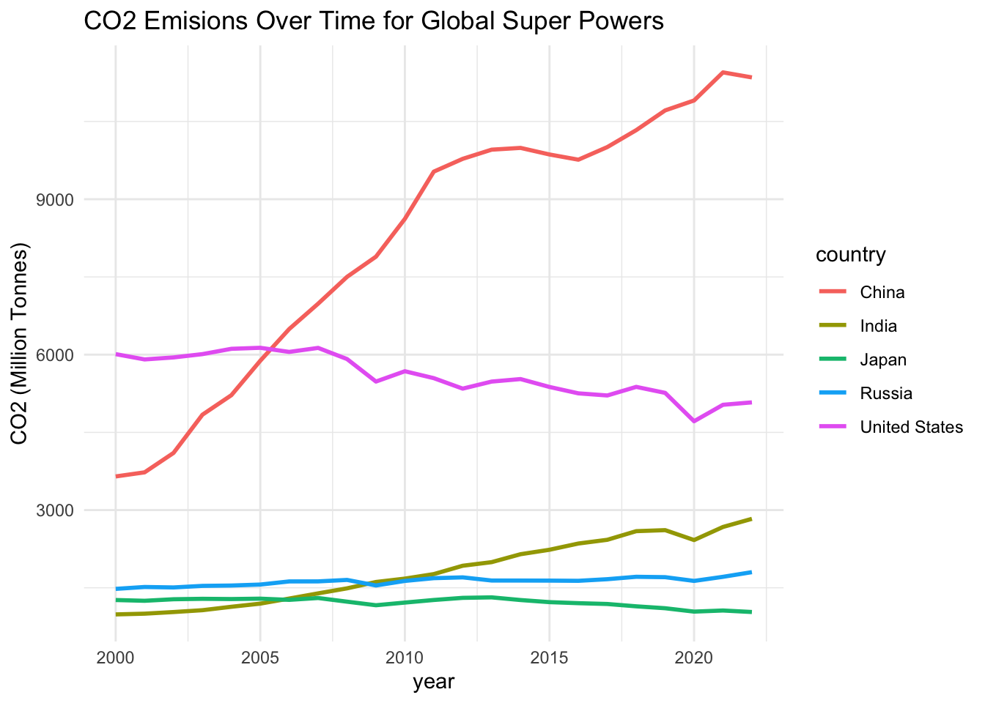
Exploratory Data Analysis - Dataset 1

Slide 13
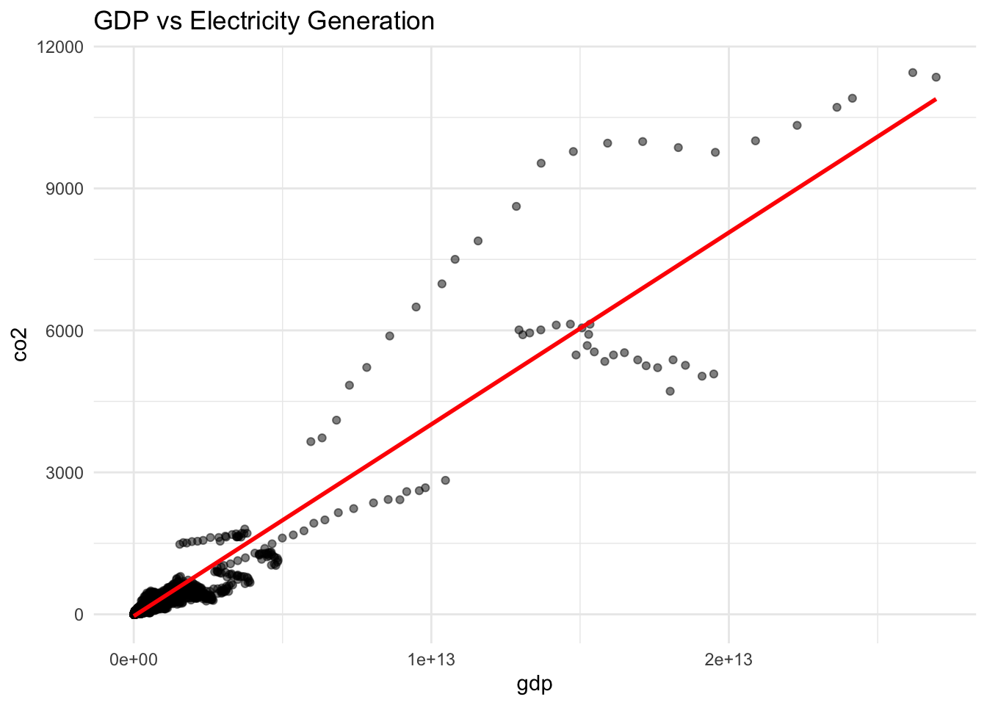
Exploratory Data Analysis - Dataset 1

Slide 14
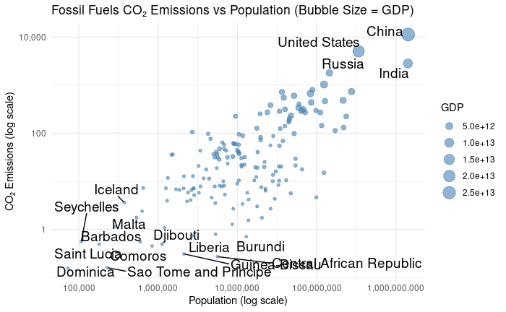
Exploratory Data Analysis - Dataset 1

Slide 15
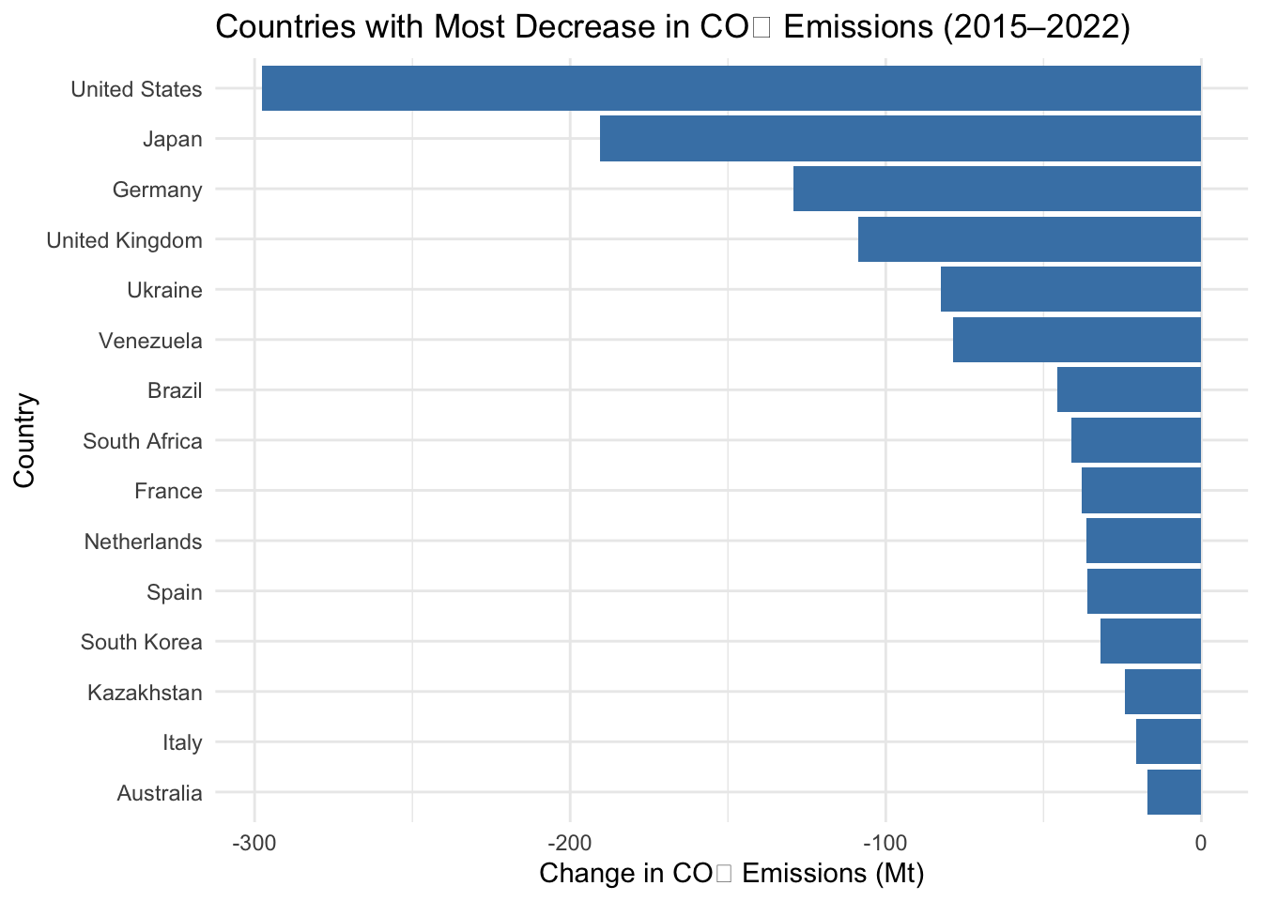
Exploratory Data Analysis - Dataset 1
The Paris Agreement is an international treaty on climate change adopted in 2015 that tries to make countries limit global warming to below 2 degrees Celsius,

Slide 16
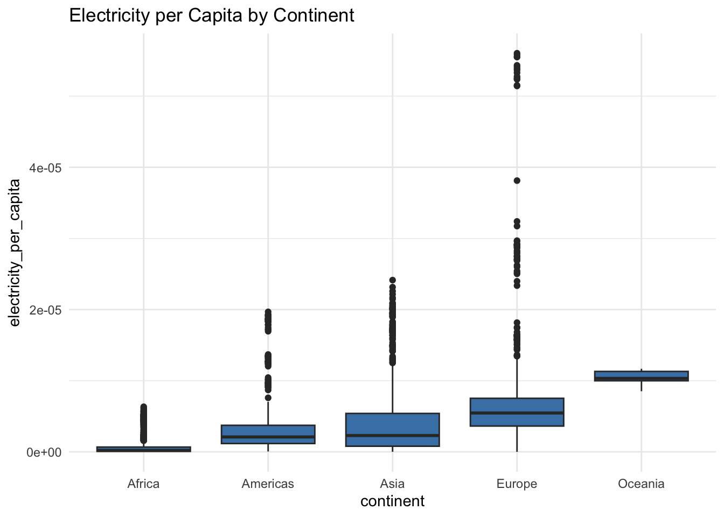
Exploratory Data Analysis - Dataset 2

Slide 17
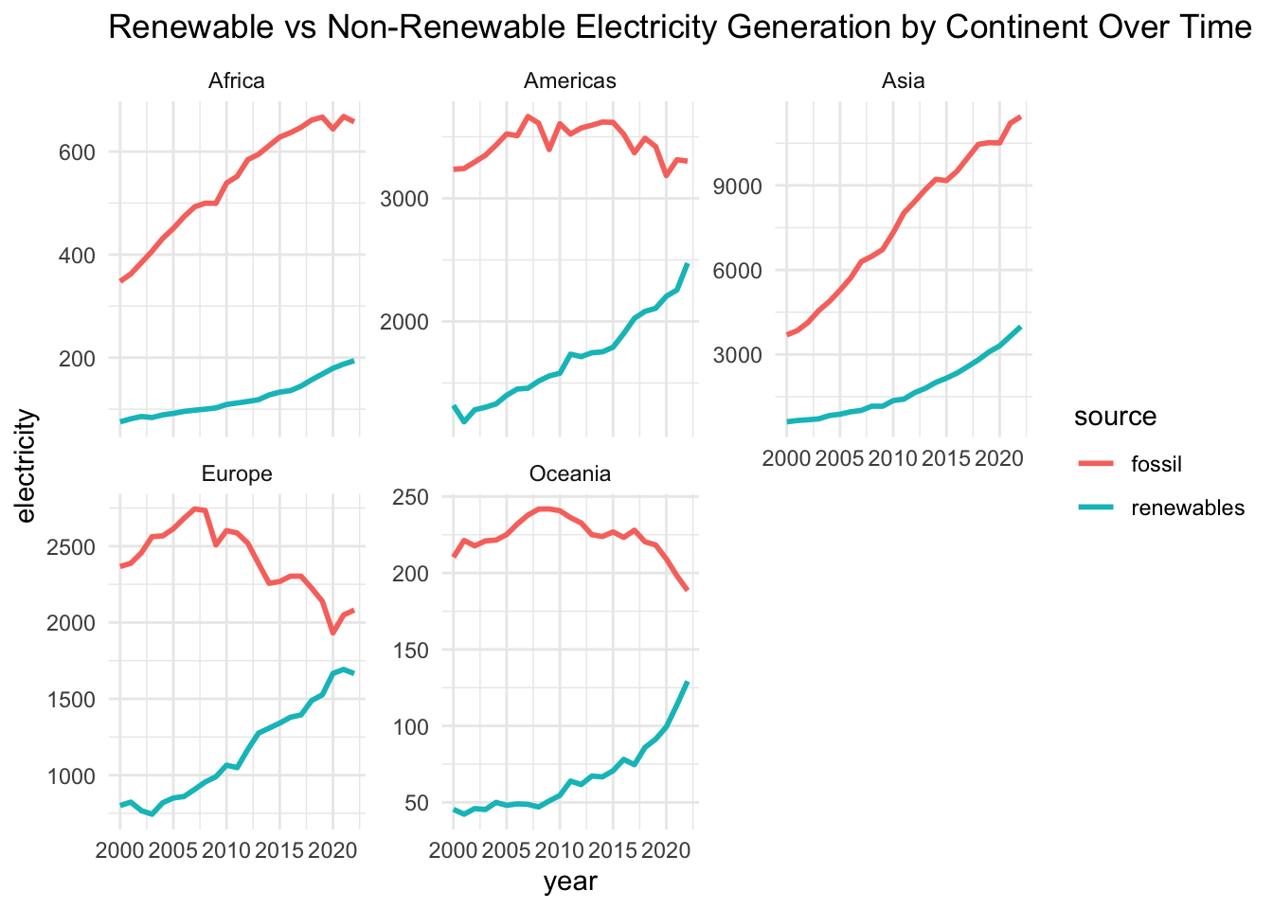
Exploratory Data Analysis - Dataset 2

Slide 18
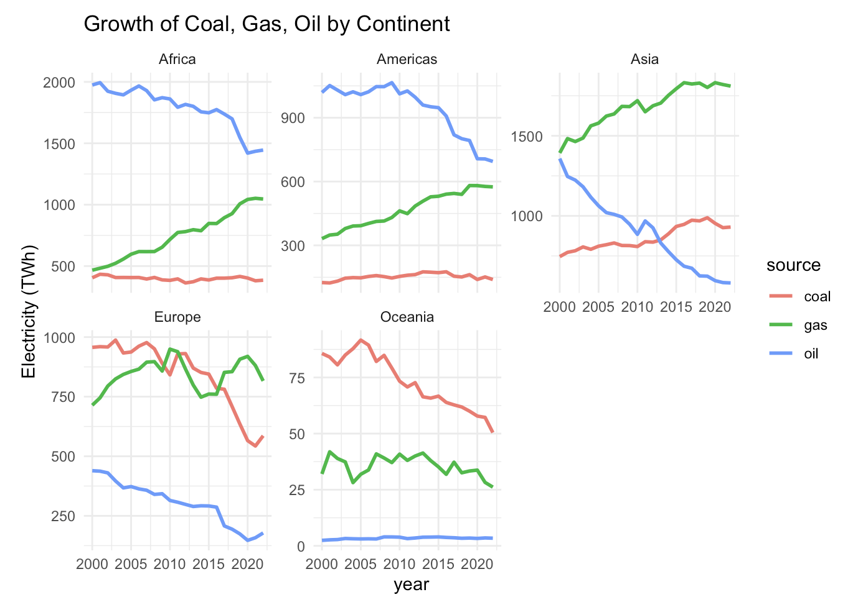
Exploratory Data Analysis - Dataset 2

Slide 19
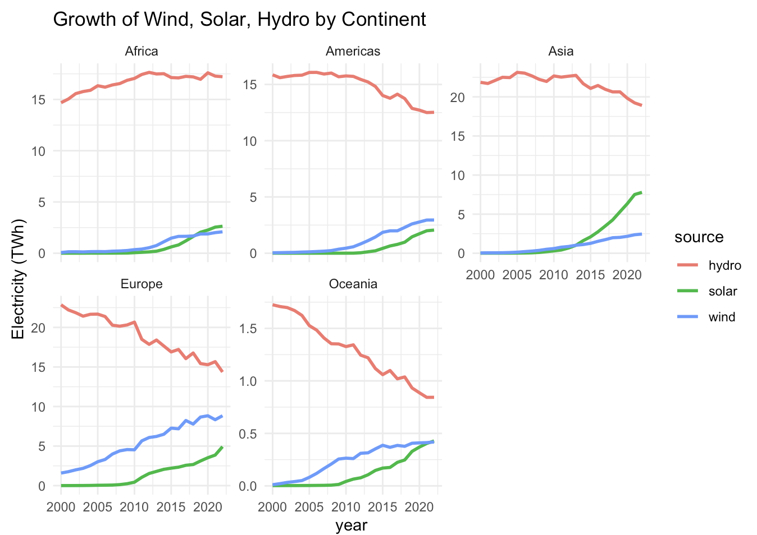
Exploratory Data Analysis - Dataset 2

Slide 20
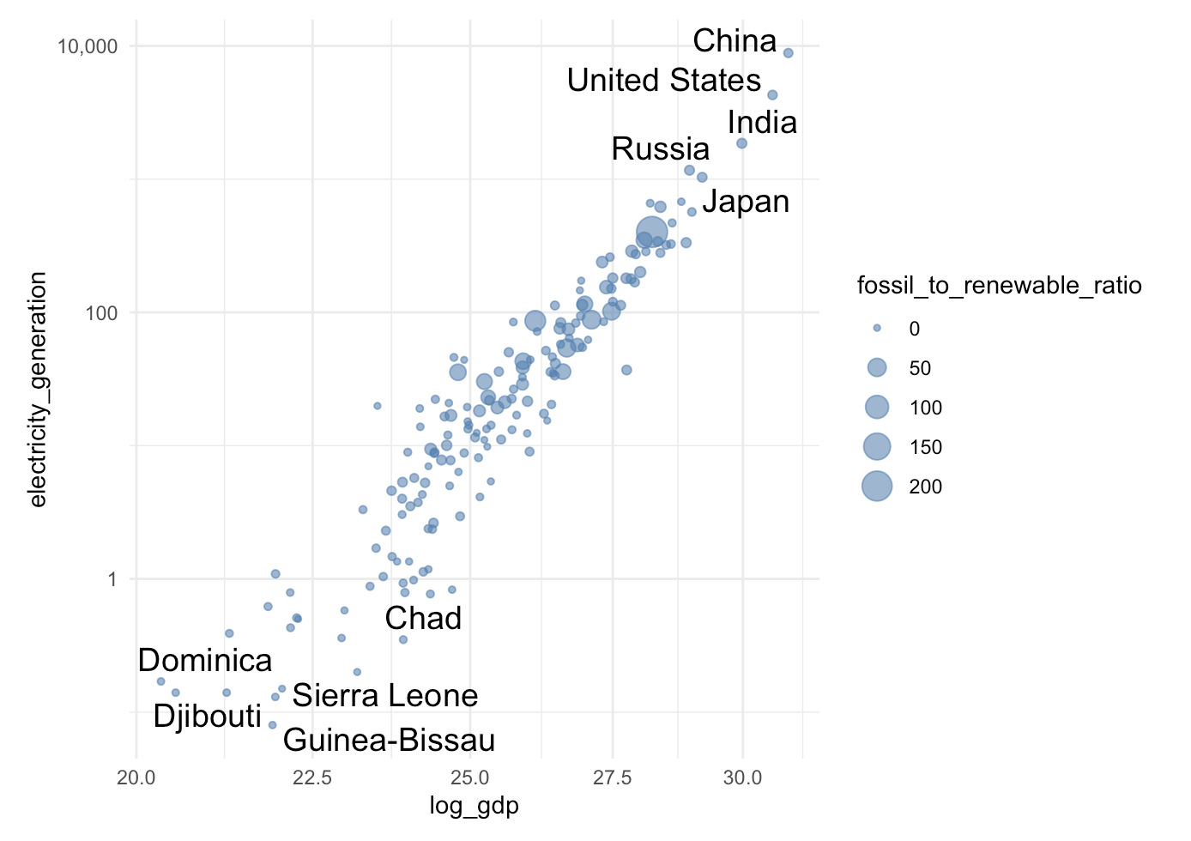
Exploratory Data Analysis - Dataset 2

Slide 21
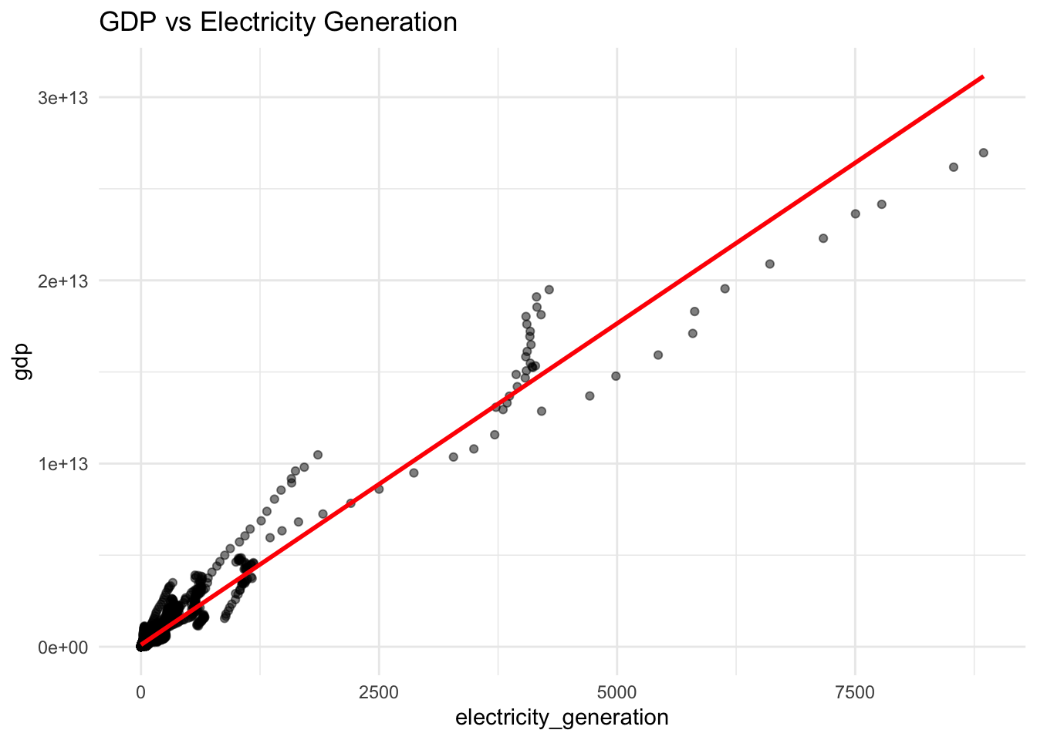
Exploratory Data Analysis - Dataset 2

Slide 22
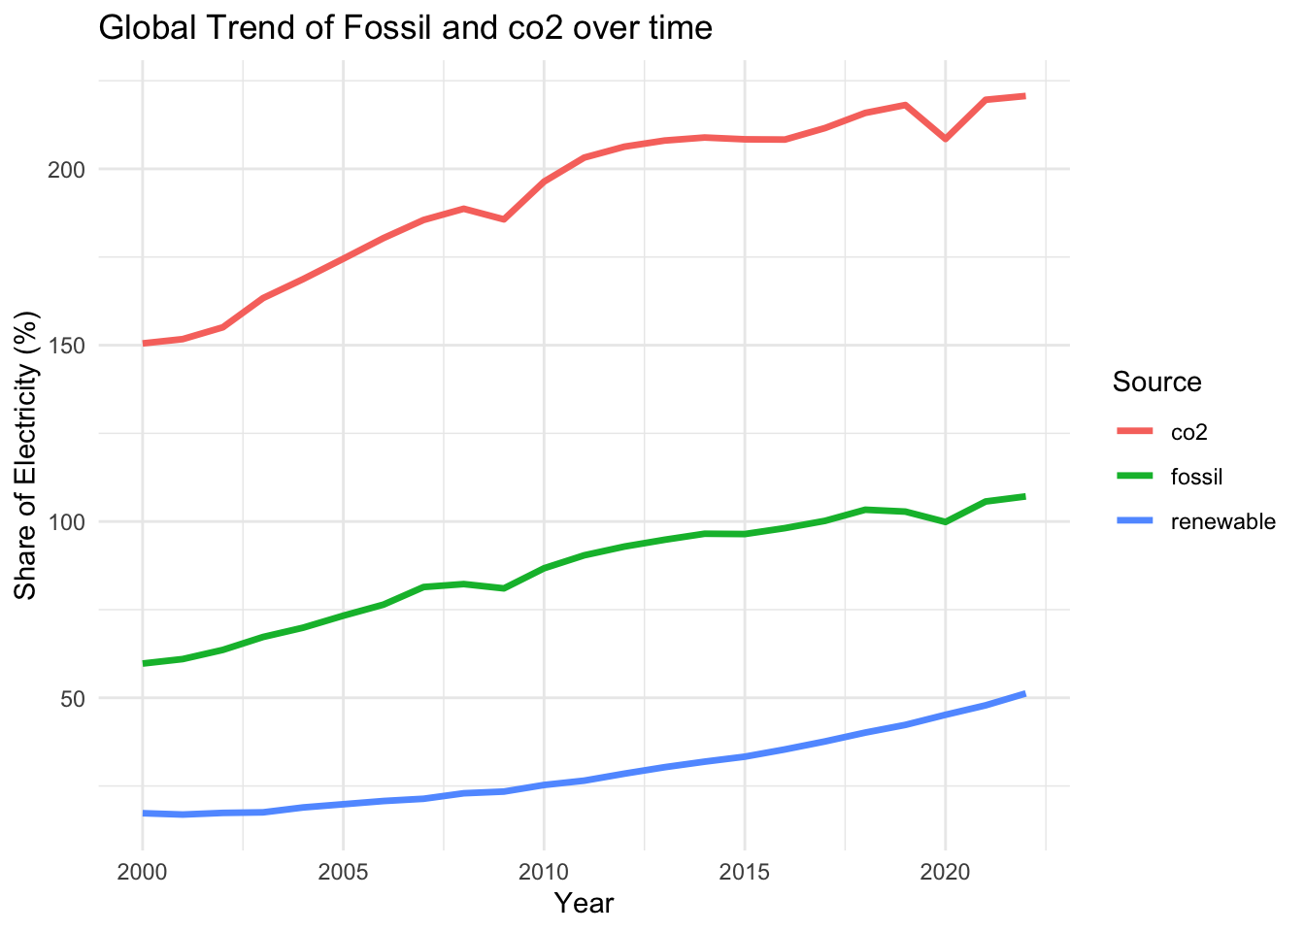
Exploratory Data Analysis - Merged Dataset

Slide 23
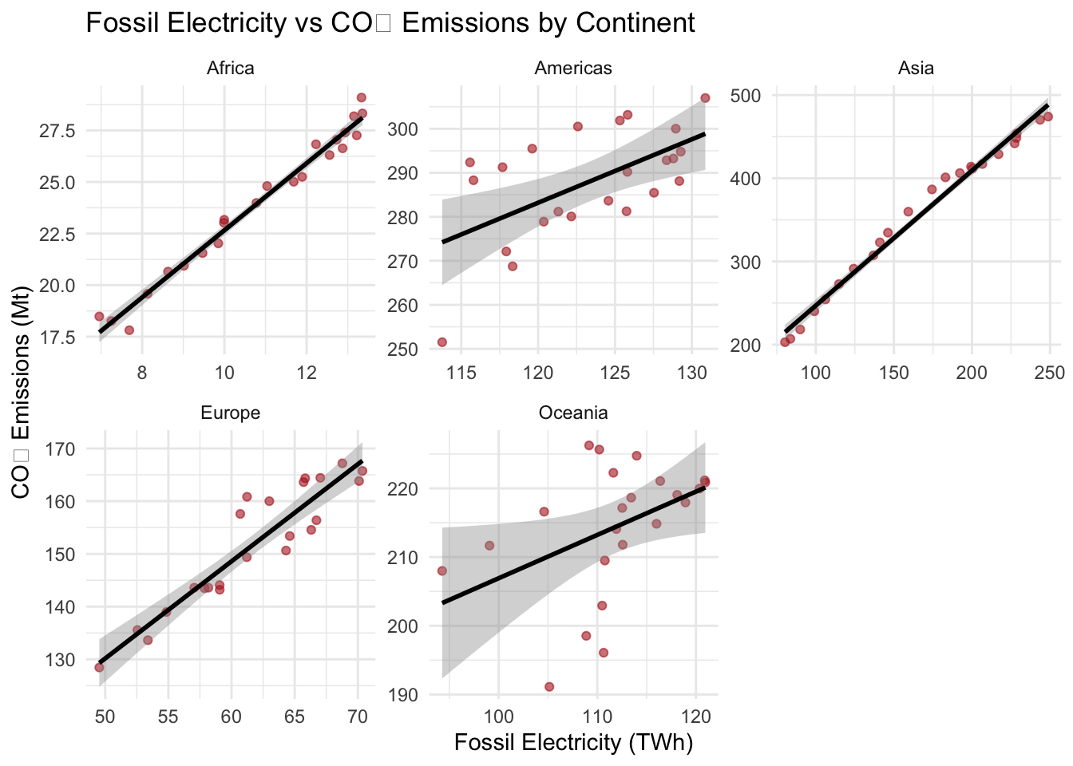
Exploratory Data Analysis - Merged Dataset

Slide 24
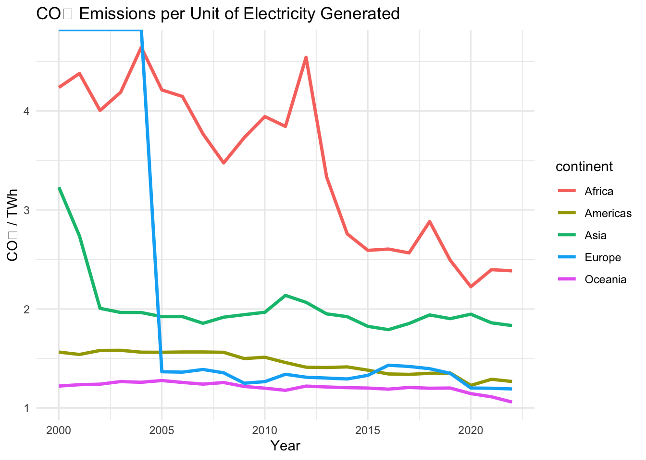
Exploratory Data Analysis - Merged Dataset

Slide 25
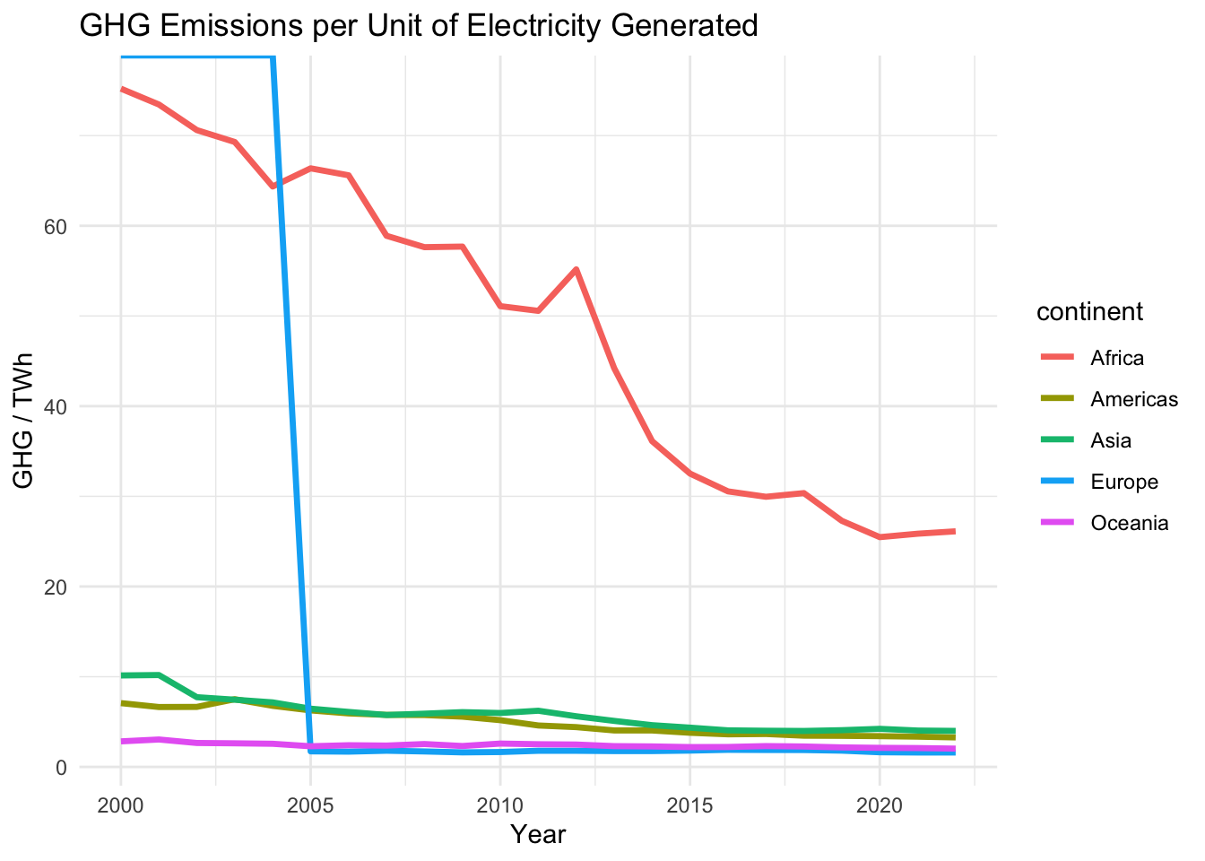
Exploratory Data Analysis - Merged Dataset

Slide 26
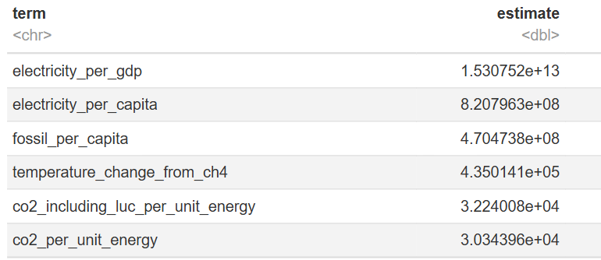
Exploratory Data Analysis - Merged Dataset
Linear regression of CO2 against every other column sorted by estimate

Slide 27
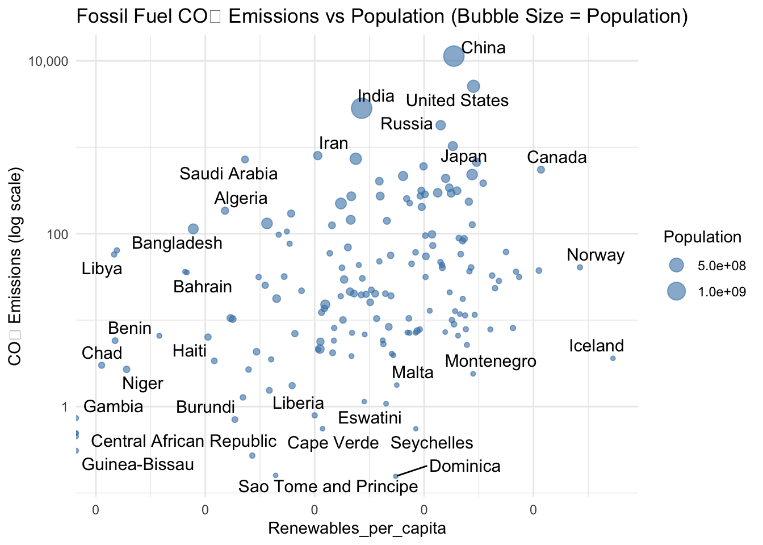
Exploratory Data Analysis - Merged Dataset

