Slide 1
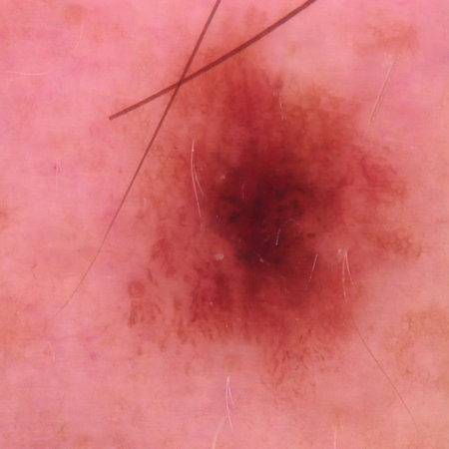
Skin Cancer Detection
Using Deep Learning and Explainable AI
HAM10000 | PyTorch | EfficientNet | ViT | Grad-CAM | Streamlit
End-to-end application
From dataset loading to a working web app with prediction heatmaps.
01

Slide 2
SKIN CANCER DETECTION
Project objective
Build a complete pipeline that can classify dermoscopic lesion images and explain the visual evidence behind each prediction.
7
- Use HAM10000 as the supervised image dataset.
- Compare a CNN against a Vision Transformer.
- Expose predictions through a Streamlit app with Grad-CAM Explainable AI.
diagnostic classes
02

Slide 3
SKIN CANCER DETECTION
Dataset: HAM10000
akiec
Actinic keratoses
bcc
Basal cell carcinoma
bkl
Benign keratosis-like
df
Dermatofibroma
mel
Melanoma
nv
Melanocytic nevi
vasc
Vascular lesions
The model cannot predict diseases outside these labels unless new labeled data is added.
03

Slide 4
SKIN CANCER DETECTION
End-to-end workflow
1
2
3
4
5
6
>
>
>
>
>
Dataset
Preprocess
Train
Evaluate
Explain
Deploy
04

Slide 5
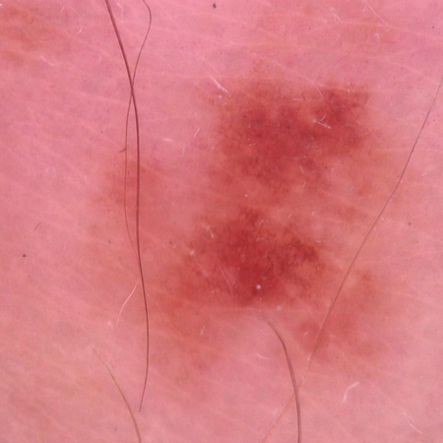
SKIN CANCER DETECTION + XAI
Preprocessing and augmentation
Training images are transformed to improve robustness.
- Resize every image to 224 x 224 pixels.
- Normalize with ImageNet mean and standard deviation.
- Apply random flips, rotations, and color jitter only during training.
HAM10000 Deep Learning Project | 05

Slide 6
SKIN CANCER DETECTION
Model comparison design
EfficientNet-B0
Vision Transformer
- CNN architecture
- Extracts local features using convolutional filters
- Pretrained on ImageNet
- Best practical choice for CPU demo
- Tranformer based architecture
- Learns global image relationships
- Useful comparison against CNNs
- Usually slower on CPU
05

Slide 7
SKIN CANCER DETECTION + XAI
Training setup
224
32
15
7
Image size
Batch size
Epochs configured
Classes
Training used weighted sampling and weighted cross-entropy to handle the class imbalance visible in HAM10000.
- AdamW optimizer
- Cosine learning-rate schedule
- Early stopping
- Best checkpoint saved by validation F1
HAM10000 Deep Learning Project | 07

Slide 8
SKIN CANCER DETECTION + XAI
EfficientNet training progress
Best checkpoint
Epoch 7
Saved as checkpoints/best_efficientnet.pt
HAM10000 Deep Learning Project | 08

Slide 9
SKIN CANCER DETECTION + XAI
Evaluation results: EfficientNet checkpoint
Result interpretation
- ROC-AUC is strong, showing useful class separation.
- Accuracy and F1 are limited because training ran on CPU and stopped early.
- Recall is high, but precision needs improvement with longer training and tuning.
HAM10000 Deep Learning Project | 09

Slide 10
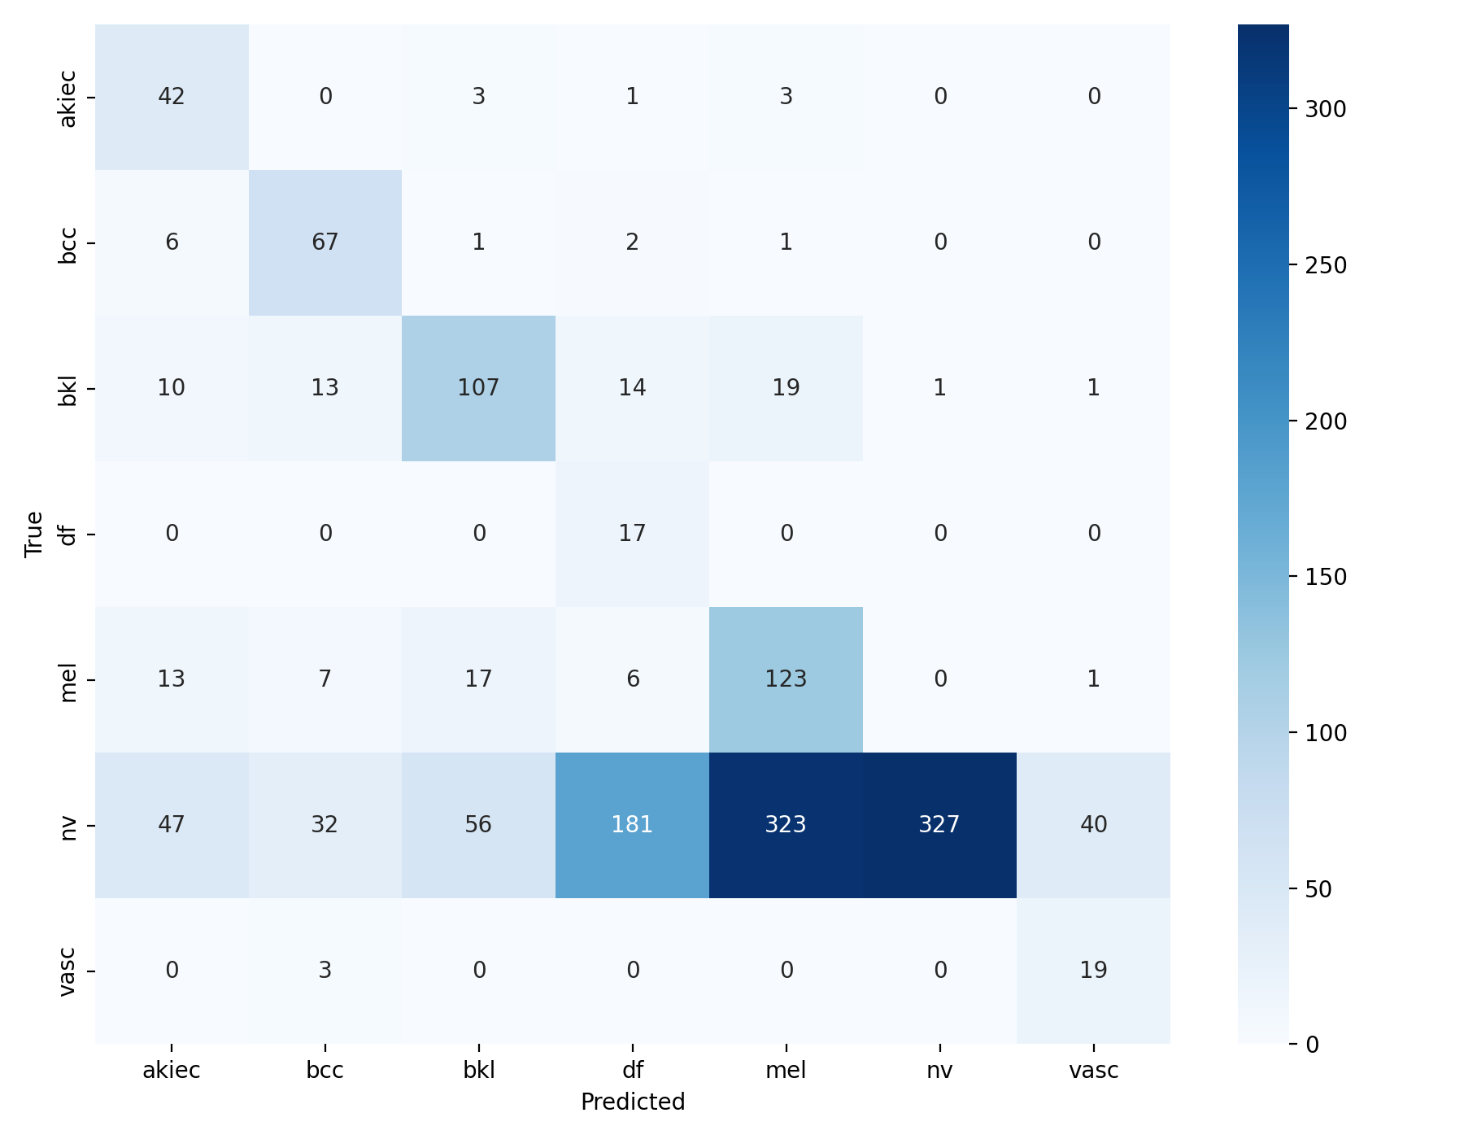
SKIN CANCER DETECTION + XAI
Confusion matrix
Why this matters
- Shows which classes are confused with each other.
- More informative than accuracy for imbalanced medical data.
- Helps identify classes that need more samples or stronger augmentation.
HAM10000 Deep Learning Project | 10

Slide 11
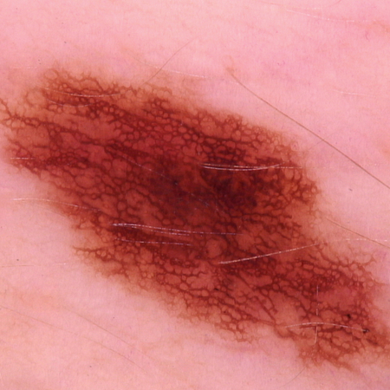
SKIN CANCER DETECTION
Explainability and web app
Streamlit app output
Grad-CAM
- Upload lesion image
- View predicted class
- View confidence score
- Inspect Grad-CAM overlay
- Read short explanation
heatmap
Generated at inference time
O6

Slide 12
SKIN CANCER DETECTION
Limitations and next steps
Current limitations
Recommended improvements
- Not a medical diagnostic device
- HAM10000 is class-imbalanced
- CPU training limits final accuracy
- Grad-CAM explains influence, not correctness
- Train longer with GPU support
- Tune augmentation and class weights
- Complete ViT comparison
- Add external validation data
07

Slide 13
Thank you
Skin Cancer Detection Using Deep Learning and Explainable AI
Demo: Derma Vision AI

