Slide 1
Cloud Healthcare Data Analytics System
2320030205-N.ManasaLahari 2320030489- G AKASH 2320030397-N NANDINI NAGAR

Slide 2
Abstract
Modern hospitals rely on multiple disconnected systems for managing patients, staff, beds, equipment, and clinical workflows. This fragmentation causes delays in identifying high-risk patients and operational bottlenecks.
The proposed Intelligent Hospital Operations & Patient Risk Intelligence Web Platform integrates real-time patient vitals, lab summaries, admission data, bed occupancy, and staff availability into a unified dashboard.
Using machine learning-based risk prediction and explainable AI, the system correlates clinical and operational signals to generate early warning alerts. The platform enhances patient safety, optimizes resource allocation, and supports data-driven hospital decision-making.

Slide 3
Introduction & Motivation
• Fragmented hospital systems cause delayed decisions
• No unified clinical + operational intelligence
• Increasing patient load requires predictive monitoring
• Need real-time web-based risk detection platform

Slide 4
Objectives
• Integrate vitals, labs, admissions & staffing data
• Develop AI-based risk scoring engine
• Provide real-time interactive dashboard
• Enable role-based secure access
• Generate explainable early warning alerts

Slide 5
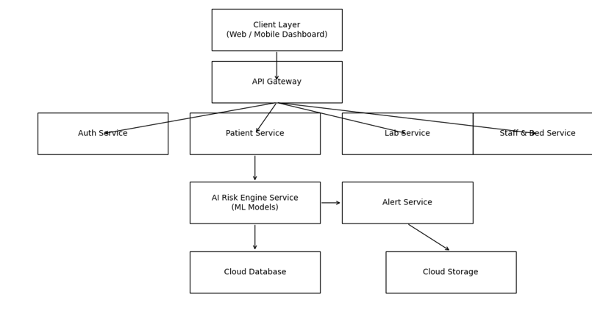
Proposed System Architecture

Slide 6
Existing System Analysis
• Disconnected hospital systems
• Manual monitoring of patient vitals
• No centralized risk prediction
• Delayed emergency response (25–30 mins avg)
• Frequent ICU overload during peak hours
• No operational forecasting
• No explainable AI support

Slide 7
Proposed System Improvements (Expected Results)
• Alert response time reduced to <10 mins
• 85–92% patient risk prediction accuracy
• Real-time ICU occupancy forecasting
• 30–40% improvement in resource allocation efficiency
• Transparent explainable AI-based alerts
• Scalable cloud deployment for multi-hospital use

Slide 8
Timeline (5 Months)
Month 1: System Design
Month 2: Backend & Database Development
Month 3: Frontend Dashboard
Month 4: AI Model Integration
Month 5: Testing & Deployment

Slide 9
References
Rajkomar et al., NPJ Digital Medicine, 2018
Churpek et al., Critical Care Medicine, 2016
Topol E., Nature Medicine, 2019
Sendak et al., NPJ Digital Medicine, 2020
WHO Global Strategy on Digital Health, 2021

Slide 10
THANK YOU

