Slide 1
Aim:
To develop a real-time, event-driven vision system that efficiently detects and tracks moving objects by processing only pixel-level changes, mimicking neuromorphic sensors, thereby reducing computational load and latency compared to conventional frame-based vision systems.

Slide 2
Problem statement:
Conventional frame-based vision systems continuously process entire image frames, resulting in high computational cost, increased latency, and redundant data processing.
Hence, there is a need for an efficient event-driven vision system that processes only significant pixel-level changes to enable faster and real-time motion detection.

Slide 3
Literature survey :
Sl.no | Title of the project | Year of publication | Existing design description | Limitations
1 | Retinomorphic Event-Based Vision Sensors | 2014 | Spiking pixel sensors, asynchronous event generation, neuromorphic camera design. | Focused mainly on hardware, minimal algorithmic processing.
2 | 240×180 Spatiotemporal Vision Sensor | 2014 | High-resolution event camera, global shutter, microsecond latency | High hardware cost; requires specialized setup
3 | Real-Time Visual-Inertial Odometry for Event Cameras | 2017 | Event camera + IMU, keyframe-based optimization, real-time motion tracking | Complex sensor fusion and calibration needed.

Slide 4
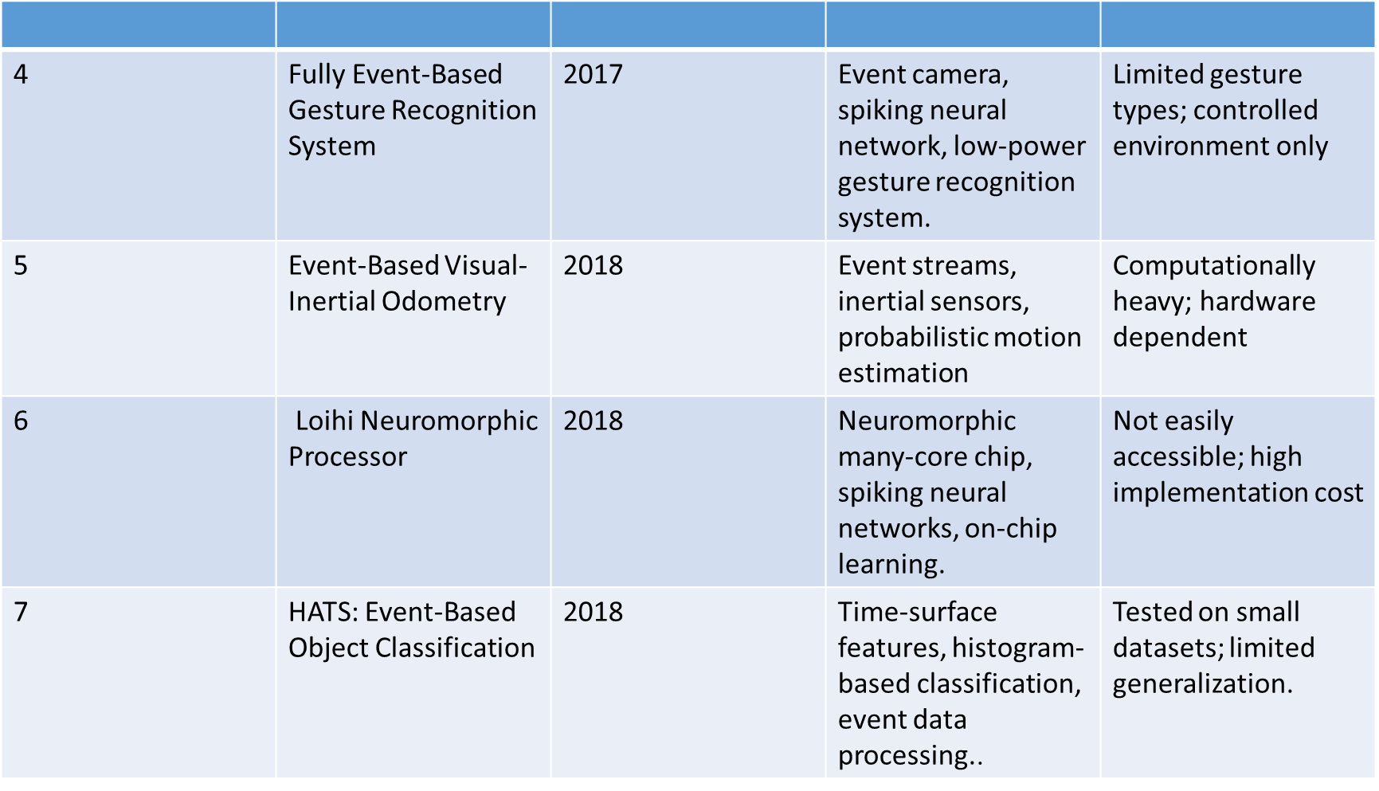

Slide 5
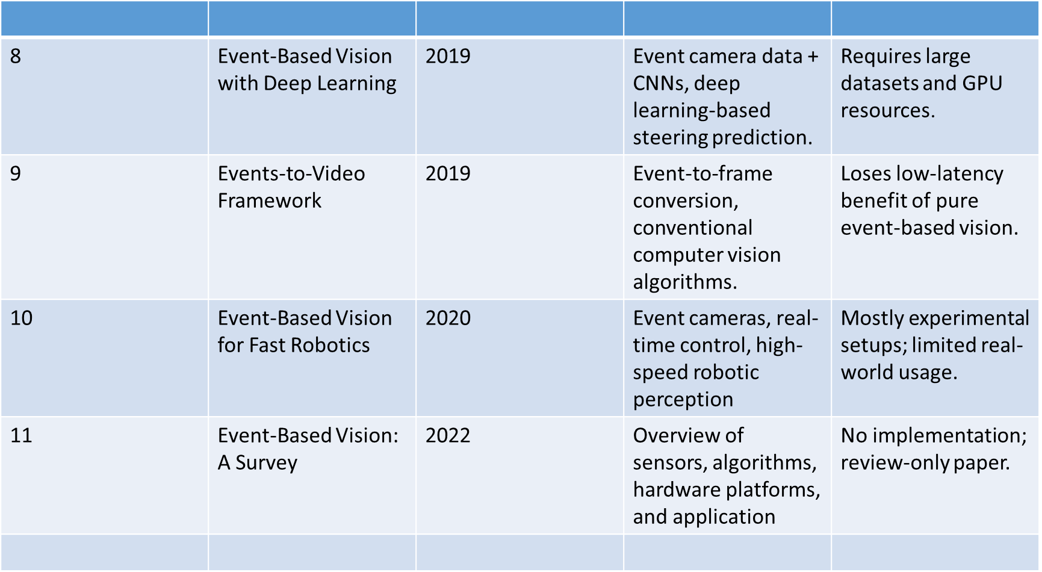

Slide 6
Existing design
Frame-by-frame image processing
Continuous pixel processing regardless of motion
Uses full-frame storage and analysis
High computational load and memory usage

Slide 7
Existing design-limitations
High latency due to full-frame processing
Redundant data processing
Increased memory consumption
Not suitable for real-time applications
Inefficient for low-power systems

Slide 8
Proposed design
Event-driven processing using pixel-level changes
Frame differencing for motion detection
Thresholding to generate events
Contour detection for identifying moving objects
Real-time visualization with bounding boxes

Slide 9
Innovation in proposed design
Event-based motion representation
Pixel-level analysis
Lightweight non-AI approach
Configurable sensitivity control
Works on standard hardware without special sensors

Slide 10
Methodology
Capture video using webcam
Convert frames to grayscale
Apply frame differencing
Apply thresholding to detect events
Detect contours for motion regions
Draw bounding boxes around moving objects
Display real-time output

Slide 11
Objectives:
1. To implement a software-simulated event-based vision system that detects meaningful pixel-level changes instead of processing full image frames.
2. To visualize motion in real-time using both white-on-black event representation and overlay on the original-colored frame with bounding boxes highlighting moving regions.
3. To demonstrate the efficiency of event-driven processing in reducing computational load, latency, and memory usage compared to conventional frame-based vision systems.

Slide 12
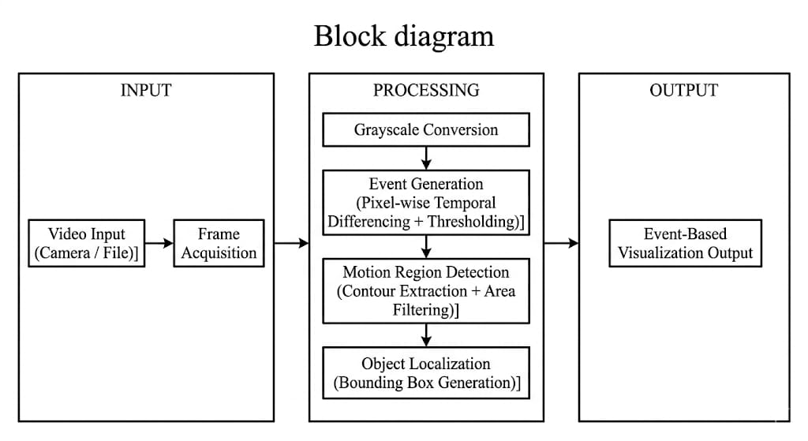
Block diagram

Slide 13
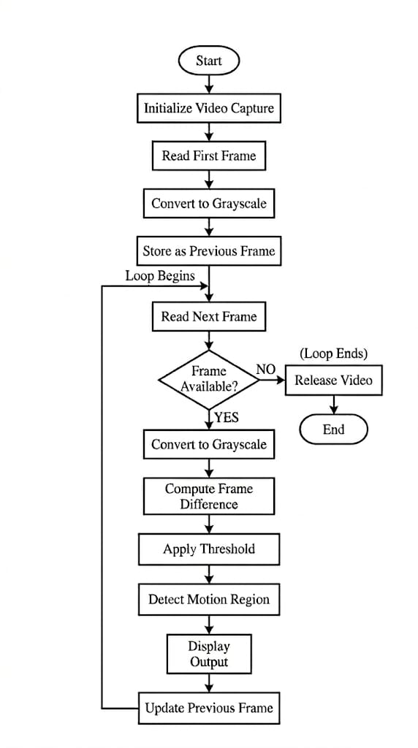
Flow chart

Slide 14
Design - implementation & technical innovations:
Modular structure
Frame differencing for motion detection
Threshold-based event extraction
Dual-frame buffering
Real-time visualization
Design and Implementation:
Technical Innovations:
Event-driven motion representation
Pixel-level temporal analysis
Lightweight non-AI approach
Configurable sensitivity control
Real-time execution on standard hardware

Slide 15
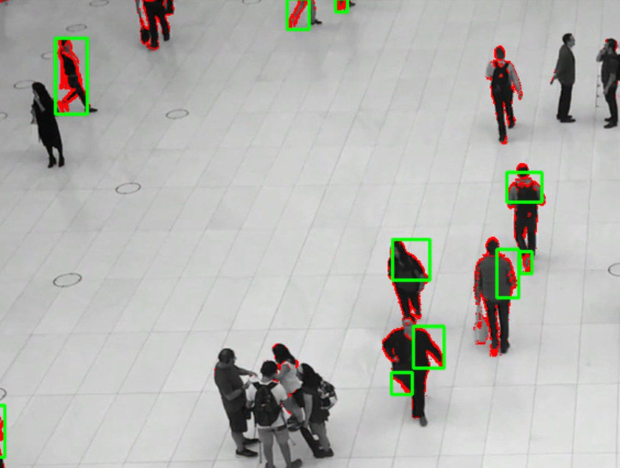
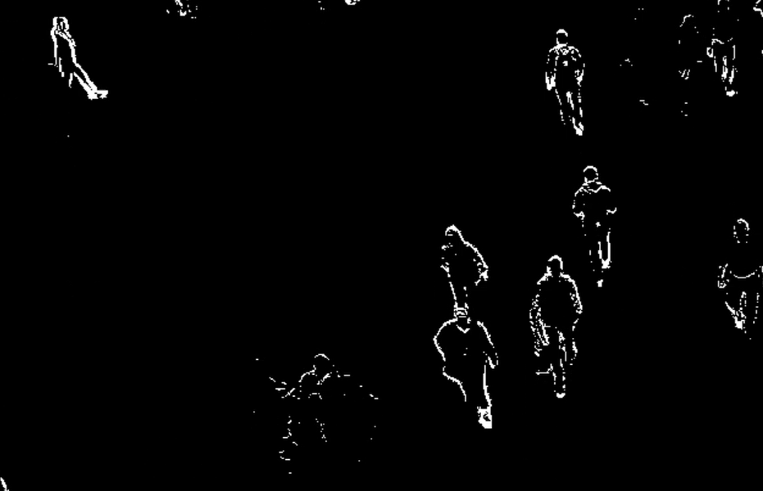
Objective-1:Results and Outcomes
Results:
Outcomes:
Motion regions clearly visualized
Reduced computational load compared to full-frame processing
Ready for monitoring applications

Slide 16
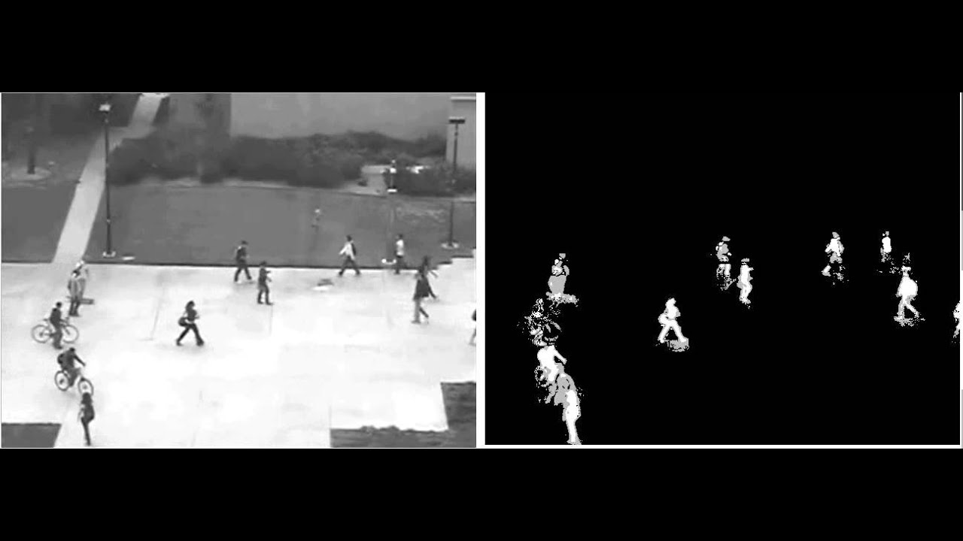

Objective-2: Results and Outcomes:
Results:
Real-time detection using live webcam feed
System maintained performance at 15-30 FPS
Efficient dual-frame memory usage
Stable event generation with minimal noise
Outcomes:
Provides continuous motion tracking
Robust against minor illumination changes
Configurable threshold improves detection
accuracy.

Slide 17
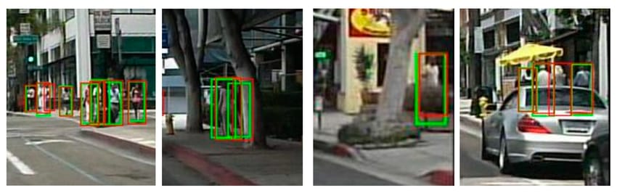
Objective-3: Results and Outcomes:
Scalable to multiple video sources for broader motion monitoring
Can integrate with real-time alert/notification systems
Applicable for robotics and autonomous vehicle motion tracking
Provides a foundation for intelligent, event-driven surveillance systems
Adaptable for real-time software platforms(desktop or edge devices)
Extensible for future neuromorphic vision application

Slide 18
Comparative analysis
Feature | Traditional System | Proposed System
Processing | Full frame | Event-based
Latency | High | Low
Memory | High | Low
Efficiency | Low | High
Real-time | Limited | Achieved

Slide 19
Conclusion-future Scope
Conclusion:
Successfully implemented event-driven vision system
Reduced computation and latency
Real-time motion detection achieved
Future Scope:
Multi-camera support
GUI improvements
Integration with alert systems
AI-based object classification
Hardware implementation using neuromorphic sensors

