Slide 1

SENTIMENT ANALYSIS OF AMAZON REVIEWS

Slide 2
About the team
Guide
Dr Roshan Fernandes
Associate Professor
Department of Computer Science and Engineering
Team Members
●M Ramya Prabhu : 4NM17CS094
●Manasa : 4NM17CS099
●Avinash B : 4NM18CS401
●Meghashree S : 4NM18CS409

Slide 3
Introduction
Sentiment analysis:Process of detecting positive or negative sentiment in text.
Customers express their thoughts and feelings more openly than ever before.
Allows brands to learn what makes customers happy or frustrated, so that they can tailor products and services to meet their customers’ needs.
The aim of the project is to implement an algorithm for automatic classification of text into positive or negative sentiments and to develop a feature extraction model.

Slide 4
Literature Survey

Slide 5
Paper Name | Dataset | Techniques | Advantages | Disadvantages
1)Sentiment analysis of product based reviews - Manvee Chauhan, Divakar Yadav (December 2015) | Collected from different sites like consumerreview.com,cnet.com,download.com, zdnet.com. It consists of 13094 product reviews where 12094 are of training and 1000 for testing. | To develop an interface Microsoft visual studio is used. It is possible to test and train datasets,extract features out of it. Either naïve bayes or support vector is used to work upon the data and predict polarity of opinions. | Naïve bayes gives better accuracy that is 84.02% . | Large text files take long time for computation.

Slide 6
Paper Name | Dataset | Techniques | Advantages | Disadvantages
2)Twitter Sentiment Analysis Based on Ordinal Regression-Shihab Elbagir,Jing Yang (October 2019) | Data is collected from Twitter using Twitter API which contains 5000 positive tweets and 5000 negative tweets. | Machine learning techniques such as Multinomial logistic regression,Support Vector Regression,Decision Trees and Random Forest used to build and study machine learning classifier. | Experimental results conclude that the proposed model can detect ordinal regression with a good accuracy result. | ---------------------

Slide 7
Paper Name | Dataset | Techniques | Advantages | Disadvantages
3)Sentiment Analysis and Sentiment Classification using NLP-G.Divya, R.Suresh (July-2016 ) | The Multi Domain Sentiment dataset: Product reviews from Amazon.com 2)Another dataset consists of reviews of 5 electronic products from Amazon and Cnet. 3)Movie review data. 4)Blogs,reviewers data from Amazon,yelp,CNETdpreview,zdnet. | Machine learning techniques like Maximum entropy,Naïve Bayes and Support vector machines for text categorization. | Maximum entropy,Naïve Bayes and SVM help achieve great success in text categorization. | Opinion word considered positive in one situation may also be considered negative in another situation. Sentence which lacks context can be difficult to understand.

Slide 8
Paper Name | Dataset | Techniques | Advantages | Disadvantages
4)Analysis of Feature Selection Methods for Text Classification using Multiple Datasets-Archit Aggarwal, Bhavya Gola,Tushar Sankla (June 2020) | a)20Newgroups Dataset b)Polarity Dataset c)Reuters21578 Dataset | Naive Bayes, Bagging, Random Forest and Naive Bayes Multinomial classifiers for text classification on various datasets. | It usually gives more often than not, better or equally good results without using any feature selection as compared to using feature selectors taking into account all the evaluation measures. | --------------------

Slide 9
Paper Name | Dataset | Techniques | Advantages | Disadvantages
5)Sentiment analysis on hotel reviews using Multinomial Naïve Bayes classifier - Arif Abdurrahman Farisi, Yuliant Sibaroni ,Said Al Faraby. (2019) | In this research the dataset is derived from Data finitis’s Business Database which contains hotel reviews of as many as 5000 English sentences in CSV File. | Multinomial Naïve Bayes Model,K-Fold Cross Validation. | The use of preprocessing in figure 1 greatly affects the performance of the system so it can be seen if using preprocessing F1-Score average results can improve performance optimally. | By doing a test scenario will result in different performance because each scenario can affect the model built. Each scenario is validated using 10 fold cross validation each time

Slide 10
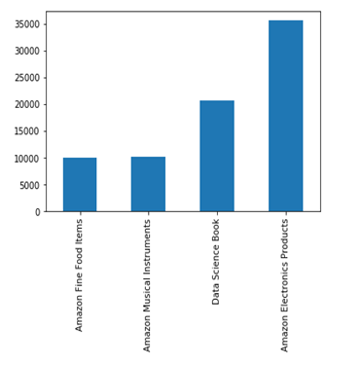
Data set analysis
Importing the libraries.
Load the dataset.
Validate the dataset.
Check for NULL values.

Slide 11
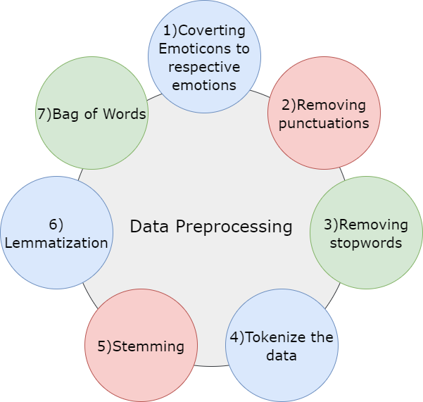
Steps in Data Pre-processing

Slide 12
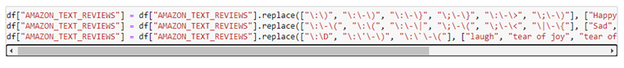
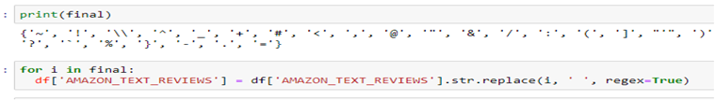
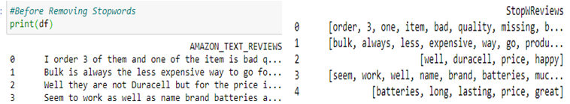
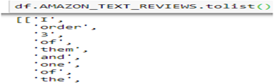
1)
2)
3)
4)

Slide 13
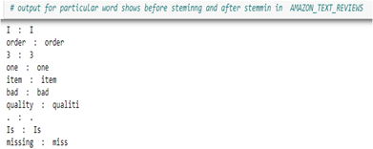
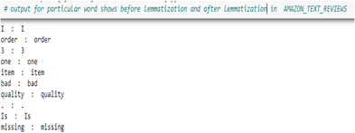
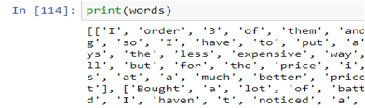
5)
6)
7)

Slide 14
Future Work
Our data is pre-processed and ready for implementation.

Slide 15
Thank you

Slide 16
Phase 1 Progress
Literature Survey
Dataset Acquisition
Data Preprocessing

Slide 17
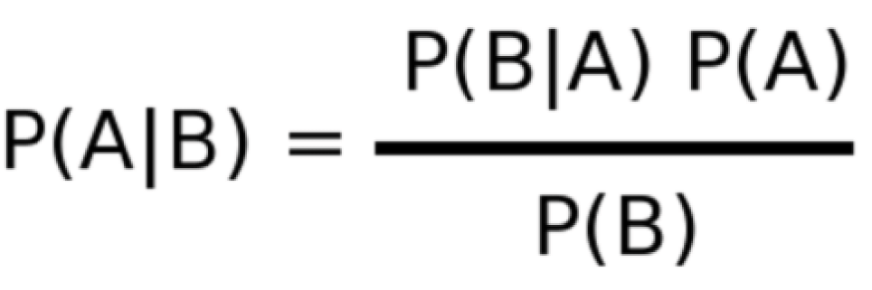
Naive Bayes
Family of Probabilistic classifier based on applying Bayes theorem.
As the name suggests, here this algorithm makes an assumption as all the variables in the dataset is “Naive” i.e not correlated to each other.
It calculates probability of a class given a set of feature values

Slide 18
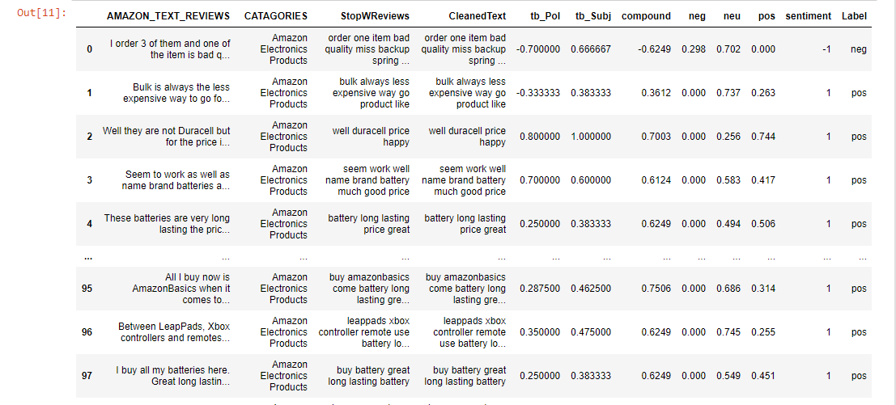

Slide 19
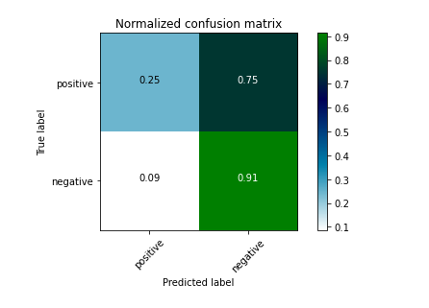
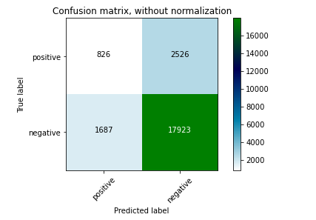

Slide 20
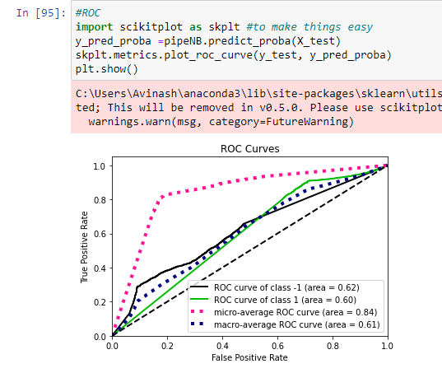
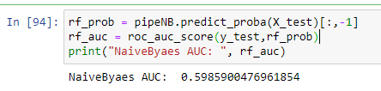
ROC with AUC score Naïve Bayes

Slide 21
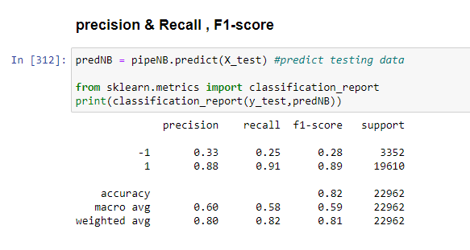
Naïve bayes

Slide 22
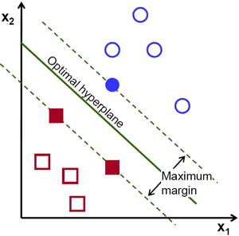
Support Vector Machine(SVM)
Supervised Machine Learning model.
Objective is to find a hyperplane in an N-dimensional space that distinctly classifies the data points.
There are many possible hyperplanes that could
be chosen.
Our objective is to find a plane that has the maximum margin, i.e the maximum distance between data points of both classes.

Slide 23
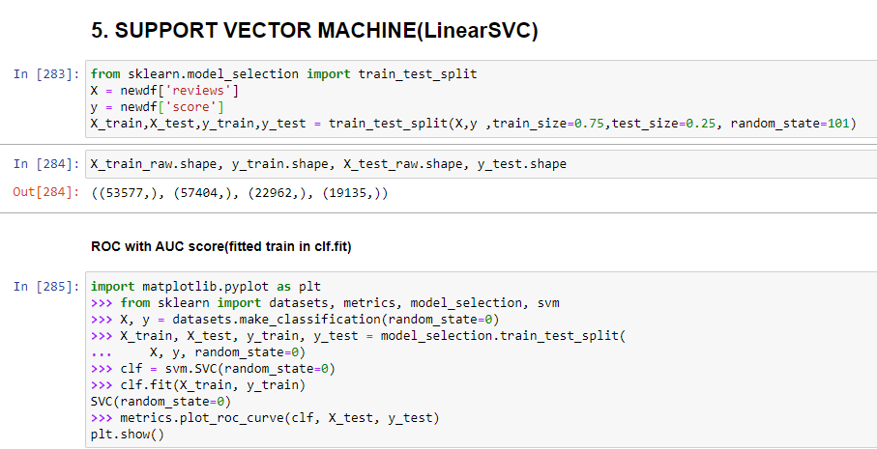

Slide 24
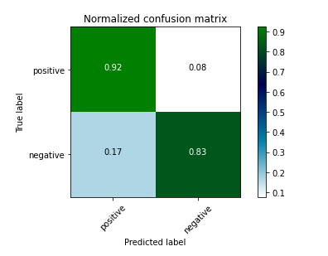
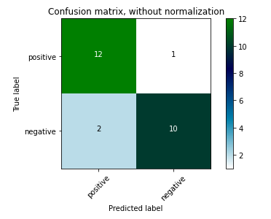

Slide 25
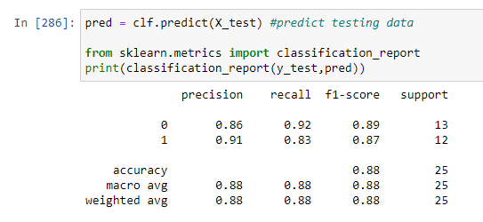
SVM

Slide 26
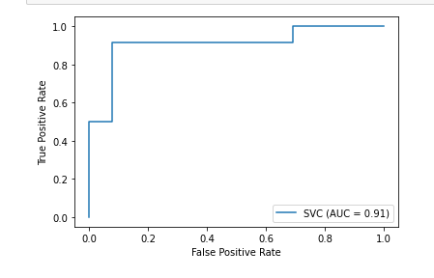
ROC with Auc Score(SVM)

Slide 27
Logistic Regression
Logistic Regression is a 'Statistical Learning' technique.
Classification algorithm.
Used to examine the association of (categorical or continuous) independent variable(s) with one dichotomous dependent variable

Slide 28
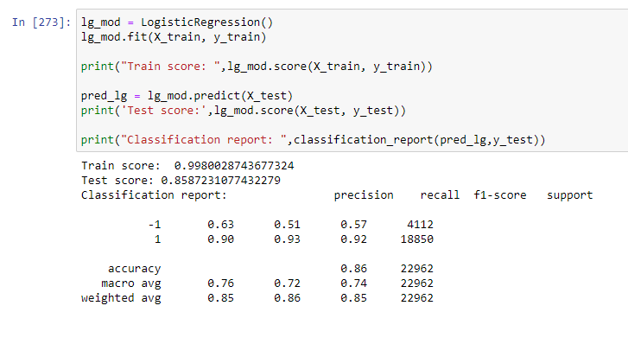
Logistic Regression

Slide 29
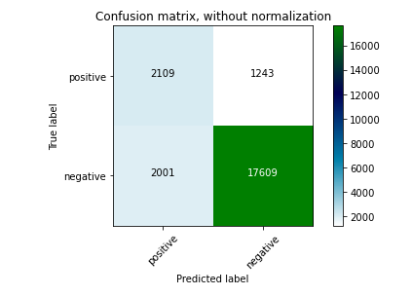
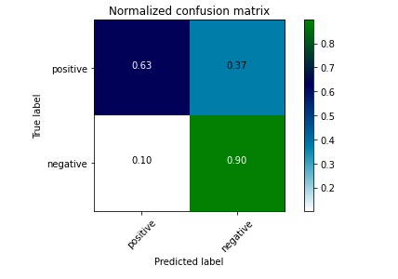

Slide 30
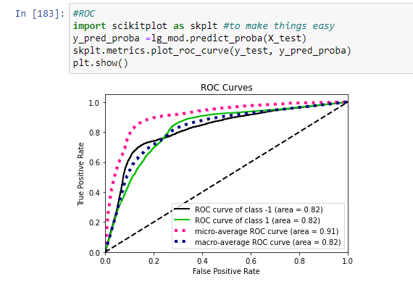
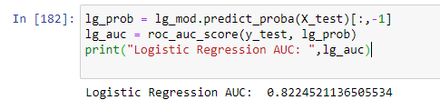
ROC with AUC score(LR)

Slide 31
Decision Tree
Data is continuously split according to a certain parameter.
Use multiple algorithms to decide to split a node into two or more sub-nodes.
Homogeneous sub-nodes.
Easy to understand.

Slide 32
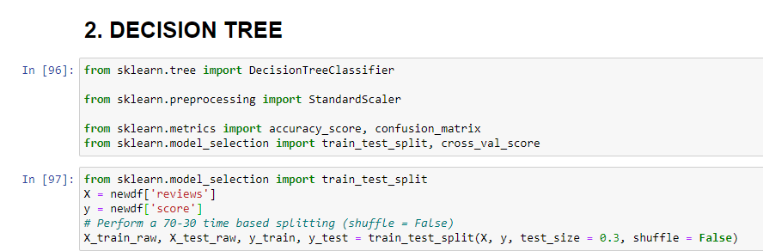
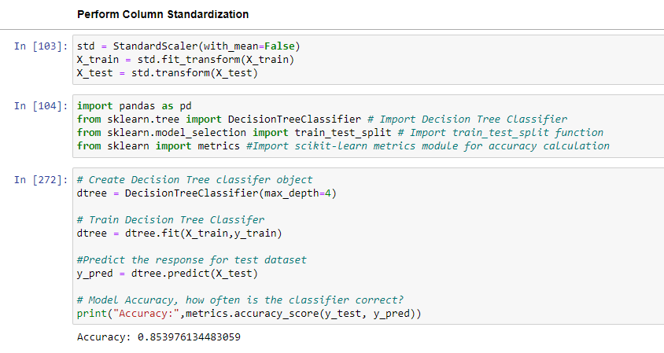

Slide 33
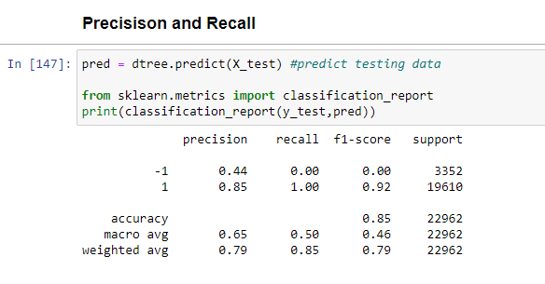
Decision Tree

Slide 34
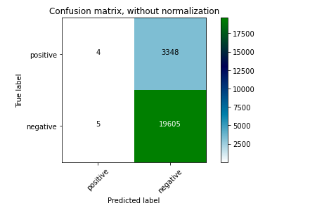
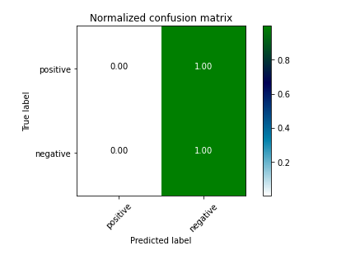

Slide 35
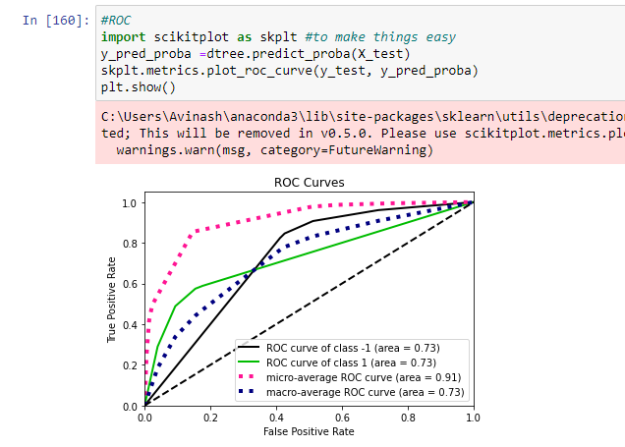
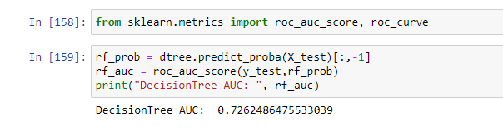
ROC with AUC score(Decision Tree)

Slide 36
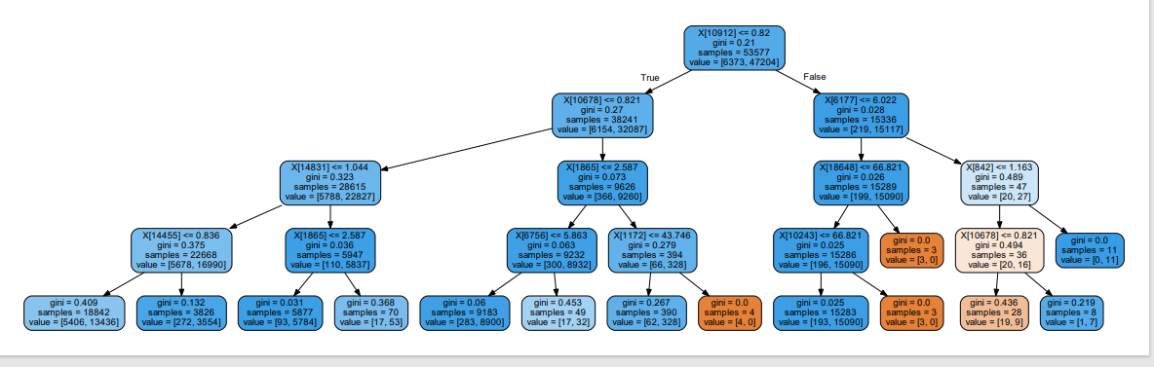
Decision Tree Visualization(Depth=4)

Slide 37
Random Forest
Supervised learning algorithm.
Creates decision trees on data samples and then gets the prediction from each of them.
Accurate and stable prediction.
Adds additional randomness to the model.
Much more robust than a single decision tree.

Slide 38
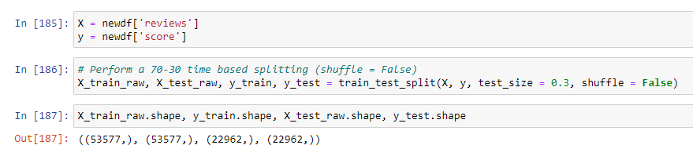
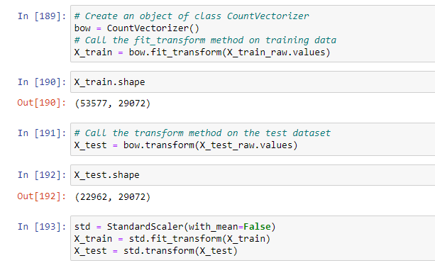

Slide 39
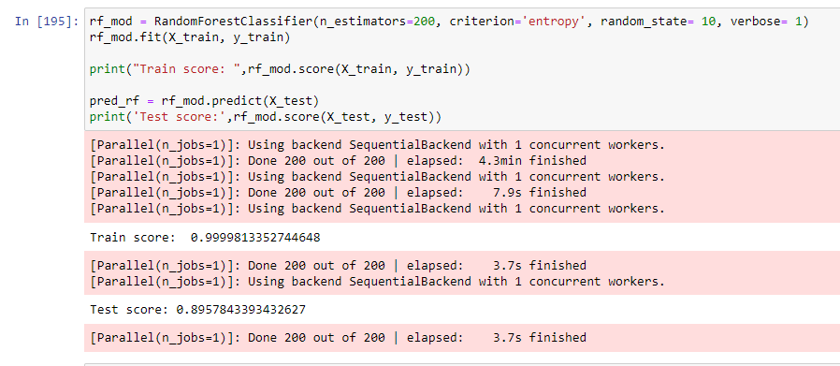
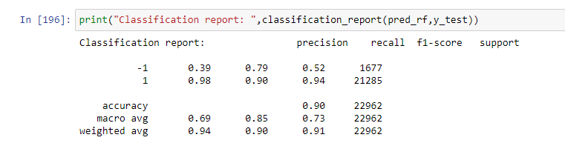

Slide 40
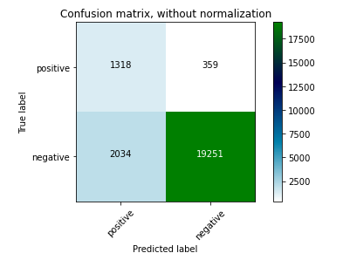
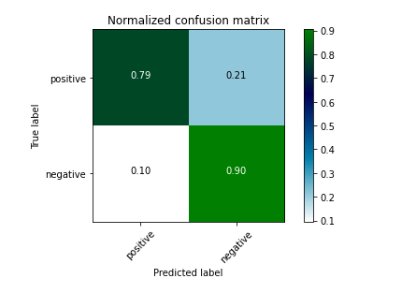

Slide 41
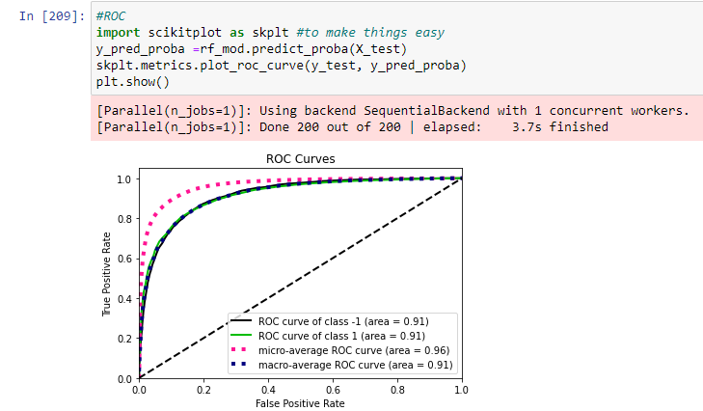
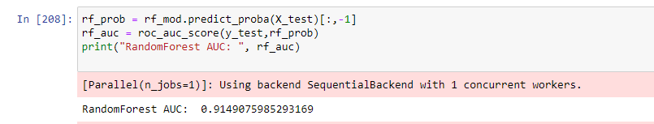
ROC with AUC score(RF)

Slide 42
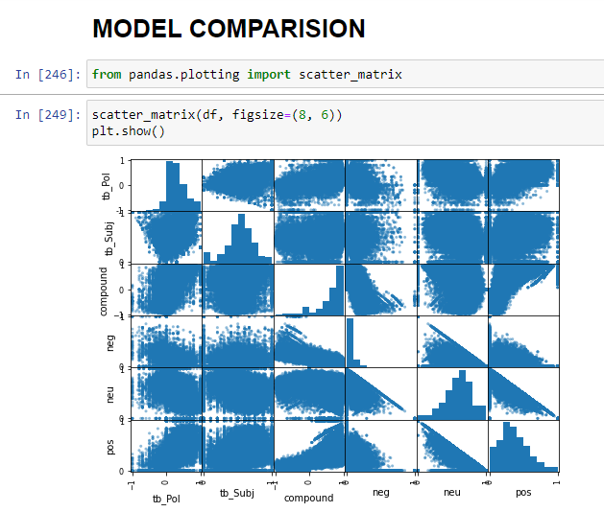

Slide 43
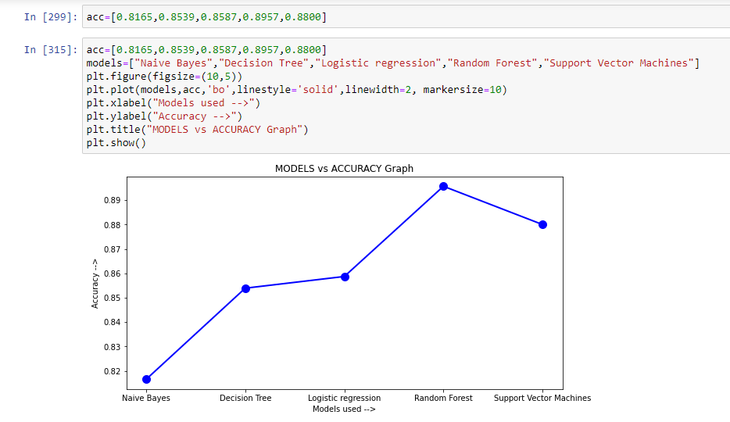
Model Evaluation

Slide 44
CONCLUSION
We have applied 5 Machine learning algorithms to each text reviews.
Determined Classification metrics for each algorithm.
We have got 90% of accuracy in RandomForest classifier.

Slide 45
THANK YOU

