Slide 1

Global Energy & Environmental InsightsA MySQL-Based Data Analysis Project
Presented By:
Manasa Reddy

Slide 2
About me
Manasa Reddy
Background : B.Tech – Electronics & Communication Engineering
Why Data Science? : I am interested in working with data, solving real- world problems, and using analytical thinking to gain meaningful insights.
Work Experience : Fresher
LinkedIn : htpp://www.linkedin.com/in/manasa-reddy-a0a057373
GitHub : htpp://www.github.com/manasareddy2023-pixel

Slide 3
AGENDA
Objective of the Project
Database Schema & ER Diagram Explanation
Key Analysis Questions
SQL Analysis & Key Insights
Conclusion & Overall Findings
Challenges / Learning Experience

Slide 4
Objective :
➤ Analyzing global energy consumption, production, emissions, GDP, and population using SQL.
➤ Compare energy production and consumption across different countries and years.
➤ Identify trends and relationships between economic growth, energy usage, population, and emissions.
➤ Generate meaningful insights to understand country-wise energy and emission patterns.

Slide 5
Problem Statement :
➤ Energy consumption and production vary significantly across different countries and years.
➤ Understanding the relationship between energy use, GDP, population, and emissions is challenging.
➤ Energy-related data is distributed across multiple tables, making comparison and analysis difficult.
➤ A structured SQL-based analysis is needed to identify trends, compare countries, and understand energy and emission patterns.

Slide 6
Overview :
Technologies Used :
• MySQL
• SQL
• MySQL Workbench
Key Features :
• Global Energy Consumption Analysis
• Energy Production & Consumption Comparison
• GDP & Population Analysis
• Emission Trend Analysis
• Per-Capita Analysis

Slide 7
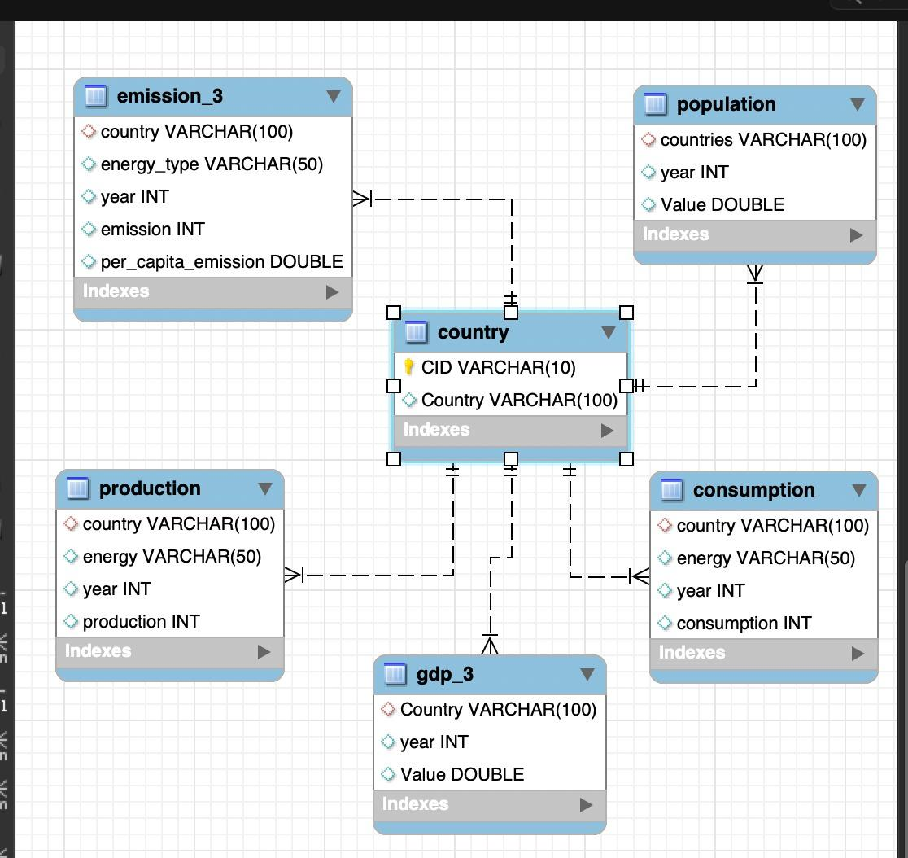
ER Diagram:

Slide 8
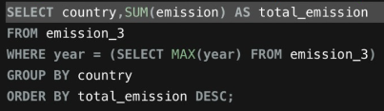
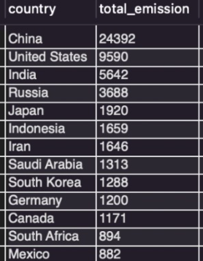
Analysis Questions
1.General & Comparitive Analysis
QUERY:
OUTPUT:
Key Insights:
The query calculates the total emissions for each country in the latest available year.
Countries are ranked from highest to lowest based on their total emissions.
The results show which countries contribute the most to overall emissions.

Slide 9
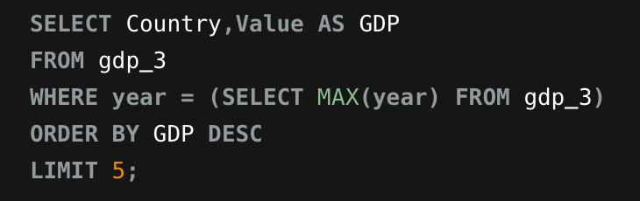
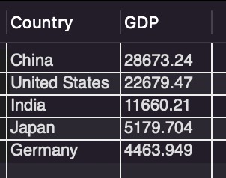
QUERY:
OUTPUT:
Key Insights:
The query identifies the top 5 countries by GDP in the most recent year.
China has the highest GDP, followed by the United States.
India ranks third, followed by Japan and Germany.

Slide 10
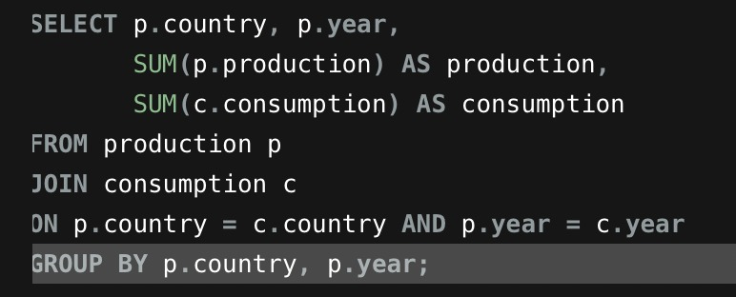
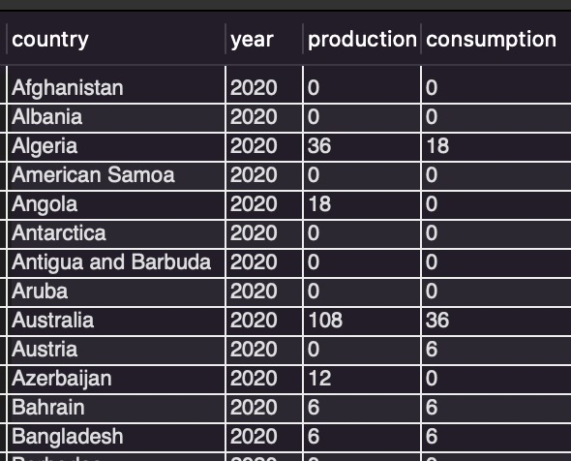
Compare energy production and consumption by country and year.
QUERY:
OUTPUT:
Key Insights:
The query compares energy production and consumption for each country and year.
The output shows how much energy each country produces and consumes.
This helps identify countries with higher production or higher consumption levels.

Slide 11
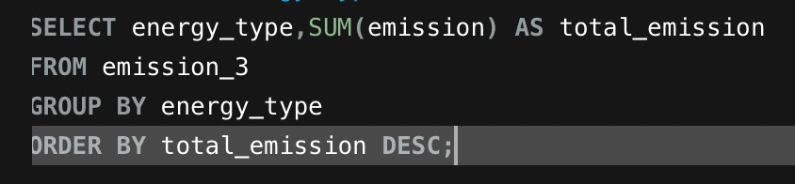
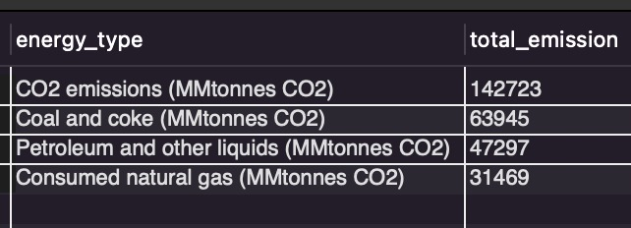
QUERY:
OUTPUT:
Key Insights:
CO2 emissions contribute the most to total emissions.
Coal and coke are the second-largest contributor.
Natural gas has the lowest contribution among the listed energy types.

Slide 12
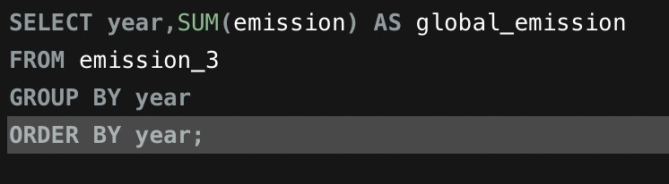
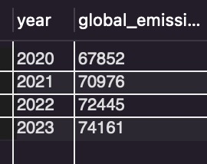
2.Trend Analysis Over Time
QUERY:
OUTPUT:
Key Insights:
Global emissions increased every year from 2020 to 2023.
Emissions rose from 67,852 in 2020 to 74,161 in 2023.
The results show a continuous upward trend in global emissions.

Slide 13
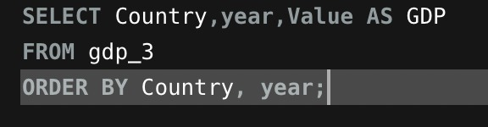
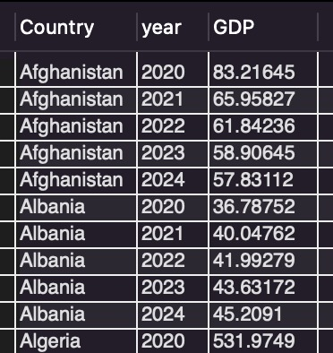
QUERY:
OUTPUT:
Key Insights:
The query shows GDP values for each country across the given years.
GDP trends vary from country to country, with some increasing and others decreasing.
The results help identify countries with rising or falling GDP over time.

Slide 14
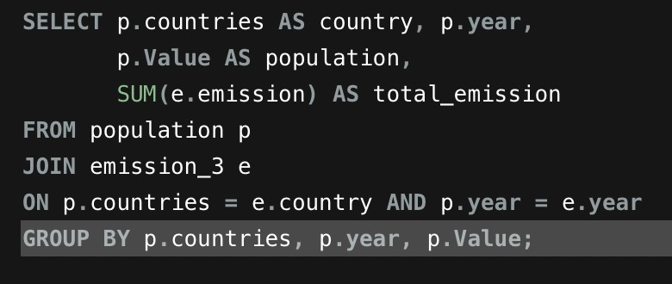
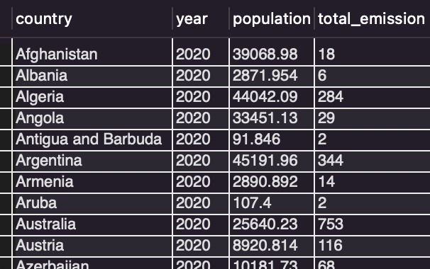
How has population growth affected total emissions in each country?
QUERY:
OUTPUT:
Key Insights:
Population and total emissions can be compared for each country and year.
Countries with larger populations generally show higher total emissions.
The results help identify the relationship between population size and emission levels.

Slide 15
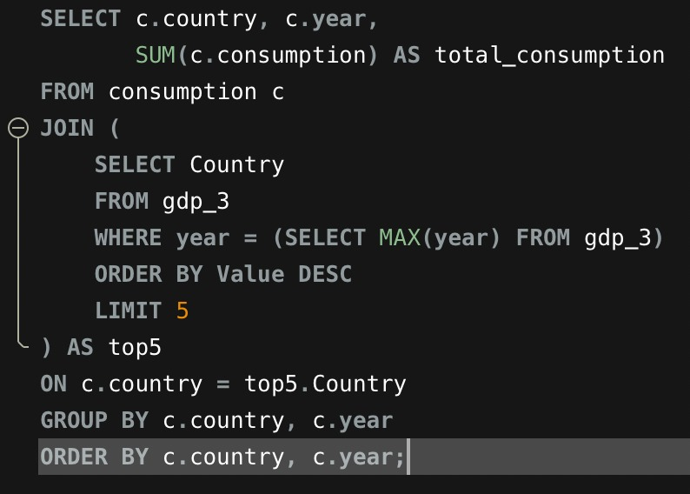
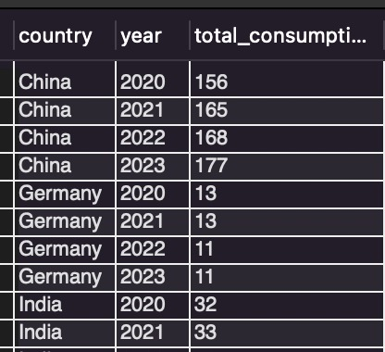
Has energy consumption Increased or decreased over the years for major economies?
QUERY:
OUTPUT:
Key Insights:
China shows a clear increase in energy consumption, from 156 in 2020 to 177 in 2023.
Germany’s consumption decreased slightly, from 13 to 11 over the same period.
Energy consumption trends vary across major economies, showing different patterns over the years.

Slide 16
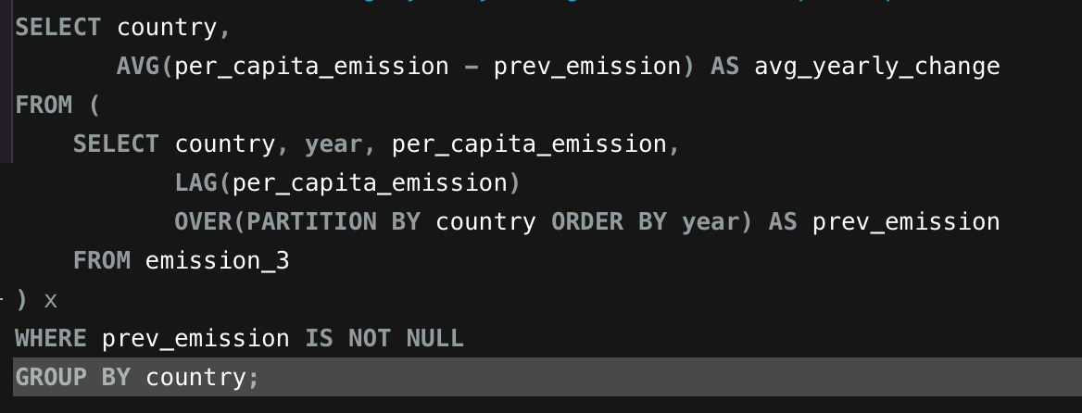
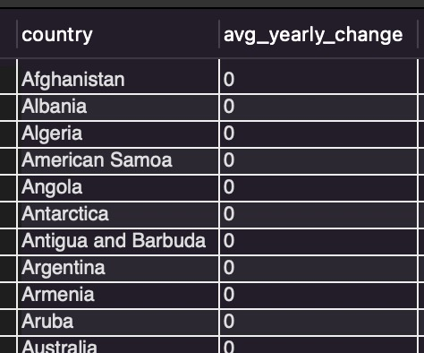
QUERY:
OUTPUT:
Key Insights:
The query calculates the average yearly change in per-capita emissions for each country.
A positive value indicates increasing emissions, while a negative value indicates a decrease.
The results help compare how per-capita emissions are changing across countries over time.

Slide 17
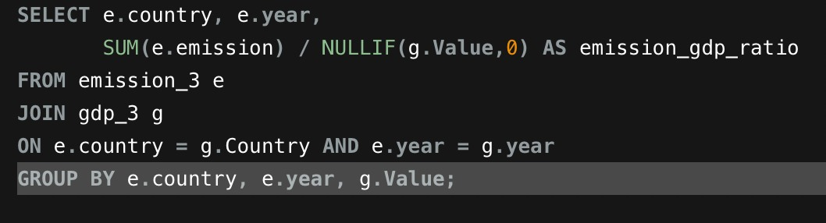
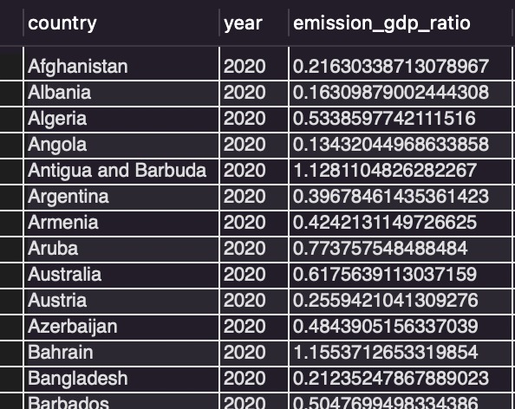
3.Ratio & Per Capita Analysis
QUERY:
OUTPUT:
Key Insights:
The query calculates energy consumption per person for each country over the last decade.
It helps compare energy usage relative to population size across countries.
Higher values indicate greater energy consumption per person.

Slide 18
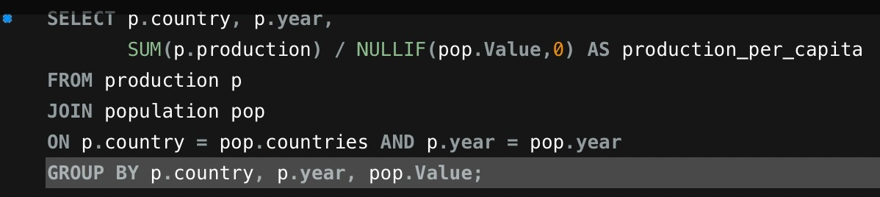
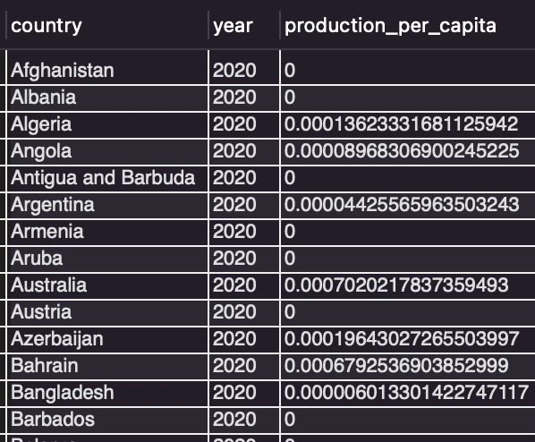
How does energy production per capita vary across countries?
QUERY: OUTPUT
Key Insights:
The query calculates energy production per person for each country and year.
It helps compare energy production based on population size.
Higher values indicate greater energy production per person.

Slide 19
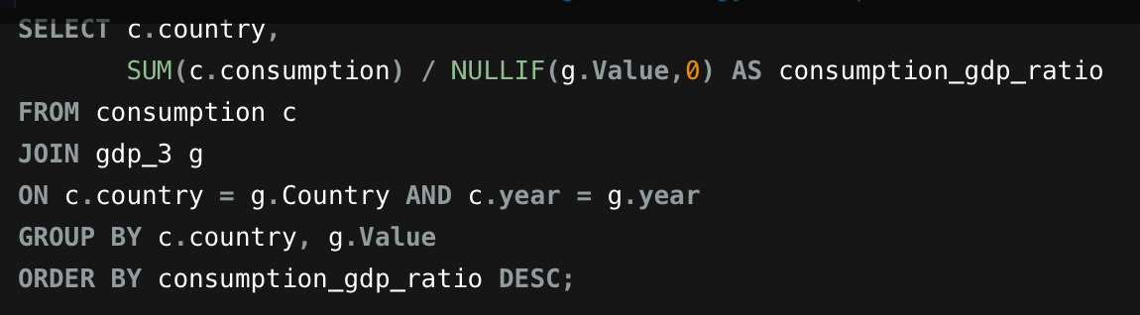
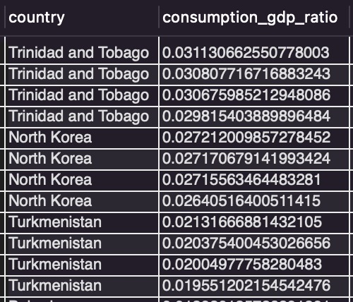
QUERY:
OUTPUT:
Key Insights:
The query compares energy consumption with GDP for each country.
A higher ratio means more energy is consumed relative to economic output.
The results help identify countries with relatively high energy use compared to their GDP.

Slide 20
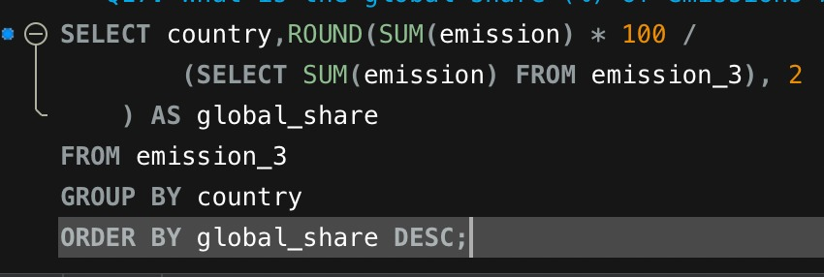
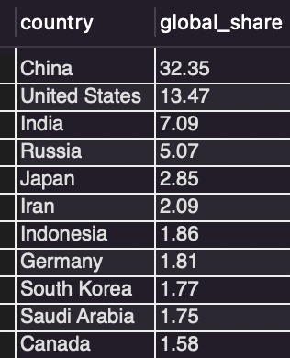
4.Global comparisons
QUERY:
OUTPUT:
Key Insights:
Average GDP, emissions, and population are calculated for each year.
The results help identify year-wise changes in economic, environmental, and population trends.
Comparing these averages over time shows how global conditions have changed.

Slide 21
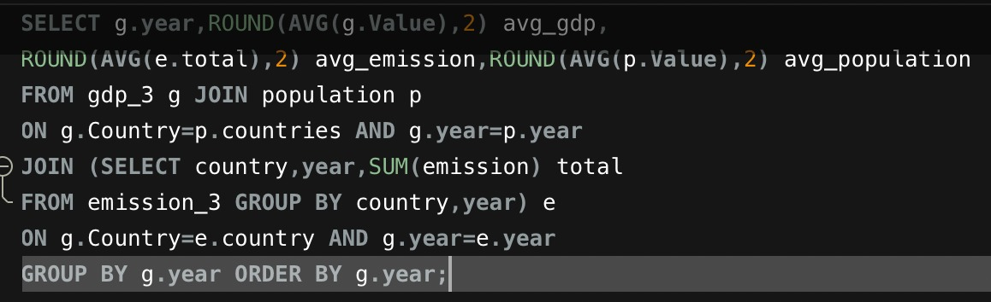
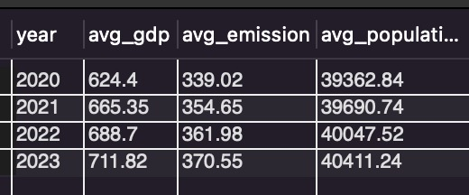
QUERY:
OUTPUT:
Key Insights:
The query compares energy consumption with GDP for each country.
A higher ratio means more energy is consumed relative to economic output.
The results help identify countries with relatively high energy use compared to their GDP.

Slide 22
Experience / Challenges
Gained practical experience in MySQL and SQL data analysis using real-world energy data.
Learned to work with multiple related tables and connect data using SQL JOINs.
Improved skills in GROUP BY, aggregate functions, subqueries, and filtering.
Faced challenges in matching countries and years correctly across different tables.
Learned to handle ratios, missing/zero values, and complex analysis questions to get accurate results.

Slide 23
Conclusion
Successfully analyzed global energy production, consumption, GDP, population, and emissions using SQL.
Compared countries and yearly trends to understand major differences in energy and emissions.
Identified important emission, consumption, and per-capita patterns across countries.
Used SQL JOINs, GROUP BY, subqueries, and aggregate functions to generate meaningful insights.
Improved my practical SQL and data analysis skills through this project.

Slide 24

THANK YOU

