Slide 1
Connecting Motion Sensor with Raspberry Pi Model B using libupm and libmraa
By Manasa

Slide 2
Rasberry Pi Specifications
A 900MHz quad-core ARM Cortex-A7 CPU
1GB RAM4 USB ports
40 GPIO pins
Full HDMI port
Ethernet port
Combined 3.5mm audio jack and composite video
Camera interface (CSI)
Display interface (DSI)
Micro SD card slot
VideoCore IV 3D graphics core

Slide 3
Setup
Raspberry PI 2 & SD Card with Raspbian Operating System
USB Power Supply
USB Cable
Breadboard & Jumper Wires
Motion Sensor [biss0001]
The sensor has 4 Pins. Pin 1 is VCC, Pins 2 is Data, Pin 3 is NOT USED, Pin 4 is Ground.
Connect Pin 1 and Pin 4 is connected to the VCC and GND of Pi (5v)
Connect Pin 2(Data) to GPIO 23 [ pin 16]
Led is directly connected to ouput (Data pin) of Motion Sensor

Slide 4
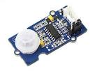
Biss0001 Motion Sensor

Slide 5
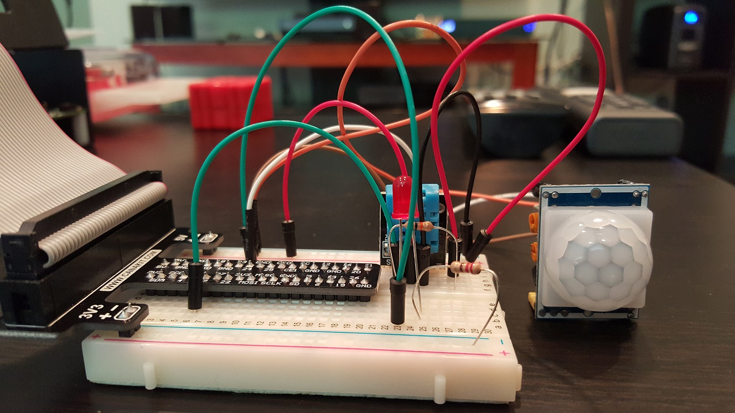
No Motion Detected – Led Off

Slide 6
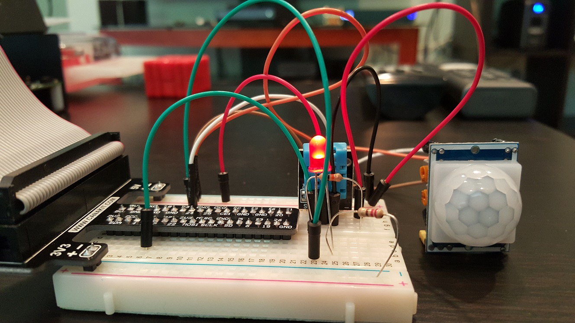
Motion Detected – Led On

Slide 7
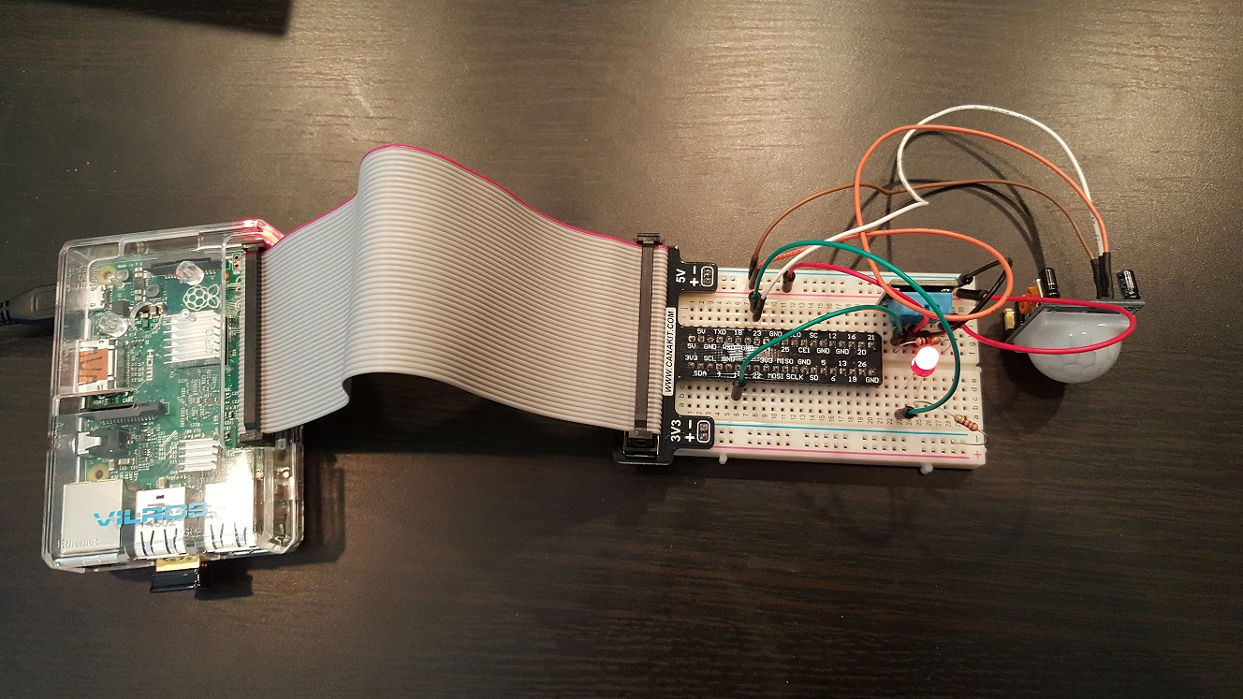
Complete Setup

Slide 8
Libraries used
libmraa - Low Level Skeleton Library for Communication on GNU/Linux platforms
libupm– Is a high level repository for sensors that use libmraa
Dygraph – Javascript Library for plotting time series data

Slide 9
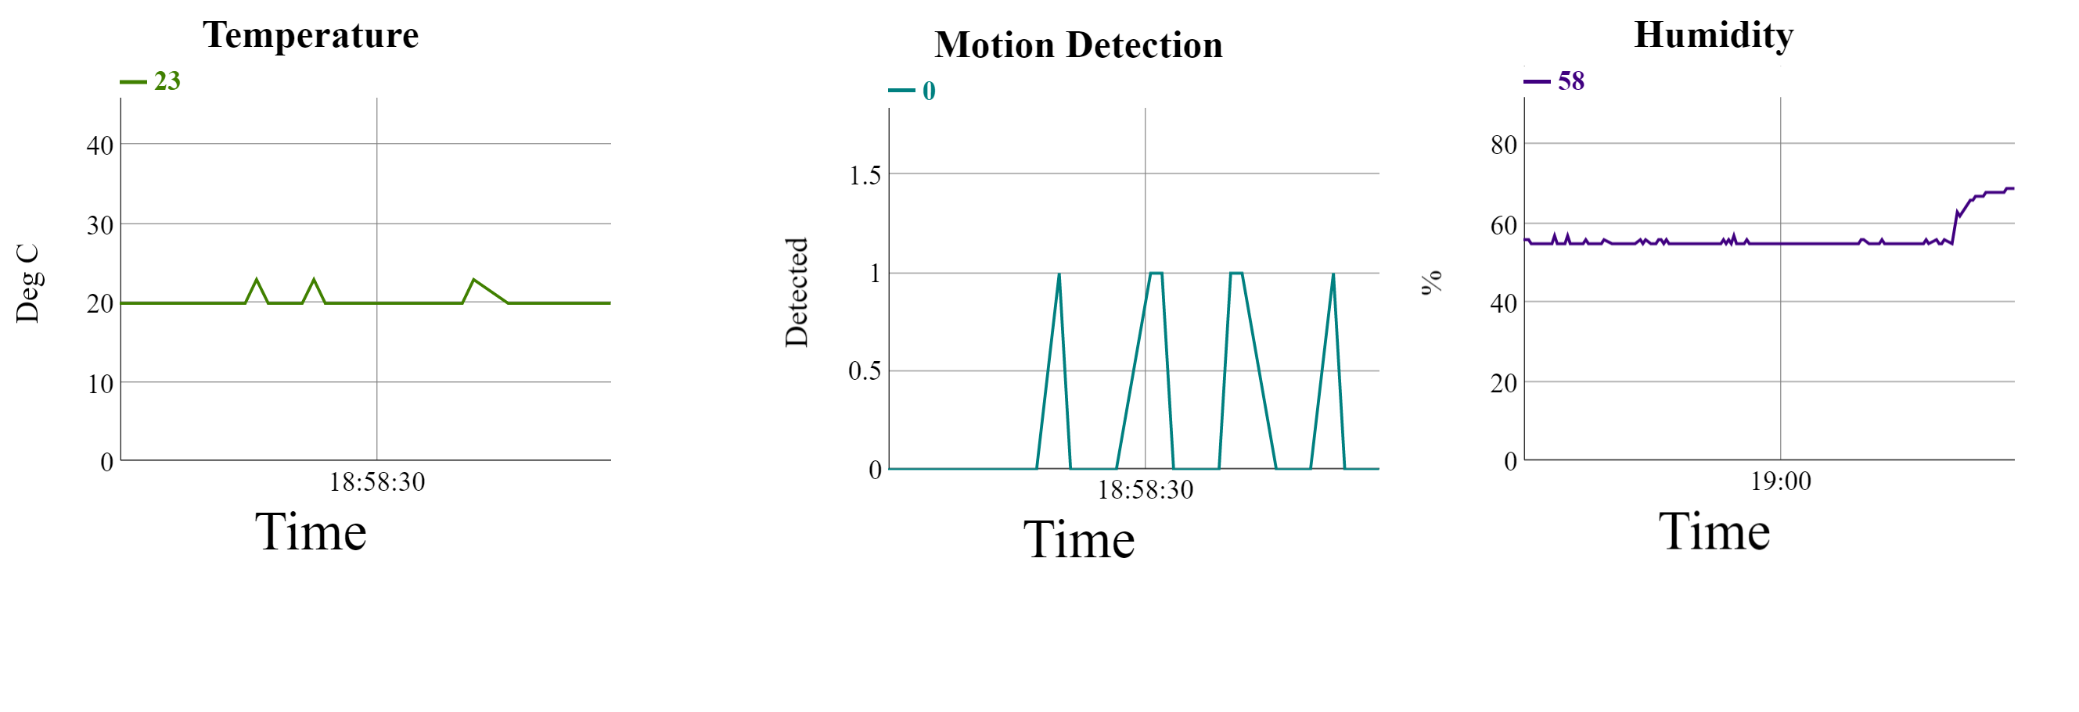
Graph

Slide 10
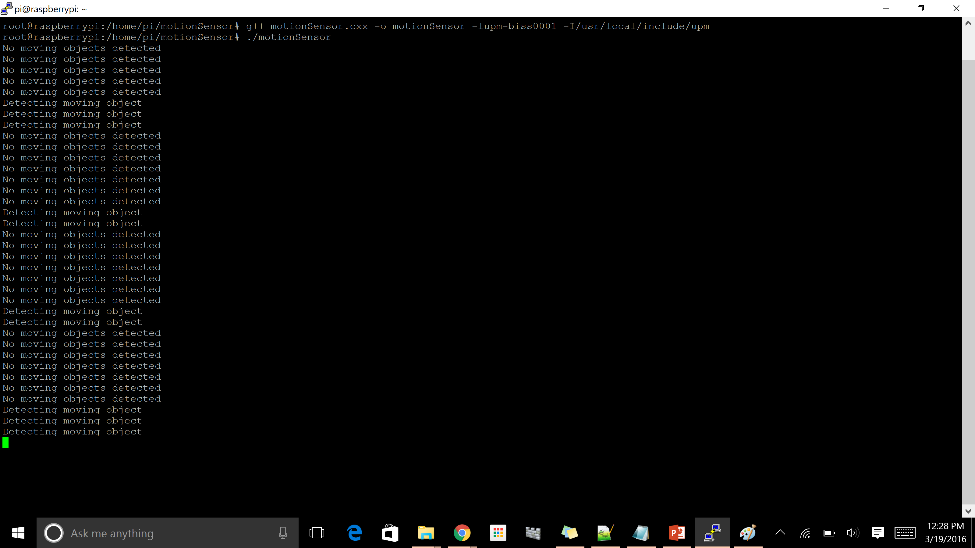
Output

