Slide 1
Java 8 (Lambda & Stream)

Slide 2
Agenda
Lambda Expressions
Why/What Lambda
Structure of Lambda Expressions
Functional Interface
Default and Static Methods – Interface
Method References
Functional Interface Toolkit
Stream API
What & Why Streams
Stream Operations
Intermediate Operations
Terminal Operations

Slide 3
Why Lambda Expression ?
There is no way of defining just a function / method which stays in Java all by itself.
There is no way of passing a method as argument or returning a method body for that instance
In short, it is not easy to pass plain methods / functionalities in Java that can be passed as arguments. Due to this limitation Java 8 adds a brand new language level feature called Lambda Expressions.
Lambda expression adds that missing link of functional programming to Java.
Lambda expression let us have functions as first class citizen. Although this is not 100% correct.
In Java, the lambda expressions are represented as objects, and so they must be bound to a particular object type known as a Functional interface..

Slide 4

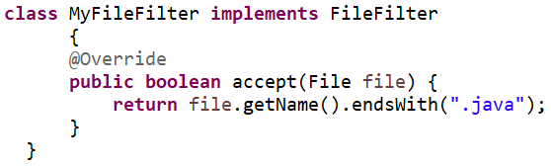

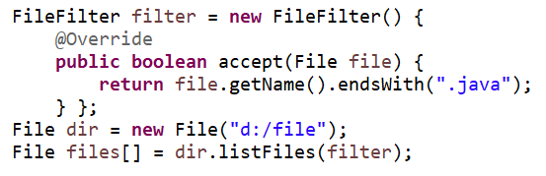
Why Lambda Expression ?
Let’s implement this interface
And use it
Let’s use an anonymous class

Slide 5
Why Lambda Expression ?
Anonymous class
This is Java8 Lambda Expression
Method Signatures
Method Implementation

Slide 6
What Is a Lambda Expression ?
A lambda expression is an anonymous function (not 100% true for Java but lets assume it for time being). Simply put, it’s a method without a declaration, i.e., access modifier, return value declaration, and name.
It’s a shorthand that allows you to write a method in the same place you are going to use it. Especially useful in places where a method is being used only once, and the method definition is short. It saves you the effort of declaring and writing a separate method to the containing class.
To make instances of anonymous classes easier to write and read. It lets developers simplify and shorten their code and making it more maintainable.
Lambda expressions can only appear in places where they will be assigned to a variable whose type is a functional interface.

Slide 7
Structure of Lambda Expressions
A lambda expression can have zero, one or more parameters.
The type of the parameters can be explicitly declared or it can be inferred from the context.
E.g : (int a) is same as just (a).
Parameters are enclosed in parentheses and separated by commas.
E.g : (a, b) or (int a, int b) or (String a, int b, float c)
Empty parentheses are used to represent an empty set of parameters.
E.g : () -> 42.
When there is a single parameter, if its type is inferred, it is not mandatory to use parentheses.
E.g : a -> return a*a.
The body of the lambda expressions can contain zero, one or more statements.
If body of lambda expression has single statement curly brackets are not mandatory .
When there is more than one statement in body than these must be enclosed in curly brackets (a code block) and the return type of the anonymous function is the same as the type of the value returned within the code block, or void if nothing is returned.

Slide 8
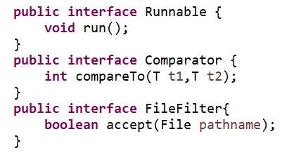
Functional Interface – Lambda Expressions Type
A lambda expression is an instance of A functional interface .
A functional interface is an interface with only one abstract method.
Examples:

Slide 9
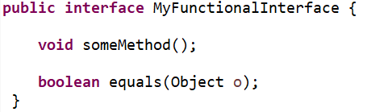
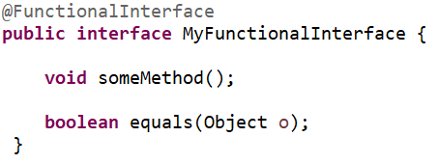
Functional Interface – Lambda Expressions Type
Methods from the Object class don’t count:
A functional interface can be annotated and It’s just for convenience, the compiler can tell me whether the interface is functional or not.

Slide 10
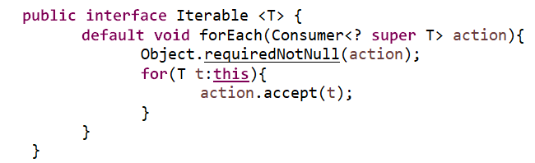
Default Methods
Java 8 introduces “Default Method” or (Defender methods) new feature, which allows developer to add new methods to the interfaces without breaking the existing implementation of these interface.
It provides flexibility to allow interface define implementation which will use as default in the situation where a concrete class fails to provide an implementation for that method

Slide 11
Default Methods - Why
Re-engineering an existing JDK framework is always very complex. Modify one interface in JDK framework breaks all classes that extends the interface which means that adding any new method could break millions of lines of code.
Therefore, default methods have introduced as a mechanism to extending interfaces in a backward compatible way.
Default methods can be provided to an interface without affecting implementing .An implementing class can override the default implementation provided by the interface.
For Java 8, the JDK collections have been extended and forEach method is added to the entire collection (which work in conjunction with lambdas).

Slide 12
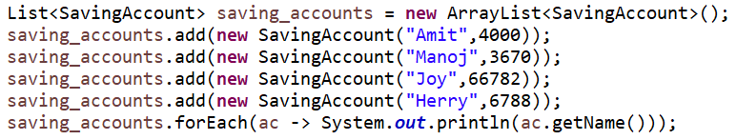
Traversing Collections with Lambda Expressions
In Java SE 8, you can use lambda expressions to traverse a collection of items. Examples of collections include lists, maps, and sets. All of these data types implement an interface called Iterable.
It accepts an instance of a functional interface, called consumer. The consumer interface, has a single abstract method, named accept. And by implementing this interface and its single abstract method, you can add code that operates on an item in the collection.

Slide 13
Default Methods – Summary
Also referred to as Defender Methods or Virtual extension methods.
Goal of Default method is to eliminate inheritance layer.
It help us in extending interfaces without having the fear of breaking implementation classes.
It bridge down the differences between interfaces and abstract classes.
Help us in avoiding utility classes, such as all the Collections class method can be provided in the interfaces itself.
Help us in removing base implementation classes.
If any class in the hierarchy has a method with same signature, then default methods become irrelevant.
A default method cannot override a method from java.lang.Object .

Slide 14
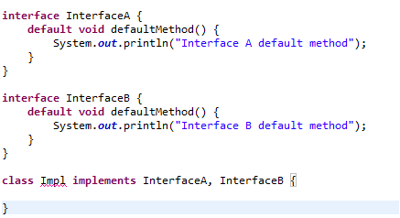
Default Methods – Multiple Inheritance
Since java class can implement multiple interfaces and each interface can define default method with same method signature, therefore, the inherited methods can conflict with each other.
The above code will fail to compile with the following error,
java: class Impl inherits unrelated defaults for defaultMethod() from types InterfaceA and InterfaceB
In order to fix this class, we need to provide default method implementation:
Further, if we want to invoke default implementation provided by any of super interface rather than our own implementation, we can do so as follows, InterfaceA.super.defaultMethod();

Slide 15
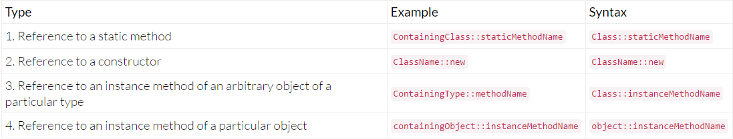
Method Reference
Sometimes lambda expression does nothing but call an existing method. In those cases, it's often clearer to refer to the existing method by name. Method references enable you to do this; they are compact, easy-to-read lambda expressions for methods that already have a name.
The goal is to make your code more concise and more readable.
This lambda expression:
Function<String, String> f = s -> s.toLowerCase();
Can be written like that:
Function<String, String> f = String::toLowerCase;

Slide 16
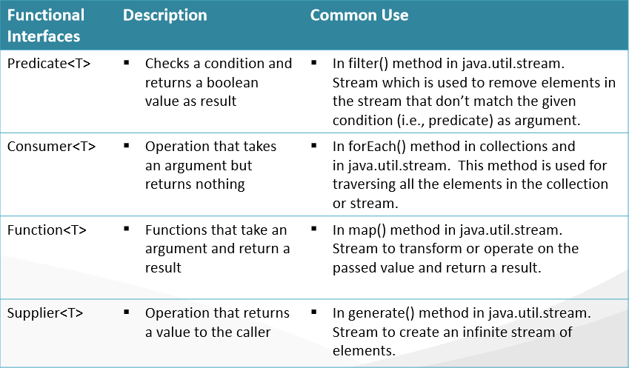
Functional Interface Toolkit
Below is the list of four important built-in interfaces in the java.util.function package:

Slide 17
Primitive Versions of Functional Interfaces
The built-in interfaces Predicate, Consumer, Function, and Supplier operate on reference type objects.
For primitive types there are specializations available for int, long and double types for these functional interfaces
For example
Consider Predicate that operates on objects of type T, i.e., it is Predicate<T>.
The specializations for int, long, and double for Predicate are IntPredicate, LongPredicate, and DoublePredicate respectively.
When you try to use primitive types with these functional interfaces, it results in implicit autoboxing and unboxing

Slide 18
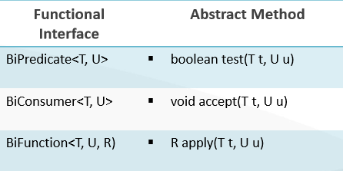
Binary Versions of Functional Interfaces
Predicate, Consumer, and Function takes only one argument.
These interfaces also have binary versions.
The prefix “Bi” indicates the version that takes “two” arguments.
eg : BiFunction, BiPredicate, BiConsumer.
Since the abstract method in Supplier does not take any argument, there is no equivalent BiSupplier available.

Slide 19
What are Streams ?
Definition : A short definition is “a sequence of elements from a source that supports data processing operations.” Let’s break down this definition step by step:
Sequence of elements: A stream provides an interface to a sequenced set of values of a specific element type. However, streams don’t actually store elements; they are computed on demand.
Source: Streams consume from a data-providing source such as collections, arrays, or I/O resources.
Data processing operations: Streams support SQL-like operations such as filter, map, reduce, find, match, sorted, and so on.
In addition, stream operations have two important characteristics:
Pipelining: Many stream operations return a stream themselves. This allows operations to be chained to form a larger pipeline. This enables certain optimizations, such as laziness and short-circuiting
Internal iteration: In contrast to collections, which are iterated explicitly (external iteration), stream operations do the iteration behind the scenes for you.

Slide 20
Why Stream Needed ?
Despite collections being necessary for almost any Java application, manipulating collections is far from perfect.
For example, you might want to create a collection of banking transactions to represent a customer’s statement. Then, you might want to process the whole collection to find out how much money the customer spent.
First, typical processing patterns on collections are similar to SQL-like operations such as “finding” (for example, find the transaction with highest value) or “grouping” (for example, group all transactions related to grocery shopping). Most databases let you specify such operations declaratively.
For example, the following SQL query lets you find the transaction ID with the highest value: "SELECT id, MAX(value) from transactions".

Slide 21
Why Stream Needed ?
We only express what we expect. This basic idea means that you need to worry less about how to explicitly implement such queries—it is handled for you. Why can’t we do something similar with collections? How many times do you find yourself re-implementing these operations using loops over and over again?
Second, how can we process really large collections efficiently? Ideally, to speed up the processing, you want to leverage multi-core architectures. However, writing parallel code is hard and error-prone. Java SE 8 to the rescue! . Stream lets you process data in a declarative way.

Slide 22
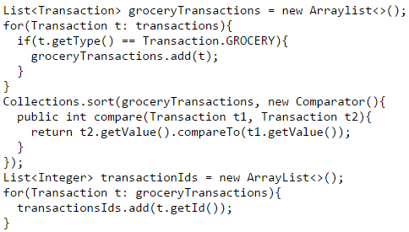
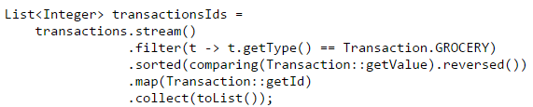

Two Approaches
The code is written in declarative way
You chain together several building-block operations to express a complicated data processing pipeline

Slide 23
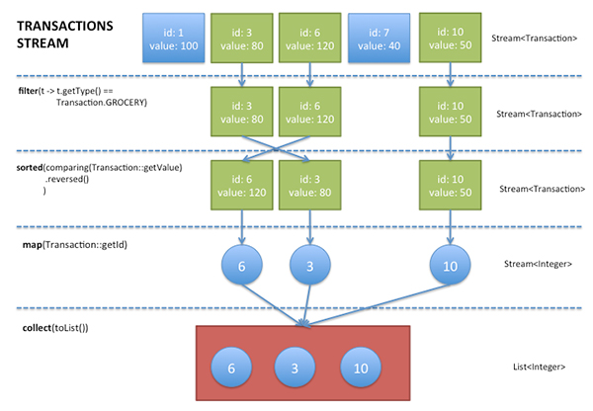
What are Streams ?

Slide 24
Properties of Stream
Its a Java type interface.
Stream that lets you process data in a declarative way.
An object that does not hold any data (not like collections)
An object that should not change the data it processes .
An object is able to process data in <<one pass>>
An object optimized from the algorithm point of view ,and able to process data in parallel

Slide 25
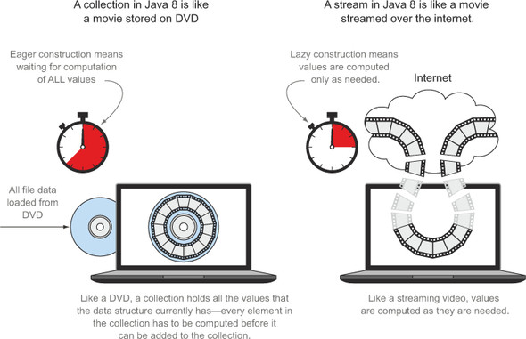
Streams Versus Collections

Slide 26
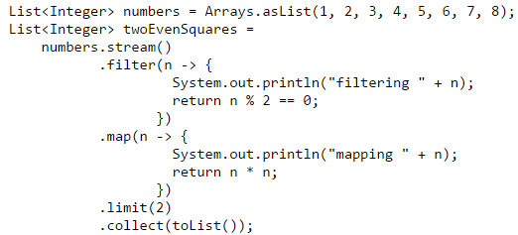
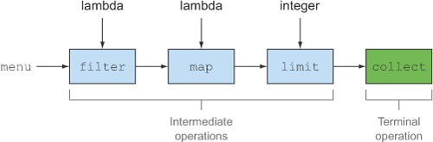
Stream Operations (java.util.stream)
The Stream operations can be classified into two categories.
Intermediate operations
filter, sorted, and map, which can be connected together to form a pipeline
Terminal operations
collect,limit which closed the pipeline and returned a result
You might be wondering why the distinction is important. Well, intermediate operations do not perform any processing until a terminal operation is invoked on the stream pipeline; they are “lazy.” This is because intermediate operations can usually be “merged” and processed into a single pass by the terminal operation.

Slide 27
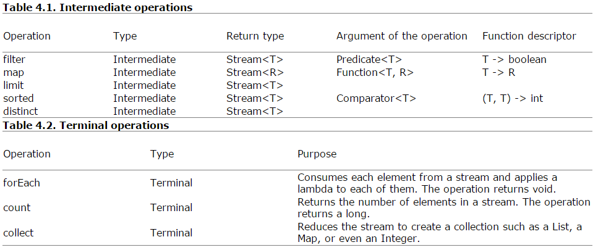
Working with Streams
Working with streams, in general, involves three things:
A data source (such as a collection) on which to perform a query
A chain of intermediate operations, which form a stream pipeline
One terminal operation, which executes the stream pipeline and produces a result
f

Slide 28
Thank you

