Slide 1
JUPYTER NOTEBOOK LAB EVALUATOR
Grading code and conceptual understanding with transparent NLP
Group 3 · S016 · S017 · S020 · S025 · S026 · S027
Notes:
Introduce the group and the project: an automatic grader for Jupyter lab notebooks that marks both the code and the student's explanation of it.

Slide 2
AGENDA
01
02
03
04
05
06
PROBLEM & PROPOSAL
THEORY & CONCEPTS
SYSTEM & CODE WALKTHROUGH
DATASET
RESULTS & ERROR ANALYSIS
IMPROVEMENTS & CONCLUSION
Notes:
The talk moves from the problem, through the theory behind each component, to the system, the evaluation and what we would improve.

Slide 3
THE PROBLEM AND OUR PROPOSAL
CODE-ONLY GRADING MISSES THIS:
 | Proposal
Users | Instructors and TAs, students, and AI University components such as a student dashboard
Input | A student's .ipynb and the lab's rubric.json: model answer, concepts, expected outputs, tests
Output | Five marks out of 100, a grade, a one-line reason per deduction, and a wrong-explanation flag
NLP tasks | Code/text separation, concept and algorithm extraction, semantic similarity, comment analysis
Working code
+ wrong explanation
= full marks
Notes:
Lab notebooks mix code, outputs, comments and prose. Autograders usually check only that the code runs, so working code with a wrong explanation earns full marks. Our proposal defines the users, the input, the output and the NLP tasks involved.

Slide 4
THEORY 1 · TF-IDF AND COSINE SIMILARITY
BAG OF WORDS
TF-IDF
A text becomes a vector of word counts over the vocabulary; word order is ignored.
“the model stems words” → {model:1, stems:1, words:1}
tf-idf(t, d) = tf(t, d) × log(N / df(t))
Frequent in this text, rare across texts → high weight; stop words removed.
COSINE SIMILARITY
HOW WE USE IT
cos(a, b) = (a · b) / (‖a‖ ‖b‖)
1 = same direction, 0 = no shared terms
Student explanation vs rubric model answer
Score = min(1, cosine / 0.5) so 0.5+ counts as a full match
Limitation: rewards shared words, not meaning
Notes:
Bag of words represents a text as a vector of word counts and ignores order. TF-IDF reweights each count by how rare the word is across documents, so common words count for little and distinctive words count for more. Cosine similarity measures the angle between two such vectors, giving 1 for identical direction and 0 for no shared words. This is our fallback similarity: it is fast and offline, but it only rewards shared words, not shared meaning.

Slide 5
THEORY 2 · SENTENCE EMBEDDINGS
SENTENCE-BERT
ALL-MINILM-L6-V2
IN THE EVALUATOR
Transformer encoder trained in a siamese setup
Similar meaning → nearby vectors
Captures paraphrase and synonyms
6 layers, ≈ 22 M parameters
Token embeddings mean-pooled
384-dimensional, unit-normalised vector
Fast enough to run on a CPU
score = clip((cos − 0.2) / 0.5, 0, 1)
Used automatically when it loads (e.g. Colab)
Falls back to TF-IDF offline
Confidence drops 0.1 on fallback
Notes:
Sentence-BERT fine-tunes a BERT-style transformer with a siamese network so that sentences with similar meaning land close together in vector space. We use all-MiniLM-L6-v2, a small six-layer model that maps a passage to a 384-dimensional vector by mean-pooling its token embeddings. Two explanations that say the same thing in different words get a high cosine similarity even with few shared words. We rescale cosine so that 0.7 and above counts as a full match.

Slide 6
THEORY 3 · CONCEPTS AND ALGORITHMS
CONCEPT LEXICON
ALGORITHM TABLE
CONSISTENCY CHECK
Rubric lists each concept with trigger words
stemming → “stem”, “porter”
Coverage = concepts found / concepts listed
15 algorithms in 5 families
Code tokens: TfidfVectorizer, KMeans …
Text phrases: “inverse document frequency” …
Regex word-boundary matching
Same family = alternatives
Stem OR lemmatize · TF-IDF OR bag of words · K-Means OR hierarchical
Text claims A, code uses B, same family → contradiction
Notes:
Concepts are matched with a lexicon: each rubric concept lists the words that count as mentioning it. Algorithms use a table of fifteen techniques, each with a family, words that show it in code and words that show it in text, matched on word boundaries. Algorithms in one family are alternatives, so if the text claims one member while the code uses another, the explanation contradicts the code. This is a rule-based form of information extraction followed by a consistency check.

Slide 7
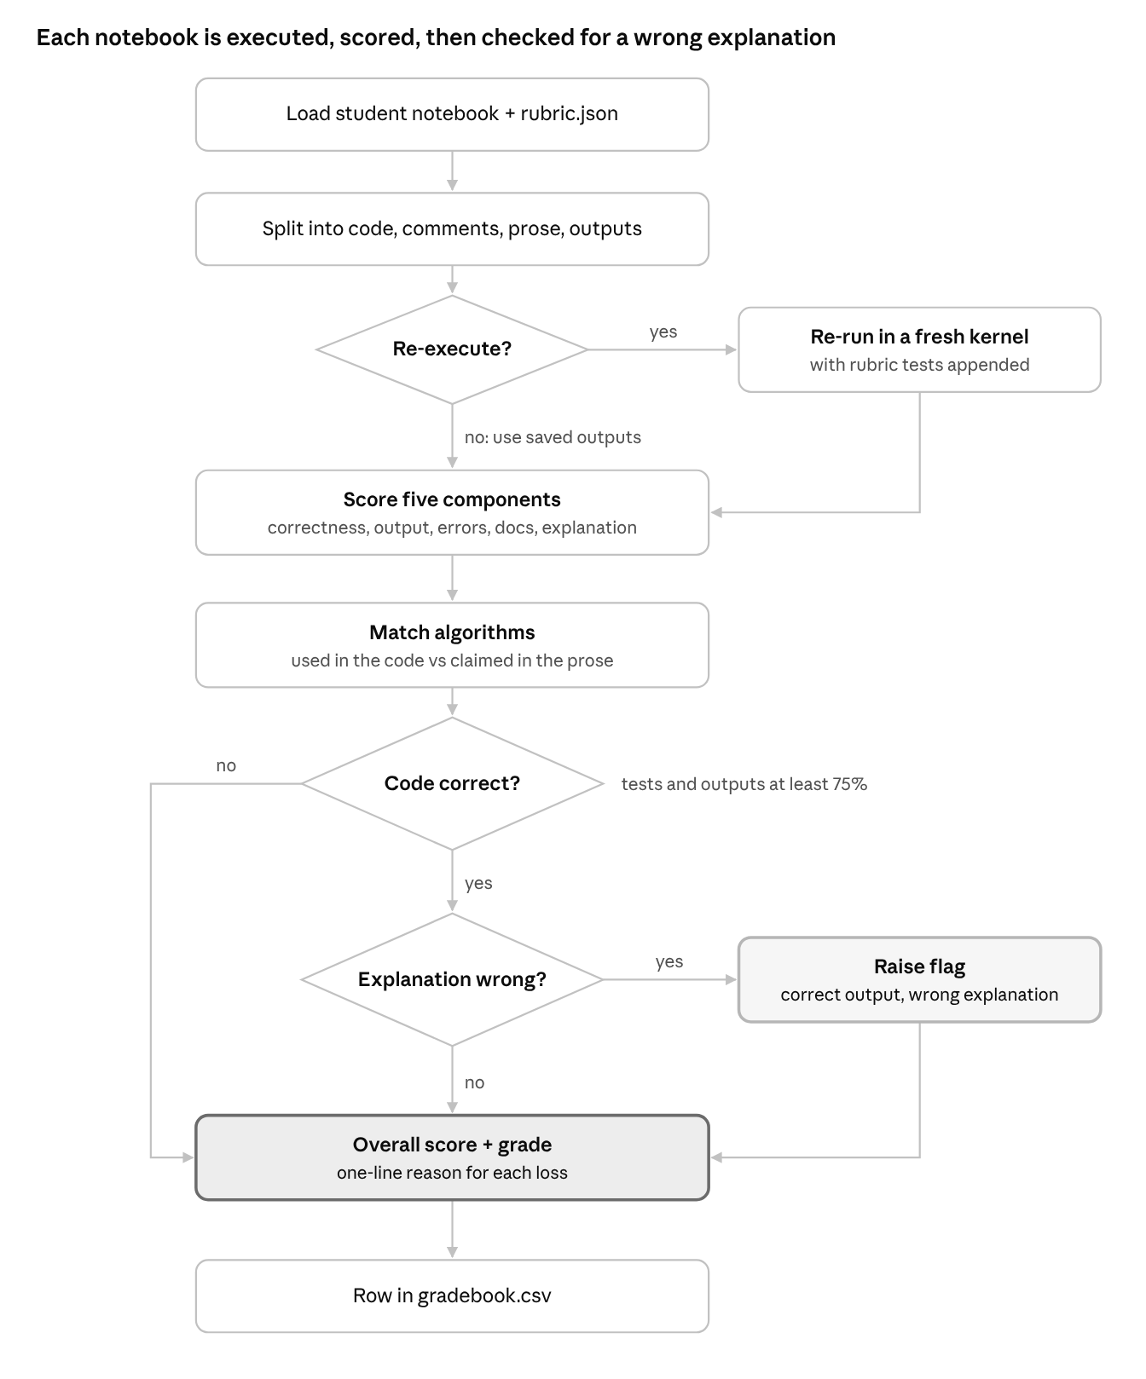
SYSTEM ARCHITECTURE
1 · Read: split code, comments, text, outputs, errors
2 · Run: fresh kernel + rubric tests
3 · Extract: concepts and algorithms
4 · Compare: similarity to the model answer
5 · Score: five checks, each 0–1 with a reason
6 · Report: gradebook.csv + results.json
Notes:
One notebook flows through three decisions. Does it run? Is the code correct by the rubric tests? If so, does the explanation describe the algorithm the code actually uses? The five component scores are then weighted into one report row.

Slide 8
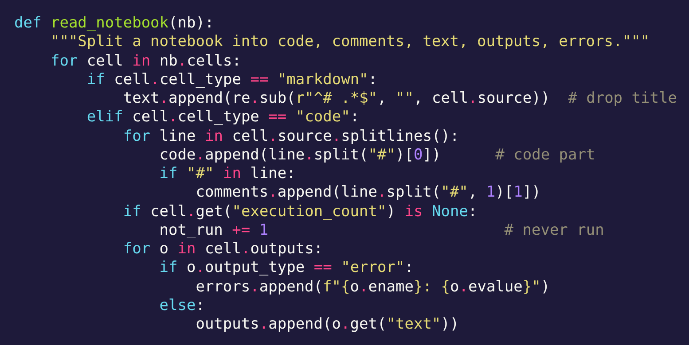
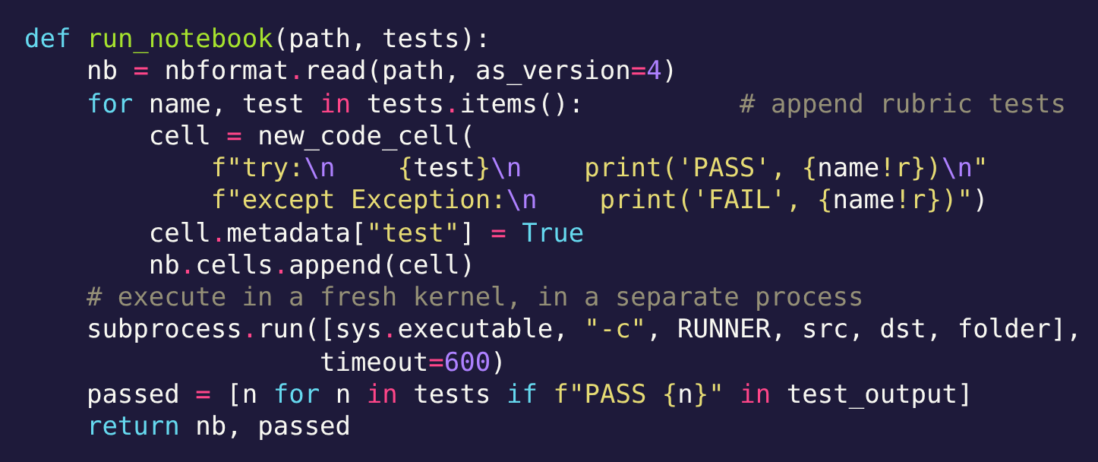
CODE 1 · READING & RUNNING
read_notebook()
• Markdown → explanation text
• Code split at # into code and comments
• No execution count → unrun cell
• Outputs and errors kept apart
run_notebook()
• Each rubric test → try/assert cell printing PASS or FAIL
• Fresh kernel, separate process, timeout
• Tests run against the student's real variables
Notes:
read_notebook walks the notebook's JSON cell by cell. Markdown cells become the explanation text, with the lab title removed. Each code line is split at the hash sign into code and comment. Cells with no execution count were never run. Outputs and error tracebacks are collected separately. run_notebook then appends each rubric test as a try/except cell that prints PASS or FAIL, executes the whole notebook in a fresh kernel in a separate process with a time limit, and reads back which tests passed.

Slide 9
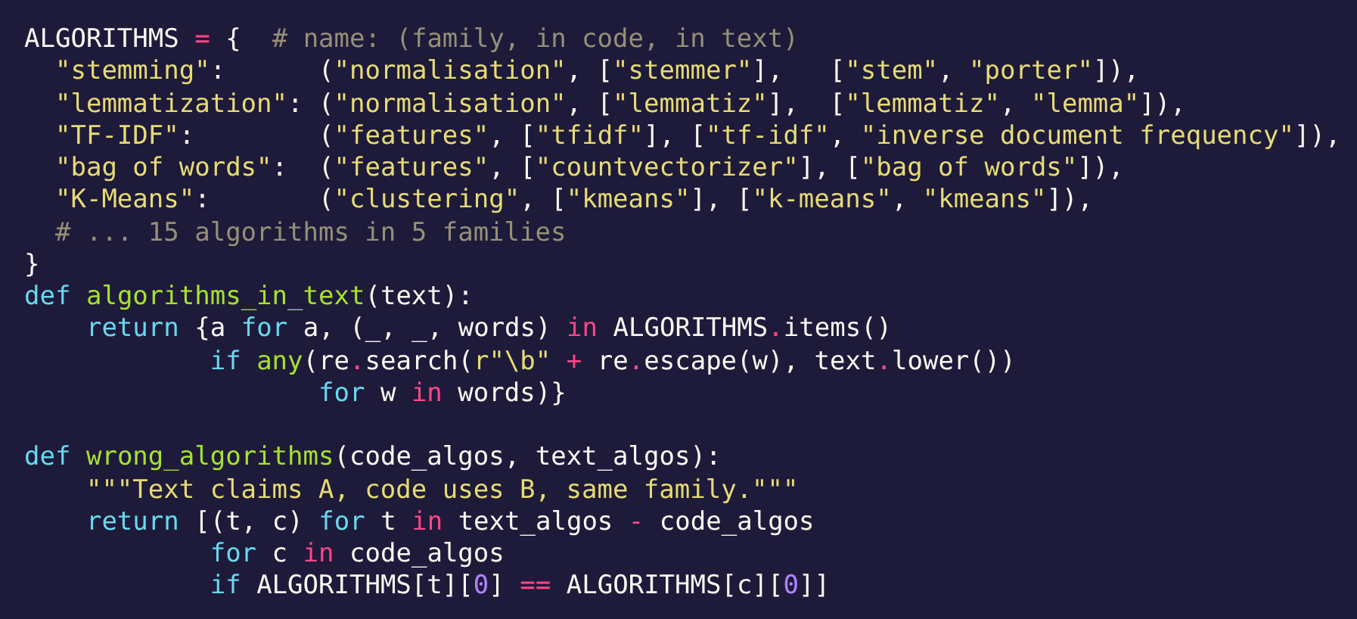
CODE 2 · DETECTING THE ALGORITHMS
ALGORITHMS: 15 techniques × (family, code strings, text phrases)
In code: substring search, e.g. “countvectorizer”
In text: regex with \b word boundary
wrong_algorithms(): text claims A, code uses B, A and B in the same family
Output: pairs like (lemmatization, stemming)
Notes:
The ALGORITHMS dictionary is the knowledge base: for each technique, its family, the strings that show it in code, and the phrases that show it in text. algorithms_in_code does a substring search over the lower-cased code; algorithms_in_text uses a word-boundary regular expression so 'stem' matches 'stemmed' but not 'system'. wrong_algorithms returns every pair where the text claims an algorithm the code doesn't use and the code uses another algorithm from the same family.

Slide 10
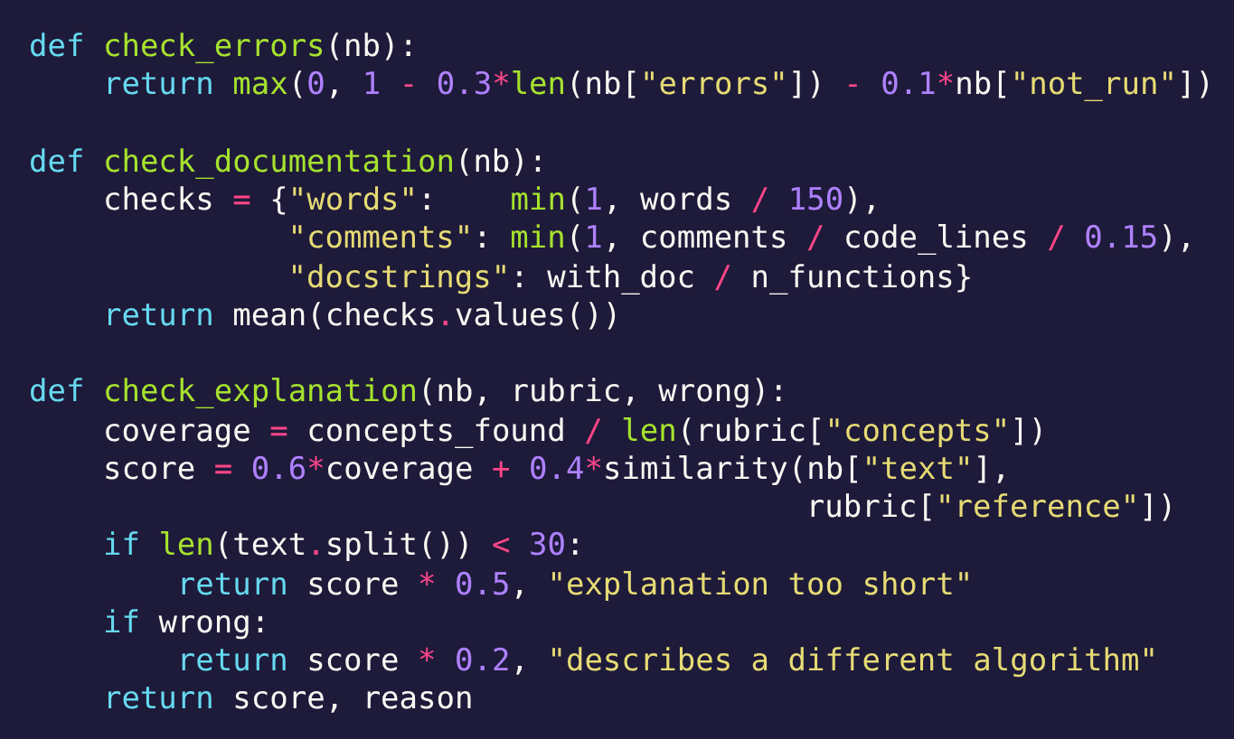
CODE 3 · THE SCORING CHECKS
Every check → (score 0–1, reason)
Correctness = tests passed / tests
Output = expected results found / expected
Errors = 1 − 0.3·errors − 0.1·unrun
Documentation = mean of 3 ratios
Explanation = 0.6·coverage + 0.4·similarity, ×0.5 short, ×0.2 contradiction
Notes:
Each check returns a score from 0 to 1 and a reason. check_errors subtracts 0.3 per runtime error and 0.1 per unrun cell. check_documentation averages three ratios: words of explanation against 150, comments per code line against 0.15, and the share of functions with docstrings. check_explanation combines concept coverage and similarity sixty-forty, halves the score for explanations under 30 words, and cuts it to a fifth when wrong_algorithms found a contradiction. check_correctness is the share of rubric tests passed and check_output the share of expected results found in the printed output.

Slide 11
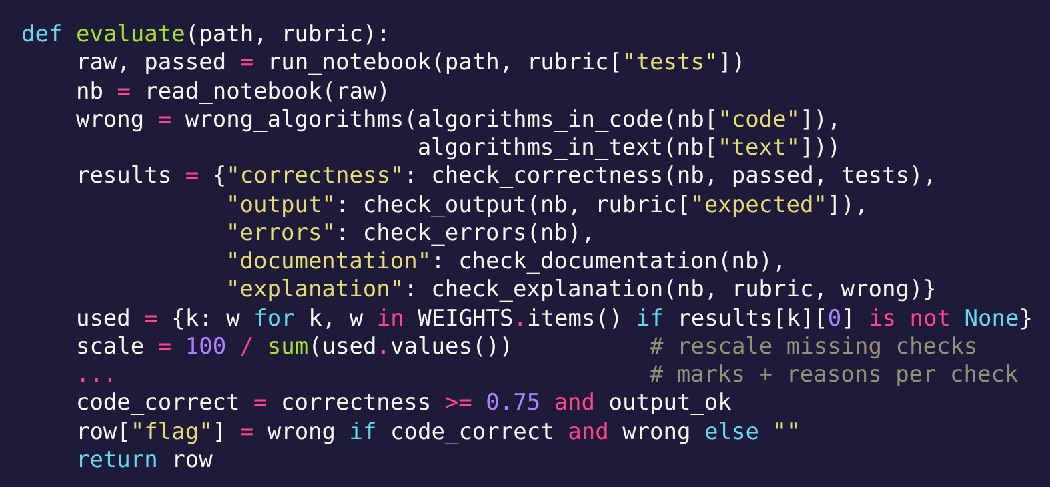
CODE 4 · PUTTING IT TOGETHER: evaluate()
Run → parse → detect → five checks
Missing checks dropped, weights rescaled to 100
Reason recorded for every loss ≥ 0.5 marks
Flag only if code correct (≥75% tests and outputs) and a contradiction exists
Confidence: 1 − 0.1 TF-IDF − 0.2 no tests − 0.2 flagged − 0.1 near boundary
Output: gradebook row + results.json record
Notes:
evaluate is the function the rest of the platform calls. It runs the notebook with the tests, parses the executed result, detects algorithms in code and text, runs the five checks, drops any check the lab doesn't have and rescales the weights to 100, writes marks and reasons per check, and sets the flag only when the code is correct. A confidence score is added afterwards: start at 1, subtract 0.1 for the TF-IDF fallback, 0.2 if there are no tests, 0.2 if flagged, and 0.1 near a grade boundary.

Slide 12
DATASET: 23 NOTEBOOKS
5 REAL NOTEBOOKS
18 SYNTHETIC NOTEBOOKS
Text classification (TF-IDF + Naive Bayes, 24 reviews)
K-Means clustering (300 points)
2 misexplained · 1 broken · 2 strong
Spam: bag of words + logistic regression
Customers: hierarchical clustering
News: TF-IDF + linear SVM
Strong · wrong algorithm · broken · one-line · names alternative · paraphrase
Notes:
We evaluated on 23 notebooks. Five are real student submissions from two course labs. Eighteen are randomly generated synthetic notebooks across three further labs, with six designed submission types per lab, to test failure patterns the real set does not cover. There is no train/test split because the evaluator has no learned parameters.

Slide 13
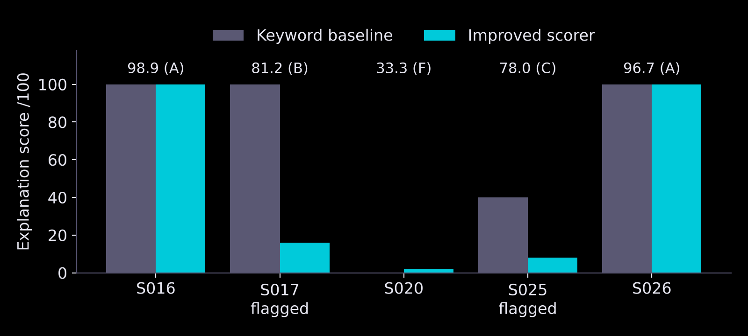
BASELINE VS IMPROVED: REAL NOTEBOOKS
Notes:
The keyword baseline scores an explanation by the share of rubric concepts mentioned. It gives the misexplained S017 full marks because its headings use the right words. The improved scorer adds similarity and the contradiction penalty, dropping misexplained notebooks while correct ones stay at 100.

Slide 14
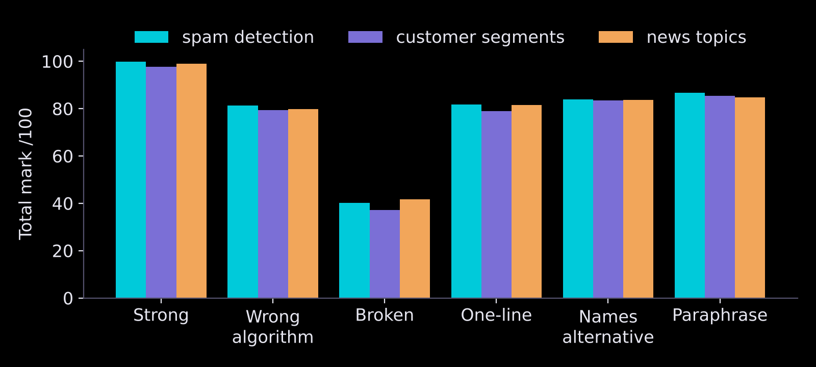
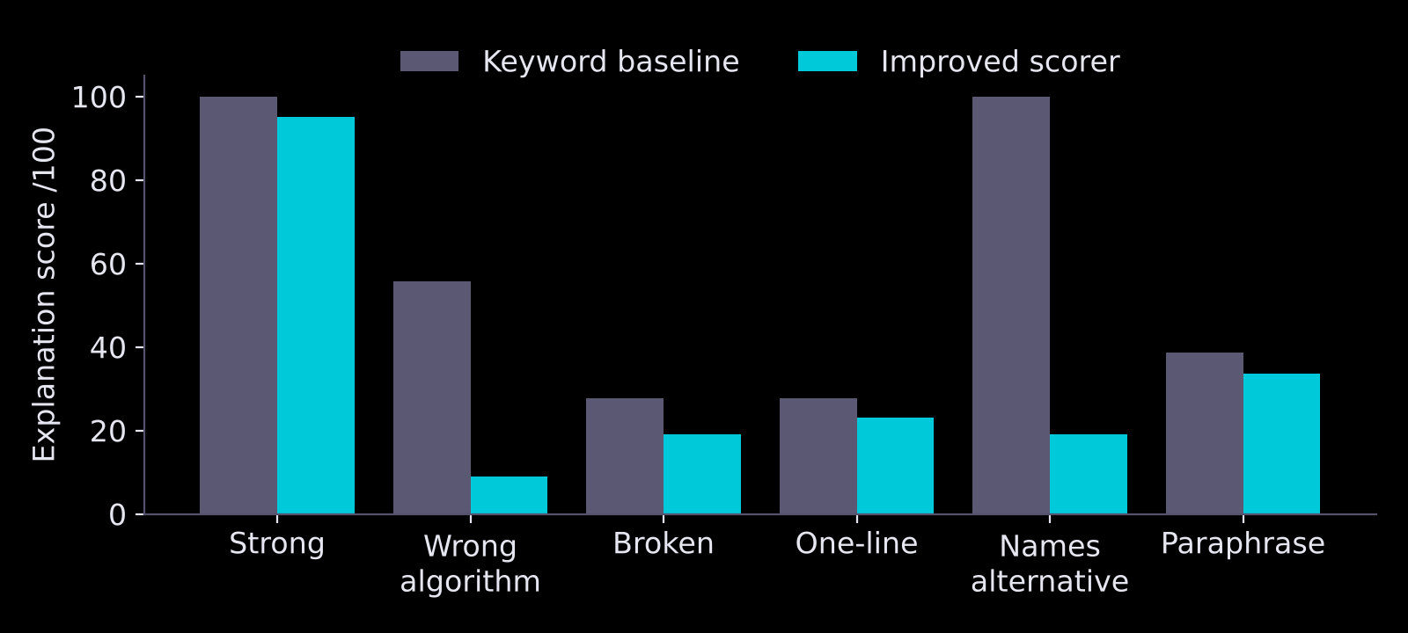
RESULTS: SYNTHETIC NOTEBOOKS
Strong 97.7–99.8 (A) · Broken 37–42 (F)
All 23: recall = TP/(TP+FN) = 5/5 = 1.00
Precision = TP/(TP+FP) = 5/8 = 0.63
Wrong algorithm: 56 → 9
Names alternative: 100 → 19 (false flag)
Paraphrase: 39 → 34
Notes:
On three synthetic labs, strong work scored an A and broken code an F everywhere. Wrong explanations dropped from 56 to 9 under the improved scorer. Two weaknesses show up: mentioning a rejected alternative causes a false flag, and plain-English paraphrases score low.

Slide 15
ERROR ANALYSIS
Case | What happens | Fix
Rejected alternative (“we did not use Naive Bayes”) | Read as a claim → false flag, ≈ −16 | Skip negated / comparative clauses
Headings counted as explanation | “Too short” rule never fires | Score only the Explanation cell
Paraphrase without technical words | Concepts missed, ≈ −13 | Per-concept Sentence-BERT
Length used in two checks | Short write-ups lose ≈ 4 extra | Judge explanation quality once
Hard-coded output, e.g. print("Accuracy: 0.95") | Output check passes | Trust executed tests
Tests tied to variable names | Correct work fails a test | Test behaviour, not names
Notes:
The evaluator matches words, not meaning, so it fails in predictable ways. Each row was observed in our evaluation, with the fix we propose.

Slide 16
AREAS FOR IMPROVEMENT
DATA & VALIDATION
NLP MODELLING
SYSTEM & DEPLOYMENT
30+ real notebooks with teacher marks
Report MAE, RMSE and correlation
Tune weights against teacher marks
Validate each rubric on a reference solution
Handle negation and comparison with a dependency parser
Per-concept semantic matching
Detect hand-written algorithms from code structure (AST)
Multilingual / simpler-English robustness
Score only the Explanation cell; credit long comment blocks
Route every flag to a teacher
Plagiarism / similarity across submissions
POST /evaluate-notebook API and dashboard integration
Notes:
Beyond fixing the observed errors, these are the areas we would improve next, from data and validation through modelling to deployment.

Slide 17
RESPONSIBLE AI AND LIMITATIONS
PRIVACY
SECURITY
GROUNDED
Runs locally; nothing sent to outside services.
Student code runs in a separate process or container.
Reasons come only from failed checks.
BIAS
OVERSIGHT
LIMITATIONS
Plain-English explanations scored ≈ 13 marks lower.
First-pass only; flagged notebooks go to a teacher.
5 real notebooks, no teacher marks; hand-set weights.
Notes:
Everything runs locally, student code runs in a separate process, and no generative model is used, so every reason comes from a check that actually failed. The main risk is bias against plain-English explanations, which is why this is a first-pass grader with a teacher in the loop. The real set is small and has no teacher marks yet.

Slide 18
THANK YOU!
Questions?
Group 3
Notes:
Close: a transparent NLP grader that catches every wrong explanation in our tests and names the mismatch, with clear next steps. Invite questions.

