Slide 1
Credit Card Default Prediction
Low-code AutoML with PyCaret
Group 8 — Syed Fazal Mehdi (S011) · Manas Dabhade (S025) · Deven Bhole (S027)
MLOps · MBA Tech (Data Science) · NMIMS MPSTME, Mumbai

Slide 2
Problem Statement
Banks lose money when card holders miss payments. Can we flag, one month ahead, which customers are likely to default — so the bank can act before the loss?
Business goal
ML task
Why PyCaret
Predict default next month from limit, demographics and 6 months of bill/payment history.
Binary classification (default = 1/0). Imbalanced: only ~22% of customers default.
Trains, compares and tunes 10+ models in a few lines, with a reusable pipeline ready for deployment.
Group 8 · PyCaret Project · 2

Slide 3
Dataset: UCI Credit Card Clients
24,000
23
22%
Feature group | Columns
Credit limit | LIMIT_BAL
Demographics | SEX, EDUCATION, MARRIAGE, AGE
Repayment status | PAY_1 … PAY_6
Bill amounts | BILL_AMT1 … 6
Amounts paid | PAY_AMT1 … 6
customers
input features
default rate
Source: Yeh & Lien (2009), Taiwan bank, Apr–Sep 2005
Version shipped with PyCaret (get_data('credit'))
Target column: default (1 = defaulted next month)
Group 8 · PyCaret Project · 3

Slide 4
Architecture
UCI dataset
Load & split
setup()
compare_models()
24,000 rows × 24 cols
5% kept as unseen
encode · normalise · SMOTE
10 algorithms, 5-fold CV
Streamlit app
finalize & save
predict_model()
tune_model()
single + batch scoring
pipeline → .pkl
hold-out test + plots
random search on AUC
Navy = PyCaret functions
Group 8 · PyCaret Project · 4

Slide 5
Implementation in PyCaret
from pycaret.classification import *
setup(data, target='default',
categorical_features=['SEX','EDUCATION',
'MARRIAGE'],
normalize=True, fix_imbalance=True,
train_size=0.8, fold=5, session_id=42)
top3 = compare_models(n_select=3, sort='AUC')
tuned = tune_model(top3[0], optimize='AUC')
predict_model(tuned) # hold-out test
final = finalize_model(tuned)
save_model(final, 'credit_default_model')
~10 lines replace hundreds of scikit-learn code
setup() builds one pipeline: encoding, scaling and SMOTE travel with the model
Runs in VS Code: python train.py, then streamlit run app.py
Group 8 · PyCaret Project · 5

Slide 6
Model Leaderboard (5-fold CV)
0.783
CV AUC (best: GBC)
0.811
Hold-out accuracy
0.827
Accuracy, 1,200 unseen customers
Group 8 · PyCaret Project · 6

Slide 7
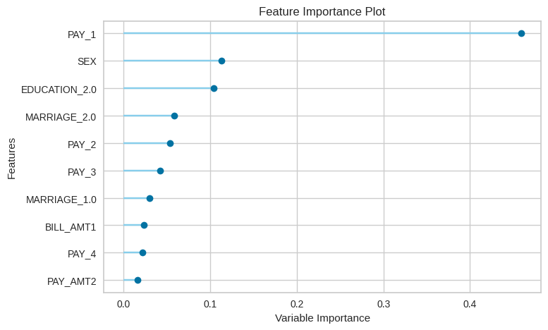
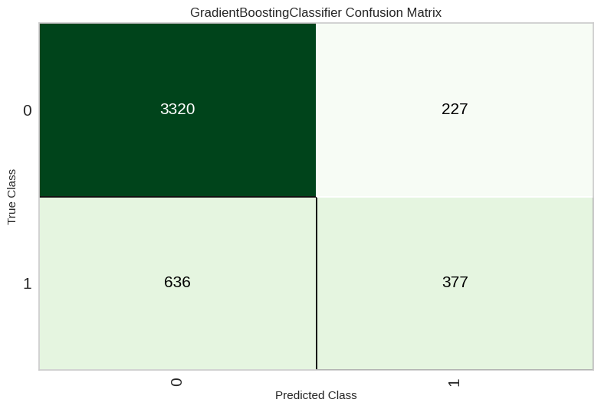
What Drives Default?
Last month's repayment status (PAY_1) dominates
Boosting models win; trees beat linear models
Recall ≈ 0.40: catches 4 in 10 defaulters — threshold tuning can trade precision for recall
Group 8 · PyCaret Project · 7

Slide 8
PyCaret vs Traditional Notebook
 | PyCaret | Traditional
Core modelling code | ~12 lines | ~65 lines
Whole script | 70 lines | 89 lines
Imports needed | 1 module | 13 libraries/classes
End-to-end runtime* | 5.8 min | 10.6 min
Best model | Gradient Boosting | Gradient Boosting
Tuning helped? | No (kept default) | Yes, +0.004 AUC
*Same 2-vCPU machine, same split, same 10 models, 5-fold CV + SMOTE (Colab free tier also has 2 vCPUs)
Group 8 · PyCaret Project · 8

Slide 9
Notable Differences and Insights
Speed of development
Runtime
PyCaret: 6 function calls. Notebook: hand-built ColumnTransformer, SMOTE pipeline, CV loop, search grid and metric code.
PyCaret finished in ~45% less time; notebook tuning of GBC with a wider grid took ~4 min alone.
Model quality
Precision vs recall
Same winner (Gradient Boosting), similar ranking; PyCaret ahead by ~0.01 AUC and ~3 pts accuracy.
Notebook model caught more defaulters (recall 0.51 vs 0.37) but raised more false alarms (precision 0.51 vs 0.62).
Control & transparency
Free extras
Notebook exposes every step and default; PyCaret hides choices (fold shuffling, defaults) unless you inspect them.
PyCaret gives leaderboard, Kappa/MCC, plots, choose_better and a deployable pipeline with no extra code.
Group 8 · PyCaret Project · 9

Slide 10
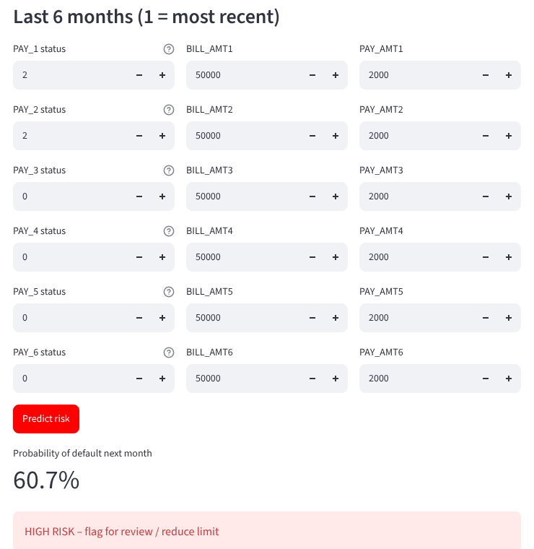
Working Demo: Streamlit App
Single customer
Enter limit, profile and 6 months of history → probability of default + Low / Medium / High risk label.
Batch scoring
Upload a CSV (e.g. outputs/unseen_sample.csv) → every customer ranked by risk, downloadable.
Group 8 · PyCaret Project · 10

Slide 11
Key Learnings
1
AutoML speeds iteration
2
Pipelines prevent leakage
compare_models() benchmarked 10 algorithms in minutes
Preprocessing is fit inside CV folds and saved with the model
3
Accuracy can mislead
4
Low-code vs full control
With 22% defaults, AUC, recall and F1 matter more
PyCaret was faster to write and run; the notebook gave finer control over every step
5
Environment matters
6
Model → product
PyCaret 3.3 needs Python 3.9–3.11; use a venv in VS Code
save_model + Streamlit turn a notebook into a usable tool
Group 8 · PyCaret Project · 11

Slide 12
Conclusion
Gradient Boosting predicts next-month default with AUC 0.78 using PyCaret in ~12 lines
Vs a traditional Colab notebook: ~5x less modelling code, ~45% faster, equal or better AUC
End-to-end: data → pipeline → model → Streamlit demo, all runnable in VS Code
Next: cost-sensitive threshold, MLflow tracking, SHAP explanations, Docker deployment
Thank you — Questions?

