Slide 1

Smart Garbage Collection
CS 684 - Embedded Systems
Spring 2018
Group members
Manas (163236001)
Sambit (163230013)
Emmey (163230003)

Slide 2
Problem Statement
Brief description of the goal of project :
Placing Sensor based static waste collection garbage bins
Making it IoT enabled by LoRaWan protocol
Geo-tagging of bins
Build an application with an integration to Google Map as background layer
Indicating different levels of waste to the user

Slide 3
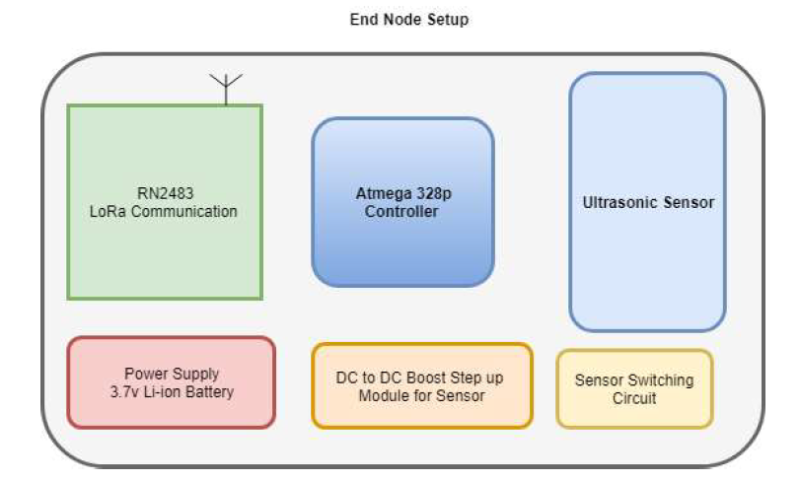
Requirements :- Hardware
Software

Slide 4
Requirements :- Software
Web application having (specific features)
Waste Level Indicator
Google Map indication of location of bins
Framework : javascript, node.js

Slide 5
Challenges :
Packaging the hardware in a single PCB
Making the setup as compact as possible
Low power design
Coming up with a web application with specific features
Problem with Ultrasonic sensor calibration.

Slide 6
Deliverables
Hardware
Two no. of sensor nodes with gateway on Rpi
Software
Web appliation with facility of level indicator of waste and location specifier

Slide 7
Test Strategies
Hardware testing with sensor
LoRaWan communication with the sensor node
Testing of the sensor node and gateway communication with python script
Testing of the whole setup with node, gateway and web application.

Slide 8
Timeline
Circuit Diagram & PCB Design on KiCad (22nd March)
Sensor node Setup (29th March)
Web application (5th April)
Testing & Final delivary(12th April)

Slide 9
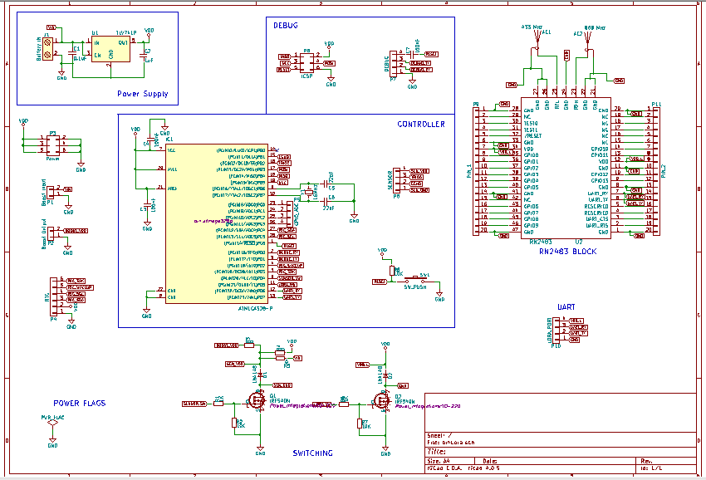
Deliverables-I:Schematic & PCB

Slide 10
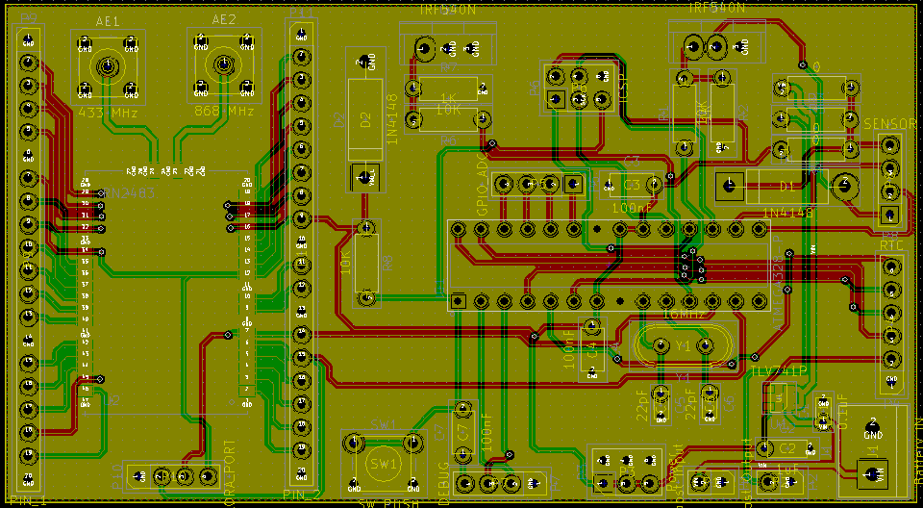
Deliverables-I:Schematic & PCB

Slide 11
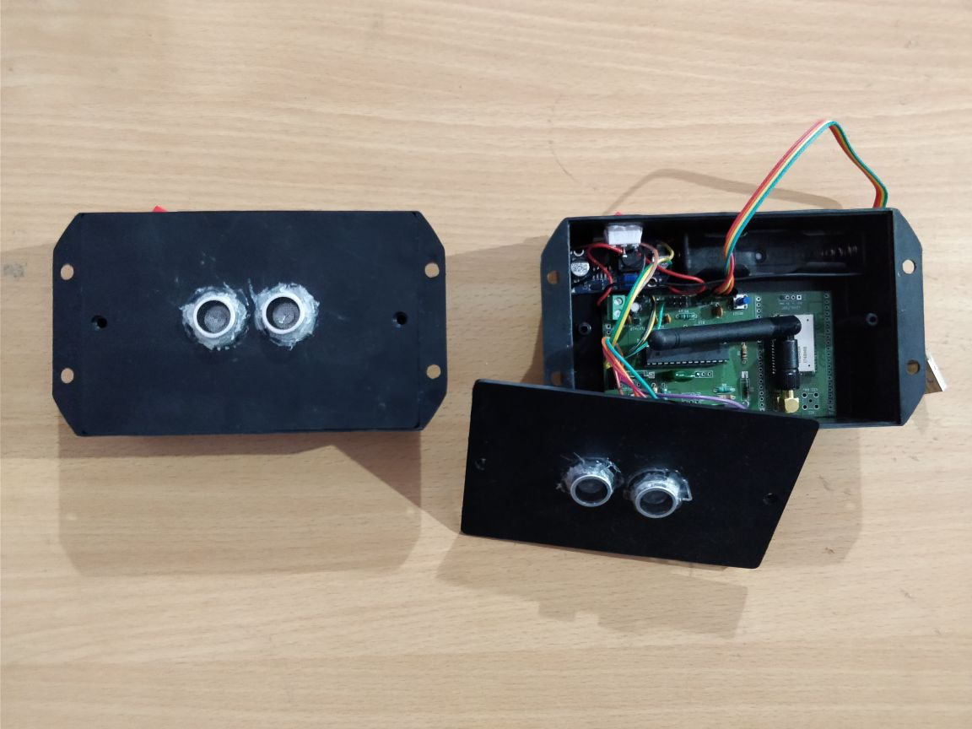
Deliverables-II: Node setup

Slide 12
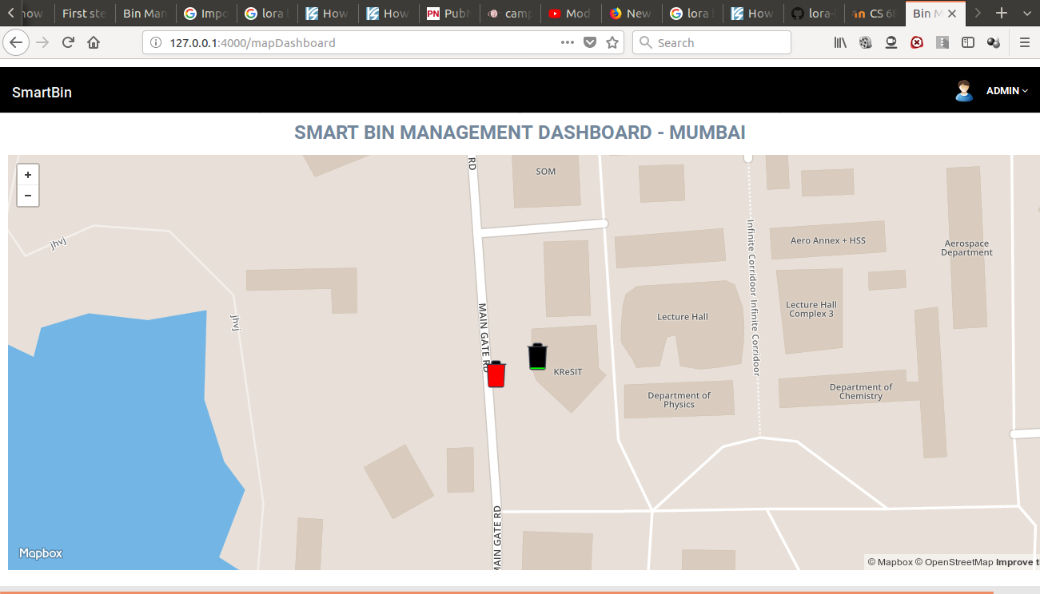
Deliverables-III: Dashboard

Slide 13
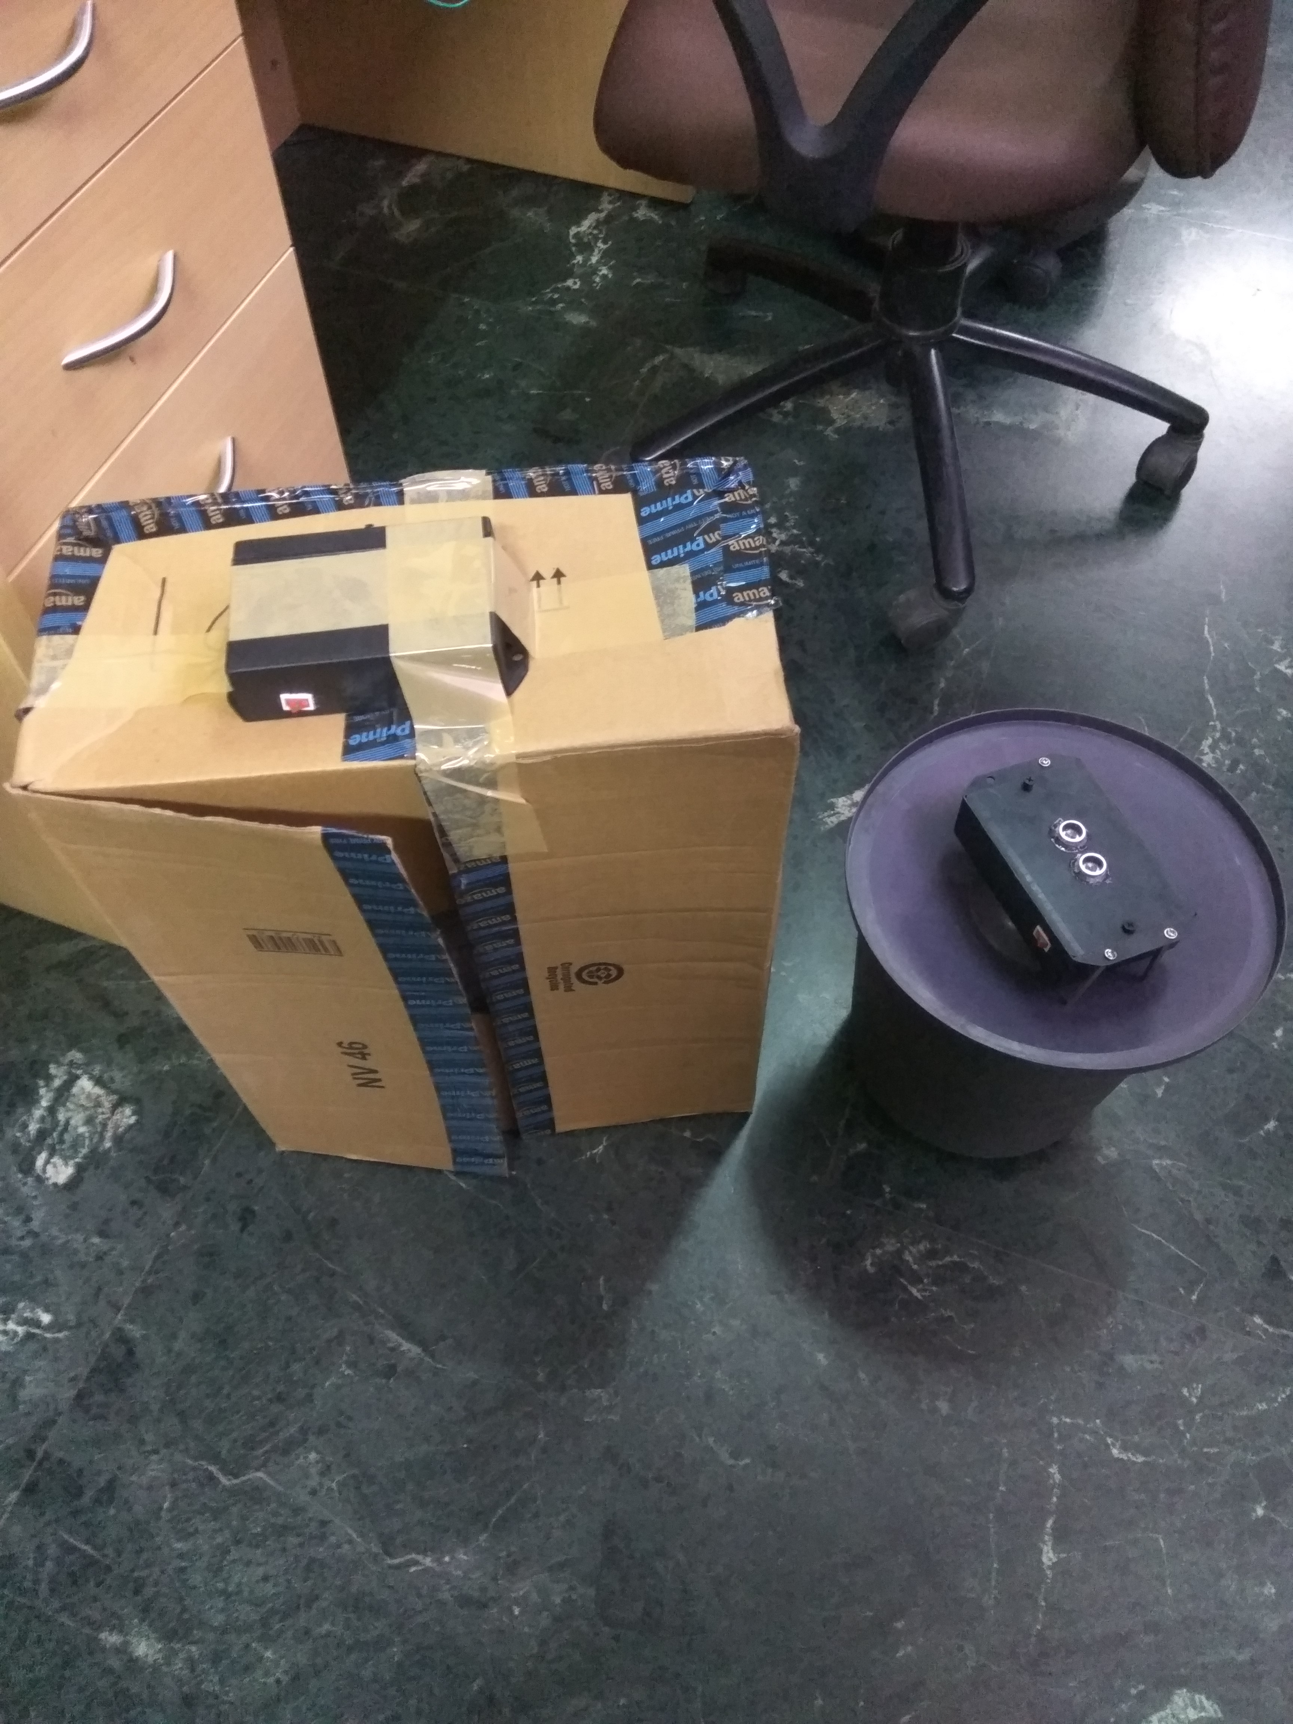
Deliverables-IV: Testing

