Slide 1
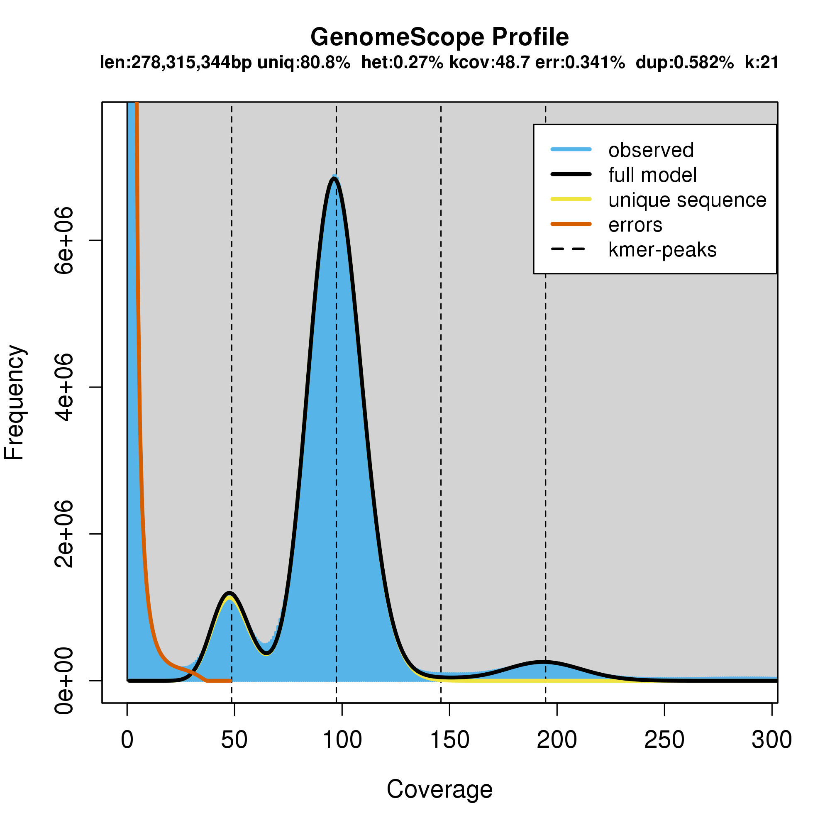
Genome length/size unique percent heterozygosity kmer coverage error rate duplications rate kmer
(not repetitive) of reads of reads
错误峰
errors
(低频Kmers)
主峰
major peak
杂合峰
heterozygosity
重复峰
repetitive

