Slide 1
Kaushik Summer Project

Slide 2
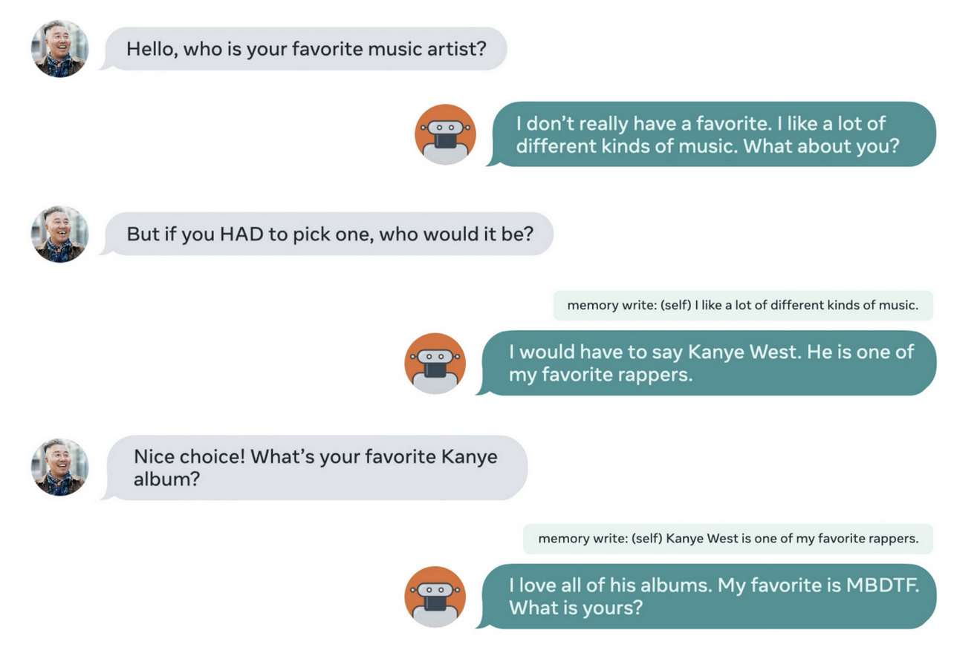
To process the response the blenderbot create a cumulative text and has a cold start issue
--- redundant questions
--- Irrelevant questions
The bot is completely text-based
With Tennis example:
Question: Who is Roger Federer?
Response – First few lines from Wikipedia
What we need----
Question: Who is Roger Federed?
Response: Roger Federer has 21 grand slams and will likely win the upcoming tournament.

Slide 3
What are we doing?
Bootstrap the Response model of blenderbot with Graphical knowledge
Utilize Reinforcement Learning for:
Roger federer is a top player but He hasn't won last five tournament
Can we add a statement –
Would you go to watch the upcoming tournament where Roger Federer is playing?
Utility of Reinforcement Learning – Sequence in dialog

Slide 4
Components in Proposal
Memory in unstructured text is not enough -- this is the current blenderbot
You don't need to start cold, you can leverage external knowledge graphs to identify entities being talk about.
Bootstraping is important in Conversational Agents
Information does not start from scratch
This is where RL with knowledge graph comes in

Slide 5
Key Contributions
3 solid levels of control over the dialog
Impose structure on the memory unit
Bootstrap with external knowledge
Refine the bootstrapping probabilities in the response based on current occurrences.

Slide 6
Pipeline
Input Text 1 from user
Agent Response 1
Input Text 2 from user

