Slide 1

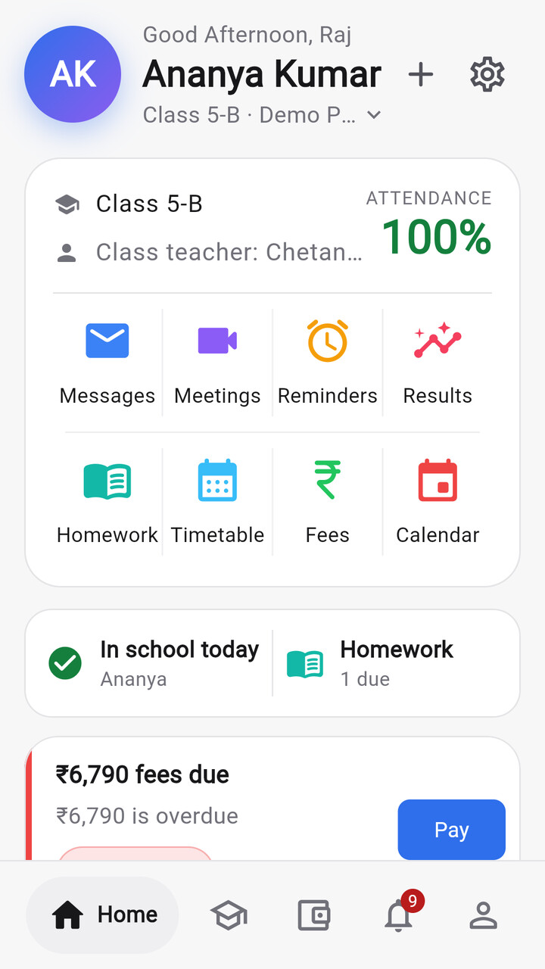
Your whole school, in one simple app
Attendance, fees, exams, homework, ID cards and parent messages. The office on the web; parents and teachers on their phones.
Built for Indian schools · Web + Android · Multi-school SaaS
Notes:
Good morning. Imagine you're a parent in Pune at 9 a.m. You don't know if your daughter reached school, whether the fee is overdue, or what the homework is, unless you scroll through three WhatsApp groups.
We built Bastaa so that a school's whole day lives in one place. The office works on the web, and parents and teachers use one simple Android app.
Everything I show today runs in our codebase. Every screenshot is the real product running on our demo school of 750 students. Where something is still waiting on an account or a decision, I'll say so.

Slide 2




Schools still run on registers, fee books and WhatsApp
THE PROBLEM
Paper registers
Fee books and Excel
WhatsApp chaos
Results by hand
Attendance is written by hand, tallied at month-end, and parents only hear about absences much later.
Installments, concessions and late fees tracked by hand. Receipts get lost and dues are hard to chase.
Notices, homework and complaints scattered across groups. Nobody knows who has read what.
Marks typed into spreadsheets, report cards formatted one by one, ID cards sent to a print shop.
14.7 lakh
24.7 crore
1 crore+
Every one of them takes attendance, collects fees and reports results, every single day.
schools in India
students enrolled
teachers
Source: UDISE+ 2024-25 (Ministry of Education), as summarised by educationforallinindia.com
Notes:
India has about 14.7 lakh schools, nearly 25 crore students and more than one crore teachers. That's UDISE+ 2024-25, the Ministry of Education's own census.
Every one of those schools runs the same daily loop: take attendance, collect fees, set homework, tell parents things, publish results.
In most schools we've seen, that loop still runs on paper registers, fee books, Excel files and WhatsApp groups. Nothing connects, and the parent is usually the last to know.

Slide 3






Five people, one school day, no shared system
WHO FEELS IT
TODAY
WITH BASTAA
School office
Re-enters the same student data in three places
One record, imported once from Excel
Principal
Sees problems only at month-end
A live dashboard of what needs attention today
Accountant
Chases dues with a register and a phone
Invoices, online payments and day close
Teacher
Spends class time on registers and marks sheets
Mark attendance in seconds, even offline
Parent
Finds out late, from a WhatsApp group
Their child's day, fees and results in one app
Notes:
The problem isn't one person. It's five people sharing one school day with no shared system.
The office types the same student into three registers. The principal finds problems at month-end. The accountant chases fees by phone. Teachers lose class time to registers. And the parent finds out last.
Bastaa gives each of them their own view of the same data: one record, permission-checked, live.

Slide 4
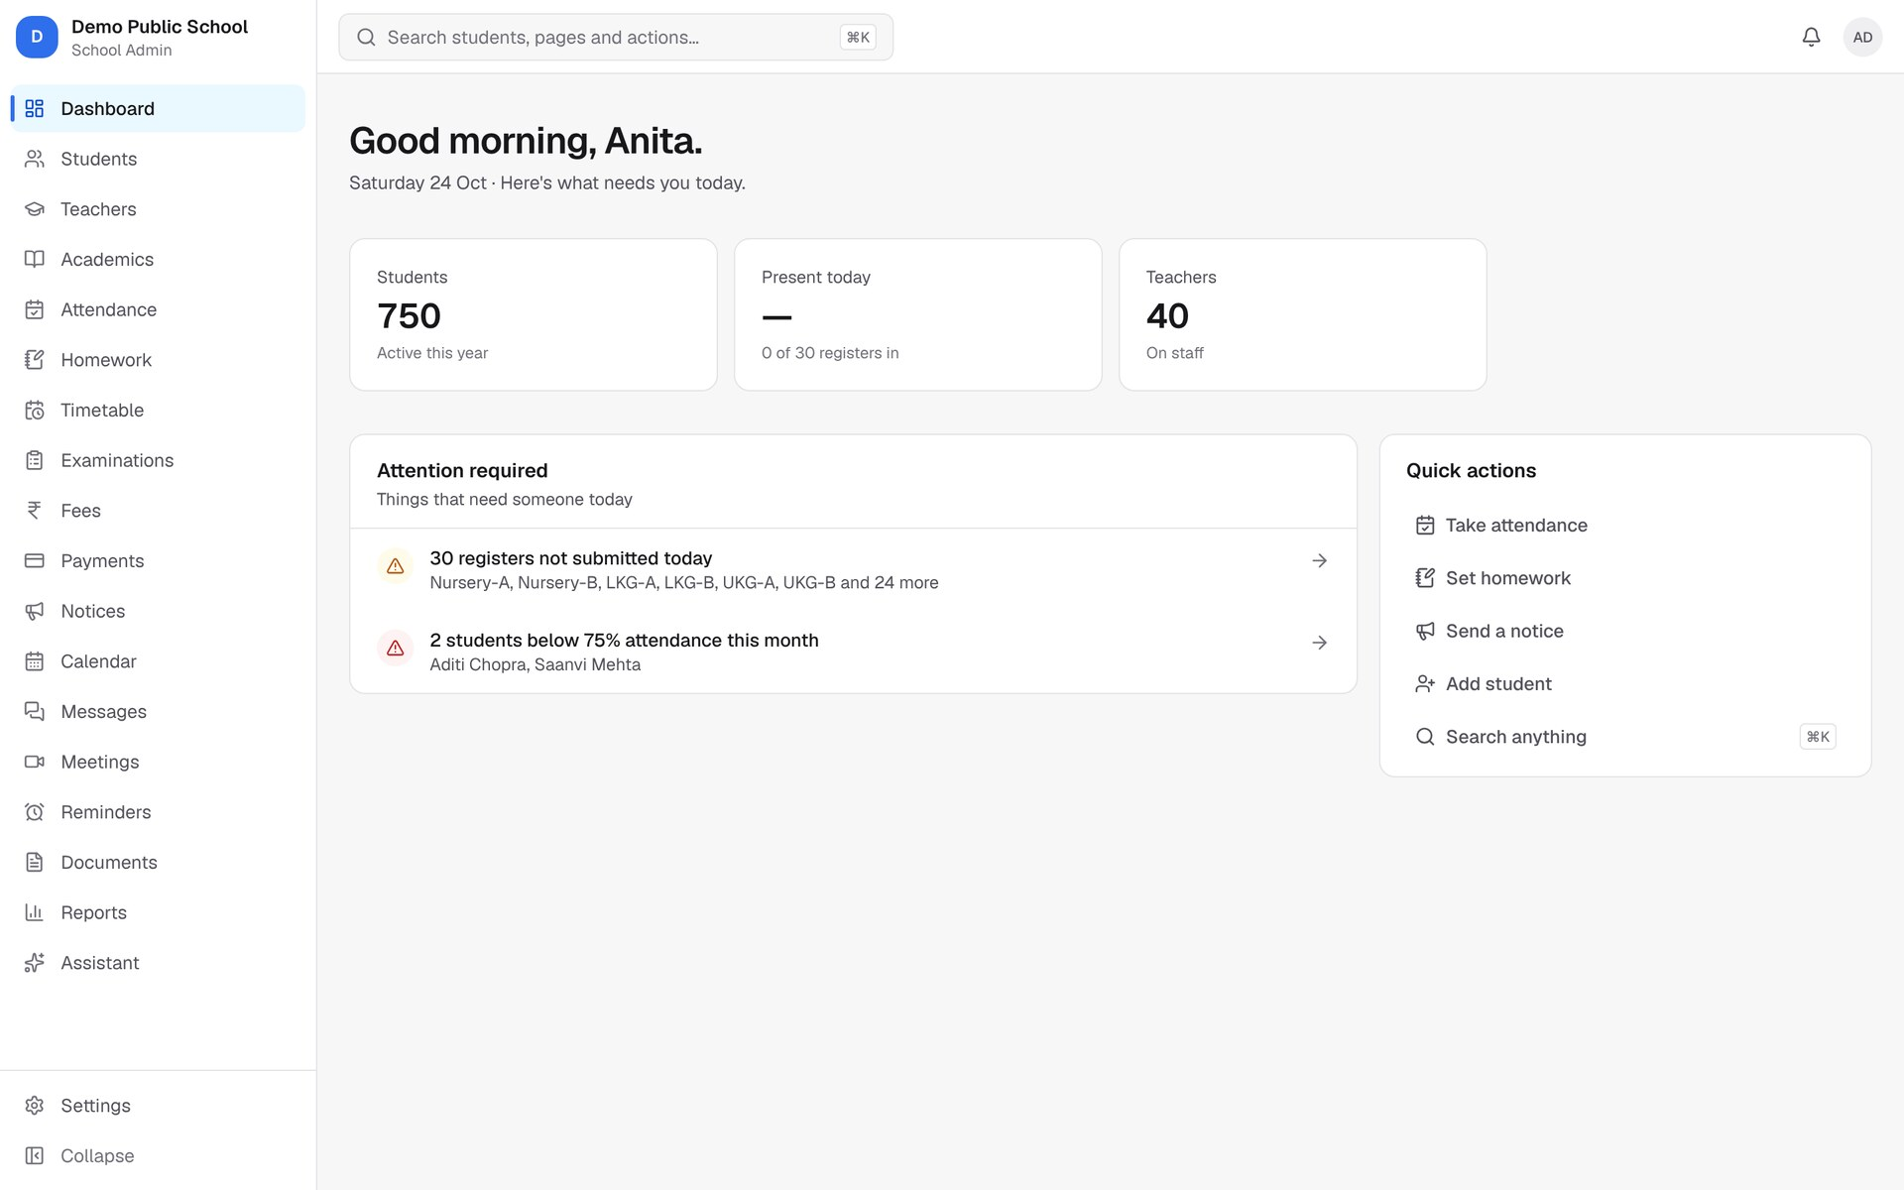
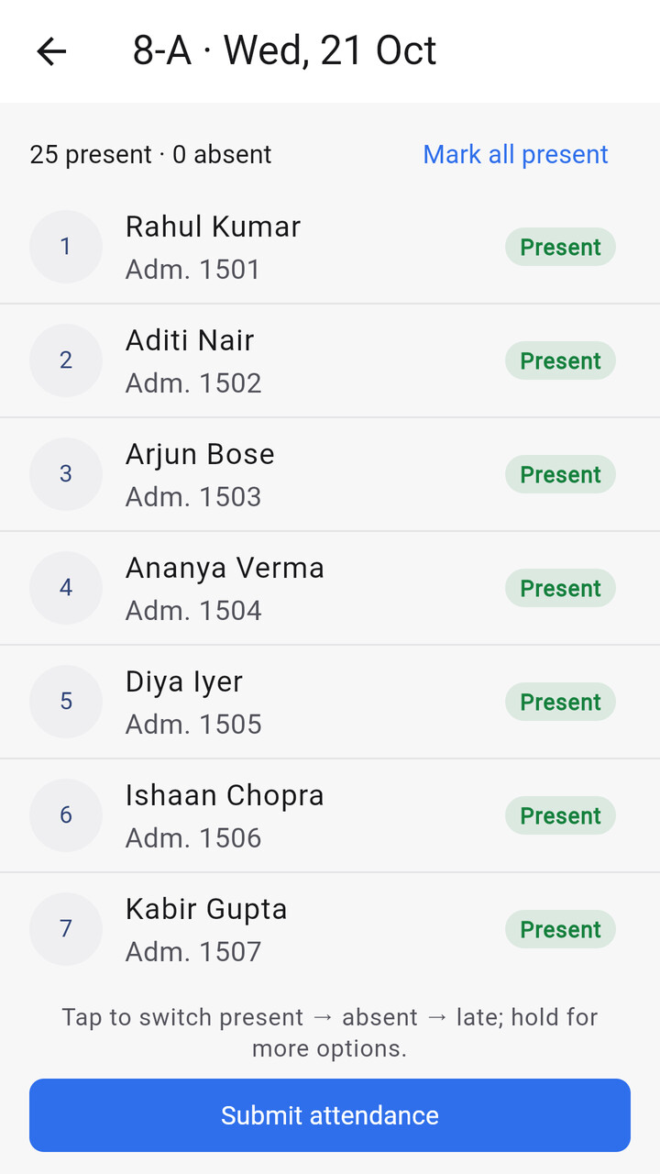
One school, one system, three ways in
THE SOLUTION
School portal (web)
Parent & teacher app
Bastaa console
stmarys.bastaa.in: office, principal, accountant, teachers
One Android app; the home screen follows the role
admin.bastaa.in: onboard schools, plans, support
Notes:
Bastaa is one platform with three ways in.
The school portal is a website with its own address for each school, for example stmarys.bastaa.in. The office, principal, accountant and teachers work there.
Parents and teachers use one Android app. After sign-in, the home screen follows the person's role, and someone who is both can switch.
And we have our own console at admin.bastaa.in, where we onboard schools, manage plans and give support, but only when the school approves it.
All three talk to the same API, so the data is always the same everywhere.

Slide 5




The office starts every day on one screen
PRODUCT TOUR
Role-aware home
Numbers and "needs attention" items are different for an admin, teacher or parent.
Problems, not reports
Registers not submitted, students below 75% attendance, overdue fees: surfaced before month-end.
Find anything
One search (Ctrl + K) across students, teachers and parents, limited to what you may see.
Your school's brand
Logo and colour on the portal, the app, receipts, report cards and ID cards.
Notes:
This is the school admin's home page in the demo school.
It doesn't open on a wall of charts. It opens on what needs attention today: 30 registers not yet submitted, two students below 75% attendance.
Each role gets its own version of this page. A teacher sees the registers to take and today's classes. A parent sees their child's day.
Search works across students, teachers and parents, and it only shows what that person is allowed to see.
Every school's logo and colour carry through the portal, the app and every printed document.

Slide 6
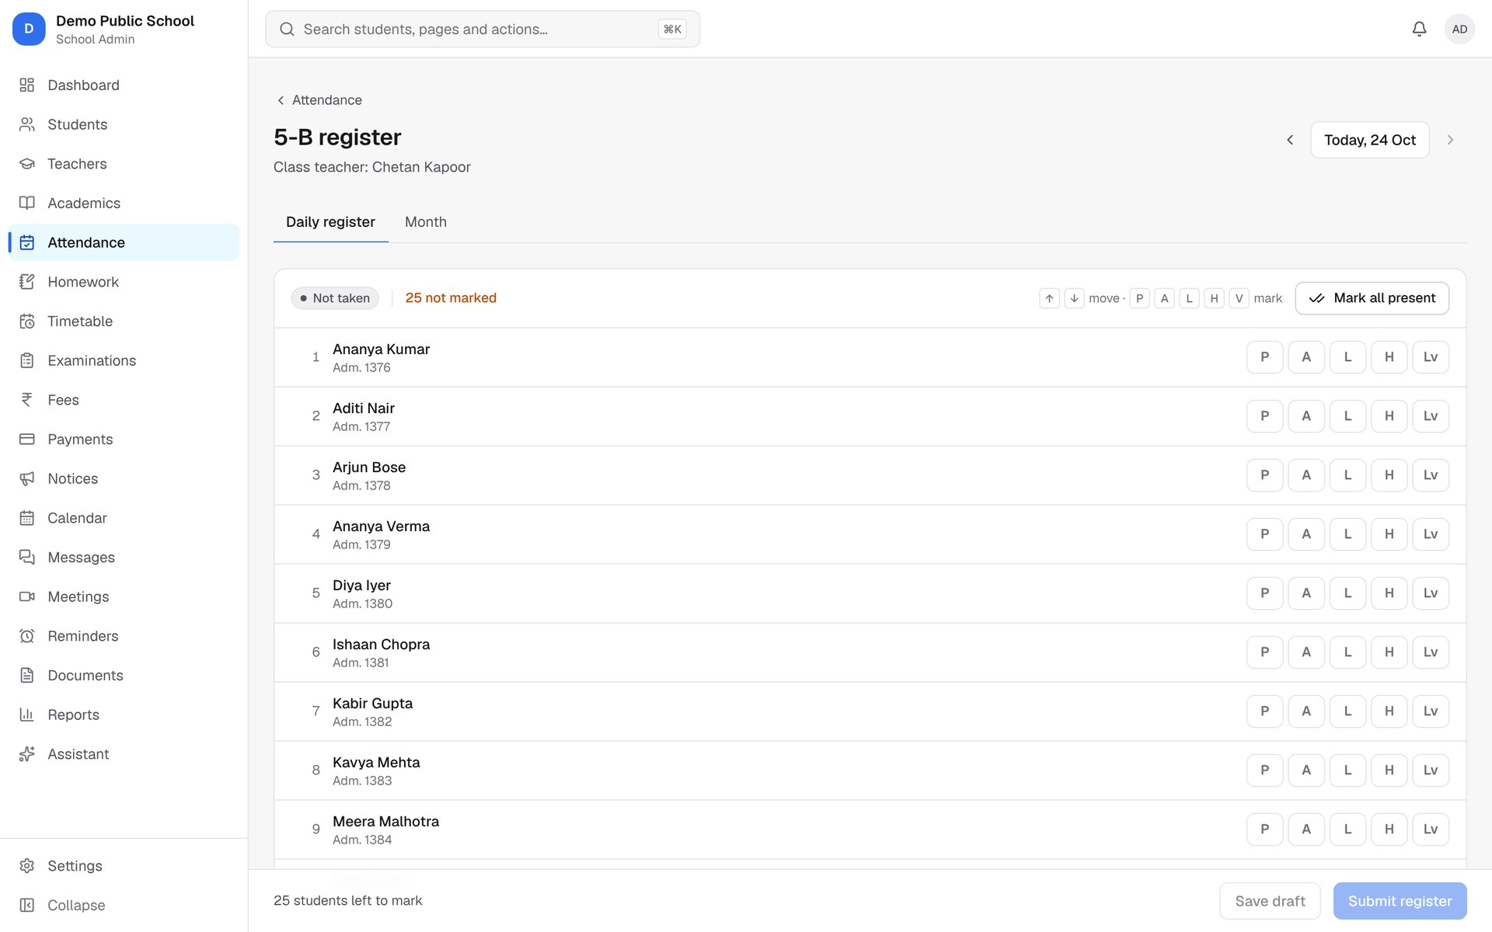
A register in seconds, even with no signal
DAILY OPERATIONS · ATTENDANCE
One-tap marks: present, absent, late, half day, leave
Offline in the app: queued on the phone, sent when back online, never counted twice
Parents get an alert when their child is absent, or arrives
Edit window, staff attendance and monthly grids
Notes:
Attendance is the first thing every school does each morning, so it has to be fast.
On the web the class teacher marks a section with one tap per student, or "mark all present". In the app it works with no signal at all. The register is saved on the phone and sent when the connection comes back.
Each offline submission carries an ID, so if it's sent twice the server ignores the repeat. Nothing gets double-counted.
As soon as a register is submitted, parents of absent children are told. The office can set an edit window, track staff attendance and see the monthly grid.

Slide 7
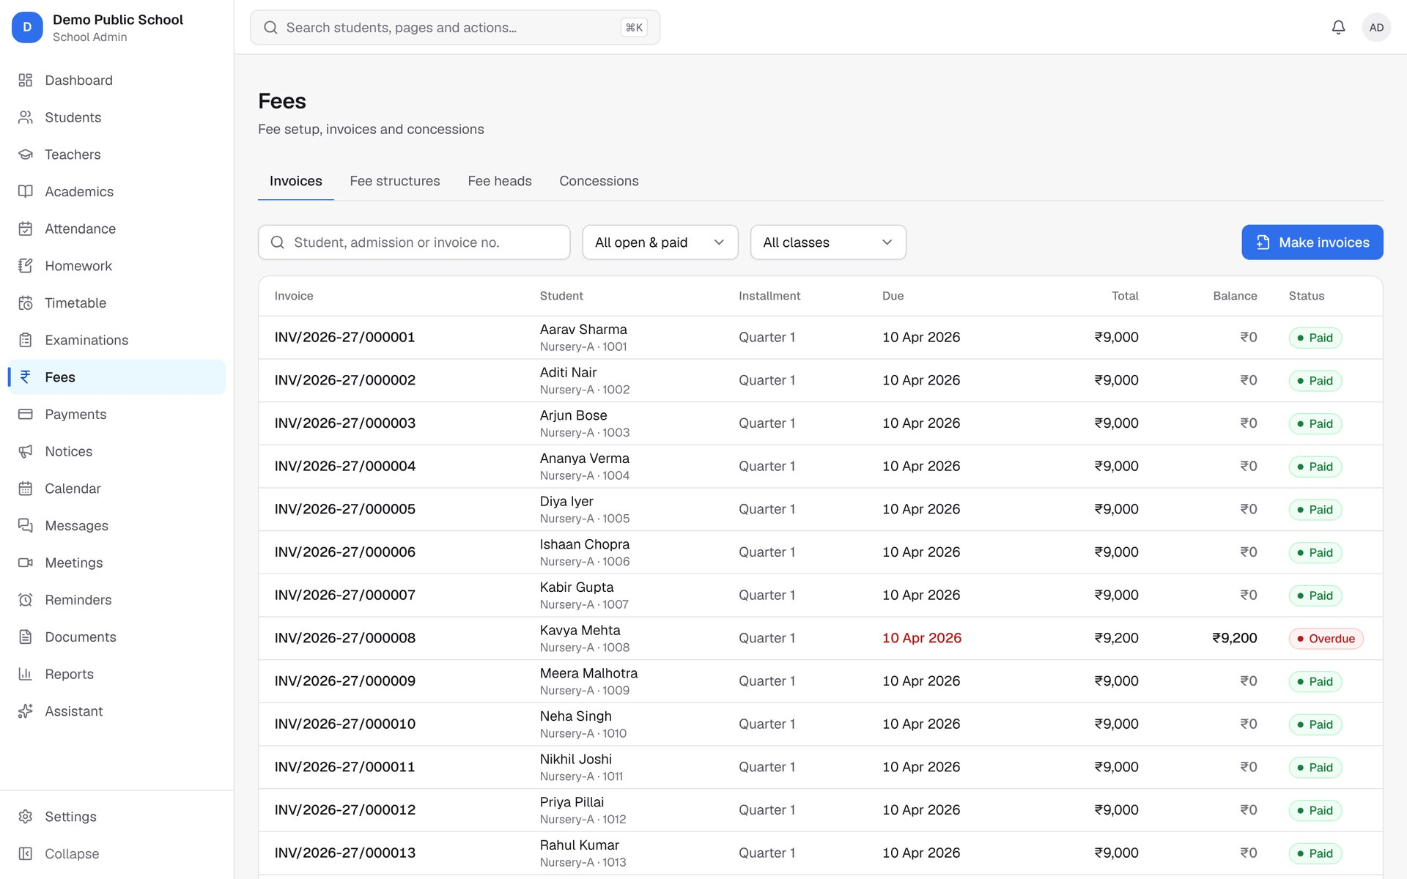




From fee structure to receipt, without a fee book
DAILY OPERATIONS · FEES
Structure
Fee heads, class-wise amounts, installments
Invoice
Gap-free numbers for every student
Pay
Counter, or online from the parent app
Receipt
Instant, re-printable, day close
Concessions with approval, late-fee rules, refunds and reminders. Online payments go to each school's own Razorpay account; Bastaa never holds the money.
Notes:
Fees are where schools lose the most time and the most money.
The accountant sets up fee heads like tuition and transport, then class-wise structures with installments. Invoices come out with gap-free numbers.
Parents pay at the counter or online in the app. Online payments go straight to the school's own Razorpay account, so we never hold the money. We verify every payment's signature and webhook.
Receipts are instant and can be re-printed. There's a day close for the cash counter, concessions that need approval, late-fee rules, refunds and reminders.

Slide 8
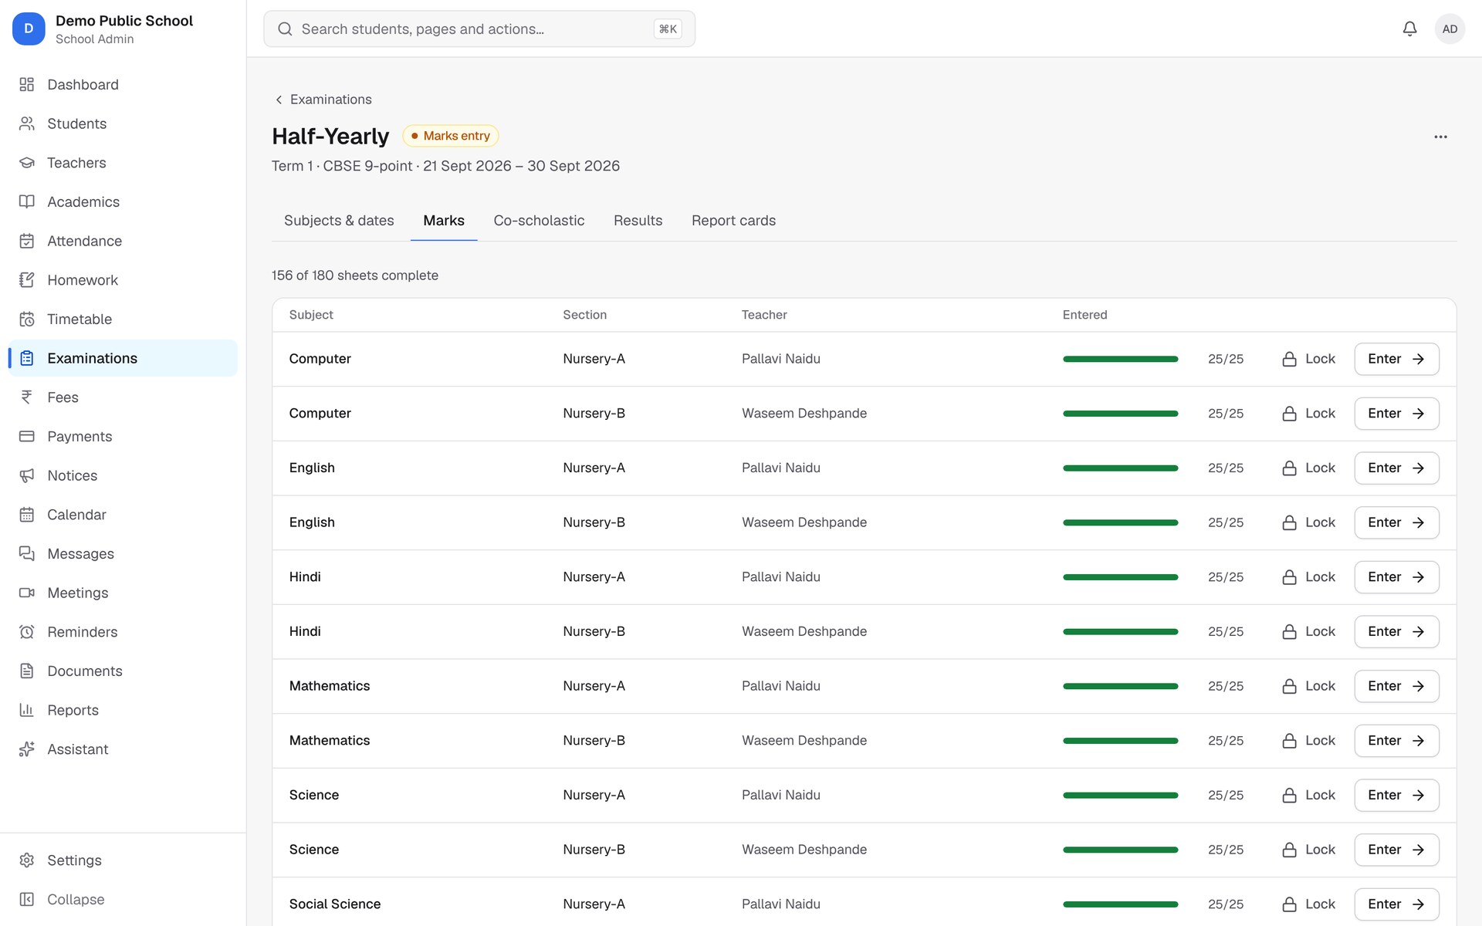
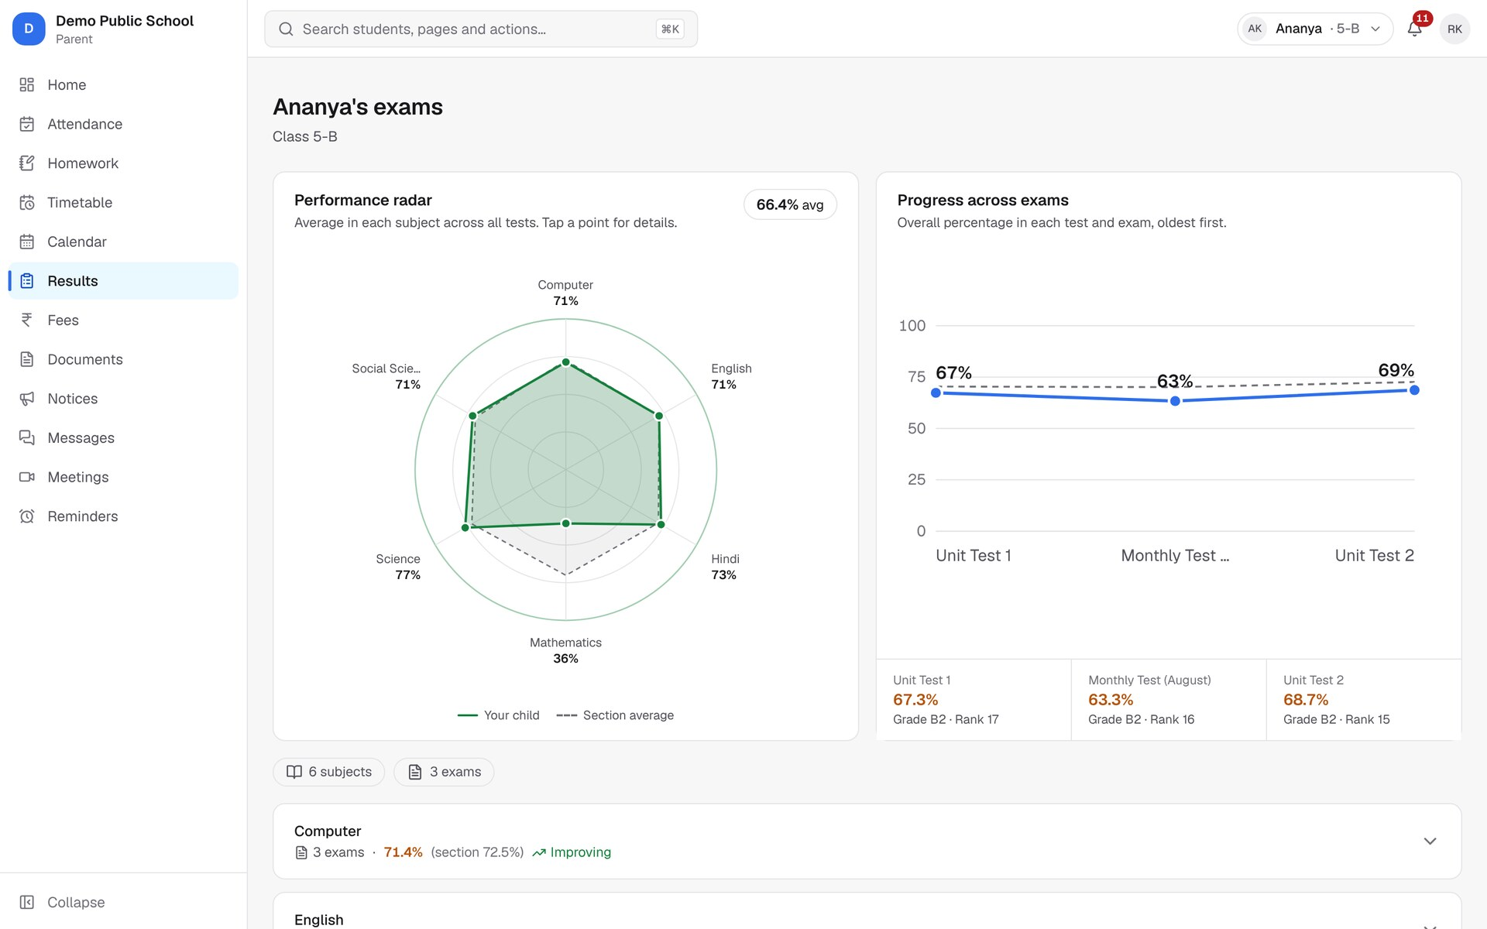
Marks in, report cards out
ACADEMICS · EXAMS AND RESULTS
Exams, date sheets and grading scales (CBSE 9-point and custom)
Marks entry by subject, or Excel import; lock when done
Results, ranks, co-scholastic grades, term results
Report cards in three layouts, generated for a whole section
Notes:
Exams follow one path: set up the exam, enter marks, publish results, print report cards.
Teachers enter marks for their own subjects, on the web, on the phone, or by uploading an Excel sheet. The office can see progress per subject and section, and lock sheets once they're done.
When the principal publishes results, parents see them with a performance radar and progress across exams, like this one for Ananya.
Report cards come in three layouts the school chooses from: classic, modern or compact. They're generated for a whole section in the background.

Slide 9
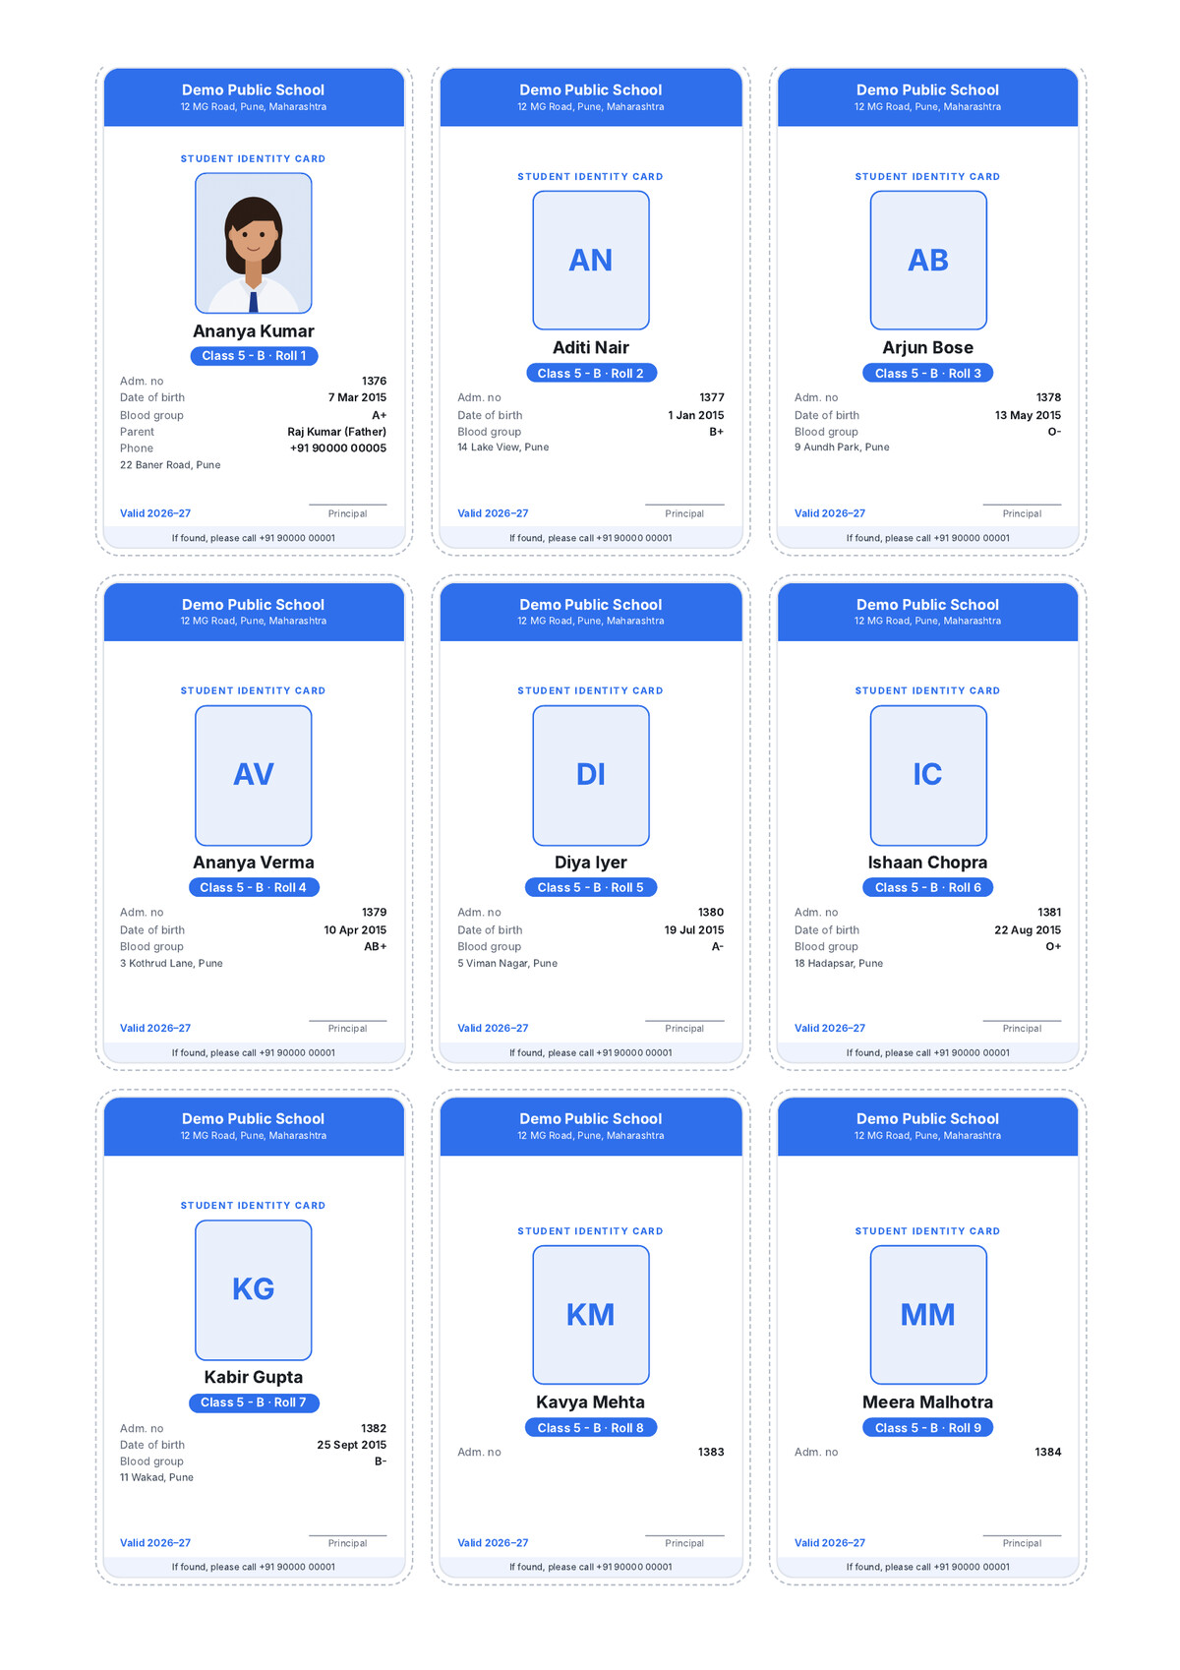
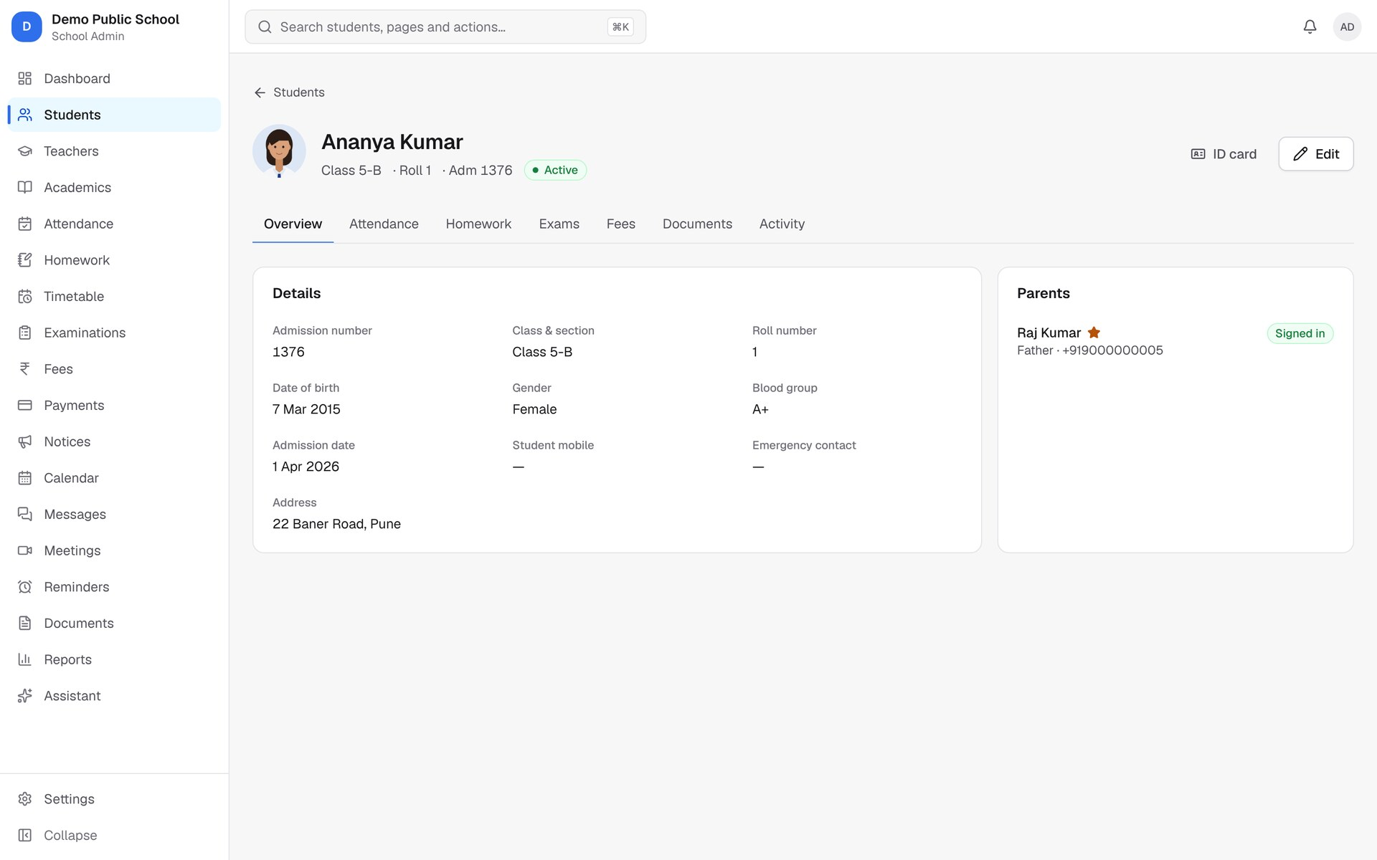
Every student, one record, and an ID card from it
SCHOOL MANAGEMENT · STUDENT RECORDS
One record feeds attendance, fees, results and the ID card. Nothing is typed twice.
A4 sheet for 5-B, straight from the system
Notes:
Everything about a student lives on one profile: admission details, class and roll number, parents, photo, blood group, plus tabs for attendance, homework, exams, fees and documents.
Because that record already exists, we can print things from it instead of typing them again. The newest example is ID cards.
On the right is a real A4 sheet the system produced for Class 5-B: nine cards per page, at the standard card size, with cut lines. The office opens it from the Students page or from one student's profile.

Slide 10
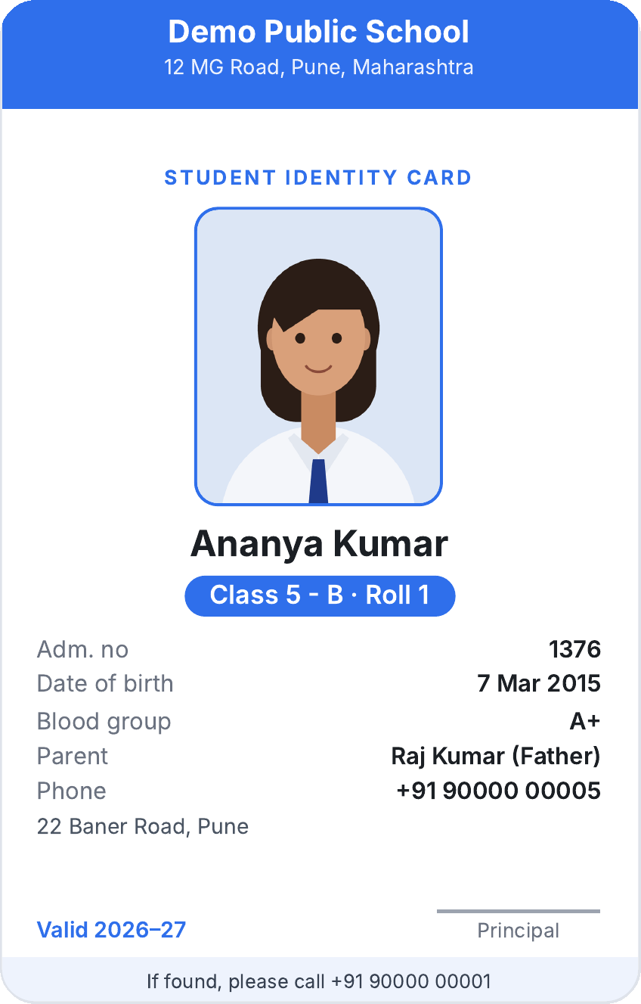
Print-ready ID cards in one click
SCHOOL MANAGEMENT · STUDENT ID CARD
54 × 85.6 mm
9 per A4
1 click
standard card size
with cut lines
per section or student
1
School colour, name and address from Branding
2
Student photo from the profile (initials if none)
3
Name, class, section and roll number
4
Admission no, date of birth, blood group, parent and phone
5
Academic year, principal's signature, "if found" phone
Notes:
Here's one card up close. This is the actual PDF the system rendered for Ananya in the demo school, not a mock-up.
One: the header uses the school's own colour, name and address from its branding settings.
Two: the photo comes from the student's profile. If there's no photo yet, it prints the student's initials instead of a blank box.
Three: name, class, section and roll number.
Four: admission number, date of birth, blood group, and the primary parent with their phone, which is what matters in an emergency.
Five: the academic year, the principal's signature, and an "if found, please call" line with the school's number.
If a field is empty, it's left off rather than printed as a blank. Only office staff with edit rights can print, and asking for another school's student returns "not found".
Today the school prints these on any printer and laminates them, so no more sending lists to a print shop.

Slide 11
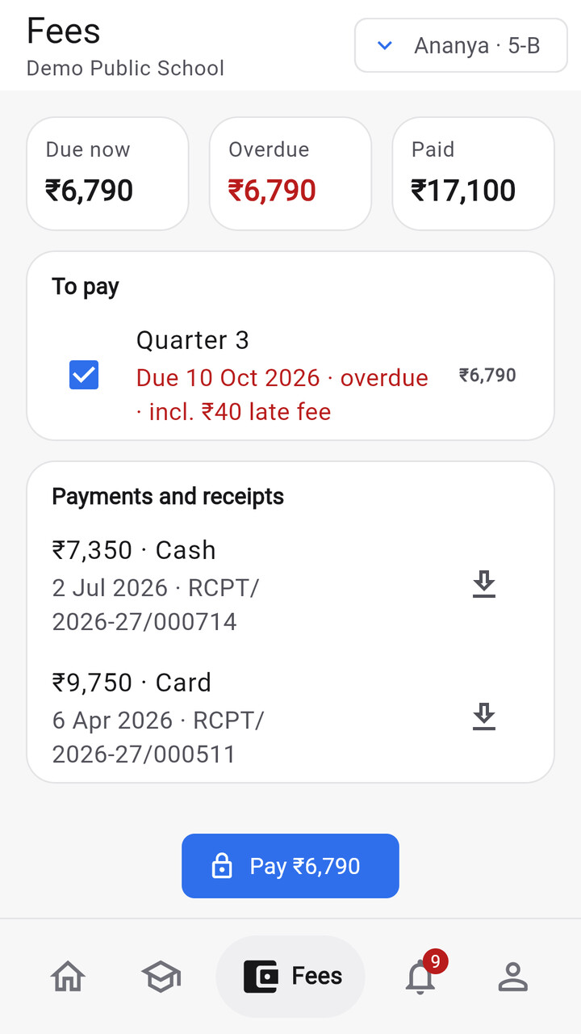
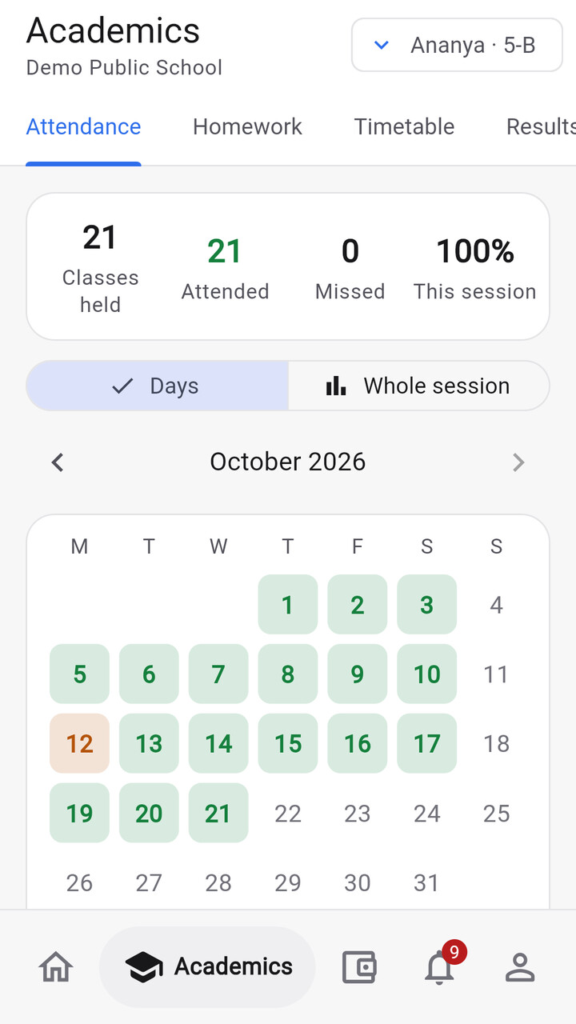
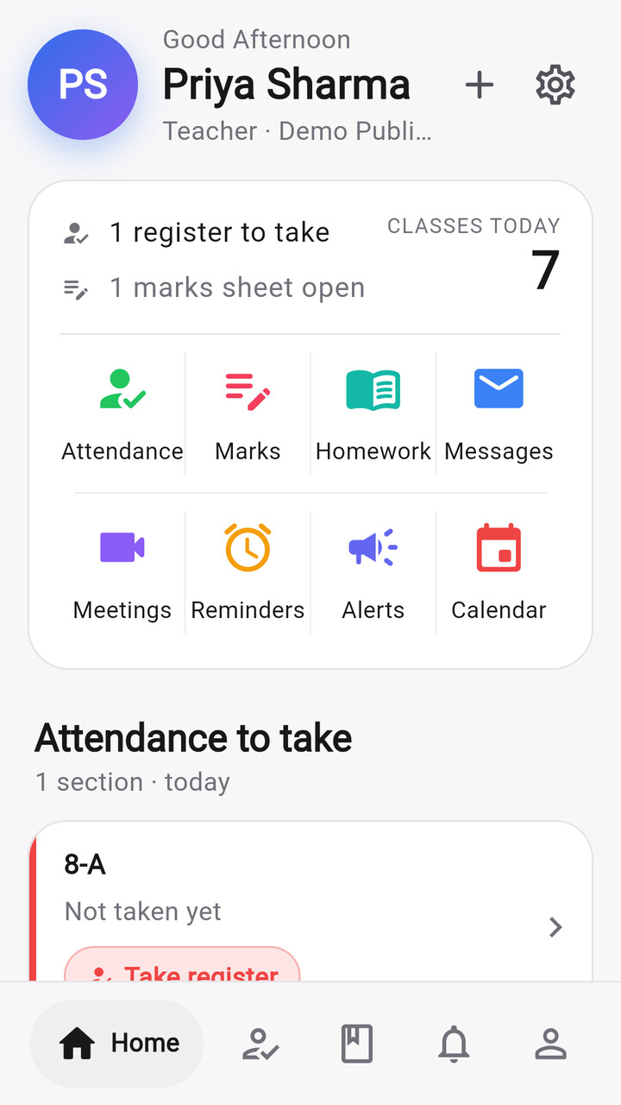
One app for parents and teachers
MOBILE APP
Parents: today, attendance, homework, timetable, results, fees and receipts
Teachers: registers (offline), homework with camera photos, marks
Both: messages, video meetings, calendar, reminders, push alerts
Demo build runs with no server, ready for Google Play testing
Parent · Home
Parent · Fees
Parent · Academics
Teacher · Home
Notes:
Parents and teachers live on their phones, so the app is where most people meet Bastaa.
A parent sees whether their child is in school today, the timetable, homework, results with charts, and fees. They can pay and download receipts.
A teacher takes registers, even offline, posts homework with a photo of the board, and enters marks.
Both get messages, video meetings, the school calendar, reminders and push notifications.
The app is built in Flutter. We also have a demo build that carries a sample school inside the app and needs no server. That's the version going to Google Play for internal testing first.

Slide 12







Every message reaches the right parent, at the right time
COMMUNICATION
NOTIFICATION ENGINE
20 school events, each switchable per school
Notices
Messages & complaints
To the whole school, a class or parents only, scheduled, with read receipts.
Parent to class or subject teacher, with categories, statuses and read receipts.
In-app inbox always
App push Firebase
SMS MSG91, optional
Email optional
Video meetings
Calendar & reminders
Parent–teacher meetings on Jitsi, with reminders before they start.
Holidays, events and exam dates; personal reminders with repeats.
Quiet hours (9 pm–7 am by default) hold pushes and SMS until morning. A daily SMS limit keeps costs predictable.
Notes:
This replaces the WhatsApp group.
Notices go to exactly the audience you pick, and you can see who read them. Parents message their child's class teacher or subject teachers directly, and complaints have a status, so nothing gets lost. Meetings run on Jitsi video with reminders, and the calendar carries holidays, events and exam dates.
Under all of this is one notification engine: 20 school events, each switchable per school, delivered to the in-app inbox and optionally by push, SMS or email.
Quiet hours hold night-time pushes and SMS until morning, and a daily SMS limit keeps the bill predictable.

Slide 13




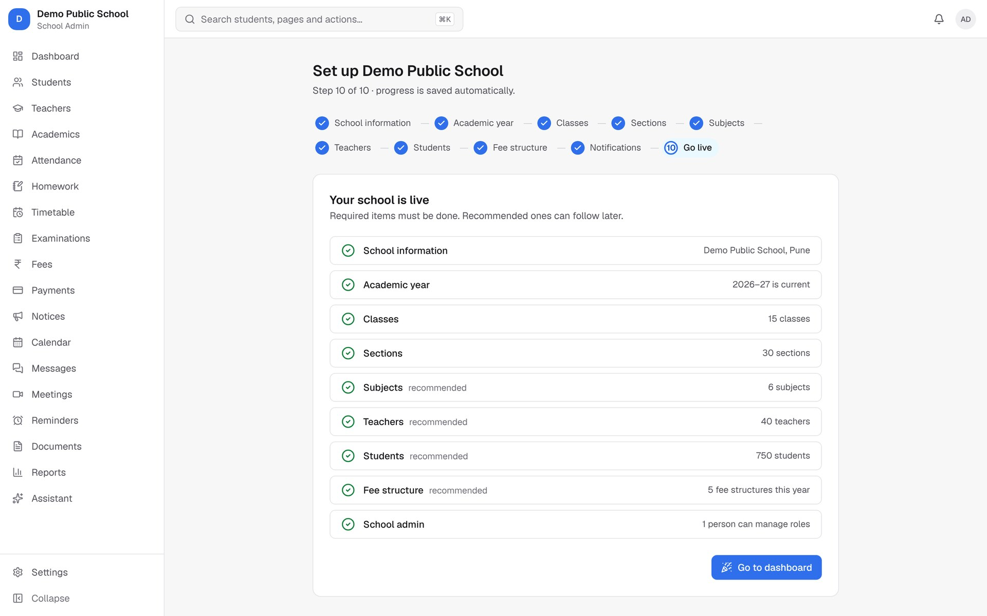
From signed contract to live school, guided step by step
USER JOURNEY
Create school
Setup wizard
Excel import
Invite people
Go live
Bastaa console: name, web address, plan
10 steps: year, classes, sections, subjects…
Students, parents, teachers, fees; rows checked first
Logins by SMS code or a code from the office
Checklist must pass first
Then every day
Morning: teachers mark registers; absent alerts go to parents
Day: homework, notices and messages; the office collects fees
Exams: marks, results, report cards; parents see them in the app
Year end: promote students to the next class in one step
Notes:
Here's how a school goes from signing up to running on Bastaa.
We create the school in our console and give it a web address. The school admin then follows a ten-step setup wizard: school details, academic year, classes, sections, subjects, teachers, students, fees and notifications.
Existing records come in from Excel. The import checks every row first and shows the problems to fix before anything is saved.
People get their logins either by SMS code or, if SMS isn't set up, by a one-time code from the school office. Go-live is blocked until the required checklist passes.
After that, the daily loop on the right just runs, all the way to promoting the whole school to the next year in one step.

Slide 14
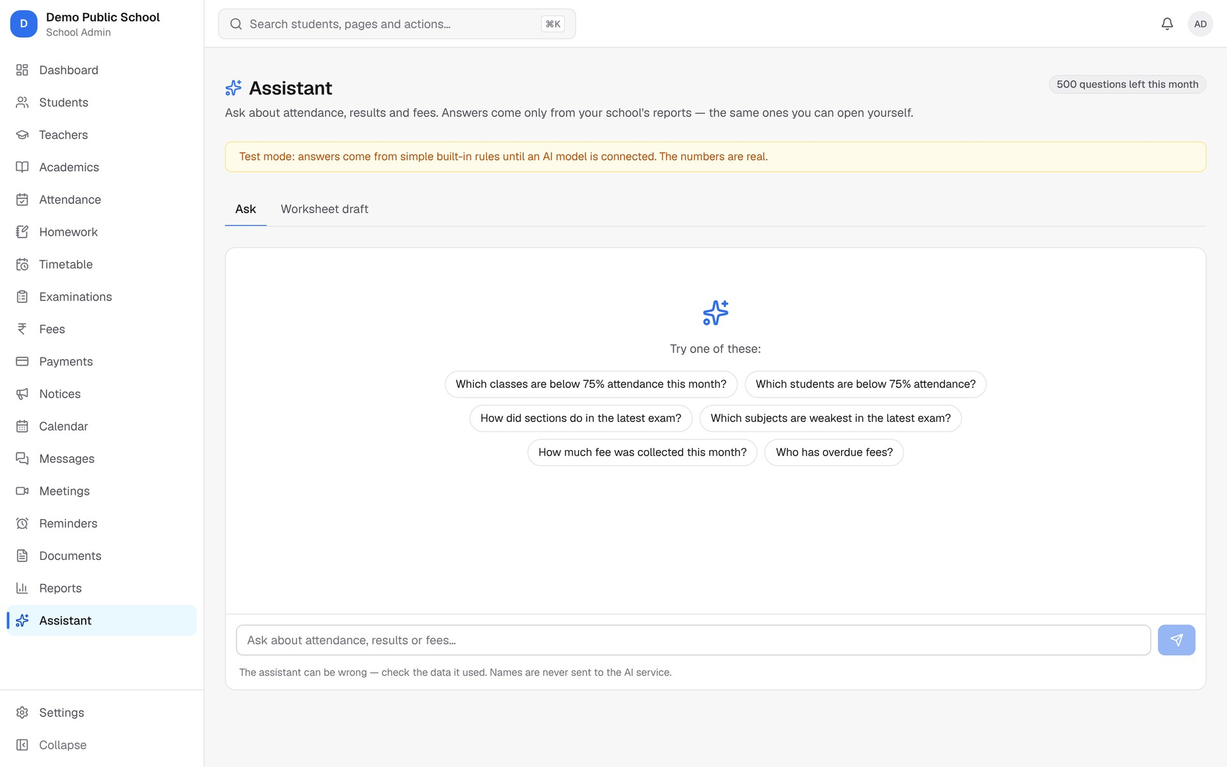
Ask the school a question in plain words
INNOVATION · AI ASSISTANT
1
Question
"Which classes are below 75% attendance this month?"
2
8 report tools
Permission-checked: only data this person may see
3
Names masked
People become [P1], [P2] before anything leaves the school
4
Answer + source
With the report it came from, names restored for the asker
Status: built and tested offline (22-case evaluation, incl. Hindi and Hinglish). Switched on per school once the live Gemini evaluation passes.
Notes:
Principals don't want to build reports. They want answers.
So the assistant takes a plain question, like "which classes are below 75% attendance this month?", and answers it only by calling eight permission-checked report tools. It can't see anything the person asking couldn't already open.
Before any table goes to the AI model, every person's name and phone becomes a placeholder like P1 or P2. Names never leave the school. The answer is turned back for the person who asked, with a link to the report it came from.
To be clear about status: it's fully built and passes a 22-case evaluation offline, including Hindi and Hinglish questions. It goes live per school only after the same evaluation passes against the live Gemini model, which needs an API key we haven't set up yet. Usage is metered per plan.

Slide 15
Architecture: one API, every screen, strict tenant isolation
TECHNICAL IMPLEMENTATION
PEOPLE
Android app
Cloudflare edge
Web (Next.js 16)
PostgreSQL 17
Flutter 3 · Riverpod · offline queue
DNS, TLS, WAF
Worker routes
*.bastaa.in → web
api.bastaa.in → API
Edge secret closes the raw Cloud Run URLs
React 19 · BFF with httpOnly cookies · public website
Row-level security on 86 tables
School portal
Browser · <school>.bastaa.in
API (NestJS 12)
Workers
30 modules · 289 endpoints
Zod contracts shared with web and app
Permission check on every route
Queues on Postgres: PDFs, notifications, reports, scheduled jobs
Cloud Storage
Files, signed links
Bastaa console
admin.bastaa.in
Plugged-in services Razorpay (each school's own account) · MSG91 SMS · Firebase push · Gemini AI · Jitsi video · Sentry errors · Chromium PDF rendering
Hosting: Google Cloud Run + Cloud SQL in Mumbai (asia-south1), fully scripted in infra/; first deployment pending the cloud account and domain.
Notes:
Here's how it's built.
Three front ends: the Flutter Android app, the school portal in the browser, and our console. They all go through Cloudflare, which handles DNS, TLS and the firewall, and routes each subdomain. A shared edge secret means nobody can bypass Cloudflare and hit the servers directly.
The web app is Next.js 16. It acts as a backend-for-frontend, so session tokens live in httpOnly cookies and never touch browser JavaScript.
Everything talks to one NestJS API: 30 modules and 289 endpoints. Their request and response shapes are Zod contracts shared by the web, the app and the server, so they can't drift apart. Background work like PDFs, notifications and scheduled reports runs on queues stored in Postgres itself, so there's no Redis to run.
Data sits in PostgreSQL 17 with row-level security on 86 tenant tables. Files go to Cloud Storage behind signed links.
Hosting is Google Cloud Run in Mumbai. Every step is scripted; the first deployment is waiting on the cloud account and the domain.

Slide 16



One school can never see another school's data
TRUST AND SECURITY
Database
ALSO BUILT IN
Row-level security on 86 tenant tables. Even a buggy query returns only the current school's rows.
Tokens in httpOnly cookies; refresh tokens rotate, and reuse is detected
Lockout and rate limits on sign-in, shared across servers
Audit log of every sensitive change, visible to the school
Bastaa support sees a school only after its admin approves: read-only, time-limited, logged
AI never receives names; PDFs render with scripts and network off
Uploads checked by content, downloads through short-lived links
Every request
School resolved from the web address; 69 permission keys at 4 scopes (all, assigned, own children, self).
Every build
An automated probe hits each record route with another school's IDs and must get "not found".
Under India's DPDP Act the school is the data fiduciary and Bastaa the processor. Legal review is scheduled before the first live school.
Notes:
For a school, the scariest question is: can another school see our children's data? Our answer is three independent layers.
First, the database itself. Row-level security on all 86 tenant tables means even a buggy query only returns the current school's rows.
Second, every request. The school comes from the web address, and each route checks one of 69 permission keys at a scope: the whole school, assigned classes, own children, or self. We check permissions, never role names, so schools can design their own roles safely.
Third, every build. An automated probe calls every record route with another school's IDs and must get "not found" back. If anyone breaks isolation, CI goes red.
On top of that: httpOnly cookies, rotating refresh tokens with reuse detection, sign-in lockout, an audit log, and support access that only works with the school's approval. Under the DPDP Act, the school is the data fiduciary and we're the processor. A legal review is planned before the first live school.

Slide 17

Built like a product, tested like one
ENGINEERING QUALITY
289
95
30
595
API endpoints, each with declared access
data models, 13 migrations
API modules, each with a README
automated tests across API, app and browser
Every pull request runs
Lint and type checks
API, app and browser tests
Docker images for API, web and migrations
Android build
OpenAPI spec must match the code
Notes:
A school can't afford software that breaks on result day, so we've treated quality as a feature.
The API has 289 endpoints, and every one declares who may call it. There are 95 data models and 30 modules, each with its own README.
There are 595 automated tests: 535 API integration tests against a real Postgres with row-level security on, 38 Flutter tests in the app, and 22 Playwright browser tests on the critical paths. Some of those browser tests caught real bugs before any user did.
Every pull request runs lint, type checks, all three test suites, builds the Docker images and the Android app, and checks the API spec still matches the code.

Slide 18





Modern, mainstream, and cheap to run
TECHNOLOGY STACK
Mobile
Web
API
Data
Cloud & ops
Flutter 3.47
Next.js 16
NestJS 12
PostgreSQL 17
Cloud Run
Riverpod 3
React 19
TypeScript
Row-level security
Cloudflare
Offline queue
Tailwind 4
Zod 4 contracts
Prisma 7
GitHub Actions
Firebase push
TanStack Query
BullMQ on Postgres
Cloud Storage
Sentry
About $25–45 a month to run a staging environment in "lean mode": scales to zero when idle, no Redis, queues inside Postgres.
Notes:
The stack is deliberately mainstream, so it's easy to hire for and cheap to run.
Flutter for the app, Next.js and React for the web, NestJS on TypeScript for the API, Postgres for everything durable, including the job queues.
One monorepo holds all of it, with the shared contracts package between them.
Because the queues live in Postgres and Cloud Run scales to zero, our infrastructure notes put a staging environment at roughly 25 to 45 dollars a month. Production keeps one instance always on.

Slide 19



A yearly subscription per school, sized by students
BUSINESS MODEL
Go to market
Basic
Professional
Enterprise
Demo app on Google Play to show any principal
Up to 500 students
Up to 2,000 students
No student limit
Core school management
2,000 SMS / month
5 GB storage
Online fee payments
Report builder
10,000 SMS · 500 AI questions / month
Everything, incl. AI assistant
5,000 AI questions / month
Custom terms
Start with private schools in one city
Pilot, then a yearly contract
Plan limits are enforced in the product today (students, SMS, AI, storage). Prices are set per school in the console; launch pricing will be fixed after pilots.
Website with "book a demo"
Notes:
The business is simple: a yearly subscription per school, sized by number of students.
The product already models three plans, and their limits are enforced in code: student numbers, monthly SMS, AI questions and storage. Online payments, the report builder and the AI assistant switch on by plan.
We set prices per school in our console. The demo has working figures in it, but we'll fix launch pricing after our first pilots rather than guess now.
Going to market, we start with private schools in one city. We show the demo app on a phone, then run a pilot that turns into a yearly contract. The website already has a "book a demo" flow.

Slide 20
Built and tested today, and what turns it on
WHERE WE ARE
Built and tested
Ready, waiting on an account
Planned next
All school modules shown today
Student ID cards
Web portal, Android app, console
Public website, privacy and terms
Multi-school isolation and permissions
Demo app for Google Play
Cloud deployment (Google Cloud + domain)
Google Play listing (developer account)
Push notifications (Firebase project)
SMS (DLT registration + MSG91)
Live AI (Gemini key + evaluation)
Error monitoring (Sentry)
iOS app
Online subscription billing
Bank settlement reconciliation
Student logins (V2)
Self-hosted video meetings
Nothing in amber needs new code: each one is an account to open or a key to add.
Notes:
I want to be precise about where we are.
Green is built and tested in the codebase today: every module you've seen, the new ID cards, the portal, the app, the console, the public website and the isolation layers.
Amber is built, but switched on by an account we haven't opened yet. Cloud deployment needs the Google Cloud project and the domain. The Play listing needs the developer account. Push needs a Firebase project. SMS needs DLT registration. Live AI needs a Gemini key and a passing evaluation. None of these needs more code; they need accounts.
Grey is the honest next list: iOS, online subscription billing, bank settlement reconciliation, student logins and self-hosted meetings.

Slide 21




What changes for a school on day one, and where it goes
IMPACT AND FUTURE
FUTURE POTENTIAL
Hours back for teachers
Fees collected on time
Every Indian school board, in local languages
iOS and student logins
Payments and billing fully online
AI that drafts worksheets and flags at-risk students early
A school network: one owner, many branches, one console
Registers and marks on the phone instead of paper and retyping
Online payment, instant receipts, clear dues and reminders
Parents in the loop
No more print-shop lists
Absence alerts, homework, results and notices as they happen
ID cards and report cards straight from the records
Notes:
What does a school get on day one? Teachers get time back, because registers and marks move from paper to the phone. Fees come in on time with online payment and instant receipts. Parents stop finding out last. And the office stops sending lists to a print shop for ID cards and report cards.
Where does this go? The same platform can serve every board, with local-language support. iOS and student logins are next. Billing becomes fully online. The assistant already drafts worksheets, and it can grow into flagging students at risk early.
Because Bastaa is multi-school from the first line of code, a group with many branches can run them all from one place.

Slide 22
See Bastaa with your own school
We're looking for our first pilot schools, and for partners who know Indian schools.
Built
Ready
Ask
Every module you saw today runs and is tested
Deployment is fully scripted; accounts are next
Pilot schools, mentors and early support
Notes:
Let's go back to that parent in Pune at 9 a.m. With Bastaa, her phone tells her that her daughter reached school, what the homework is, and that the fee is paid, with the receipt right there. The school didn't have to work harder to make that happen. It just stopped using paper.
Everything you saw today is built and tested. Deployment is scripted, and what's left is opening accounts.
So our ask is simple: help us find our first pilot schools, and give us your advice on the road from pilot to a hundred schools.
Thank you. I'd be glad to take your questions.

Slide 23
Questions we expect: product and market
APPENDIX · JUDGE Q&A 1/2
Is any school using it yet?
Why another school ERP?
Not yet. The product is complete and tested on a 750-student demo school; deployment is scripted. Pilots are the next step.
Built for how Indian schools work: works without SMS (office sign-in codes), offline attendance, each school's own Razorpay, Excel import, multi-school from day one.
How do you stop data leaks between schools?
What about poor internet?
Three layers: database row-level security on 86 tables, a permission check on every route, and an automated cross-school probe in CI.
The app keeps the class list on the phone and queues registers offline. Replays are ignored, so nothing is counted twice.
Do you hold parents' money?
SMS needs DLT registration. Are you blocked?
No. Payments go to the school's own Razorpay account. We verify signatures and webhooks and reconcile orders and refunds.
No. The product runs on passwords and one-time codes from the school office; push is free. SMS switches on after DLT, with a daily limit.
Notes:
Backup slide. Keep answers short and honest. If asked about traction, say plainly that there's no live school yet: the product is complete and tested, and pilots are the next step. Offer to show the live demo on a laptop or the demo app on a phone.

Slide 24
Questions we expect: risk, money and roadmap
APPENDIX · JUDGE Q&A 2/2
Is the AI safe for children's data?
How do ID cards work? QR or RFID?
Names and phones are masked before anything reaches the model; it can only call permission-checked report tools; it's off until the live evaluation passes.
Today: a print-ready PDF from profile data, one student or a whole section, office-only. QR or RFID would be a future enhancement; it isn't built.
What does it cost to run?
How will you price it?
Our infrastructure notes put lean staging at about $25–45 a month: Cloud Run scales to zero and queues live in Postgres.
Yearly subscription by plan, sized by students. Limits are enforced in code; launch prices will be set after pilots.
What about iOS?
Privacy law compliance?
Planned. The app is Flutter, so the same code targets iOS; it needs an Apple developer account and a Mac build.
Designed around the DPDP Act: the school is the fiduciary, Bastaa the processor; data in Indian regions; audit log; legal review before go-live.
Notes:
Backup slide. On AI and ID cards, be precise about what exists today and what's planned. Never promise QR codes, RFID or iOS as existing features. On pricing, explain that plan limits are enforced in code but launch prices come after pilots.

