Slide 1

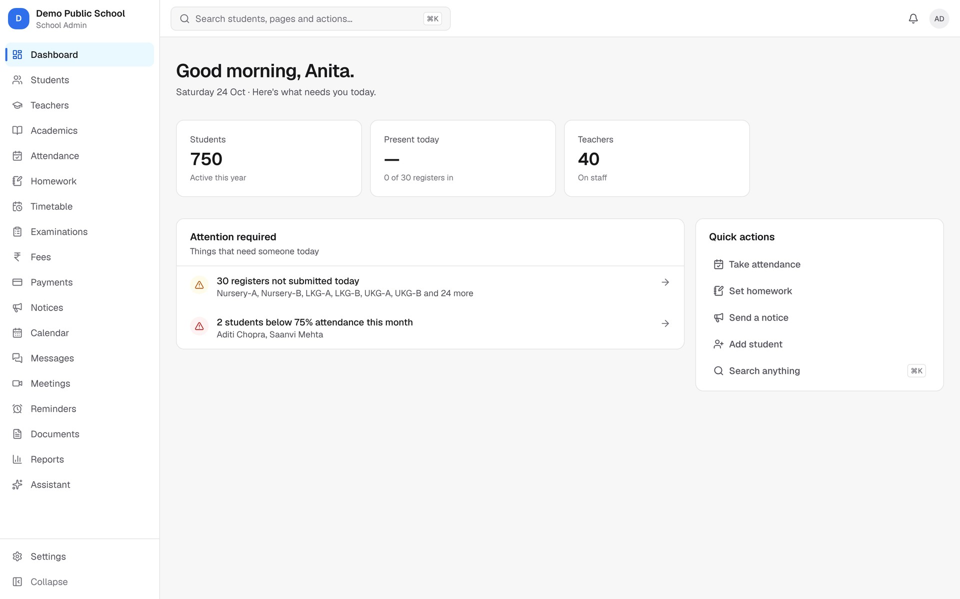
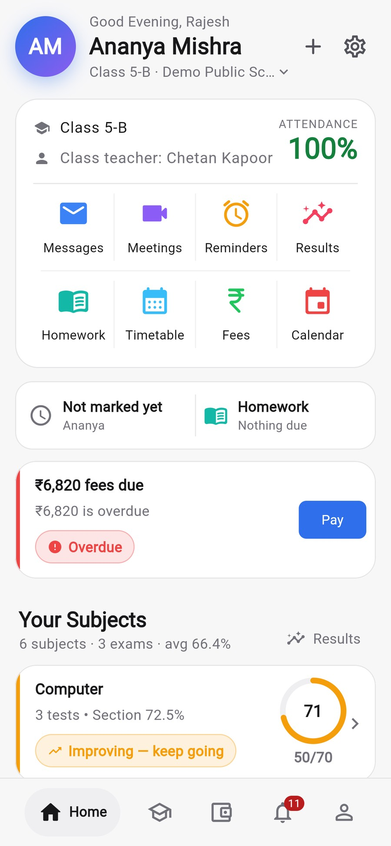
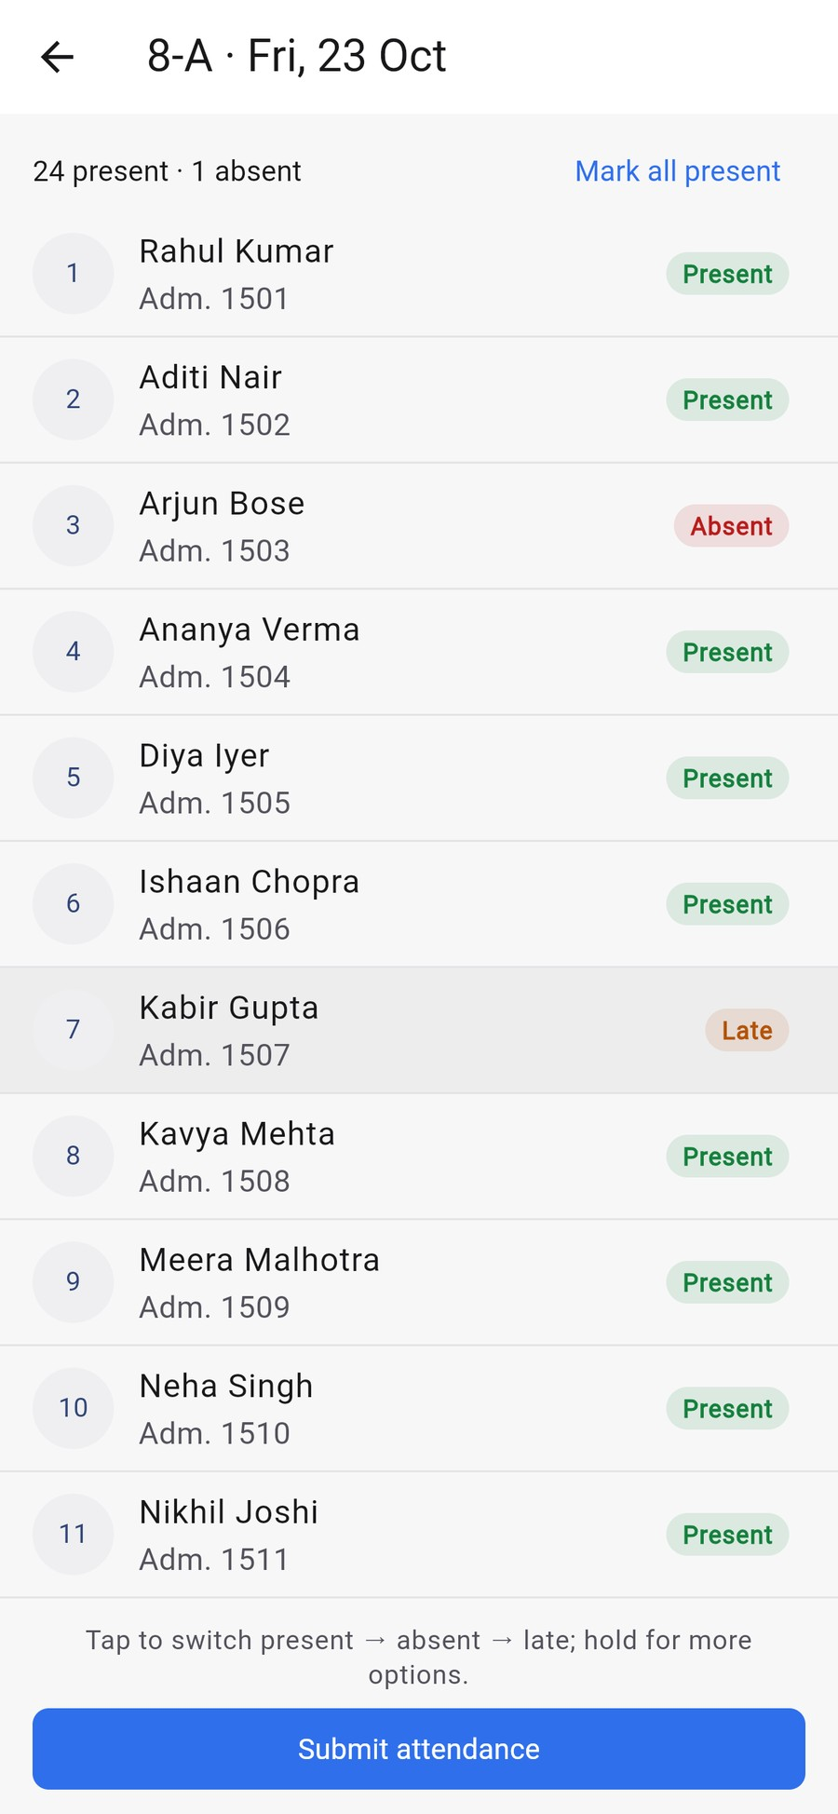
Run your school.
Not the paperwork.
Attendance, fees, exams, homework, ID cards and parent updates in one simple app, for your office, your teachers and every parent.
Book a free demo
See it with your own school's data
Notes:
Namaste, and thank you for your time.
Let me start with a simple question: how much of your school's day goes into paperwork instead of teaching? Registers, fee books, result sheets, phone calls from parents, WhatsApp groups.
Bastaa puts all of it into one simple app. Your office works on a computer. Your teachers and every parent use it on their phones.
In the next 15 minutes I'll show you exactly what changes for your school, using real screens from the app.

Slide 2






Does this sound like your school?
YOUR SCHOOL TODAY
The office phone never stops
Fees come late
Teachers buried in registers
Parents call to ask about attendance, fees, homework and results.
Dues pile up, receipts get lost, and someone has to chase every parent.
Attendance and marks on paper, then typed again into Excel.
Result season is stressful
WhatsApp groups out of control
ID cards from the print shop
Marks sheets, calculations and report cards take weeks.
Important notices get lost; nobody knows who has read what.
Lists sent outside, mistakes, delays and reprint costs every year.
Each of these costs your school time, money and parents' trust, every single day.
Notes:
Let me ask you: how many of these happen in your school?
The office phone rings all day with parents asking simple questions. Fees come in late and someone has to chase them. Teachers fill registers and marks sheets, then type them again. Result season takes weeks. Notices get lost in WhatsApp groups. ID cards go to a print shop every year.
[Pause and let them answer. Most principals will nod at three or four of these.]
Each one costs time, money, and most importantly, parents' trust.

Slide 3




One simple app that takes care of all of it
IMAGINE THIS INSTEAD
Fees on time
Parents always informed
Teachers free to teach
You in full control
Parents pay from their phone. Receipts are instant.
Absence, homework, notices and results reach them on their phone.
Registers, marks and homework take a few taps.
See your whole school on one screen, any time.
That's Bastaa. Built for Indian schools: CBSE, ICSE and state boards.
Notes:
Now imagine your school where fees come in on time because parents pay from their phone. Where every parent knows about absence, homework and results without calling the office. Where teachers spend a few taps on registers instead of twenty minutes. And where you, as principal, see the whole school on one screen.
That's Bastaa. It's built for how Indian schools actually work: CBSE, ICSE or state board, with Indian fee structures and installments.

Slide 4




One system. Everyone on the same page.
FOR EVERYONE IN YOUR SCHOOL
Management & principal
Office & accountant
Teachers
Parents
Computer or phone browser
Computer
Mobile app
Mobile app or website
Live dashboard of the whole school
Approve, publish results, send notices
Reports any time, in one click
Admissions and student records
Fees, receipts and daily collection
ID cards and report cards printed in-house
Attendance in a few taps, even offline
Marks and homework from the phone
Their own timetable and classes
Child's attendance, homework, timetable
Results, fees and receipts
Message the teacher directly
Notes:
Everyone in your school uses the same system, each with exactly what they need.
You and the management get a live dashboard and reports. The office and accountant handle admissions, fees, receipts, and print ID cards and report cards in-house. Teachers use the mobile app for attendance, marks and homework. And parents get their child's whole school life on their phone, or on the website if they prefer.
One record per student, entered once, used everywhere. Nobody types the same thing twice.

Slide 5
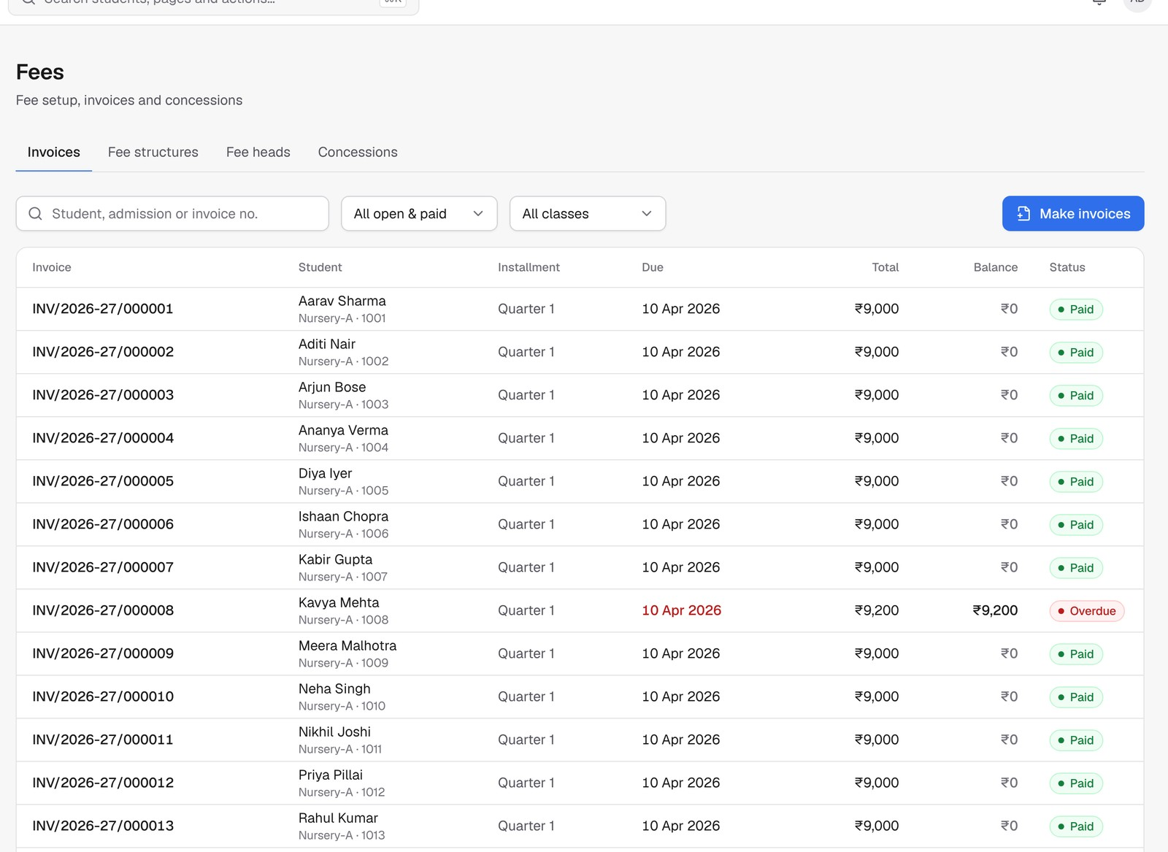
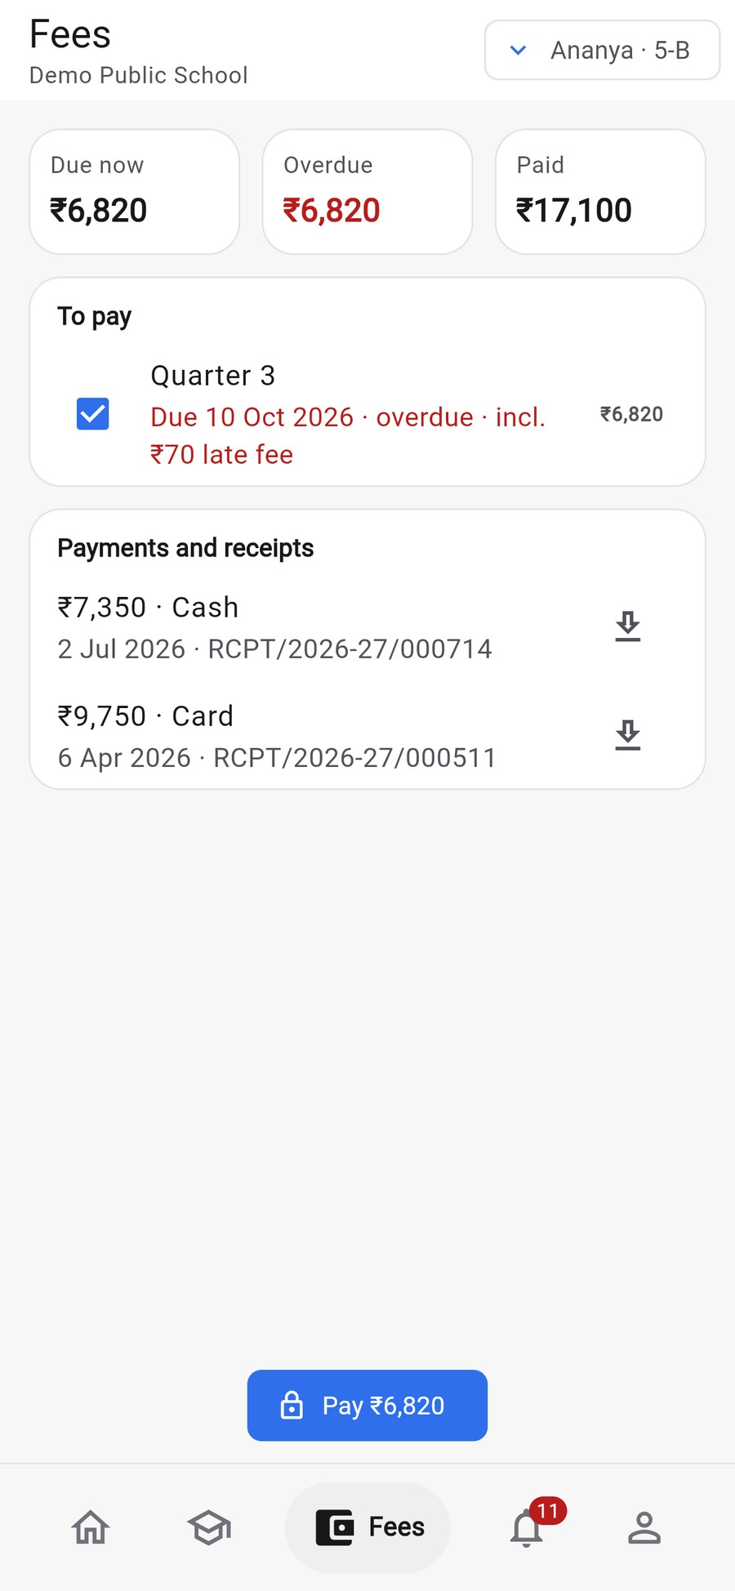



Collect fees on time, without chasing anyone
FEES
Parents pay from their phone in seconds. You see every rupee, every day.
Online payment from the app
UPI, cards and net banking, straight into your school's own account.
Automatic reminders and late fees
Parents are reminded before and after the due date. No phone calls.
Instant receipts, no fee books
Counter or online, every payment gets a receipt. Daily collection report.
WHAT YOU GET Fewer pending dues, every rupee accounted for.
Notes:
Let's start with what every school worries about: fees.
With Bastaa, you set up your fee structure once: tuition, transport, installments, concessions. Every student gets an invoice automatically.
Parents see exactly what's due on their phone and pay by UPI, card or net banking. The money goes straight into your school's own account. Bastaa never holds your money.
Reminders and late fees happen automatically, so nobody has to call parents. Every payment, at the counter or online, gets an instant receipt. At the end of the day the accountant closes the counter in one click and you see the day's collection.
The result: fewer pending dues, and every rupee accounted for.

Slide 6
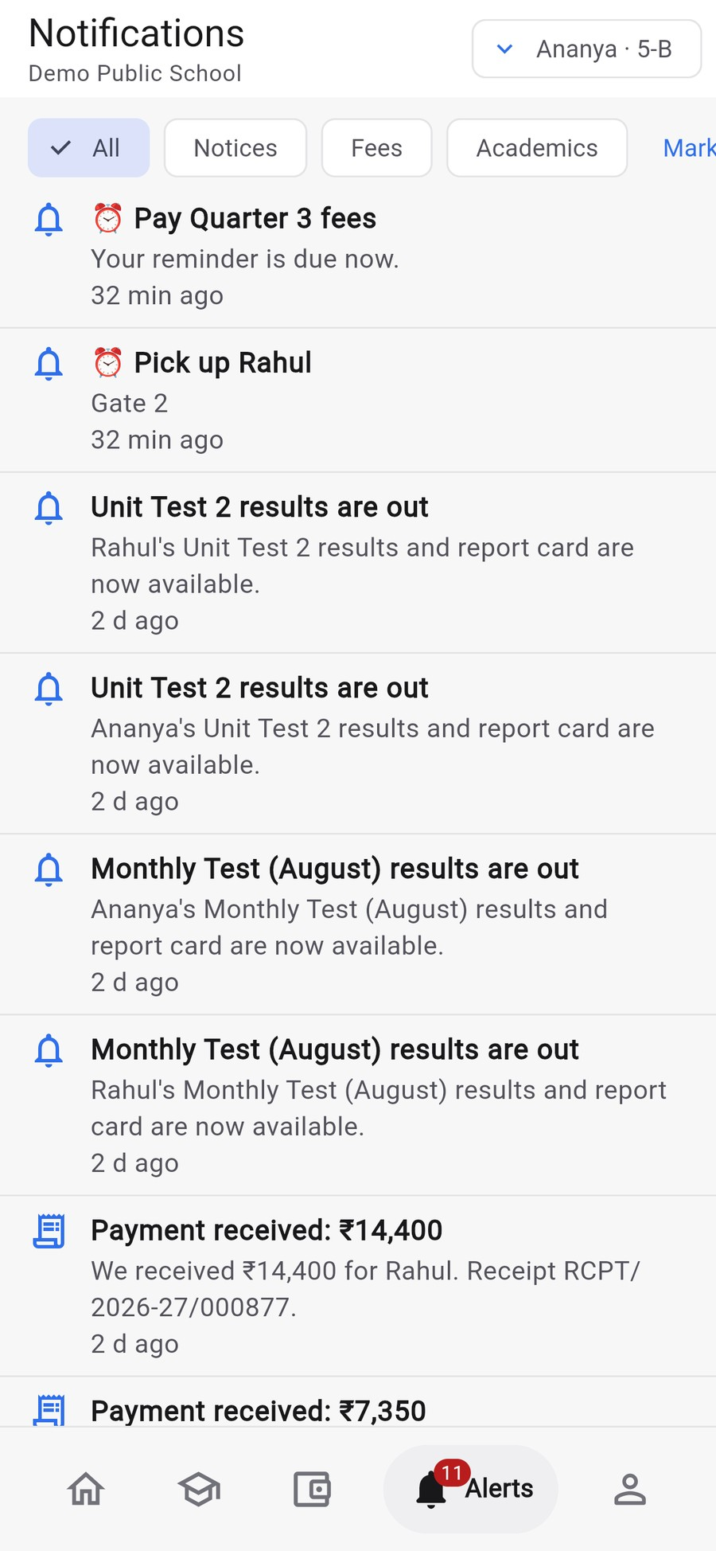


Parents always in the loop
PARENTS
Everything a parent wants to know, on their phone, the moment it happens.
Instant absence alerts
If their child is absent, or arrives at school, parents know at once.
Homework, timetable and results
No more "what was today's homework?" calls or messages.
Talk to the class teacher directly
Messages and complaints tracked till they're resolved.
WHAT YOU GET Happier parents, fewer calls, more trust in your school.
Notes:
Parents today expect to know what's happening, the way they track a food delivery.
Here's Rajesh's app. He's Ananya's father. He sees whether Ananya is in school today, her attendance, homework, timetable, fees and results. If she's absent, he gets an alert right away.
On the right are his notifications: results published, fee reminders, payment received.
When parents get information without asking, they stop calling the office. And a school that keeps parents informed is a school they recommend to others.

Slide 7
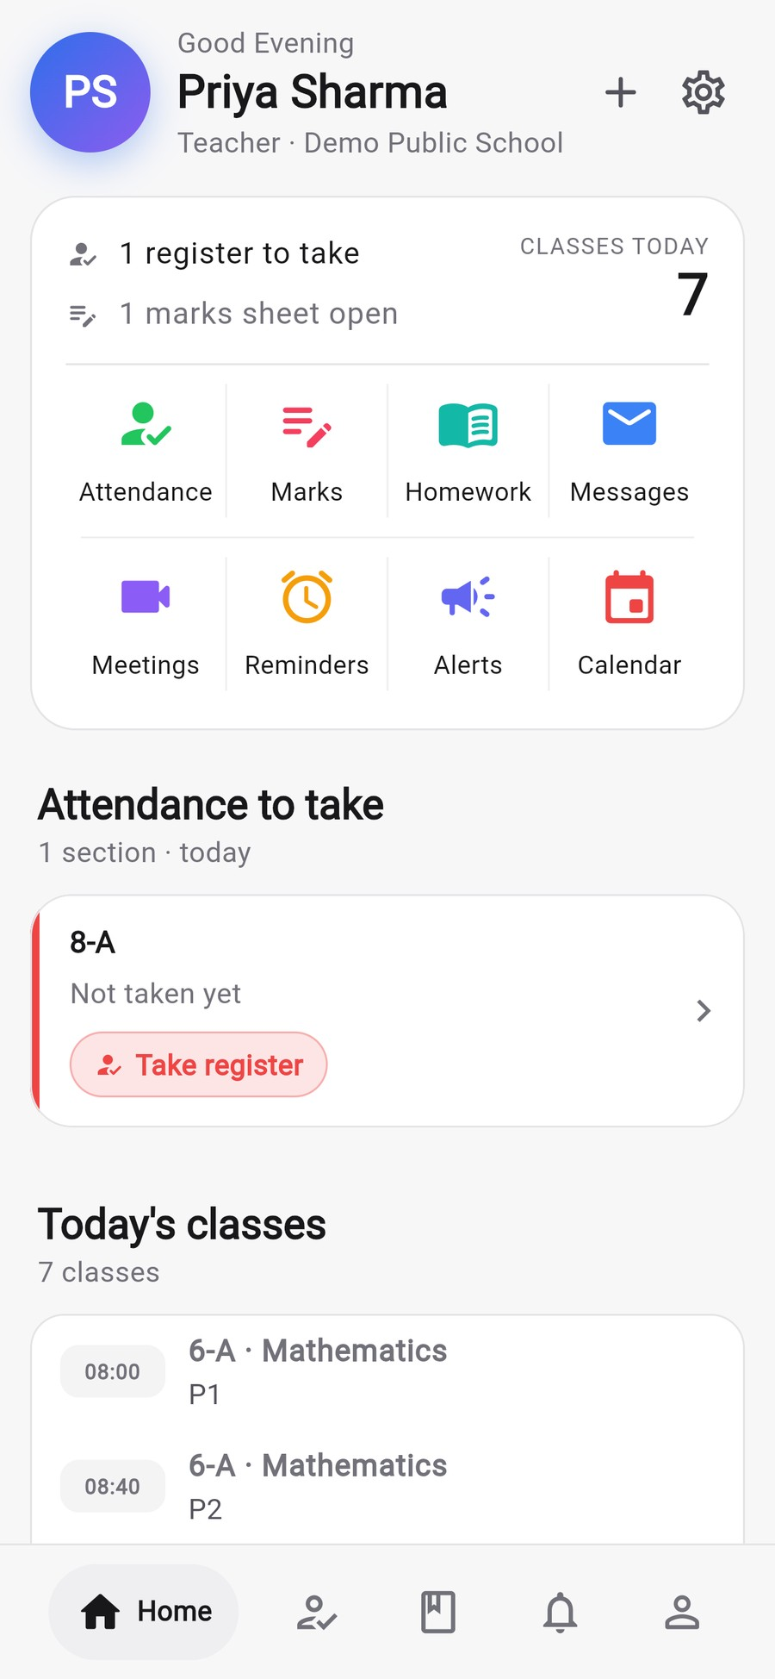



Give your teachers their time back
TEACHERS
The daily paperwork moves to the phone, so class time goes to teaching.
Attendance in a few taps
Everyone starts as present; tap only the absent or late. Works without internet.
Marks from the phone
Enter marks subject-wise or upload an Excel sheet. No retyping.
Homework with a photo
Snap the board, post it, and every parent sees it the same day.
WHAT YOU GET Less paperwork, more teaching, no double entry.
Notes:
Your teachers are your most valuable people, and today they lose a lot of time to paperwork.
This is the register on a teacher's phone. Every student starts as present, so the teacher only taps the ones who are absent or late, then submits. It works even when the internet is down and syncs later.
Marks go in from the phone or an Excel sheet. Homework goes out with a photo of the board.
The teacher's home screen shows today's classes and what's pending. Less paperwork, more teaching.

Slide 8
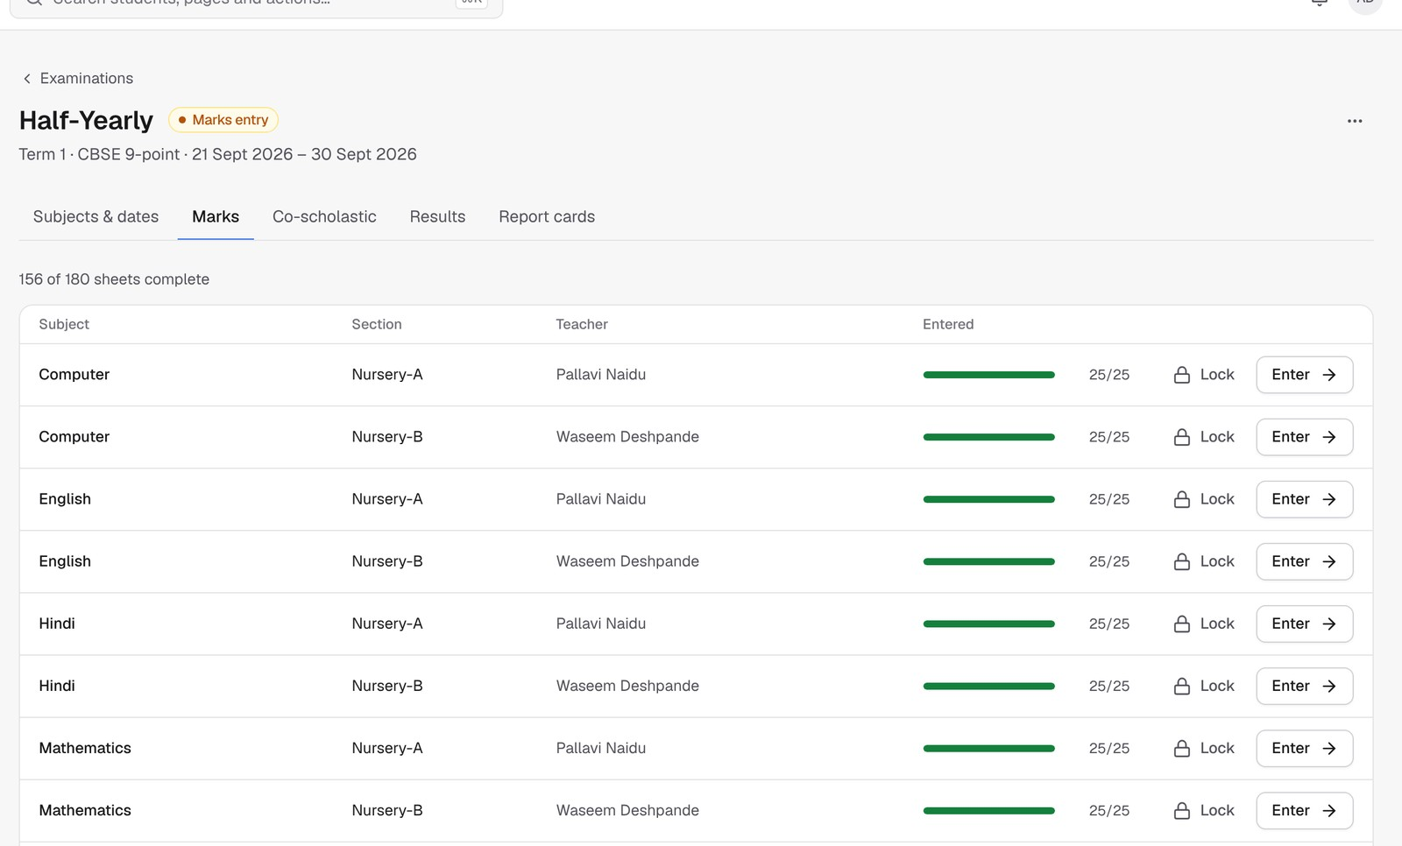
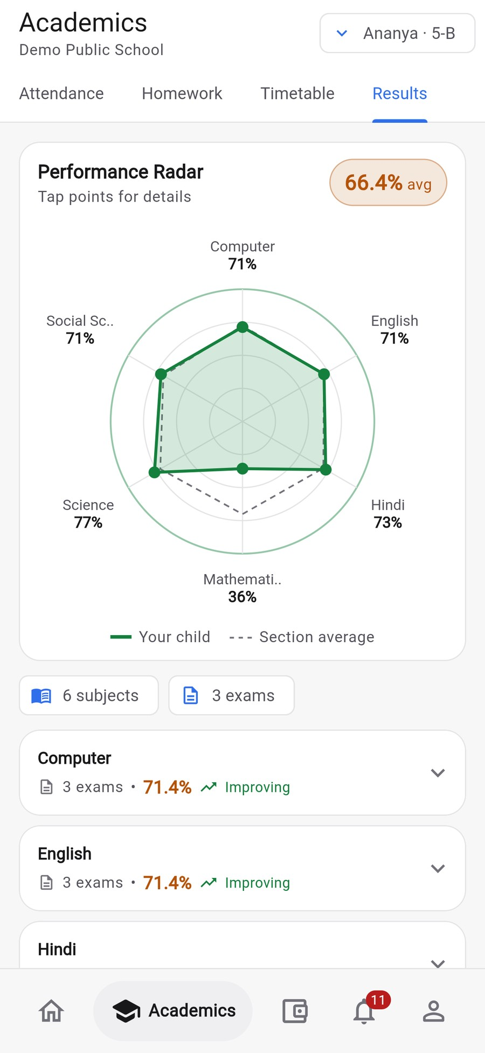



Result day without the stress
EXAMS AND RESULTS
From marks entry to printed report cards, without spreadsheets.
Grades and ranks worked out for you
CBSE 9-point grading or your own scale. No manual calculation.
Report cards ready to print
Choose from three designs, with your logo and the principal's signature.
Parents see results instantly
With a subject-wise chart and progress across exams.
WHAT YOU GET Results out in days, not weeks.
Notes:
Result season is usually the most stressful time of the year for your office.
With Bastaa, teachers enter marks for their subjects. You can see on one screen which marks sheets are done and which are pending. Grades and ranks are calculated automatically, with CBSE 9-point grading or your own scale.
Report cards come out ready to print, in a design you choose, with your logo and the principal's signature.
And when you publish results, parents see them instantly on their phone, with a chart showing where their child is strong and where they need help.

Slide 9
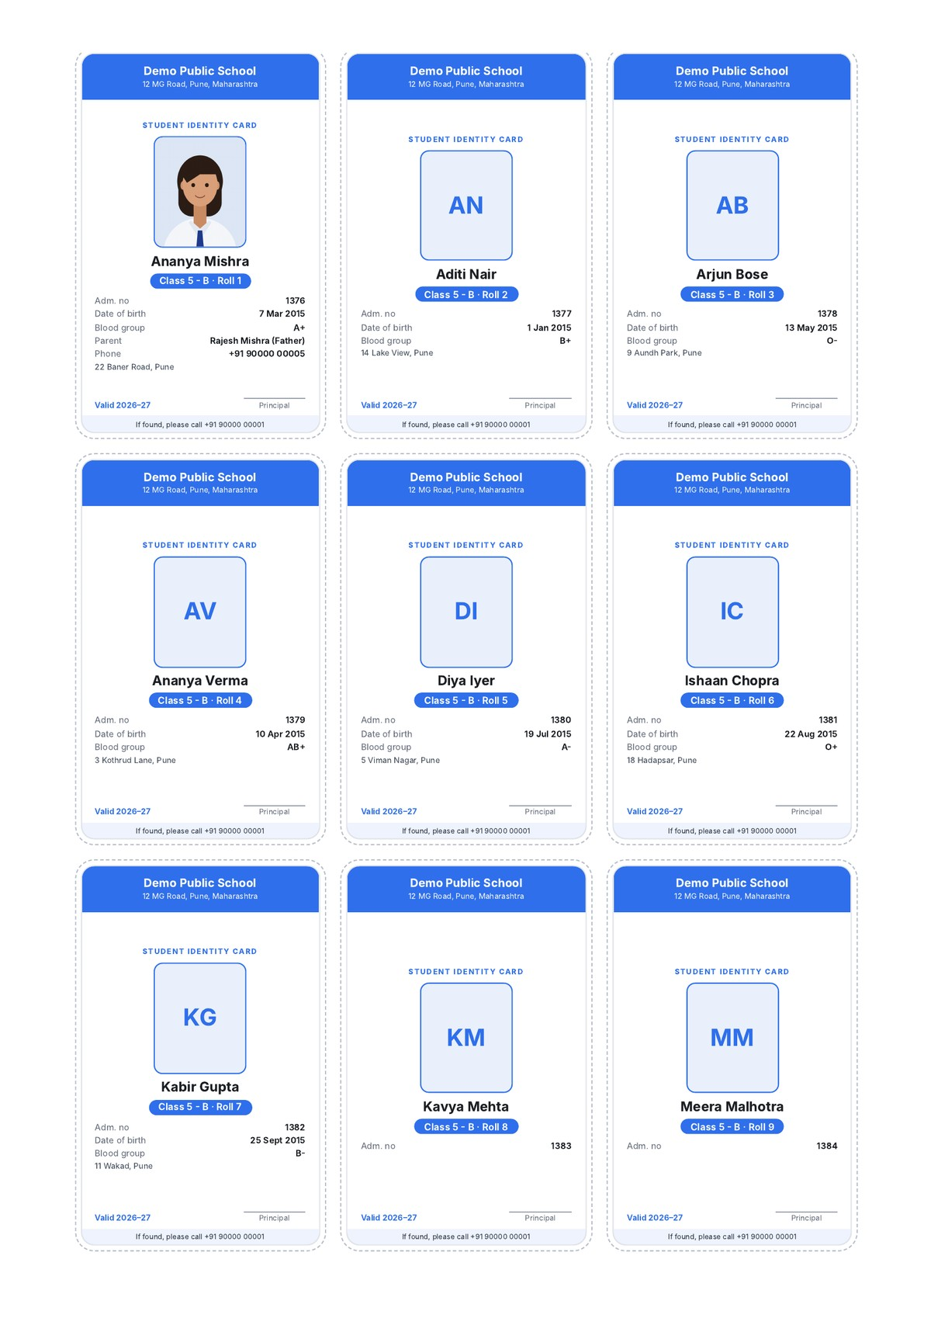
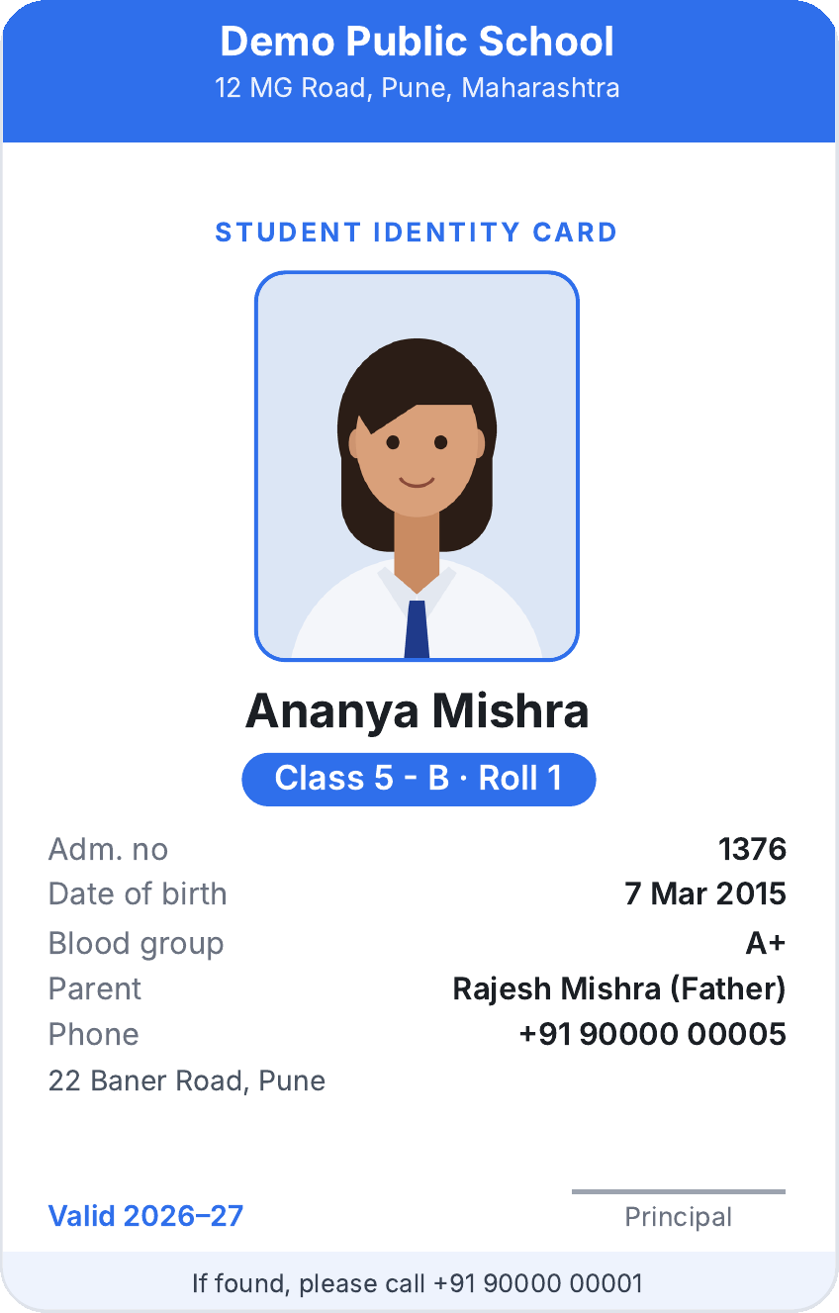



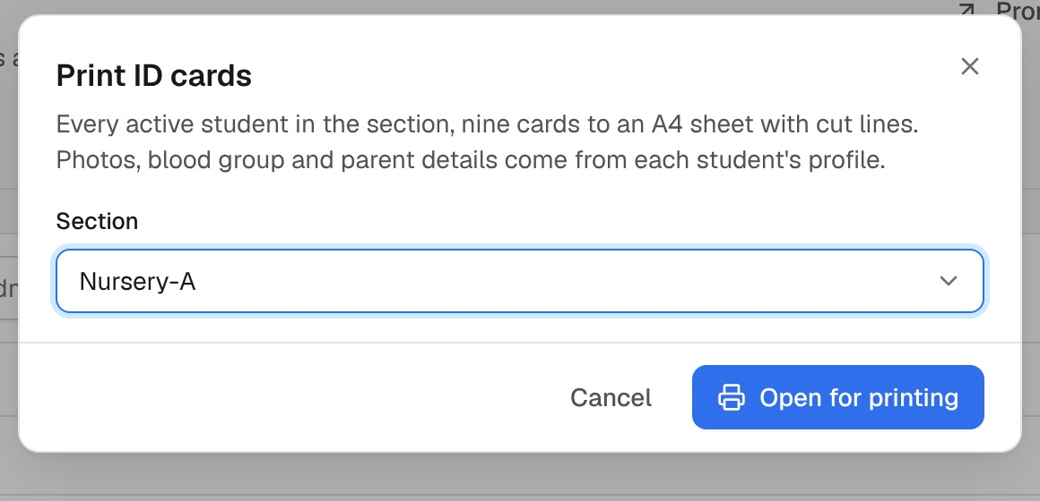
ID cards for a whole class in one click
STUDENT ID CARDS
Printed in your school, from the records you already have. No print-shop lists.
A whole class on A4 sheets
Standard card size, nine per sheet with cut lines. Print, cut, laminate.
Safety details on every card
Photo, blood group, parent's name and phone, address.
Your logo and colours
Lost card? Reprint one student's card in seconds.
WHAT YOU GET No outside vendor, no mistakes, no waiting.
Real output for Class 5-B, printed from Bastaa
Notes:
Every year schools send student lists to a print shop for ID cards, then wait, then fix mistakes, then pay for reprints.
With Bastaa, the office picks a class and clicks "Open for printing". You get A4 sheets of ID cards at the standard card size, nine per sheet, with cut lines. Print on any printer, cut and laminate.
Look at Ananya's card. It has your school's name and colour, her photo, class and roll number, admission number, date of birth, blood group, and her father's name and phone number. In an emergency, that's exactly what matters.
Lost a card? Reprint just that one student's card from their profile in seconds.

Slide 10
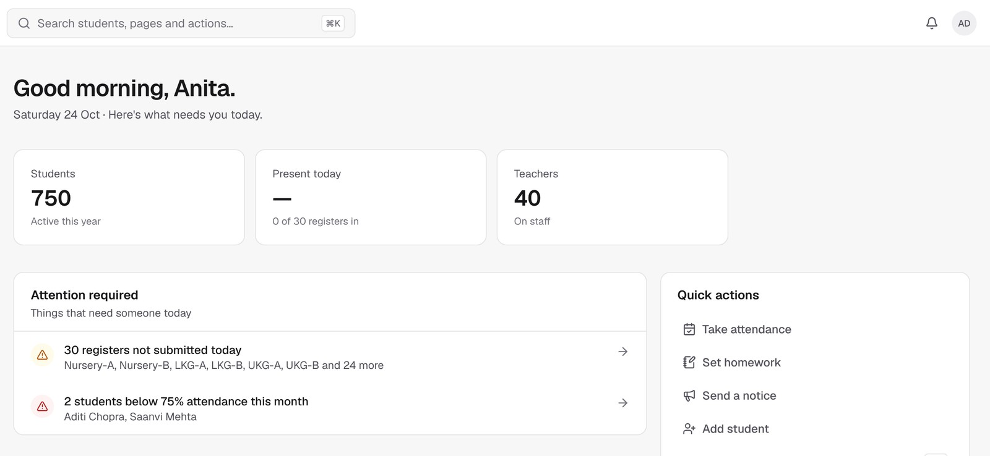


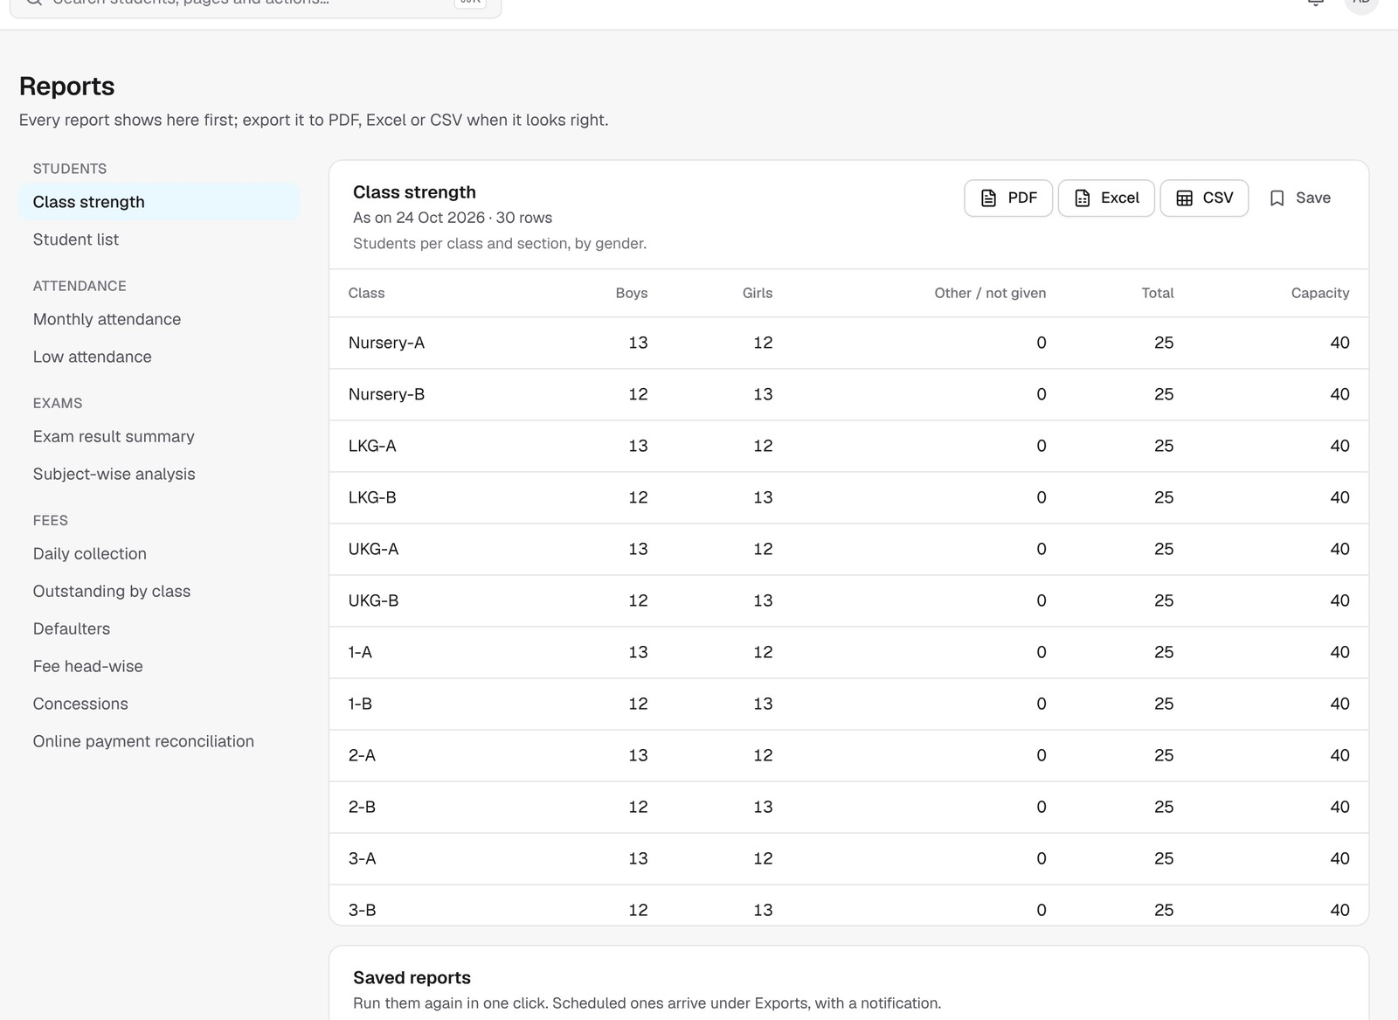

See your whole school on one screen
FOR THE PRINCIPAL
Know what needs your attention today, not at the end of the month.
Problems flagged early
Registers not taken, students below 75% attendance, overdue fees.
Reports in one click
Attendance, fees, results and defaulters, as Excel or PDF.
Weekly reports to your inbox
Save any report and get it every week or month, automatically.
WHAT YOU GET Decisions based on facts, any time, from anywhere.
Notes:
As a principal, you shouldn't have to wait for month-end to know what's happening.
When you log in, the dashboard shows what needs attention today: which registers aren't taken, which students are falling below 75% attendance, which fees are overdue.
Any report you need, attendance, fee collection, defaulters, results, is one click away, and you can download it as Excel or PDF. Save the reports you use often and Bastaa emails them to you every week or month.
You can check all of this from your phone too.

Slide 11
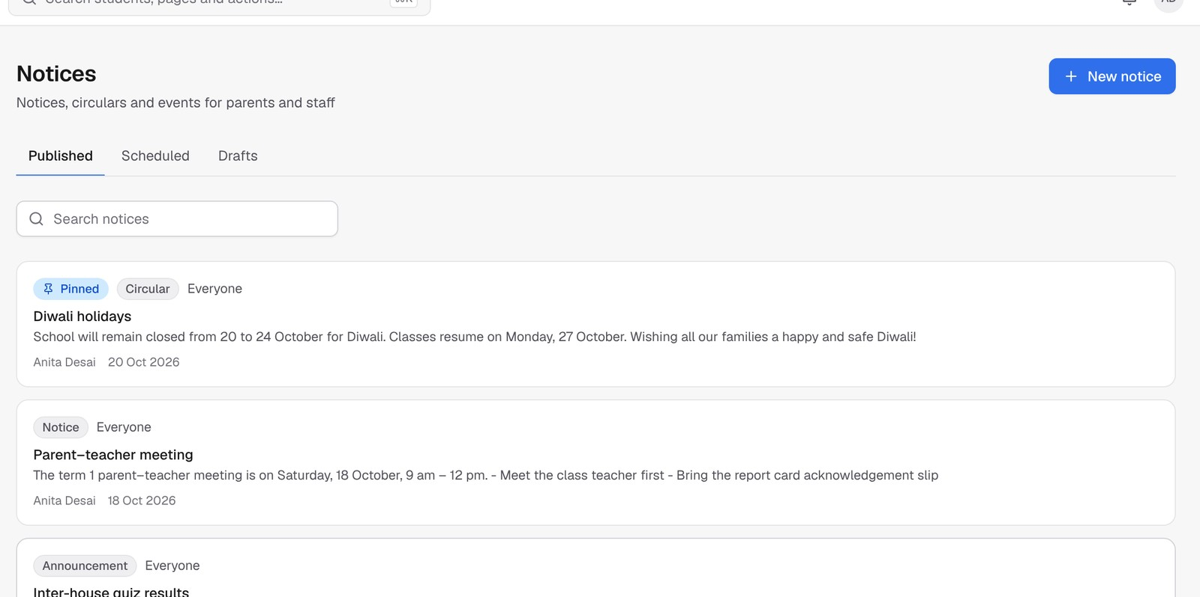


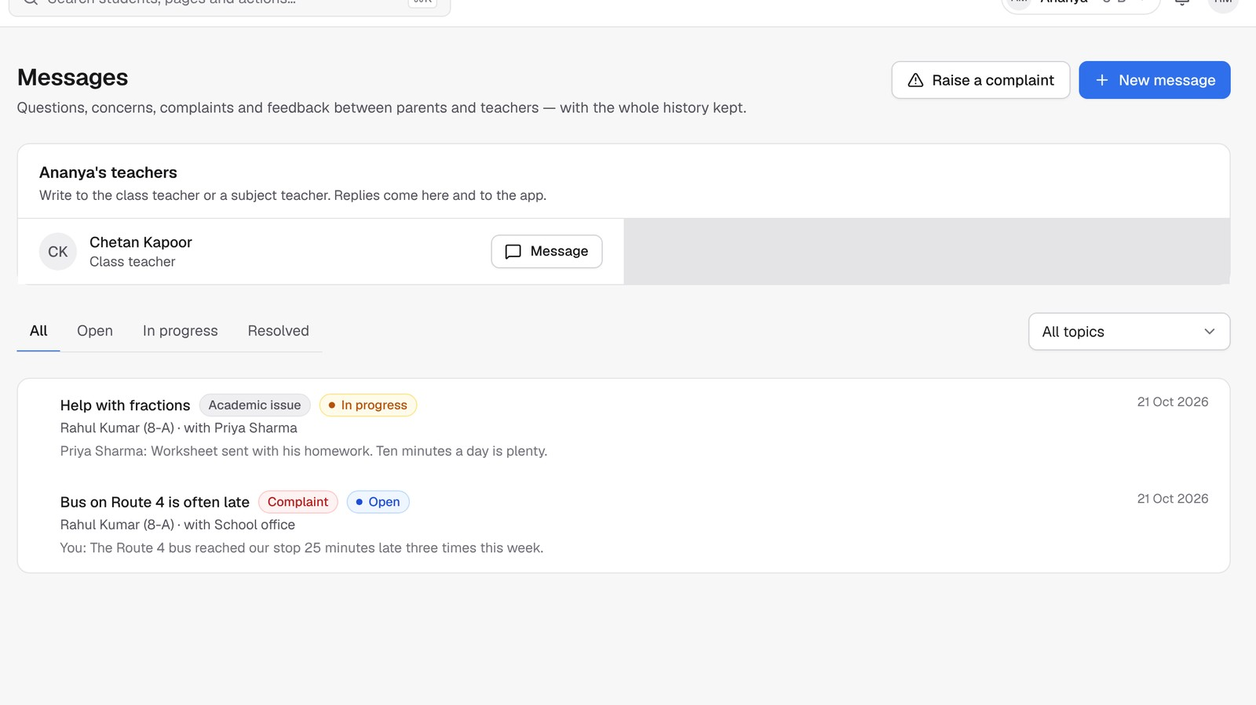

Replace the WhatsApp chaos
COMMUNICATION
The right message to the right parents, and you know who has read it.
Notices with read receipts
To the whole school, one class or only parents. Schedule them in advance.
Parent–teacher meetings by video
Book a meeting; both sides get a reminder and a join link.
No messages at midnight
Quiet hours hold alerts until morning. You choose which alerts go out.
WHAT YOU GET Organised, professional communication parents trust.
Notes:
Most schools run on WhatsApp groups today, and important notices get lost between good-morning messages.
With Bastaa, notices go to exactly the right audience, the whole school, one class, or only parents, and you can see who has read them. Parents message their child's teacher directly, and complaints are tracked until they're resolved.
You can hold parent–teacher meetings by video, with reminders. And quiet hours mean nobody gets alerts at midnight.

Slide 12
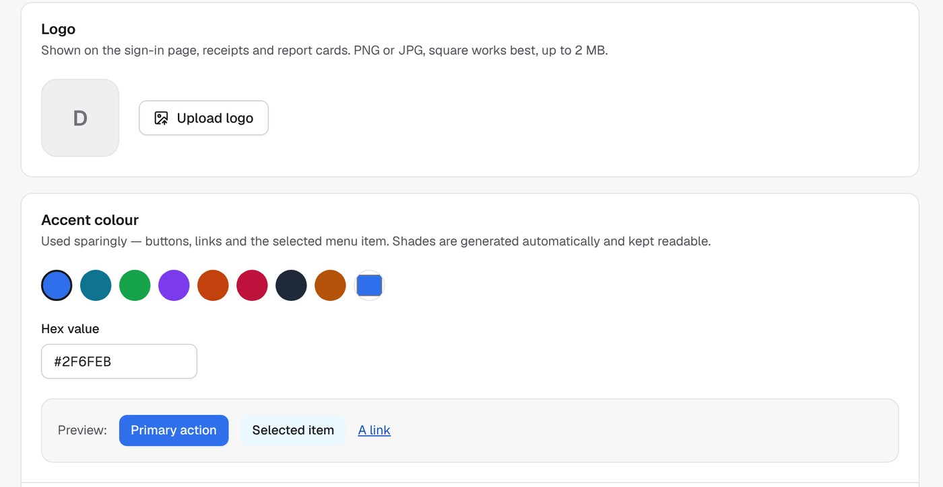


Your school's name on everything
YOUR BRAND
Parents see your school, not ours. A modern image that helps admissions.
Your logo and colours
On the app, the website, receipts, report cards and ID cards.
Your own web address
For example yourschool.bastaa.in, where staff and parents sign in.
Principal's signature on documents
Report cards and receipts look official, every time.
WHAT YOU GET A school that looks as good as it teaches.
Notes:
When parents open the app or receive a receipt, they should see your school, not a software company.
Upload your logo, pick your school colour, add the principal's signature once. From then on, everything carries your brand: the app, your own web address, receipts, report cards and ID cards.
For parents choosing a school, this says you're a modern, organised school, and that helps admissions.

Slide 13






Here's what tomorrow could look like
A DAY AT YOUR SCHOOL WITH BASTAA
8:00
8:05
11:00
1:30
4:00
Monday
Teachers mark attendance
Parents are alerted
A parent pays fees
Homework goes out
You check the dashboard
Weekly report arrives
A few taps on the phone
Absent? Parents know right away
Receipt arrives instantly
Photo of the board, sent to every parent
Attendance, fees, pending work
In your inbox, without asking anyone
No registers to collect, no fee books to tally, no calls to make.
Notes:
Let me walk you through a normal day with Bastaa.
At 8 o'clock, teachers mark attendance on their phones. By 8:05, parents of absent children already know. At 11, a parent pays the term fee from their phone and gets the receipt instantly. After lunch, a teacher posts homework with a photo of the board. At 4, you open the dashboard and see the whole day. And every Monday morning, your weekly report is already in your inbox.
No registers to collect, no fee books to tally, no calls to make.

Slide 14

Ask any school ERP these 8 questions
WHY BASTAA, NOT JUST ANOTHER ERP
Will every parent and teacher actually use it?
Does it work when the internet doesn't?
One clean app; each person sees only what they need.
Yes. Teachers can take attendance offline; it syncs later.
Will we pay for every SMS?
Does fee money come straight to us?
No. App alerts are free; SMS is optional, with a daily limit you set.
Yes. Into your school's own account. We never hold it.
Can we print ID cards and report cards ourselves?
Will it carry our school's name?
Yes, in one click, on any printer.
Yes. Your logo, colours and web address everywhere.
How hard is it to move our data?
Is our data private to our school?
Send your Excel sheets; we set it up with you.
Yes. Only your school sees it; every change is recorded.
Bastaa answers yes to all eight. Ask the others the same questions.
Notes:
You may already be looking at other school software. Before you decide, here are eight questions I'd ask any vendor, including us.
Will parents and teachers actually use it? Does it work when the internet is down? Will you pay for every SMS? Does fee money come straight to you? Can you print ID cards and report cards yourself? Will it carry your school's name? How hard is it to move your data? And is your data private to your school?
With Bastaa, the answer to every one of these is yes, and I can show you each one live.

Slide 15








Up and running without the headache
GETTING STARTED
1
2
3
4
Free demo
Send your Excel sheets
We set it up with you
Go live
We show you Bastaa with a sample school, on your phone and computer.
Students, parents, teachers and fees. We check every row.
Classes, subjects, fee structure, logo and logins.
Teachers and parents get their logins and start using it.
No hardware to buy
Prints on any printer
Simple, plain-language screens
Setup done with you
Notes:
Changing systems sounds scary, so we've made it simple.
Step one: a free demo, so you see exactly how it works. Step two: send us your existing Excel sheets of students, parents, teachers and fees. Bastaa checks every row and shows anything that needs fixing before it's saved. Step three: we set up your classes, subjects, fees, logo and logins together with your office. Step four: go live. Teachers and parents get their logins and start using it.
You don't need to buy any hardware. It works on the phones and computers you already have, and ID cards and report cards print on any printer.

Slide 16






Your school's data stays your school's
SAFE AND PRIVATE
Private to your school
Right person, right data
Every change recorded
No other school can ever see your data.
Parents see only their child; teachers only their classes.
See who changed what, and when, in the audit log.
Support only with your OK
No ads, ever
Works without SMS
Our team can look only when your admin approves, read-only.
Your data is never sold or used for advertising.
Passwords and one-time codes from your office.
Notes:
Schools hold sensitive information about children, so let me be clear about safety.
Your data is private to your school. No other school can see it. Inside your school, everyone sees only what they should: parents only their own child, teachers only their classes.
Every important change is recorded, so you can always see who changed what. Our support team can look at your school only when your admin approves it, and only to view. We never show ads and never sell data.
And you don't depend on SMS. People can sign in with a password or a one-time code from your office.

Slide 17
A plan for every size of school
PLANS
Basic
Professional
Most popular
Enterprise
Up to 500 students
Up to 2,000 students
Large schools and groups
All core school management
Attendance, homework, exams
Parent and teacher app
2,000 SMS a month included
Everything in Basic
Online fee payments
Report builder
10,000 SMS a month included
Everything in Professional
No student limit
AI assistant (coming soon)
Custom terms
Priced by the number of students. Tell us your school size and we'll send a quote for your school.
Notes:
We have plans for every size of school, priced by the number of students, so a small school never pays for what a big school needs.
Basic covers all core school management for up to 500 students. Professional, our most popular plan, adds online fee payments and the report builder, for up to 2,000 students. Enterprise is for large schools and groups, with no student limit and the AI assistant as soon as it launches.
Tell us your school size and we'll send you a quote for your school.

Slide 18

Your questions, answered
QUESTIONS SCHOOLS ASK 1/2
Do parents need a smartphone?
Our teachers aren't tech-savvy. Will they manage?
Most parents use the Android app. Others can open the website on any phone or computer.
Yes. Attendance is one tap per student, and we show your staff how during setup.
What if the internet is slow or down?
How does fee money reach us?
Teachers can still take attendance in the app; it is sent once the connection is back.
Online payments go straight into your school's own payment account, then to your bank.
Can we bring our existing records?
Do we need to buy any hardware?
Yes. Students, parents, teachers, classes, subjects and fees come in from Excel.
No. It works on the phones and computers you already have.
Notes:
These are the questions schools ask us most often. [Use this slide if time allows, or keep it ready for the Q&A.]
The short version: parents can use the app or the website, teachers find it easy, attendance works offline, fee money comes straight to you, your existing Excel data comes in, and you don't need any new hardware.

Slide 19
More questions, answered
QUESTIONS SCHOOLS ASK 2/2
Does it support our board?
Will parents get too many messages?
CBSE 9-point grading is built in, and you can set your own grading scale for ICSE or state boards.
You choose which alerts go out, and quiet hours hold them until morning.
What about parents with iPhones?
Can we try it before deciding?
They use the website in their phone browser today; an iPhone app is planned.
Yes. Book a free demo and see it working with a sample school.
What does it cost?
What support do we get?
It depends on your number of students. We'll send you a quote for your school.
We set up your school with you, and help whenever you need it, only with your permission.
Notes:
More common questions. Be honest about iPhone: today iPhone parents use the website, and an iPhone app is planned. On price, always offer to send a quote for their school size rather than quoting on the spot.

Slide 20
Go paperless this term.
A 30-minute demo is all it takes to see the difference.
1
2
3
Free demo
We set it up
Go live
At your school, on your phone
With your Excel sheets
Parents and teachers join
Book your demo: manashsanskrityayan@gmail.com
Notes:
So that's Bastaa: fees on time, parents informed, teachers free to teach, ID cards and report cards printed in-house, and you in full control.
Here's what I'd suggest as the next step. Let us give you a free 30-minute demo at your school, on your own phone. If you like what you see, send us your Excel sheets and we'll set it up with your office. Your teachers and parents can be on it soon after.
Shall we fix a time for the demo this week?

