Slide 1




COLLEGE FORETELL SYSTEM
This Photo by Unknown author is licensed under CC BY-SA.

Slide 2
INTRODUCTION :
This will be platform for students as well as Colleges.
Our platform will help student to get the List of Maharashtra colleges & courses they can get on the basis of their MHTCET rank and scores. Candidates need to enter their ranks and other information like seat type, gender, category, caste, etc.
Our platform will use an advanced algorithm and last years’ data and trends to predict the best possible college for students to pursue Engineering.
Just by putting information students will get to know their chances of selecting into particular Engineering college accepting MHT CET across India.
Also ,Engineering colleges will get to know how many students are eligible for particular branch in their colleges and can approach to those students thereby increasing admission rate.

Slide 3
NEED OF WORK :
A person’s education plays a vital role in their life. Securing admission in their dream university is one of their main concerns.
HSC is one of the crucial stage of every student’s life in India. It decides the future of every student career. MHTCET scores of the student decides in which stream and in which college the student will take admission.
With the help of our platform colleges will get the list of students so that they can contact the students from the list and can increase admission rate by directing them.
Our goal in this project is to automate this college list generation. We in this project aim to reduce all this manual working by making a system which will generate a list of colleges in which candidate is eligible and also provide him functionality of inter-college comparison.

Slide 4
PROBLEM STATEMENT :
Develop a reliable and user-friendly platform which will predict the possibility of a student getting admitted into a college based on different criteria. Also, develop a platform for college admission cell to derive insights about the students who are more likely to take admissions into their college.

Slide 5
OBJECTIVES :
To reduce time in information gathering.
To minimize manual work and switch to automation.
To obtain updated list of colleges offering different courses.
To save the consultancy fee for under graduation admissions.
To grab the maximum opportunities.
To reduce the efforts taken by students while choosing a college.
To help colleges to attain maximum admissions.
To provide detailed information about all the courses under single platform.

Slide 6
PROPOSED WORK :
Facilities we plan to provide are:
Provide list of colleges that a student can most likely get admitted into for all cap rounds.
Provide chances of a student getting admission into a particular college.
Provide list of colleges a student can likely get selected according to its preferences eg region, university etc.
Recommendation of the best suited college as per user's area of interest Give insights to the admissions cell about number of students that most likely can take admissions into their college.

Slide 7
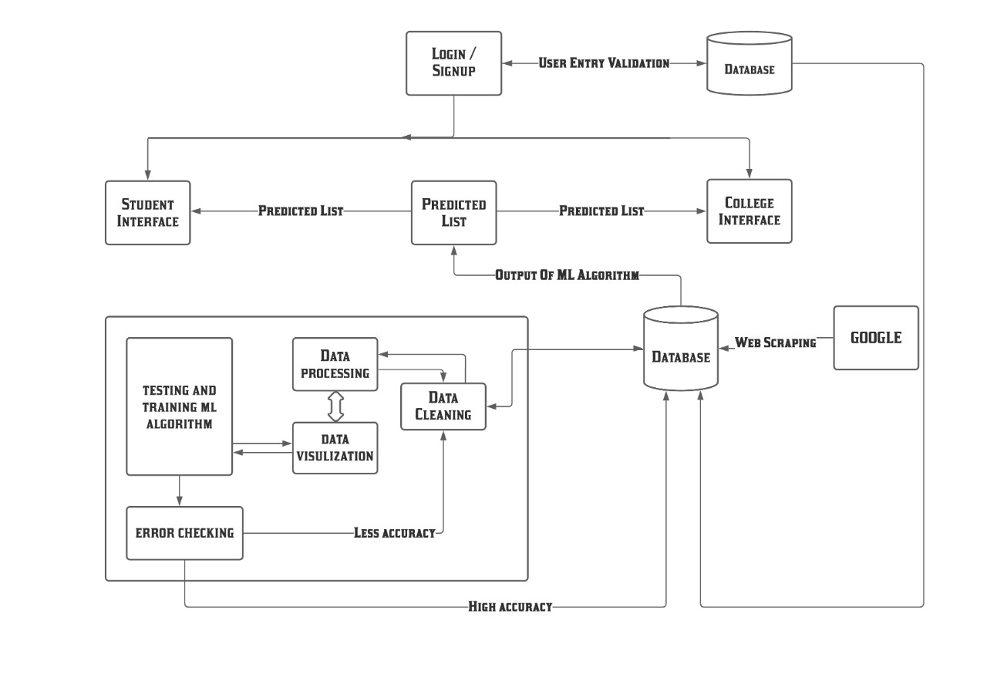
System Architecture:

Slide 8
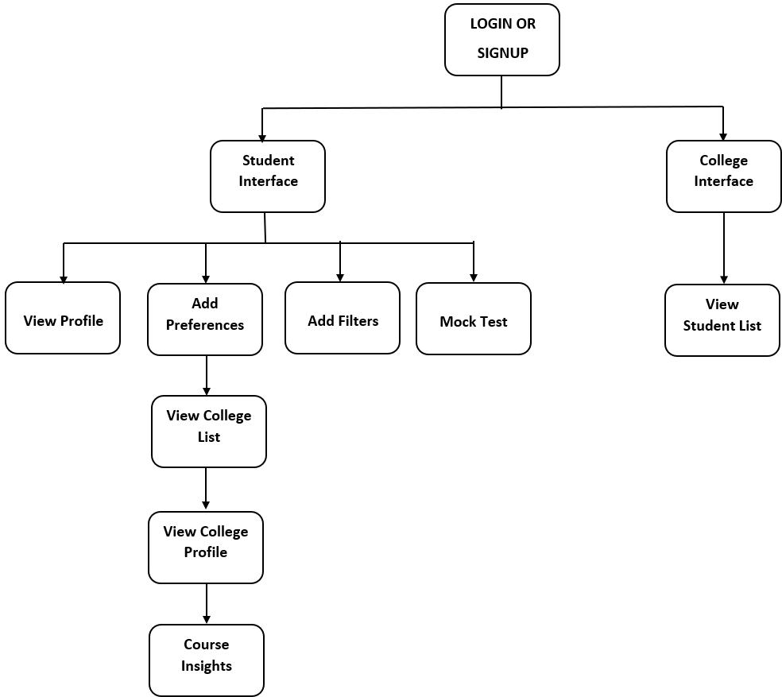
Modular Diagram:

Slide 9
FUTURE SCOPE :
1. Pre-exam preparation
2. Mock test
3.Prediction for 10th passout students
4. Prediction for Gate exam college

Slide 10
CHALLENGES :
Data Collection.
Data cleaning and preprocessing.
Selection of appropriate ml algorithm to achieve best accuracy.
Connection of python code to the flutter or android application.
Generalization of this system so that it will be applicable for other competitive exam.

Slide 11


Any Questions???
This Photo by Unknown author is licensed under CC BY-SA-NC.

Slide 12
Thank you!!!

