Slide 1
Heart Disease Detection Expert System
CS549 (Topics in AI)
Bhushan Bamane (916-56-0463)

Slide 2
Problem Definition:
Here we are going to detect Heart Disease and its severity level using diagnosis attributes present in the dataset from UCI(Cleveland dataset).
The data sets available have different values for their respective diagnosis attributes and are in the form which cannot be directly applied to the Neural Networks input(normalization require).
I have total 13 diagnosis attributes present in data set which are necessary to detect the Heart Disease of an Individual.
I have applied here Min-Max normalization process to convert the data sets available into appropriate 0’s and 1’s.
To classify the input into appropriate output I am using feed forward back propagation algorithm.

Slide 3
Output Data
Based on input attributes value, Neural network determines the severity level of heart disease.
Output classification is as follows:
Target Output | Multiclass classification (in 0’s and 1’s format) | Heart disease type
0 | 1 0 0 0 0 | Healthy
1 | 0 1 0 0 0 | Unhealthy - 1
2 | 0 0 1 0 0 | Unhealthy - 2
3 | 0 0 0 1 0 | Unhealthy - 3
4 | 0 0 0 0 1 | Serious

Slide 4
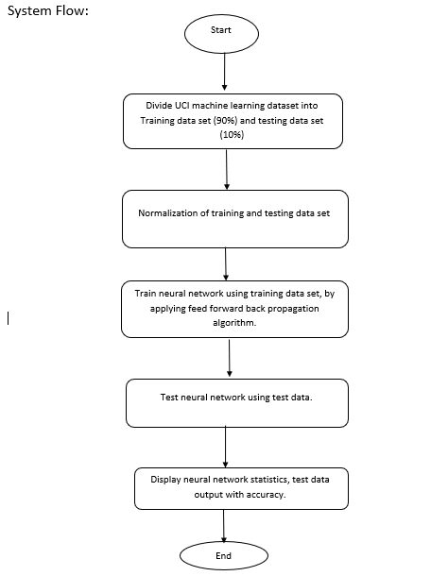

Slide 5
System Implementations
Read training and test dataset files.
Normalization of training and test dataset.
Implementation of Feed forward backpropagation algorithm.
Testing of test data.
GUI to represent statistical details about the system performance.
GUI to represent all test data evaluation with all input attributes and expected output.

Slide 6
Experimental Results
Case1
No of input Units | No of hidden Units | No of output Units | Total record in training dataset | Total record in testing dataset | No of epochs | Learning Coefficient | Accuracy of Training dataset | Accuracy of Testing dataset
13 | 16 | 5 | 273 | 30 | 15000 | 0.9 | 86.45% | 85%

Slide 7
Case 2
Case 3
No of input Units | No of hidden Units | No of output Units | Total record in training dataset | Total record in testing dataset | No of epochs | Learning Coefficient | Accuracy of Training dataset | Accuracy of Testing dataset
13 | 4 | 5 | 273 | 30 | 20000 | 0.6 | 55.31% | 51.67%
No of input Units | No of hidden Units | No of output Units | Total record in training dataset | Total record in testing dataset | No of epochs | Learning Coefficient | Accuracy of Training dataset | Accuracy of Testing dataset
13 | 17 | 5 | 273 | 30 | 20000 | 0.5 | 90.11% | 75%

Slide 8
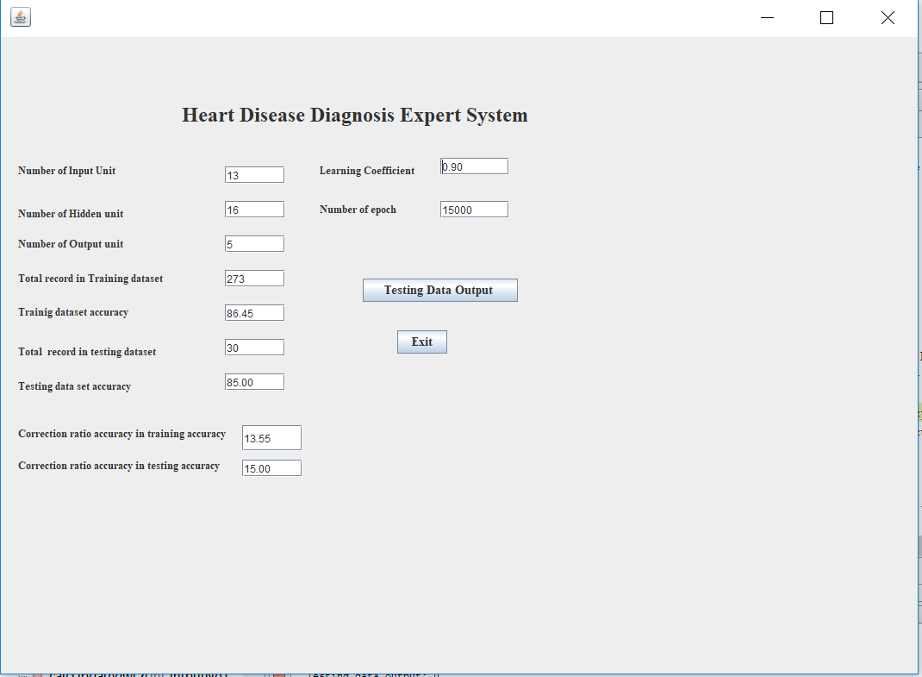
User Interface Module

Slide 9
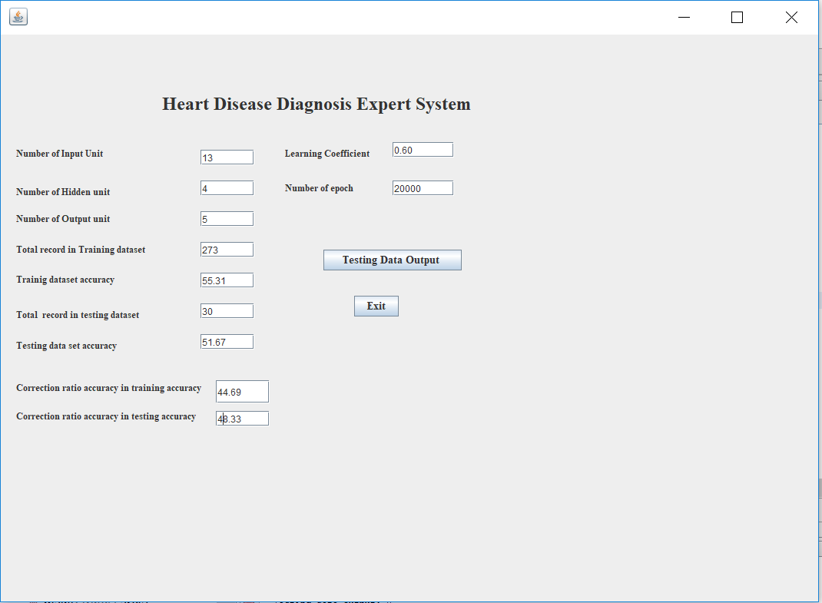

Slide 10
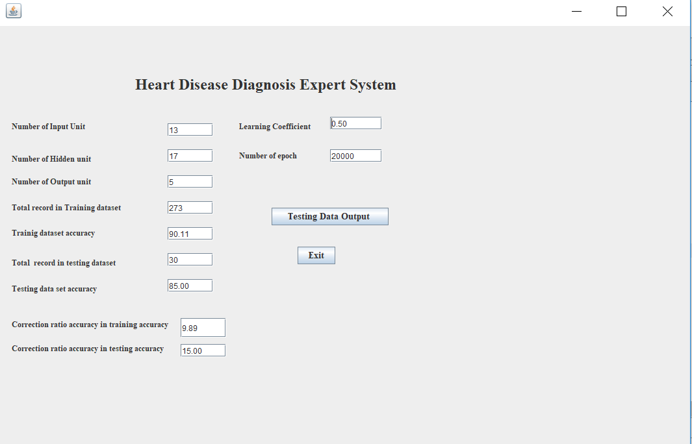

Slide 11
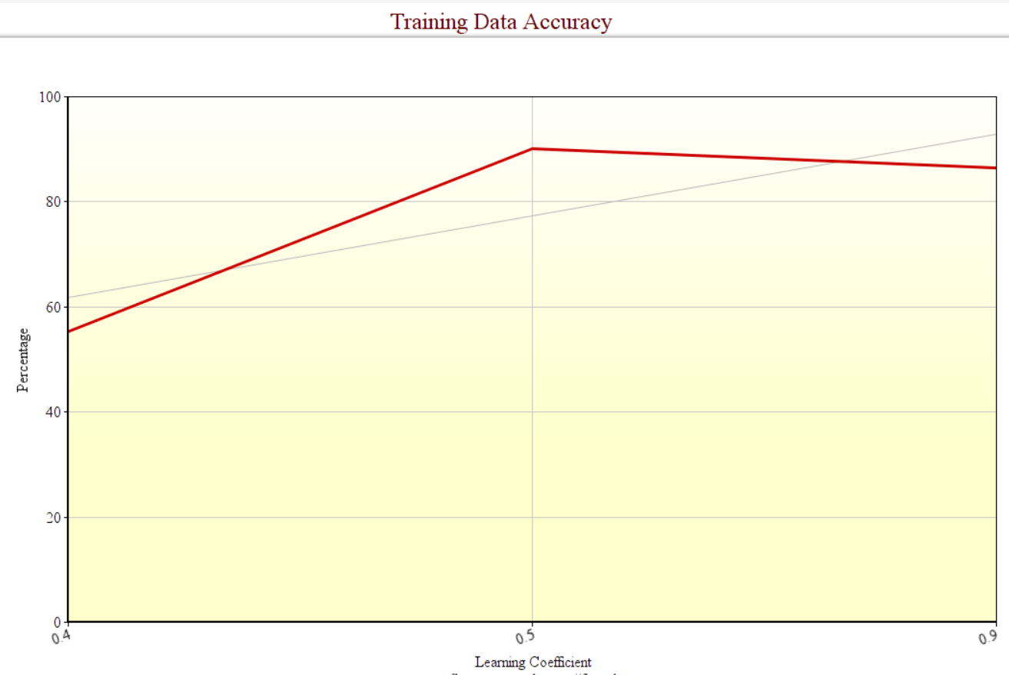
Graphical Representation

Slide 12
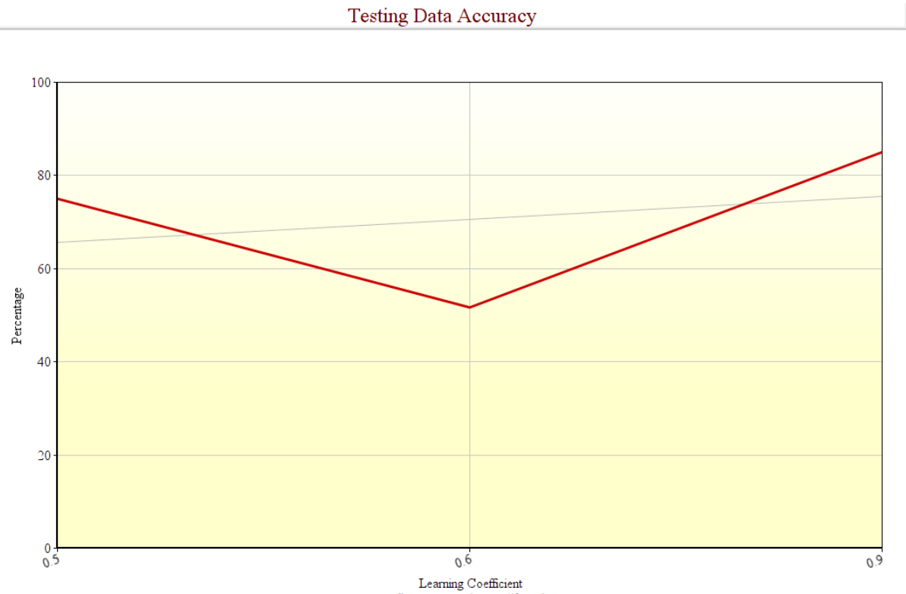

Slide 13
Conclusion
The system I have designed recognizes the Heart Disease. I have used Feed Forward Back Propagation learning algorithm to test the model based on their ability to diagnosis Heart disease. By considering appropriate activation function for hidden layer and 17 neurons in hidden layer, I have reach to the classification accuracy for heart disease to 85%. Artificial Neural Network showed significant results in heart disease diagnosis.

